Slide 1
NMR spectroscopy
Prepared by Dr. Upali Siriwardane
For
CHEM 481 Lab

Slide 2
Objectives
Student should gain better understanding of NMR spectroscopy.
Student should gain experience in the acquisition, processing, and displaying NMR data.
Student should gain experience in interpreting NMR data in order to establish structure for unknown organic molecules.
Student should gain understanding in advanced 1Dimensional and 2Dimensional NMR techniques.

Slide 3
Information from ¹H-nmr spectra:
Number of signals: How many different types of hydrogens in the molecule.
Position of signals (chemical shift): What types of hydrogens.
Relative areas under signals (integration): How many hydrogens of each type.
Splitting pattern: How many neighboring hydrogens.

Slide 4
Introduction
The Nobel Prize has been awarded twice for work related to NMR. F. Bloch and E.M. Purcell received the Nobel Prize in Physics, in 1952, for the first experimental verifications of the phenomenon, and Prof. R.R. Ernst received the Nobel Prize in Chemistry, in 1991, for the development of the NMR techniques.
Since its discovery 50 years ago, in 1945, it has spread from physics to chemistry, biosciences, material research and medical diagnosis.

Slide 5
Spin quantum number(I)
Nuclear spin is characterized by a spin number, I, which can be zero or some positive integer multiple of 1/2 (e.g. 1/2, 1, 3/2, 2 etc.). Nuclei whose spin number, I= 0 have no magnetic moment(μ);eg. ¹²C and ¹⁶O show no NMR signal. Elements such as ¹H, ¹³C, ¹⁹F and ³¹P have I=1/2, while others have even higher spin numbers:
I=1 ¹⁴N, ²H
I=3/2 ¹¹B, ³⁵Cl, ³⁷Cl, ⁷⁹Br, ⁸¹Br.
As the values for I increase, energy levels and shapes of the magnetic fields become progressively more and more complex.

Slide 6
NMR = Nuclear Magnetic Resonance
Physical Principles:
Alignment with the magnetic field (called α) is lower energy than against the magnetic field (called β). How much lower it is depends on the strength of the magnetic field

Slide 7
NMR = Nuclear Magnetic Resonance
Physical Principles:

Slide 8
Boltzmann Distribution of Spin States
In a given sample of a specific nucleus, the nuclei will be distributed throughout the various spin states available. Because the energy separation between these states is comparatively small, energy from thermal collisions is sufficient to place many nuclei into higher energy spin states. The numbers of nuclei in each spin state are described by the Boltzman distribution

Slide 9

Boltzman distribution
where the N values are the numbers of nuclei in the respective spin states, is the magnetogyric ratio, h is Planck's constant, H(B) is the external magnetic field strength, k is the Boltzmann constant, and T is the temperature.
In NMR, the energy separation of the spin states is comparatively very small and while NMR is very informative it is considered to be an insensitive technique .

Slide 10
Example: Boltzman distribution
For example, given a sample of ¹H nuclei in an external magnetic field of 1.41 Tesla
ratio of populations = e((-2.67519x10e8 rad.s-1.T-1 * 1.41T * 6.626176x10-34 J.s) / (1.380662x10e-23 J.K-1 *K 293)) = 0.9999382
At room temperature, the ratio of the upper to lower energy populations is 0.9999382. In other words, the upper and lower energy spin states are almost equally populated with only a very small excess in the lower energy state.
If N₀= 10⁶ or 1,000,000 then N_{j} 999,938
N₀- N_{j} =1,000,000 – 999,938 = 62
62 ppm excess in the ground state

Slide 11
NMR: Basic Experimental Principles
But there’s a problem. If two researchers want to compare their data using magnets of different strengths, they have to adjust for that difference. That’s a pain, so, data is instead reported using the “chemical shift” scale as described on the next slide.

Slide 12
NMR: Basic Experimental Principles
Imagine placing a molecule, for example, CH₄, in a magnetic field.
We can probe the energy difference of the α- and β- state of the protons by irradiating them with EM radiation of just the right energy.
In a magnet of 7.05 Tesla, it takes EM radiation of about 300 MHz (radio waves).
So, if we bombard the molecule with 300 MHz radio waves, the protons will absorb that energy and we can measure that absorbance.
In a magnet of 11.75 Tesla, it takes EM radiation of about 500 MHz (stronger magnet means greater energy difference between the α- and β- state of the protons)
But there’s a problem. If two researchers want to compare their data using magnets of different strengths, they have to adjust for that difference. That’s a pain, so, data is instead reported using the “chemical shift” scale as described on the next slide.

Slide 13
The Chemical Shift (Also Called δ) Scale
Here’s how it works. We decide on a sample we’ll use to standardize our instruments. We take an NMR of that standard and measure its absorbance frequency. We then measure the frequency of our sample and subtract its frequency from that of the standard. We then then divide by the frequency of the standard. This gives a number called the “chemical shift,” also called δ, which does not depend on the magnetic field strength. Why not? Let’s look at two examples.
Imagine that we have a magnet where our standard absorbs at 300,000,000 Hz (300 megahertz), and our sample absorbs at 300,000,300 Hz. The difference is 300 Hz, so we take 300/300,000,000 = 1/1,000,000 and call that 1 part per million (or 1 PPM). Now lets examine the same sample in a stronger magnetic field where the reference comes at 500,000,000 Hz, or 500 megahertz. The frequency of our sample will increase proportionally, and will come at 500,000,500 Hz. The difference is now 500 Hz, but we divide by 500,000,000 (500/500,000,000 = 1/1,000,000, = 1 PPM).
It’s brilliant.
Of course, we don’t do any of this, it’s all done automatically by the NMR machine.
Even more brilliant.

Slide 14
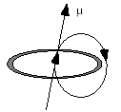
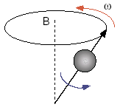
The Physical Basis of the NMR Experiment
Imagine a charge travelling circularily about an axis builds up a magnetic moment
It rotates (spins) about its own axis (the blue arrow) and precesses about the axis of the magnetic field B (the red arrow). The frequency of the precession (ω) is proportional to the strength of the magnetic field:
ω = γ B₀
= magnetogyro ratio
Magnetic field mrasured in Tesla
1 T = 10,000 gauss

Slide 15
Magnetogyric ratio(γ)
The larger the value of the magnetogyric ratio, the larger the
Magnetic moment (μ) of the nucleus and the easier it is to see by NMR spectroscopy.
Energy difference (ΔE) between I_{z} = +1/2 and I_{z} = -1/2.

Slide 16
The Physical Basis of the NMR Experiment:
Nuclear magnetic resonance, or NMR as it is abbreviated by scientists, is a phenomenon which occurs when the nuclei of certain atoms are immersed in a static strong magnetic field and exposed to a second oscillating magnetic field in the form of radiofrequency pulses, it is possible to transfer energy into the spin system and change the state of the system. After the pulse, the system relaxes back to its state of equilibrium, sending a weak signal that can be recorded.

Slide 17
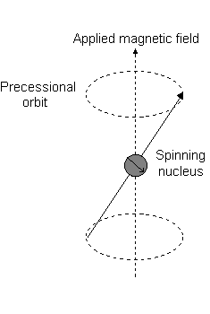
Larmour frequency
Precession: The circular movement of the magnetic moment in the presence of the applied field.
Larmour frequency : The angular frequency of the precessionis related to the external magnetic field strength B₀, by the gyromagnetic ratio γ :
ω₀ = γB₀

Slide 18
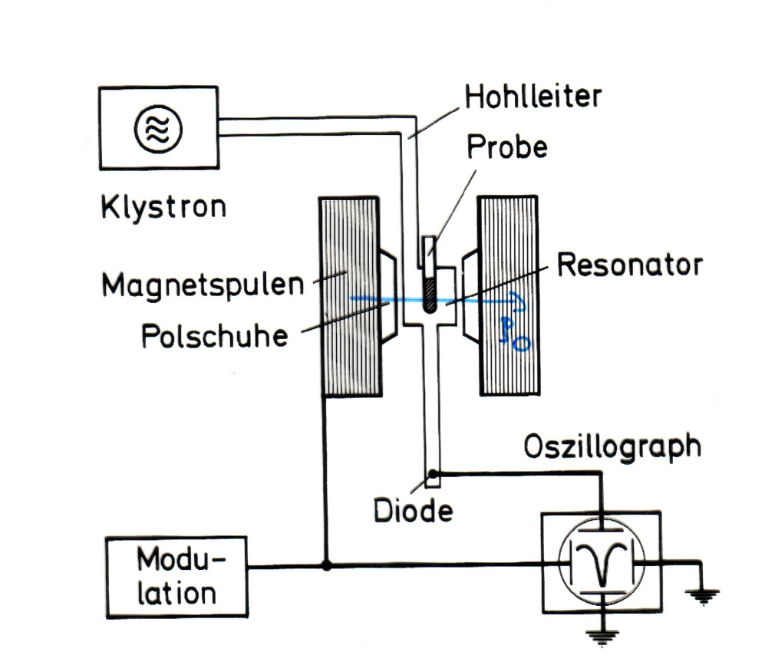
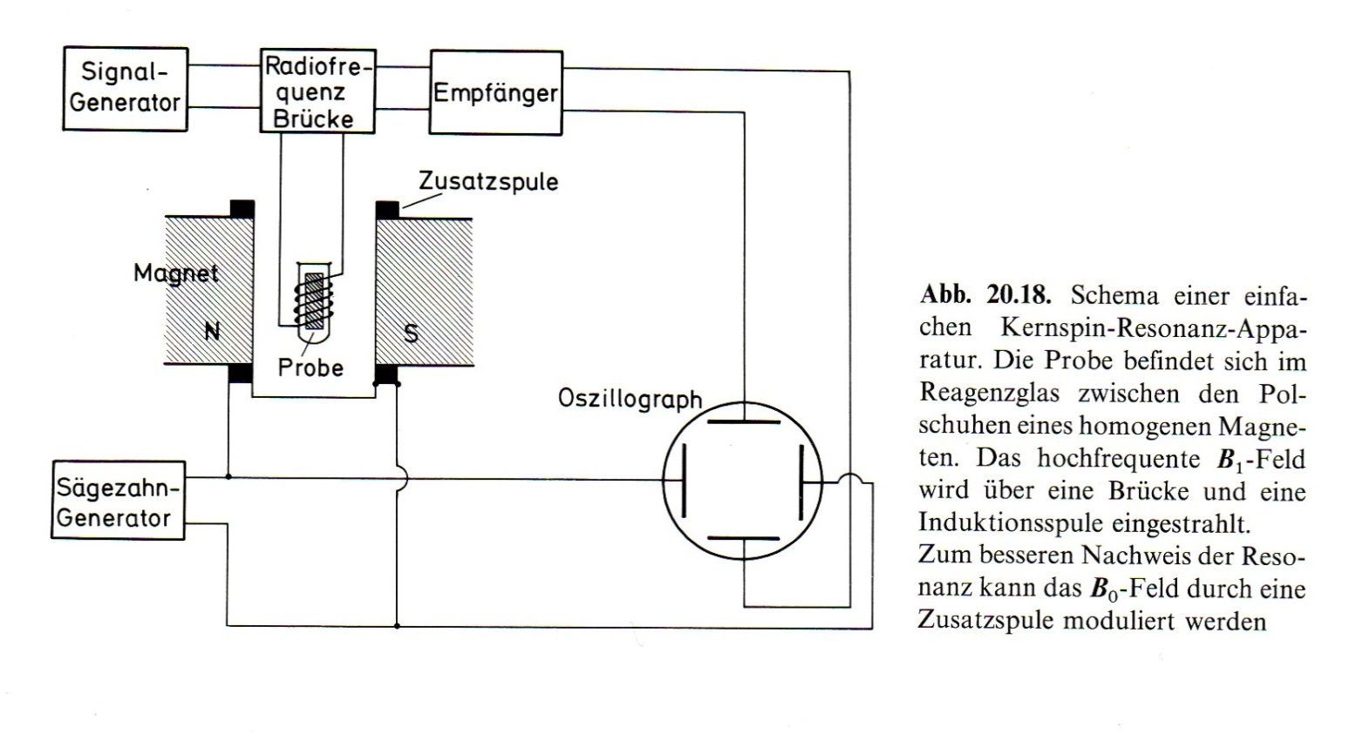
Classical NMR experiments
Absorption signal

Slide 19
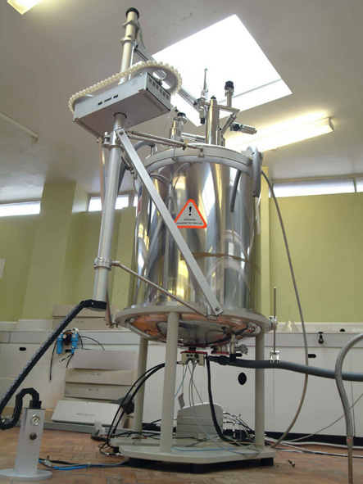
600 MHz Proton NMR Spectrometer
High frequency NMR spectrometers require very strong magnetic fields, which are produced using super-cooled coils (T = 4.2K, liquid He). The superconducting coils are surrounded by a giant vessel containing liquid N₂.
B₀
k
He
N ₂
B₁

Slide 20
Larmour frequency
Precession: The circular movement of the magnetic moment in the presence of the applied field.
Larmour frequency : The angular frequency of the precessionis related to the external magnetic field strength B₀, by the gyromagnetic ratio γ :
ω₀ = γB₀

Slide 21
Classical View of NMR
(compared to Quantum view)
Precession or Larmor frequency:
ω = 2πν ⇒ ω_{o} = γ Bο (radians)
angular momentum (l)
l
ω_{o}
μ
B_{o}
Simply, the nuclei spins about its
axis creating a magnetic moment μ
Apply a large external field (B_{o})
and μ will precess about B_{o} at its
Larmor (ω) frequency.
Maxwell: Magnetic field Moving charge
≡
Important: This is the same frequency obtained from the energy transition between quantum states

Slide 22

Quantum-mechanical treatment:
The dipole moment μ of the nucleus is described in quantum-mechanical terms as
μ = γ J
Therein, J is the spin angular momentum and γ the magnetogyric ratio of the spin. When looking at single spins we have to use a quantum-mechanical treatment.
Therein, the z-component of the angular momentum J is quantitized and can only take discrete values
J is related to spin quantum number of the nuclei I
-I,…,o,…,+I

Slide 23
Spin quantum number(I)
Nuclear spin is characterized by a spin number, I, which can be zero or some positive integer multiple of 1/2 (e.g. 1/2, 1, 3/2, 2 etc.). Nuclei whose spin number, I= 0 have no magnetic moment(μ);eg. ¹²C and ¹⁶O show no NMR signal. Elements such as ¹H, ¹³C, ¹⁹F and ³¹P have I=1/2, while others have even higher spin numbers:
I=1 ¹⁴N, ²H
I=3/2 ¹¹B, ³⁵Cl, ³⁷Cl, ⁷⁹Br, ⁸¹Br.
As the values for I increase, energy levels and shapes of the magnetic fields become progressively more and more complex.

Slide 24
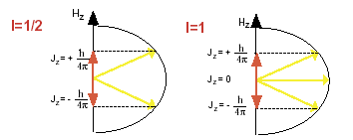
z-component of the angular momentum J
For I=1/2 nuclei, m can only be +1/2 or -1/2, giving rise to two distinct energy levels. For spins with I=1 nuclei three different values for Jz are allowed:

Slide 25
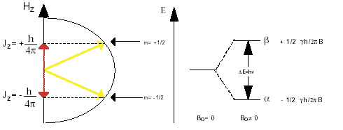
The energy difference ΔE,
Zeeman effect: splitting of energy levels in magnetic field
The energy difference ΔE, which corresponds to the two states with m=±1/2, is then (the quantum-mechanical selection rule states, that only transitions with m= ±1 are allowed):

Slide 26
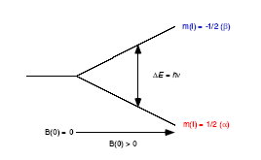
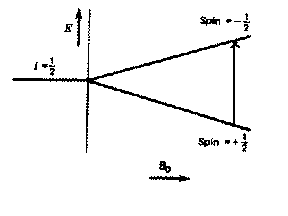
A Nuclei with I= 1/2 in a Magnetic Field
ΔE = h ν
ν = γ B_{o} / 2π
ΔE = γ h B_{o} / 2π
number of states = 2I+1

Slide 27
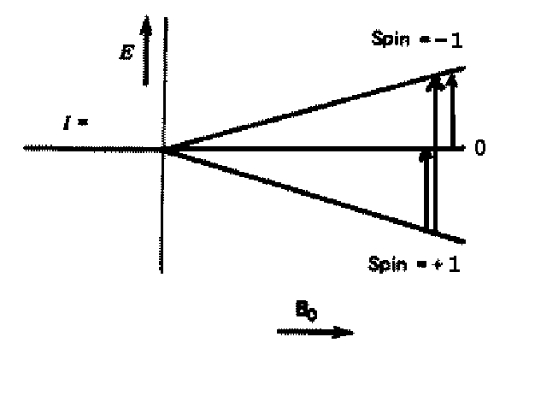
A Nuclei with I= 1 in a Magnetic Field
number of states = 2I+1

Slide 28
Boltzmann Distribution of Spin States
In a given sample of a specific nucleus, the nuclei will be distributed throughout the various spin states available. Because the energy separation between these states is comparatively small, energy from thermal collisions is sufficient to place many nuclei into higher energy spin states. The numbers of nuclei in each spin state are described by the Boltzman distribution

Slide 29
Boltzman distribution
where the N values are the numbers of nuclei in the respective spin states, is the magnetogyric ratio, h is Planck's constant, H(B) is the external magnetic field strength, k is the Boltzmann constant, and T is the temperature.
In NMR, the energy separation of the spin states is comparatively very small and while NMR is very informative it is considered to be an insensitive technique .

Slide 30
Example: Boltzman distribution
For example, given a sample of ¹H nuclei in an external magnetic field of 1.41 Tesla
ratio of populations = e((-2.67519x10e8 rad.s-1.T-1 * 1.41T * 6.626176x10-34 J.s) / (1.380662x10e-23 J.K-1 *K 293)) = 0.9999382
At room temperature, the ratio of the upper to lower energy populations is 0.9999382. In other words, the upper and lower energy spin states are almost equally populated with only a very small excess in the lower energy state.
If N₀= 10⁶ or 1,000,000 then N_{j} 999,938
N₀- N_{j} =1,000,000 – 999,938 = 62
62 ppm excess in the ground state

Slide 31
Saturation
The condition that exists when the upper and lower energy states of nuclei are equal. (no observed signal by NMR)

Slide 32
δ values chemical shifts
ν (peak) - ν(ref)
δ (ppm) =
x 10⁶
ν (ref)

Slide 33
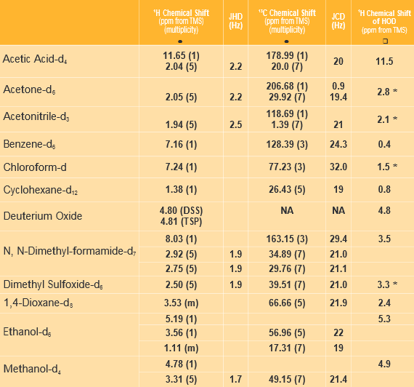
Deuterated Solvents

Slide 34
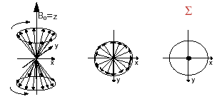
Vector representation

Slide 35
Bulk magnetization (M_{o})
Now consider a real sample containing numerous nuclear spins:
M_{o} % (Nα - Nβ)
μ = μ_{x}i + μ_{y}j +μ_{z}k
z
z
M_{o}
x
x
y
y
B_{o}
B_{o}
Since μ is precessing in the xy-plane, M_{o} = ∑ μ_{z}k – μ_{−z}k
μ is quantized (α or β), M_{o} has a continuous number of states, bulk property.

Slide 36
An NMR Experiment
We have a net magnetization precessing about B_{o} at a frequency of ω_{o} with a net population difference between aligned and unaligned spins.
z
z
M_{o}
x
x
y
y
B_{o}
B_{o}
Now What?
Perturbed the spin population or perform spin gymnastics
Basic principal of NMR experiments

Slide 37
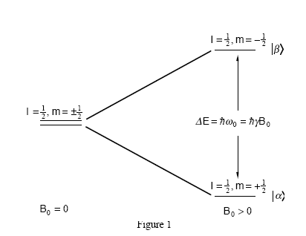
An NMR Experiment
To perturbed the spin population need the system to absorb energy.
z
M_{o}
x
B₁
B_{o}
y
i
Transmitter coil (y)
Two ways to look at the situation:
(1) quantum – absorb energy equal to difference in spin states
(2) classical - perturb M_{o} from an excited field B₁

Slide 38
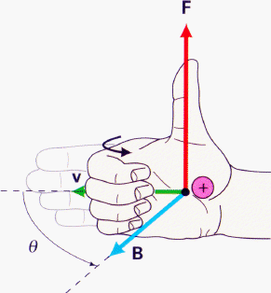
An NMR Experiment
resonant condition: frequency (ω₁) of B₁ matches Larmor frequency (ω_{o})
energy is absorbed and population of α and β states are perturbed.
z
z
M_{o}
B₁ off…
(or off-resonance)
x
x
B₁
M_{xy}
ω₁
y
y
ω₁
And/Or: M_{o} now precesses about B₁ (similar to B_{o}) for as long as the B₁ field is applied.
Again, keep in mind that individual spins flipped up or down
(a single quanta), but M_{o} can have a continuous variation.
Right-hand rule

Slide 39
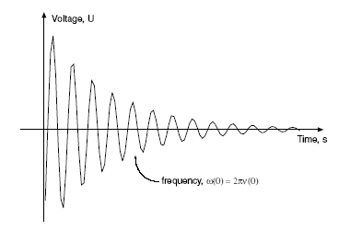
An NMR Experiment
What Happens Next?
The B₁ field is turned off and M_{xy} continues to precess about B_{o} at frequency ω_{o.}
z
x
M_{xy}
ω_{o}
y
Receiver coil (x)
⇒ NMR signal
FID – Free Induction Decay
The oscillation of M_{xy} generates a fluctuating magnetic field which can be used to generate a current in a receiver coil to detect the NMR signal.

Slide 40
NMR Signal Detection - FID
Mxy is precessing about z-axis in the x-y plane
Time (s)
y
y
y
The FID reflects the change in the magnitude of Mxy as
the signal is changing relative to the receiver along the y-axis
Again, it is precessing at its Larmor Frequency (ω_{o}).

Slide 41
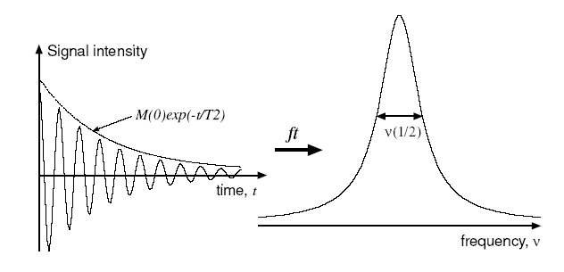
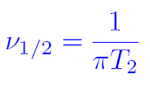
NMR Relaxation
Related to line-shape
M_{x} = M_{y} = M₀ exp(-t/T₂)
(derived from Hisenberg uncertainty principal)
T₂ is the spin-spin (or transverse) relaxation time constant.
In general: T₁ T₂
Think of T₂ as the “randomization” of spins in the x,y-plane
Please Note: Line shape is also affected by the magnetic fields homogeneity

Slide 42
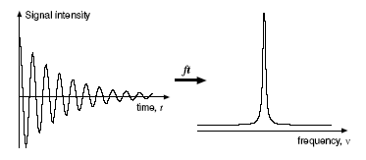

NMR Signal Detection - Fourier Transform
So, the NMR signal is collected in the Time - domain
But, we prefer the frequency domain.
Fourier Transform is a mathematical procedure that
transforms time domain data into frequency domain

Slide 43
Laboratory Frame vs. Rotating Frame
To simplify analysis we convert to the rotating frame.
z
z
x
x
M_{xy}
ω_{o}
M_{xy}
B_{o}
y
y
Laboratory Frame
Rotating Frame
Simply, our axis now rotates at the Larmor Freguency (ω_{o}).
In the absent of any other factors, M_{xy} will stay on the x-axis
All further analysis will use the rotating frame.

Slide 44
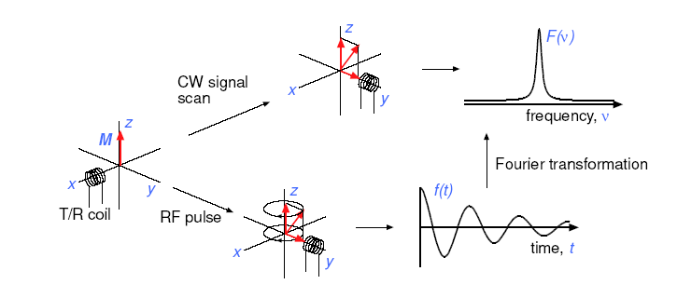
Continuous Wave (CW) vs. Pulse/Fourier Transform
NMR Sensitivity Issue
A frequency sweep (CW) to identify resonance is very slow (1-10 min.)
Step through each individual frequency.
Pulsed/FT collect all frequencies at once in time domain, fast (N x 1-10 sec)
Increase signal-to-noise (S/N) by collecting multiple copies of FID
and averaging signal.
S/N ∝ number of scans
∝

Slide 45
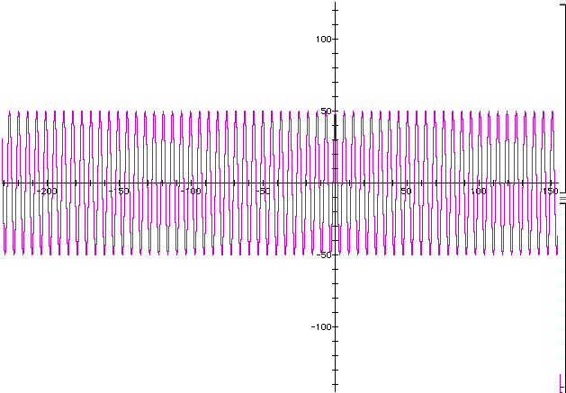
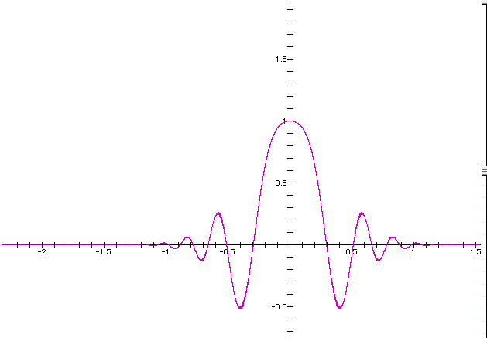
NMR Pulse
A radiofrequency pulse is a combination of a wave (cosine) of frequency ω_{o} and a step function
*
=
t_{p}
Pulse length (time, t_{p})
The fourier transform indicates the pulse covers a range of frequencies
FT
Hisenberg Uncertainty principal again: Δυ.Δt ~ 1/2π
Shorter pulse length – larger frequency envelope
Longer pulse length – selective/smaller frequency envelope
Sweep Width
f ~ 1/t

Slide 46
NMR Pulse
NMR pulse length or Tip angle (t_{p})
z
z
M_{o}
θ_{t}
t_{p}
x
x
B₁
M_{xy}
y
y
θ_{t} = γ * t_{p} * B₁
The length of time the B₁ field is on => torque on bulk magnetization (B₁)
A measured quantity – instrument dependent.

Slide 47
NMR Pulse
Some useful common pulses
z
z
90º pulse
M_{o}
π / 2
Maximizes signal in x,y-plane
where NMR signal detected
x
x
90º
M_{xy}
y
y
z
z
180º pulse
Inverts the spin-population.
No NMR signal detected
M_{o}
π
x
x
180º
-M_{o}
y
y
Can generate just about any pulse width desired.

Slide 48
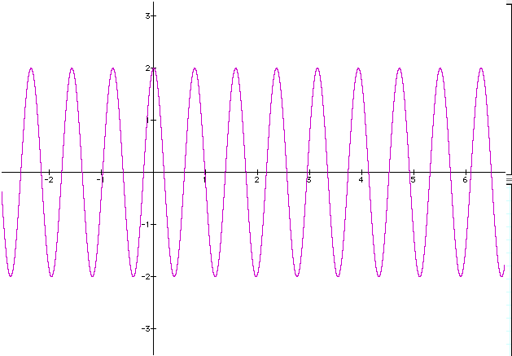
NMR Data Acquisition
Collect Digital Data
ADC – analog to digital converter
The Nyquist Theorem says that we have to sample at least twice as fast as the fastest (higher frequency) signal.
Sample Rate
- Correct rate, correct frequency
SR = 1 / (2 * SW)
½ correct rate, ½ correct frequency Folded peaks!
Wrong phase!
SR – sampling rate

Slide 49
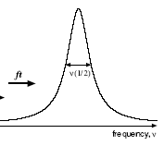
Information in a NMR Spectra
γ-rays x-rays UV VIS IR μ-wave radio
1) Energy E = hυ
h is Planck constant
υ is NMR resonance frequency
10⁻¹⁰ 10⁻⁸ 10⁻⁶ 10⁻⁴ 10⁻² 10⁰ 10²
wavelength (cm)
Observable Name Quantitative Information
Peak position Chemical shifts (δ) δ(ppm) = υ_{obs} –υ_{ref}/υ_{ref} (Hz) chemical (electronic)
environment of nucleus
Peak Splitting Coupling Constant (J) Hz peak separation neighboring nuclei
(intensity ratios) (torsion angles)
Peak Intensity Integral unitless (ratio) nuclear count (ratio)
relative height of integral curve T₁ dependent
Peak Shape Line width Δυ = 1/πT₂ molecular motion
peak half-height chemical exchange
uncertainty principal
uncertainty in energy

Slide 50
NMR Sensitivity
NMR signal depends on:
Number of Nuclei (N) (limited to field homogeneity and filling factor)
Gyromagnetic ratio (in practice γ³)
Inversely to temperature (T)
External magnetic field (B_{o}^{2/3}, in practice, homogeneity)
B₁² exciting field strength
signal (s) ∝ γ⁴B_{o}²NB₁g(υ)/T
N_{α} / N_{β} = e ^{ΔE / kT}
ΔE = γ h B_{o} / 2π
Increase energy gap -> Increase population difference -> Increase NMR signal
ΔE
≡
B_{o}
≡
γ
γ
- Intrinsic property of nucleus can not be changed.
(γ_{Η}/γ_{C})³ for ¹³C is 64x
(γ_{Η}/γ_{N})³ for ¹⁵N is 1000x
¹H is ~ 64x as sensitive as ¹³C and 1000x as sensitive as ¹⁵N !
Consider that the natural abundance of ¹³C is 1.1% and ¹⁵N is 0.37%
relative sensitivity increases to ~6,400x and ~2.7x10⁵x !!

