Slide 1
Chemistry 281(01) Winter 2017
Instructor: Dr. Upali Siriwardane
e-mail: upali@latech.edu
Office: CTH 311 Phone 257-4941

Slide 2
Chapter 3. Structures of simple solids
Crystalline solids: The atoms, molecules or ions pack together in an ordered arrangement
Amorphous solids: No ordered structure to the particles of the solid. No well defined faces, angles or shapes
Polymeric Solids: Mostly amorphous but some have local crystiallnity. Examples would include glass and rubber.

Slide 3
The Fundamental types of Crystals
Metallic: metal cations held together by a sea of electrons
Ionic: cations and anions held together by predominantly electrostatic attractions
Network: atoms bonded together covalently throughout the solid (also known as covalent crystal or covalent network).
Covalent or Molecular: collections of individual molecules; each lattice point in the crystal is a molecule

Slide 4
Metallic Structures
Metallic Bonding in the Solid State:
Metals the atoms have low electronegativities; therefore the electrons are delocalized over all the atoms.
We can think of the structure of a metal as an arrangement of positive atom cores in a sea of electrons. For a more detailed picture see "Conductivity of Solids".
Metallic: Metal cations held together by a sea of valence electrons

Slide 5
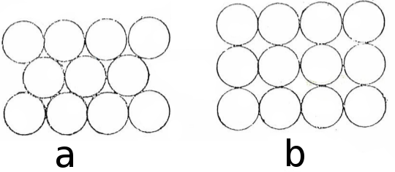
Metal Atom Packing
Close packing
Loose packing

Slide 6
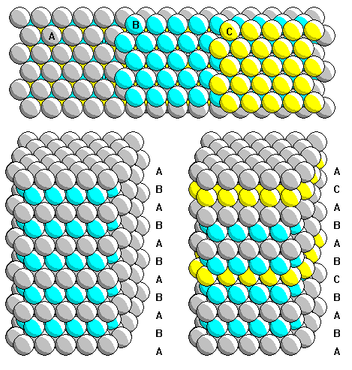
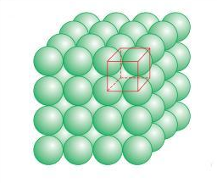
Metal Atom Packing

Slide 7
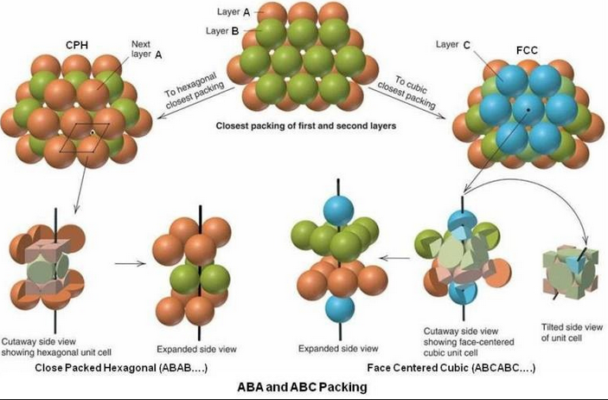
Metal Atom Close Packing

Slide 8
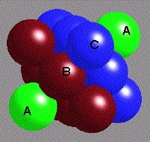
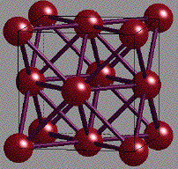
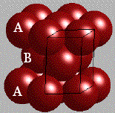
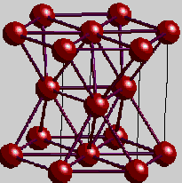
Packing and Geometry
Close packing
ABC.ABC... cubic close-packed CCP
gives face centered cubic or FCC(74.05% packed)
AB.AB... or AC.AC... (these are equivalent). This is called hexagonal close-packing HCP
HCP
CCP

Slide 9
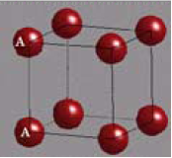
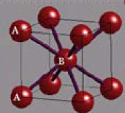
Packing and Geometry
Loose packing
Simple cube SC
Body-centered cubic BCC

Slide 10
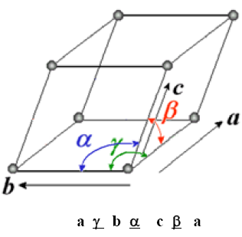
Unit Cell Dimensions
The unit cell angles are defined as:
α, the angle formed by the b and c cell edges
β, the angle formed by the a and c cell edges γ, the angle formed by the a and b cell edges
a,b,c is x,y,z in right handed cartesian coordinates
a γ b α c β a

Slide 11
Bravais Lattices & Seven Crystals Systems
In the 1840’s Bravais showed that there are only fourteen different space lattices.
Taking into account the geometrical properties of the basis there are 230 different repetitive patterns in which atomic elements can be arranged to form crystal structures.

Slide 12
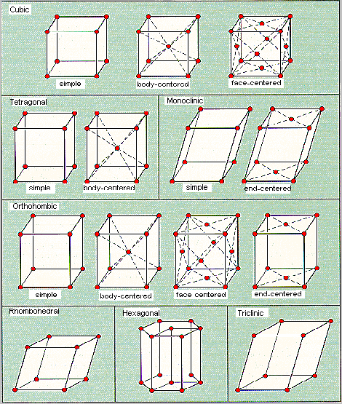
Fourteen Bravias Unit Cells

Slide 13
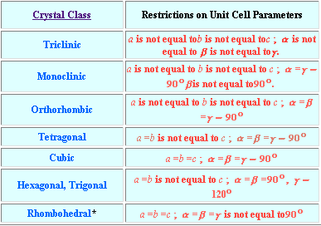
Seven Crystal Systems

Slide 14
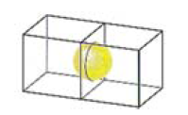
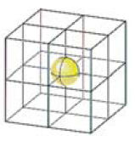
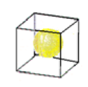
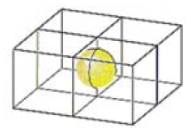
Number of Atoms in the Cubic Unit Cell
Coner- 1/8
Edge- 1/4
Body- 1
Face-1/2
FCC = 4 ( 8 coners, 6 faces)
SC = 1 (8 coners)
BCC = 2 (8 coners, 1 body)
Face-1/2
Body- 1
Edge - 1/4
Coner- 1/8

Slide 15
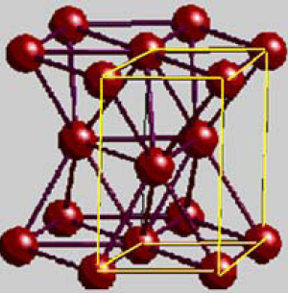
Close Pack Unit Cells
CCP
HCP
FCC = 4 ( 8 coners, 6 faces)

Slide 16
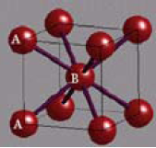
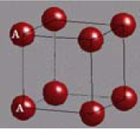
Unit Cells from Loose Packing
Simple cube SC Body-centered cubic BCC
SC = 1 (8 coners)
BCC = 2 (8 coners, 1 body)

Slide 17
Coordination Number
The number of nearest particles surrounding a particle in the crystal structure.
Simple Cube: a particle in the crystal has a coordination number of 6
Body Centerd Cube: a particle in the crystal has a coordination number of 8
Hexagonal Close Pack &Cubic Close Pack: a particle in the crystal has a coordination number of 12

Slide 18
Holes in FCC Unit Cells
Tetrahedral Hole (8 holes)
Eight holes are inside a face centered cube.
Octahedral Hole (4 holes)
One hole in the middle and 12 holes along the edges ( contributing 1/4) of the face centered cube

Slide 19
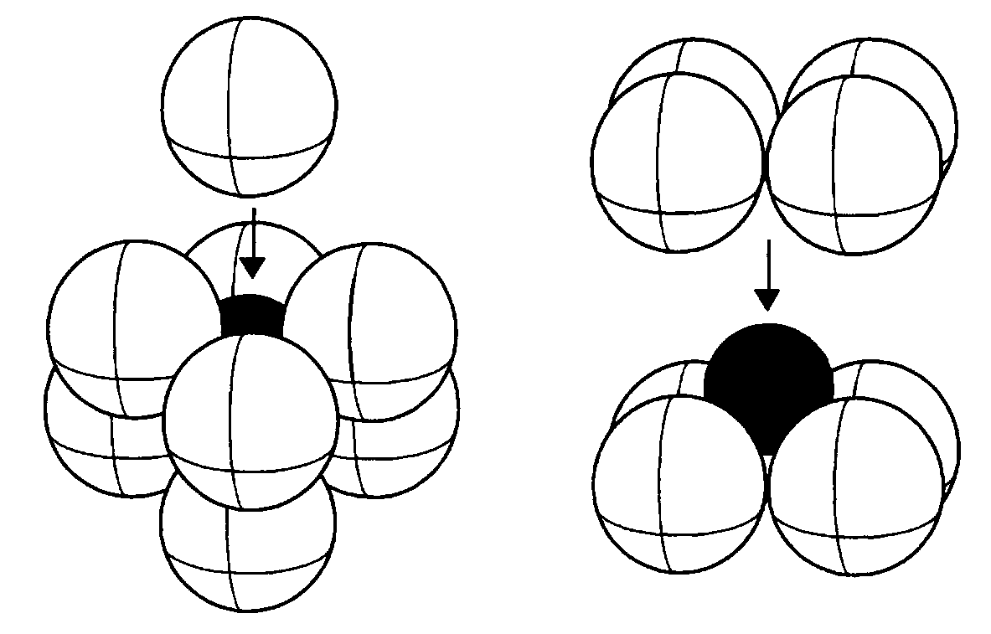
Holes in SC Unit Cells
Cubic Hole

Slide 20
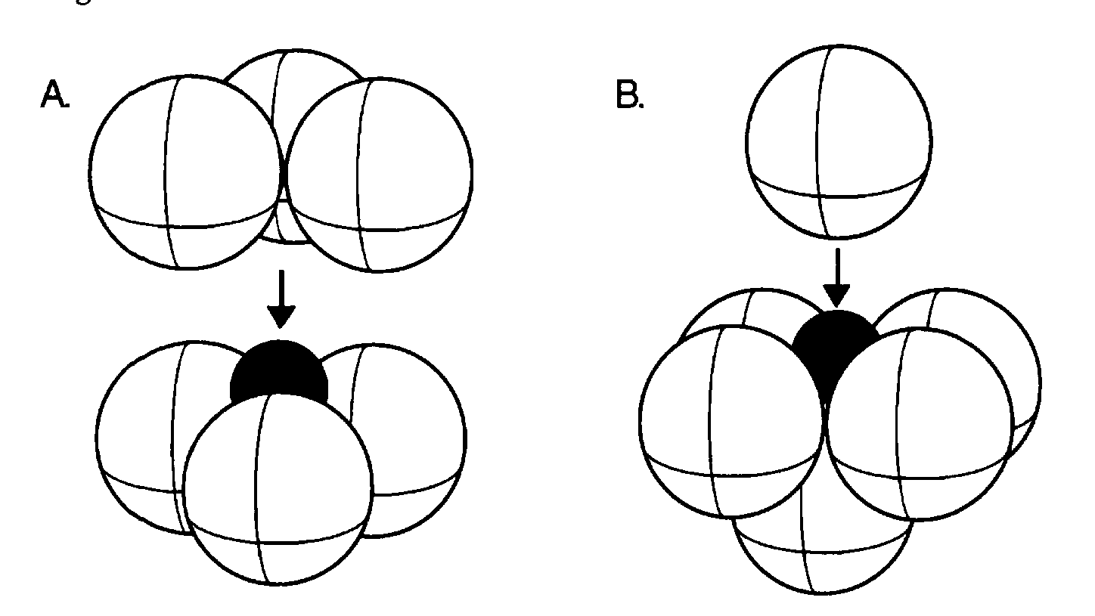
Octahedral Hole in FCC
Octahedral Hole

Slide 21
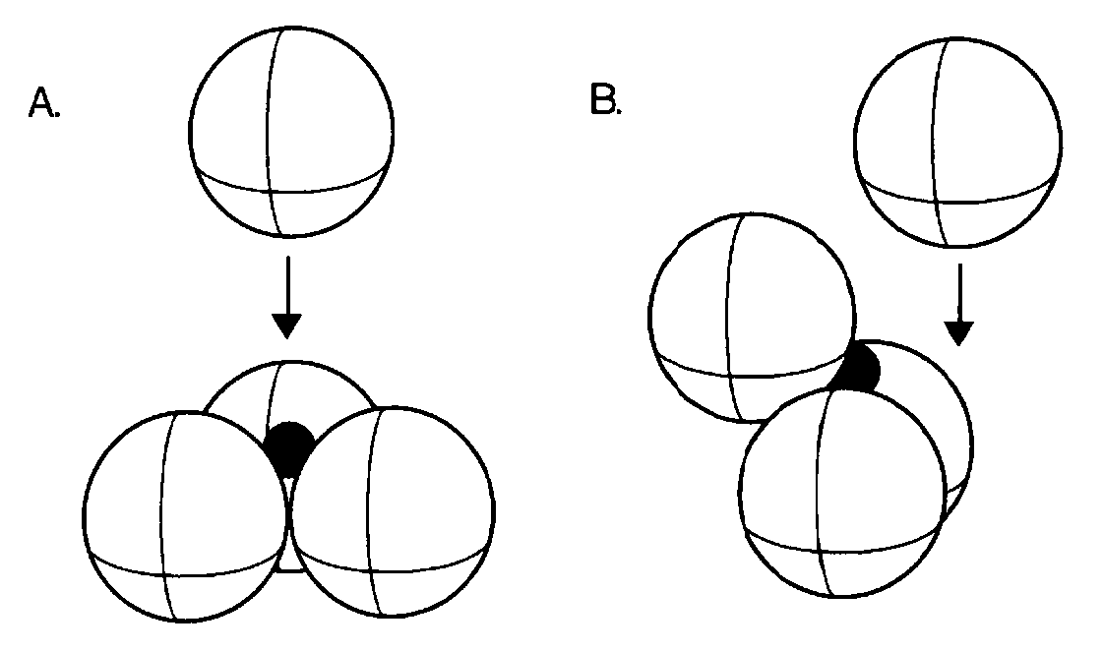
Tetrahedral Hole in FCC
Tetrahedral Hole

Slide 22
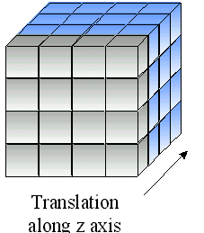
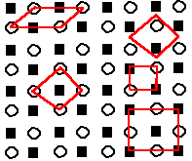
Structure of Metals
Crystal Lattices A crystal is a repeating array made out of metals. In describing this structure we must distinguish between the pattern of repetition (the lattice type) and what is repeated (the unit cell) described above.

Slide 23
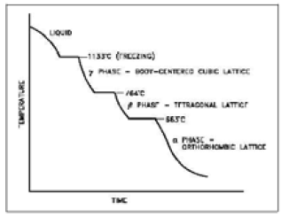
Polymorphism
Metals are capable of existing in more than one form at a time
Polymorphism is the property or ability of a metal to exist in two or more crystalline forms depending upon temperature and composition. Most metals and metal alloys exhibit this property.
Uranium is a good example of a metal that exhibits polymorphism.

Slide 24
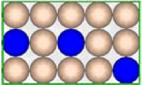
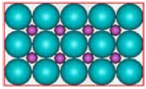
Alloys
Substitutional
Second metal replaces the metal atoms in the lattice
Interstitial
Second metal occupies interstitial space (holes) in the lattice

Slide 25
Properties of Alloys
Alloying substances are usually metals or metalloids. The properties of an alloy differ from the properties of the pure metals or metalloids that make up the alloy and this difference is what creates the usefulness of alloys. By combining metals and metalloids, manufacturers can develop alloys that have the particular properties required for a given use.

Slide 26
Structure of Ionic Solids
Crystal Lattices A crystal is a repeating array made out of ions. In describing this structure we must distinguish between the pattern of repetition (the lattice type) and what is repeated (the unit cell) described above.
Cations fit into the holes in the anionic lattice since anions are lager than cations.
In cases where cations are bigger than anions lattice is considered to be made up of cationic lattice with smaller anions filling the holes

Slide 27
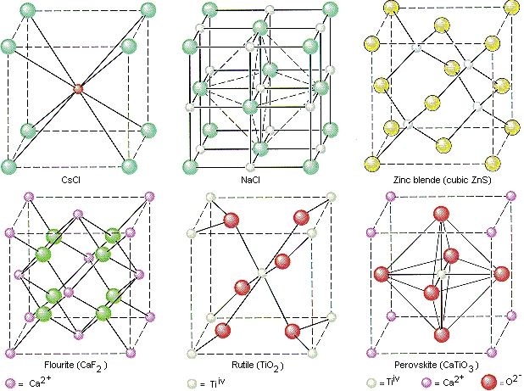
Basic Ionic Crystal Unit Cells

Slide 28
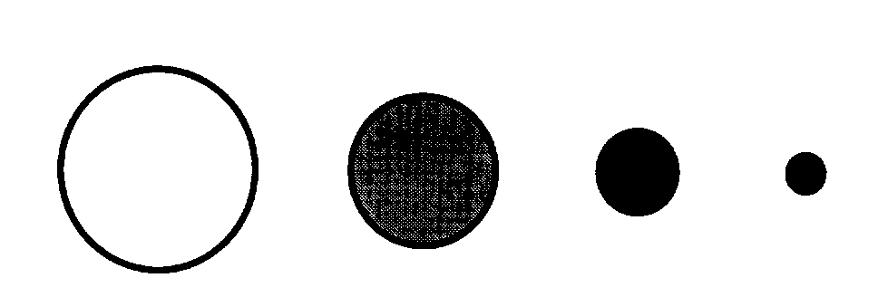
Radius Ratio Rules
r+/r- Coordination Holes in Which
Ratio Number Positive Ions Pack
0.225 - 0.414 4 tetrahedral holes FCC
0.414 - 0.732 6 octahedral holes FCC
0.732 - 1 8 cubic holes BCC

Slide 29
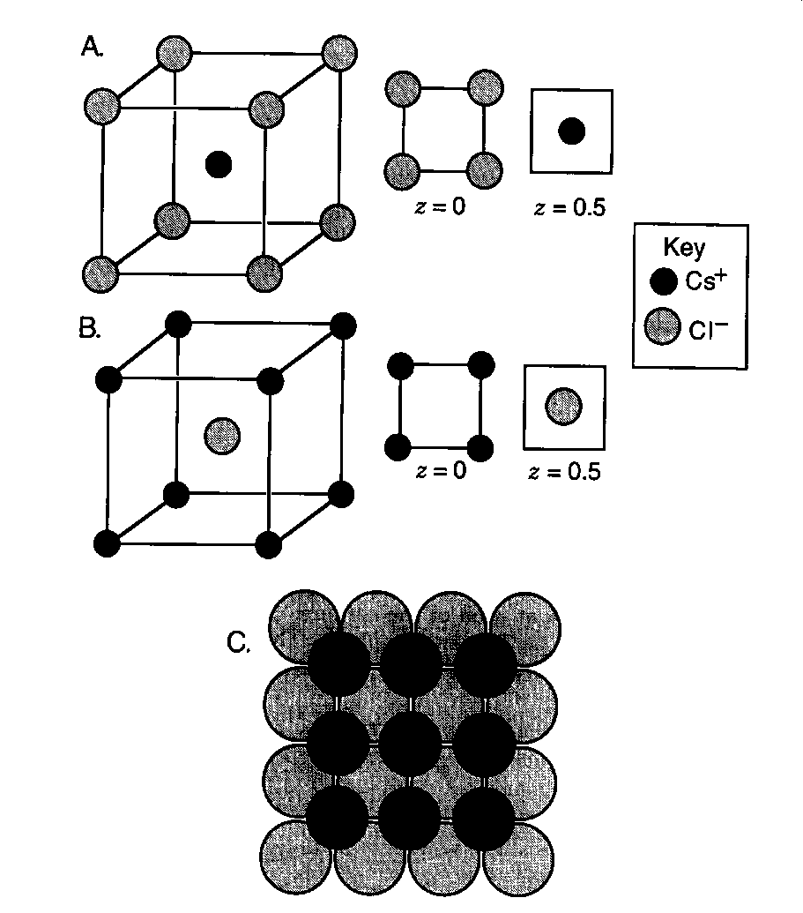
Cesium Chloride Structure (CsCl)

Slide 30
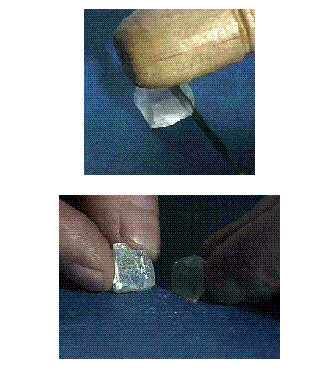
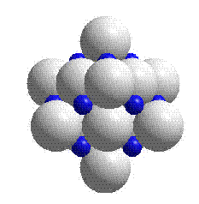
Rock Salt (NaCl)
© 1995 by the Division of Chemical Education, Inc., American Chemical Society.
Reproduced with permission from Soli-State Resources.

Slide 31
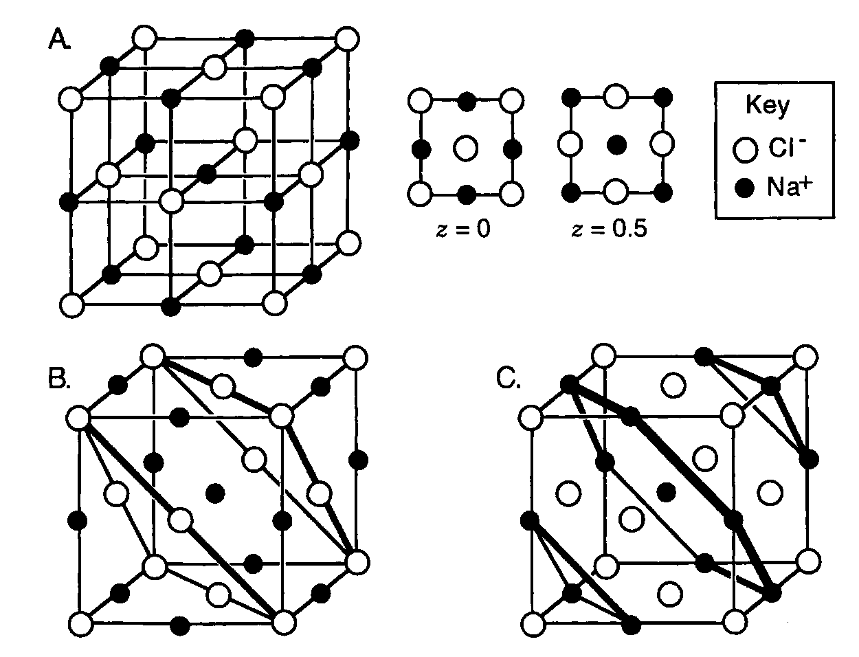
Sodium Chloride Lattice (NaCl)

Slide 32
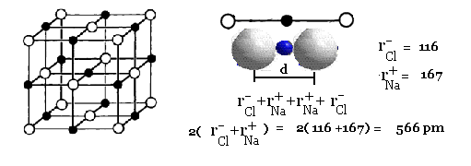
NaCl Lattice Calculations

Slide 33
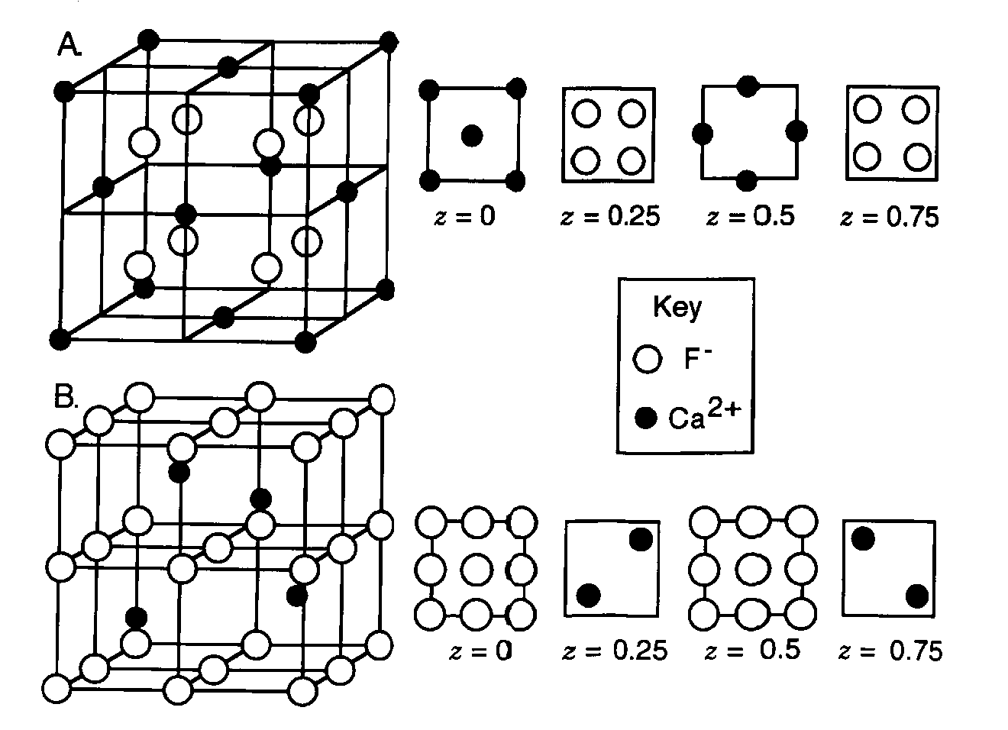
CaF₂

Slide 34
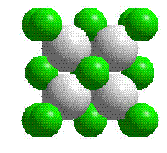
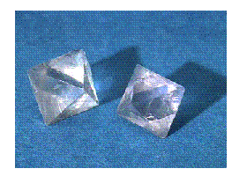

Calcium Fluoride
© 1995 by the Division of Chemical Education, Inc., American Chemical Society.
Reproduced with permission from Solid-State Resources.

Slide 35
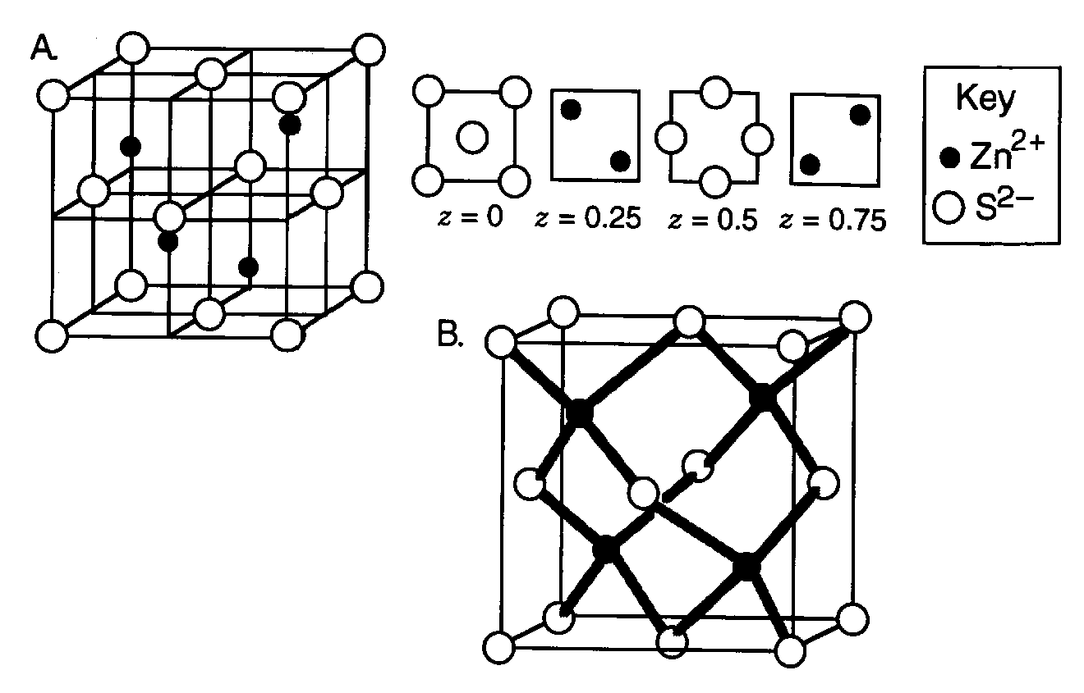
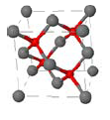
Zinc Blende Structure (ZnS)

Slide 36
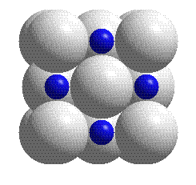
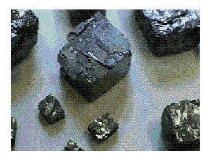
Lead Sulfide
© 1995 by the Division of Chemical Education, Inc., American Chemical Society.
Reproduced with permission from Solid-State Resources.

Slide 37
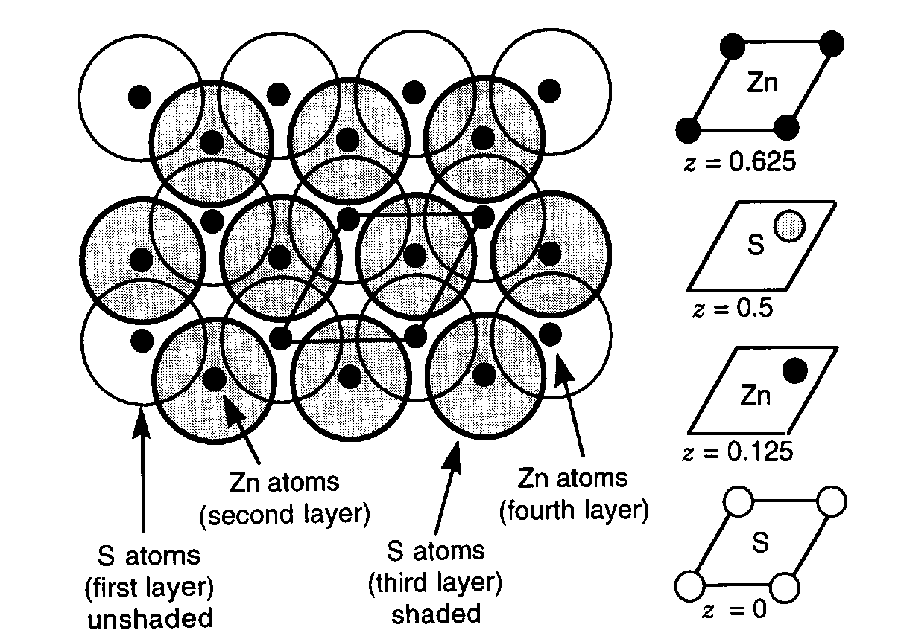
Wurtzite Structure (ZnS)

Slide 38
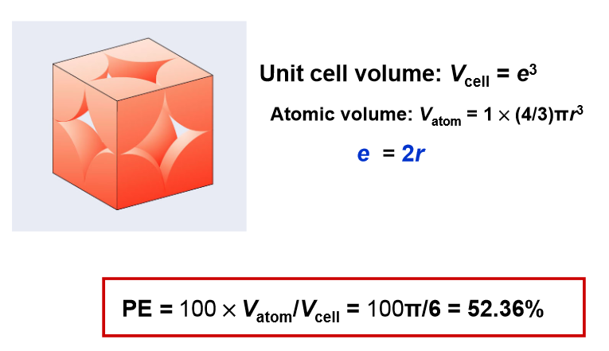
Packing Efficiency

Slide 39
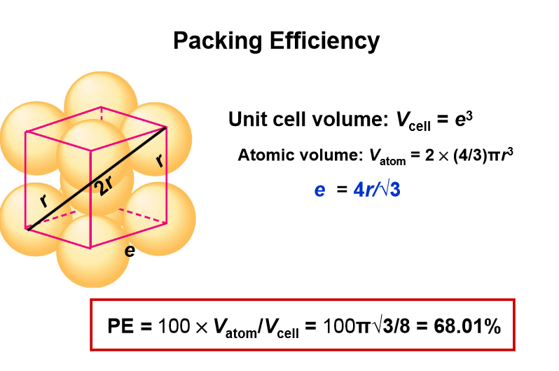
Packing Efficiency

Slide 40
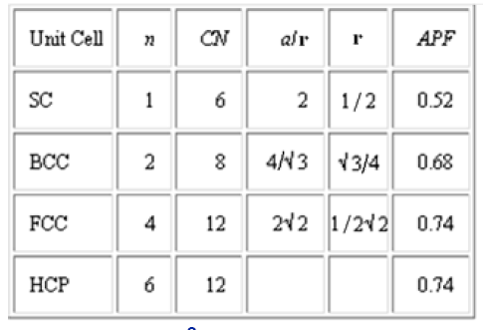
Summary of Unit Cells
Volume of a sphere = 4/3πr³
Volume of sphere in SC = 4/3π(½)³ = 0.52
Volume of sphere in BCC = 4/3π((3)^{½}/4)³ = 0.34
Volume of sphere in FCC = 4/3π( 1/(2(2)^{½}))³ = 0.185

Slide 41
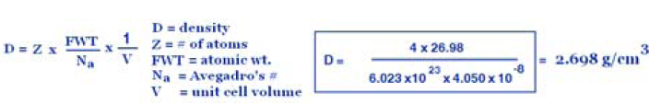
Density Calculations
Aluminum has a ccp (fcc) arrangement of atoms. The radius of Al = 1.423Å ( = 143.2pm). Calculate the lattice parameter of the unit cell and the density of solid Al (atomic weight = 26.98).
Solution:
4 atoms/cell [8 at corners (each 1/8), 6 in faces (each 1/2)]
Lattice parameter: a/r(Al) = 2(2)^{1/2}
a = 2(2)^{1/2} (1.432Å) = 4.050Å= 4.050 x 10⁻⁸ cm
Density = 2.698 g/cm³

Slide 42

Lattice Energy
The Lattice energy, U, is the amount of energy required to separate a mole of the solid (s) into a
gas (g) of its ions.

Slide 43
Lattice energy
Lattice energy
Compound kJ/mol
LiCl 834
NaCl 769
KCl 701
NaBr 732
Na2O 2481
Na2S 2192
MgCl2 2326
MgO 3795
The higher the lattice energy, the stronger the attraction between ions.

Slide 44
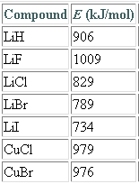
Lattice Energy

Slide 45
Properties of Ionic Compounds
Crystals of Ionic Compounds are hard and brittle
Have high melting points
When heated to molten state they conduct electricity
When dissolved in water conducts electricity

Slide 46
Trends in Melting Points
Compound Lattice Energy
(kcal/mol)
NaF -201
NaCl -182
NaBr -173
NaI -159

Slide 47
Trends in Melting Points
Compound Lattice Energy
(kcal/mol)
NaF -201
NaCl -182
NaBr -173
NaI -159

Slide 48
Trends in Properties
Compound q+ radius q- radius M.P (ºC) L.E. (kJ/mol)
LiCl 0.68 1.81 605 834
NaCl 0.98 1.81 801 769
KCl 1.33 1.81 770 701
LiF 0.68 1.33 845 1024
NaF 0.98 1.33 993 911
KF 1.33 1.33 858 815
MgCl₂ 0.65 1.81 714 2326
CaCl₂ 0.94 1.81 782 2223
MgO 0.65 1.45 2852 3938
CaO 0.94 1.45 2614 3414

Slide 49

Coulomb’s Law
k = constant
q+ = cation charge
q- = anion charge
r = distance between two ions

Slide 50
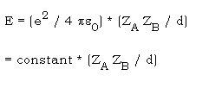
Coulomb’s Model
where e = charge on an electron = 1.602 x 10⁻¹⁹ C
e⁰ = permittivity of vacuum = 8.854 x 10⁻¹² C²J⁻¹m⁻¹
ZA = charge on ion A
ZB = charge on ion B
d = separation of ion centers

Slide 51
Ionic Bonds
An ionic bond is simply the electrostatic attraction between opposite charges.
Ions with charges Q1 and Q2:
•
•
d
Q
Q
The potential energy is given by:
E
∝
1
2
d

Slide 52
Estimating Lattice Energy
Arrange with increasing lattice energy:
KCl
NaF
MgO
KBr
NaCl
701 kJ
Q
Q
E
∝
1
2
d
910 kJ
3795 kJ
K⁺
Cl⁻
•
•
671 kJ
d
788 kJ
K⁺
Br⁻
•
•
d

Slide 53
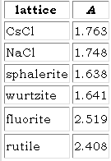
Madelung Constant
Madelung constant is geometric factor that depends on the lattice structure.

Slide 54


Madelung Constant Calculation

Slide 55
Degree of Covalent Character
Fajan's Rules (Polarization)Polarization will be increased by:
1. High charge and small size of the cation
2. High charge and large size of the anion
3. An incomplete valence shell electron configuration

Slide 56
Trends in Melting Points Silver Halides
Compound M.P. ºC
AgF 435
AgCl 455
AgBr 430
AgI 553

Slide 57
Born-Lande Model:
This modes include repulsions due to overlap of electron electron clouds of ions.
εº = permitivity of free space
A = Madelung Constant
r_{o} = sum of the ionic radii
n = average born exponet depend on the electron configuration

Slide 58

Born_Haber Cycle
Energy Considerations in Ionic Structures

Slide 59
Born-Haber Cycle?
Relates lattice energy ( L.E) to:
Sublimation (vaporization) energy (S.E)
Ionization energy metal (I.E)
Bond Dissociation of nonmetal (B.E)
ΔH_{f} formation of NaCl(s)
L.E. = E.A.+ 1/2 B.E. + I.E. + S.E. - ΔH_{f}

Slide 60

Ionic bond formation

Slide 61
Energy and ionic bond formation
Example - formation of sodium chloride.
Steps ΔHº, kJ
Vaporization of Na(s) Na(g) +92
sodium
Decomposition of 1/2 Cl₂ (g) Cl(g) +121
chlorine molecules
Ionization of sodium Na(g) Na⁺(g) +496
Addition of electron Cl(g) + e⁻ Cl⁻(g) -349
to chlorine
( electron affinity)
Formation of NaCl Na⁺(g)+Cl⁻(g) NaCl -771

Slide 62

Energy and ionic bond formation
Na⁺(s) + Cl(g)
-349 kJ (E.A.)
+496 kJ(I.E.)
Na⁺(s) + Cl⁻(g)
Na(g) + Cl(g)
Na(g) + 1/2 Cl2(g)
+121 kJ(1/2 B.D.E.)
Na(s) + 1/2 Cl2(g)
+92 kJ(S.E.)
-771 kJ (L.E.)
-411 kJ(ΔHf)
NaCl(s)

Slide 63

Calculation of ΔH_{f} from lattice Energy

Slide 64

Hydration of Cations

Slide 65
Solubility: Lattice Energy and Hydration Energy
Solubility depends on the difference between lattice energy and hydration energy holds ions and water.
For dissolution to occur the lattice energy must be overcome by hydration energy.

Slide 66
Solubility: Lattice Energy and Hydration Energy
For strong electrolytes lattice energy increases with increase in ionic charge and
decrease in ionic size
H hydration energies are greatest for small, highly charged ions
Difficult to predict solubility from size and charge of ions. we use solubility rules.

Slide 67



Thermodynamics of the Solution Process of Ionic Compounds
Heat of solution, ΔH_{solution} :
Enthalpy of hydration, ΔH_{hyd},
Lattice Energy, U_{latt}

Slide 68


Solution Process of Ionic Compounds

Slide 69
Enthalpy from dipole – dipole Interactions
The last term, ΔH _{L-L}, indicates the loss of enthalpy from dipole - dipole interactions between solvent molecules (L) when they become solvating ligands (L') for the ions.

Slide 70


Hydration Process

Slide 71

Different types of Interactions for Dissolution

Slide 72

Hydration Energy of Ions

Slide 73
Hydration Process

Slide 74

Calculation of ΔH_{solution}

Slide 75

Heat of Solution and Solubility

Slide 76
Metallic Bonding Models
The difference in chemical properties between metals and non-metals lie mainly in the fact those atoms of metals fewer valence electrons and they are shared among all the atoms in the substance: metallic bonding.

Slide 77
Metallic solids
Repeating units are made up of metal atoms,
Valence electrons are free to jump from one atom to another
+
+
+
+
+
+
+
+
+
+
+
+
+
+
+
+
+
+
+
+
+
+
+
+
+
+
+
+
+
+
+
+
+
+
+
+

Slide 78
Electron-sea model of bonding
The metallic bond consists of a series of metals atoms that have all donated their valence electrons to an electron cloud, referred to as an electron sea which permeates the entire solid. It is like a box (solid) of marbles (positively charged metal cores: known as Kernels) that are surrounded by water (valence electrons).

Slide 79
Electron-sea model Explanation
Metallic bond together is the attraction between the positive kernels and the delocalized negative electron cloud.
Fluid electrons that can carry a charge and kinetic energy flow easily through the solid making metals good electrical and thermal conductor.
The kernels can be pushed anywhere within the solid and the electrons will follow them, giving metals flexibility: malleability and ductility.

Slide 80
Delocalized Metallic Bonding
Metals are held together by delocalized bonds formed from the atomic orbitals of all the atoms in the lattice.
The idea that the molecular orbitals of the band of energy levels are spread or delocalized over the atoms of the piece of metal accounts for bonding in metallic solids.

Slide 81
Molecular orbital theory
Molecular Orbital Theory applied to metallic bonding is known as Band Theory.
Band theory uses the LCAO of all valence atomic orbitals of metals in the solid to form bands of s, p, d, f bands (molecular orbitals) just like simple molecular orbital theory is applied to a diatomic molecule, hydrogen(H₂).

Slide 82
Types of conducting materials
a) Conductor (which is usually a metal) is a solid with a partially full band.
b) Insulator is a solid with a full band and a large band gap.
c) Semiconductor is a solid with a full band and a small band gap.

Slide 83

Linear Combination of Atomic Orbitals

Slide 84

Linear Combination of Atomic Orbitals

Slide 85

Conduction Bands in Metals

Slide 86
Types of Materials
A conductor (which is usually a metal) is a solid with a partially full band
An insulator is a solid with a full band and a large band gap
A semiconductor is a solid with a full band and a small band gap
Element Band Gap C 5.47 eV Si 1.12 eV Ge 0.66 eV Sn 0 eV

Slide 87

Band Gaps

Slide 88
Band Theory of Metals

Slide 89
Band Theory
Insulators – valence electrons are tightly bound to (or shared with) the individual atoms – strongest ionic (partially covalent) bonding.
Semiconductors - mostly covalent bonding somewhat weaker bonding.
Metals – valence electrons form an “electron gas” that are not bound to any particular ion

Slide 90
Bonding Models for Metals
Band Theory of Bonding in Solids
Bonding in solids such as metals, insulators and semiconductors may be understood most effectively by an expansion of simple MO theory to assemblages of scores of atoms

Slide 91
Band Gaps

Slide 92
Doping Semiconductors

