Slide 1
NMR spectroscopy
Prepared by Dr. Upali Siriwardane
For
CHEM 281 Lab

Slide 2
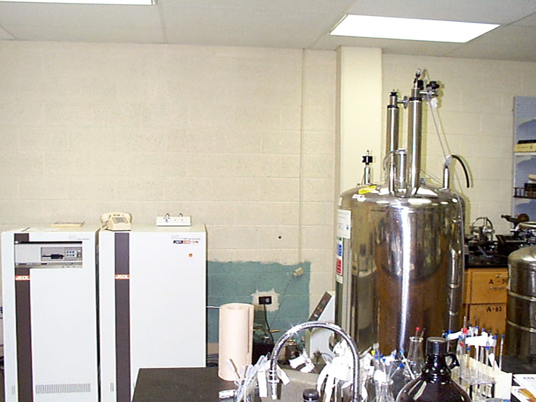
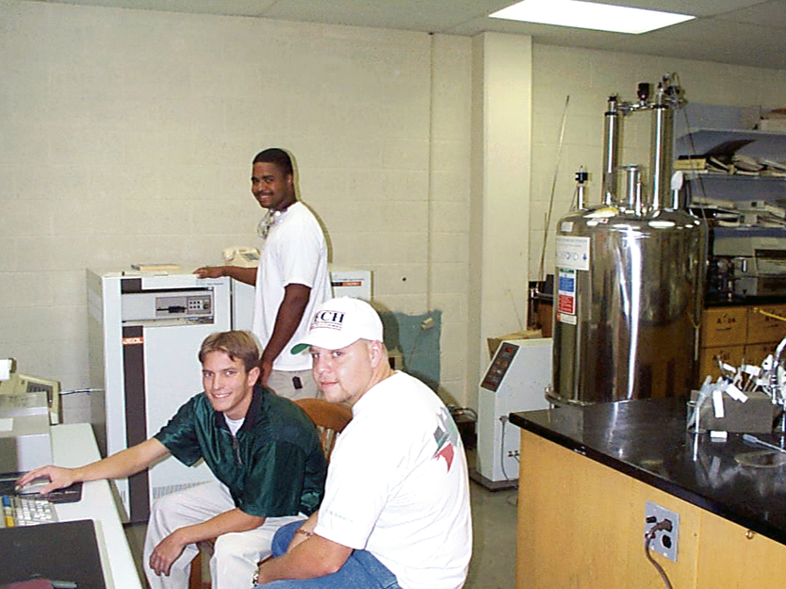
NMR is Located at Carson Taylor Hall Room 306

Slide 3
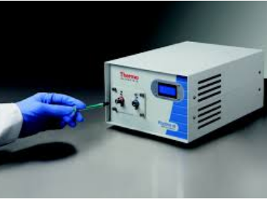
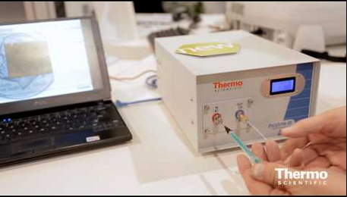
PicoSpin™ 45 NMR Spectrometer In CTH 303

Slide 4
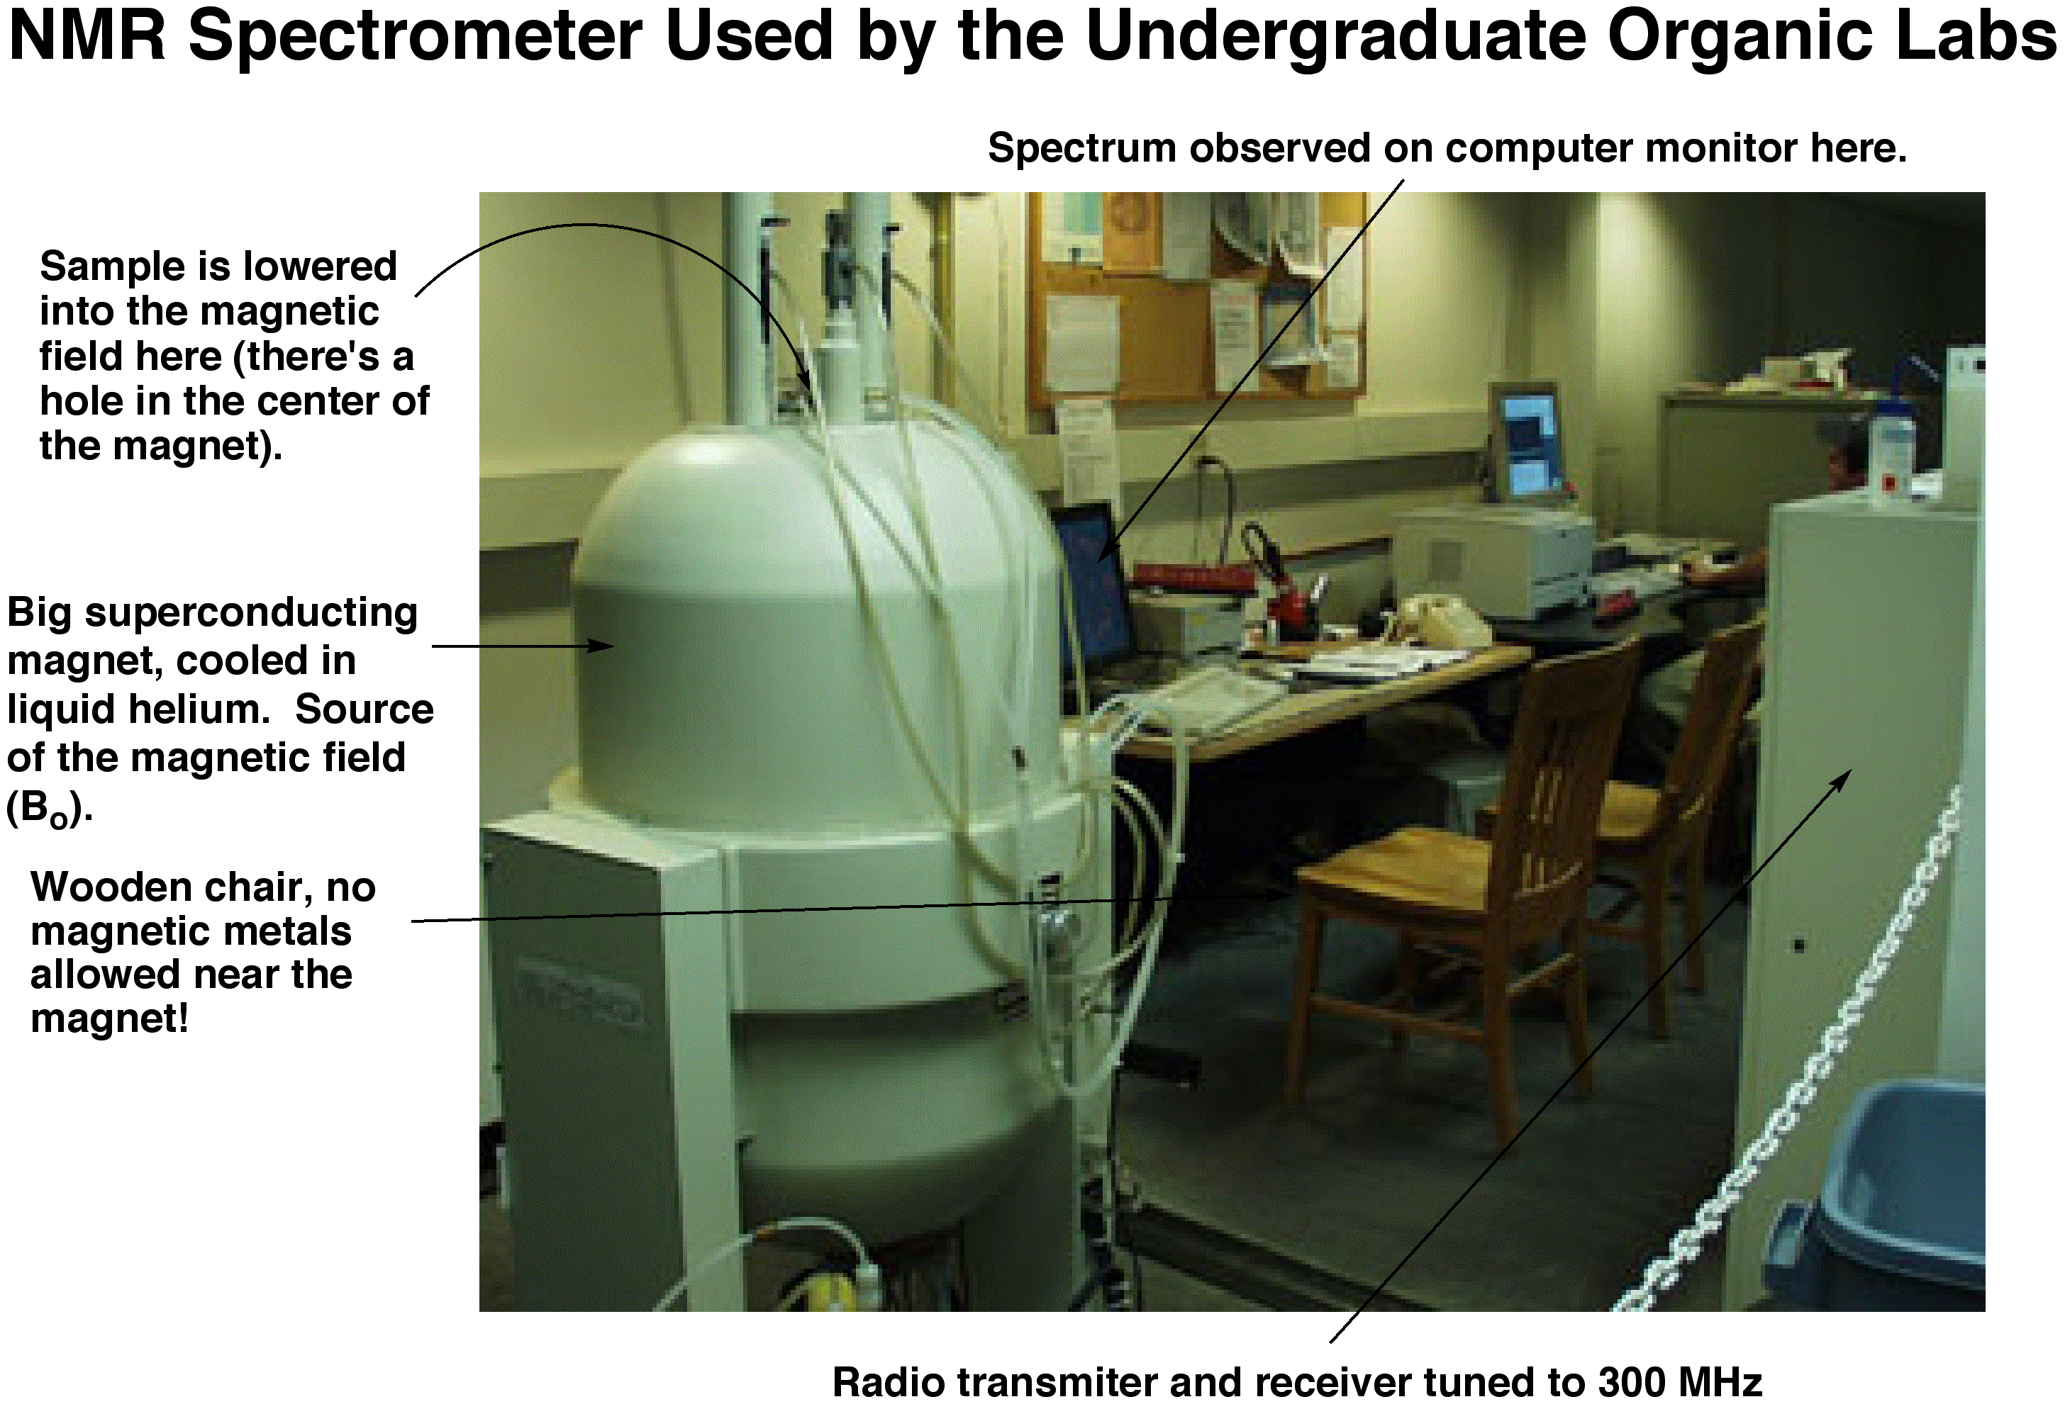

Slide 5
NMR: Basic Experimental Principles
But there’s a problem. If two researchers want to compare their data using magnets of different strengths, they have to adjust for that difference. That’s a pain, so, data is instead reported using the “chemical shift” scale as described on the next slide.

Slide 6
Information from ¹H-nmr spectra:
Number of signals: How many different types of hydrogens in the molecule.
Position of signals (chemical shift): What types of hydrogens.
Relative areas under signals (integration): How many hydrogens of each type. This only applies to ¹H-nmr spectra
Splitting pattern: How many neighboring hydrogens.

Slide 7
Spin quantum number(I) of Nuclei
Nuclear spin is characterized by a spin number, I, which can be zero or some positive integer multiple of 1/2 (e.g. 1/2, 1, 3/2, 2 etc.). Nuclei whose spin number, I= 0 have no magnetic moment(μ);eg. ¹²C and ¹⁶O show no NMR signal. Elements such as ¹H, ¹³C, ¹⁹F and ³¹P have I=1/2, while others have even higher spin numbers:
I=1 ¹⁴N, ²H
I=3/2 ¹¹B, ³⁵Cl, ³⁷Cl, ⁷⁹Br, ⁸¹Br.
As the values for I increase, energy levels and shapes of the magnetic fields become progressively more and more complex.

Slide 8
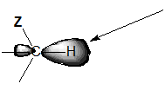
The Chemical Shift of Different Protons
NMR would not be very valuable if all protons absorbed at the same frequency. Anyone knows there are hydrogens in organic molecules. What makes it useful is that different protons usually appear at different chemical shifts (δ). So, we can distinguish one kind of proton from another. Why do different protons appear at different δ? There are several reasons, one of which is shielding. The electrons in a bond shield the nuclei from the magnetic field. So, if there is more electron density around a proton, it sees a slightly lower magnetic field, less electron density means it sees a higher magnetic field:

Slide 9
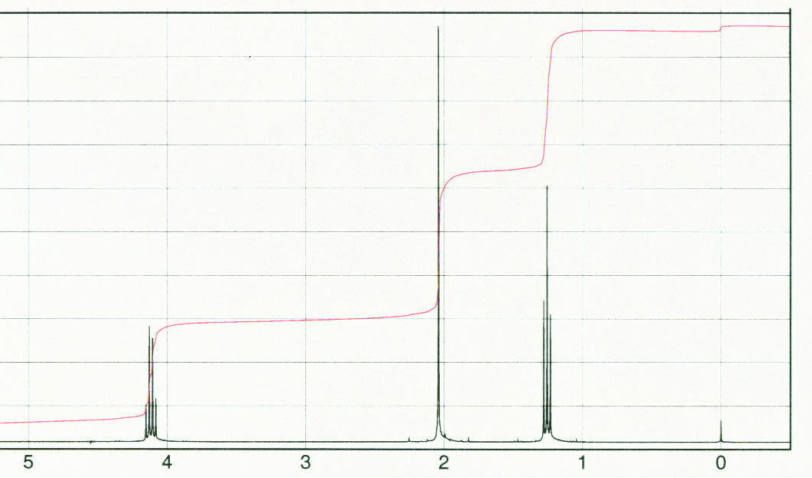
The Hard Part - Interpreting Spectra
Learning how an NMR machine works is straightforward. What is less straightforward is learning how to use the data we get from an NMR machine (the spectrum of ethyl acetate is shown below). That’s because each NMR spectrum is a puzzle, and there’s no single fact that you simply have to memorize to solve these spectra. You have to consider lots of pieces of data and come up with a structure that fits all the data. What kinds of data do we get from NMR spectra? For ¹H NMR, there are three kinds each of which we will consider each of these separately:
Chemical shift data - tells us what kinds of protons we have.
Integrals - tells us the ratio of each kind of proton in our sample.
¹H - ¹H coupling - tells us about protons that are near other protons.

Slide 10
NMR = Nuclear Magnetic Resonance
Physical Principles:

Slide 11
NMR: Basic Experimental Principles
But there’s a problem. If two researchers want to compare their data using magnets of different strengths, they have to adjust for that difference. That’s a pain, so, data is instead reported using the “chemical shift” scale as described on the next slide.

Slide 12
δ values (chemical shifts)
ν (peak) - ν(ref)
δ (ppm) =
x 10⁶
ν (ref)
Reference could internal ( known peak values in the compound) or external (TMS or CDCl₃)

Slide 13
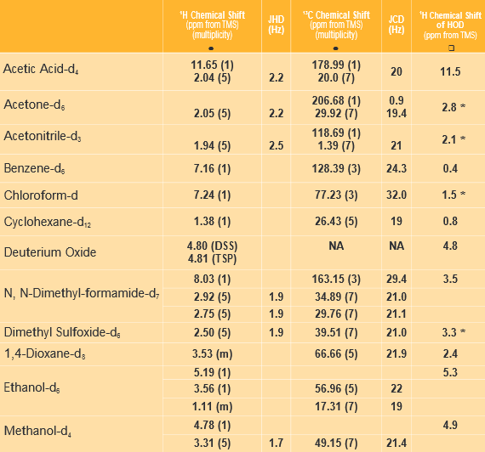
Deuterated Solvents

Slide 14
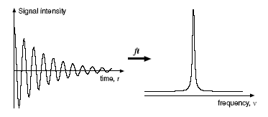

NMR Signal Detection - Fourier Transform
So, the NMR signal is collected in the Time - domain
But, we prefer the frequency domain.
Fourier Transform is a mathematical procedure that
transforms time domain data into frequency domain

Slide 15
Shielding, Deshielding, Upfieled & Downfield
Downfield
upfield
deshielding
shielding

Slide 16
Chemical Shift Data
As previously mentioned, different kinds of protons typically come at different chemical shifts. Shown below is a chart of where some common kinds of protons appear in the δ scale. Note that most protons appear between 0 and 10 ppm. The reference, tetramethylsilane (TMS) appears at 0 ppm, and aldehydes appear near 10 ppm. There is a page in your lab handout with more precise values for this chart.
Note that these are typical values and that there are lots of exceptions!

Slide 17
Integrals
Integrals tell us the ratio of each kind of proton. They are lines, the heights of which are proportional to the intensity of the signal. Consider ethyl acetate. There are three kinds of protons in this molecule, the CH₃ next to the carbonyl, the CH₂ next to the O and the CH₃ next to the CH₂.

Slide 18
¹H - ¹H Coupling
You’ll notice in the spectra that we’ve seen that the signals don’t appear as single lines, sometimes they appear as multiple lines. This is due to ¹H - ¹H coupling (also called spin-spin splitting or J-coupling).

Slide 19
More ¹H - ¹H Coupling
What happens when there is more than one proton splitting a neighboring proton? We get more lines. Consider the molecule below where we have two protons on one carbon and one proton on another.

Slide 20
Why are There Three Lines for H_{B}?
H_{B} feels the splitting of both H_{A} and H_{A’}. So, let’s imagine starting with H_{B} as a single line, then let’s “turn on” the coupling from H_{A} and H_{A’} one at a time:
Because the two lines in the middle overlap, that line is twice as big as the lines on the outside. More neighboring protons leads to more lines as shown on the next slide.

Slide 21
Splitting Patterns with Multiple Neighboring Protons
If a proton has n neighboring protons that are equivalent, that proton will be split into n+1 lines. So, if we have four equivalent neighbors, we will have five lines, six equivalent neighbors….
We keep emphasizing that this pattern only holds for when the neighboring protons are equivalent. Why is that? The answer is two slides away.

Slide 22
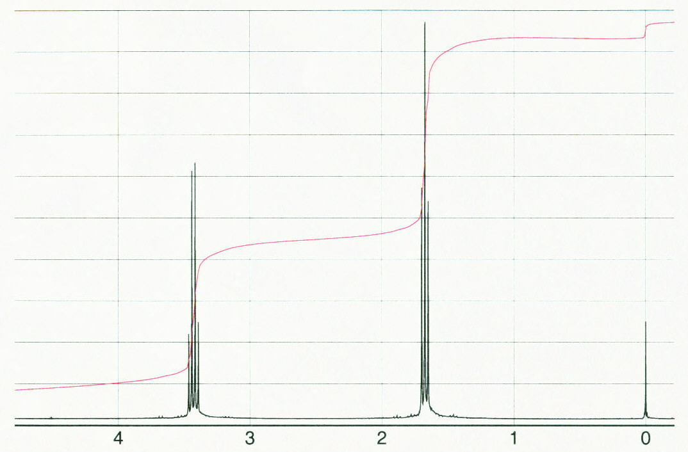
More About Coupling
Earlier we said that protons couple to each other because they feel the magnetic field of the neighboring protons. While this is true, the mechanism by which they feel this field is complicated and is beyond the scope of this class (they don’t just feel it through space, it’s transmitted through the electrons in the bonds).

Slide 23
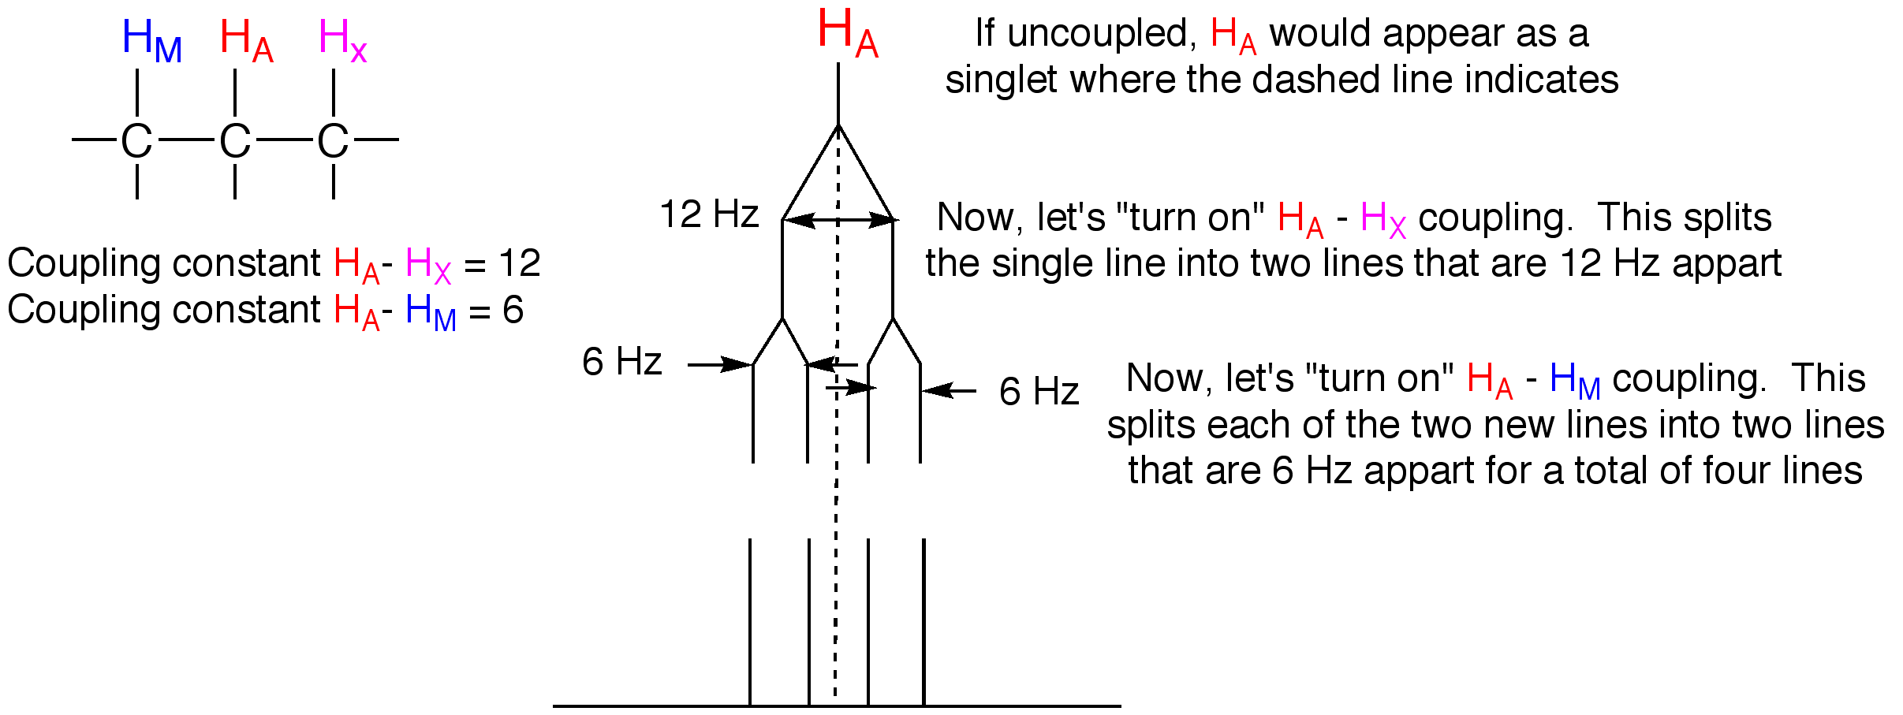
Not all Couplings are Equal
When protons couple to each other, they do so with a certain intensity. This is called the “coupling constant.” Coupling constants can vary from 0 Hz (which means that the protons are not coupled, even though they are neighbors) to 16 Hz. Typically, they are around 7 Hz, but many molecules contain coupling constants that vary significantly from that. So, what happens when a molecule contains a proton which is coupled to two different protons with different coupling constants? We get a different pattern as described in the diagram below.
So, if the protons are not equivalent, they can have different coupling constants and the resulting pattern will not be a triplet, but a “doublet of doublets.” Sometimes, nonequivalent protons can be on the same carbon as described on the next slide.

Slide 24
Coupling Constants in Alkenes
Coupling constants in alkenes can also differ depending on whether the protons are cis or trans to each other. Note that in a terminal alkene (i.e., an alkene at the end of a carbon chain), the cis and trans protons are NOT equivalent. One is on the same side as the substituent, the other is on the opposite side. The coupling of trans protons to each other is typically very large, around 16 Hz, while the coupling of cis protons, while still large, is a little smaller, around 12 Hz. This leads to the pattern shown below, and an example of a molecule with this splitting pattern is shown on the next slide.
There are other times when protons on the same carbon are nonequivalent, which we’ll see later.

Slide 25
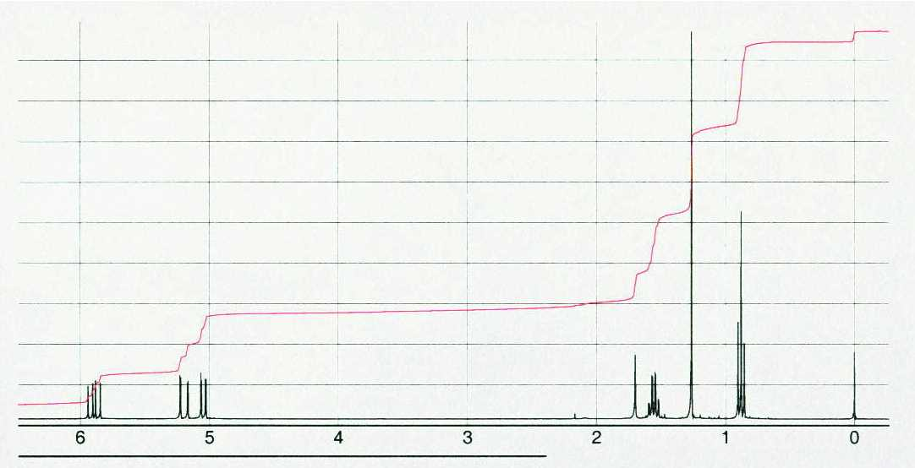
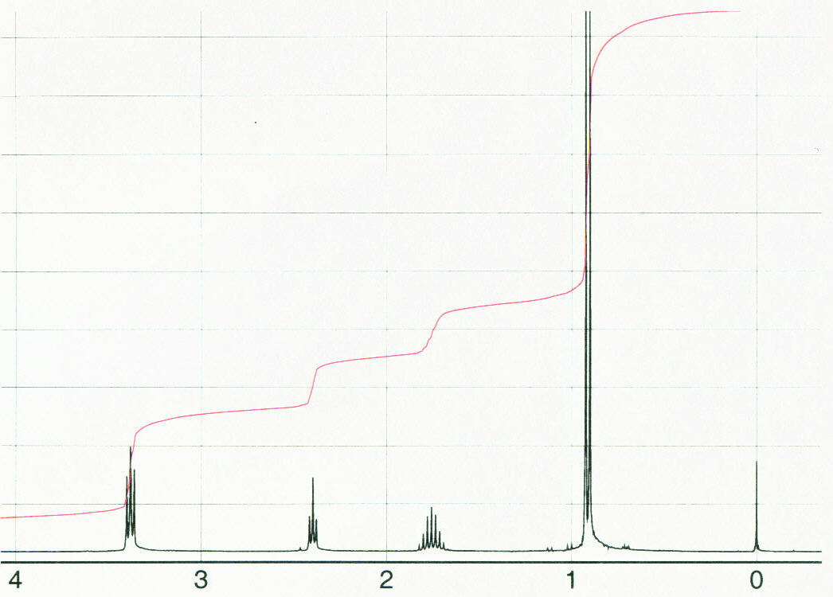

Slide 26
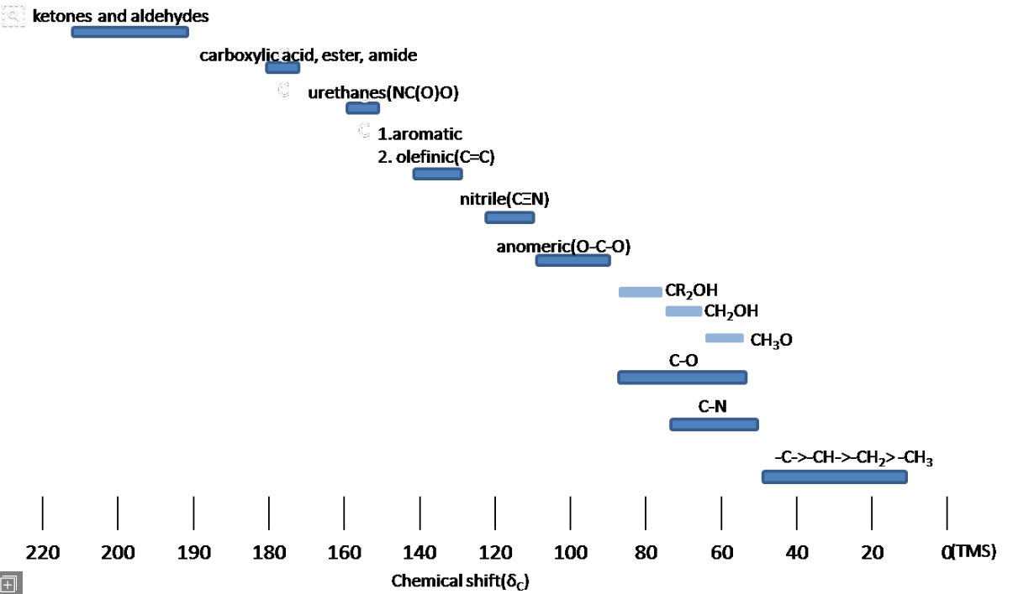

Slide 27
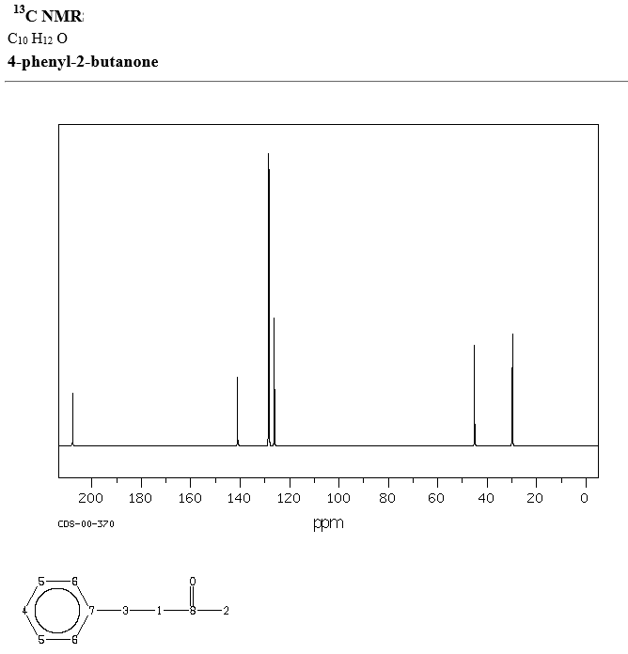

Slide 28
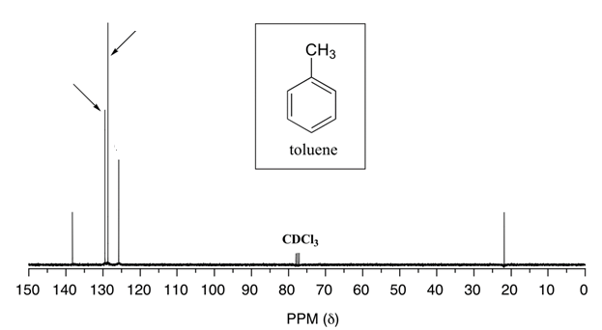

Slide 29
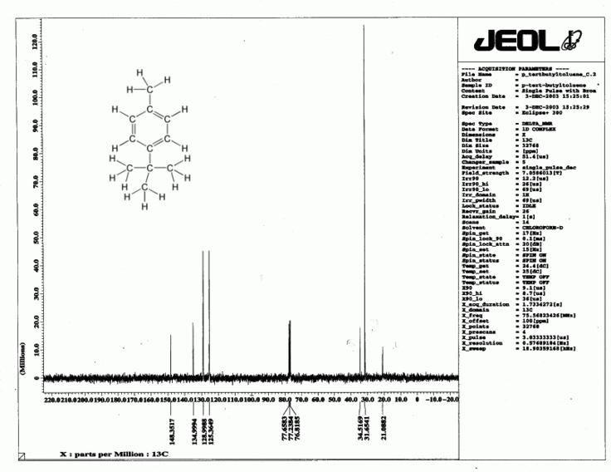

Slide 30
