Slide 1
Magnetism
Magnetic Susceptibility
Nuclear Magnetic Resonance (NMR)
Electron Paramagnetic Resonance (EPR)
Hall Probes
Magnetoresistors
Fluxgate Magnetometers
Flux Measurements with Pick Up Coils
Magnetic Alignment –center and direction

Slide 2
Magnetic Susceptibility Principle
Questions you may have include:
What are paramagnetic materials?
What are diamagnetic materials?
What are ferromagnetic materials?
What are antiferromagnetic materials?
What is supermagnets?

Slide 3
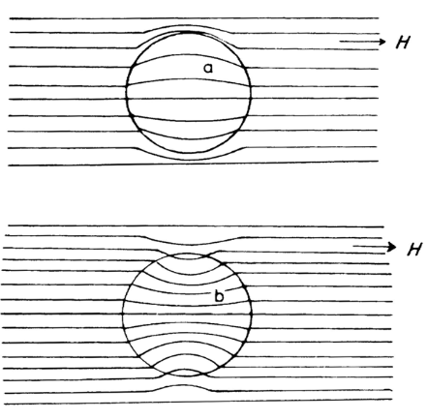
Magnetic Filed Effect
diamagnetc
Paramagnetic

Slide 4
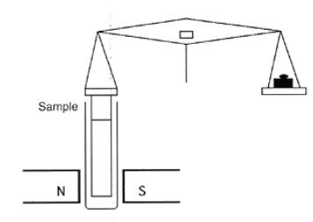
Magnetic Moments (Susceptibility)
Magnetic moment (μ): relates directly to the number of unpaired electrons
Susceptibility and magnetic moment can be determined experimentally using a Guoy Balance:
For paramagnetic substance, unpaired electrons are attracted by the magnetic field and an apparent increase in mass of the sample occurs when the field is switch on
Microbalance
Measures to 5th decimal

Slide 5
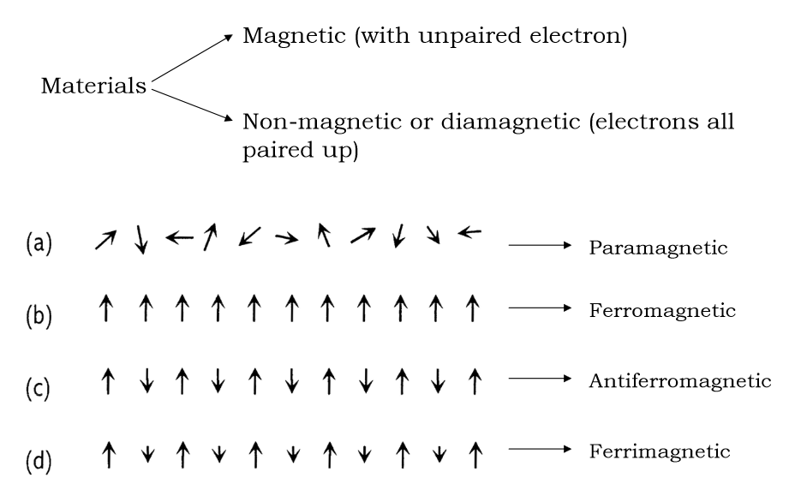
Magnetic properties and unpaired electrons

Slide 6
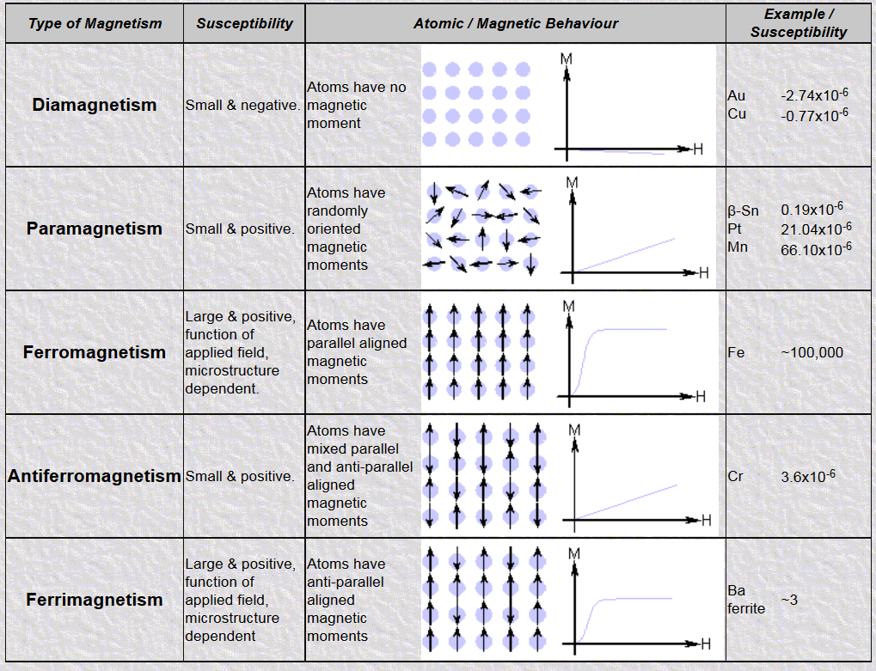

Slide 7
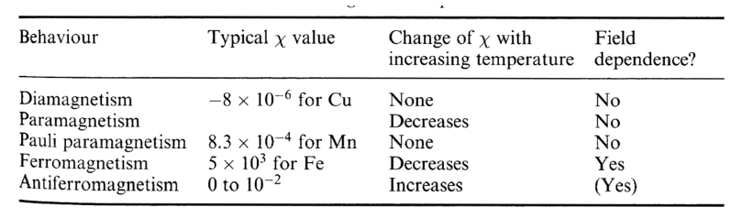
Temperature and Field Dependence

Slide 8
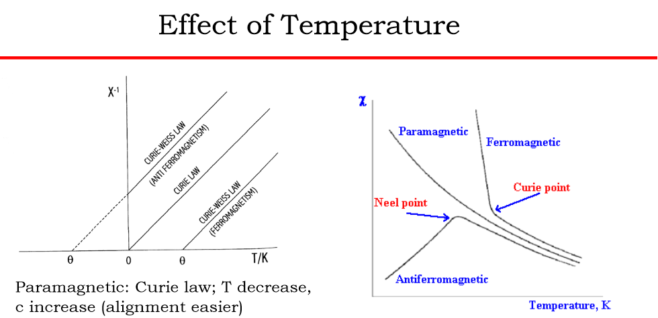

Slide 9
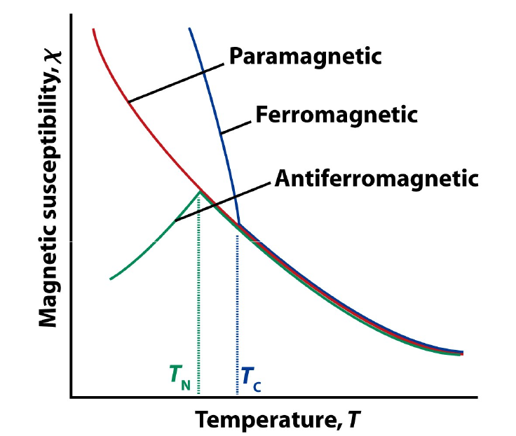

Slide 10
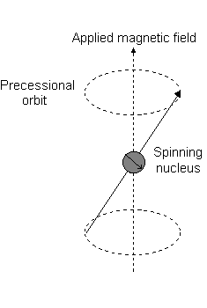
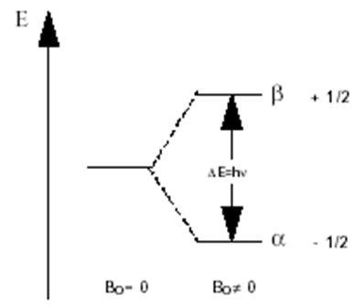
NMR/EPR Principle
A particle with a spin and a magnetic
moment precesses around an applied field.
The quantum energy levels are split into
several discrete levels, depending on the
spin of the particle.
The energy gap between these levels is
proportional to the applied field.
A resonant absorption of RF energy occurs
at a frequency corresponding to energy gap.

