Slide 1
Valence Bond (VB) and Molecular Orbital (MO) Theories
Instructor: Dr. Upali Siriwardane
e-mail: upali@latech.edu
Office: CTH 311 Phone 257-4941

Slide 2
Molecular structure and bonding
Lewis structures
2.1 The octet rule
2.2 Structure and bond properties
2.3 The VSEPR model
Valence-bond theory
2.4 The hydrogen molecule
2.5 Homonuclear diatomic molecules
2.6 Polyatomic molecules
Molecular orbital theory
2.7 An introduction to the theory
2.8 Homonuclear diatomic molecules
2.9 Heteronuclear diatomic
2.10 Bond properties

Slide 3
What is VSEPR Theory
Valence Shell Electron Pair Repulsion
This theory assumes that the molecular structure is determined by the lone pair and bond pair electron repulsion around the central atom based on the Lewis Structure.

Slide 4
What Geometry is Possible around Central Atom?
What is Electronic or Basic Structure?
Arrangement of electron pairs around the central atom is called the electronic or basic structure
What is Molecular Structure?
Arrangement of atoms around the central atom is called the molecular structure

Slide 5
Possible Molecular Geometry
Linear (180)
Trigonal Planar (120)
T-shape (90, 180)
Tetrahedral (109)
Square palnar ( 90, 180)
Sea-saw (90, 120, 180)
Trigonal bipyramid (90, 120, 180)
Octahedral (90, 180)

Slide 6
Molecular Structure from VSEPR Theory
H₂O
Bent or angular
NH₃
Pyramidal
CO₂
Linear

Slide 7
Molecular Structure from VSEPR Theory
SF₆
Octahedral
PCl₅
Trigonal bipyramidal
XeF₄
Square planar

Slide 8
What is a Polar Molecule?
Molecules with unbalanced electrical charges
Molecules with a dipole moment
Molecules without a dipole moment are called non-polar molecules

Slide 9
How do you a Pick Polar Molecule?
Get the molecular structure from VSEPR theory
From χ (electronegativity) difference of bonds see whether they are polar-covalent.
If the molecule have polar-covalent bond, check whether they cancel from a symmetric arrangement.
If not molecule is polar

Slide 10
Which Molecules are Polar
H2O
Bent or angular, polar-covalent bonds, asymmetric molecule-polar
NH3
Pyramidal, polar-covalent bonds, asymmetric molecule-polar
CO2
Linear, polar-covalent bonds, symmetric molecule-polar

Slide 11
What is hybridization?
Mixing of atomic orbitals on the central atoms valence shell (highest n orbitals)
Bonding: s p d
sp,
sp²,
sp³,
sp³d,
sp³d²
Px
Py
Pz
dz²
dx²- y²

Slide 12
What is hybridization?
Mixing of atomic orbitals on the central atom
Bonding
a hybrid orbital could over lap with another (ψ)atomic orbital or (ψ) hybrid orbital of another atom to make a covalent bond.
possible hybridizations: sp, sp², sp³, sp³d, sp³d²

Slide 13
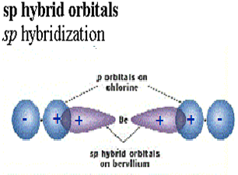
What is Valence Bond Theory
Describes bonding in molecule using atomic orbital
orbital of one atom occupy the same region with a orbital from another atom
total number of electrons in both orbital is equal to two
Be Cl2

Slide 14
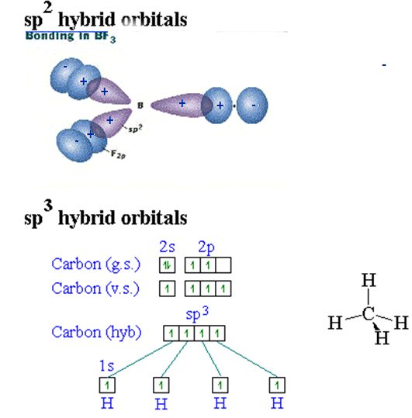
sp² and sp³ Hybridization
BF3

Slide 15
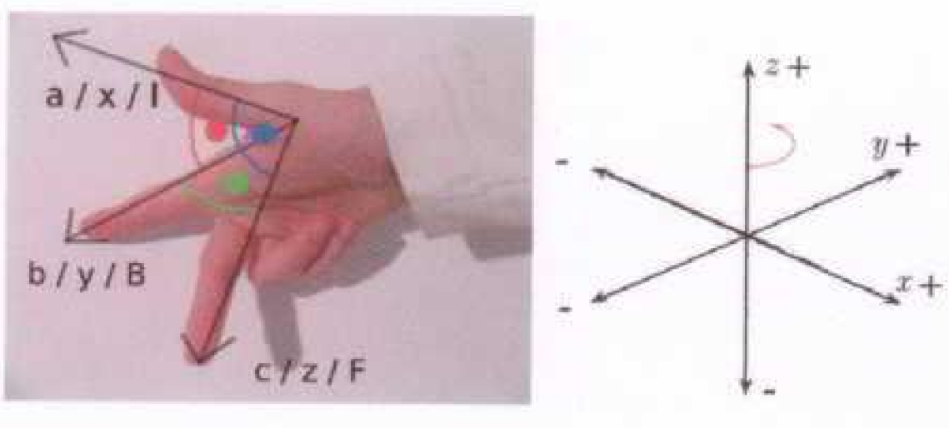
Cartesian Coordinate

Slide 16
What is hybridization?
Mixing of atomic orbitals on the central atom
Bonding
a hybrid orbital could over lap with another (ψ)atomic orbital or (ψ) hybrid orbital of another atom to make a covalent bond.
possible hybridizations: sp, sp², sp³, sp³d, sp³d²

Slide 17
How do you tell the hybridization of a central atom?
Get the Lewis structure of the molecule
Look at the number of electron pairs on the central atom. Note: double, triple bonds are counted as single electron pairs.
Follow the following chart

Slide 18
Kinds of hybrid orbitals
Hybrid geometry # of orbital
sp linear 2
sp² trigonal planar 3
sp³ tetrahedral 4
sp³d trigonal bipyramid 5
sp³d² octahedral 6

Slide 19
What is hybridization?
Mixing of atomic orbitals on the central atoms valence shell (highest n orbitals)
Bonding: s p d
sp,
sp²,
sp³,
sp³d,
sp³d²
Px
Py
Pz
dz²
dx²- y²

Slide 20
Possible hybridizations of s and p
sp-hybridization:
ψ1 = 1/√2ψs - 1/√2ψp ψ2 = 1/√2ψs + 1/√2ψp
sp²-hybridization:
ψ1 = 1/√3ψs + 1/√6ψpx + 1/√2ψpy ψ2 = 1/√3ψs + 1/√6ψpx - 1/√2ψpy ψ3 = 1/√3ψs - 2/√6ψpx
sp³-hybridization:
ψ1 = 1/√4ψs + 1/√4ψpx + 1/√4ψpy + 1/√4ψpz ψ2 = 1/√4ψs - 1/√4ψpx - 1/√4ψpy + 1/√4ψpz ψ3 = 1/√4ψs + 1/√4ψpx - 1/√4ψpy - 1/√4ψpz ψ4 = 1/√4ψs - 1/√4ψpx + 1/√4ψpy -1/√4ψpz

Slide 21
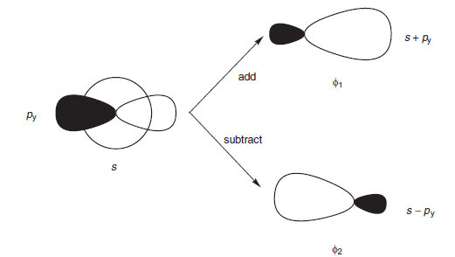
Possible hybridizations of s and p
sp-hybridization:

Slide 22
What are π and σ bonds
σ bonds
single bond resulting from head to head overlap of atomic orbital
π bond
double and triple bond resulting from lateral or side way overlap of p atomic orbitals
δ bond
double and triple bond resulting from lateral or side way overlap of d atomic orbitals

Slide 23
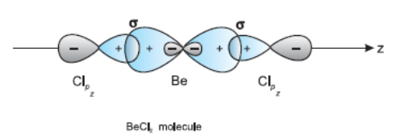
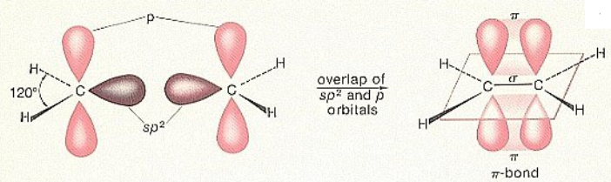
What are π and σ bonds
σ bonds
π bond

Slide 24
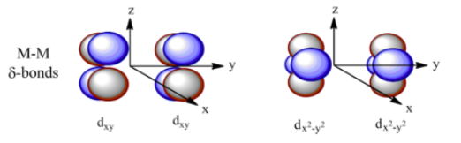
What are δ bonds
δ bond
double and triple bond resulting from lateral or side way overlap of d atomic orbitals

Slide 25
Basic Rules of Molecular Orbital Theory
The MO Theory has five basic rules:
The number of molecular orbitals = the number of atomic orbitals combined
Of the two MO's, one is a bonding orbital (lower energy) and one is an anti-bonding orbital (higher energy)
Electrons enter the lowest orbital available
The maximum # of electrons in an orbital is 2 (Pauli Exclusion Principle)
Electrons spread out before pairing up (Hund's Rule)

Slide 26
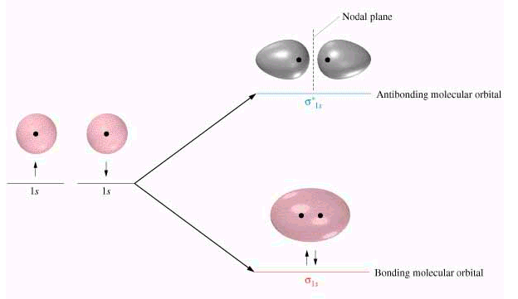
Molecular Orbital Theory
Molecular orbitals are obtained by combining the atomic orbitals on the atoms in the molecule.

Slide 27
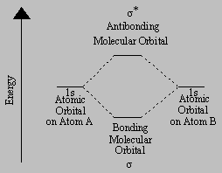
Bonding and Anti-bobding Molecular Orbital

Slide 28
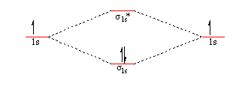
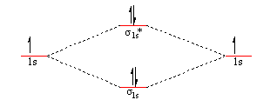
Homo Nuclear Diatomic Molecules
Period 1 Diatomic Molecules: H₂ and He₂

Slide 29

Bond Order
Calculating Bond Order

Slide 30
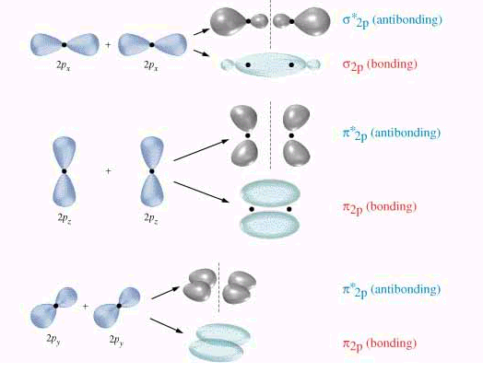
Homo Nuclear Diatomic Molecules

Slide 31
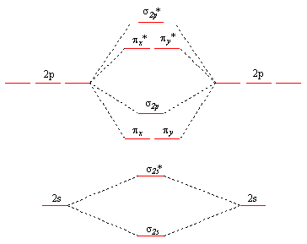
Molecualr Orbital diagram for B₂, C₂ and N₂

Slide 32
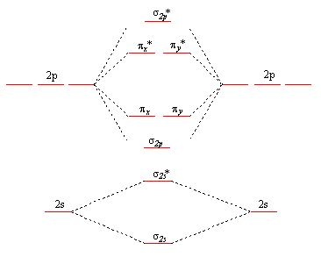
Molecualr Orbital diagram for O₂, F₂ and Ne₂

Slide 33
7. Using molecular orbital theory and diagrams, explain why, O₂ is a paramagnetic whereas N₂ is diamagnetic.

Slide 34
Electronic Configuration of molecules
When writing the electron configuration of an atom, we usually list the orbitals in the order in which they fill.
Pb: [Xe] 6s² 4f¹⁴ 5d¹⁰ 6p²
We can write the electron configuration of a molecule by doing the same thing. Concentrating only on the valence orbitals, we write the electron configuration of O₂ as follows.
O₂: (2σ) ²(2σ*) ² (2π) ⁴ (2π*) ²

Slide 35
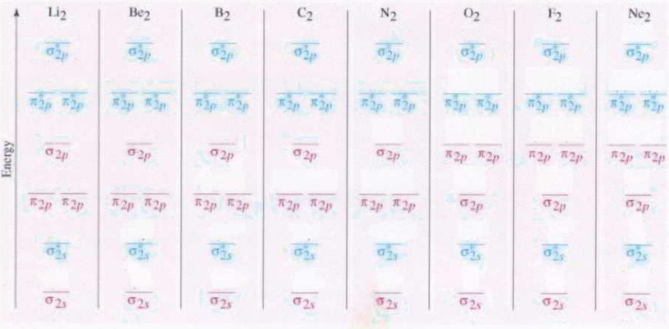
Electronic Configuration and bond order

Slide 36
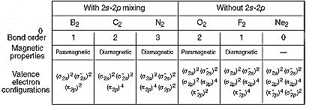
Electronic Configuration and bond order

