Slide 1
Chemistry 281(01) Winter 2017
CTH 227 10:00-11:15 am
Instructor: Dr. Upali Siriwardane
E-mail: upali@latech.edu
Office: 311 Carson Taylor Hall ; Phone: 318-257-4941;
Office Hours: MTW 8:00 am - 10:00 am;
TR 8:30 - 9:30 am & 1:00-2:00 pm.
Tests
January 17, 2017 Test 1 (Chapters 1&,2),
February 2, 2017 Test 2 (Chapters 3 &4)
February 22, 2017, Test 3 (Chapters 5 & 6),
Comprehensive Final Make Up Exam:
February 23, 2017 10:00-11:15 AM, CTH 227.

Slide 2
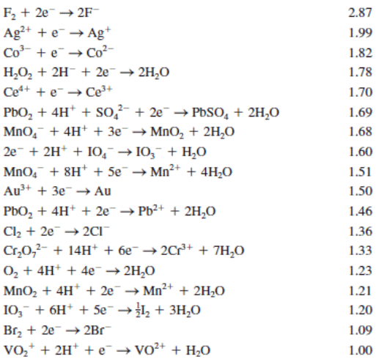
Reduction Potentials

Slide 3
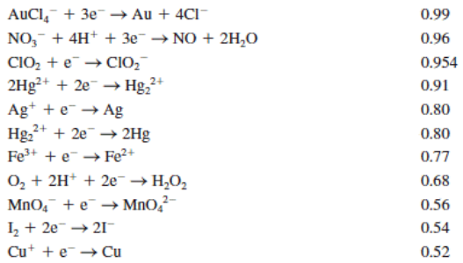
Reduction Potentials

Slide 4
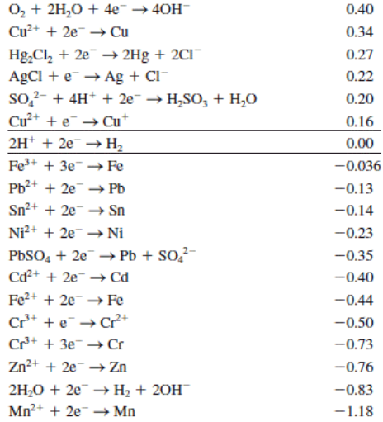
Reduction Potentials

Slide 5
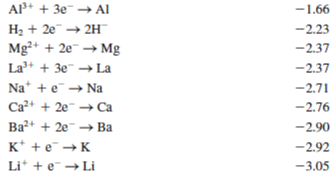
Reduction Potentials

Slide 6
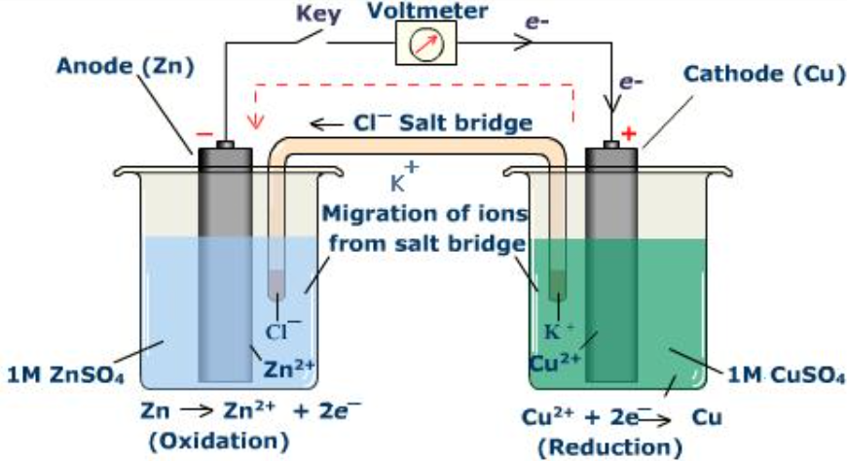
Electrochemical cell

Slide 7
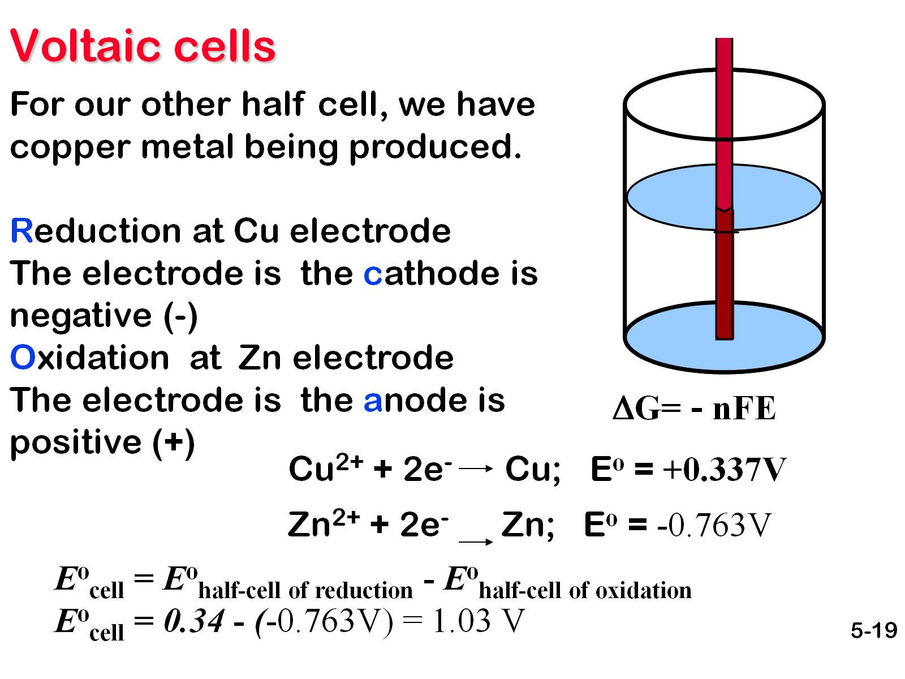
Voltaic cells

Slide 8
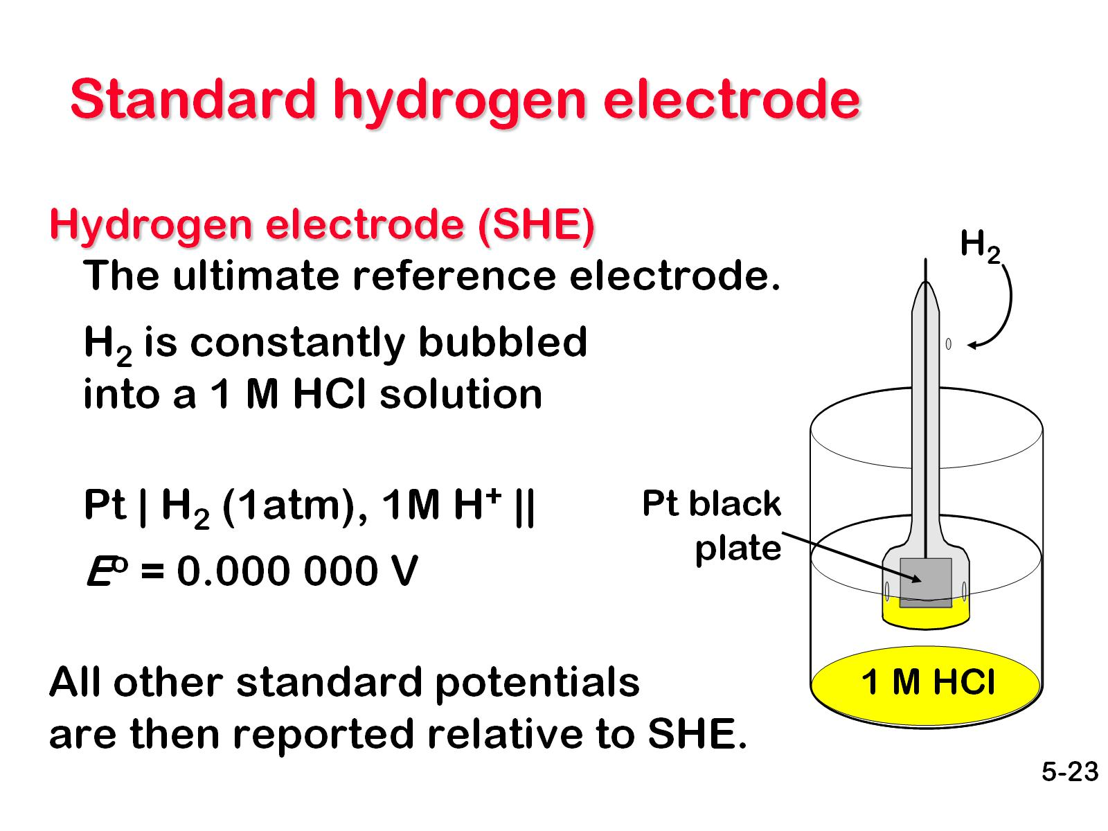
Standard hydrogen electrode

Slide 9
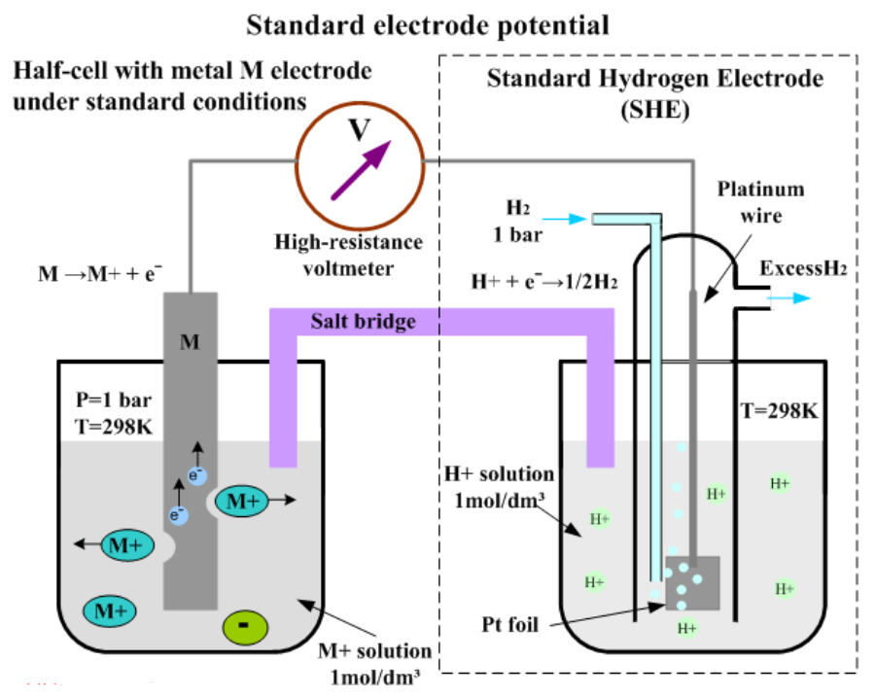
Electrochemical Standard cell

Slide 10
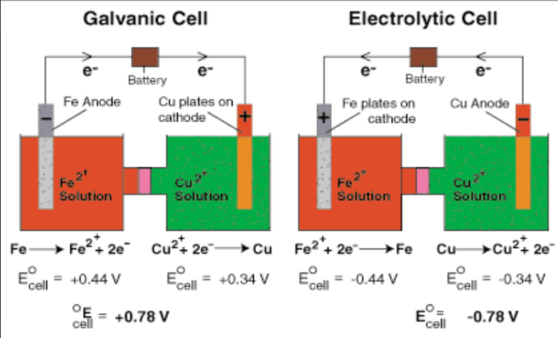
Electrochemical vs Electrolytical cell

Slide 11
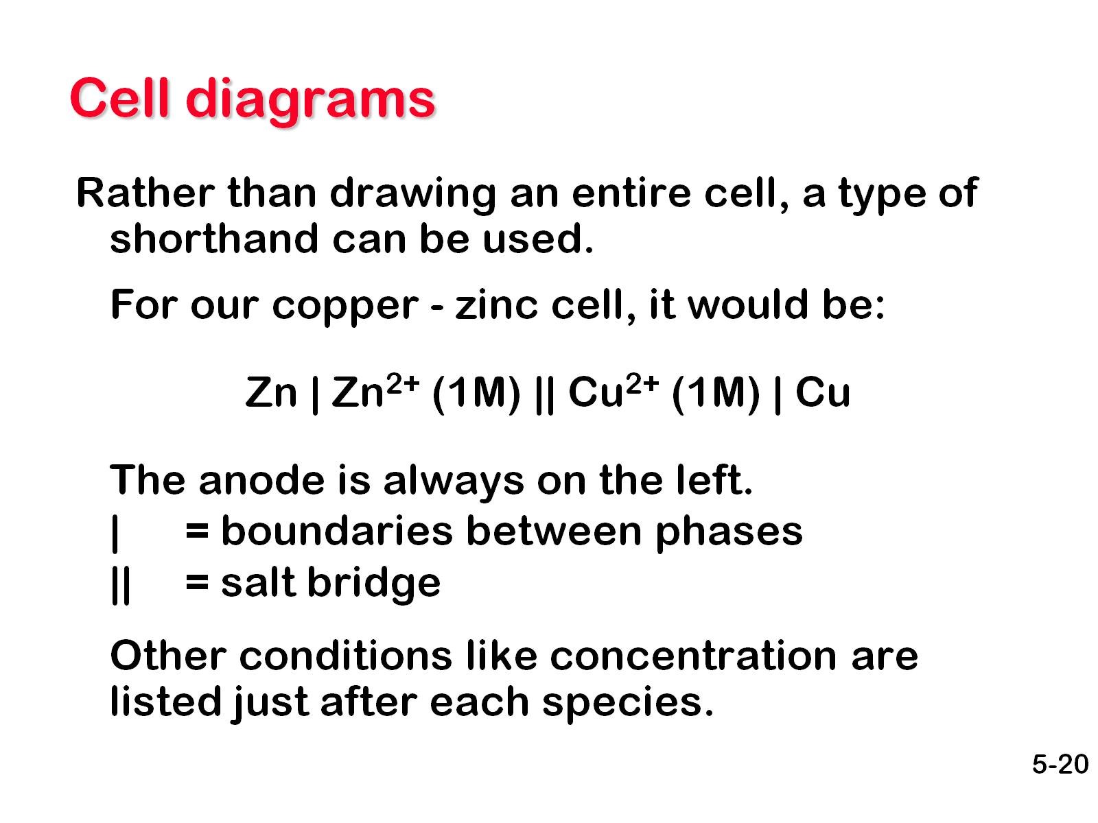
Cell diagrams

Slide 12
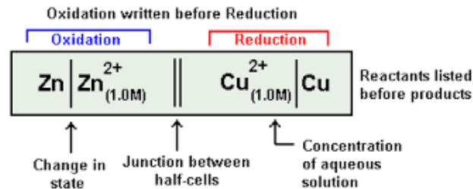
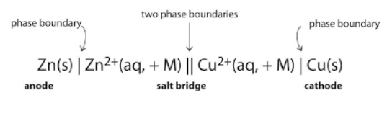

Electrochemical cell Notations

Slide 13
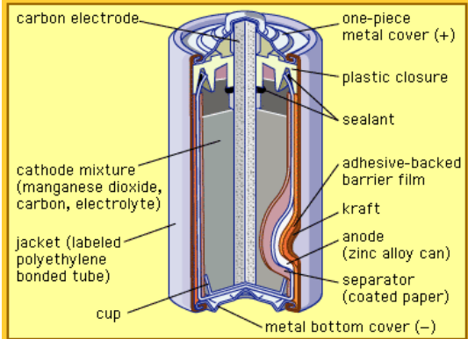
2 MnO₂(s) + 2 e⁻ + 2 NH₄Cl(aq) → Mn₂O₃(s) + 2 NH₃(aq) + H₂O(l) + 2 Cl⁻ [E° ≈ +0.5 V]
Zn(s) → Zn²⁺(aq) + 2 e⁻ [E° = −0.7626 V]

Slide 14
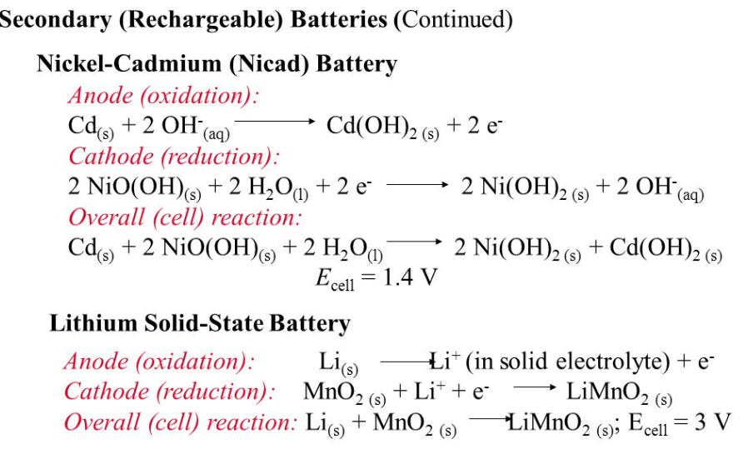
Rechargeable Dry cells

Slide 15
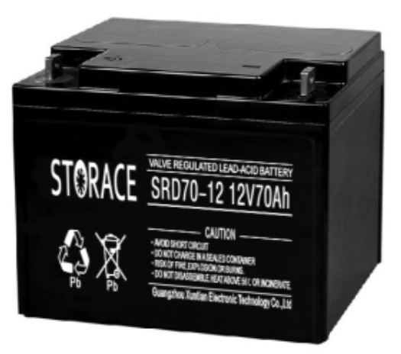
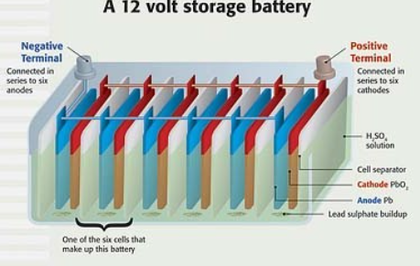
Lead Storage Battery

Slide 16
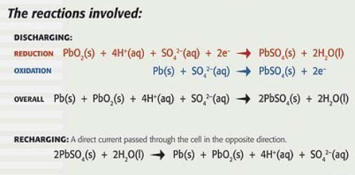
Lead Storage Battery

Slide 17
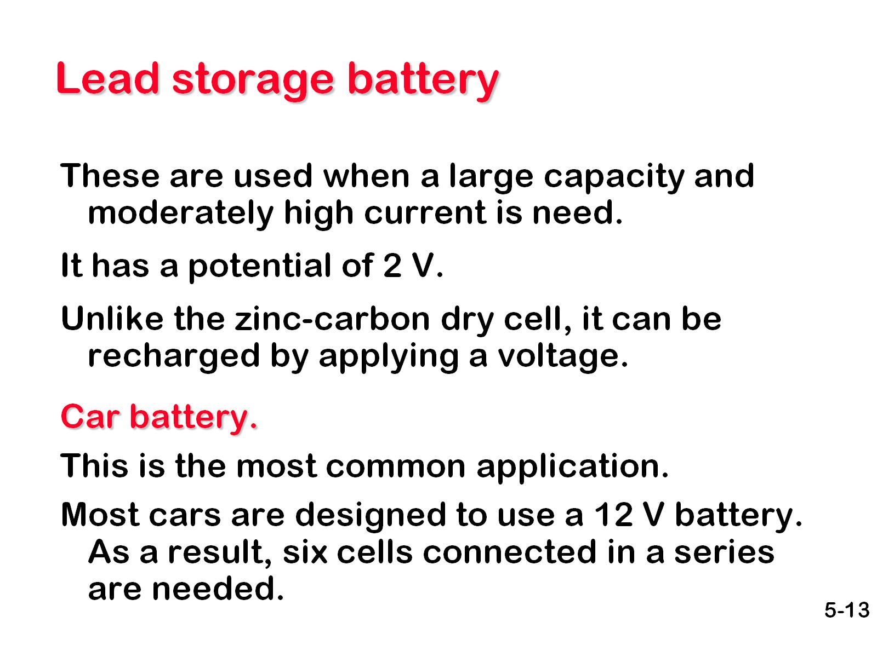
Lead storage battery

Slide 18
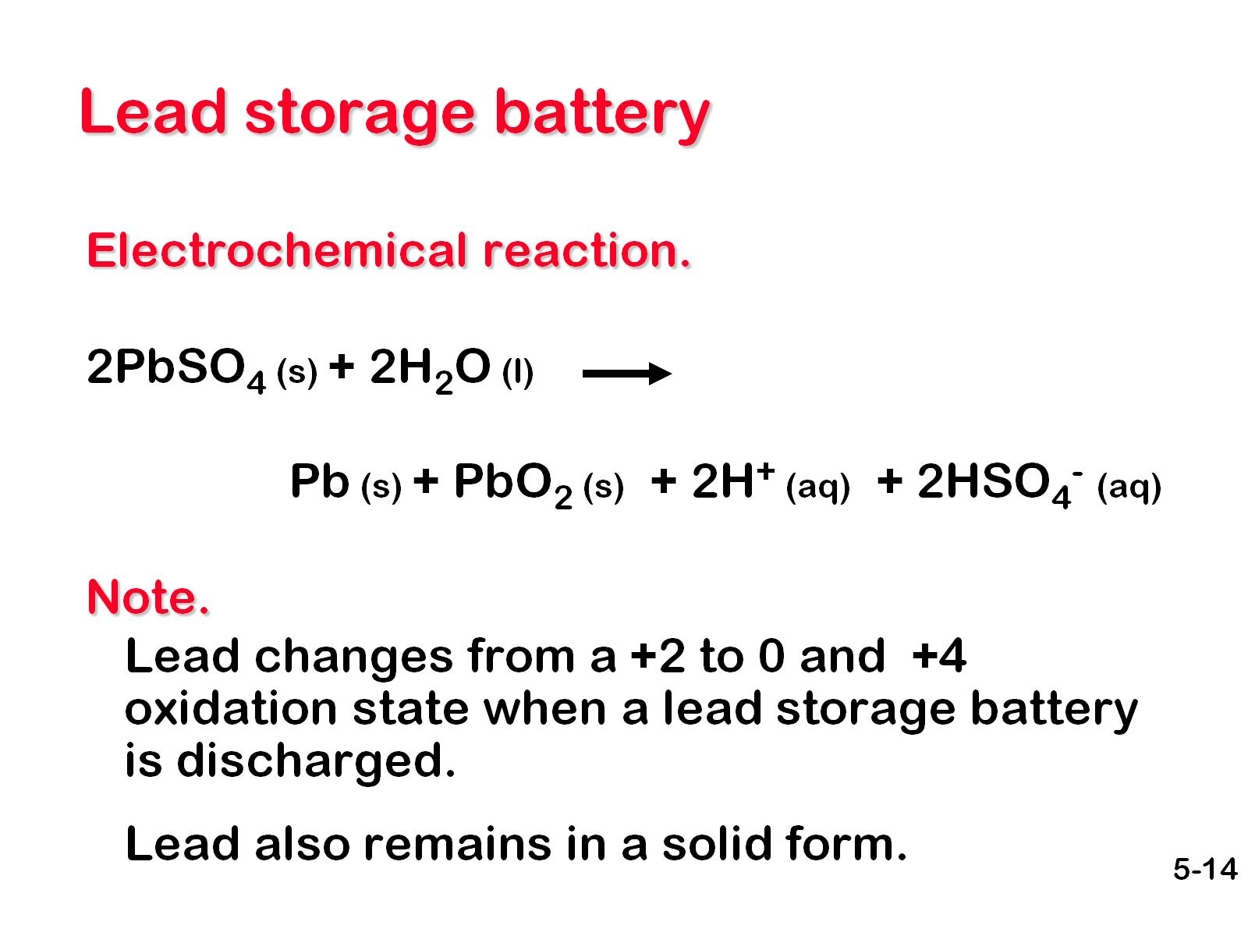
Lead storage battery

Slide 19
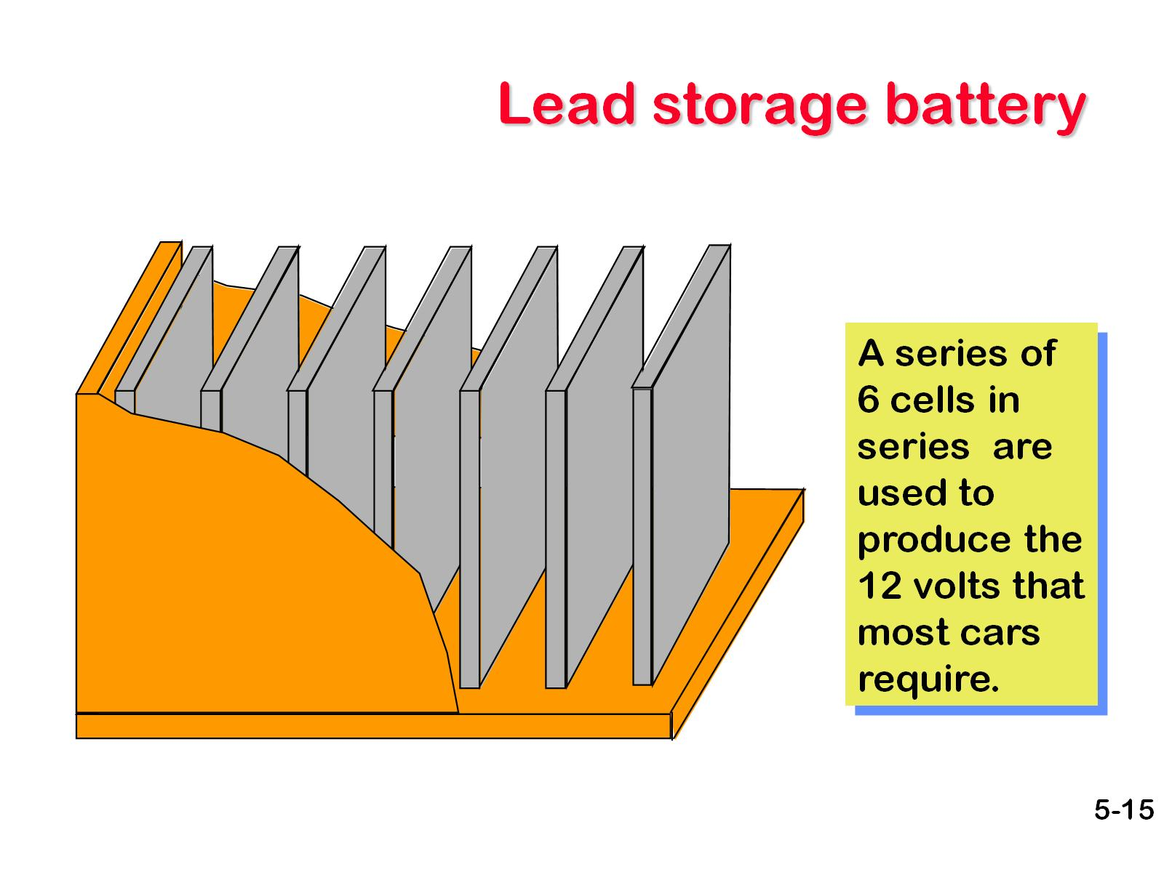
Lead storage battery

Slide 20
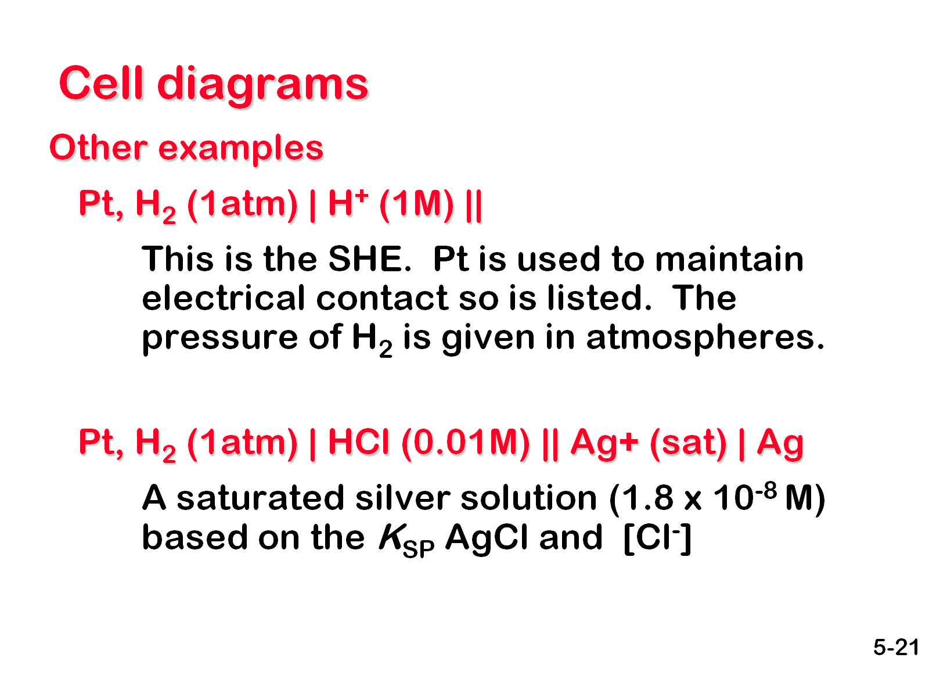
Cell diagrams

Slide 21
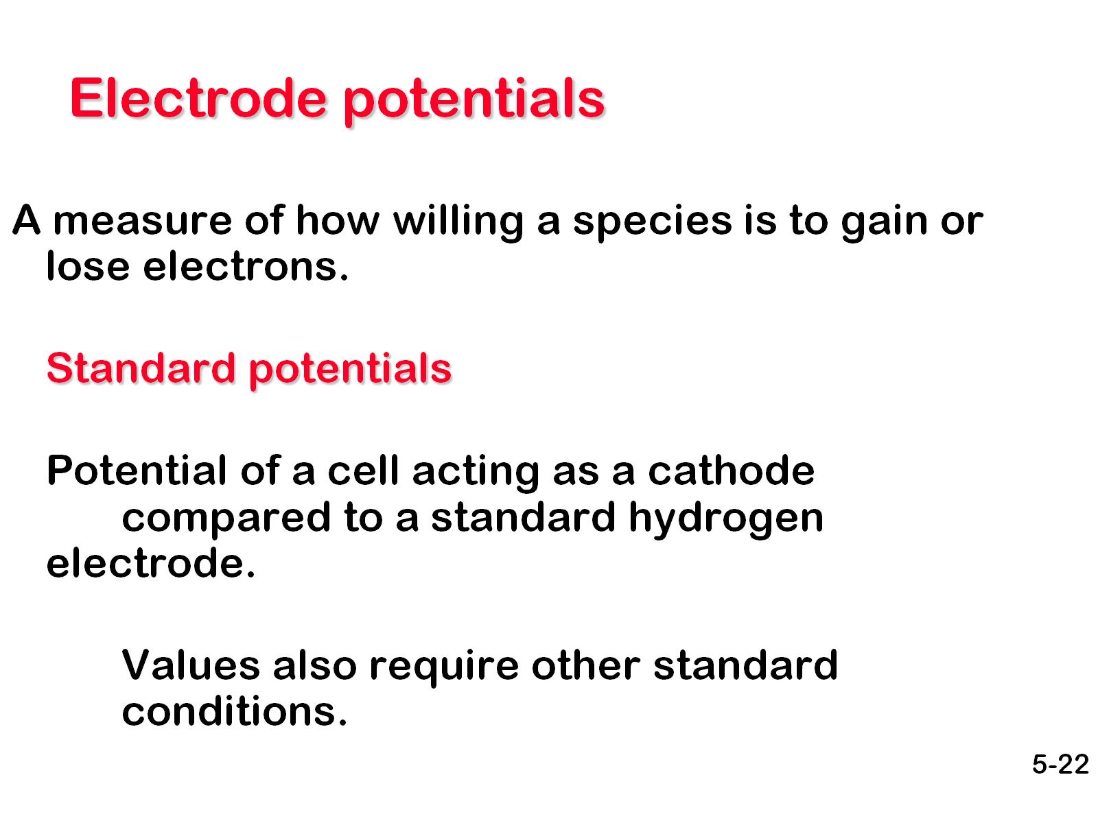
Electrode potentials

Slide 22
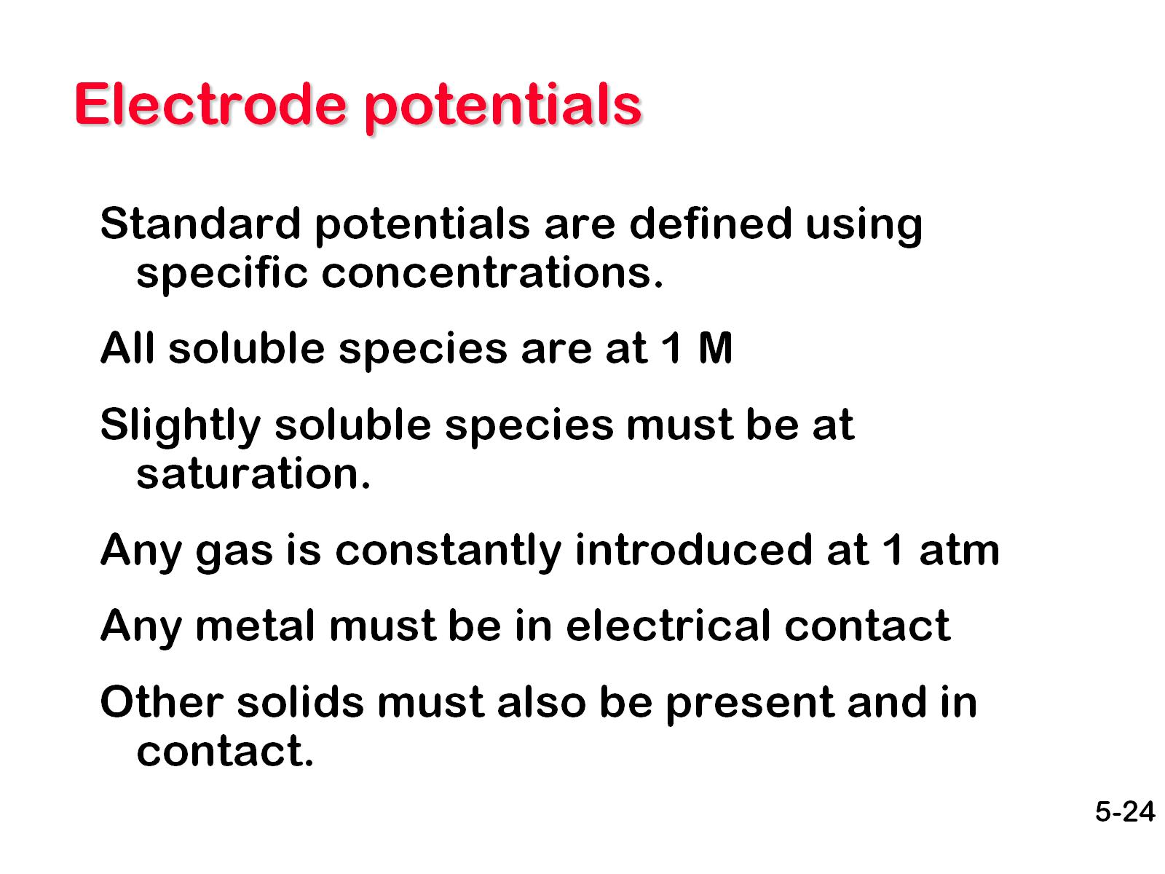
Electrode potentials

Slide 23
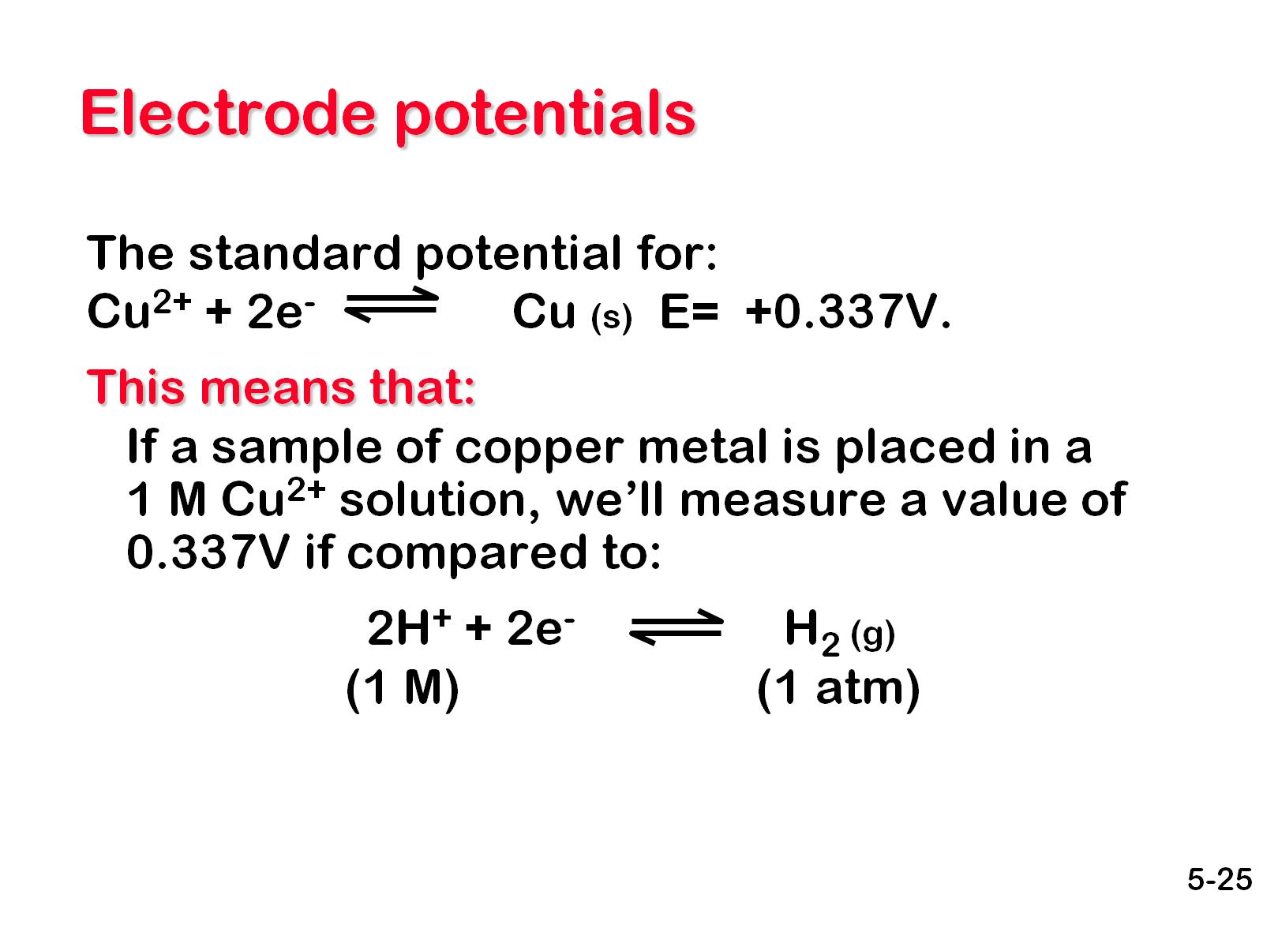
Electrode potentials

Slide 24
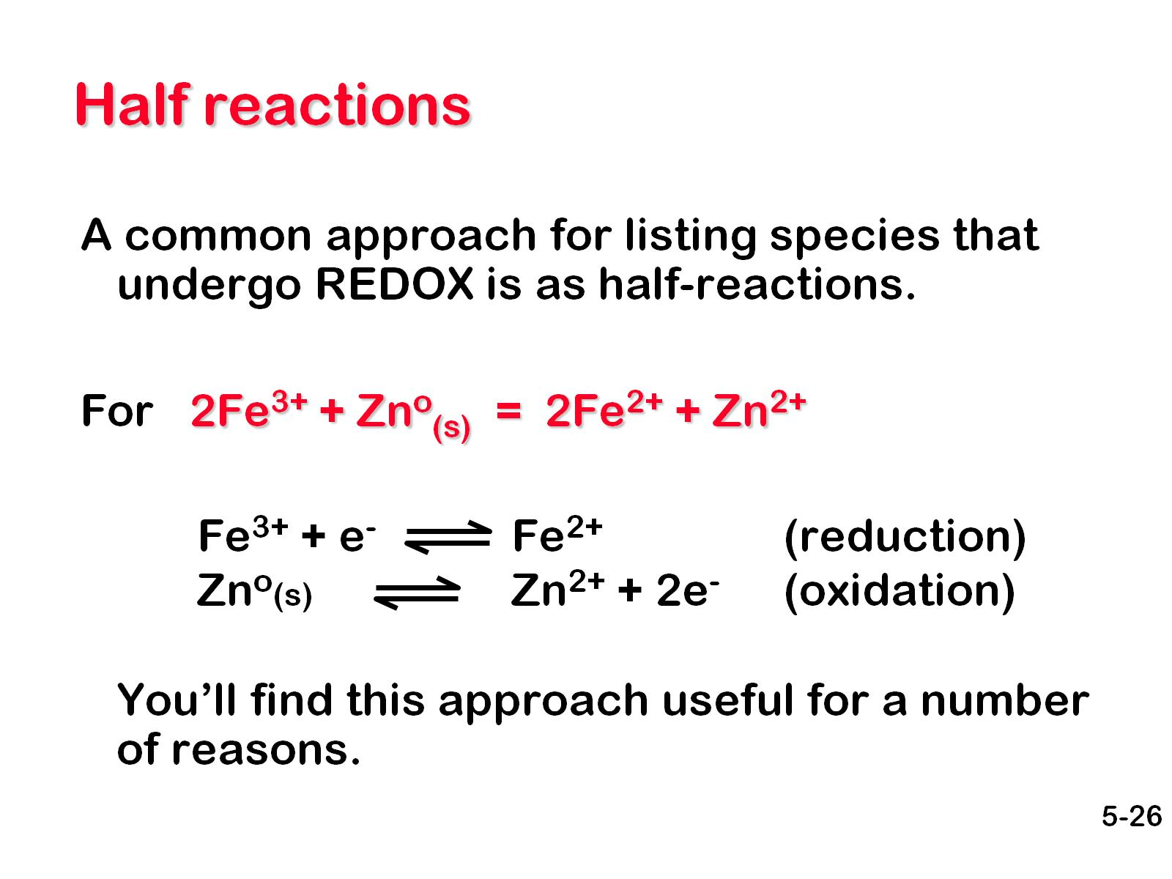
Half reactions

Slide 25
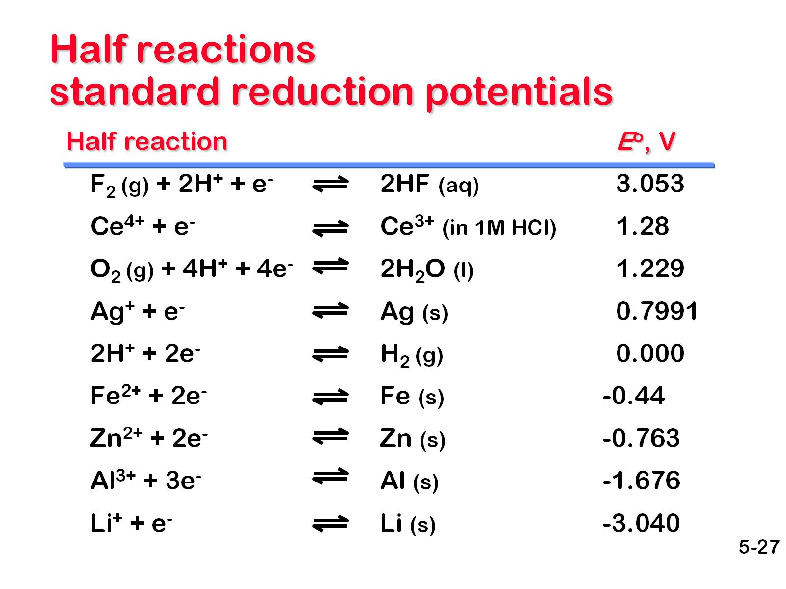
Half reactions standard reduction potentials

Slide 26
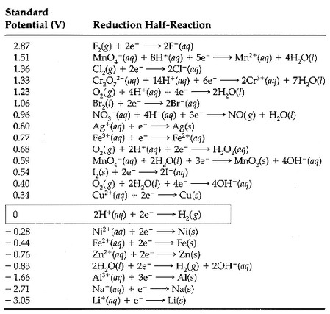
Half reactions standard reduction potentials

Slide 27
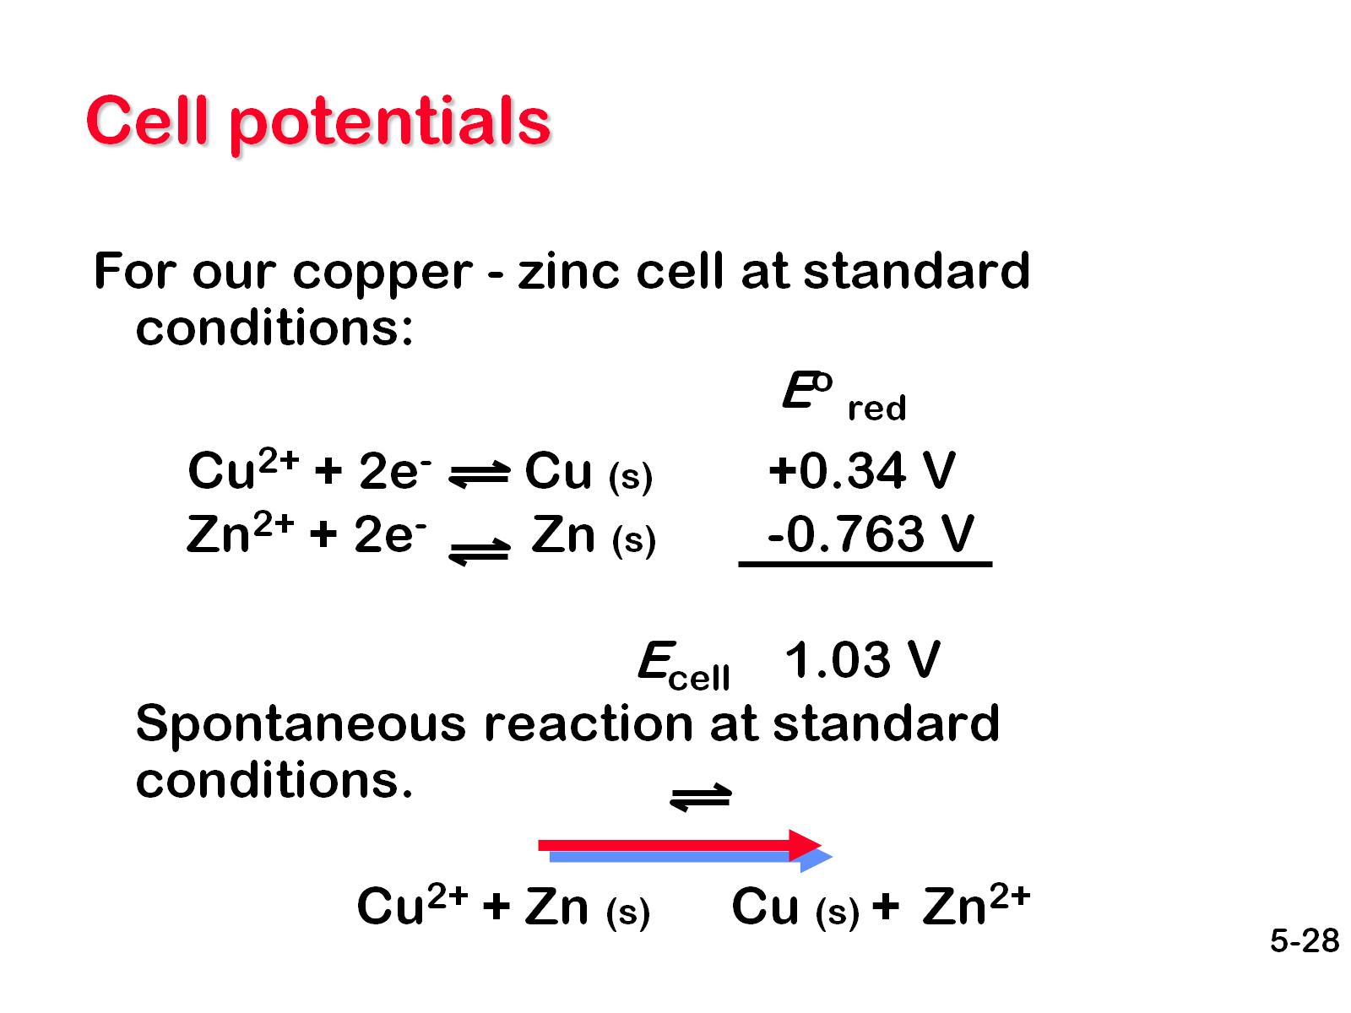
Cell potentials

Slide 28
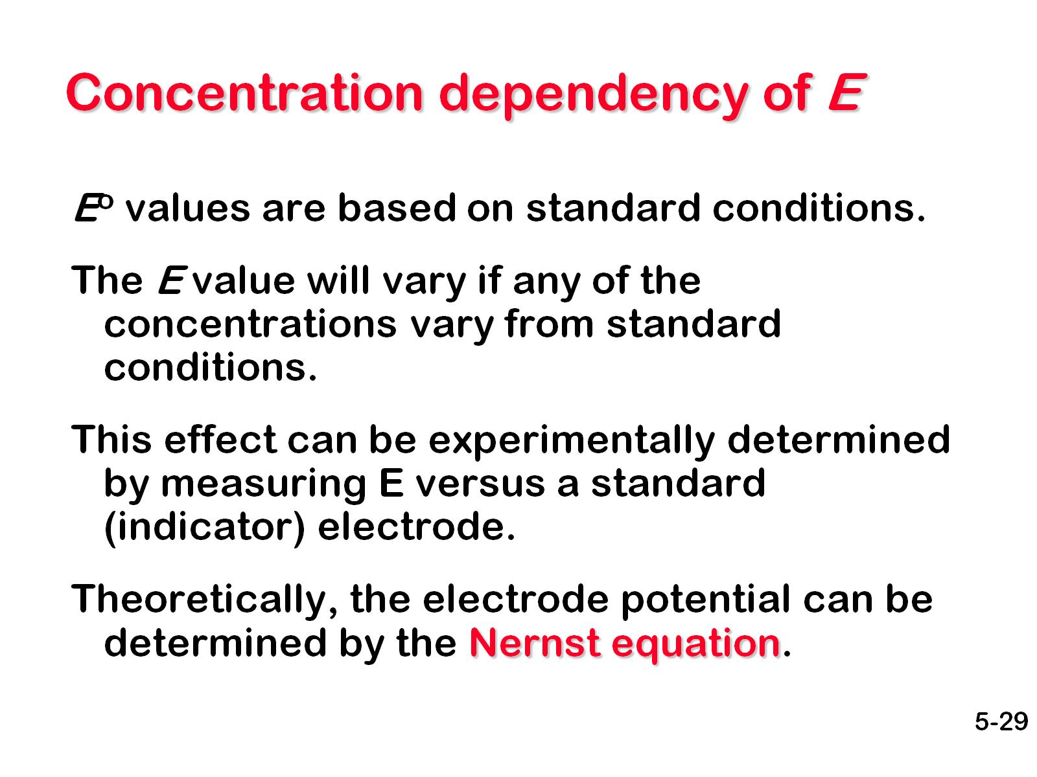
Concentration dependency of E

Slide 29
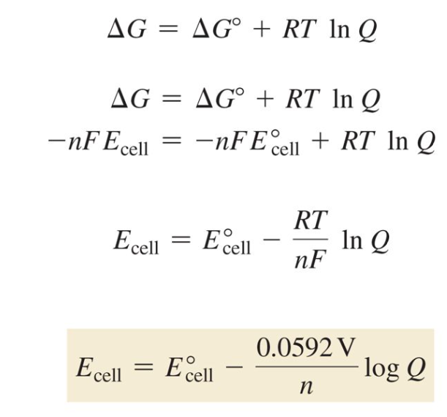
Derivation of Nernst Equation

Slide 30
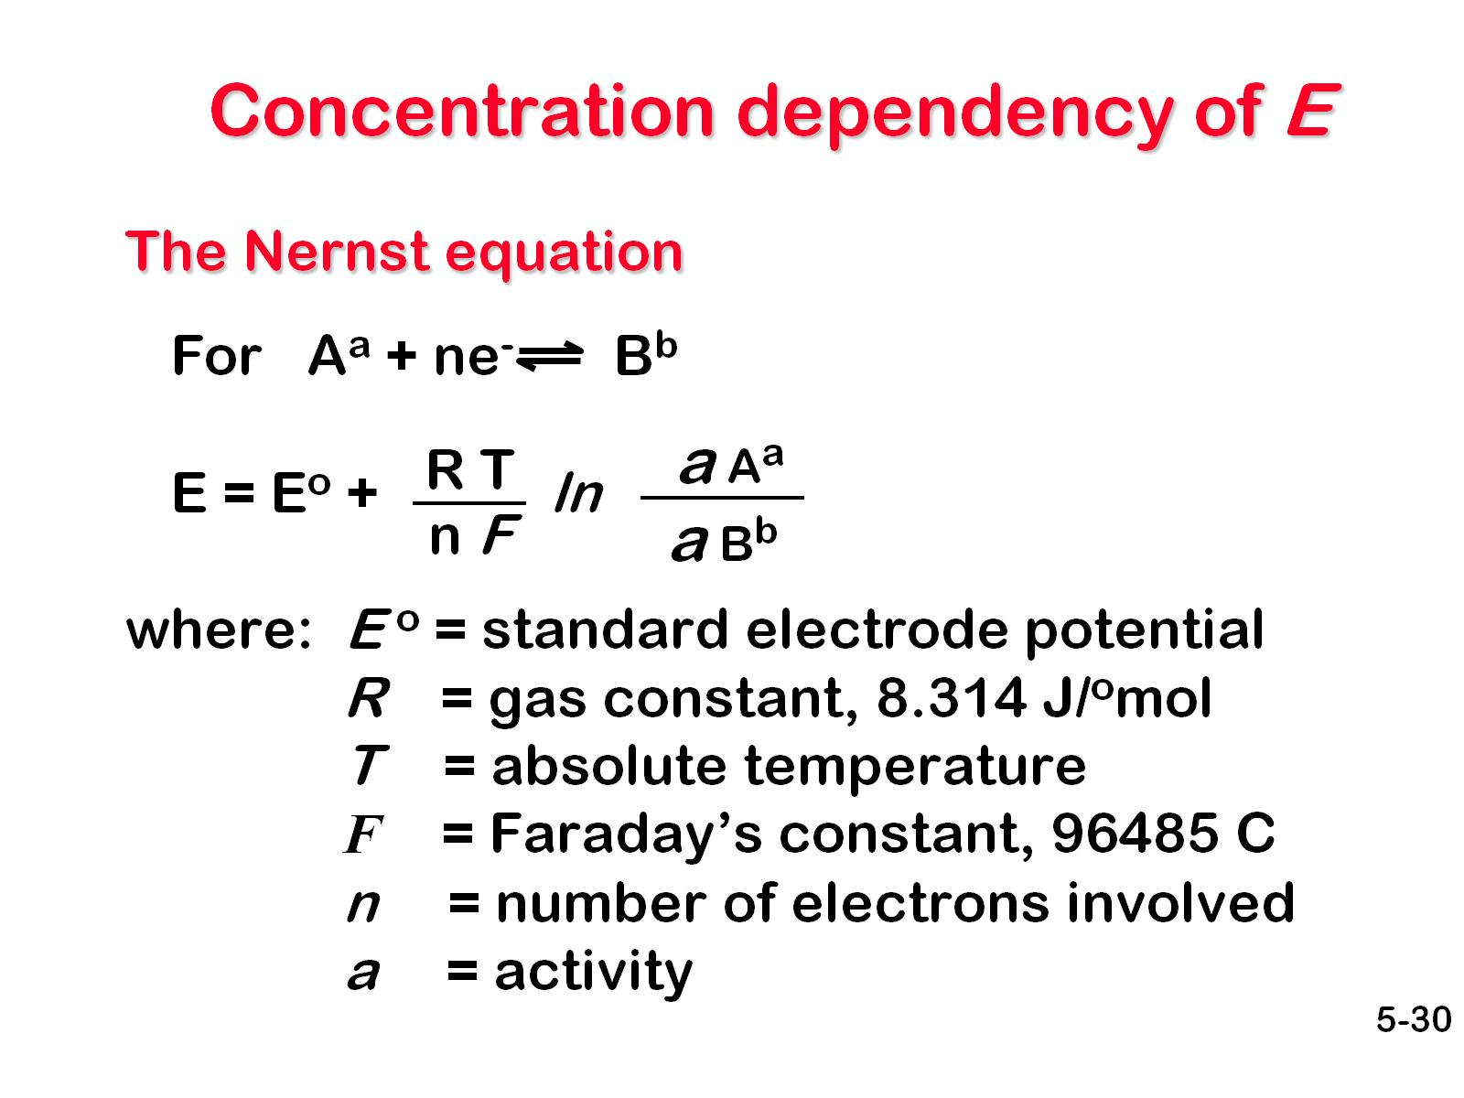
Concentration dependency of E

Slide 31
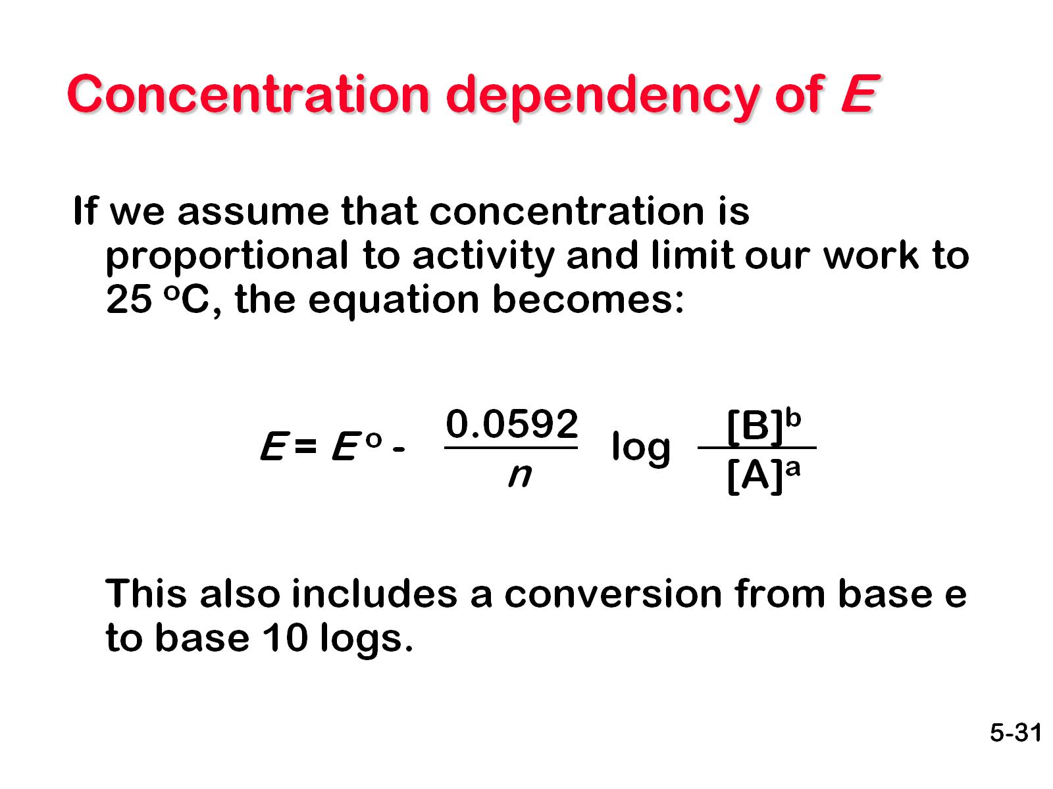
Concentration dependency of E

Slide 32
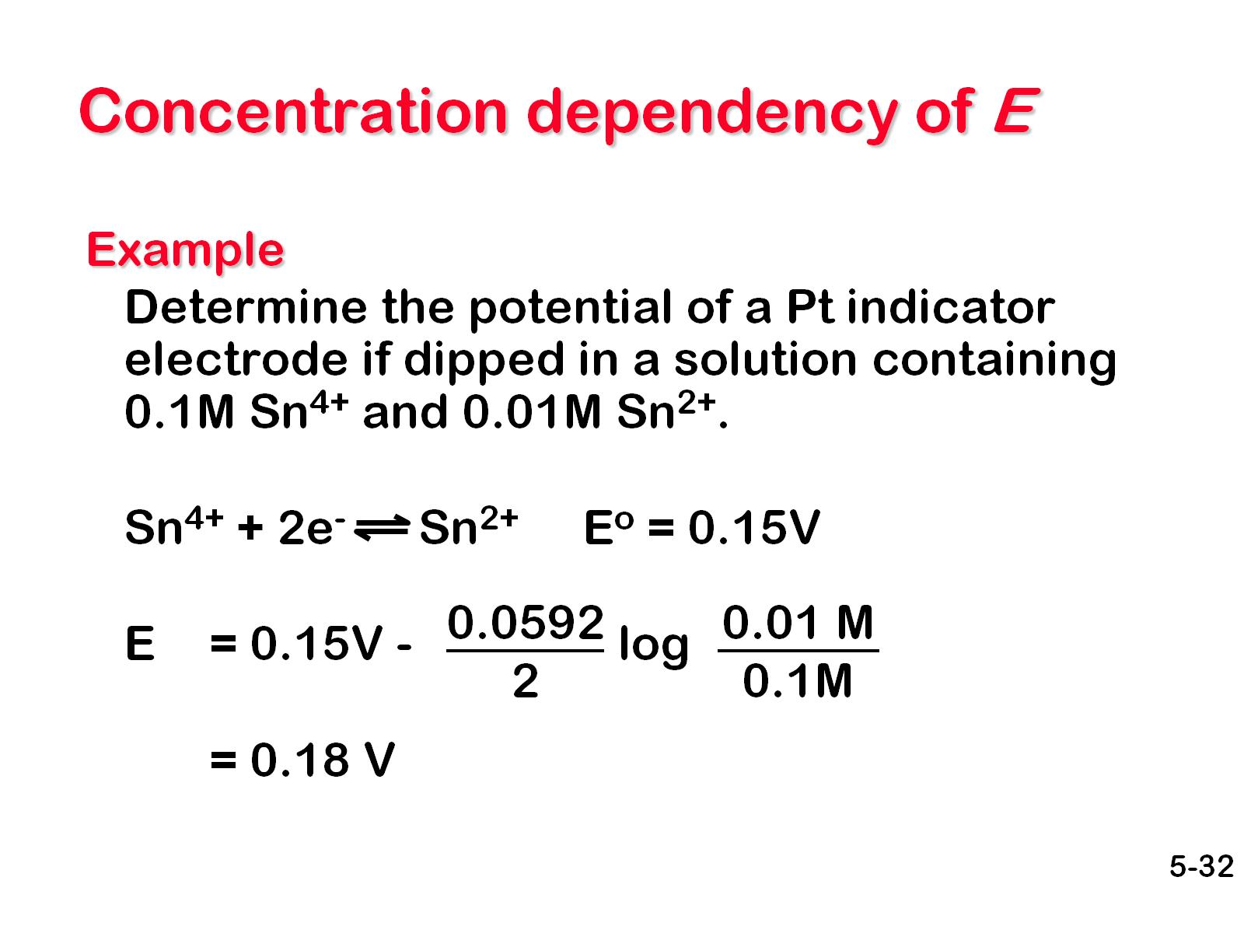
Concentration dependency of E

Slide 33
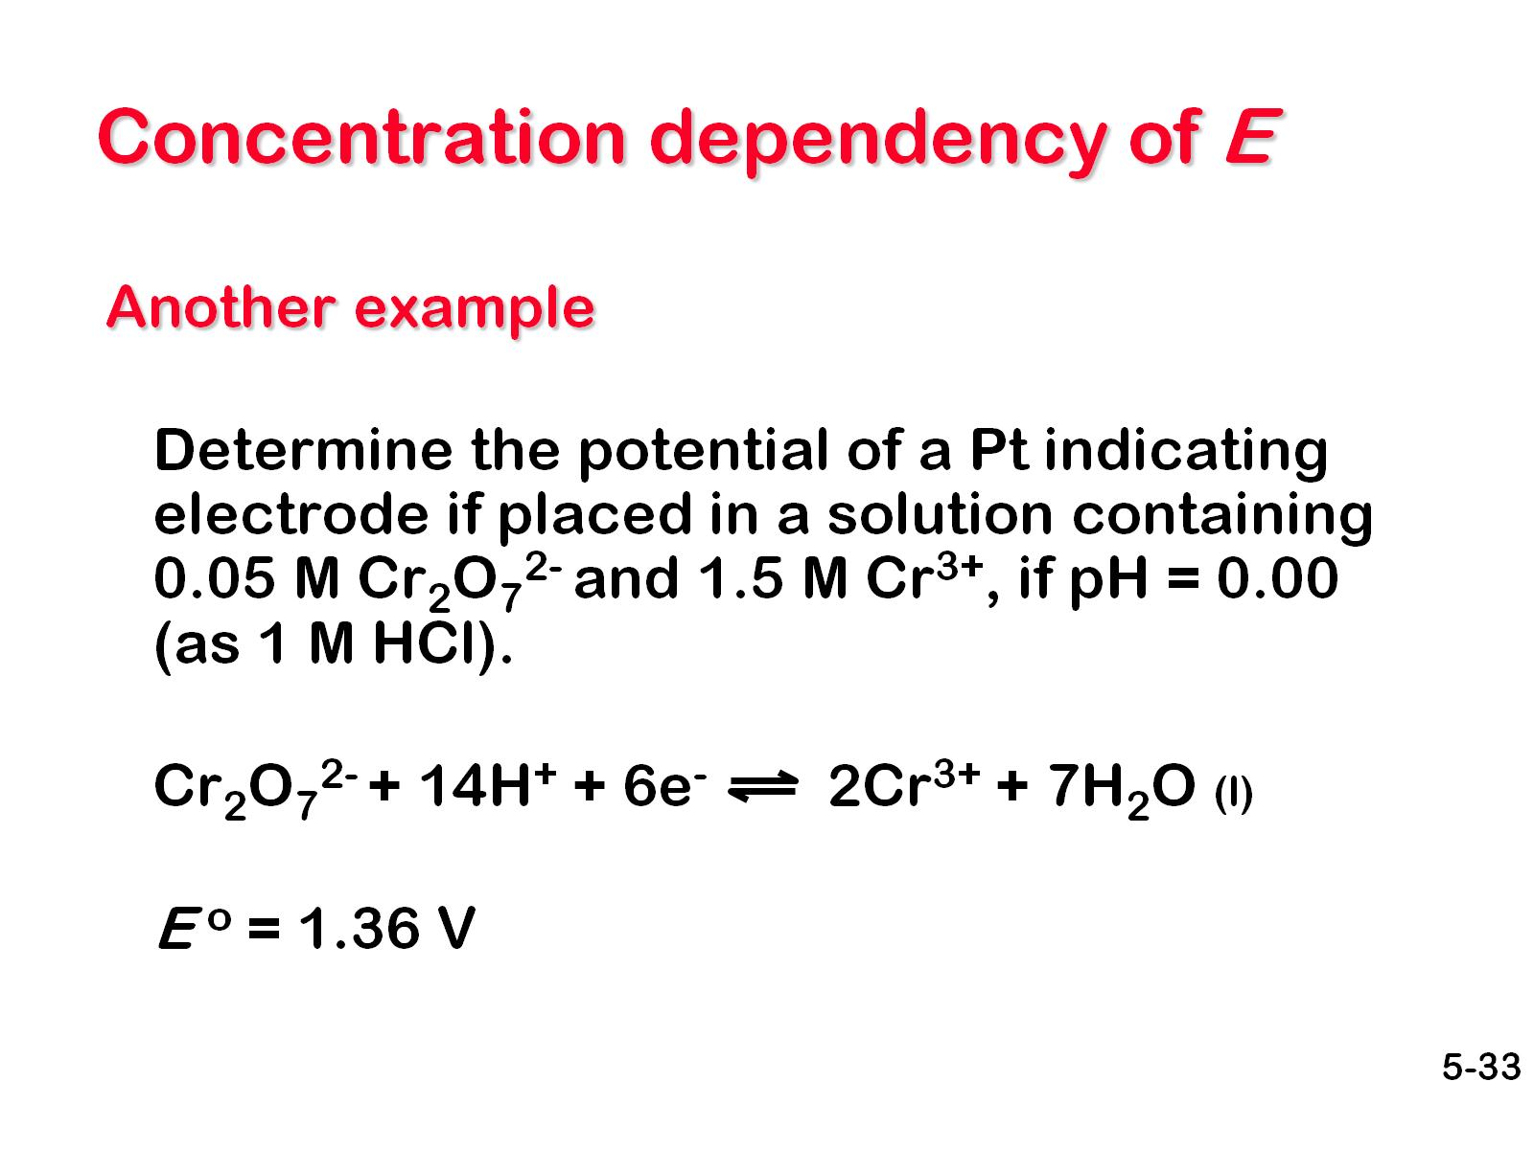
Concentration dependency of E

Slide 34
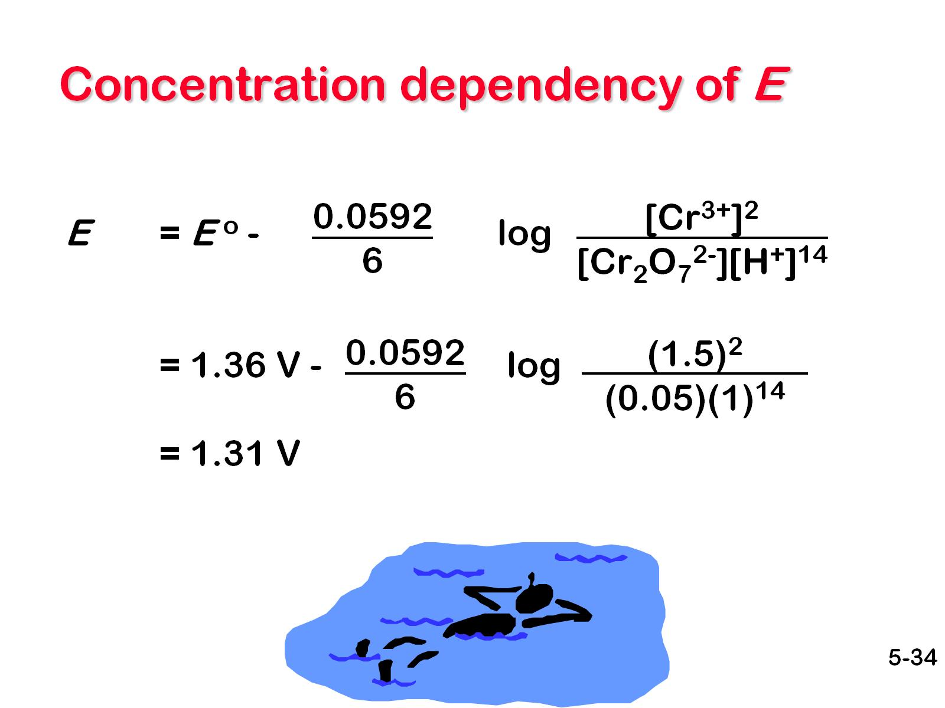
Concentration dependency of E

Slide 35
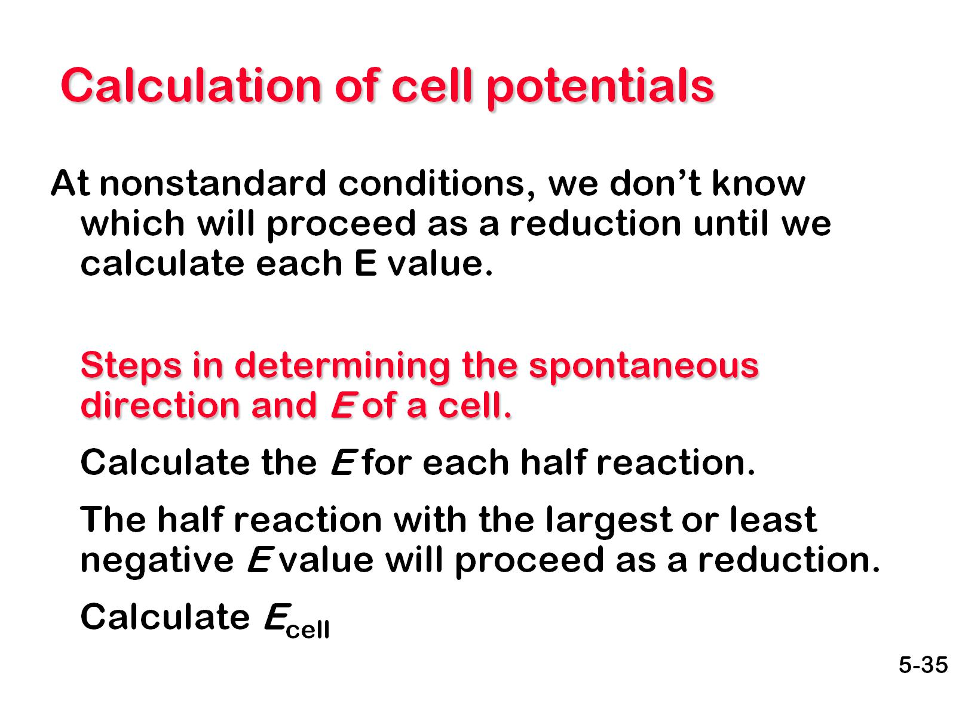
Calculation of cell potentials

Slide 36
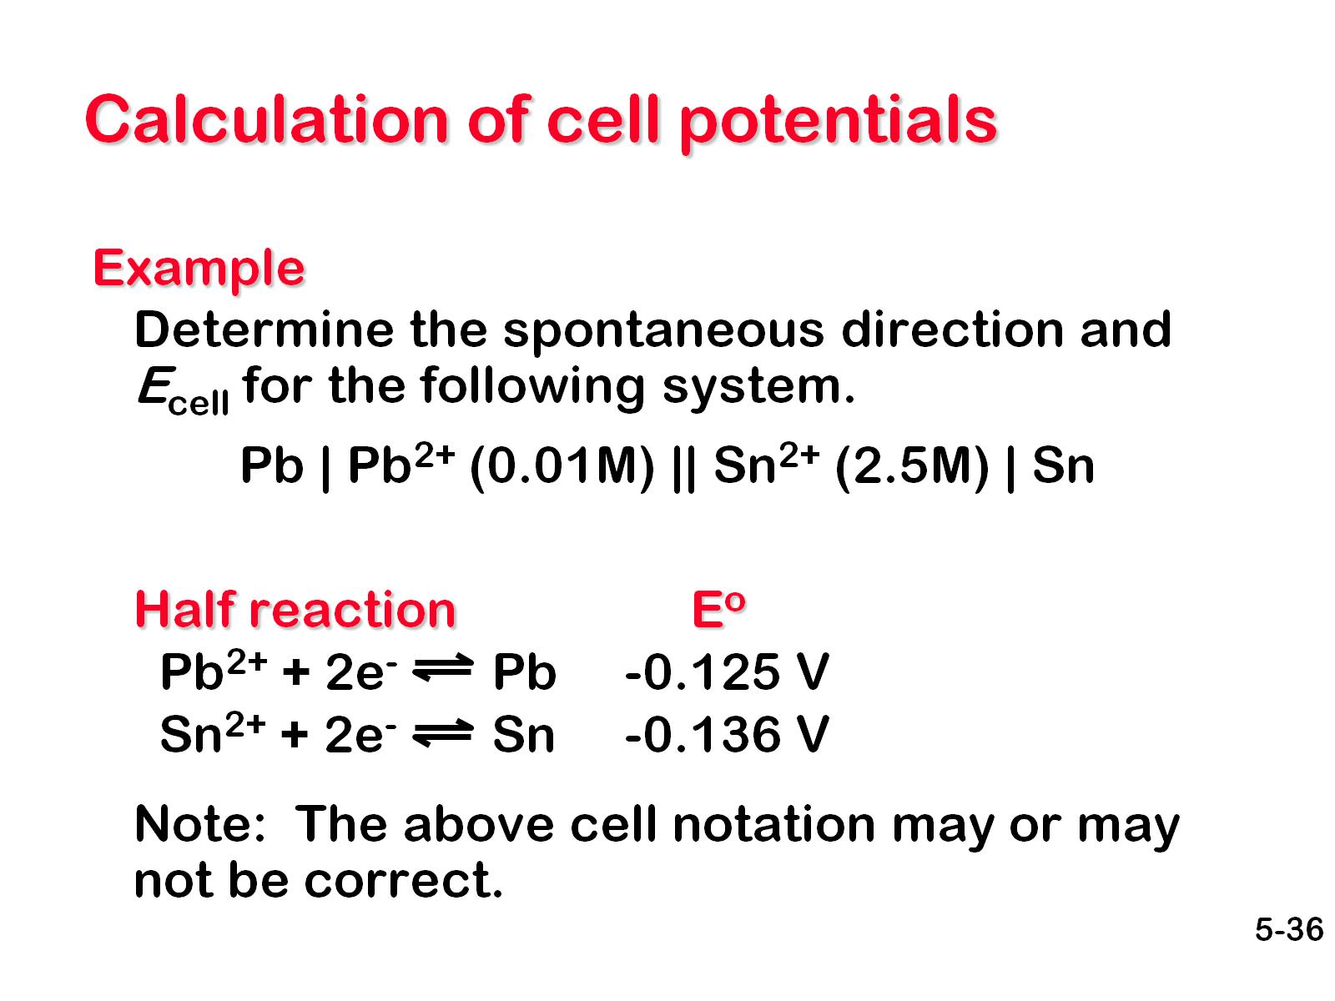
Calculation of cell potentials

Slide 37
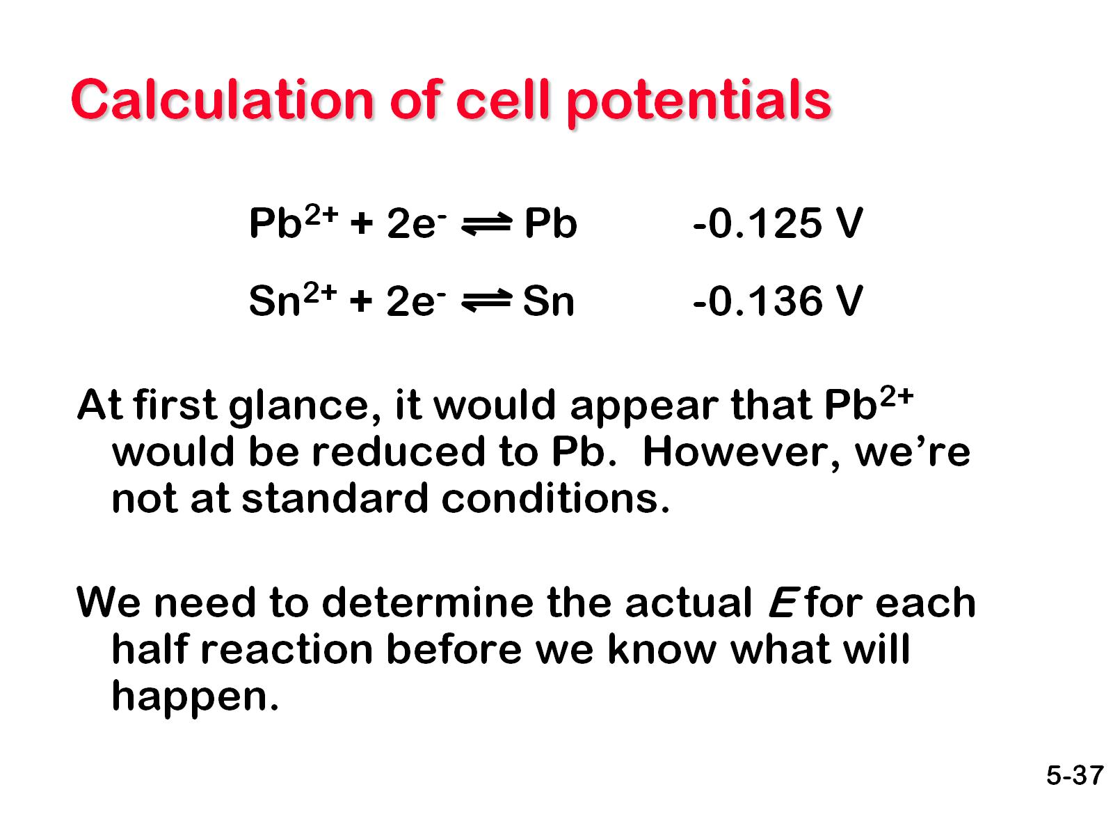
Calculation of cell potentials

Slide 38
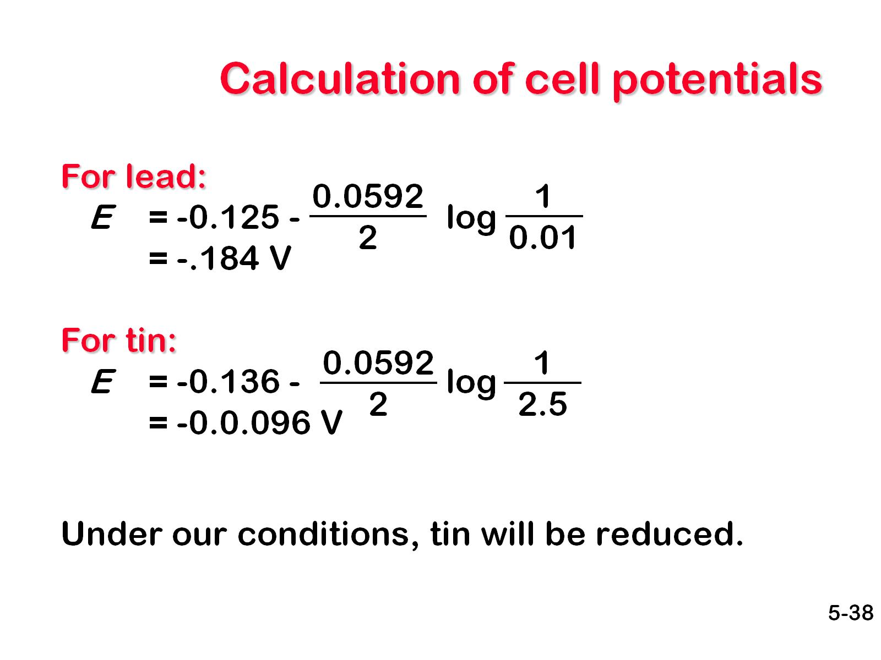
Calculation of cell potentials

Slide 39
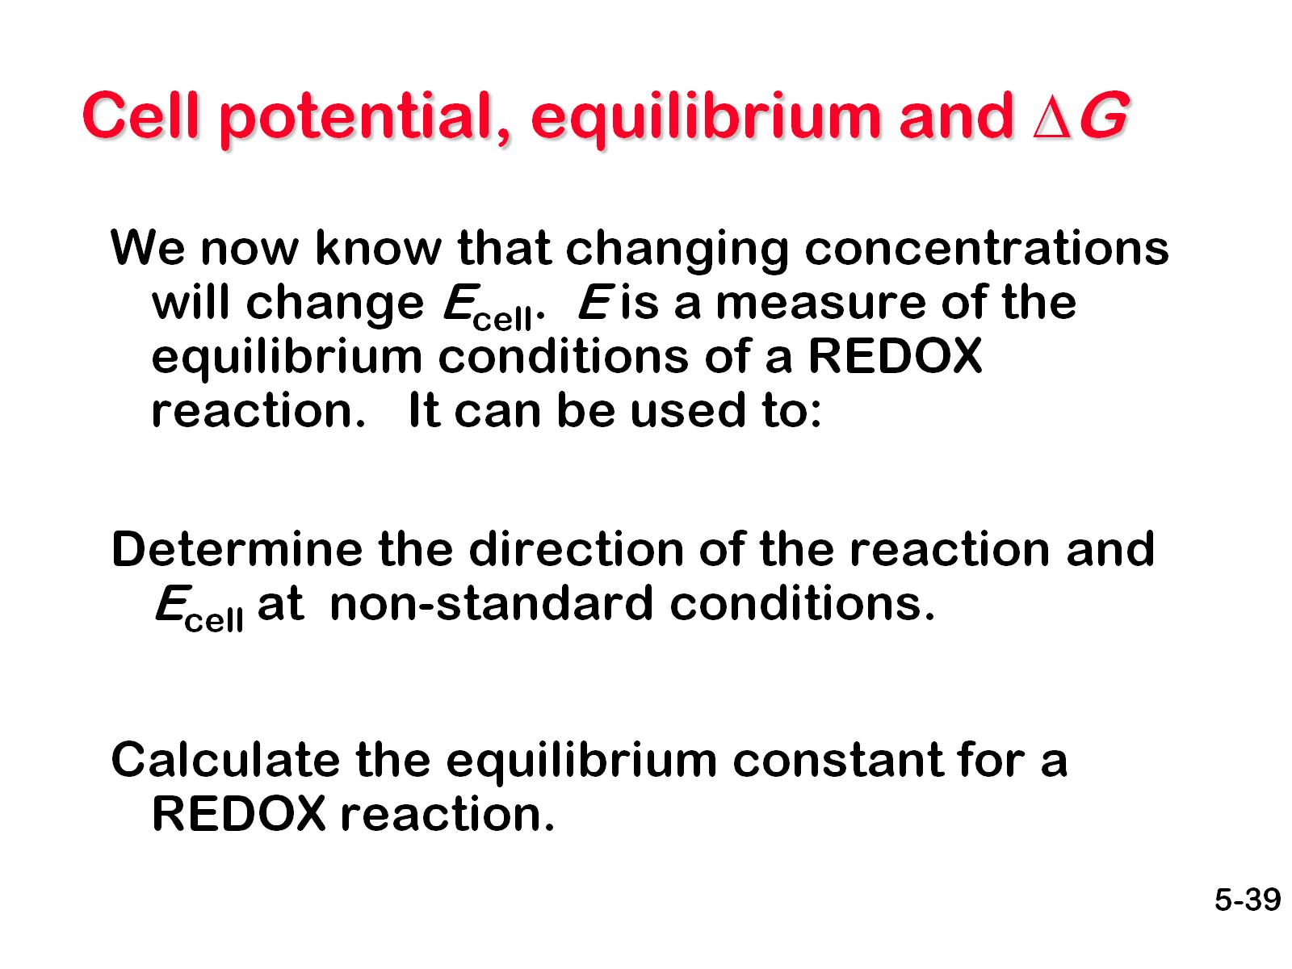
Cell potential, equilibrium and ΔG

Slide 40
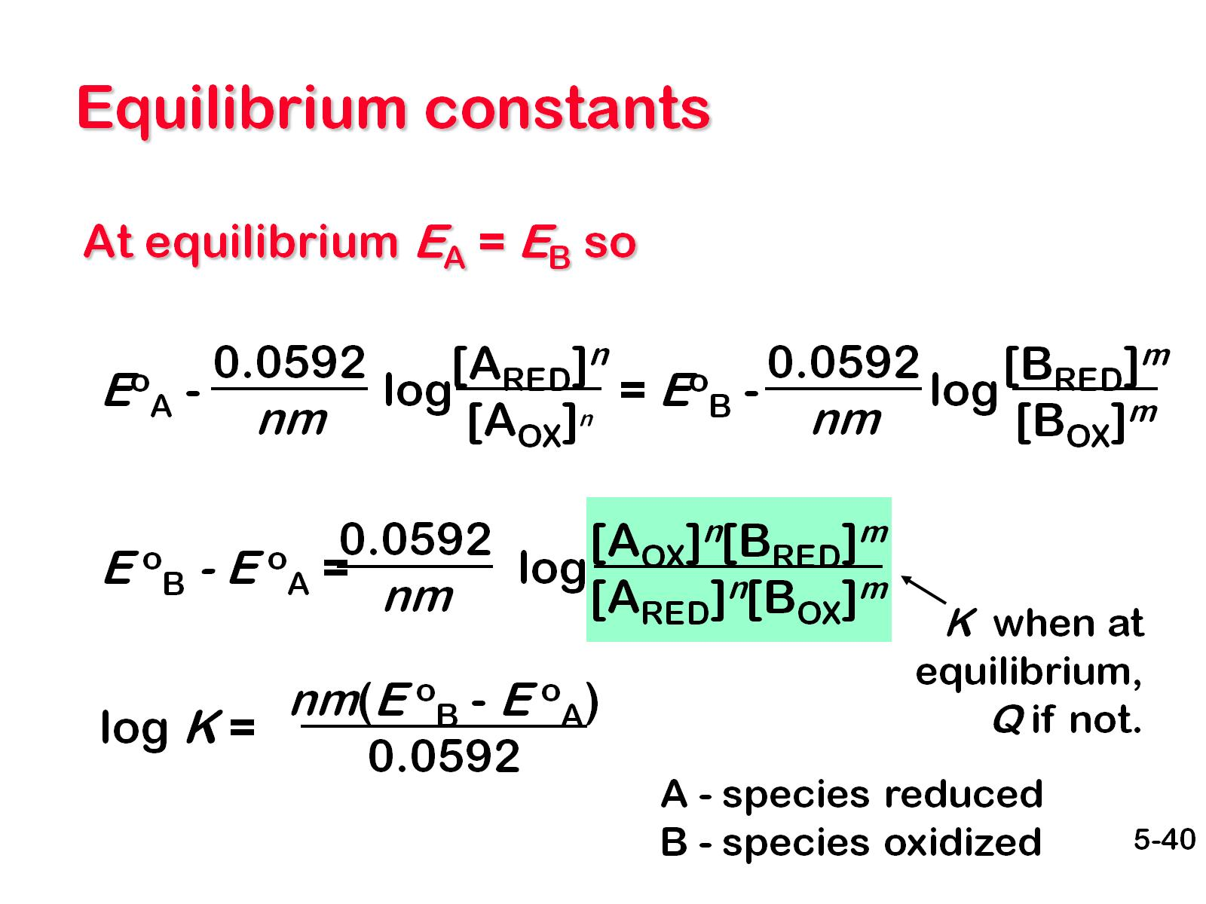
Equilibrium constants

Slide 41
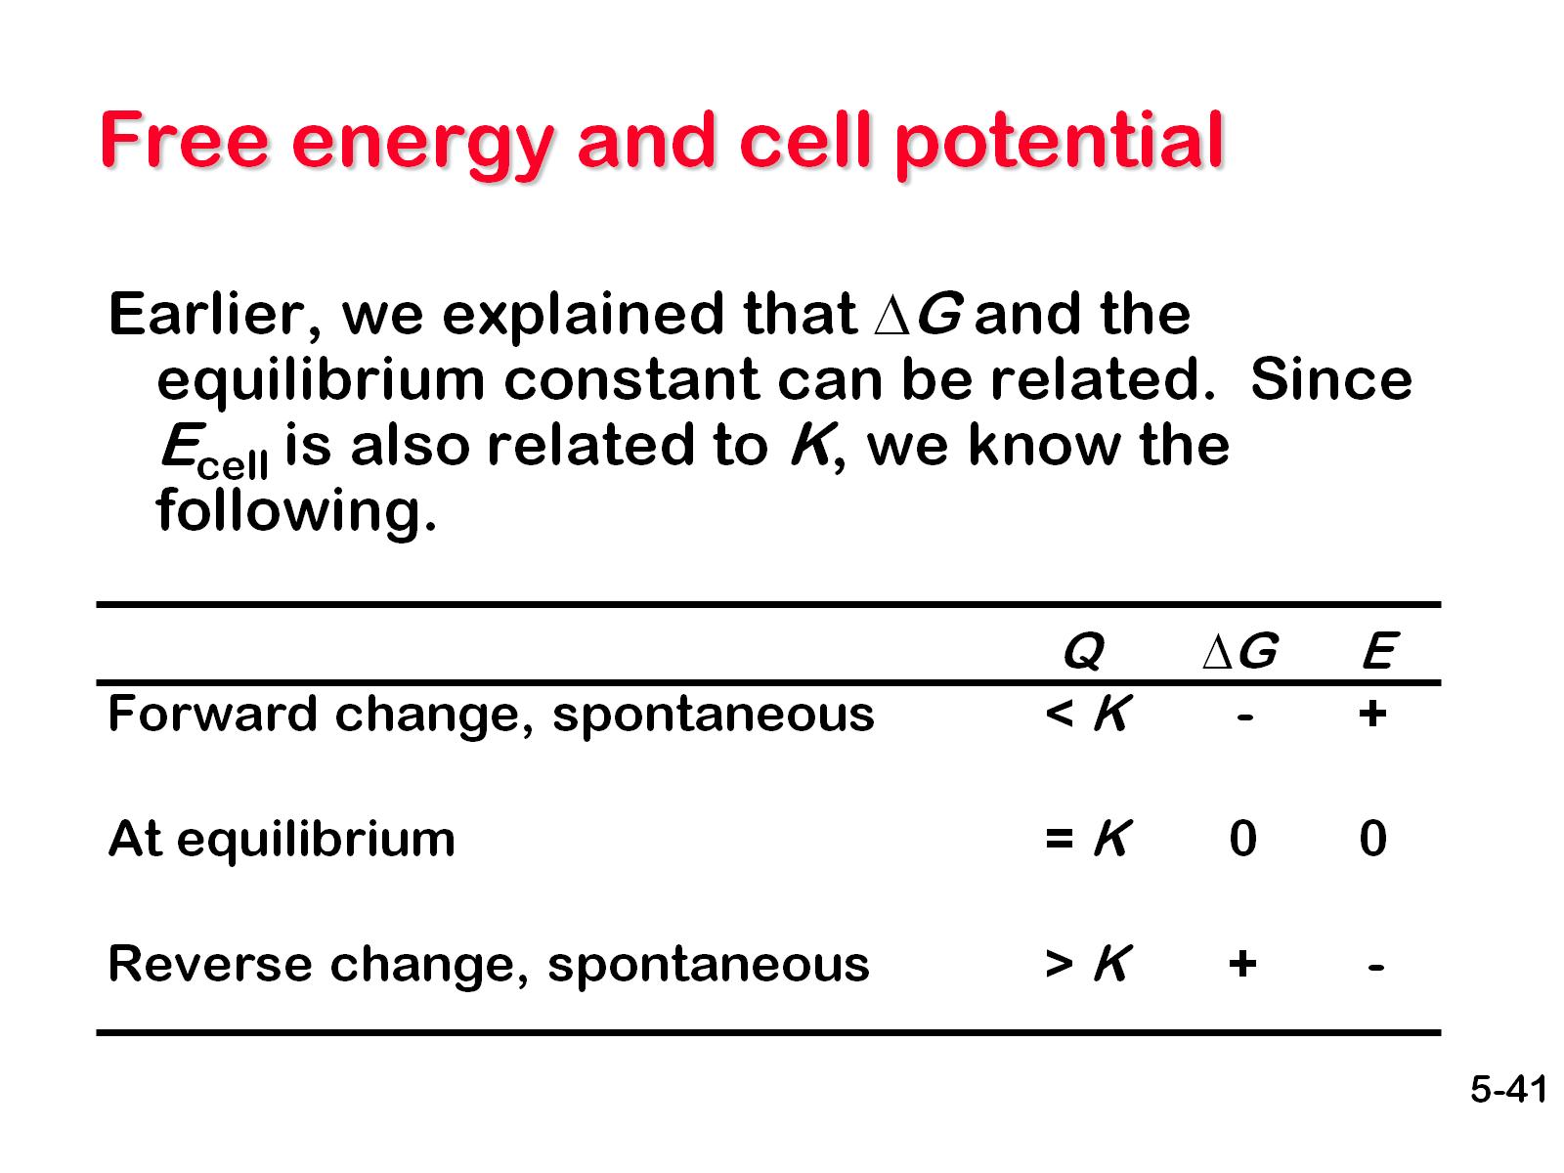
Free energy and cell potential

Slide 42
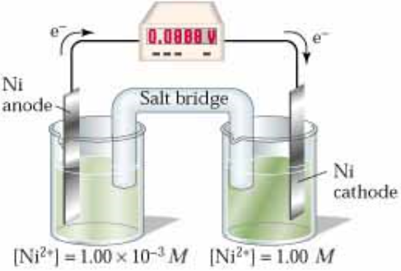
Concentration cells

Slide 43
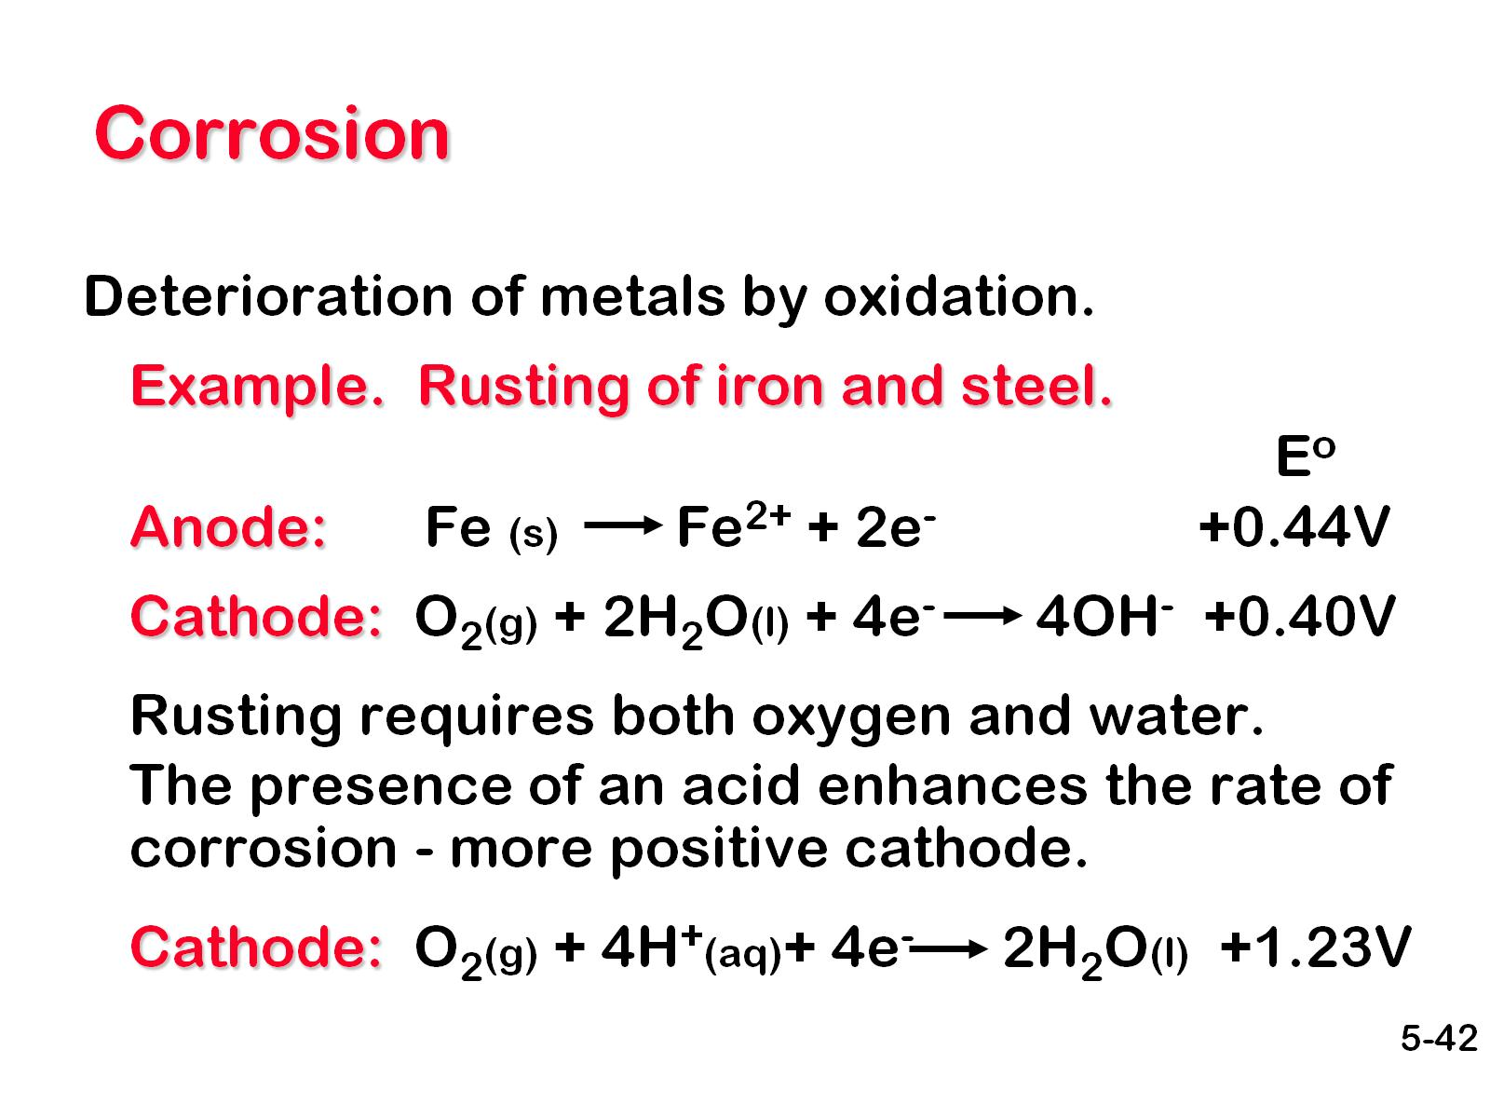
Corrosion

Slide 44
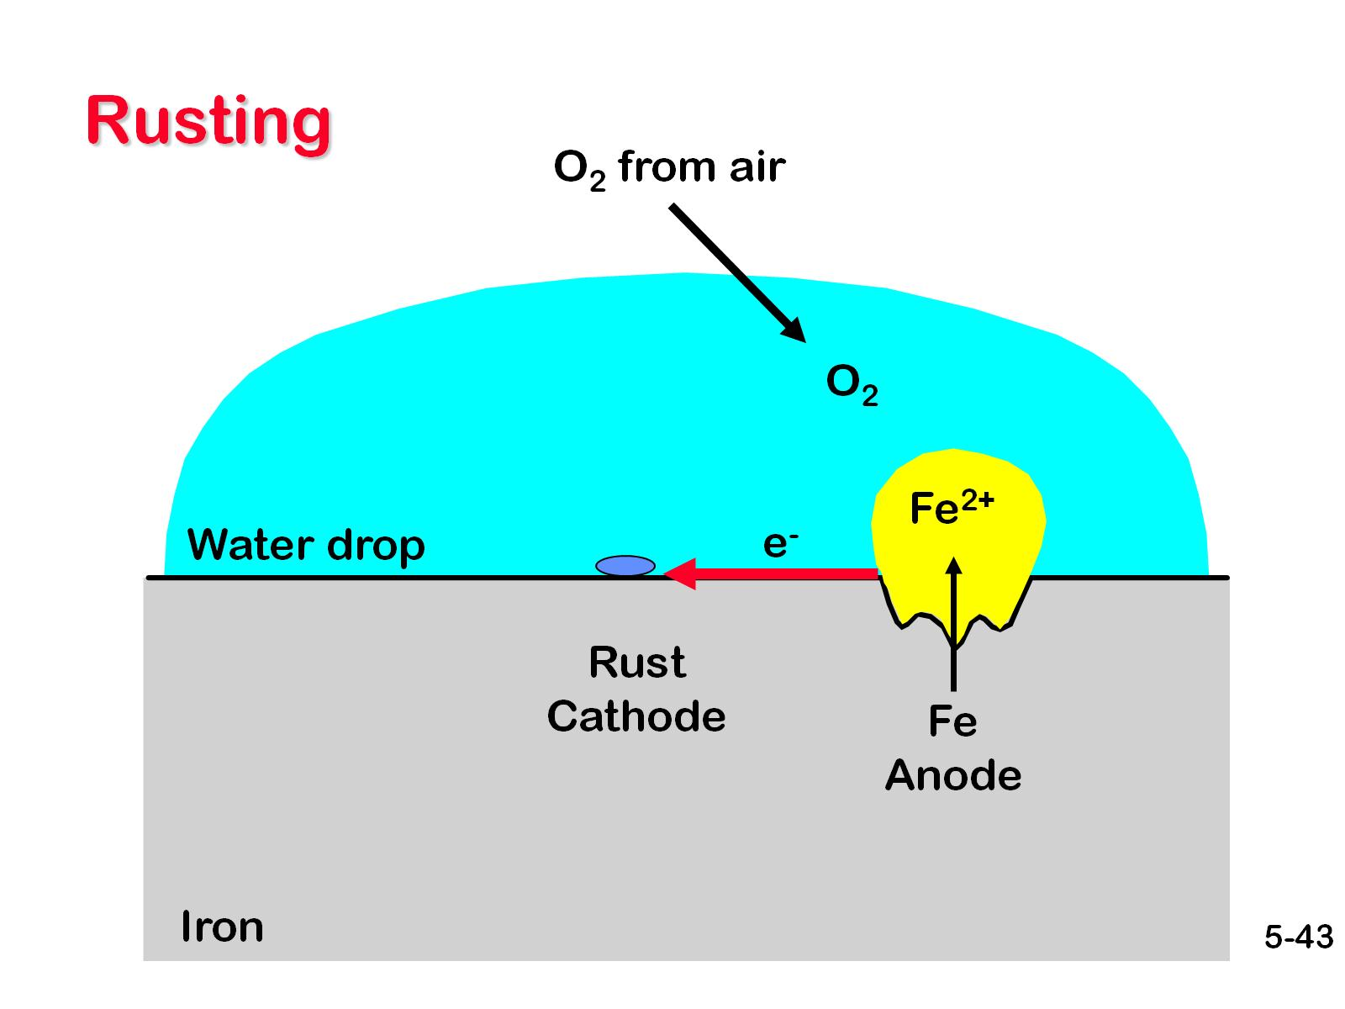
Rusting

Slide 45
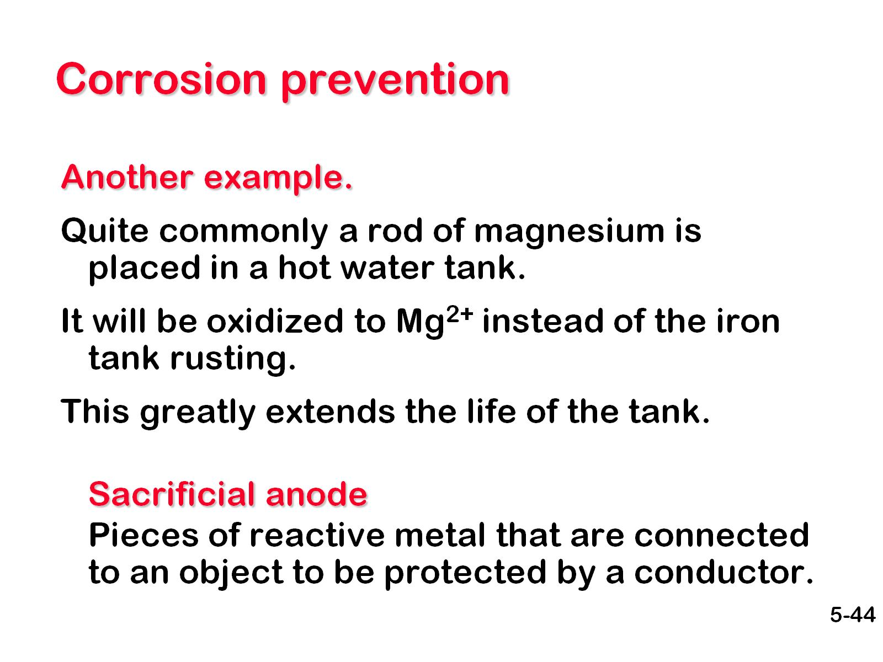
Corrosion prevention

Slide 46
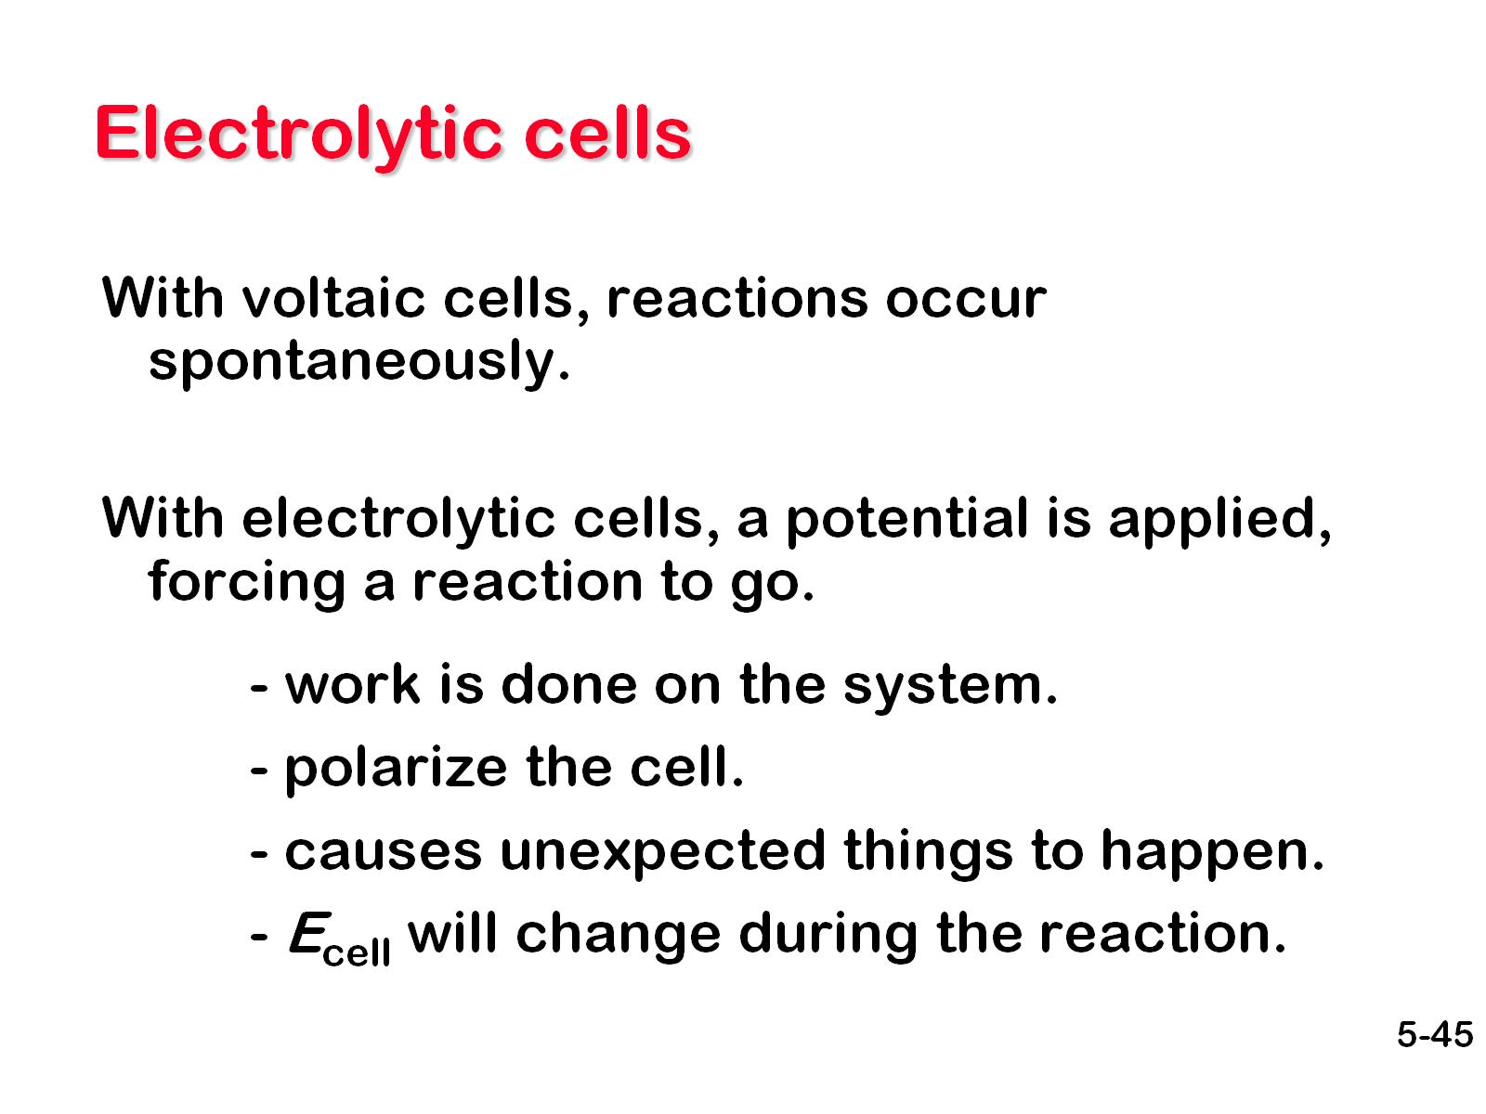
Electrolytic cells

Slide 47
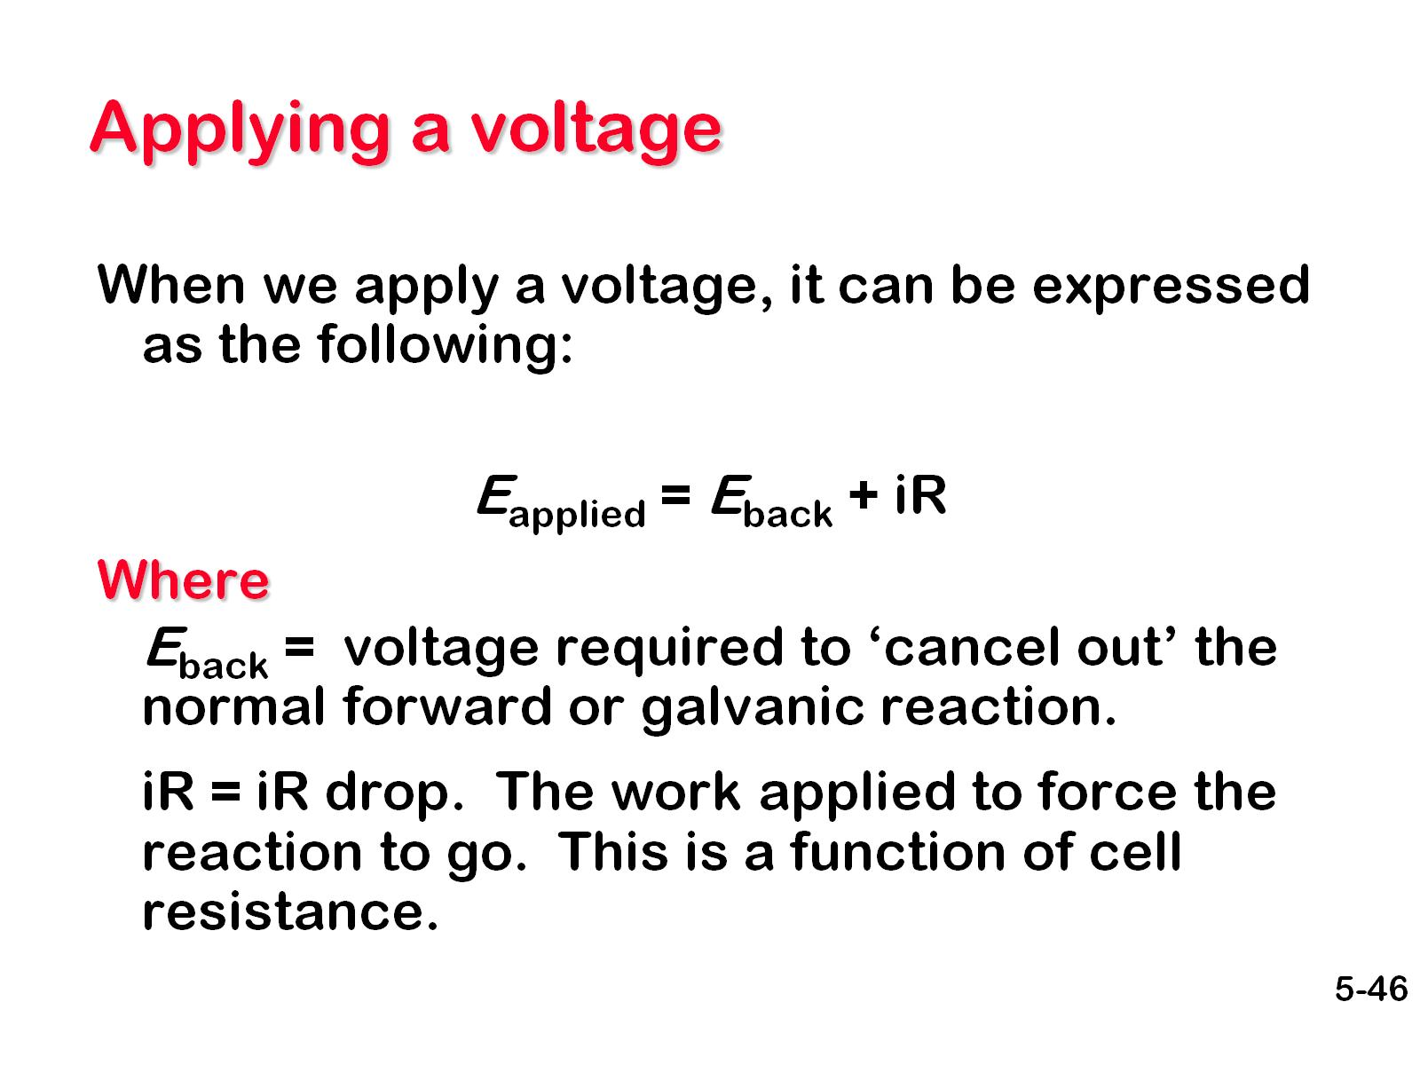
Applying a voltage

Slide 48
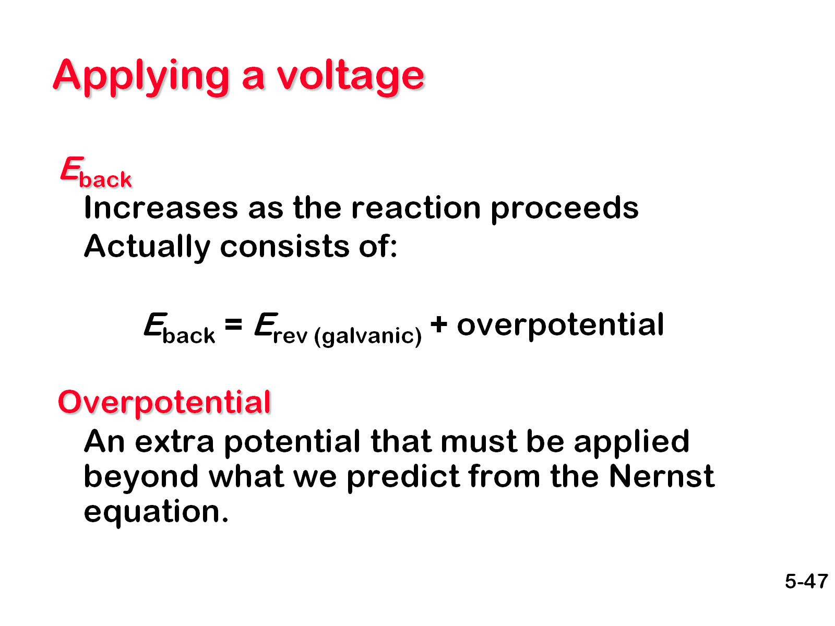
Applying a voltage

Slide 49
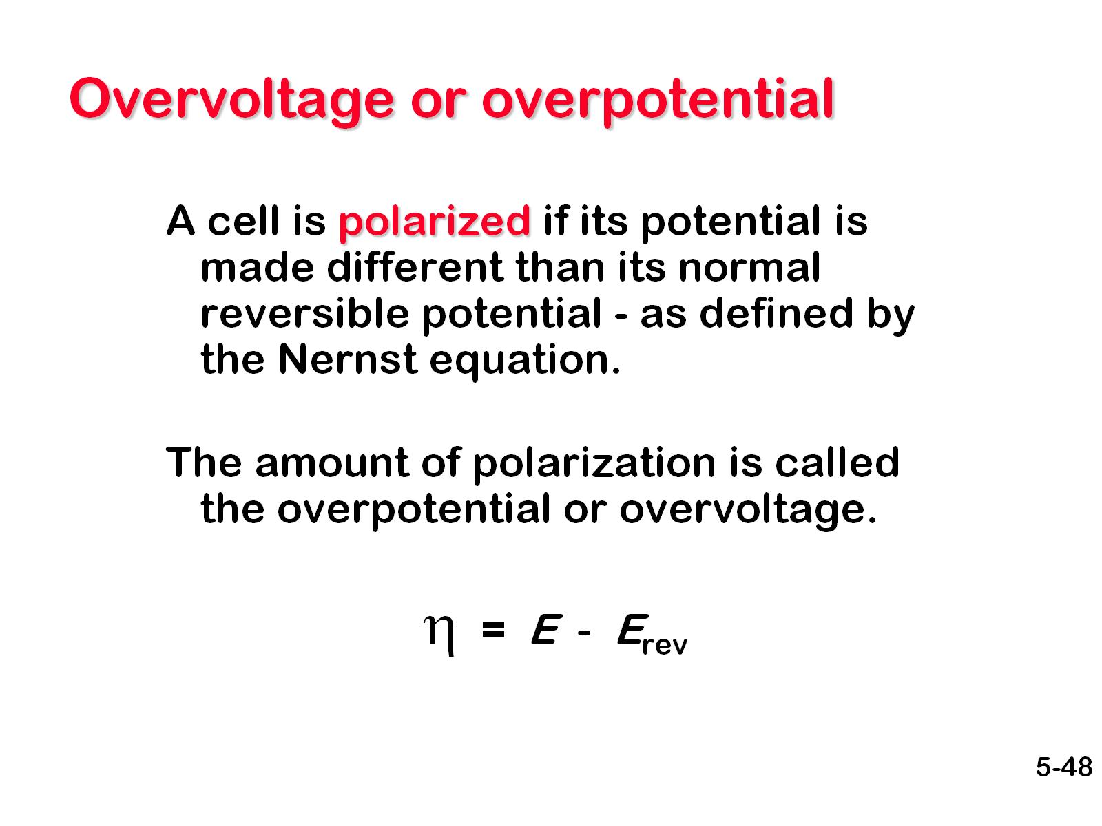
Overvoltage or overpotential

Slide 50

Overvoltage or overpotential

Slide 51

Overvoltage or overpotential

Slide 52

Overvoltage or overpotential

Slide 53

Electrolytic cells

Slide 54

Electrolytic example

Slide 55

Electrolytic example

Slide 56

Electrolytic example

Slide 57

Stoichiometry of electrochemical reactions

Slide 58

Stoichiometry of electrochemical reactions

Slide 59

Stoichiometry of electrochemical reactions

Slide 60

Example

Slide 61

pH electrode

Slide 62

pH Electrodes

Slide 63

pH electrode

Slide 64

pH electrode

Slide 65

How a pH electrode works

Slide 66

Extraction of Elements

Slide 67
Extraction of Elements

Slide 68
Electrometallurgy
Is the field concerned with the processes of metal electrodeposition. There are four categories of these processes: Electrowinning, the extraction of metal from ores. Electrorefining, the purification of metals.

Slide 69

Ellingham Diagrams

Slide 70

Extraction of Iron in a Blast Furnace

Slide 71

Extraction of Iron in a Blast Furnace

Slide 72


Slide 73

Bayer process for Aluminum

Slide 74


Slide 75

Frost and Latimer Diagrams

