Slide 1
Chapter Nine
Chemical Reactions

Slide 2

Fire Works are Chemical Reactions
CO 9.1
Jeff Hunter/Getty Images

Slide 3
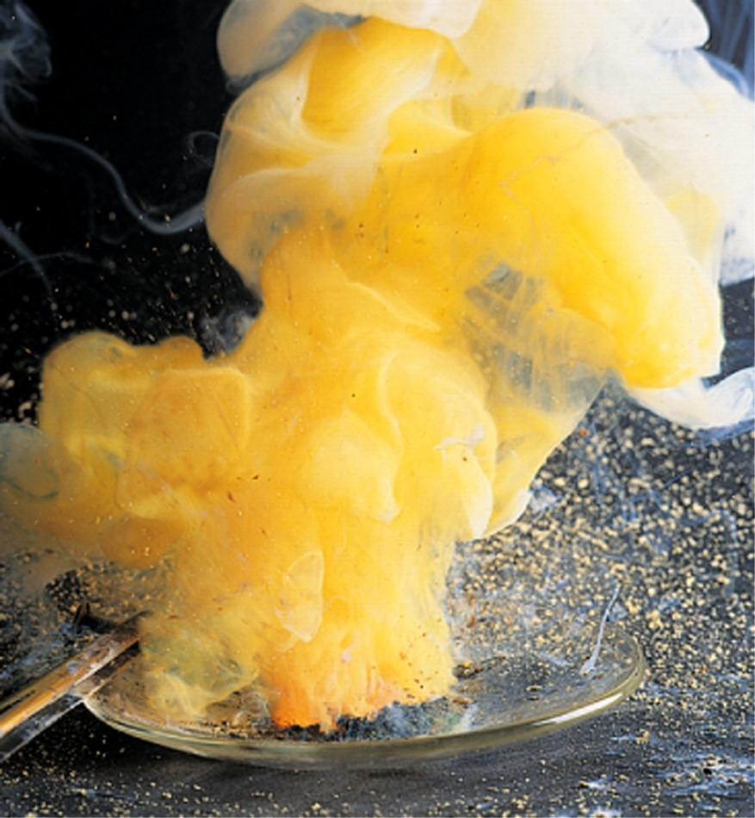
Zinc reacts with sulfur
Fig. 9.1
When a hot nail is stuck into a pile of zinc and sulfur, a fiery combination reaction occurs and zinc sulfide forms.

Slide 4
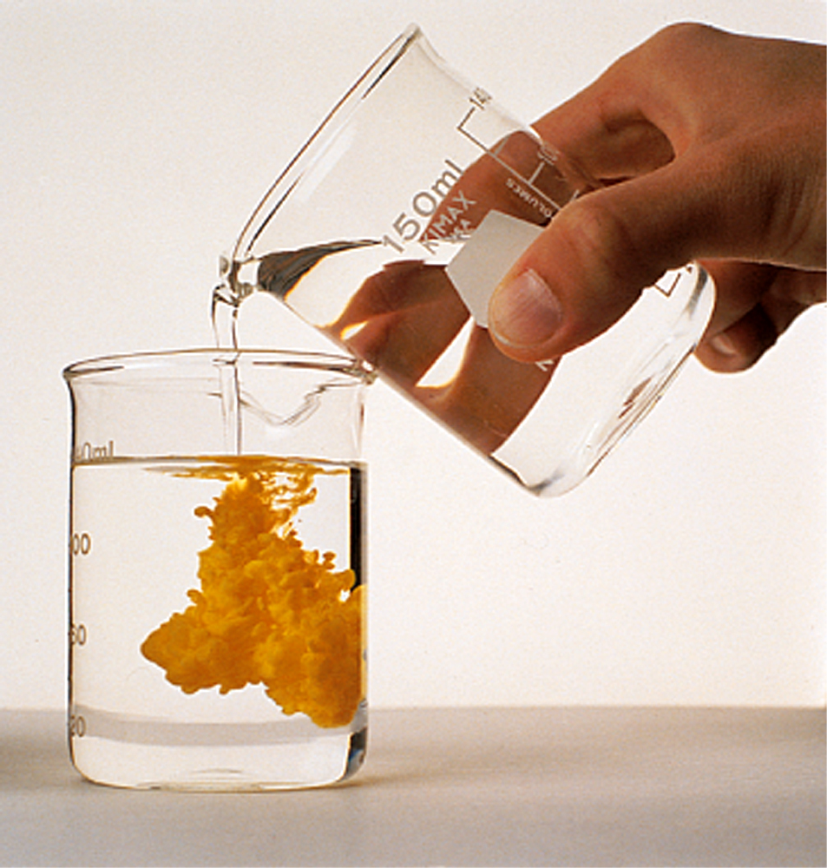
Precipitation of lead iodide In solution
Fig. 9.2
A double-replacement reaction involving solutions of potassium and lead nitrate produces yellow, insoluble lead iodide as one of the products.
James Scherer/Houghton Mifflin Company

Slide 5
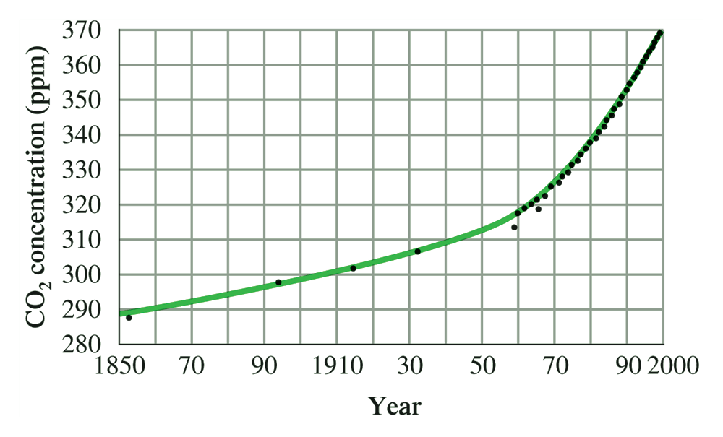
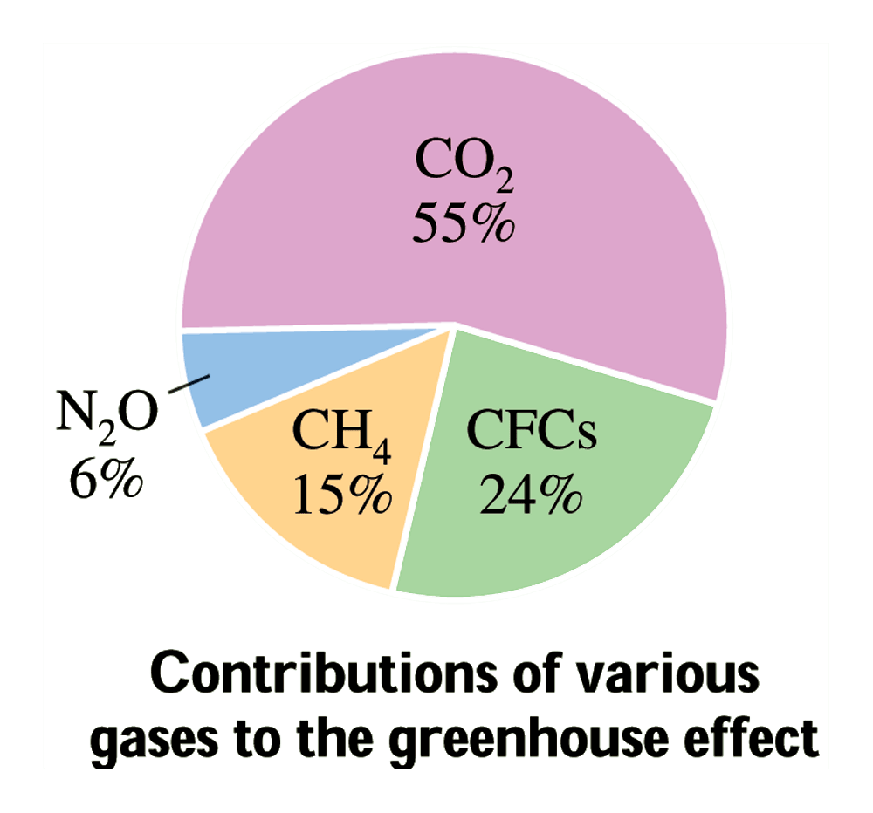
Combustion reaction and CO₂
CC 9.1
Combustion reaction and global warming

Slide 6
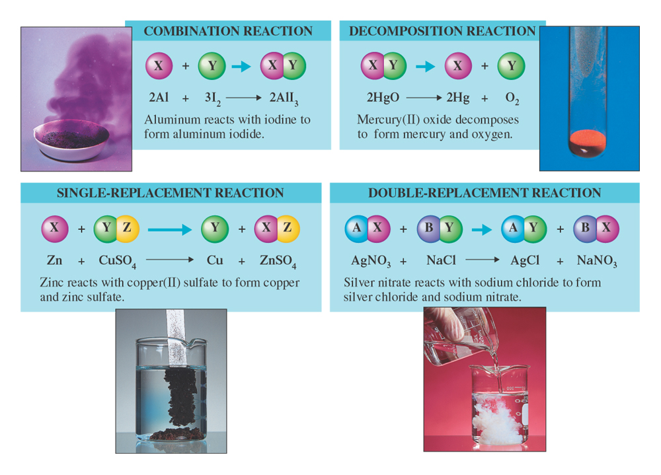
Types of Chemical Reactions
Aluminum reacting with iodine (purple smoke)
Mercury
oxide decomposing
(orange
solid)
Formation of copper and zinc sulfate
Formation of silver chloride and sodium nitrate

Slide 7
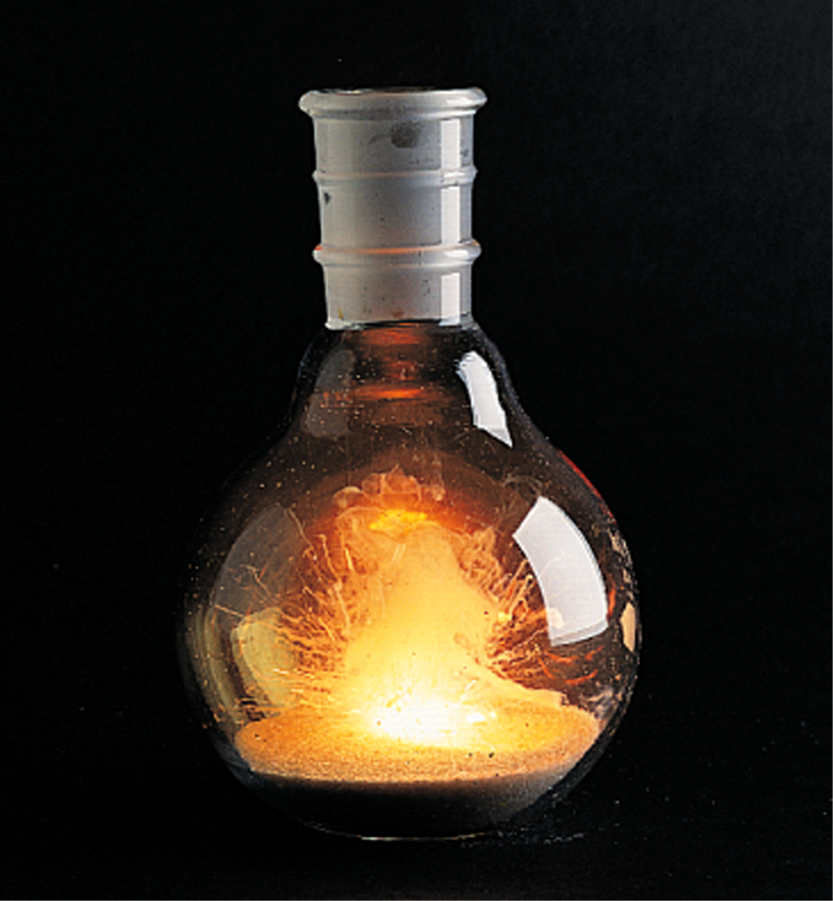
Redox Reactions: Electron transfer
Fig. 9.3
The burning of calcium metal in chlorine is a redox reaction.
James Scherer/Houghton Mifflin Company

Slide 8
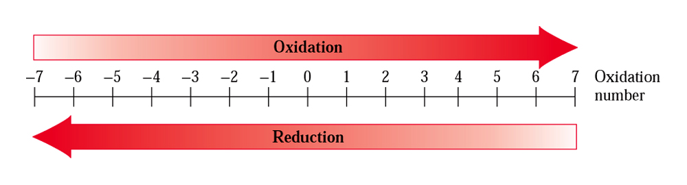
Oxidation Number
Fig. 9.4
An increase in oxidation number is associated with the process of oxidation, a decrease with the process of reduction.

Slide 9
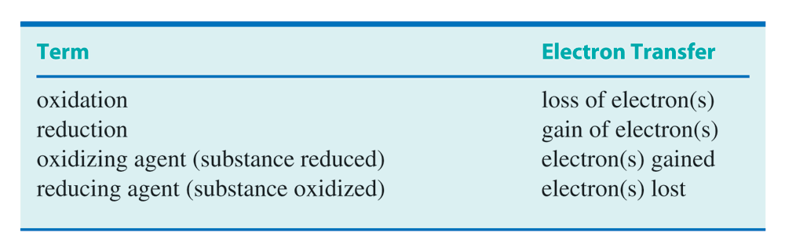
Redox terminology
LEO the Lion goes GER!
Table 9.1

Slide 10
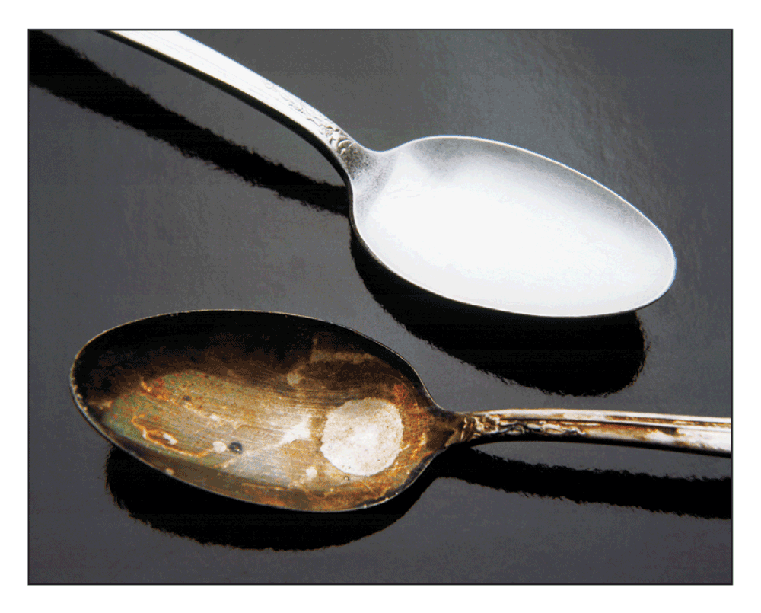
Corrosion of metal is redox
CC 9.2

Slide 11
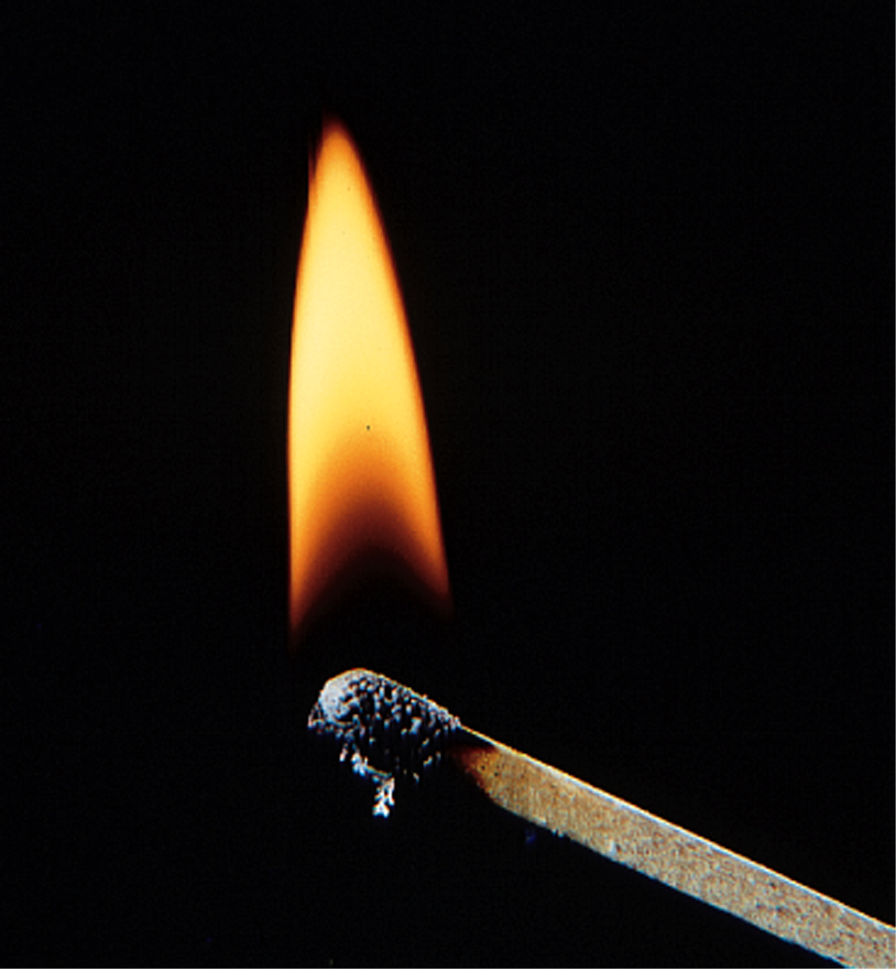
Activation Energy
Fig. 9.5
Rubbing a match head against a rough surface provides the activation energy needed for the match to ignite.

Slide 12
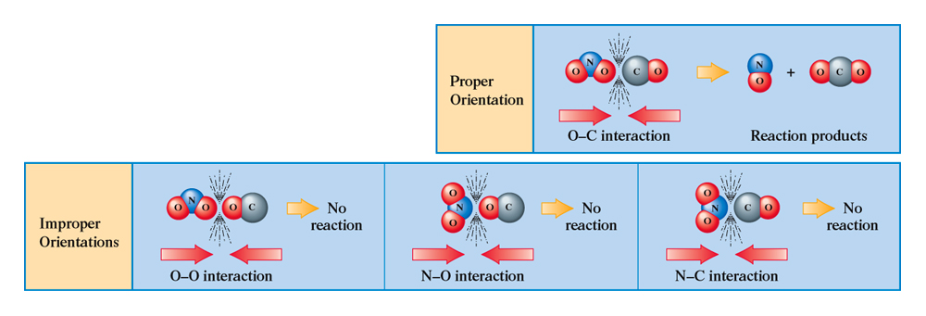
Collisions orientation matters
Fig. 9.6
The most favorable collision orientation is one that puts an O atom from NO₂ in close proximity to the C atom of CO.

Slide 13
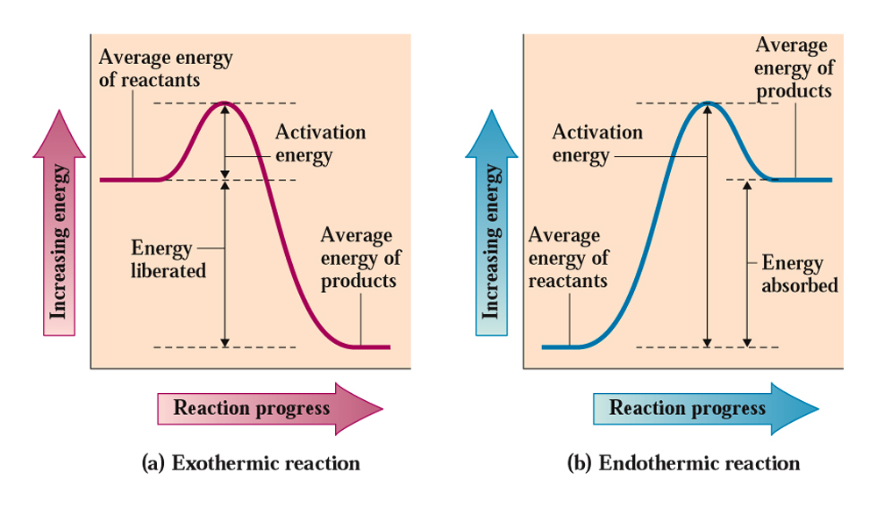
Energy graphs: Exothermic or Endothermic
Fig. 9.7
Energy graphs showing the difference between an exothermic and an endothermic reaction.

Slide 14
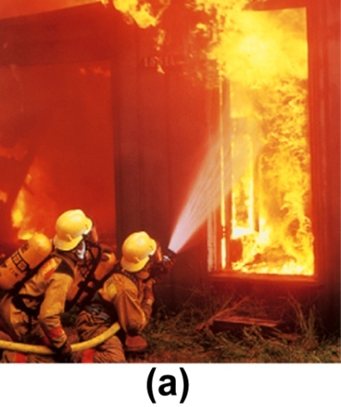
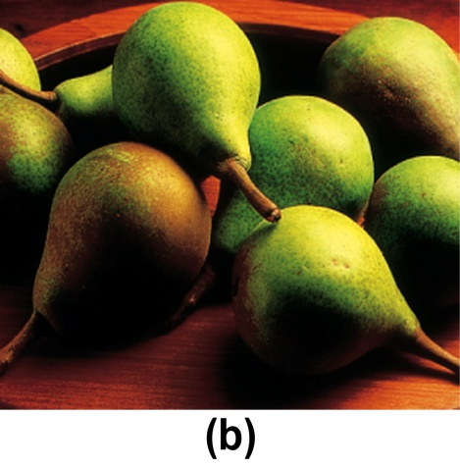
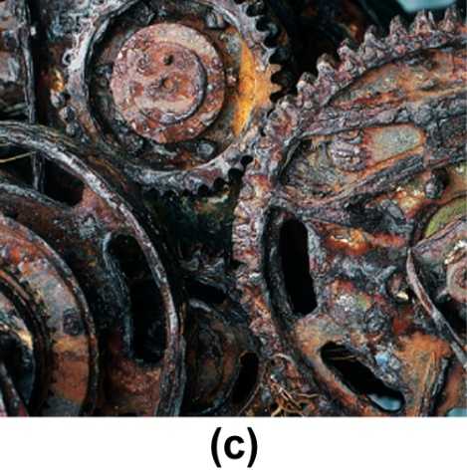
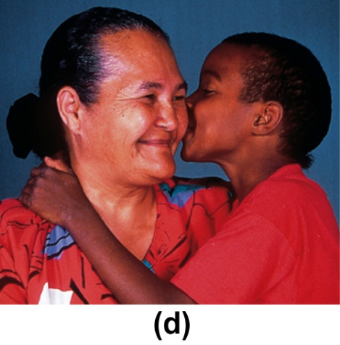
Rates of reactions are different
Vince Streano/Getty Images
© Cecile Brunswick/ Peter Arnold, Inc.
Sam Fried/Photo Researchers
Myrleen Ferguson Cate/PhotoEdit
Figs. 9.8a-d
A fire (a) is a much faster reaction than the ripening of fruit (b), which is much faster than the process of rusting (c), which is much faster than the process of aging (d).

Slide 15
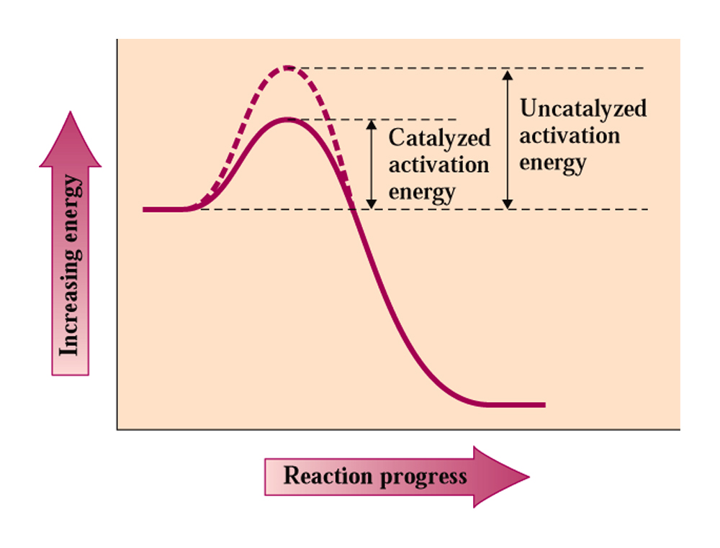
Catalysts lowers activation energy
Fig. 9.9
Catalysts lowers the activation energy for chemical reactions.

Slide 16
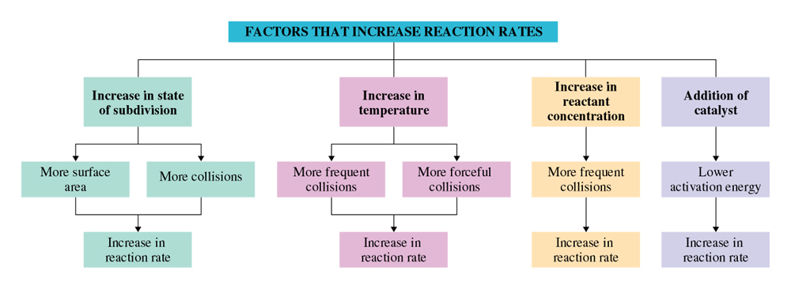
Factors affecting chemical ceactions
CC 9.3

Slide 17
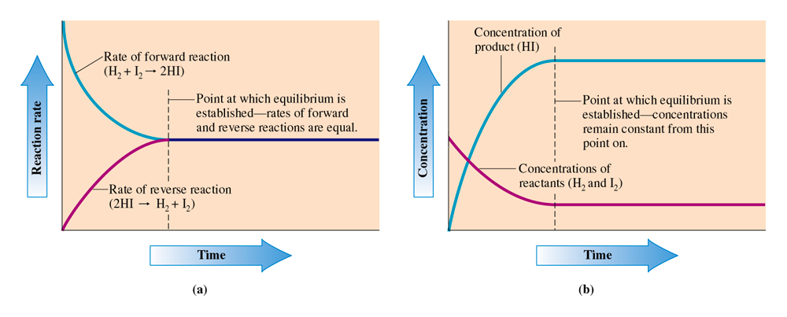
Reaction rates and reactant concentration
Fig. 9.10
Graphs showing how reaction rates and reactant concentration vary with time.

Slide 18
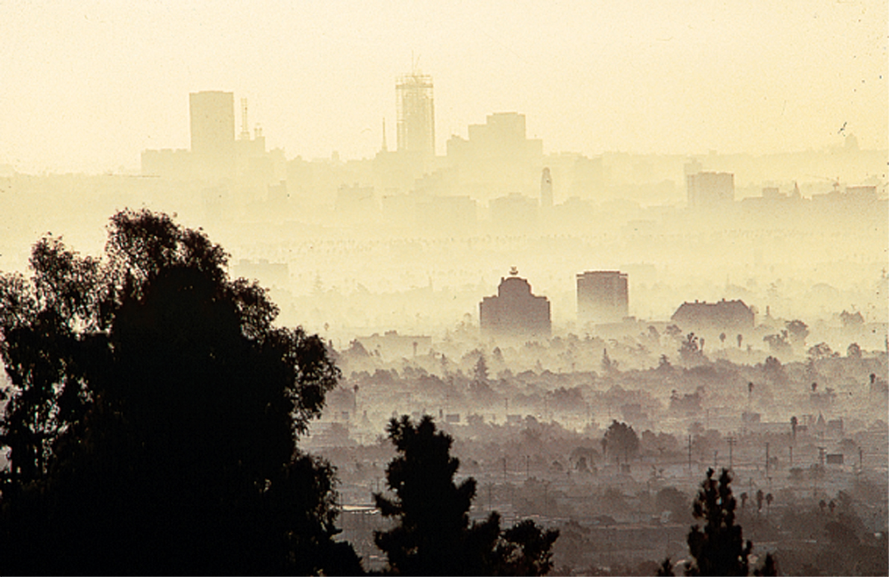
Smog is caused by automobile-emissions
CC 9.3
Los Angeles Smog
Tom McHugh/Photo Researchers

Slide 19
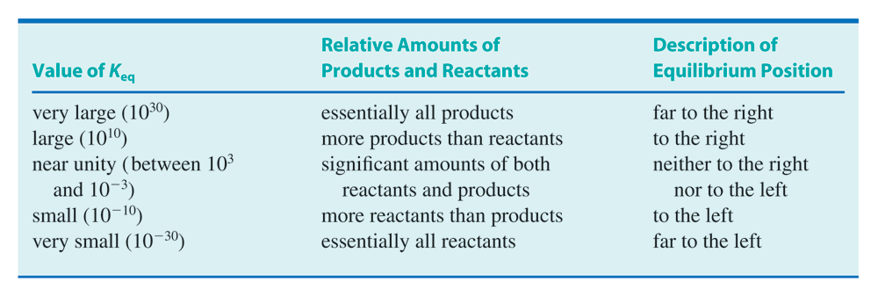
What does equilibrium constant K_{eq} means?
Table 9.2

Slide 20
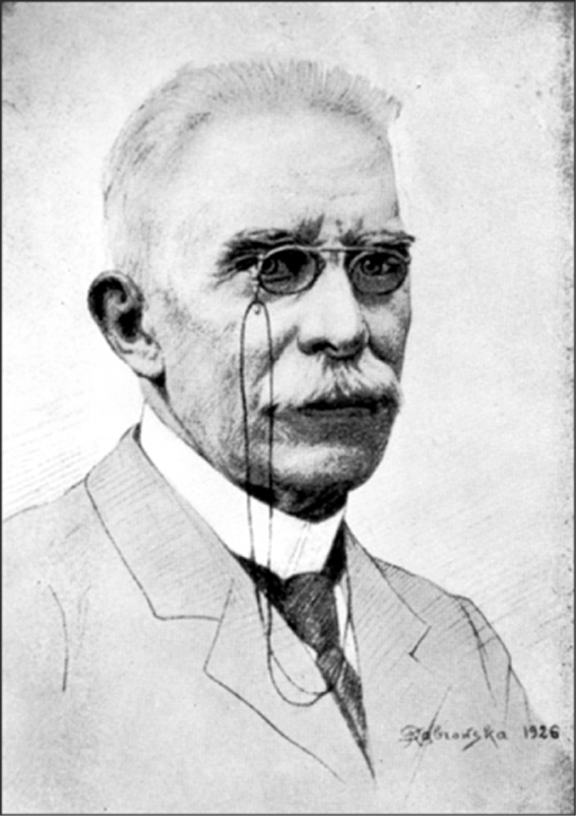
Louis Chatelier Principle
Fig. 9.11
Henri Louis Chatelier was amazingly diverse in his interests.
Edgar Fahs Smith Collection, University of Pennsylvania

Slide 21
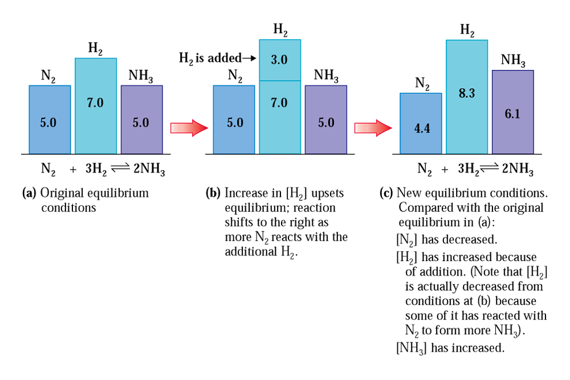
Shifts in equilibrium
Fig. 9.12
Concentration changes that result when H₂ is added to an equilibrium mixture.

Slide 22
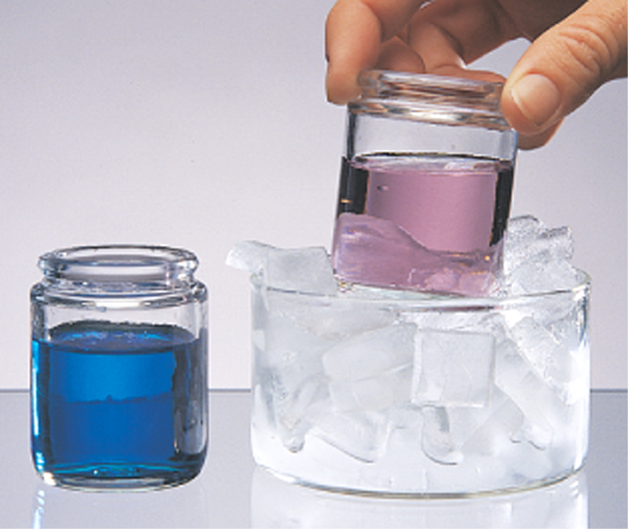
Temperature can shift the equilibrium
Fig. 9.13
Equilibrium mixtures changing color with difference in temperatures.

