Slide 1
Chapter 8
Solutions

Slide 2
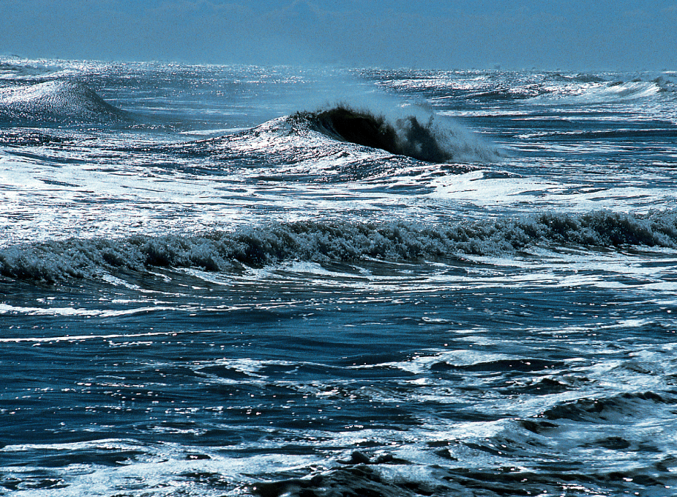
Water that makes the most common solutions
CO 8.1
Ocean water is a solution in which many different substances are dissolved.
Steve Allen/Peter Arnold, Inc.

Slide 3
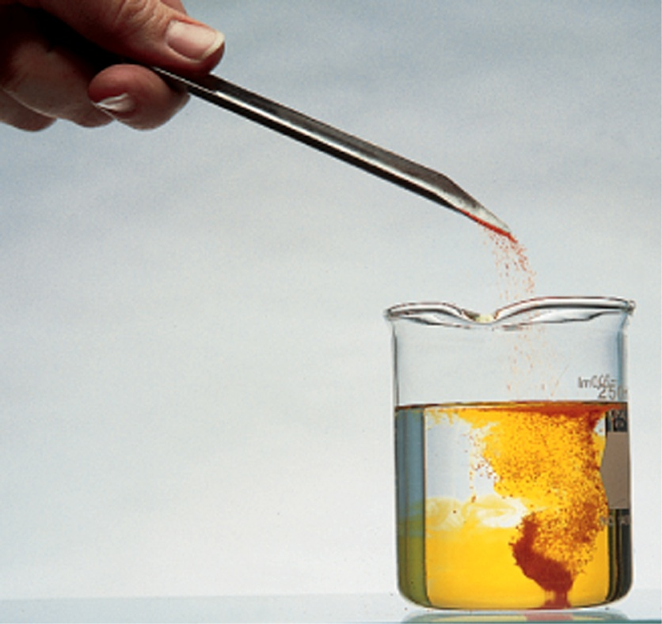
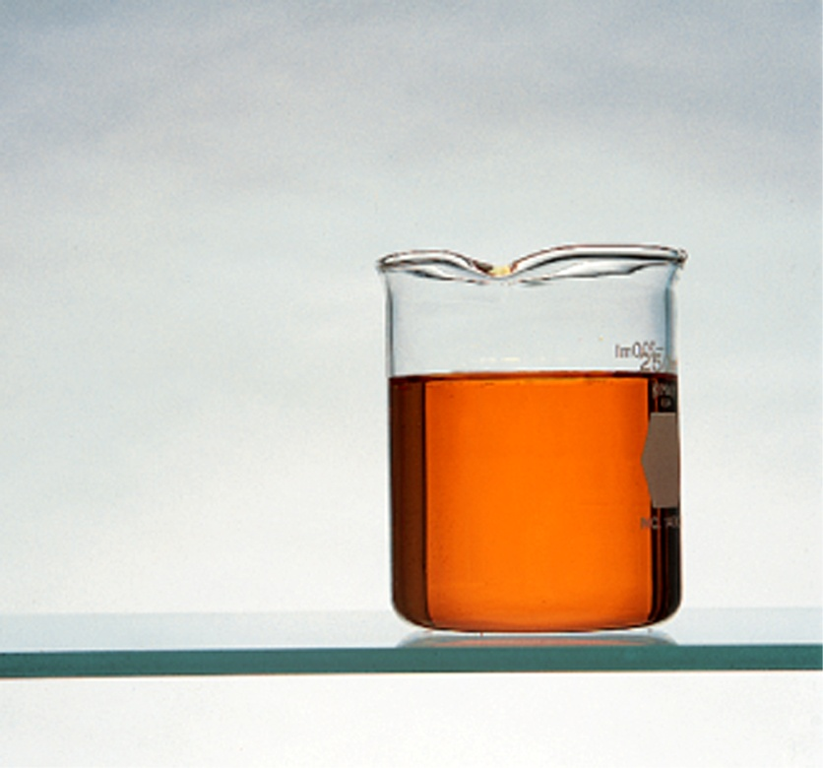
Solutions keep properties of both:
Solvent and the solute
Fig. 8.1
The colored crystals are the solute, and the clear liquid is the solvent. Stirring produces the solution.

Slide 4
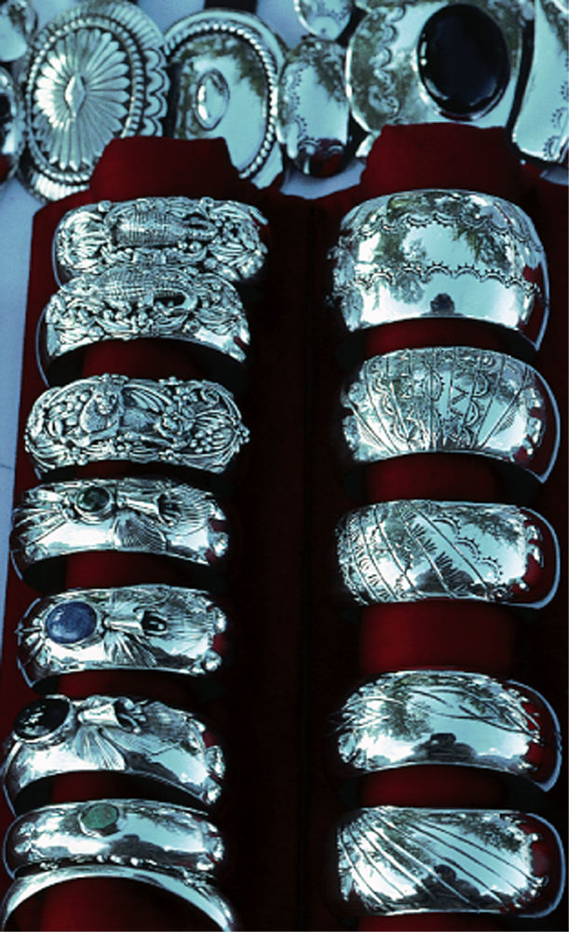
Solutions could be sold solutions
Fig. 8.2 Jewelry often involves solid solutions in which one metal has been dissolved in another metal.
© Coco McCoy/Rainbow

Slide 5
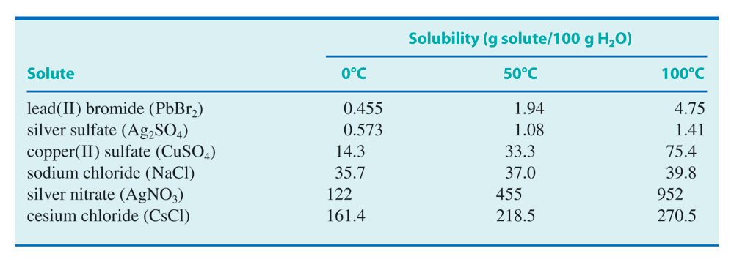
Solubility is different
Table 8.1

Slide 6
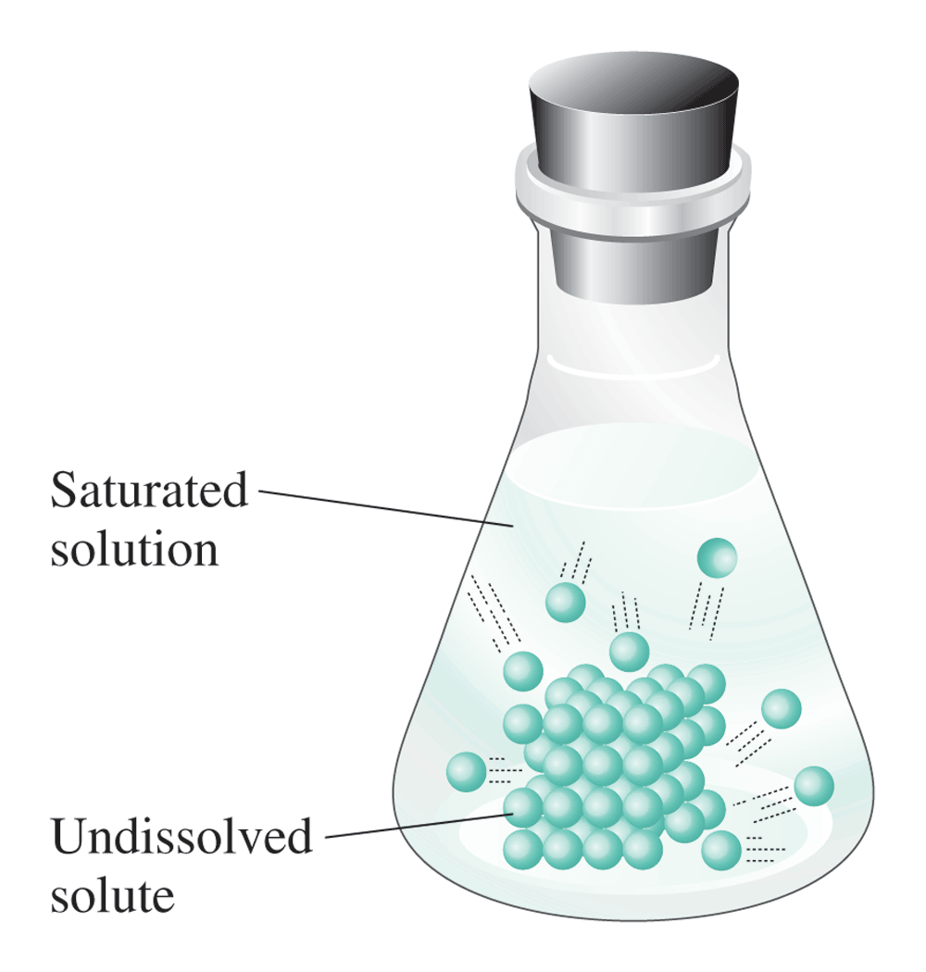
Saturated solutions
Fig. 8.3 In a saturated solution, the dissolved solute is in dynamic equilibrium with the undissolved solute.

Slide 7
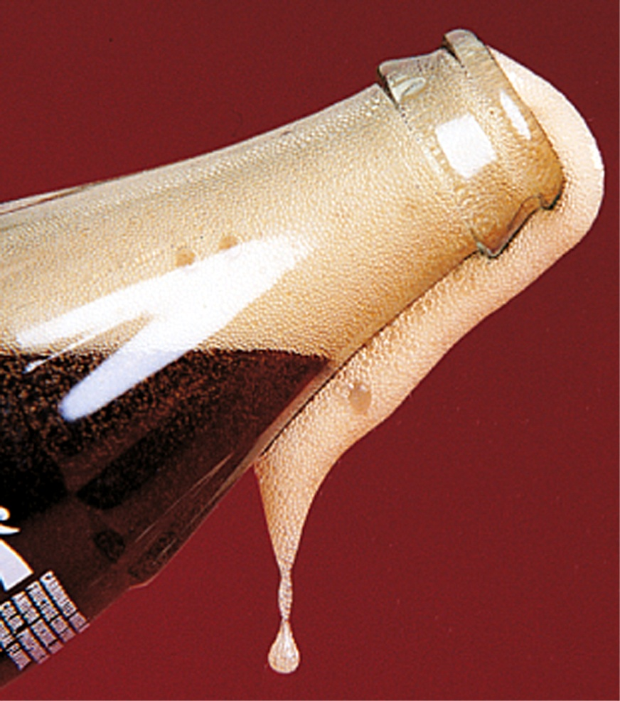
Gas in liquids: solutions
C.C. 8.1 Carbon dioxide escaping from an opened bottle of a carbonated beverage.

Slide 8
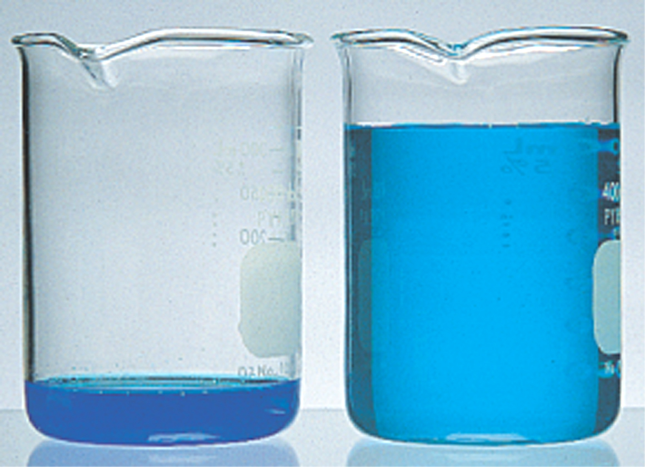
Concentrated vs. dilute olutions
Fig. 8.4 Both solutions contain the same amount of solute. A concentrated solution (left) contains a relatively large amount that could dissolve. A dilute solution contains a relatively small amount of solute compared with the amount that could dissolve.

Slide 9
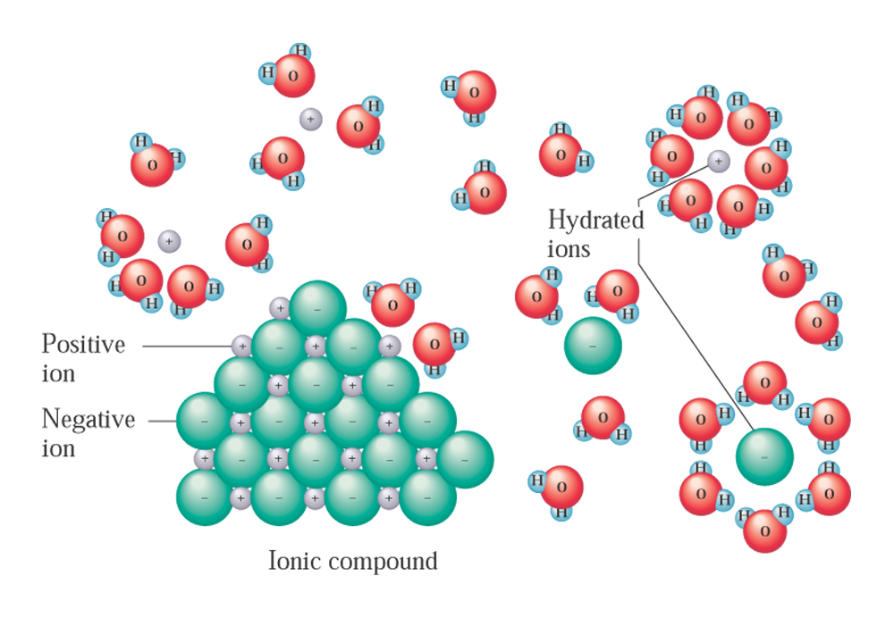
Ionic solids breaks into ions in solutions
Fig. 8.5 When an ionic solid, such as sodium chloride, dissolves in water, the water molecules hydrate the ions.

Slide 10
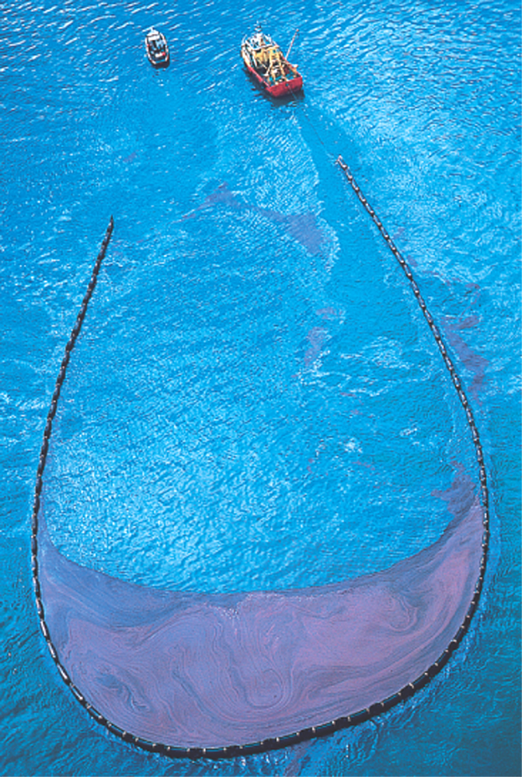
Immiscible liquids can be separated
Fig. 8.6 Oil spills can be contained to some extent by using trawlers and a boom apparatus because oil and water, having different polarities, are relatively insoluble in each other.
David Woodfall/Getty Images

Slide 11
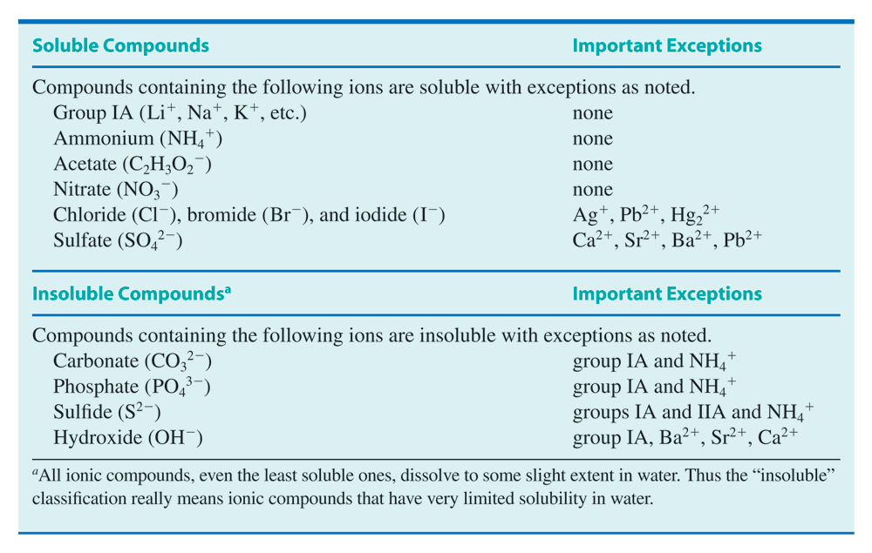
Solubility rules for ionic solids
Table 8.2

Slide 12
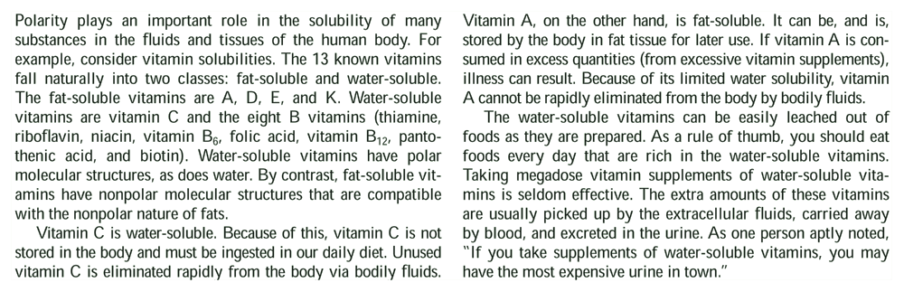
Solubility of vitamins
CC 8.2 Solubility of Vitamins
.

Slide 13
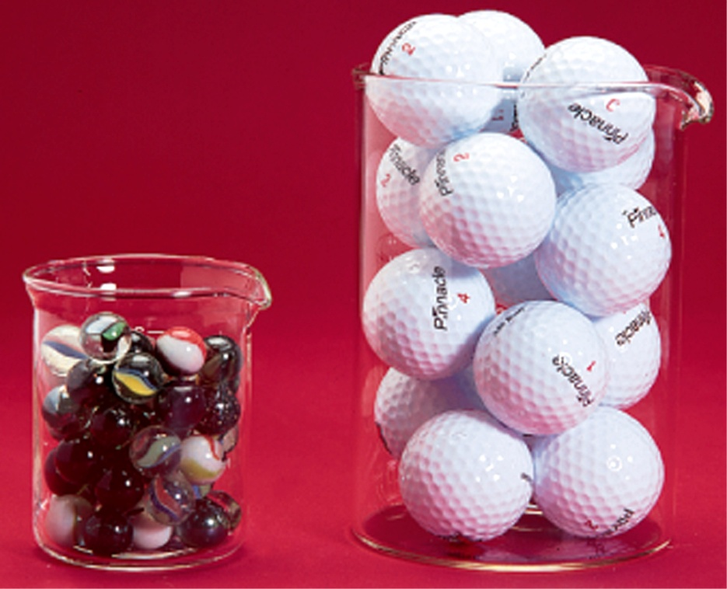
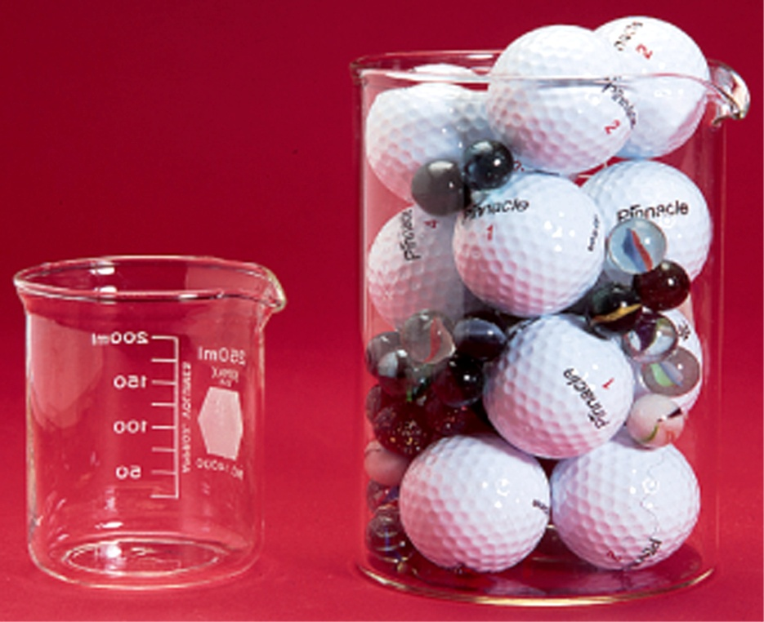
Total volume don’t add up
Fig. 8.7 When volumes of two different liquids are combined, the volumes are not additive.

Slide 14
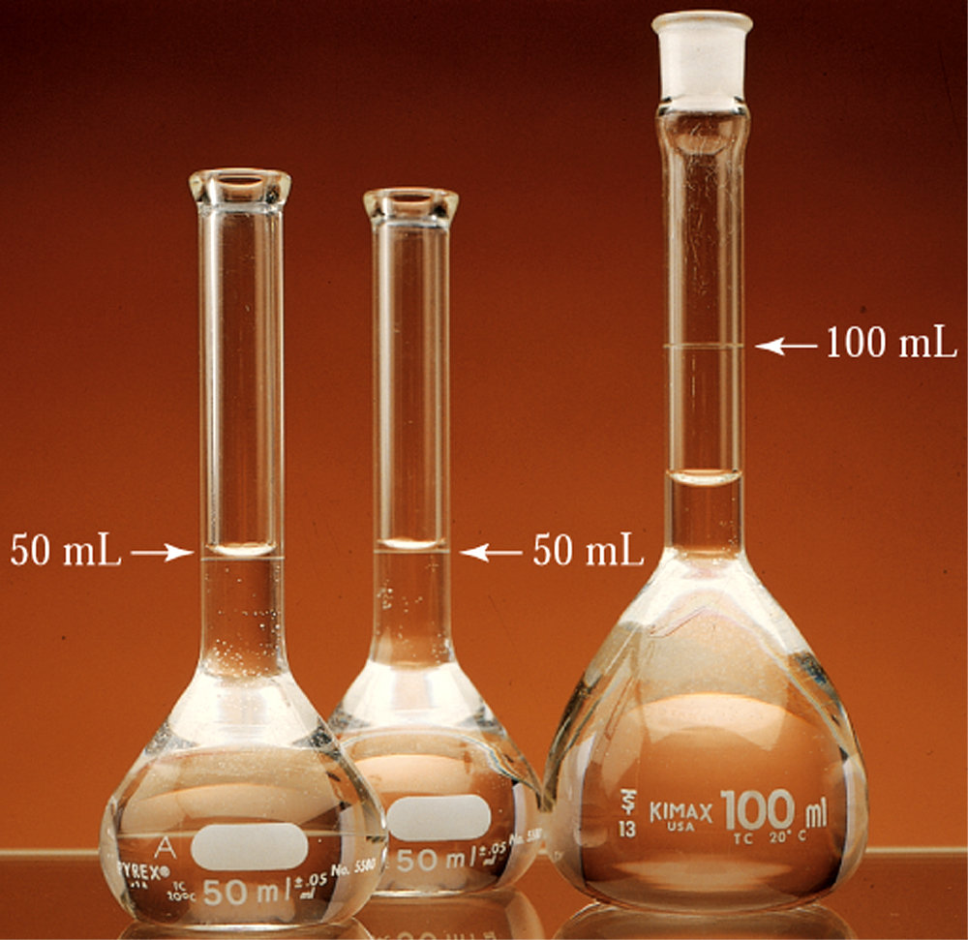
Measuring volume of solutions
Fig. 8.8 Identical volumetric flasks are filled to the 50.0-mL mark with ethanol and with water. When the two liquids are poured into a 100mL volumetric flask, the volume is seen to be less.

Slide 15
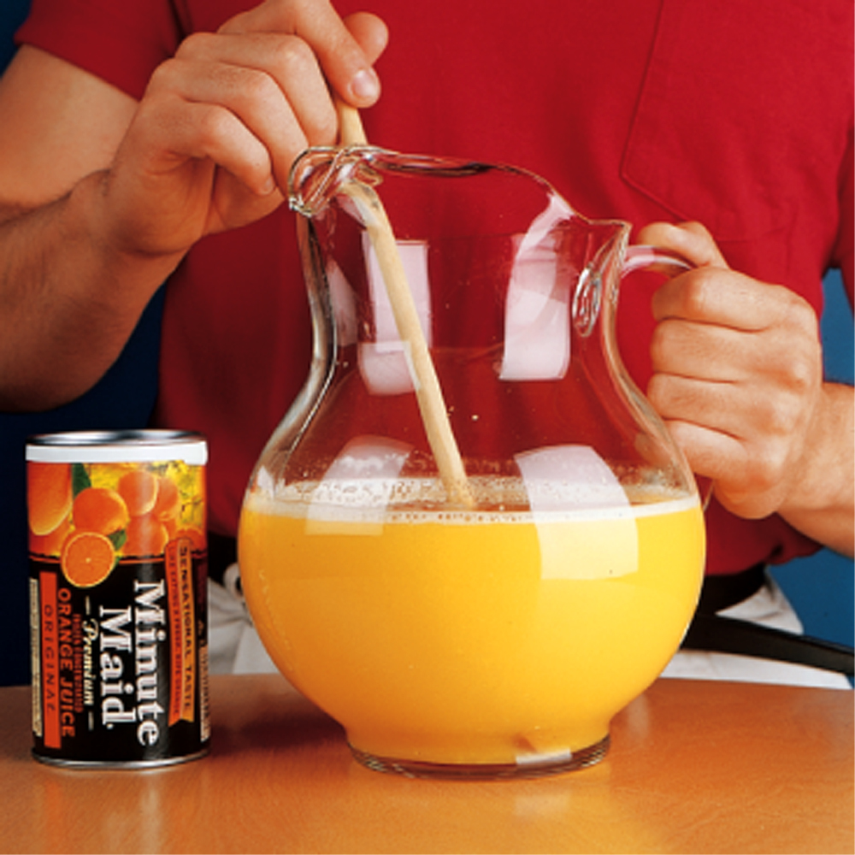
Orange juice is it a homogenous solutions?
Fig. 8.9 Frozen orange juice concentrate is diluted with water prior to drinking.

Slide 16
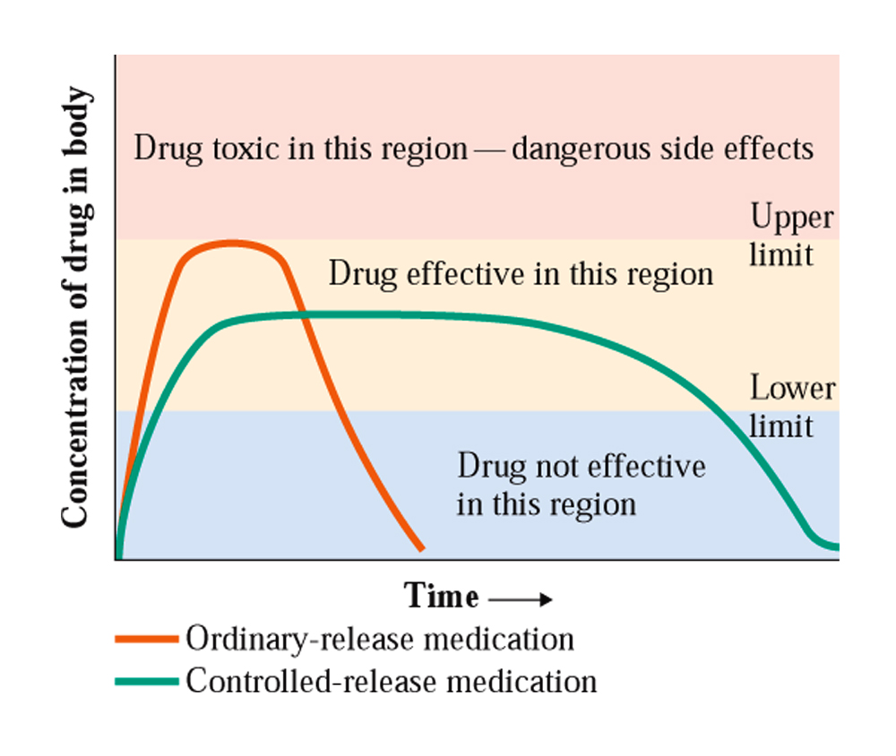
Concentration of drugs in solution
CC 8.3

Slide 17
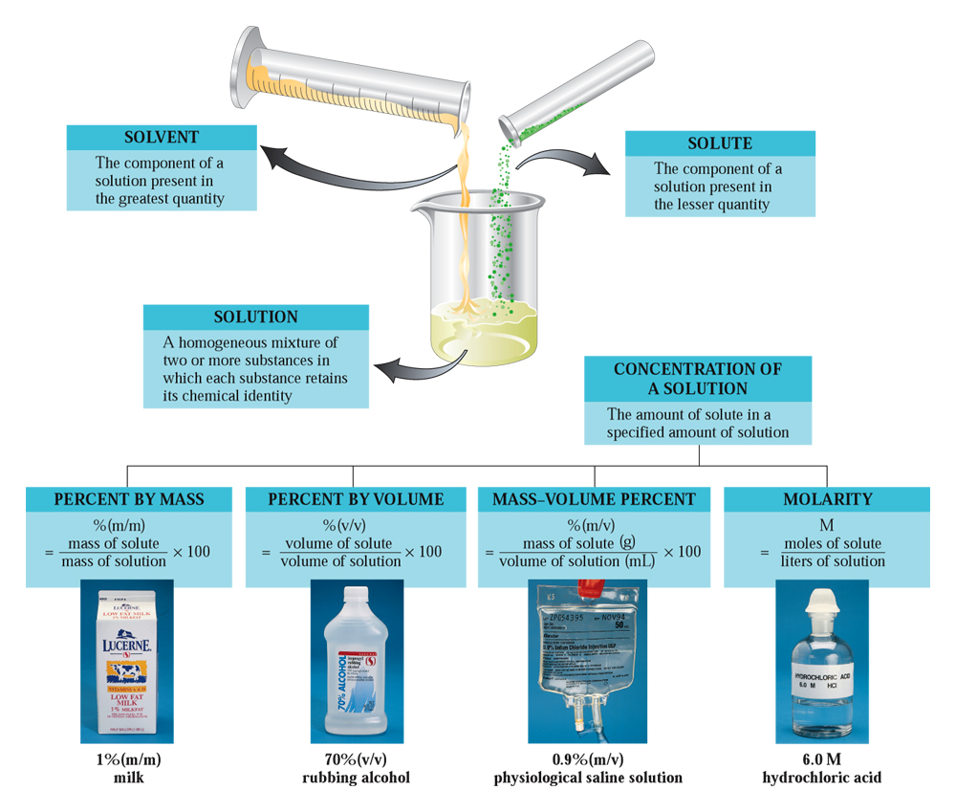
Different types of solutions
CAG 8.1

Slide 18
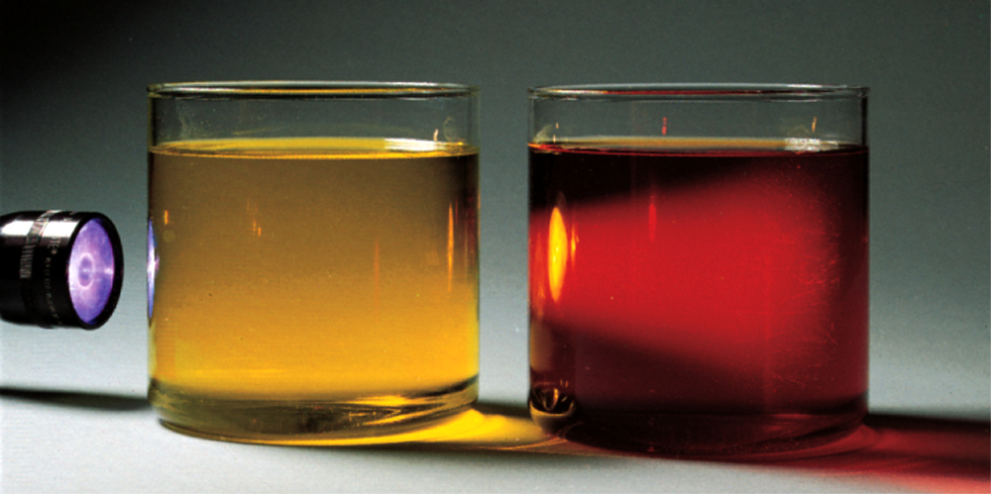
Does the light pass through solutions
Fig. 8.10 A beam of light travels through a true solution without being scattered. This is not the case for a colloidal dispersion.

Slide 19
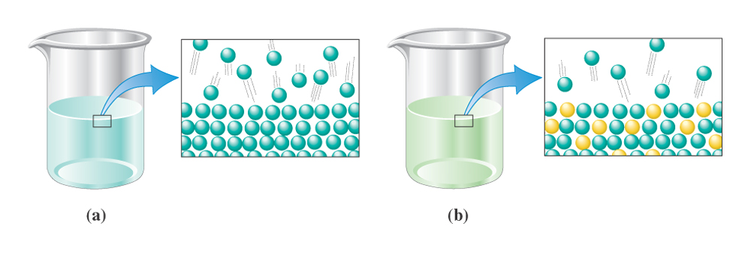
Solute lowers the vapor pressure
Fig. 8.11 Close-ups of the surface of a liquid solvent before and after solute has been added.

Slide 20
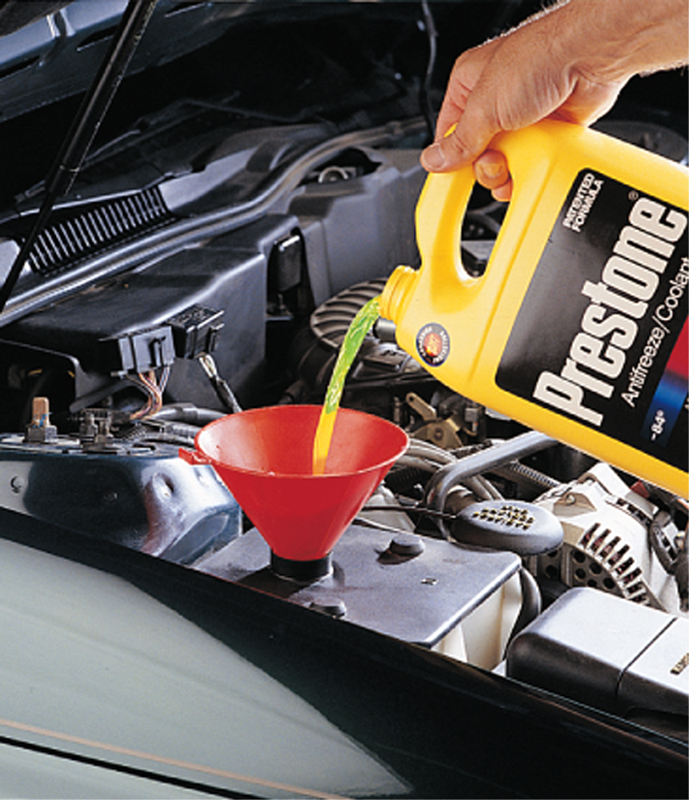
Solute lowers the freezing point
Fig. 8.12 A water-antifreeze mixture has a higher boiling point and lower freezing point than pure water.

Slide 21
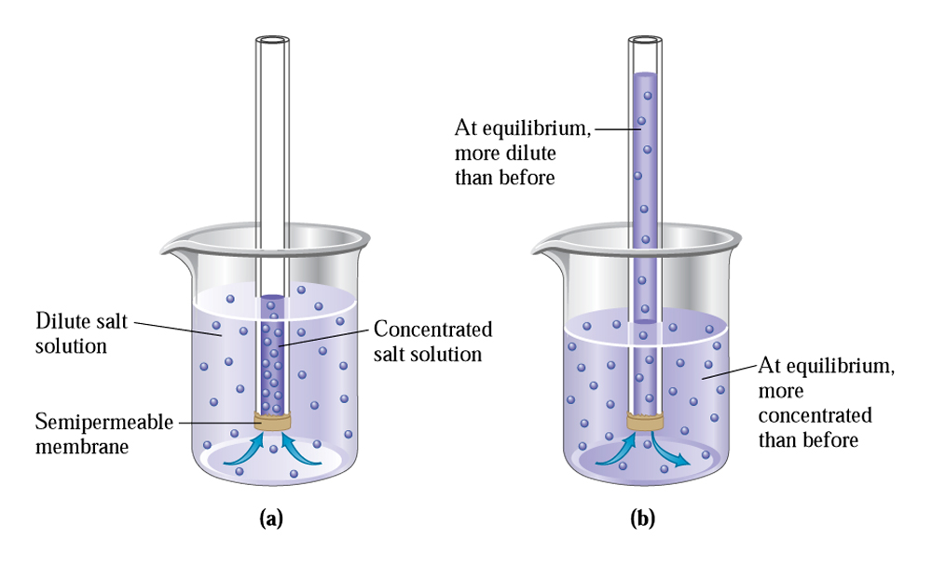
Solute increase the osmotic pressure
Fig. 8.13 (a) Osmosis can be observed with this apparatus. (b) The liquid level in the tube rises until equilibrium is reached.

Slide 22
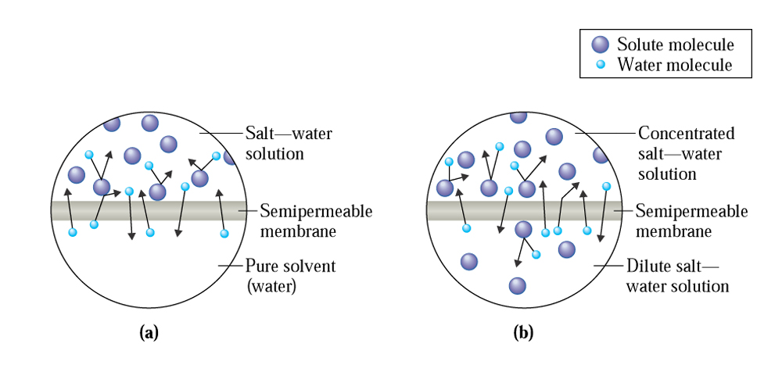
Semi permeable memebreane only allows the solvent molecules to pass
Fig. 8.14 Enlarged views of a semi-permeable membrane separating (a) pure water and a salt-water solution, and (b) a dilute salt-water solution.

Slide 23
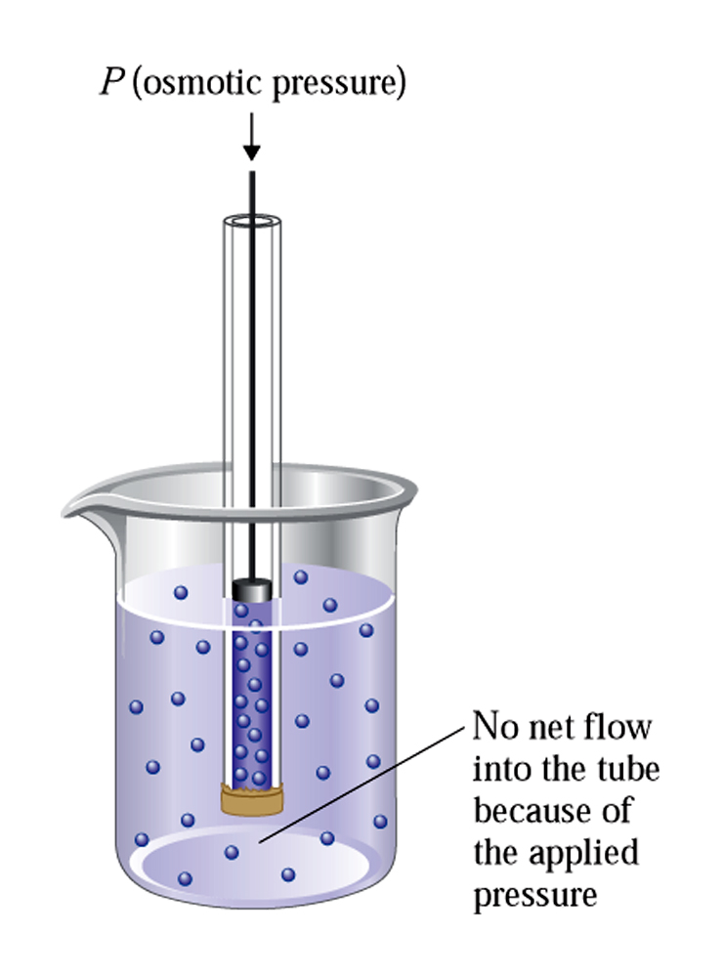
Osmotic pressure
Fig. 8.15 Osmotic pressure is the amount of pressure needed to prevent the solution in the tube from rising as a result of the process of osmosis.

Slide 24

Water can move up through capillary action
Fig. 8.16 The dissolved substances in tree sap create a more concentrated solution than the surrounding ground water.
John Mead/Photo Researchers

Slide 25
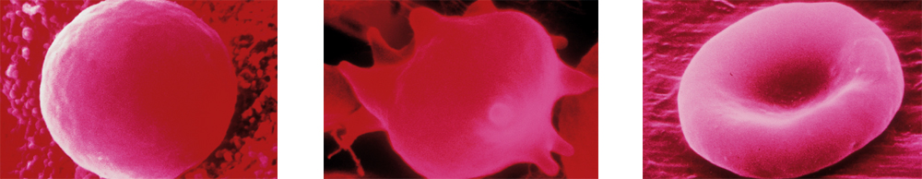
Would the blood cell survive?
Figs. 8.17 a-c
Copyright David M. Phillips/Visuals Unlimited
(a) Hyptonic solution
(b) Crenation in concentrated sodium chloride solution.
(c) Cells neither swell nor shrink in physiological saline solution.

Slide 26
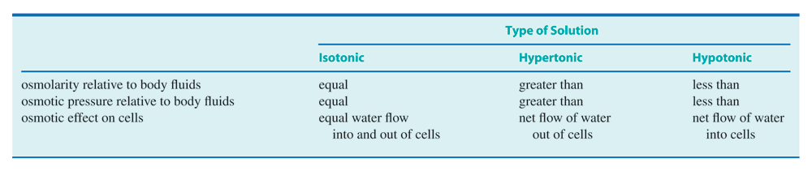
Three types of solutions
Table 8.3

Slide 27
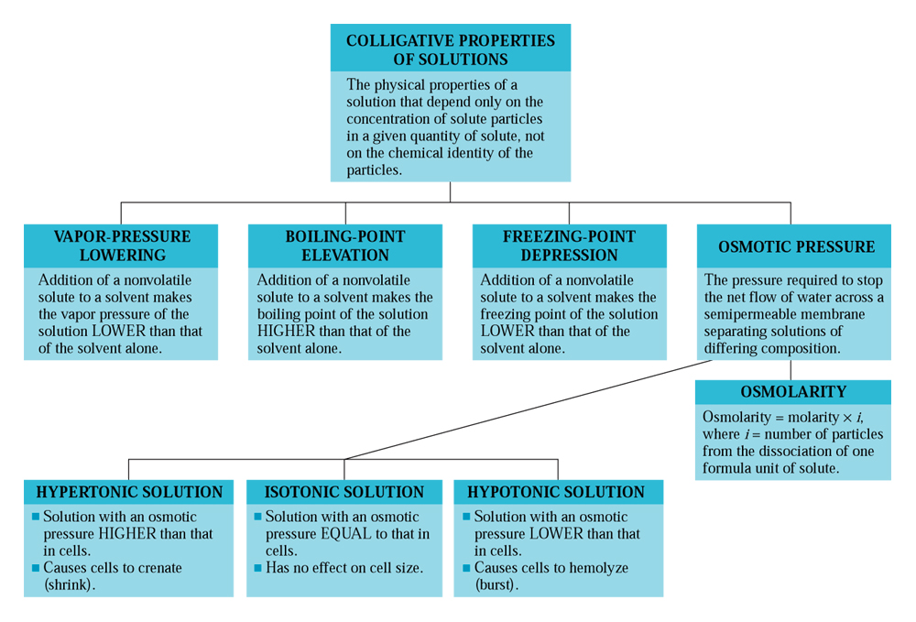
Colligative properties of solutions
CAG 8.2

Slide 28
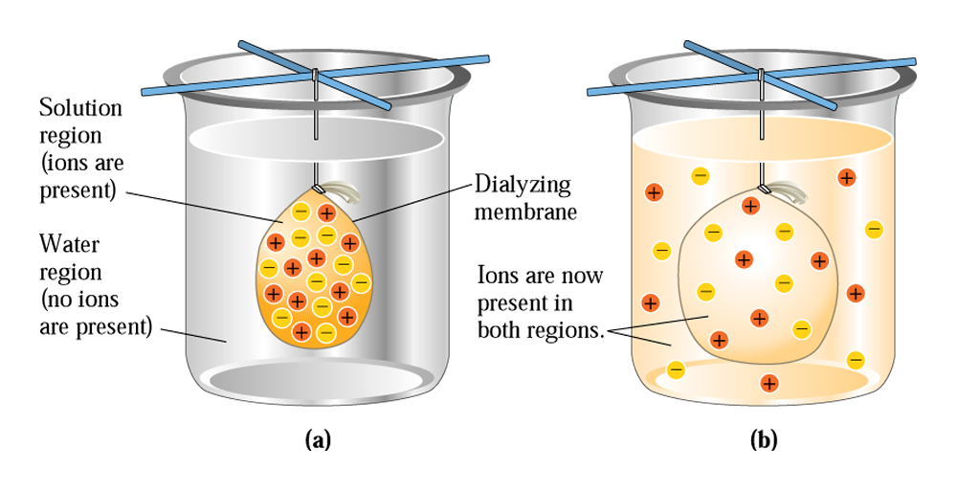
How does dialysis work?
Fig. 8.18 In dialysis, there is a net movement of ions from a region of higher concentration to a region of lower concentration.

Slide 29
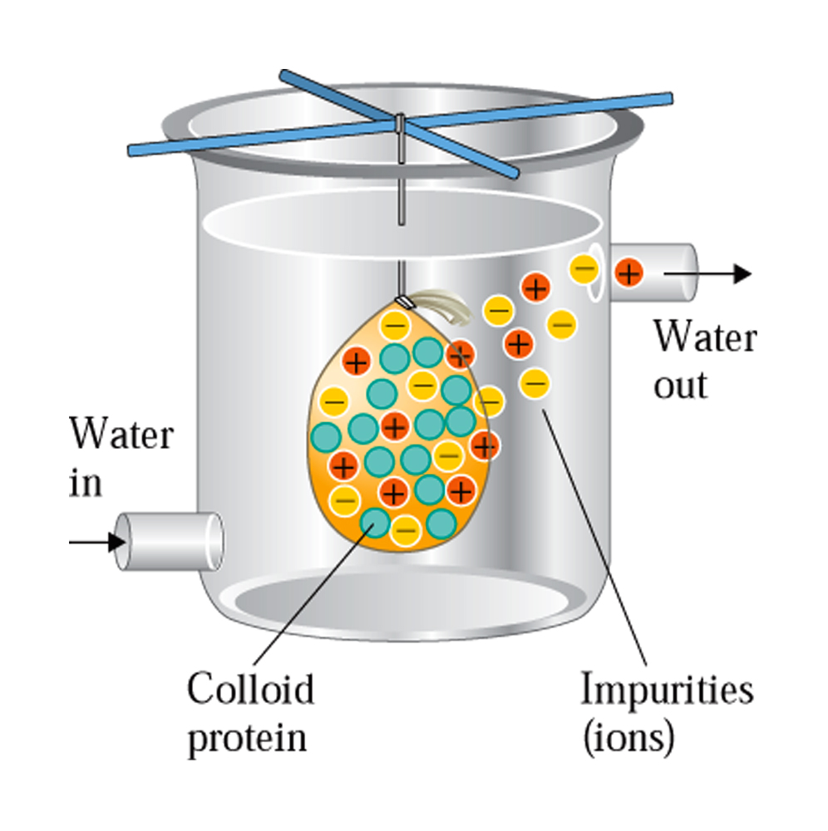
Removing impurities through dialysis
Fig. 8.19 Impurities can be removed from a colloidal dispersion by using a dialysis procedure.

Slide 30
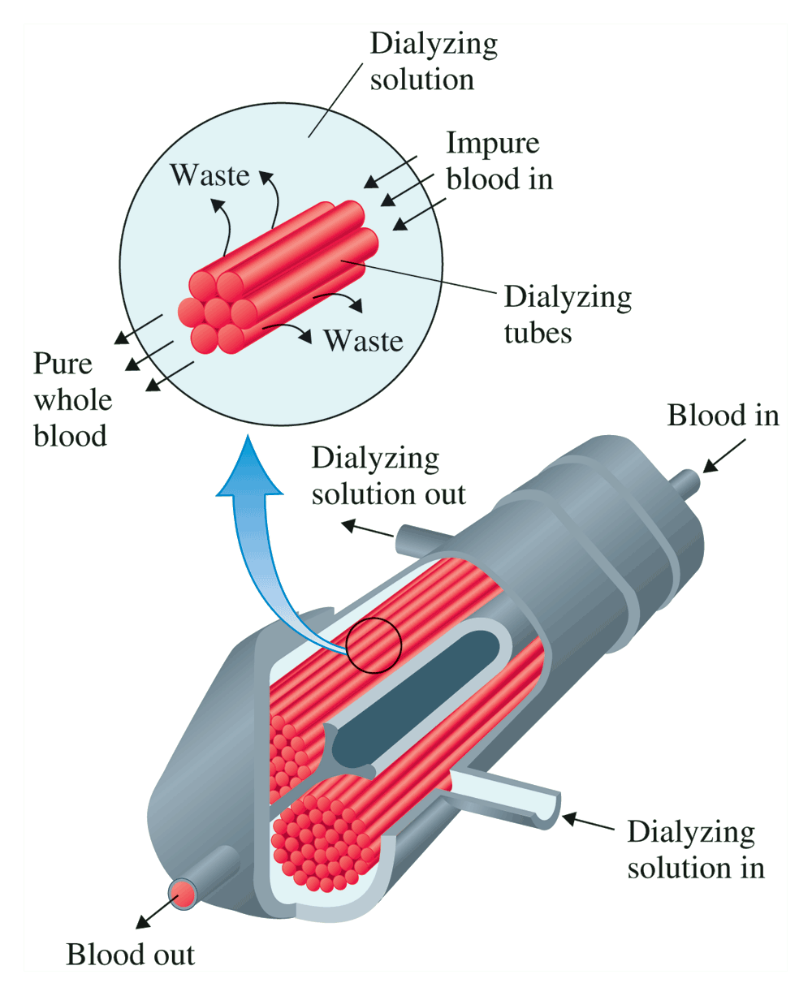
Dialysis machine a life saver
CC 8.4

