Slide 1
Chapter 7
Gases, Liquids, and Solids

Slide 2
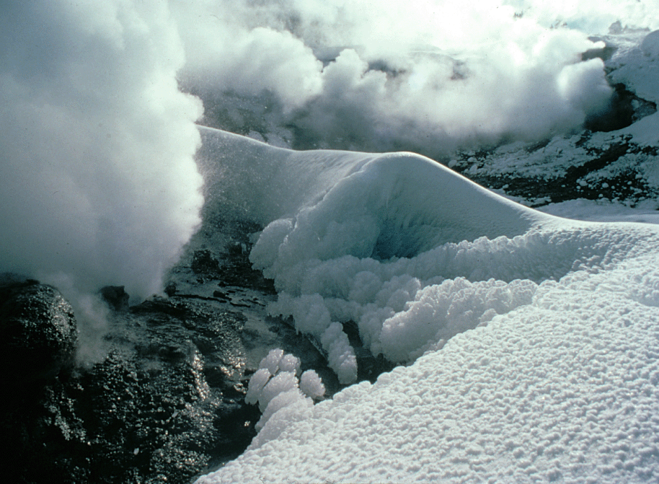
Gases, Liquids, and Solids
CO 7.1
Ice, water, and mist are simultaneously present in this winter scene in Yellowstone National Park.
© Steven Fuller/Peter Arnold, Inc.

Slide 3
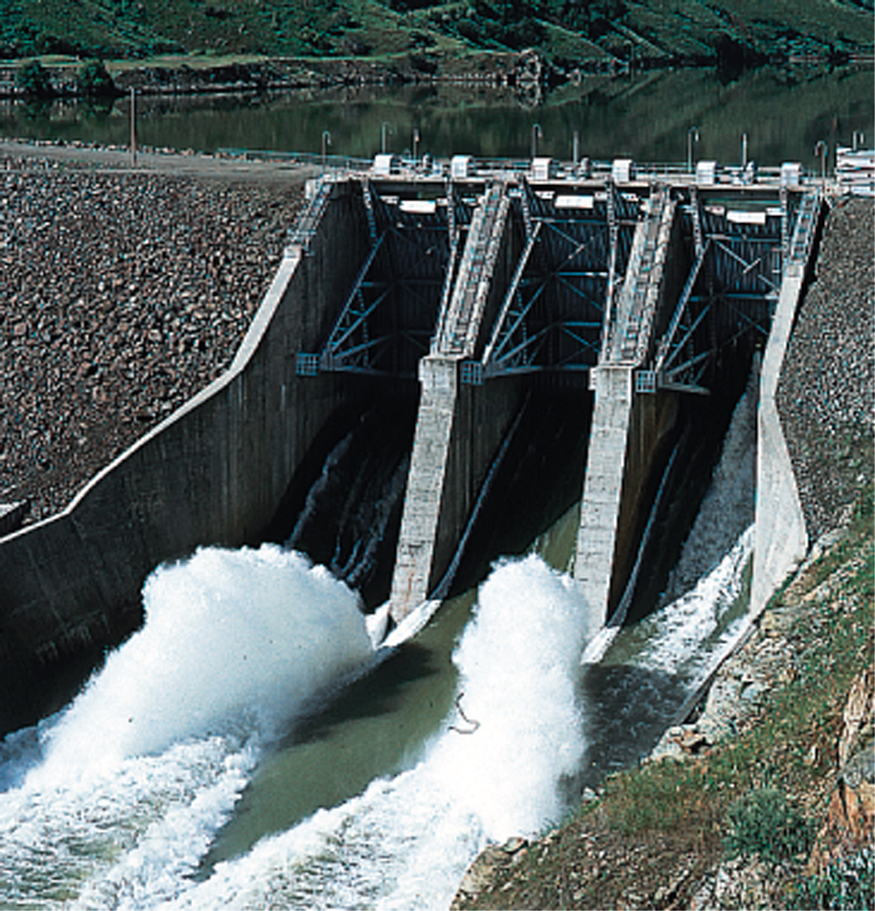
Hydro-power from potential energy
Fig. 7.1
The water in the lake behind the dam has potential energy as a result of its position.
Betty Weiser/Photo Researchers

Slide 4
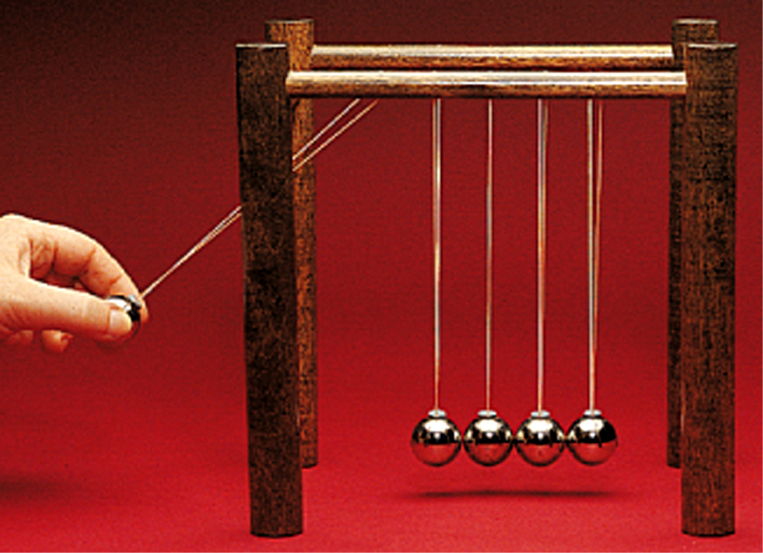
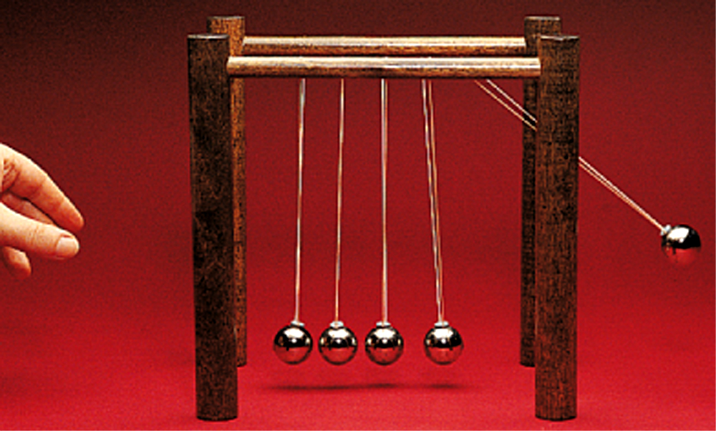
Kinetic Energy and Collisions
Fig. 7.2
Upon release, the steel ball on the left transmits its kinetic energy through a series of elastic collisions to the ball on the right.

Slide 5
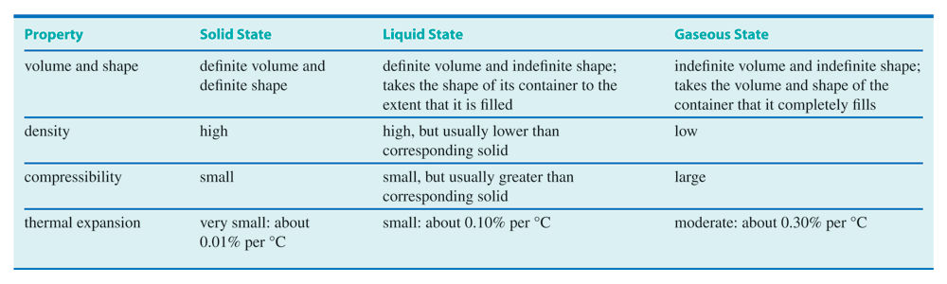
Properties of Gases, Liquids, and Solids
Table 7.1

Slide 6
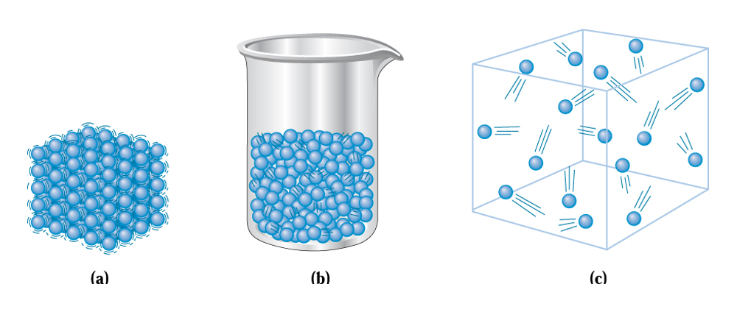
Arrangement of Particles in three States
Fig. 7.3
(a) In a solid, the particles are close together. (b) In a liquid, the particles slide freely over one another. (c) In a gas, the particles are in random motion.

Slide 7
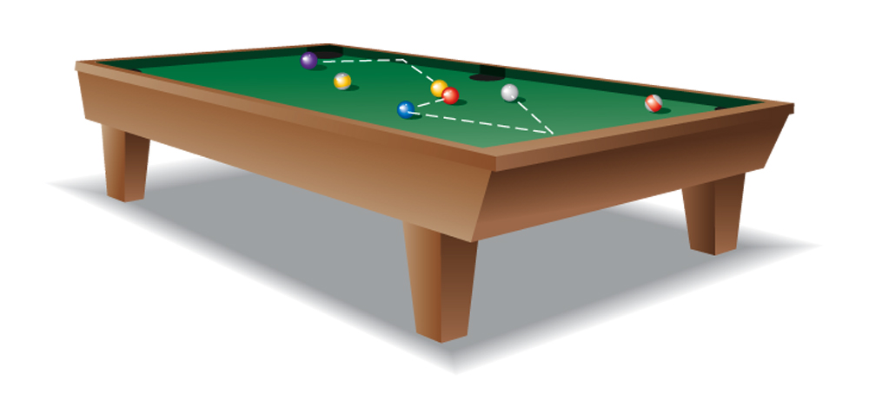
Gases in random motion
Fig. 7.4
Gas molecules can be compared to billiard balls in random motion, bouncing off one another.

Slide 8
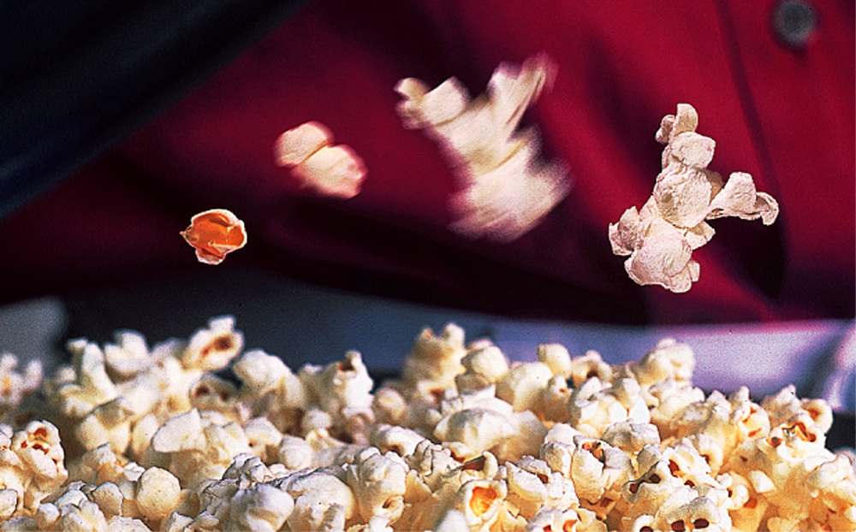
Popping into different states
CC 7.1
Phil Degginger/Color-Pic

Slide 9
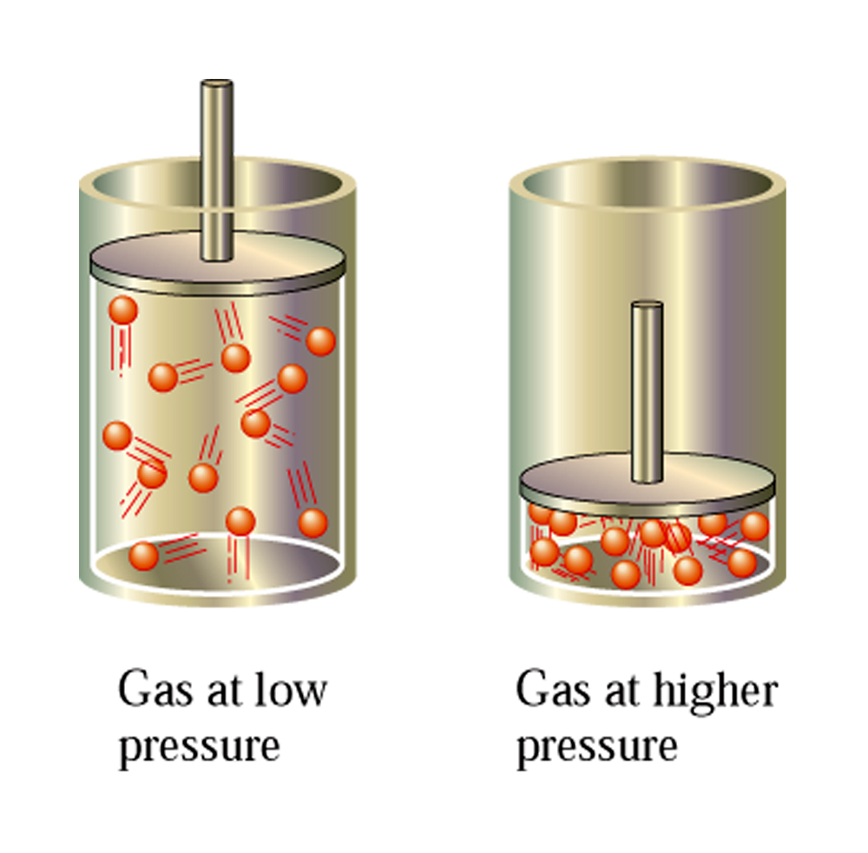
Compressibility of gases
Fig. 7.5
When a gas is compressed, the amount of empty space in the container is decreased.

Slide 10
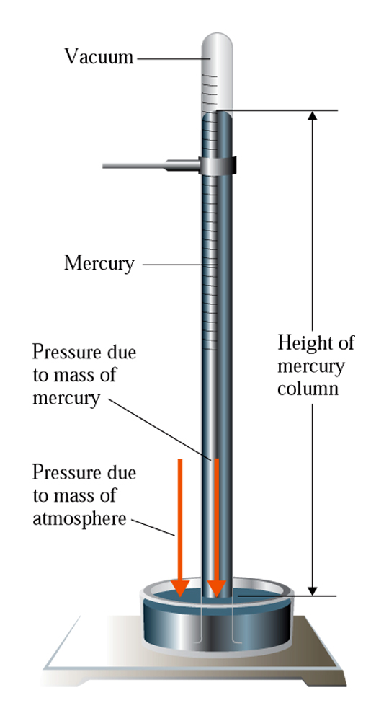
Barometer: Measuring the Pressure of gases
Fig. 7.6
The essential components of a mercury barometer are a graduated glass tube, a glass dish, and liquid mercury.

Slide 11
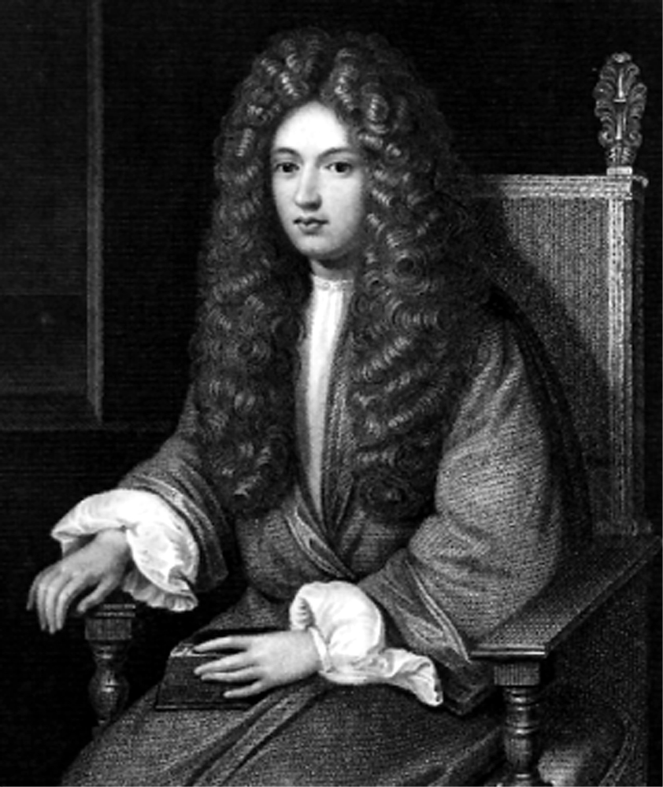
Boyle and the gas Laws
Fig. 7.7
Robert Boyle was self-taught. Through his efforts, the true value of experimental investigation was first recognized.
Edgar Fahs Smith Collection, University of Pennsylvania

Slide 12
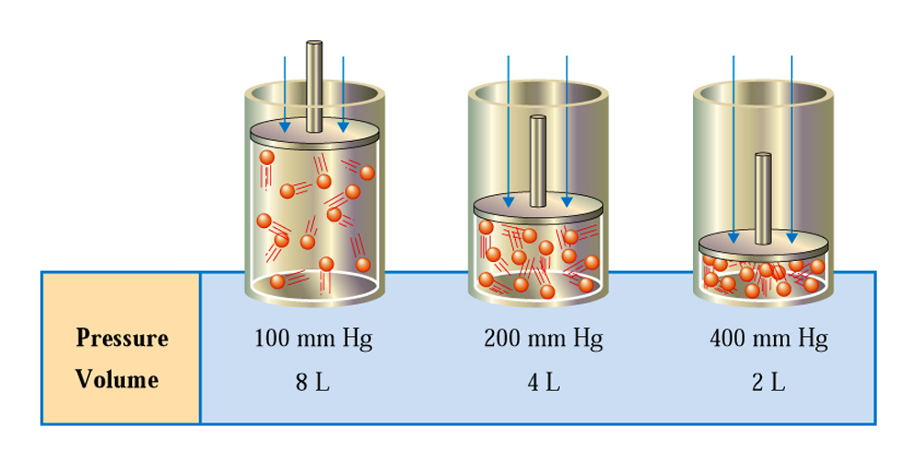
Boyles’ Law:
Fig. 7.8
Data illustrating the inverse proportionality associated with Boyle’s law.

Slide 13
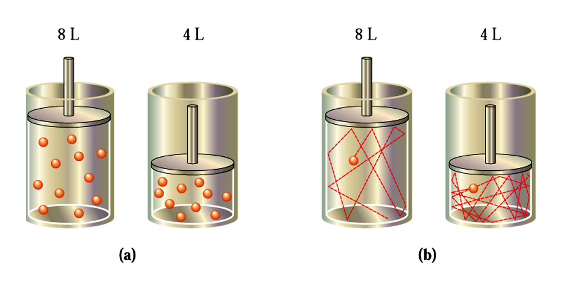
Charles Law
Fig. 7.9 When the volume of a gas at constant temperature decreases by half, the average number of times a molecule hits the container walls is doubled.

Slide 14
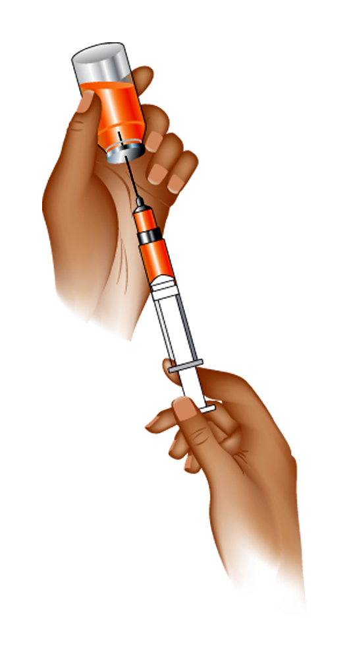
Application of Boyle’s Law
Fig. 7.10
Filling a syringe with a liquid is an application of Boyle’s law.

Slide 15
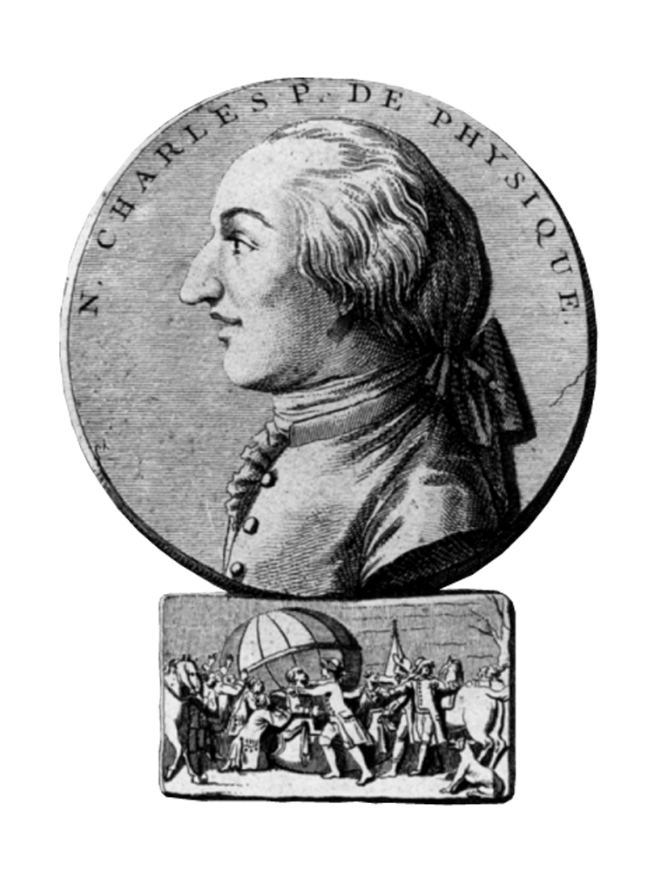
Charles and gas laws
Fig. 7.11
Jacques Charles in the process of working with hot-air balloons made the observations that led to the formulation of what is now known as Charles’s law.
Edgar Fahs Smith Collection, University of Pennsylvania

Slide 16
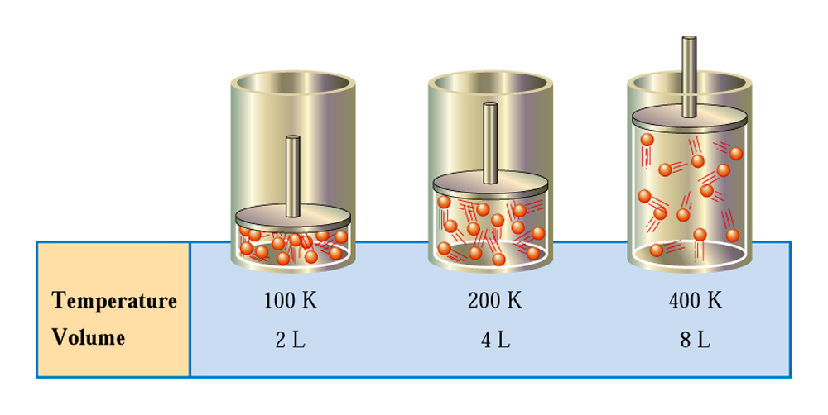
Charles Law
Fig. 7.12
Data illustrating the direct proportionality associated with Charles’s law.

Slide 17
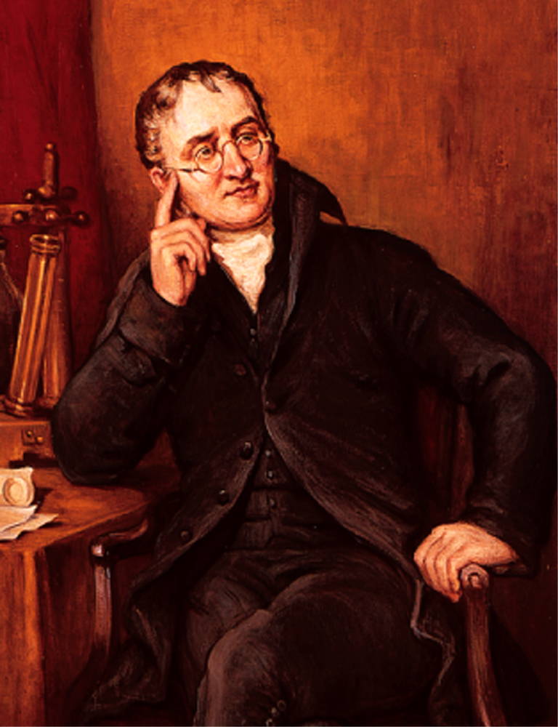
Dalton and the Partial Pressure
Fig. 7.13
John Dalton had an interest in the study of weather.

Slide 18
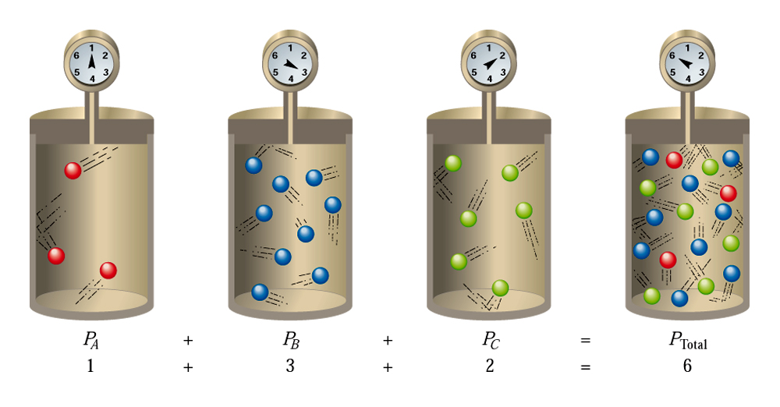
Dalton’s law of partial pressures
Fig. 7.14 A set of four containers can be used to illustrate Dalton’s law of partial pressures. The pressure in the fourth container equals the sum of the first three.

Slide 19
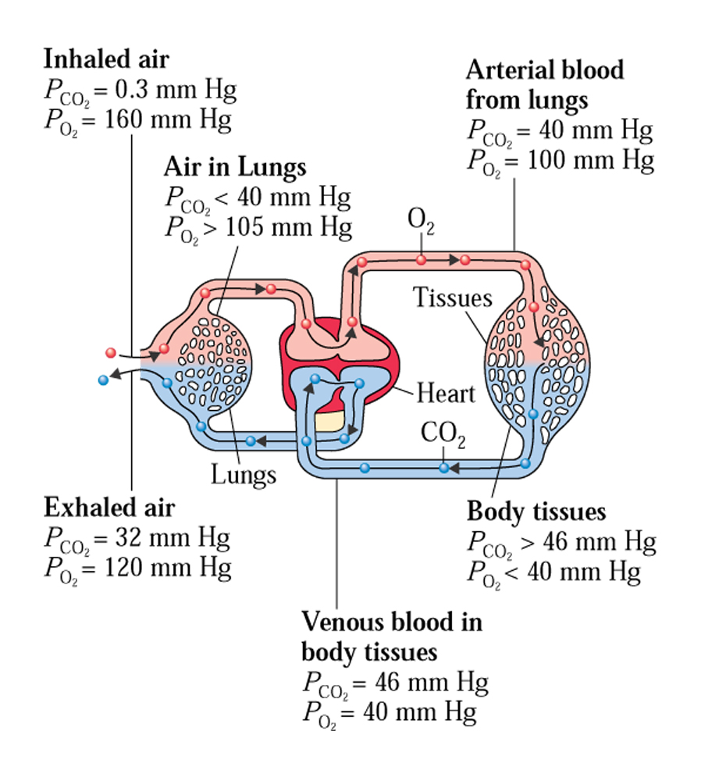
Blood gases and their solubilty
CC 7.2

Slide 20
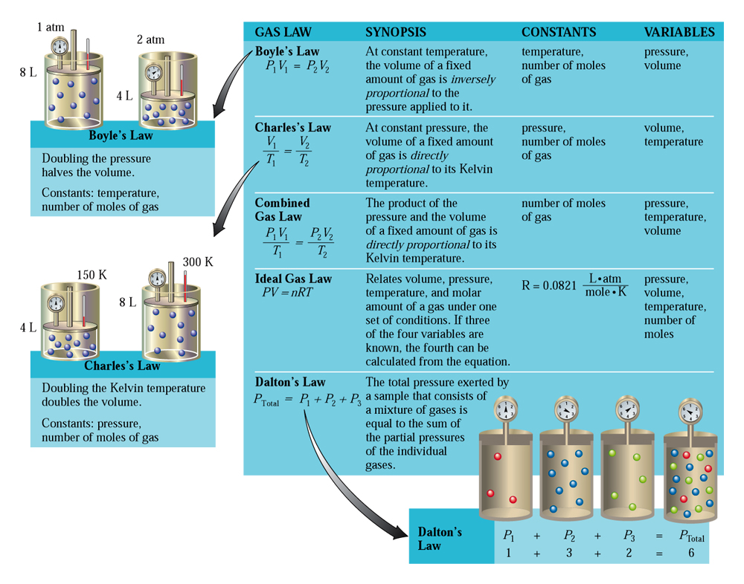
Summary of gas laws
CAG 7.1

Slide 21
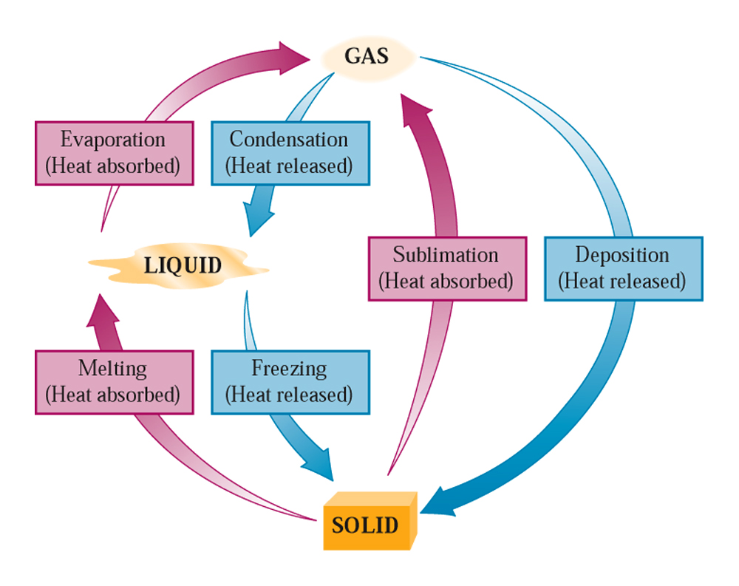
Changes of states
Fig. 7.15
There are six changes of state possible for substances.

Slide 22
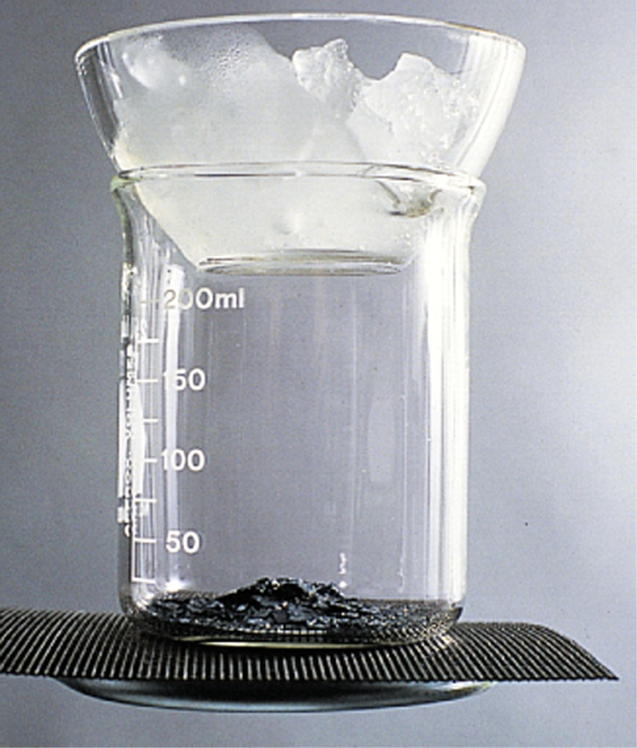
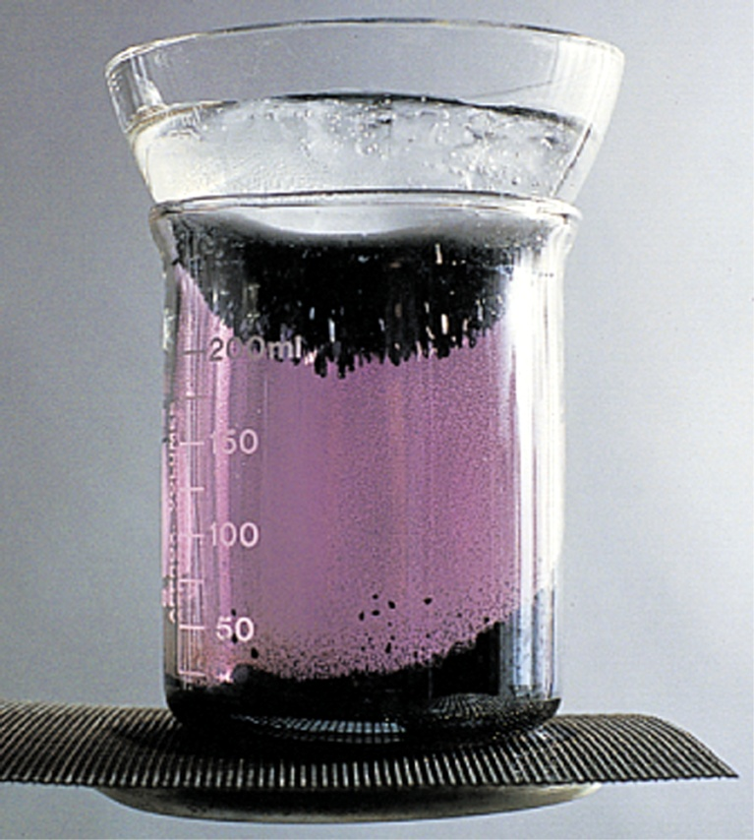
Sublimation of Iodine
The beaker contains iodine crystals.
(b) Iodine has an appreciable vapor pressure even below its melting point.
Fig. 7.15

Slide 23
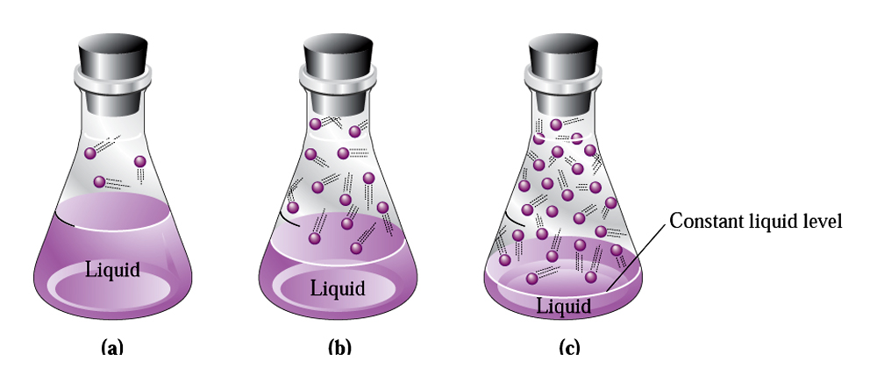
Vapor pressure and equilibrium
Fig. 7.17
(a) the liquid level drops for a time, (b) then becomes constant. At that point a state of equilibrium has been reached in which (c) the rate of evaporation equals the rate of condensations.

Slide 24
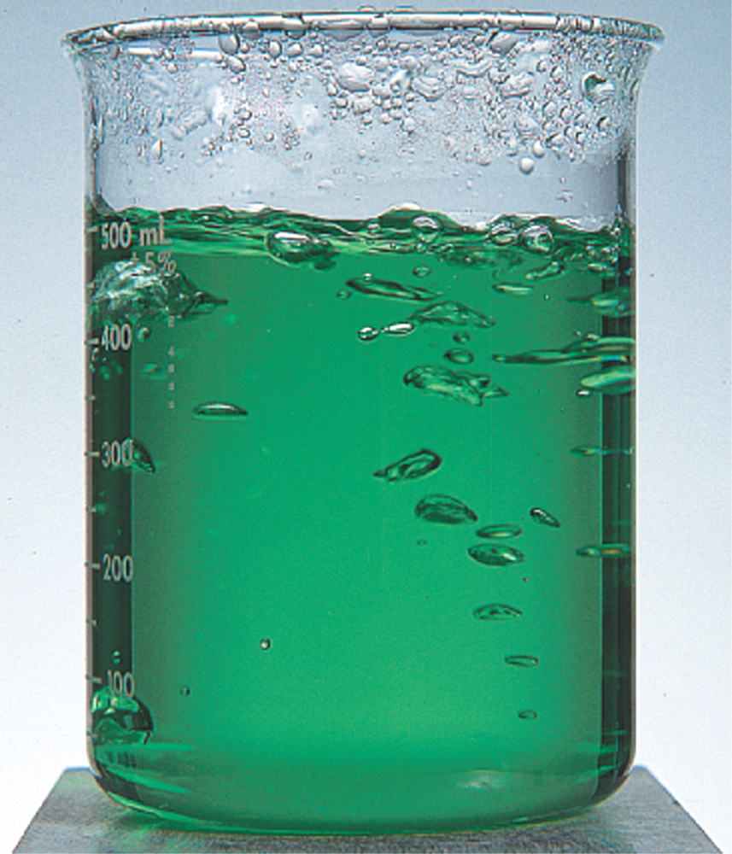
Boiling point of liquids
Fig. 7.18
Bubbles of vapor form within a liquid when the temperature of the liquid reaches the liquid’s boiling point.

Slide 25

How you cook? Low or high pressure
Fig. 7.19
The converse of the pressure cooker “phenomenon” is that food cooks more slowly at reduced pressure.
Brian Bailey/Network Aspen

Slide 26
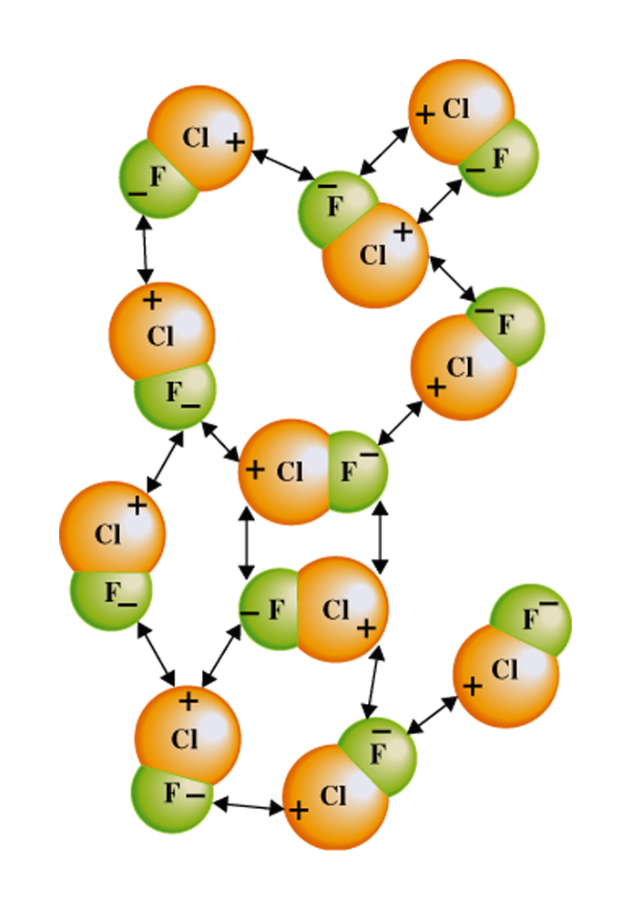
Intermolecular forces: Dipole-dipole
Fig. 7.20
There are many dipole-dipole interactions possible between randomly arranged CIF molecules.

Slide 27
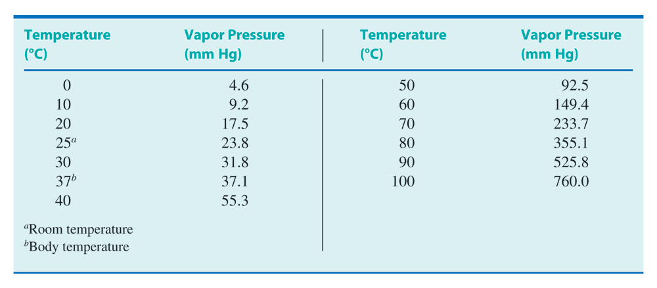
Vapor pressure and the temperature
Table 7.2

Slide 28
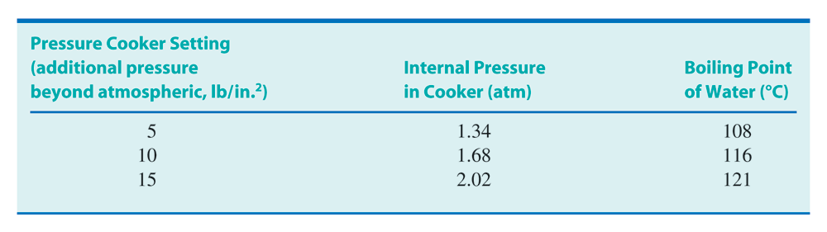
Pressure cooker: how does it work?
Table 7.4

Slide 29
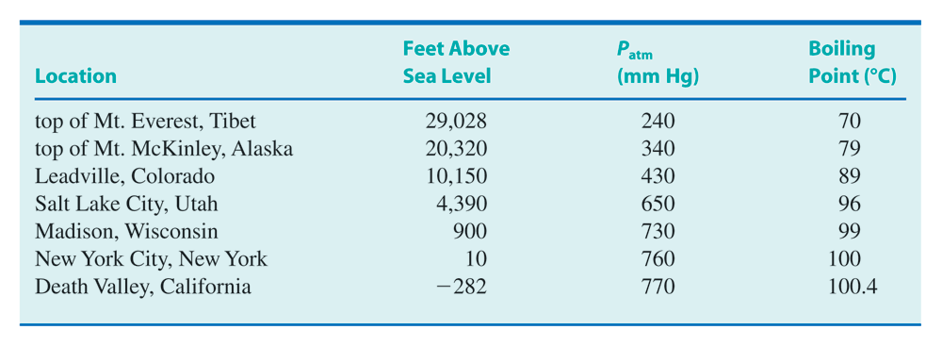
Boiling point and Eelvation
Table 7.3

Slide 30
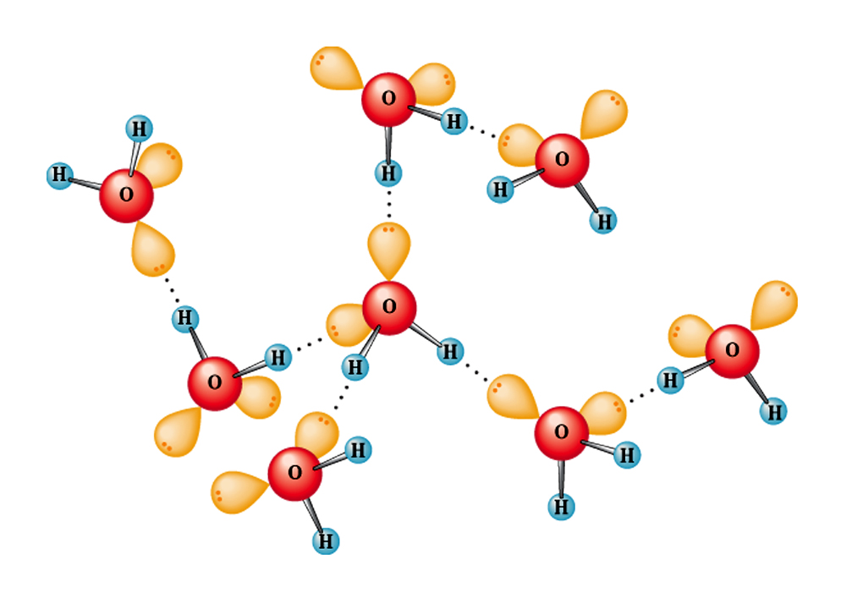
Strongest intermolecular force:
The hydrogen bonding
Fig. 7.21
Depiction of hydrogen bonding among the water molecules.

Slide 31
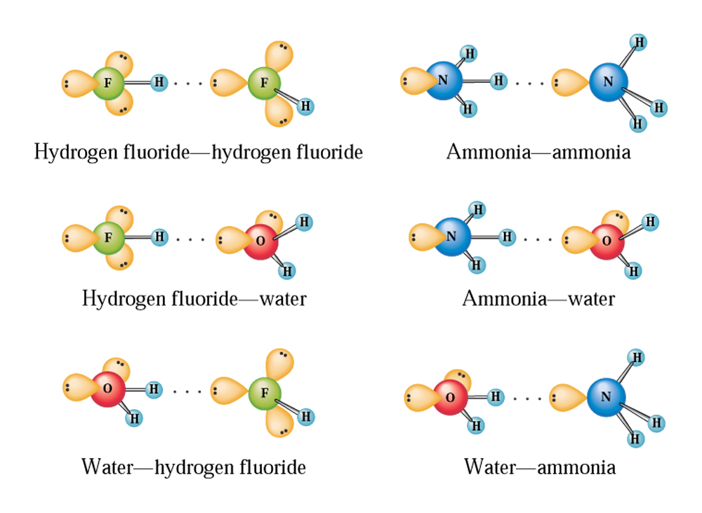
Three types of hydrogen bonding
Fig. 7.22
Diagrams of hydrogen bonding involving selected simple molecules.

Slide 32
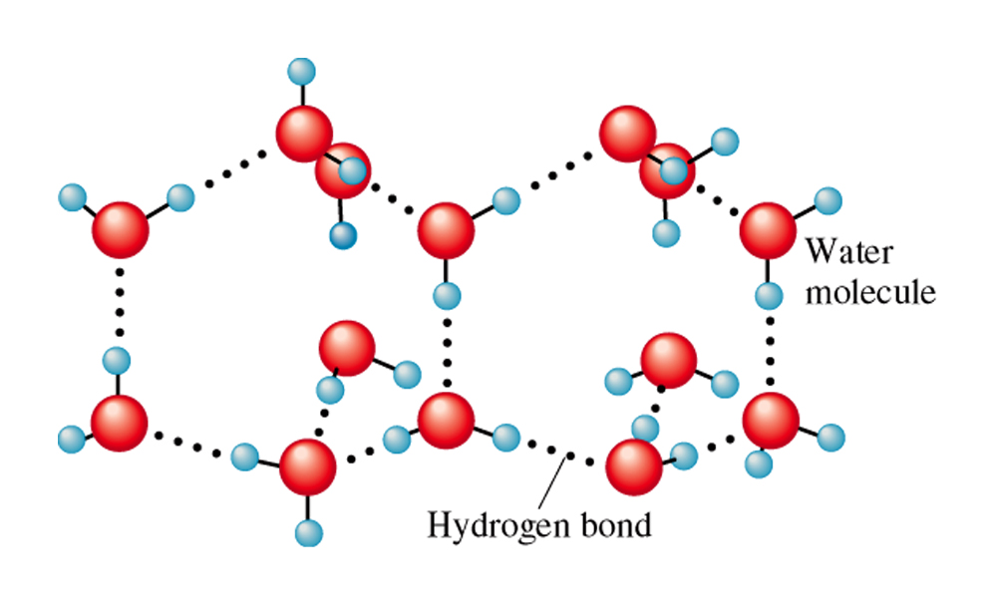
Hydrogen bonding in ice
CC 7.3

Slide 33
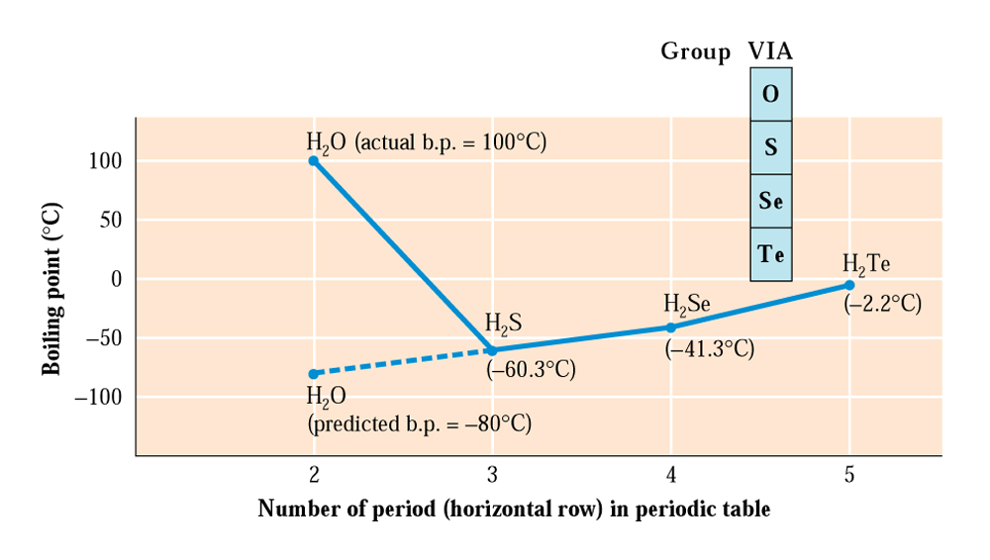
How does hydrogen bonding affect properties
Fig. 7.23
If there were no hydrogen bonding between water molecules, the boiling point of water would be approximately
-80C.

Slide 34
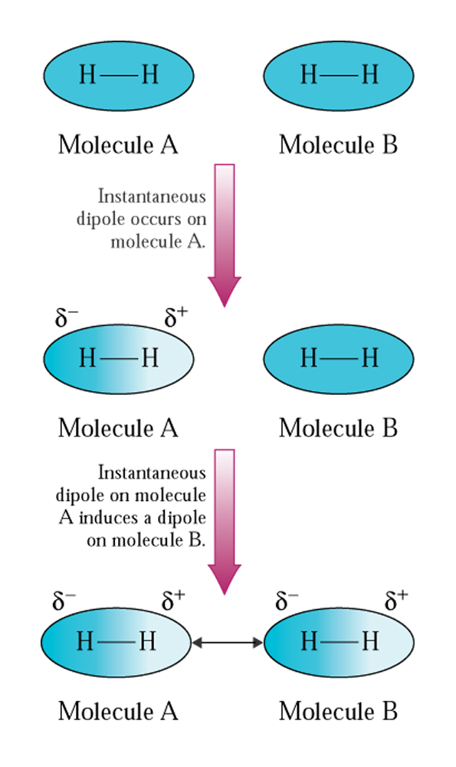
London Dispersion Forces:
Fig. 7.24
Nonpolar molecules can develop instantaneous dipoles and induced dipoles.

Slide 35
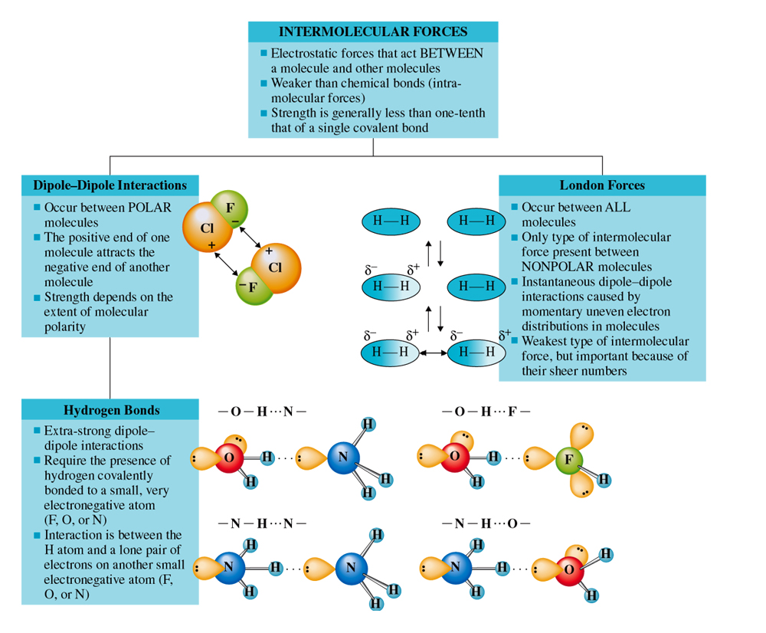
Summary of intermolecular forces
CAG 7.2

