Slide 1
Chapter 6
Calculations:
Formula Masses, Moles, and Chemical Equations

Slide 2
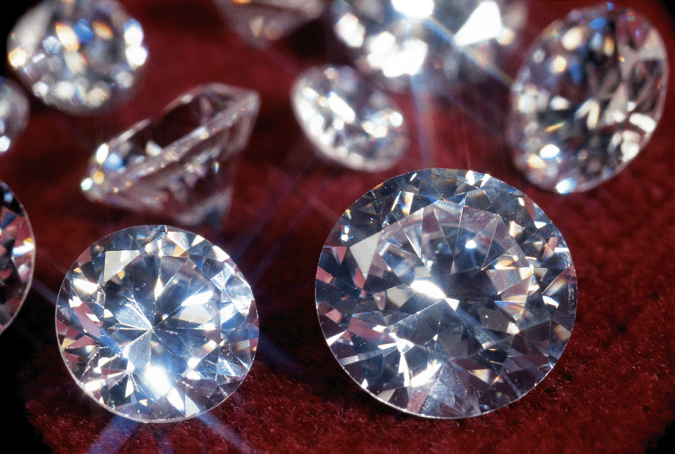
Diamond is a covalent compound with many carbon atoms
CO 6.1
Close-up of cut diamonds
© Foto Kormann/zefa/Corbis

Slide 3
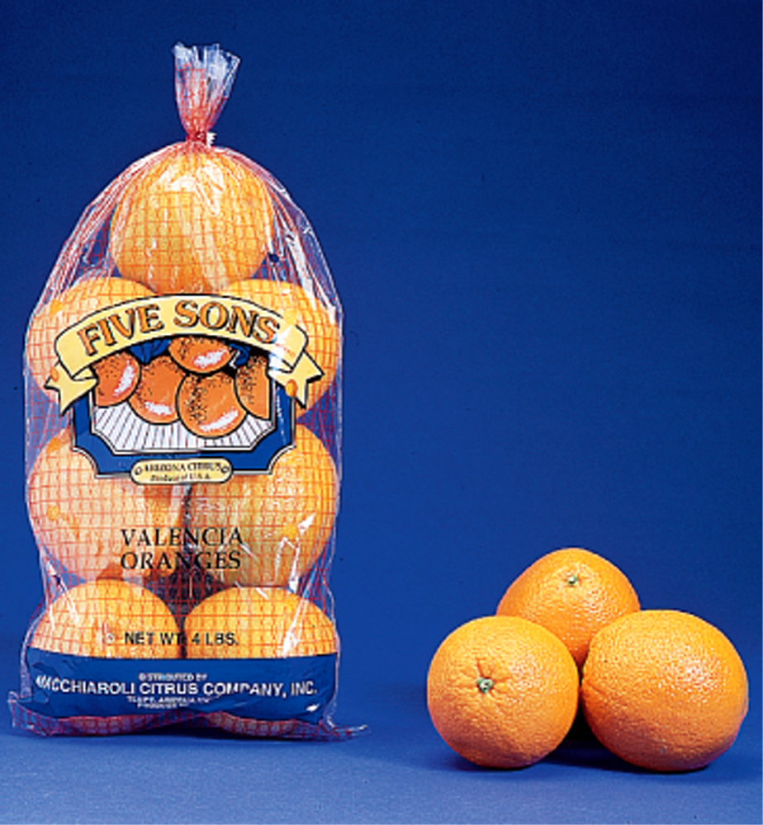
Molar mass: The mass units
Fig. 6.1
Oranges may be bought in units of mass or units of amount.

Slide 4
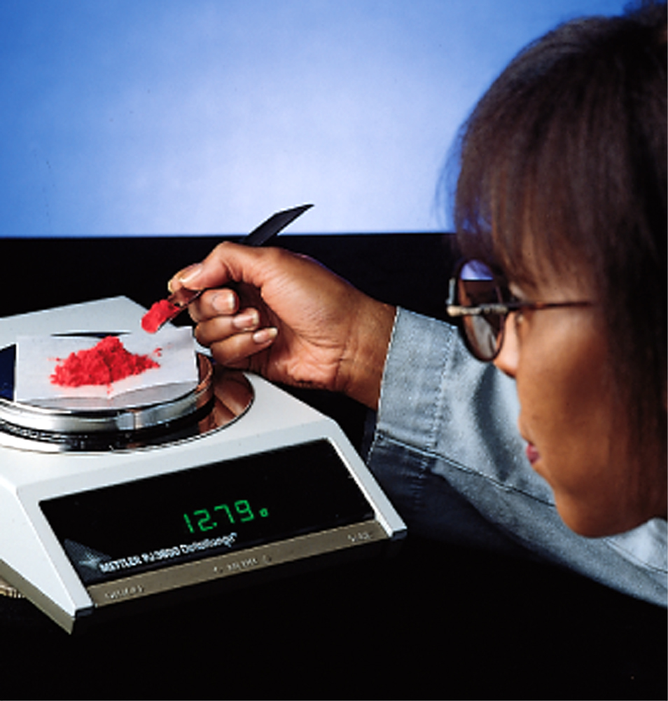
First chemical compound need to be weighed
Fig. 6.2
A basic process in chemical laboratory work is determining the mass of a substance.

Slide 5
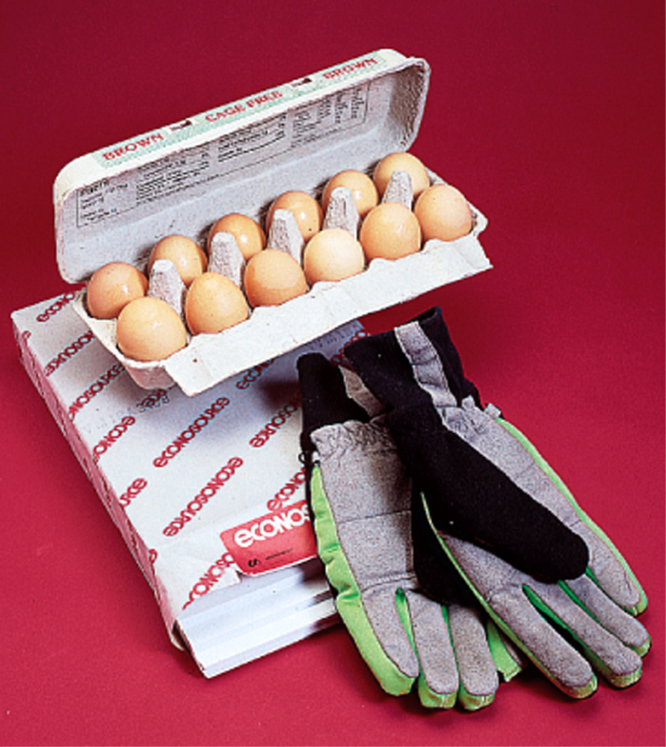
Mole is a counting unit used by chemists
Fig. 6.3
Everyday counting units.

Slide 6
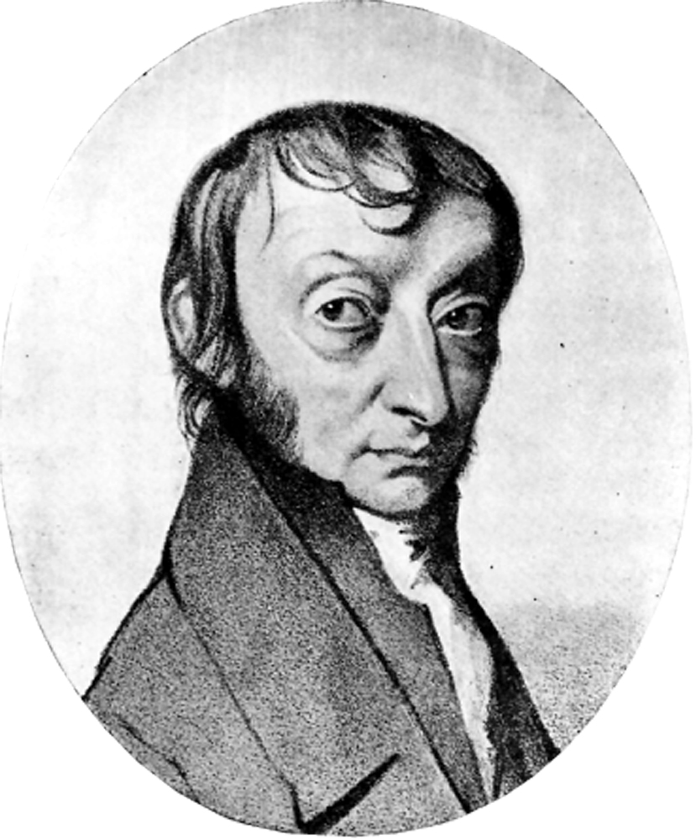
Unlike a dozen Avogadro’s number is large: 6.0022 x 10²³
Fig. 6.4
Amadeo Avogadro was the first scientist to distinguish between atoms and molecules.
Edgar Fahs Smith Collection, University of Pennsylvania

Slide 7
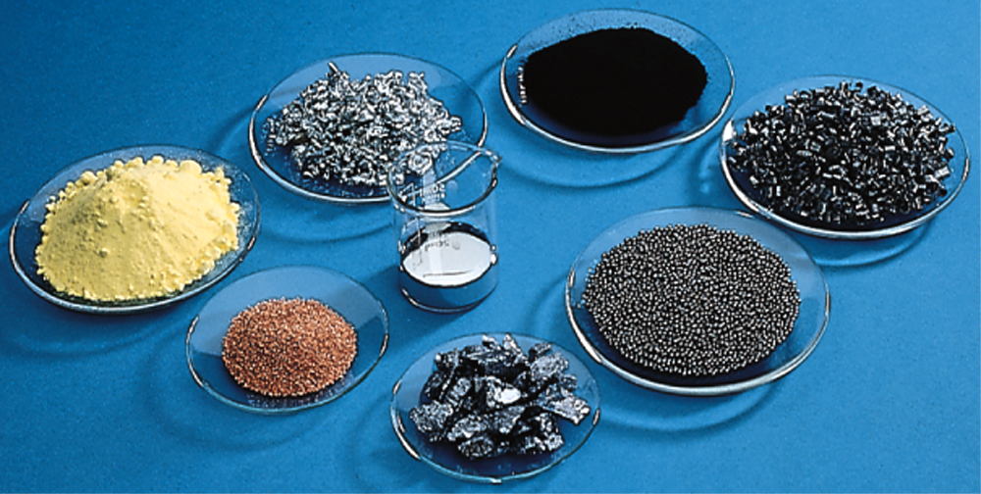
Formula Masses in grams gives a Mole of a chemical compound
Fig. 6.5
The mass of a mole depends on the substance.

Slide 8
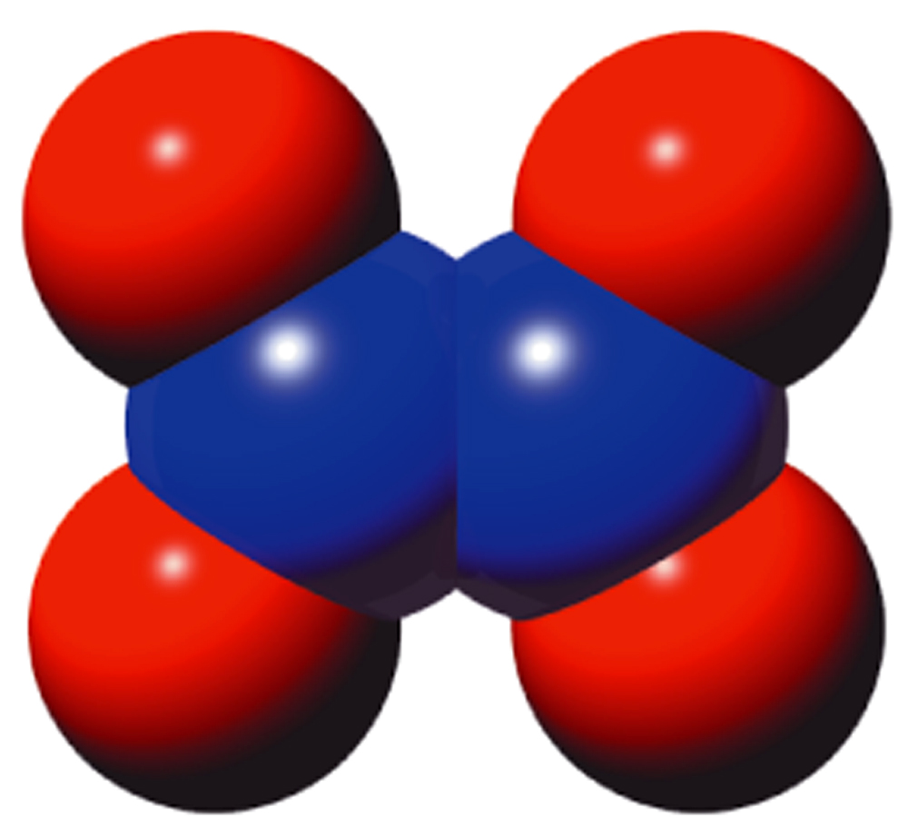
To get the Formula Masse first find the types of atoms in the compound
Fig. 6.6
A computer-generated model of the molecular compound N₂O₄.

Slide 9
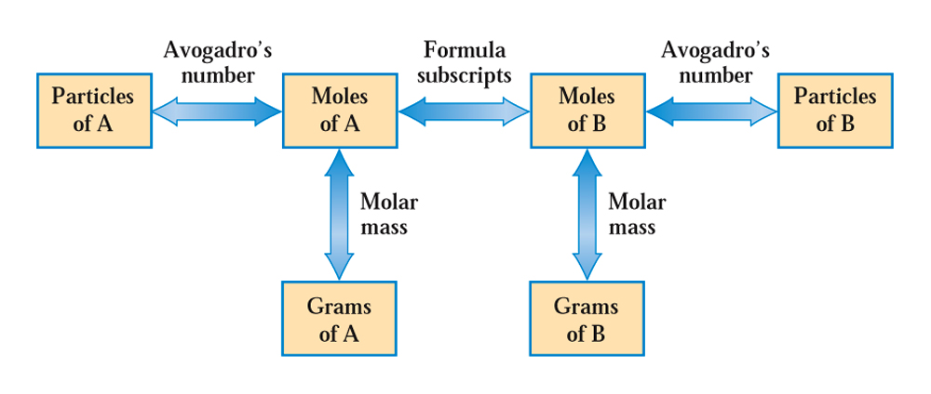
Moles multiplied by Avogadro's number gives number of atoms and molecules
Fig. 6.7
In solving chemical-formula-based problems, the only “transitions” allowed are those between quantities (boxes) connected by arrows.

Slide 10
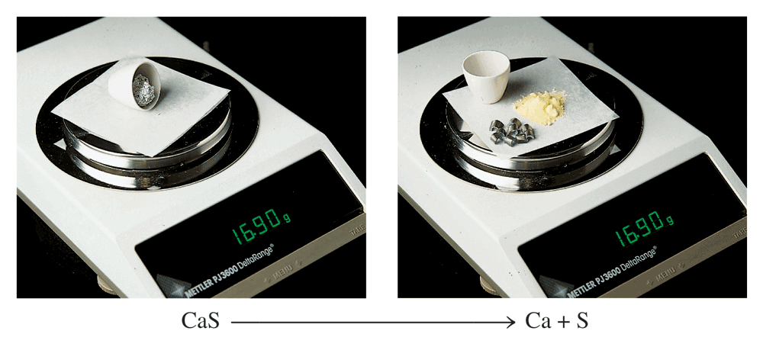
Law of conservation of mass/atoms
Fig. 6.8
When 16.90g of the compound CaS is decomposed into its constituent elements, the Ca and S produced has an identical mass of 16.90g.

Slide 11
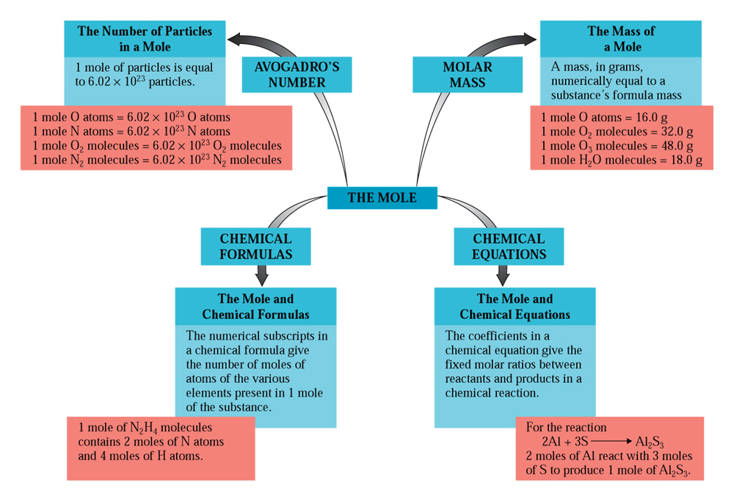
Conversion factors in chemical calculations: Stoichiometry
CAG 6.1

Slide 12
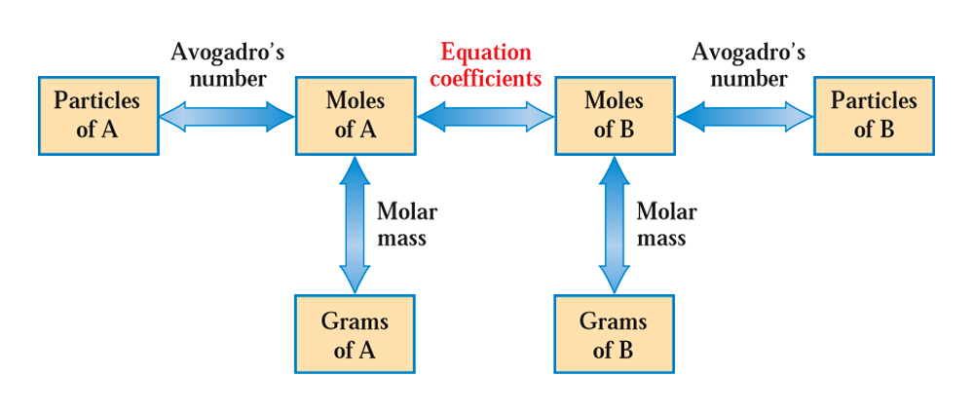
Mole conversion to grams and particles
Moles multiplied by Avogadro's number gives number of atoms and molecules( mole x N = particles)
Mole multiplied formula mass gives grams. ( mole x F.M. = grams)
Grams divided by formula mass gives moles. ( grams  F.M. = mole)
Fig. 6.9 In solving chemical-equation-based problems, the only “transitions” allowed are those between quantities (boxes) connected by arrows.

Slide 13
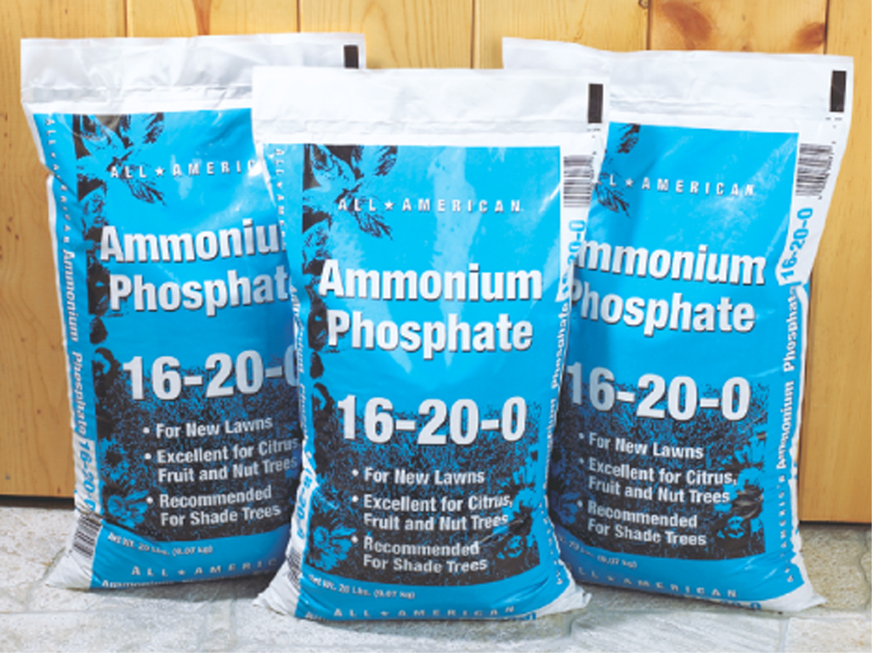
What does 16-20-0 means in fertilizer?
NITROGEN 16.0% PHOSPHATE 20.0%
CC 6.1

Slide 14
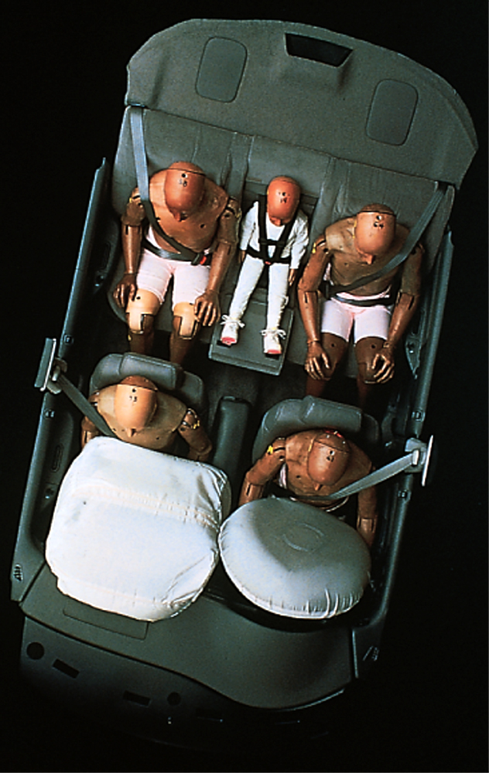
Air bag should have right amount reactants to produce gas or baby will crush.
Fig. 6.10
Testing apparatus for measuring the effects of air bag deployment.
Courtesy of Daimler Chrysler Corporation

