Slide 1
Chapter 5
Chemical Bonding: The Covalent Bond Model

Slide 2

What’s the fuel in space shuttle?
CO 5.1
Space Shuttle liftoff
NASA

Slide 3
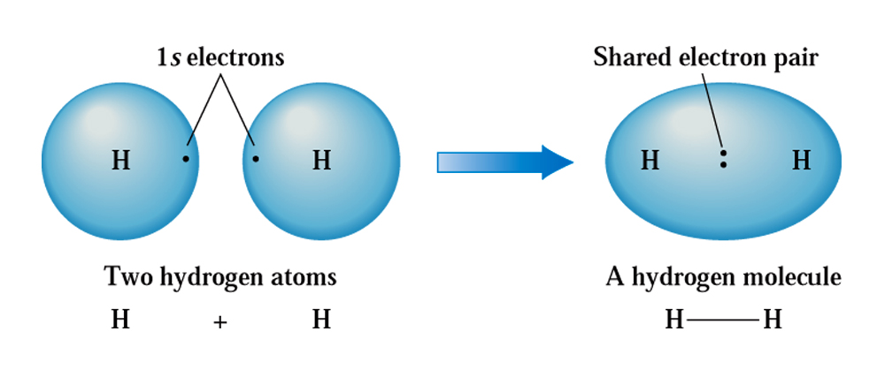
Hydrogen molecule: A covalent bond
Fig. 5.1
Electron sharing can occur only when electron orbitals from two different atoms overlap.

Slide 4
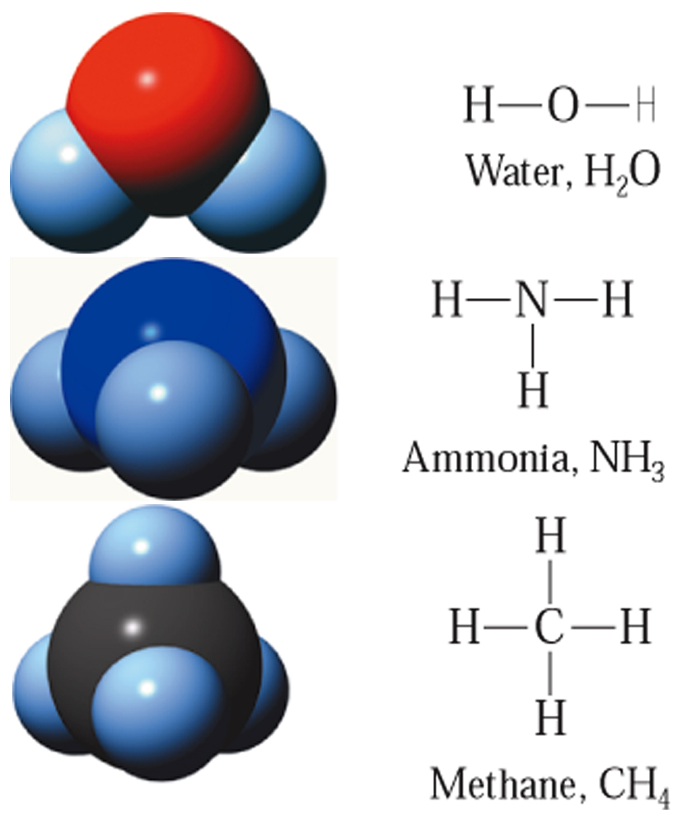
Number of covalent bonds and Lewis symbol
Fig. 5.2
The number of covalent bonds formed by a nonmetallic element is directly correlated with the number of electrons it must share in order to obtain an octet of electrons.

Slide 5
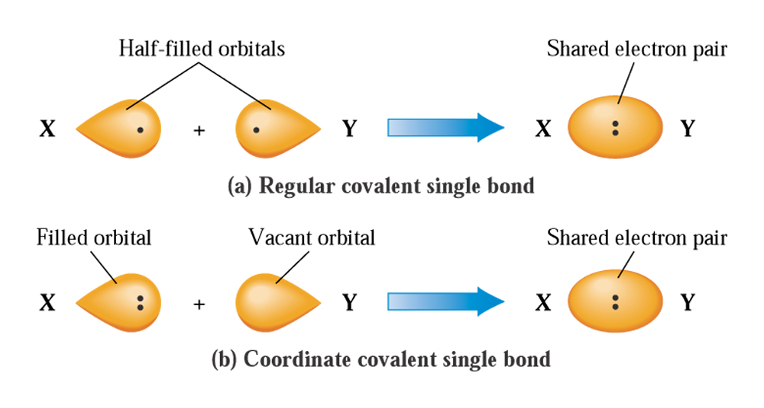
Covalent and Coordinate covalent Bond
Fig. 5.3 (a) A “regular” covalent single bond is the result of overlap of two half-filled orbitals. (b) A coordinate covalent single bond is the result of overlap of a filled and a vacant orbital.

Slide 6
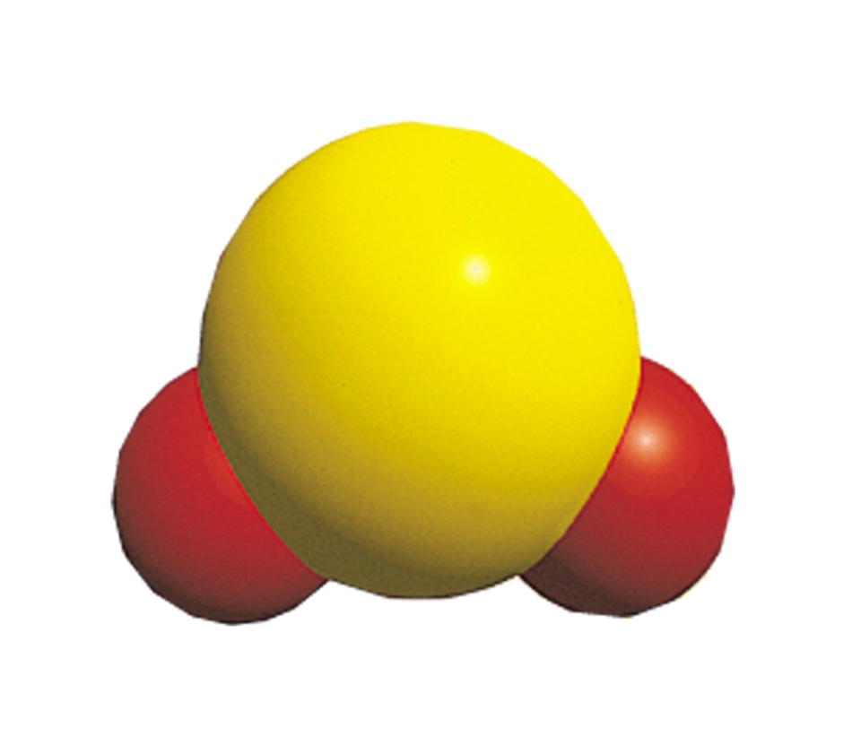
Molecular structure
Fig. 5.4
The sulfur dioxide molecule.

Slide 7
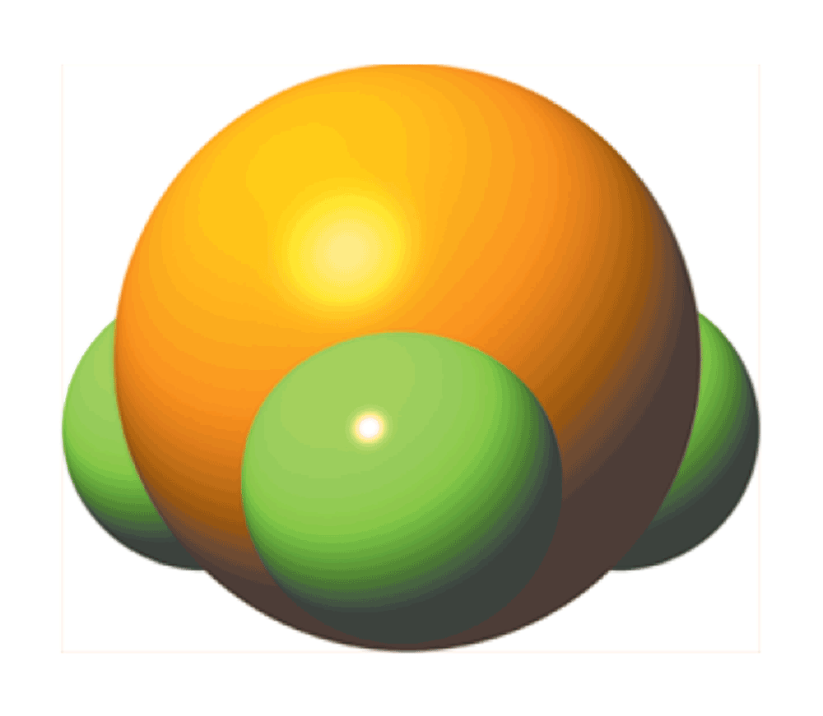
Pyramidal molecule
Fig. 5.5
The phosphorus trifluoride molecule.

Slide 8
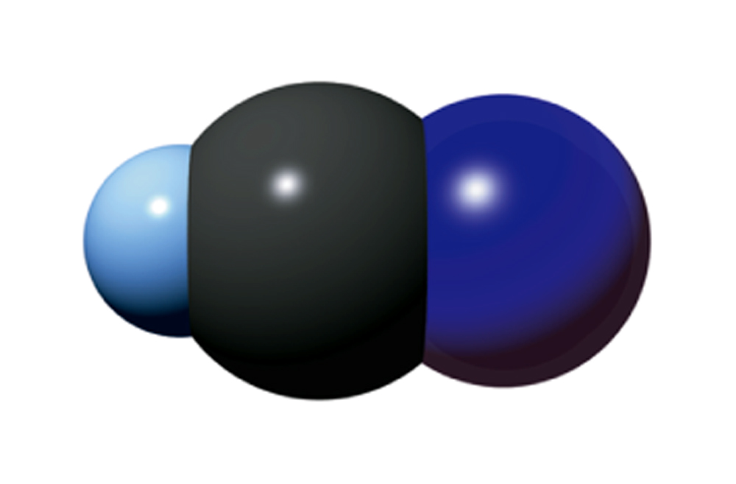
Linear Molecule
Fig. 5.6
The hydrogen cyanide molecule.

Slide 9
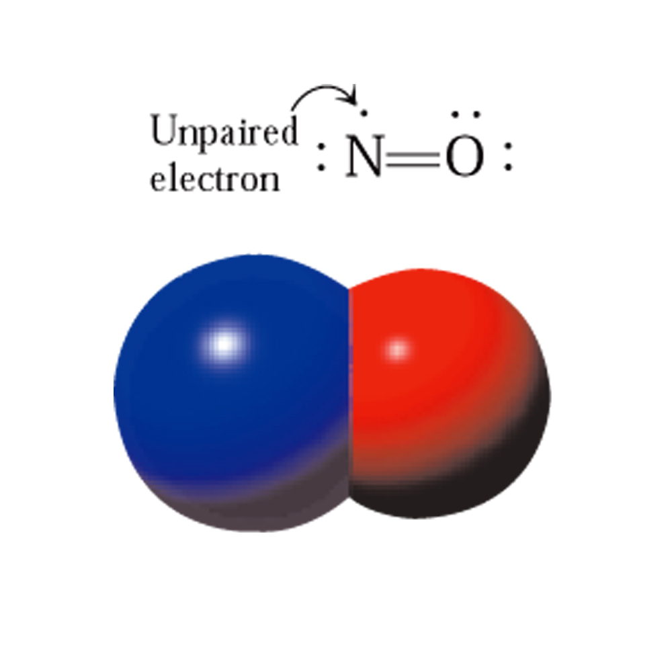
Unpaired electrons
CC 5.1

Slide 10
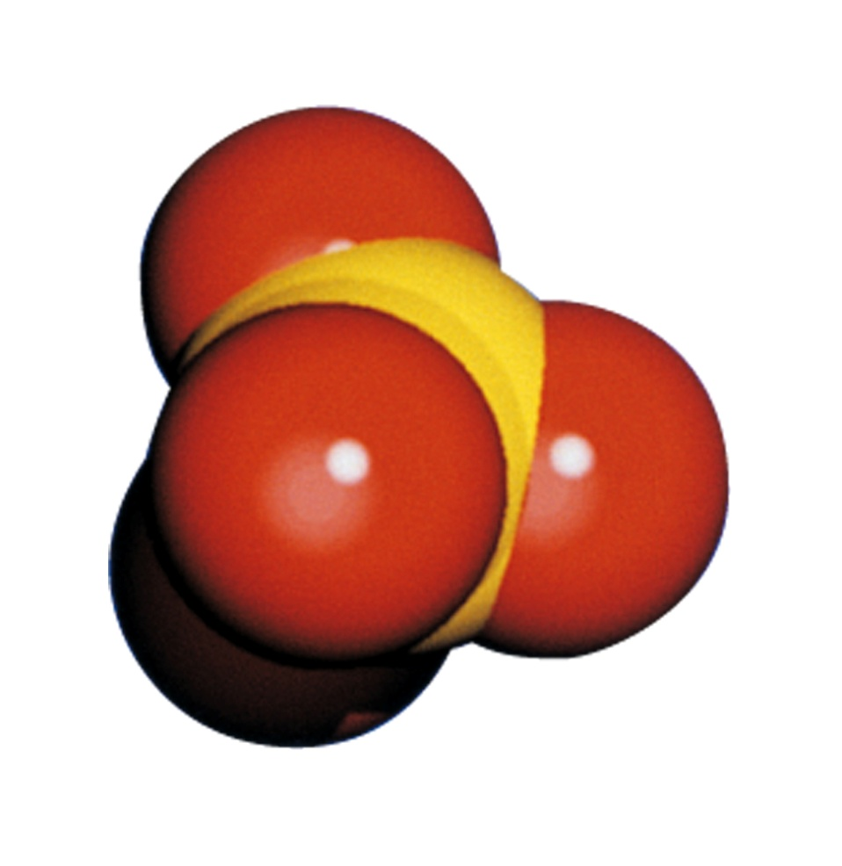
Polyatomic ions held by covalent bonds
Fig. 5.7
The sulfate ion.

Slide 11
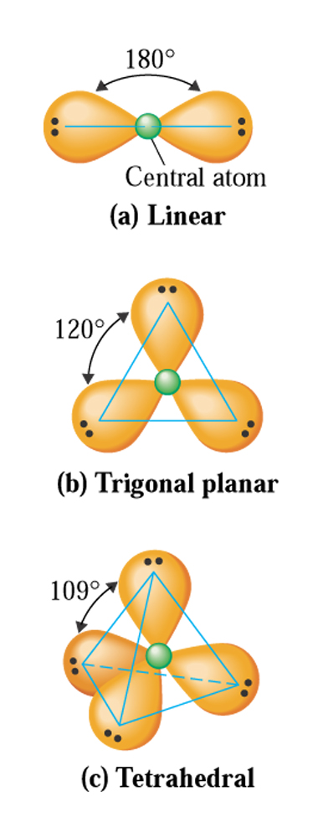
Electron pair repulsions
Fig. 5.8
Arrangement of valence electron pairs about a central atom that minimize repulsions between the pairs.

Slide 12

Where you find covalent molecules?
CC 5.2

Slide 13
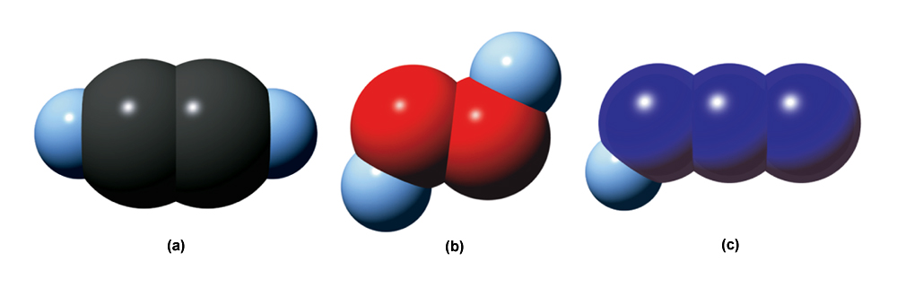
Space filling models
Fig. 5.9
(a) Acetylene molecule. (b) Hydrogen peroxide molecule. (c) Hydrogen azidde molecule.

Slide 14
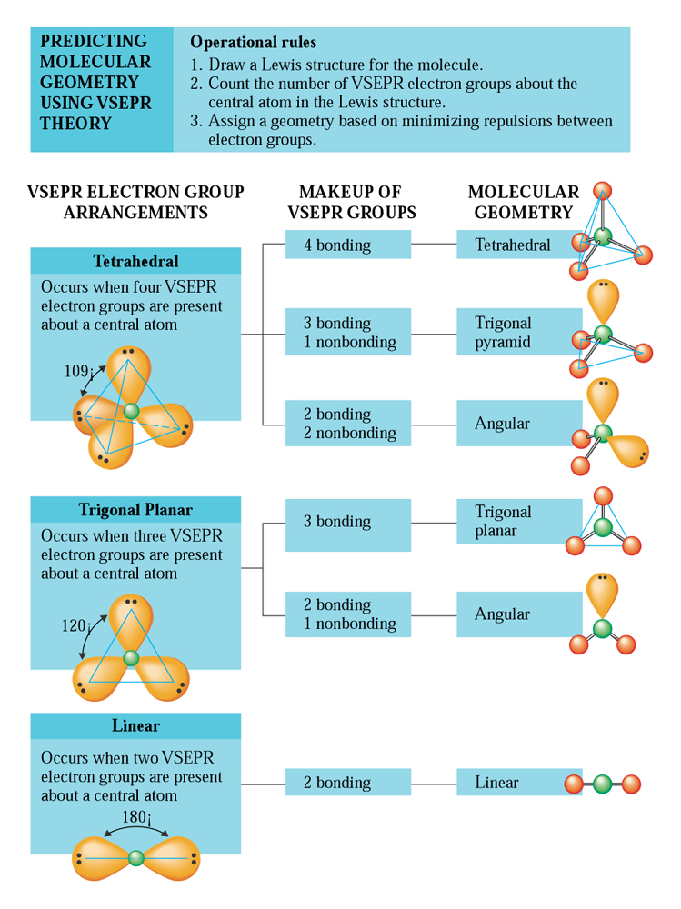
VSEPR theory and molecular geometry

Slide 15
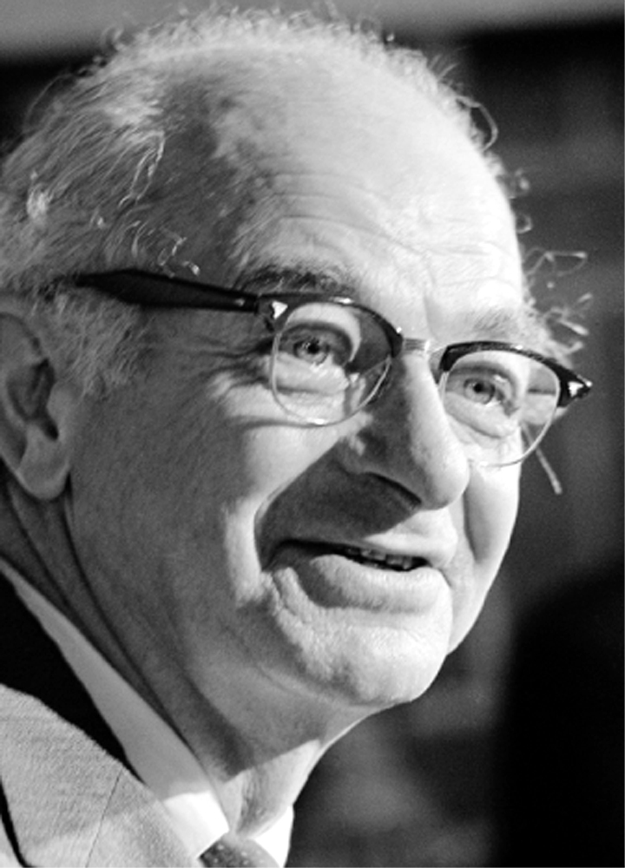
Linus Pauling and Electronegativity
Fig. 5.10
Linus Pauling received the Nobel Prize in chemistry in 1954 for his work on the nature of the chemical bond.
© Bettman/CORBIS

Slide 16
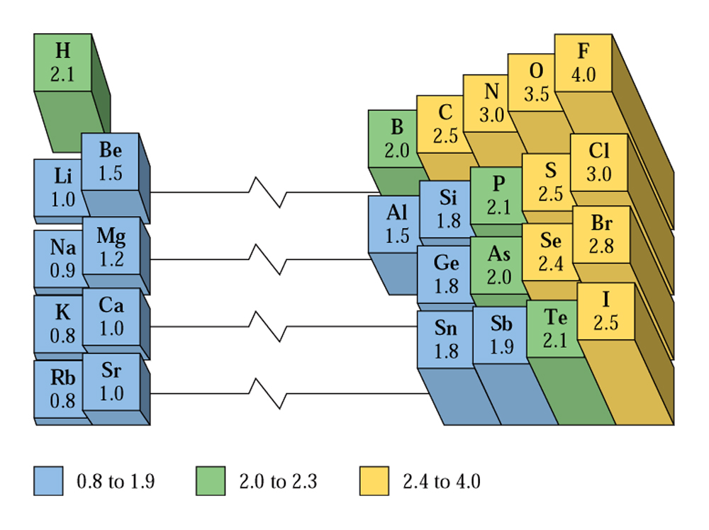
Electronegativity Trends
Fig. 5.11
Abbreviated periodic table showing Pauling electronegativity values for selected representative elements.

Slide 17
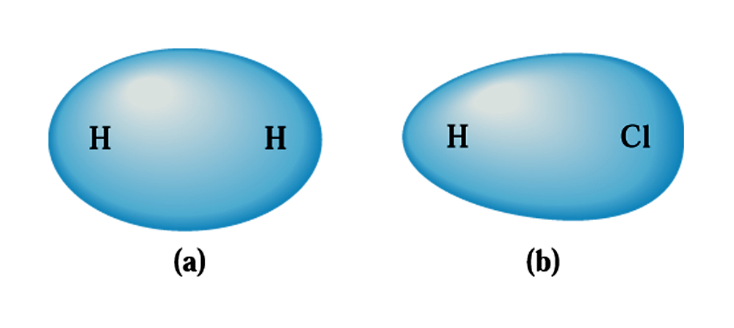
Polarity in heteonuclear diatomic molecules
Fig. 5.12
(a) In the nonpolar covalent bond present, there is a symmetrical distribution of electron density. (b) In the polar covalent bond present, electron density is displaced because of its electronegativity.

Slide 18
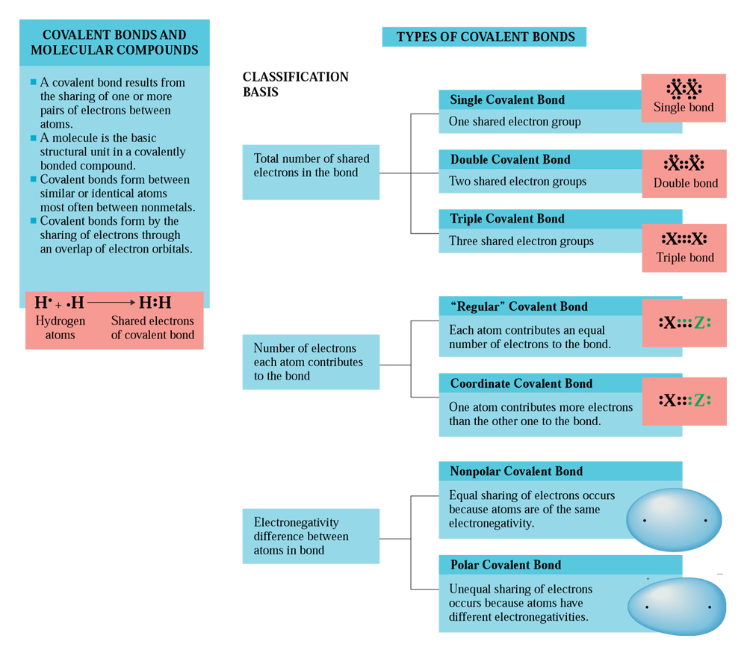
Types of covalent bond
CAG 5.2

Slide 19
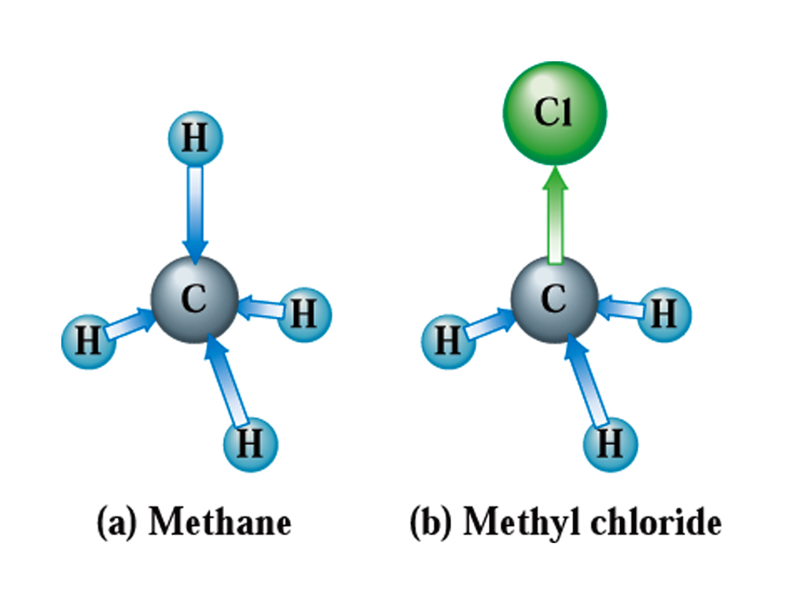
Predicting polarity of molecule
Fig. 5.13
(a) Methane is a nonpolar tetrahedral molecule. (b) Methyl chloride is a polar tetrahedral molecule.

Slide 20
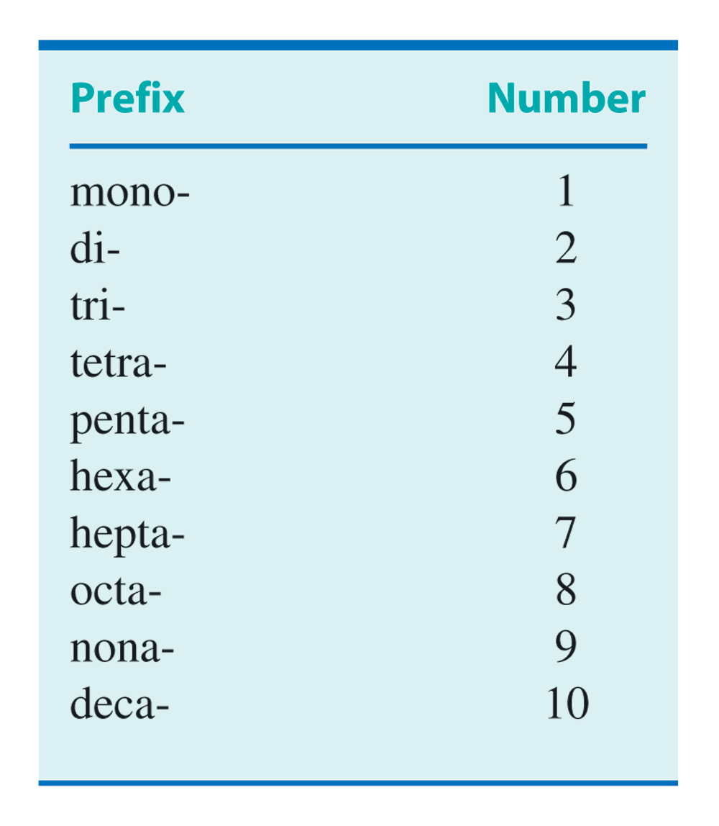
Prefixes for naming covalent compounds
Table 5.1

Slide 21
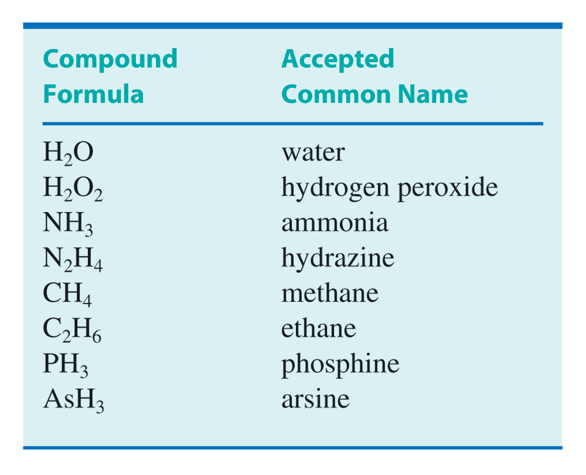
Common names of covalent compunds
Table 5.2

Slide 22
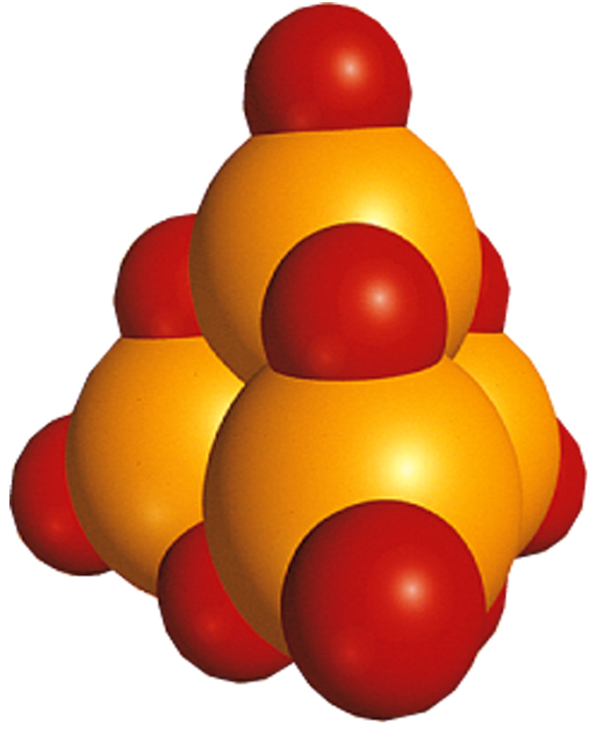
Naming covalent compounds
Fig. 5.14
The tetraphosphorous decoxide molecule.

