Slide 1
Chapter 3
Atomic Structure and the Periodic Table

Slide 2
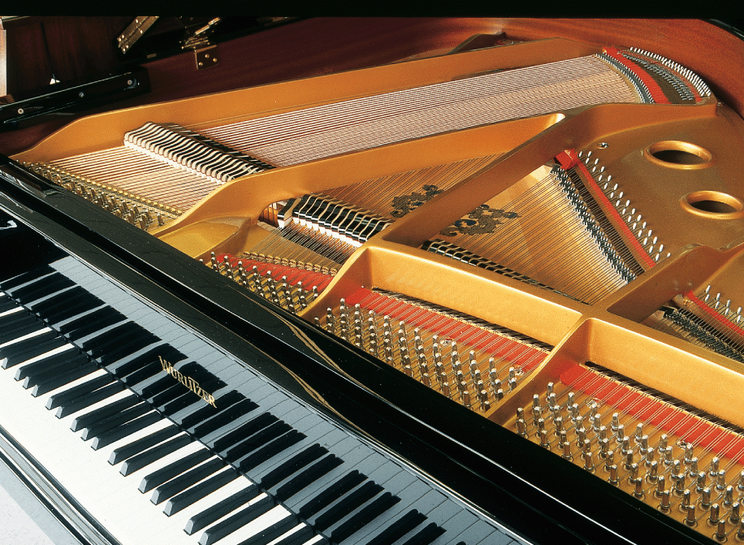
Periodicity of Element Properties
Music consists of a series of tones that build octave after octave. Similarly, elements have properties that recur period after period.
Novastock/PhotoEdit

Slide 3
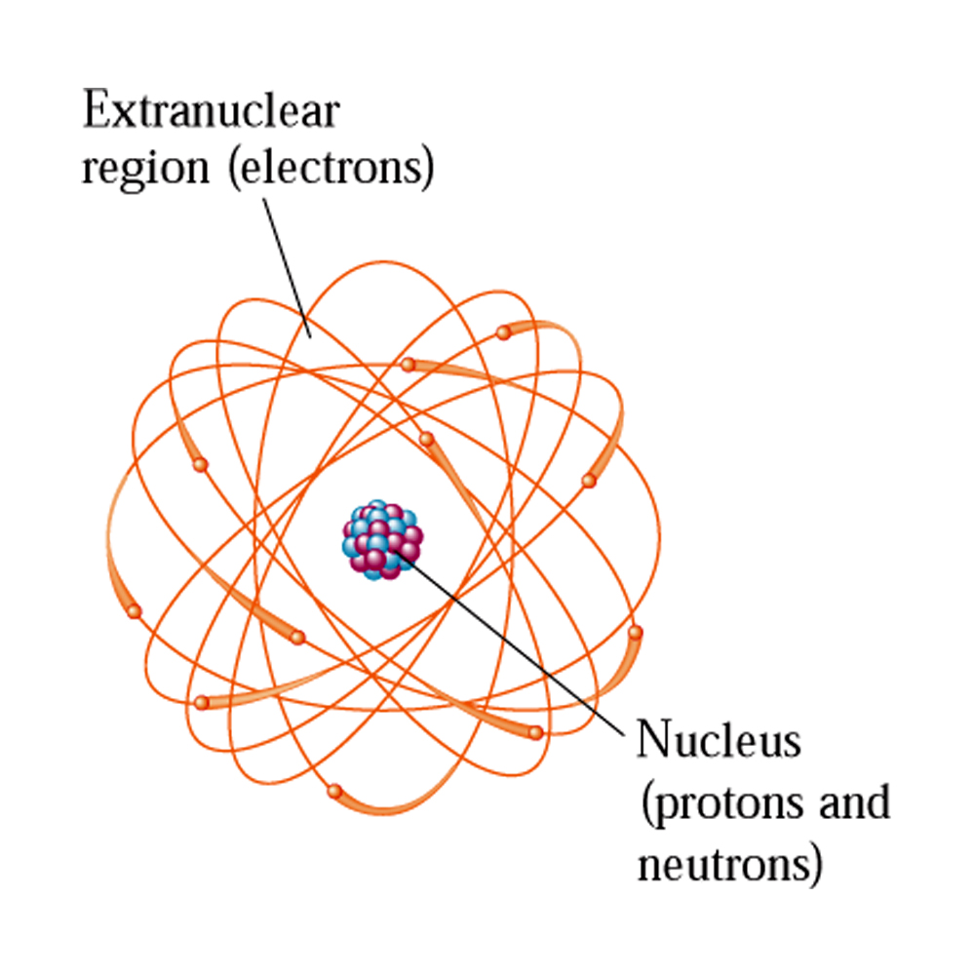
Nuclear Atom
The protons and neutrons of an atom are found in the central nuclear region, or nucleus, and the electrons are found in an electron cloud outside the nucleus.

Slide 4
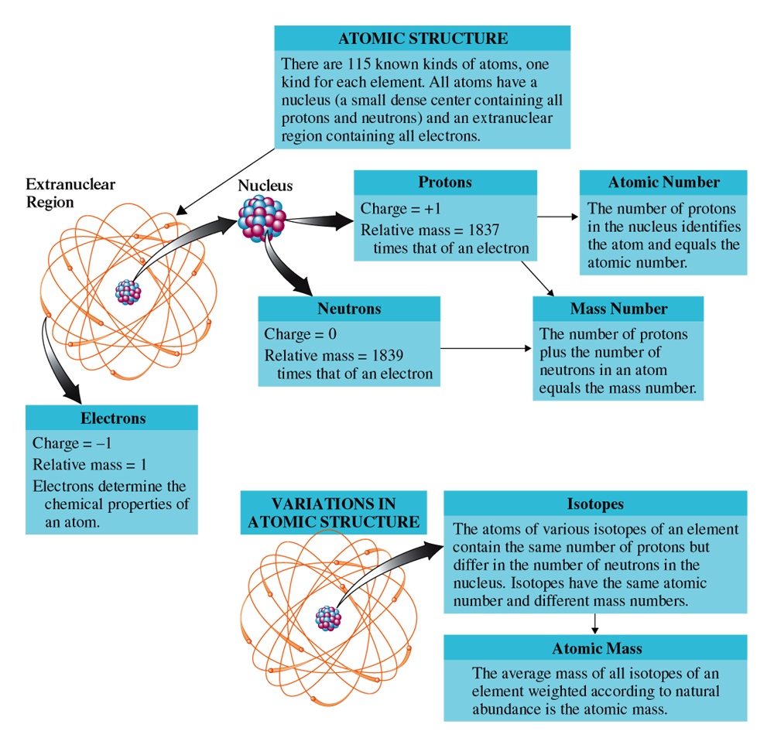
Atomic and the Subatomic Particles

Slide 5
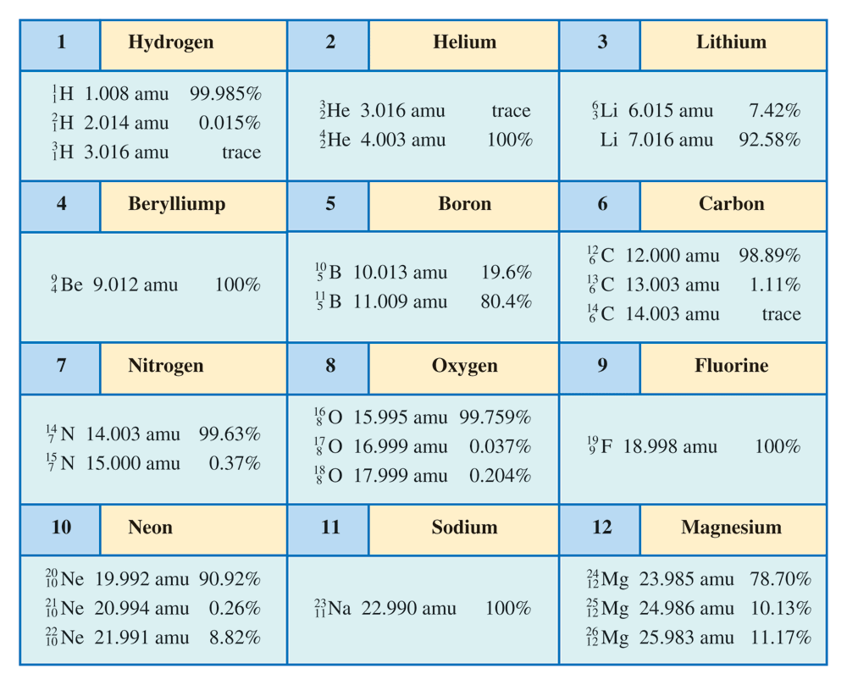
Isotopes and their Abundances

Slide 6
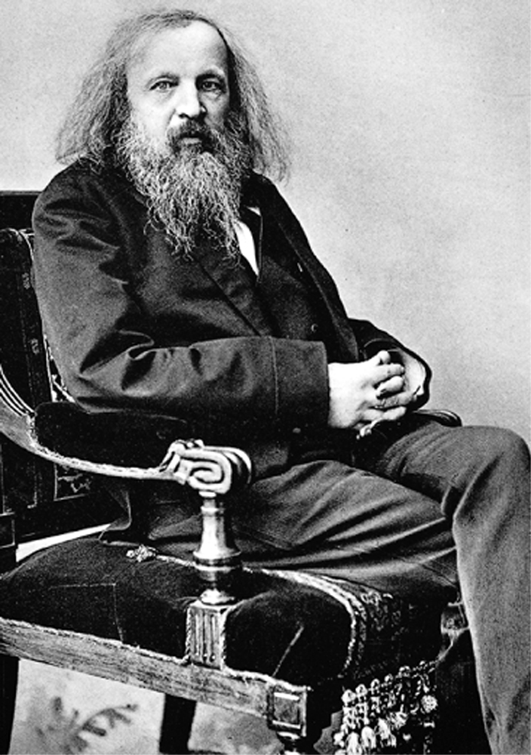
Mendeleev the Founder of Periodic Table
Mendeleev constructed a periodic table as part of his effort to systemize chemistry.
Edgar Fahs Smith Collection, University of Pennsylvania Library

Slide 7
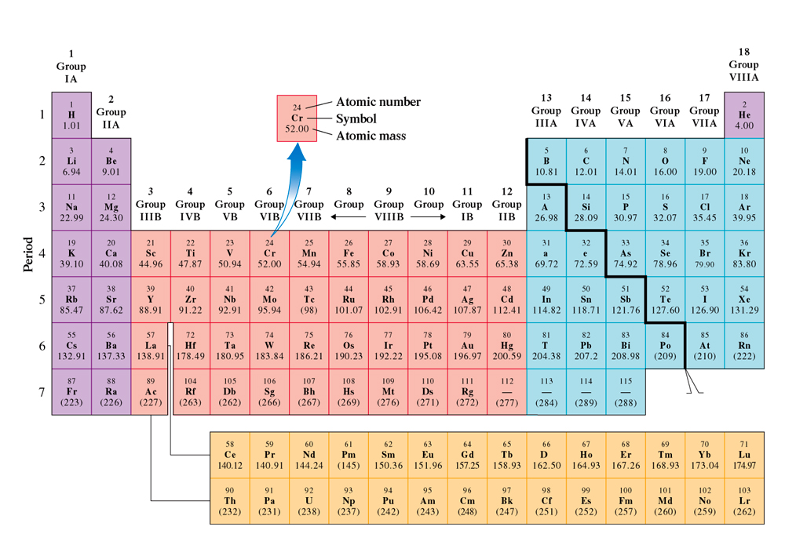
Modern Periodic Table
The periodic table of the elements is a graphical way to show relationships among the elements.

Slide 8
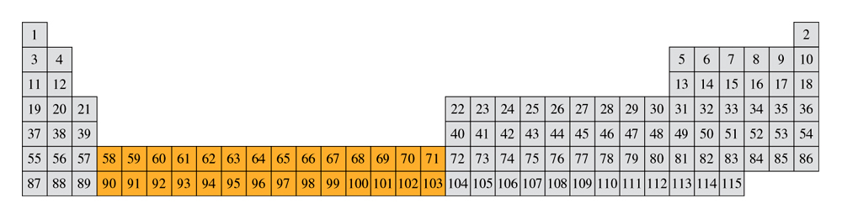
Very Long form of Periodic table
In this periodic table, elements 58 through 71 and 90 through 103 are shown in their proper positions.

Slide 9
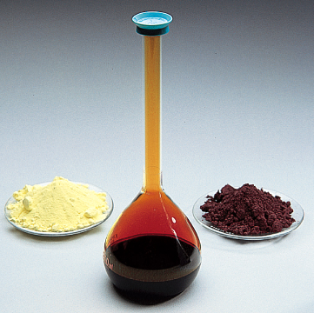
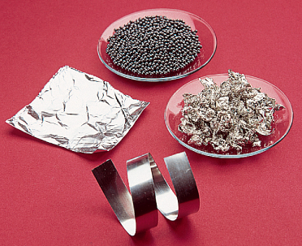
Metals and Non-metals
Some familiar metals are aluminum, lead, tin, and zinc.
(b) Some familiar nonmetals are sulfur, phosphorus, and bromine.

Slide 10
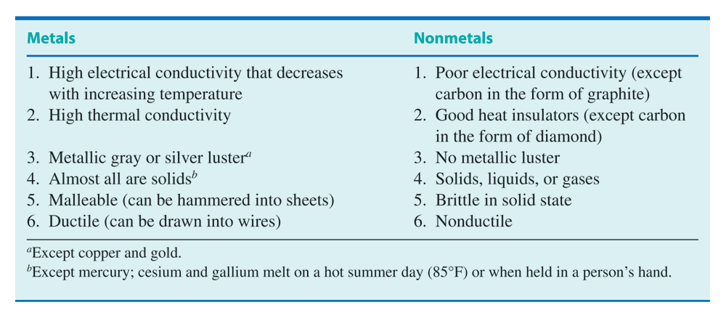
Differences between Metals/Non-metals

Slide 11
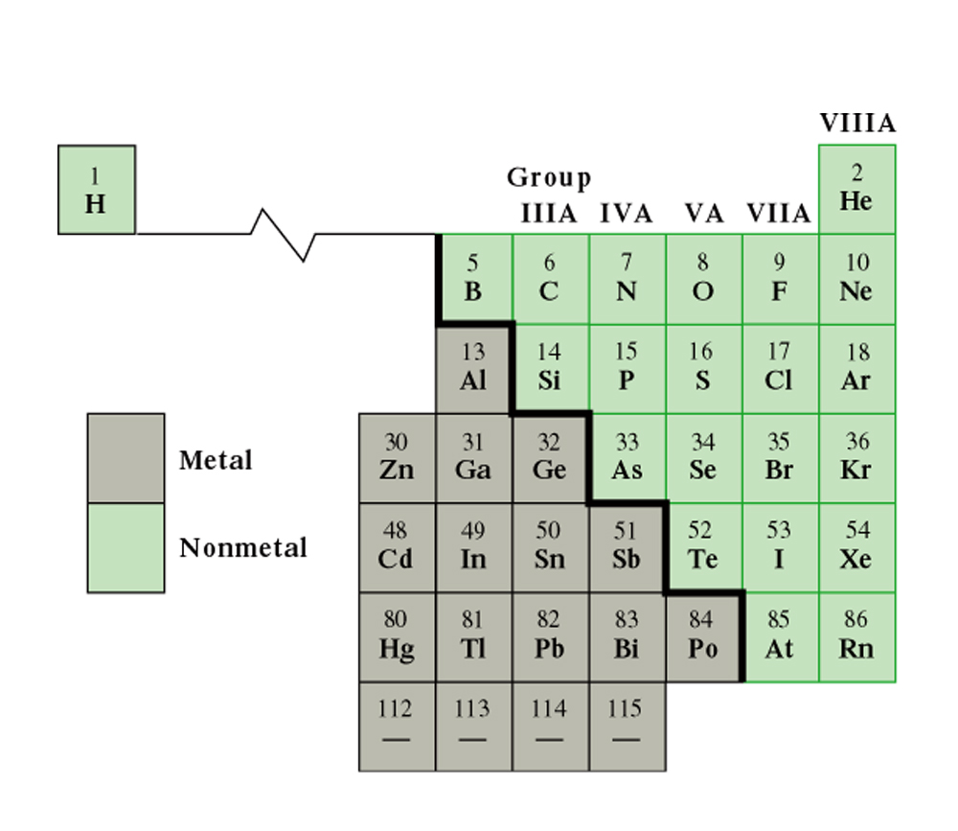
Boarder Line between Metals
This portion of the periodic table shows the dividing line between metals and nonmetals.

Slide 12
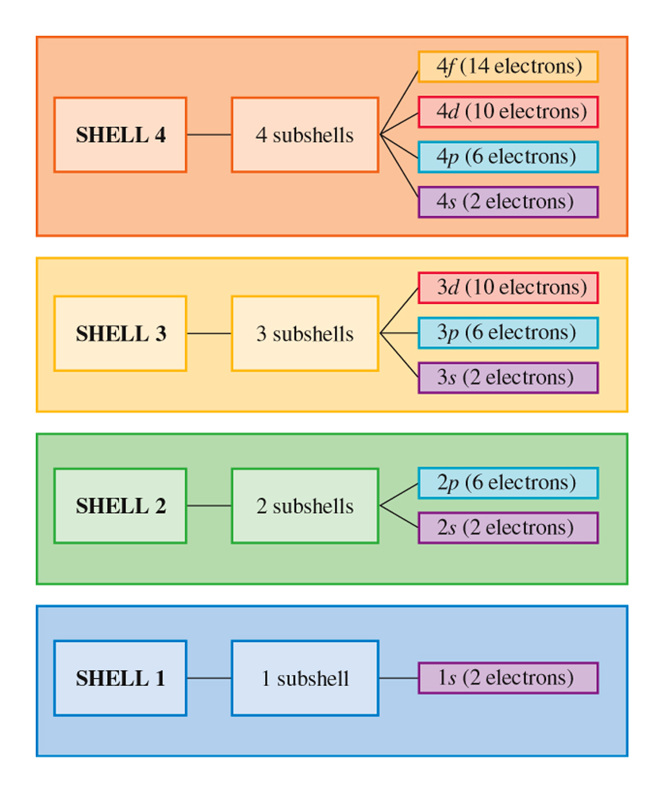
Electronic Shells sn Sub-shells
The number of subshells within a shell is equal to the shell number.

Slide 13
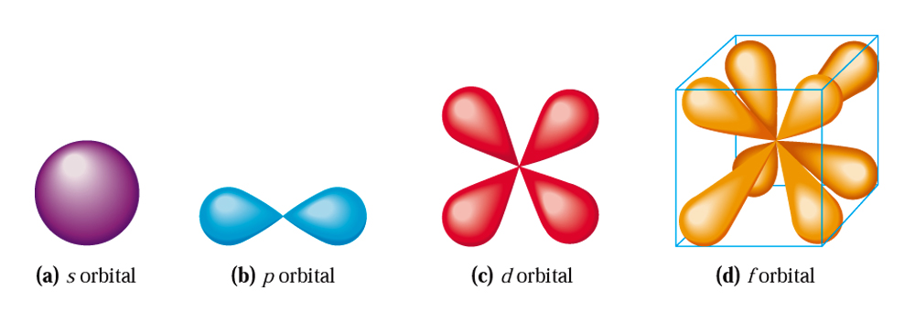
Atomic Orbitals in a Sub-Shell
An s orbital has spherical shape; a p orbital has two lobes; a d orbital has four lobes; and an f orbital has eight lobes.

Slide 14
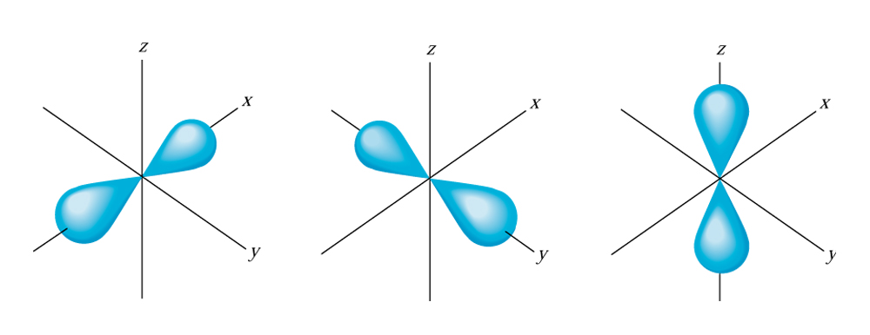
p- atomic Orbitals and their Orientation in Space
Orbitals within a subshell differ mainly in orientation.

Slide 15
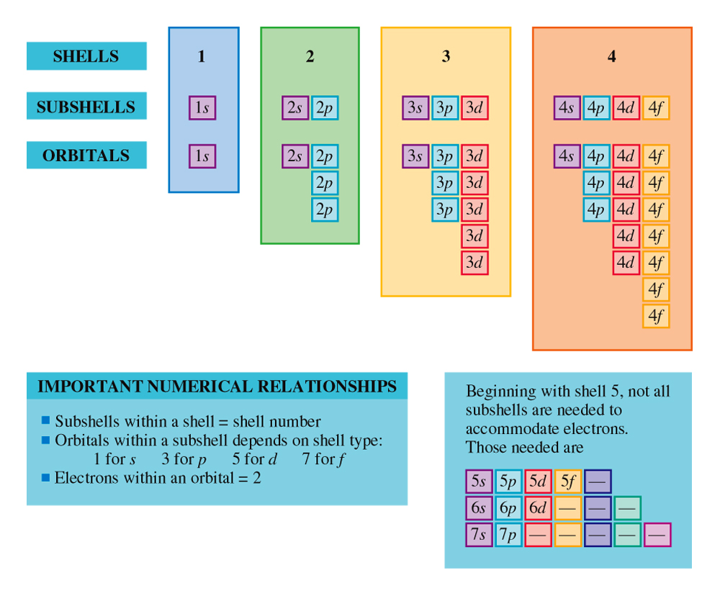
Shell, Sub-shell and Orbital Arrangement

Slide 16
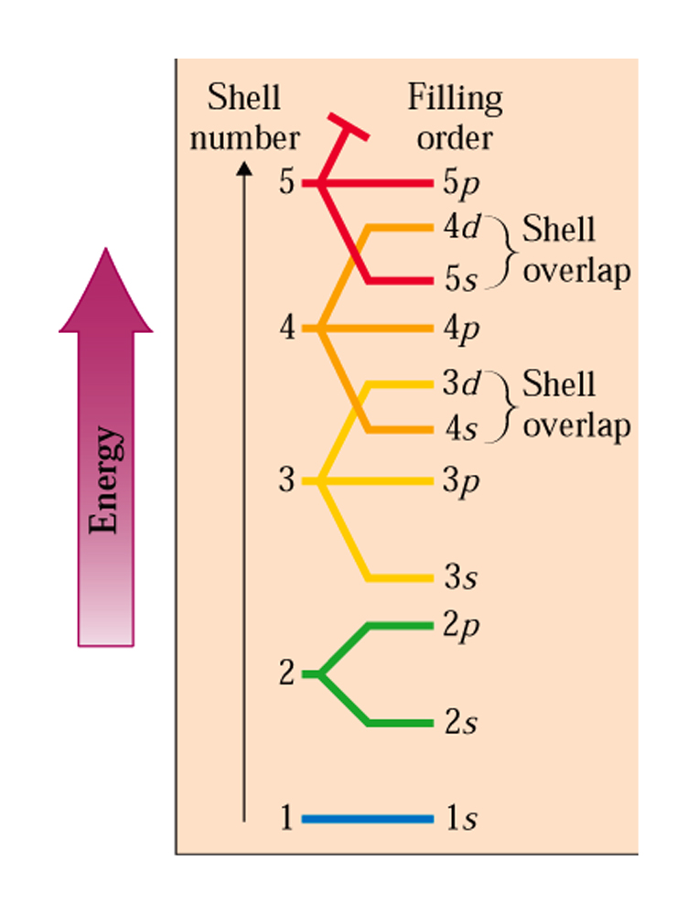
The Order of Filling of Various Atomic Subs-hells
The order of filling various electron subshells. Subshells of different shells “overlap.”

Slide 17
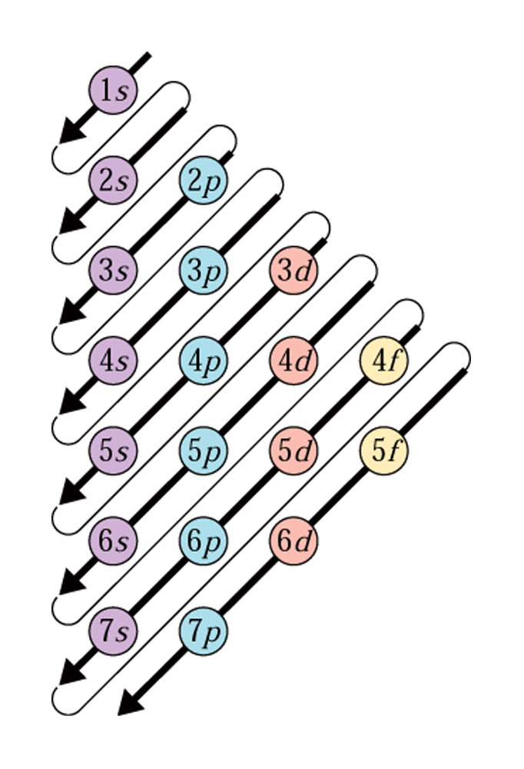
Filling Order of Atomic Orbitals
The order of filling various electron subshells with electrons follows the same order given by the arrows in this diagram.

Slide 18

Color comes from Electron Jumps
The different colors of fireworks result when heat excites the electrons of different kinds of metal atoms.
William S. Helsel/Getty Images

Slide 19
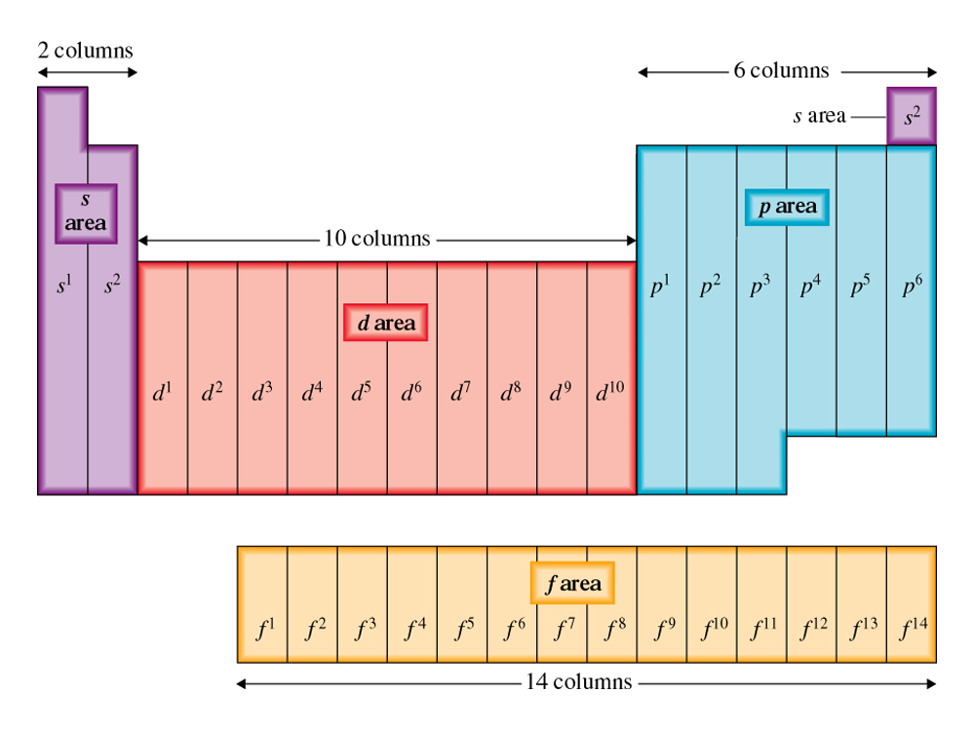
Orbital Blocks of the Periodic Table
Electron configuration and the positions of the elements in the periodic table.

Slide 20
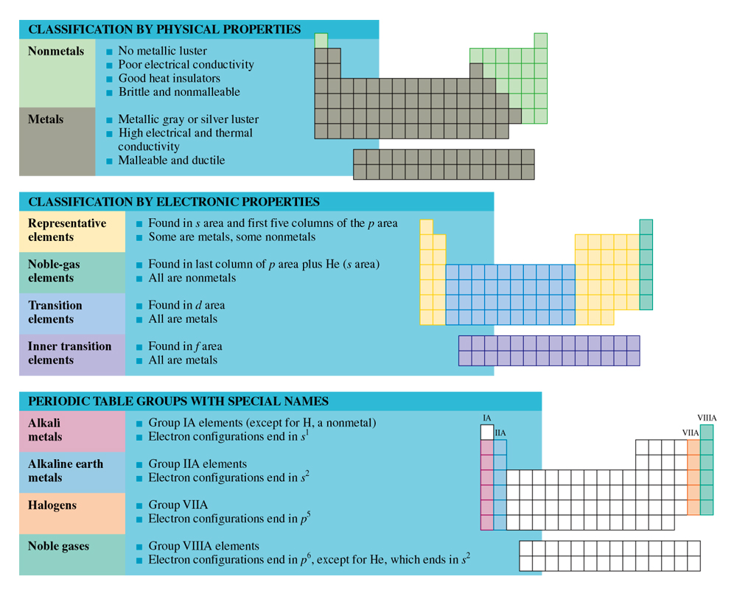
Element Types and Electronic Configuration
A classification scheme for the elements based on their electron configurations.

