Slide 1
Chapter 2
Measurements In Chemistry

Slide 2

Measurements are not exact
Measurements can never be exact; there is always some uncertainty.
© Richard Hamilton Smith/Corbis Outline

Slide 3
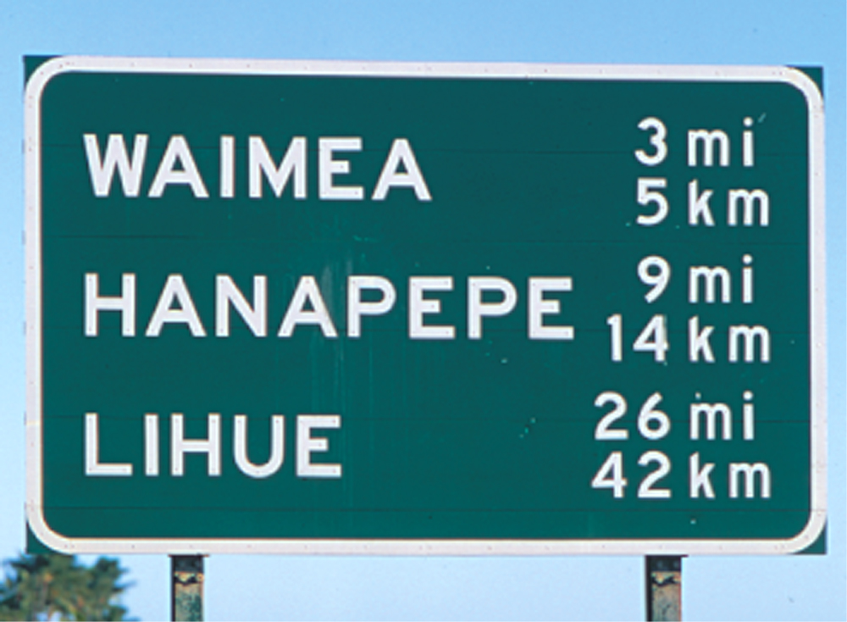
Metric System
Metric system units are becoming increasingly evident on highway signs.

Slide 4
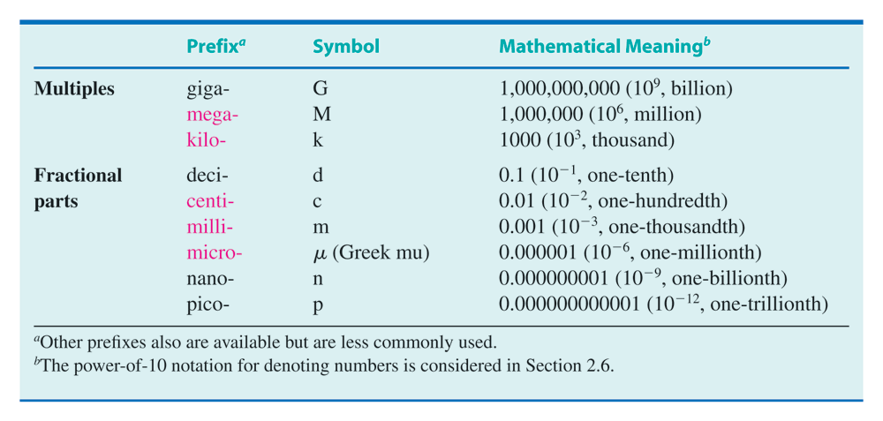
Metric Prefixes
Table 2.1

Slide 5
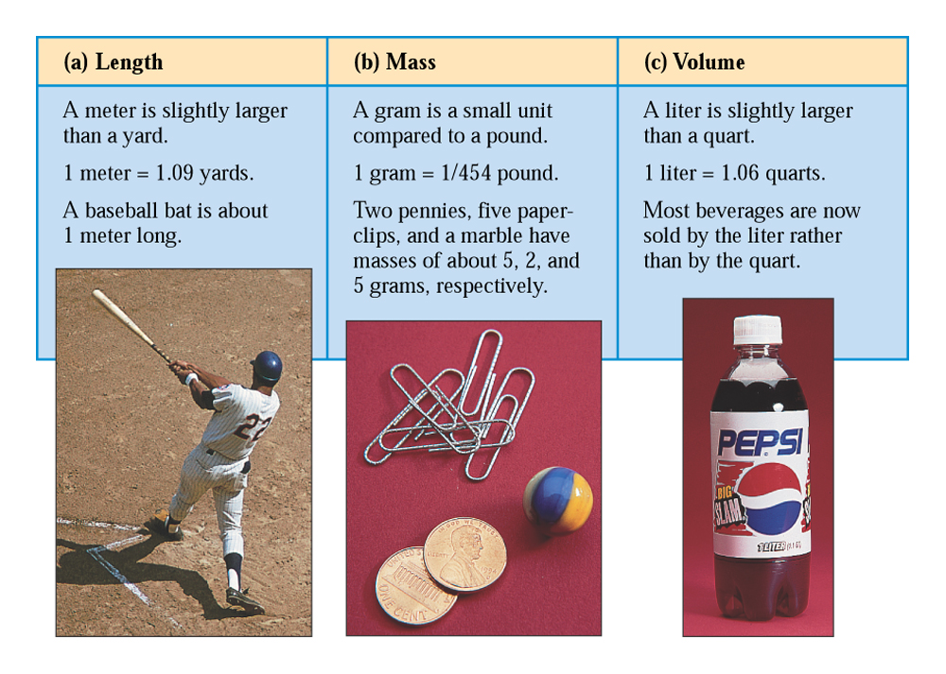
Metric System Base Units
Fig. 2.2
Comparisons of the base metric system units of length, mass, and volume with common objects.
E.R. Degginger

Slide 6
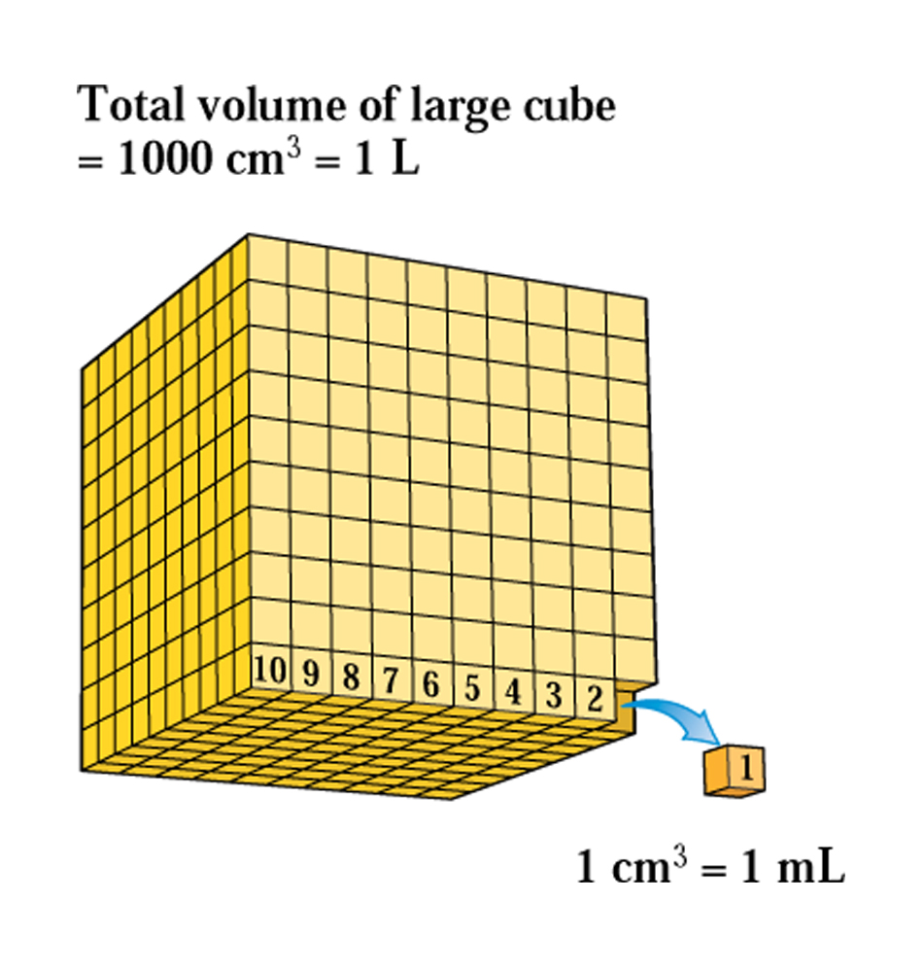
Volume Unites (cm³, L and mL)
Fig. 2.3
A cube 10 cm on a side is equal to 1 L; a cube 1 cm on a side is equal to 1 mL.

Slide 7
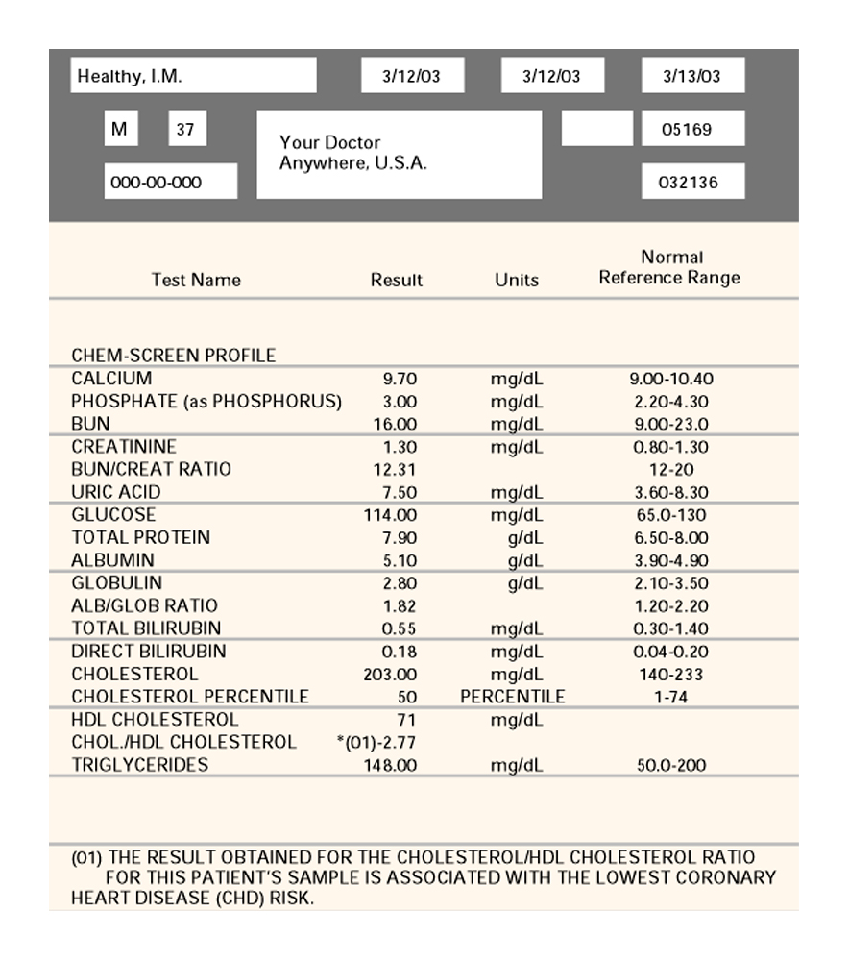
Solution Concentration Units
The use of the concentration unit milligrams per deciliteris common in clinical laboratory reports dealing with the composition of human body fluids.

Slide 8
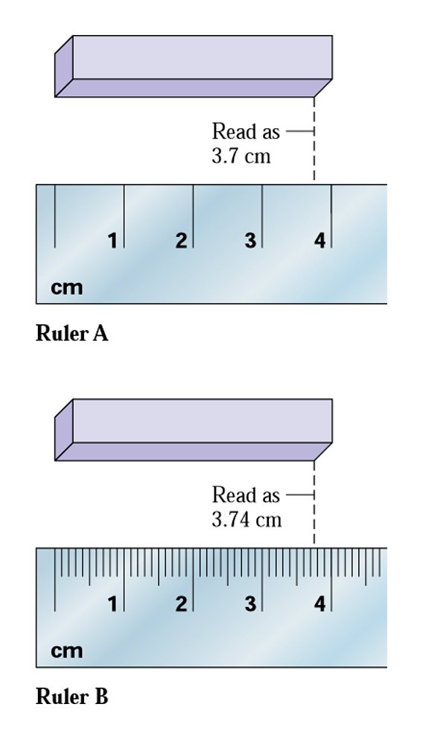
Uncertainty of Measurements
The scale on a measuring device determines the magnitude of the uncertainty for the recorded measurement.

Slide 9
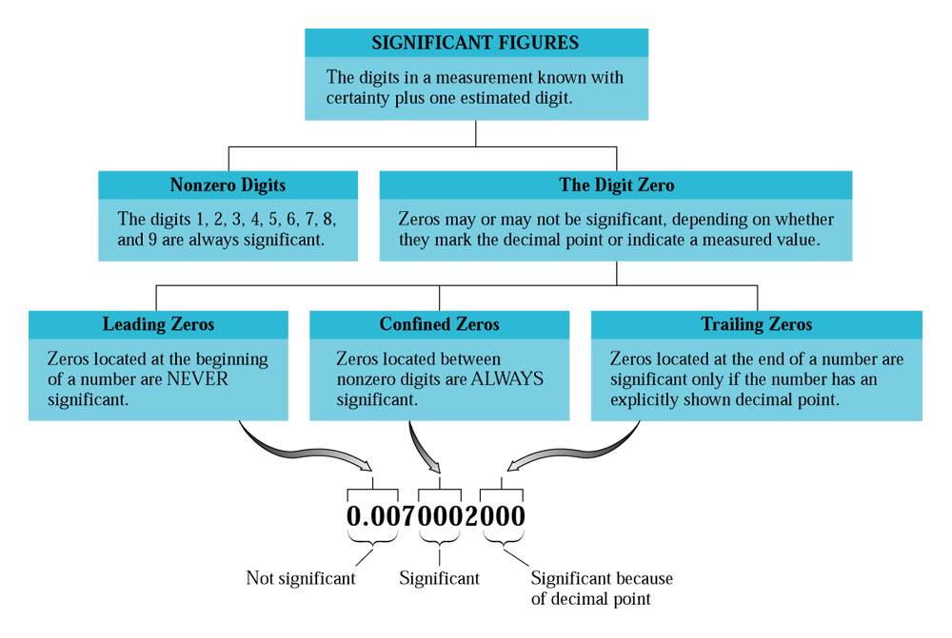
Significant Figures in Measurements

Slide 10
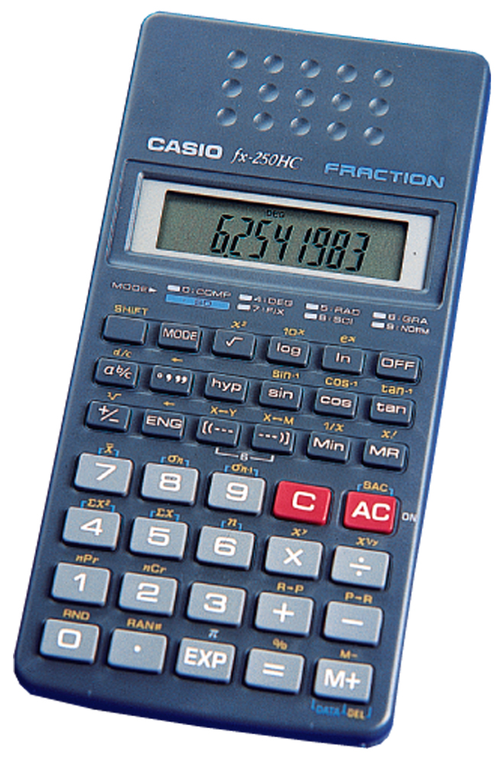
Rounding off from Calculator Answer
The digital readout on an electronic calculator usually shows more digits than are needed.

Slide 11
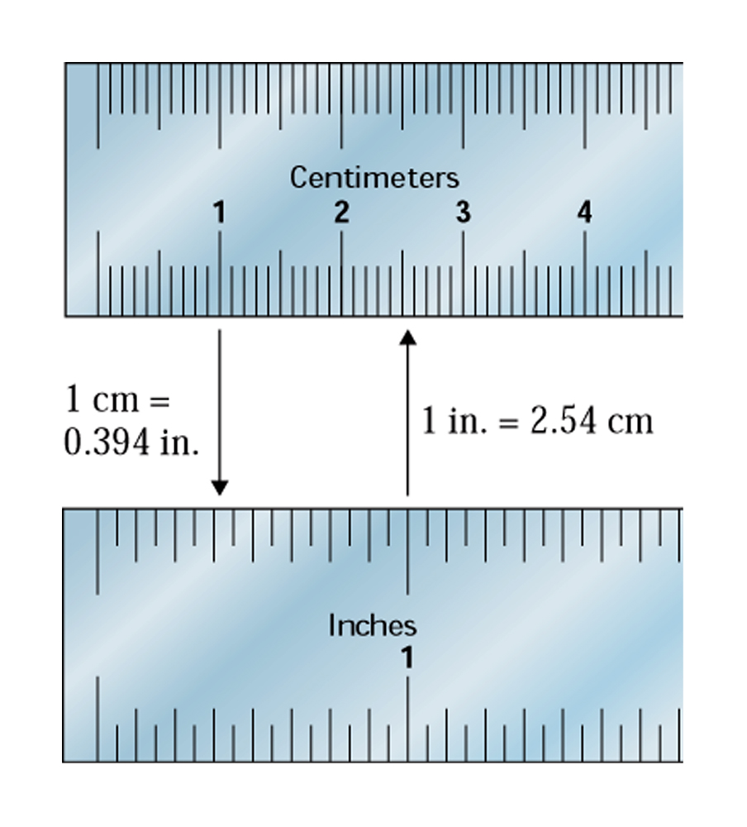
Unit Conversions
It is experimentally determined that 1 inch equals 2.54 cm, or 1 cm equals 0.394 inch

Slide 12
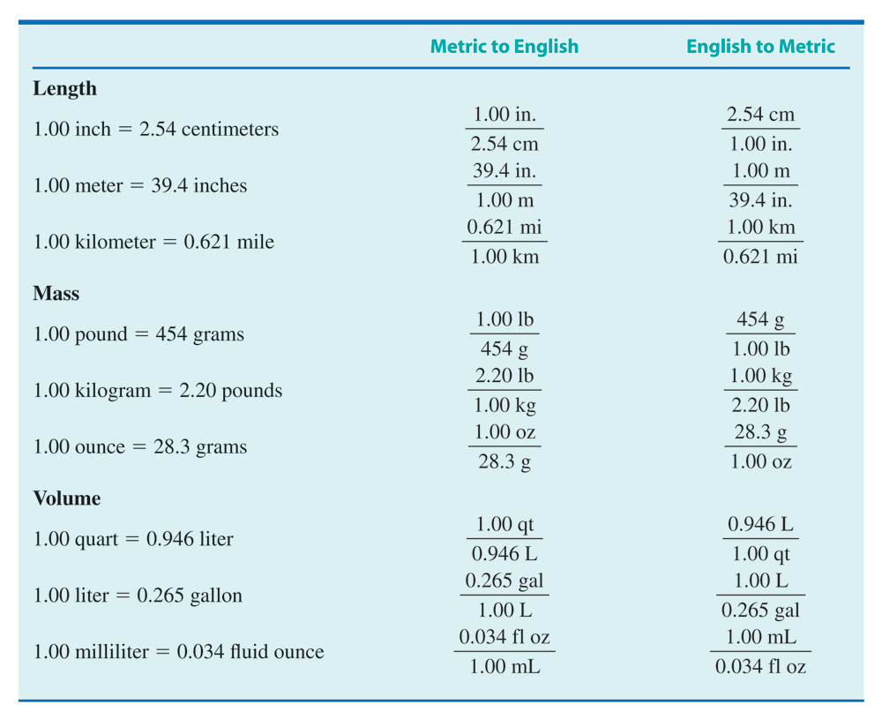
Unit Conversion Factors
Table 2.2

Slide 13
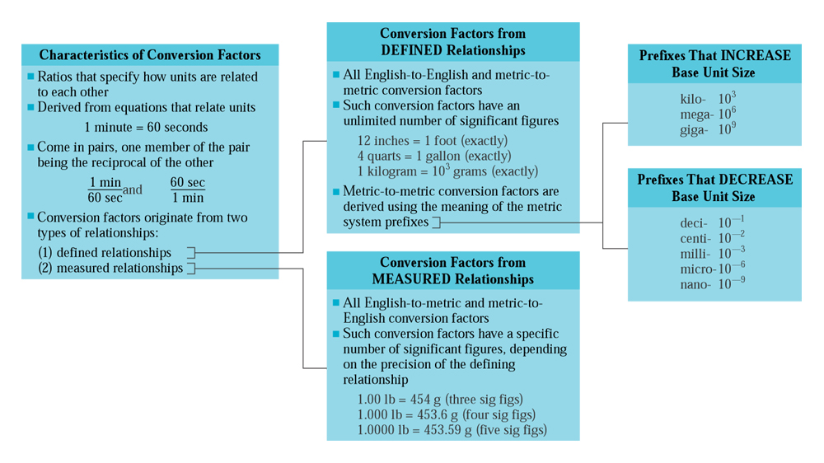
Common Conversion Factors

Slide 14
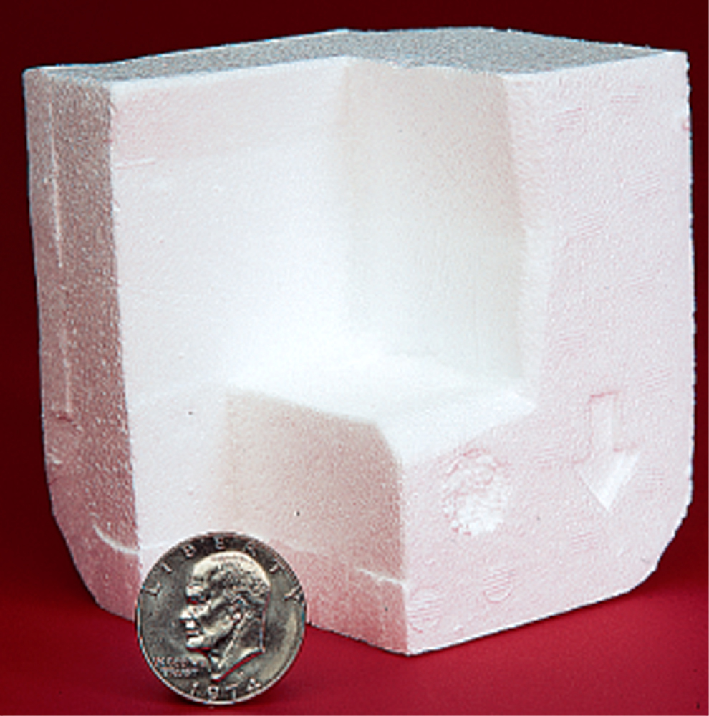
Densities and Masses
Both of these items have a mass of 23 grams, but they have very different volumes; therefore, their densities are different as well.

Slide 15
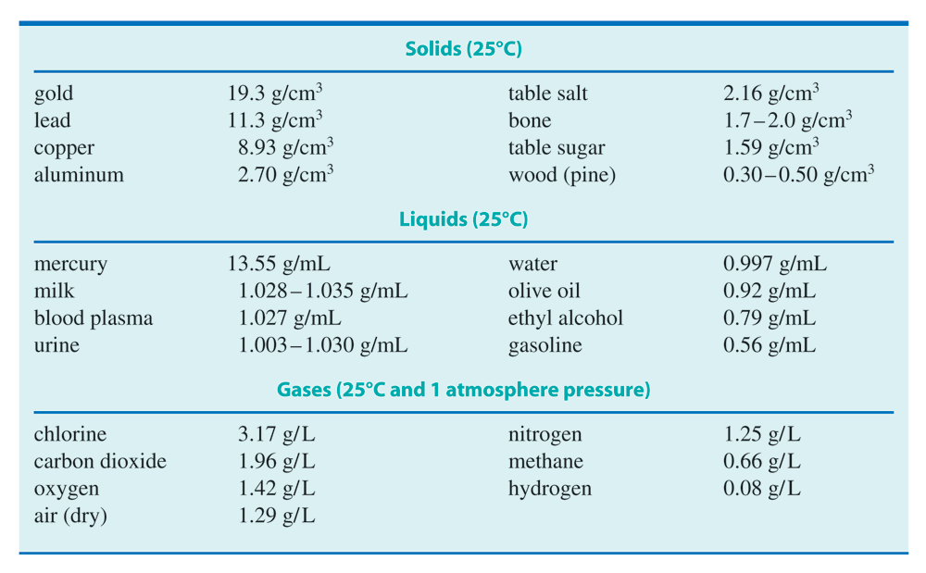
Properties of Gases, Liquids and Solids
Table 2.3

Slide 16
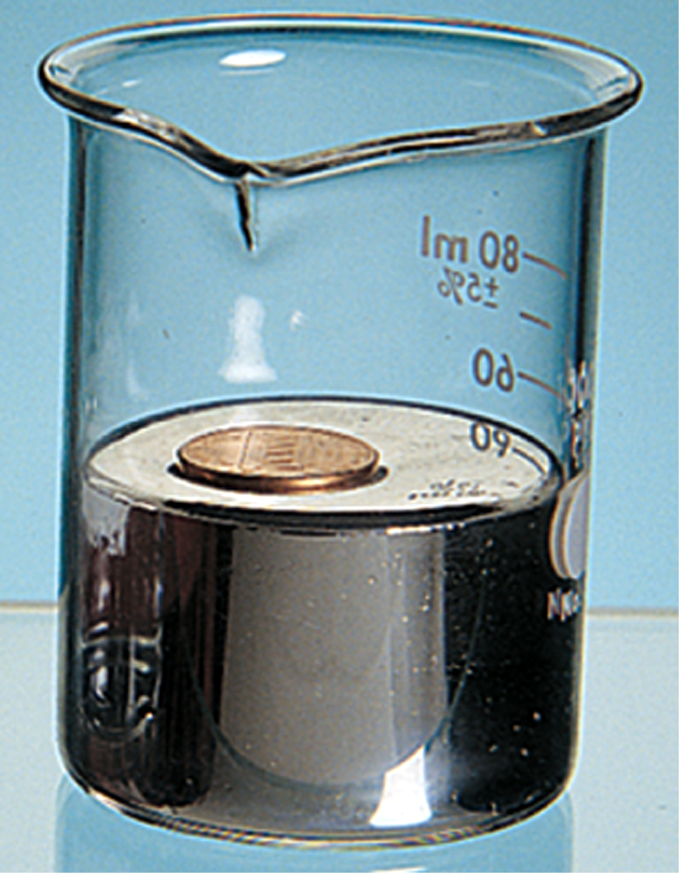
Why the Coin floats on Mercury?
Fig. 2.9
The penny is less dense than the mercury it floats on.

Slide 17
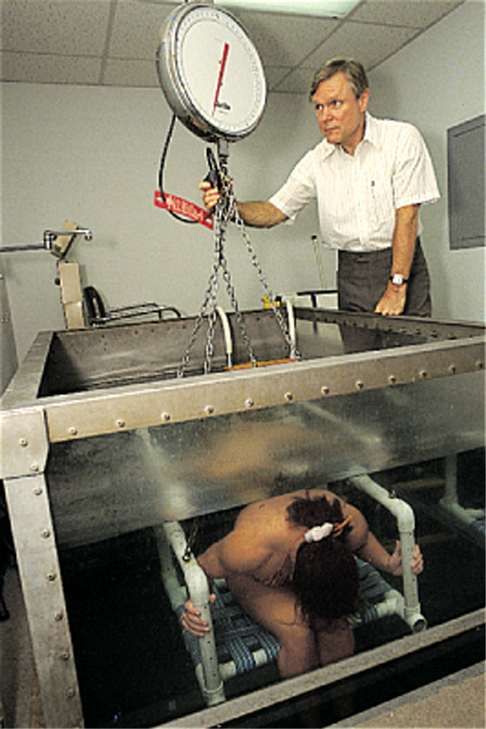
Measurements of Body Density

Slide 18
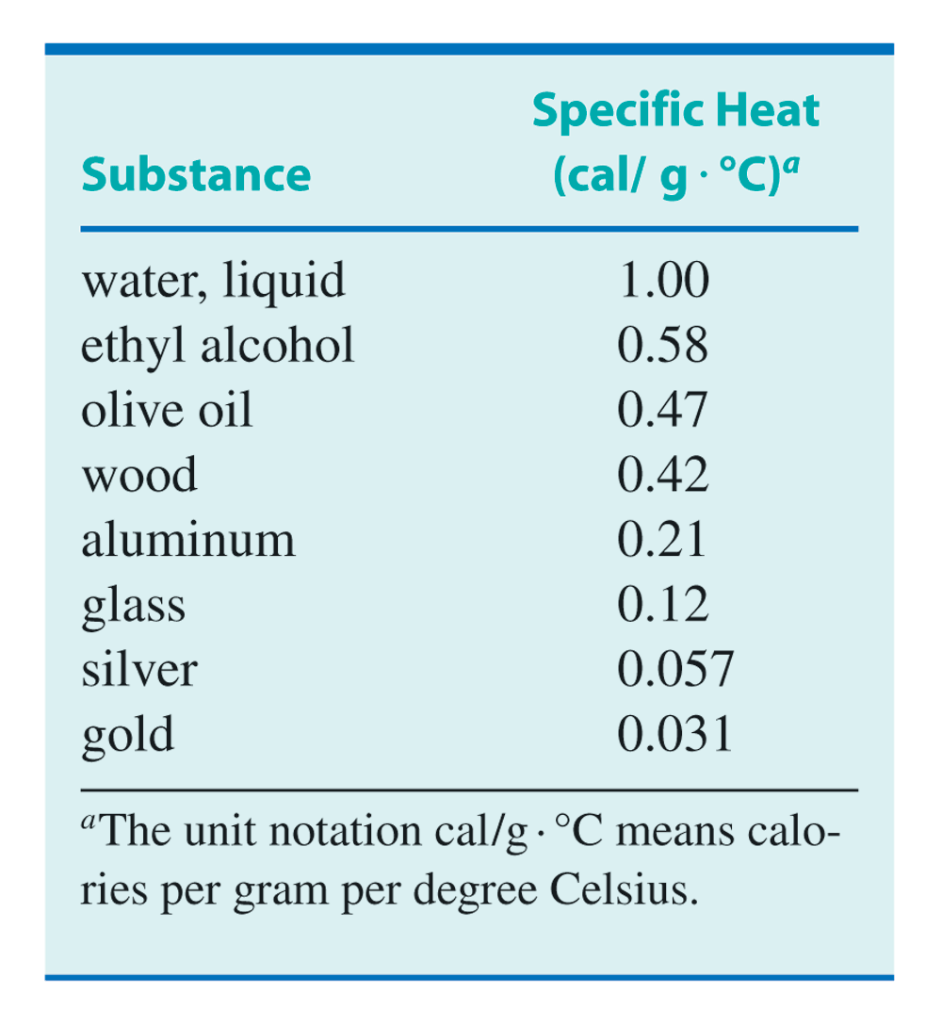
Specific Heat of Substances
Table 2.4

Slide 19
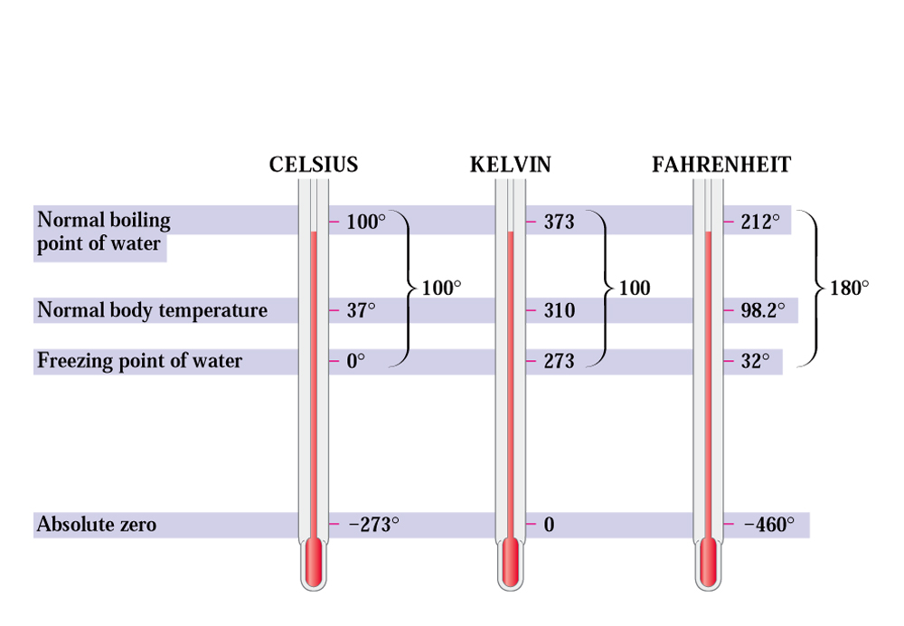
Temperature Scales
Fig 2.10
The relationships among the Celsius, Kelvin, and Fahrenheit temperature scales are determined by the degree sizes and the reference point values.

