Slide 1
Chapter Eleven
Nuclear Chemistry

Slide 2
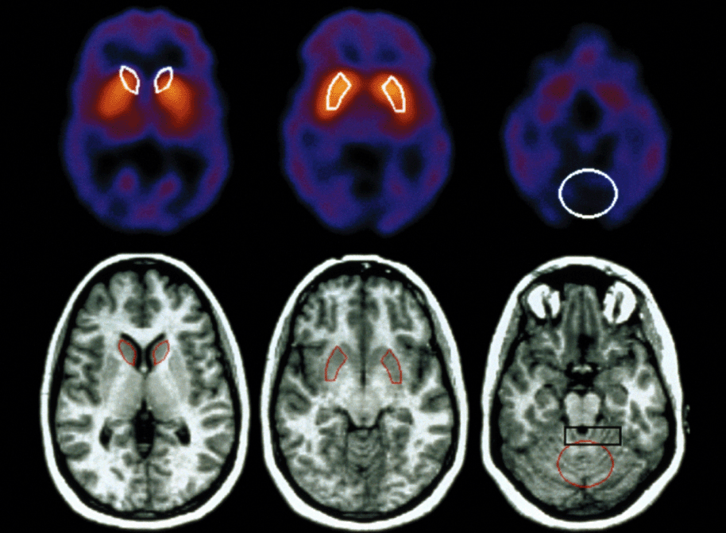
How is brain-scans done?
CO 11.1
Associated with brain-scan technology is the use of small amounts of radioactive substances.
PhotoDisc

Slide 3
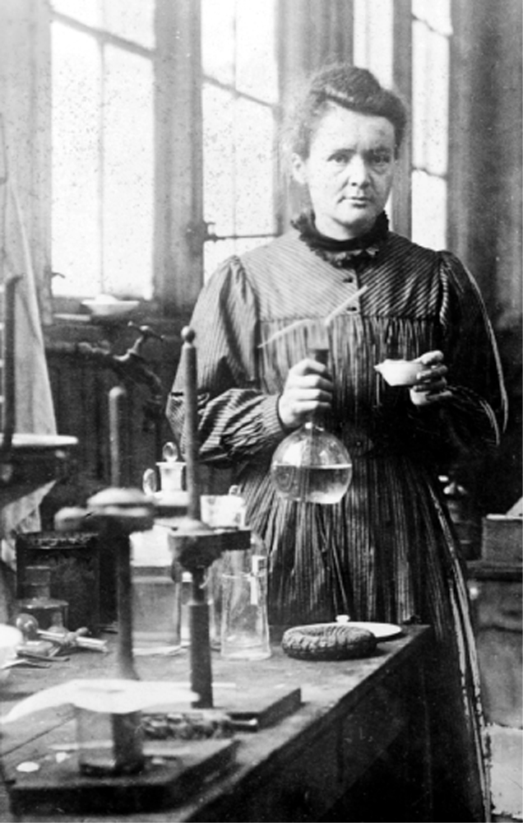
Marie Curie discovered radium
Fig. 11.1
Marie Curie, one of the pioneers in the study of radioactivity, is the first person to have been awarded two Nobel Prizes for scientific work.
© Bettmann/CORBIS

Slide 4
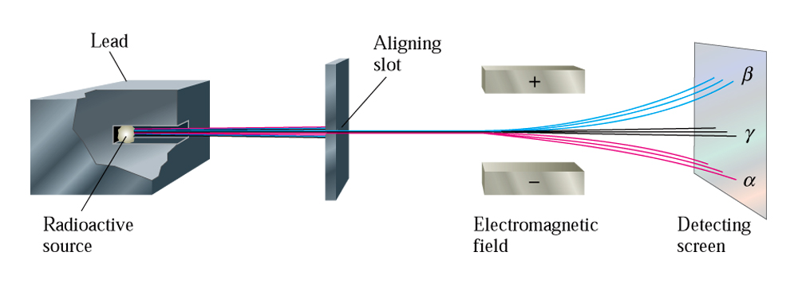
Effect of electromagnetic fields on ionization radiation
Fig. 11.2
The effect of an electromagnetic field on alpha, beta, and gamma radiation.

Slide 5
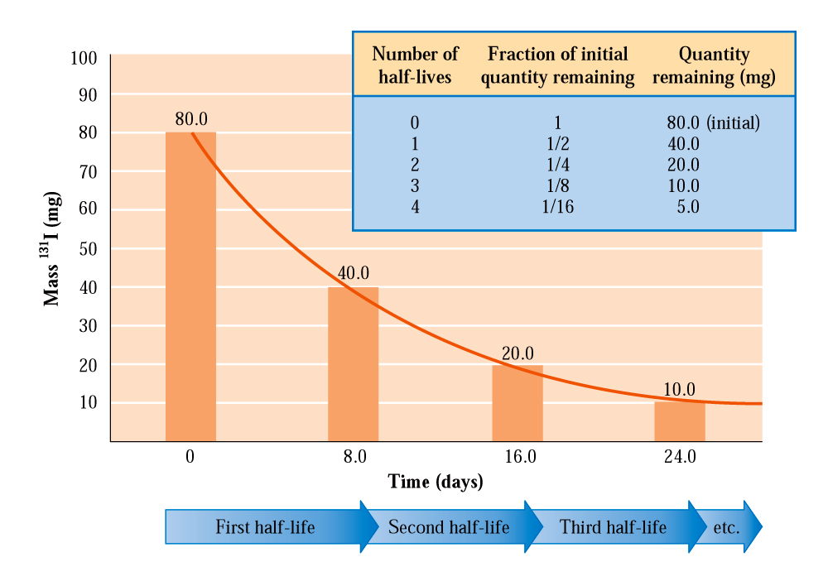
What is half-life period?
Fig. 11.3
After each half-life period, the quantity of material present at the beginning of the period is reduced by half.

Slide 6
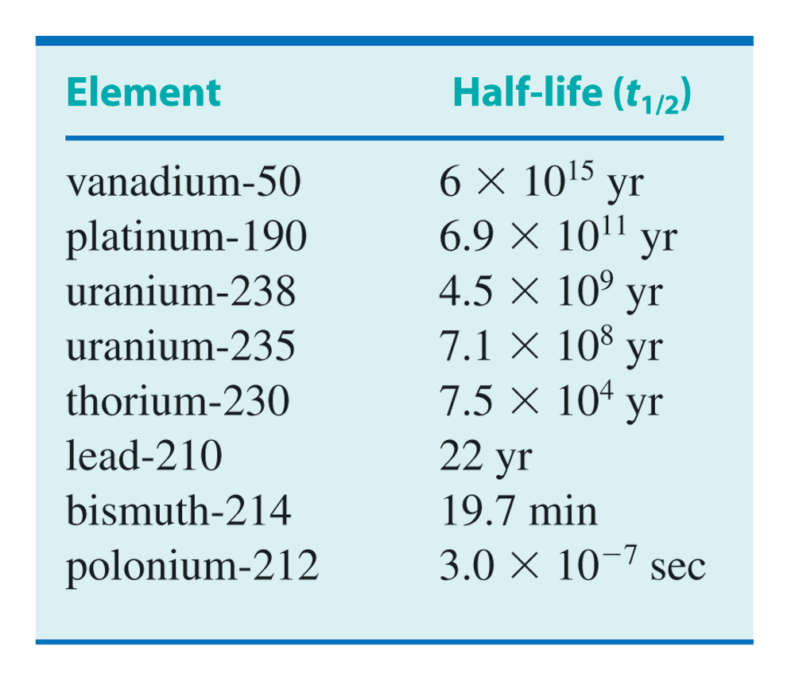
Half-life and decay
Table 11.1

Slide 7
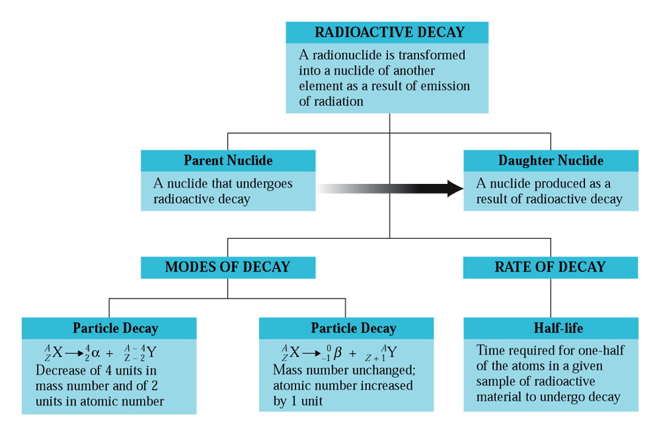
Radioactive decay
CAG 11.1

Slide 8
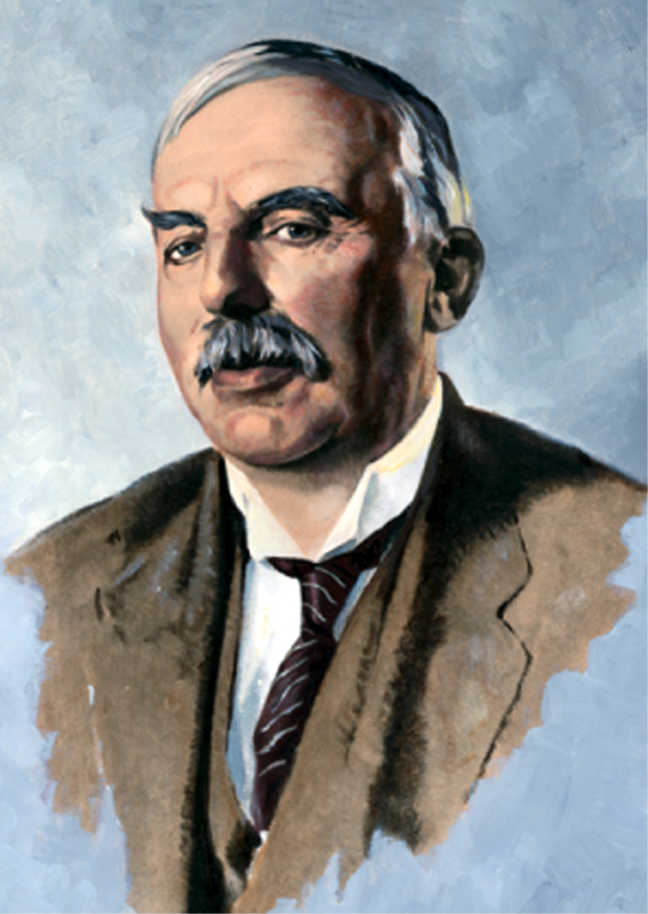
Bombardment reaction
Fig. 11.4
Ernest Rutherford was the first person to carry out a bombardment reaction.
© Bettmann/CORBIS

Slide 9
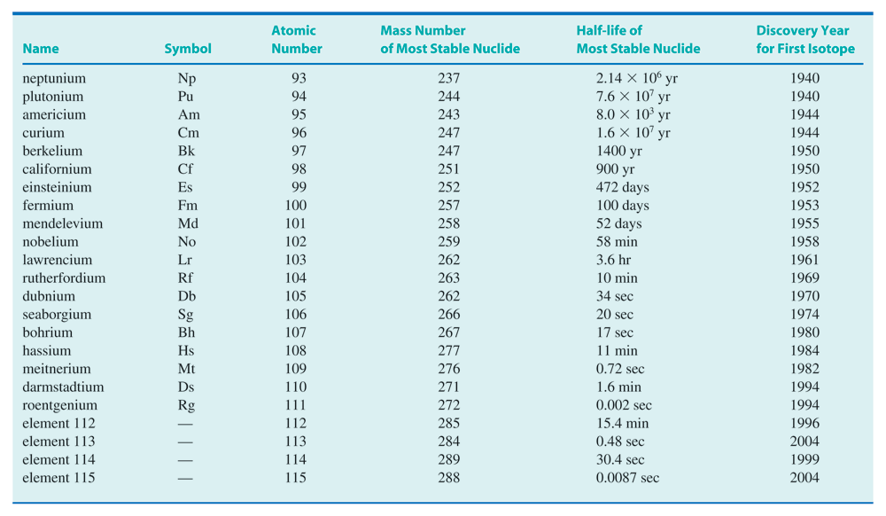
Details of radioactive nuclides
Table 11.2

Slide 10
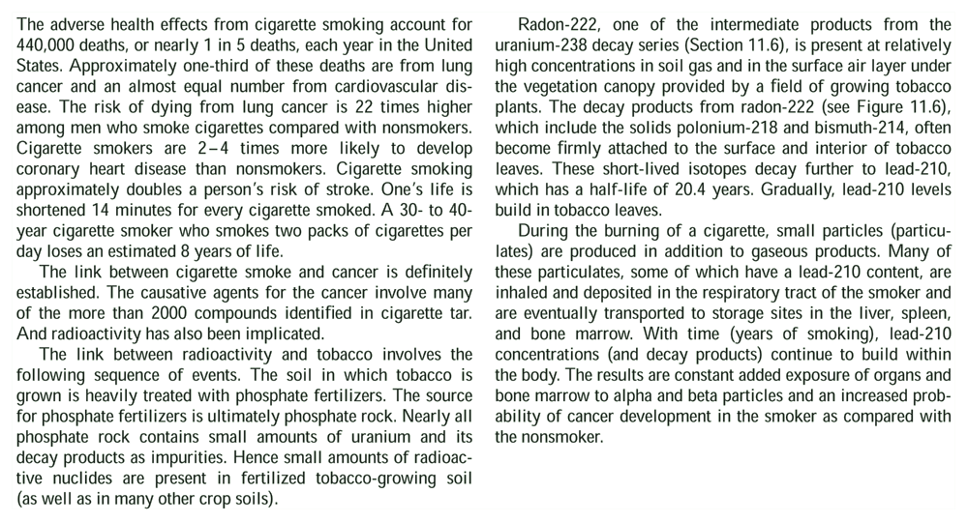
Smoking, lung-cancer & radiation
CC 11.1 Tobacco Radioactivity

Slide 11
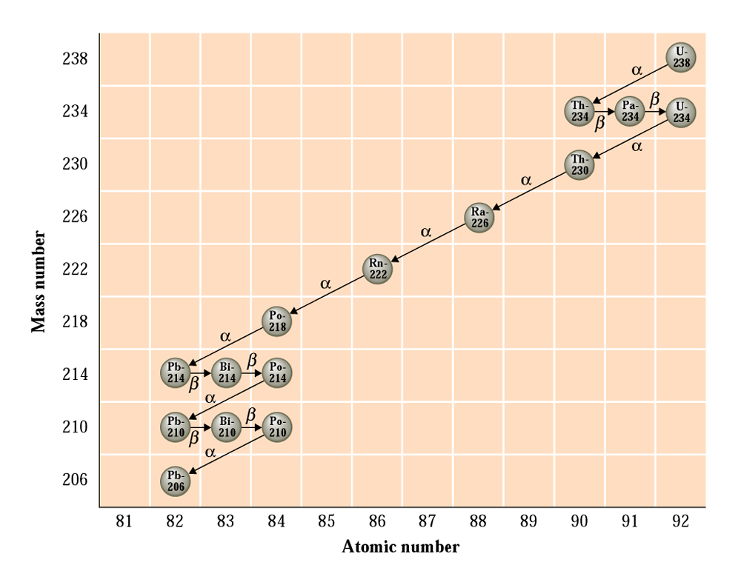
Nuclear decay series-uranium-235
Fig. 11.6
In the U-238 decay series, each nuclide is unstable except Pb-206.

Slide 12
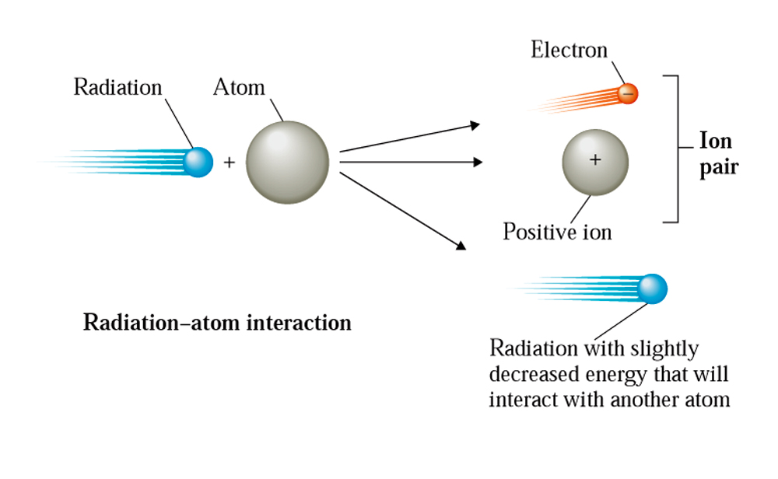
Ionizing radation
Fig. 11.7
Ion pair formation.

Slide 13
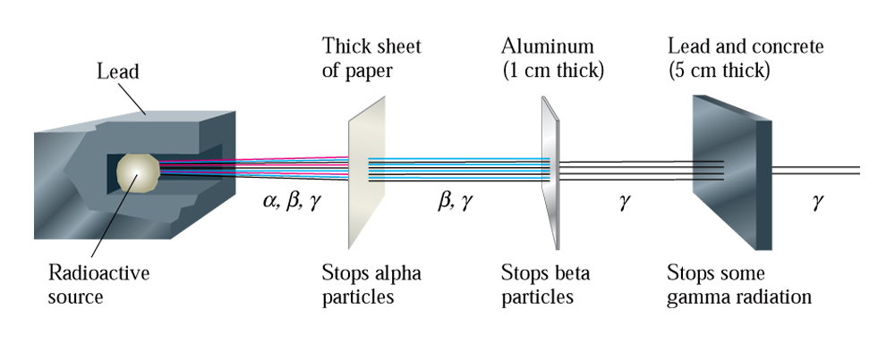
Relative penetrability of radiation
Fig. 11.8
Alpha, beta, and gamma radiation differ in penetrating ability.

Slide 14
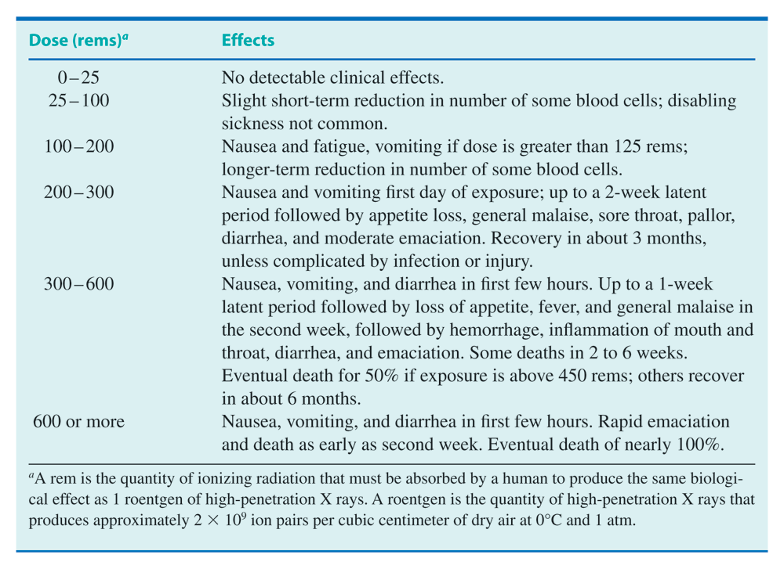
Radiation doses: rems
Table 11.3

Slide 15
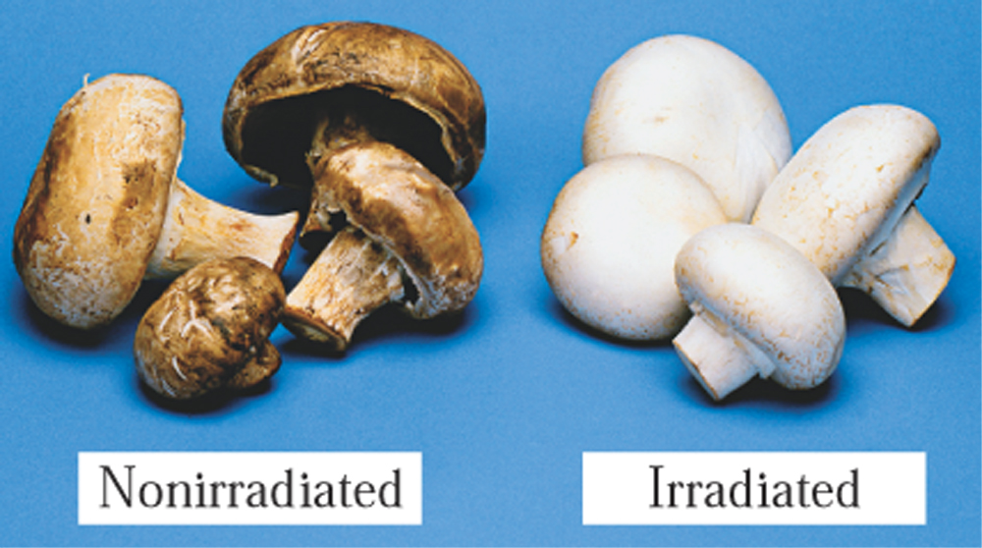
Irradiated food safe to eat?
CC 11.2
Irridated and nonradiated mushrooms
© Peticolas/Megna/Fundamental Photographs, NYC

Slide 16
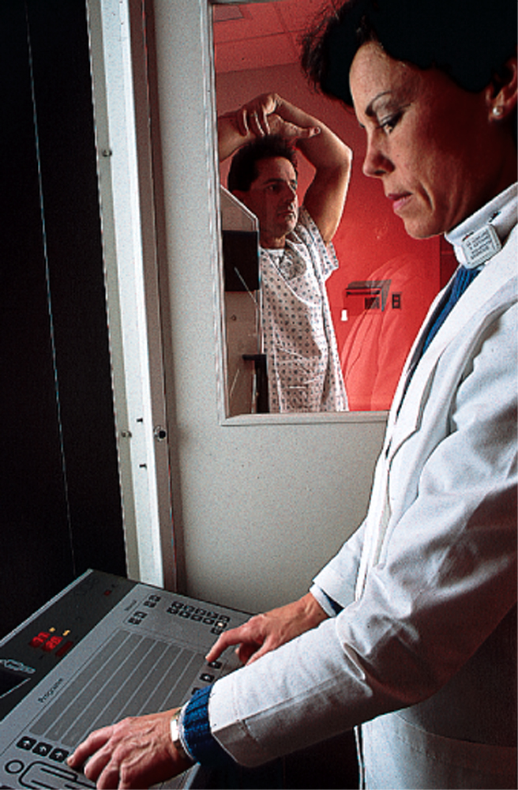
Radiation exposure
Fig. 11.9
Film badges are used to determine a person’s exposure to radiation.
Doug Plummer/Photo Researchers

Slide 17
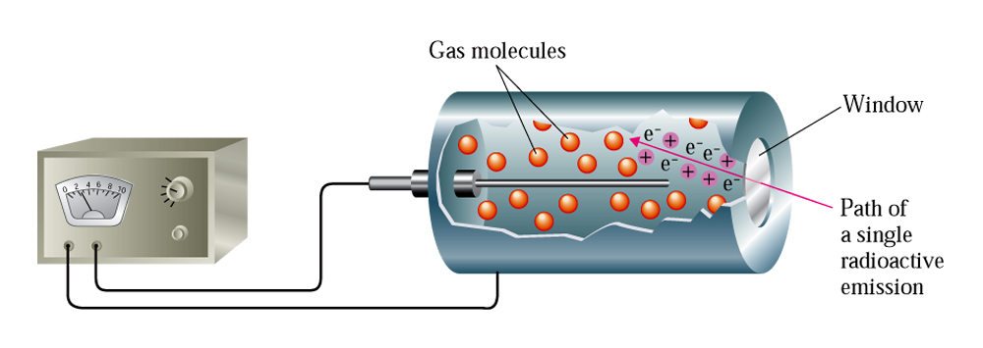
Radiation detection
Fig. 11.10
Radiation passing through a Geiger counter ionizes one or more gas atoms, producing ion pairs.

Slide 18
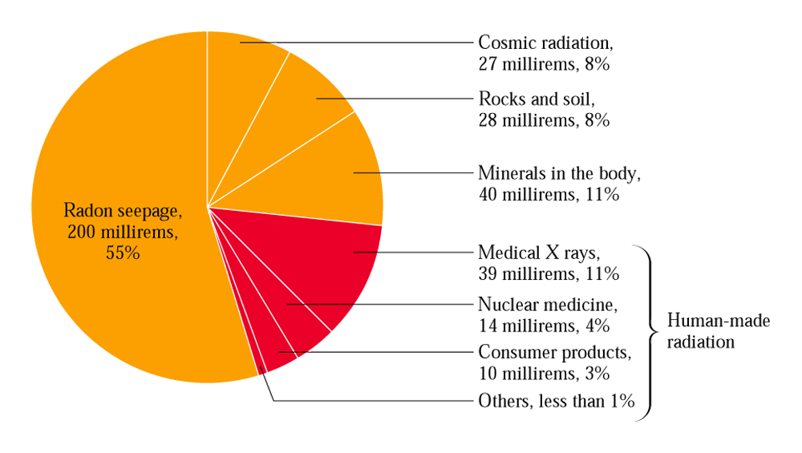
What causes radiation exposure?
Fig. 11.11
Components of the estimated annual radiation of an average American.

Slide 19
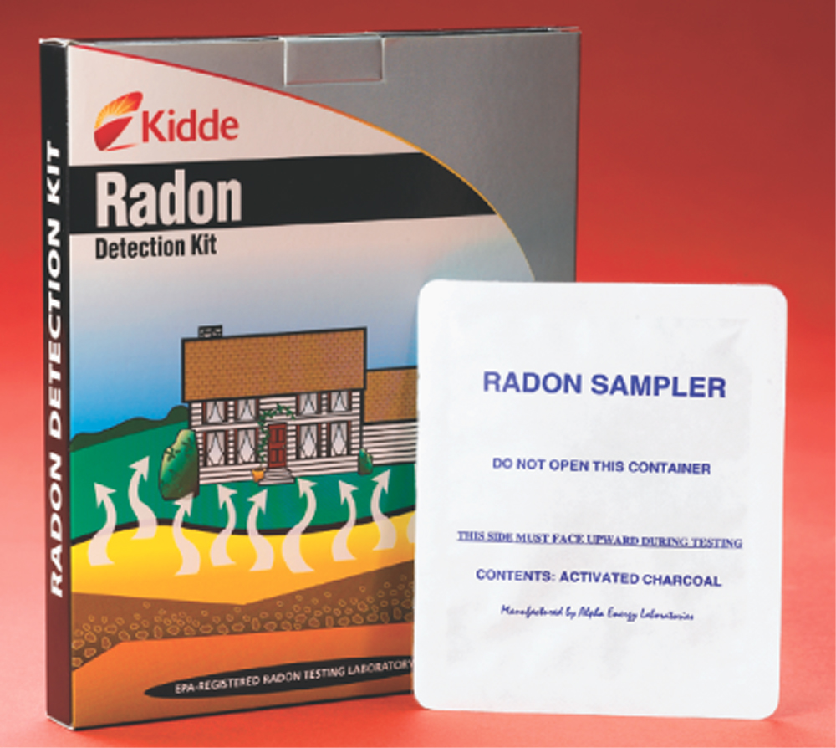
Testing radon gas
CC. 11.3
A commercially available kit to test for radon gas in the home.

Slide 20
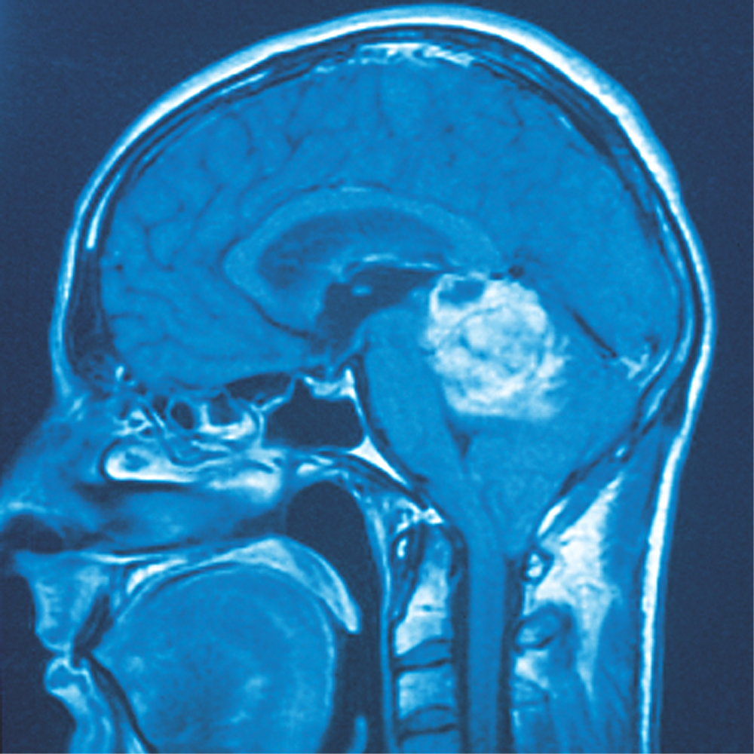
Technetium-99 used as radiation source
Fig. 11.12
Brain scans are obtained using radioactive technetium-99, a laboratory-produced radionuclide.
Science Photo/Custom Medical Stock Photo

Slide 21
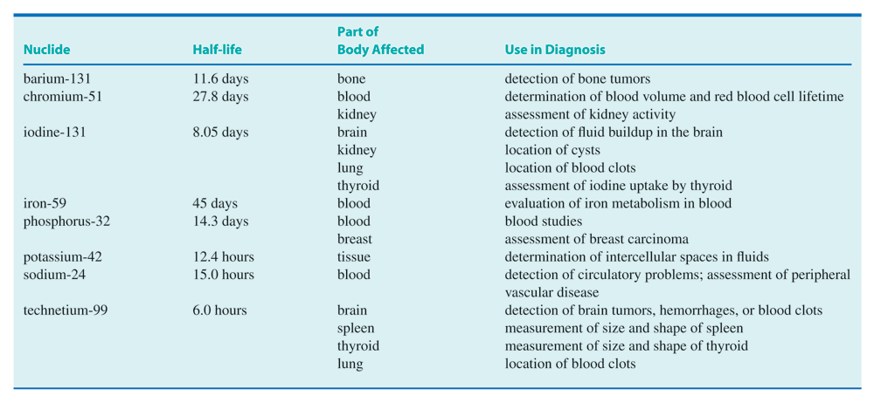
Radionuclide used in medicine
Table 11.4

Slide 22
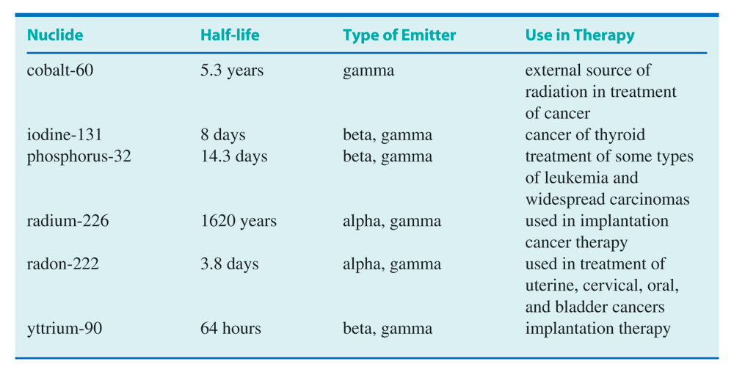
Radionuclide used in medicine
Table 11.5

Slide 23
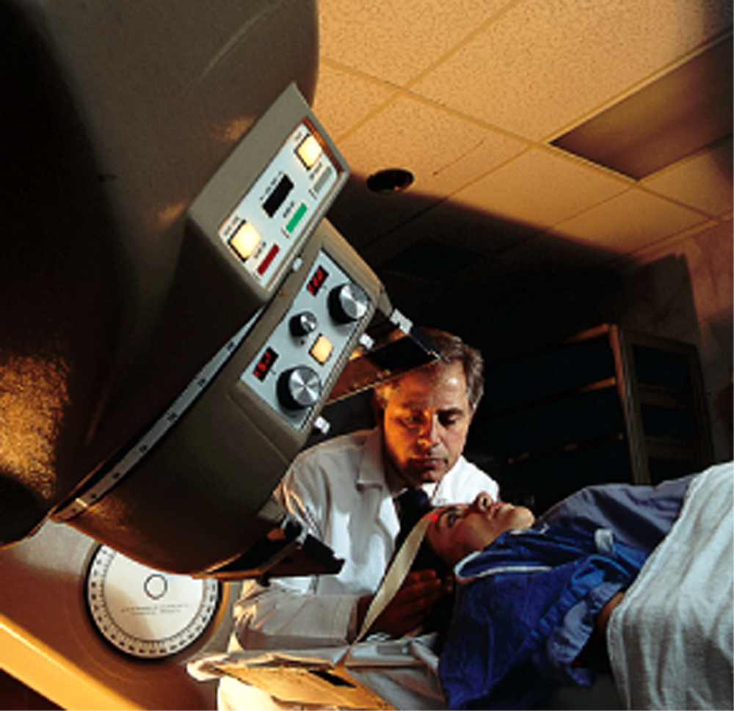
Cobalt-60 as gamma source
Fig. 11.13
Cobalt-60 is used as a source of gamma radiation in radiation therapy.
Yoav Levy/Phototake

Slide 24
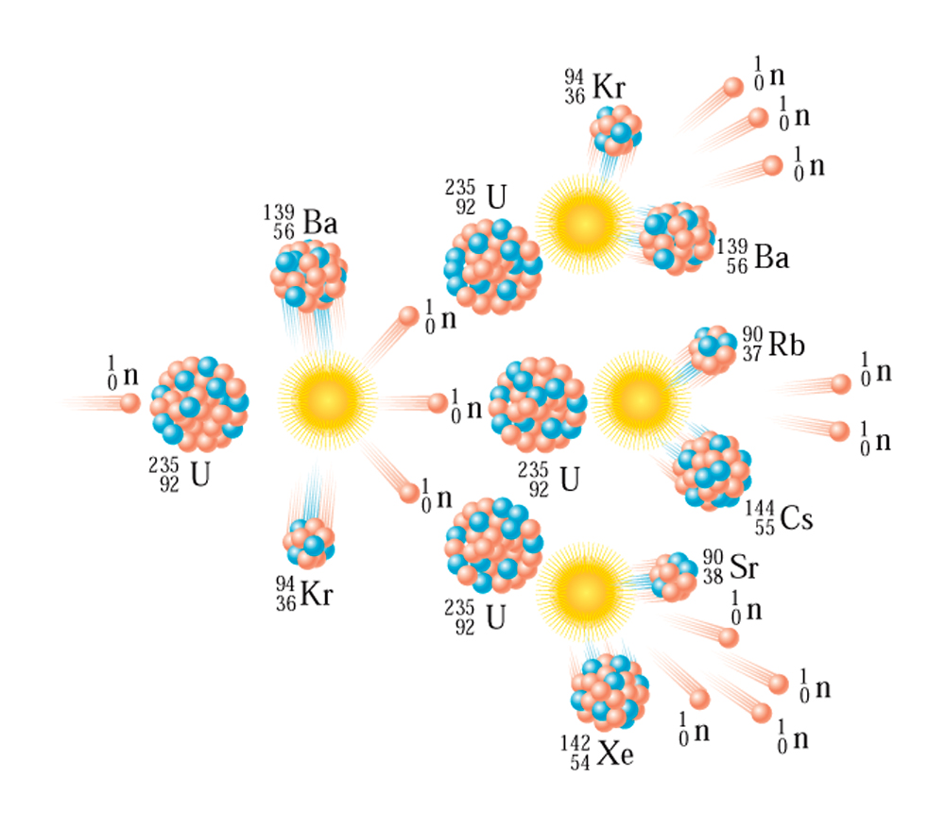
Fission chain reaction of uranium-235
Fig. 11.14
A fission chain reaction is caused by further reaction of the neutrons produced during fission.

Slide 25
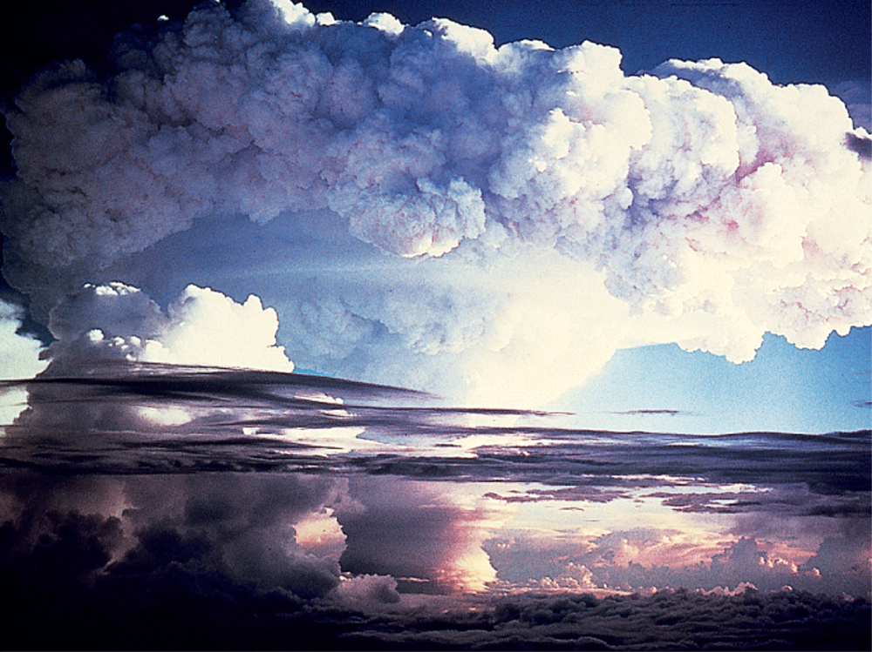
Fission bomb
Fig. 11.15
Enormous amounts of energy are released in the explosion of a nuclear fission bomb.
© Bettmann/CORBIS

Slide 26
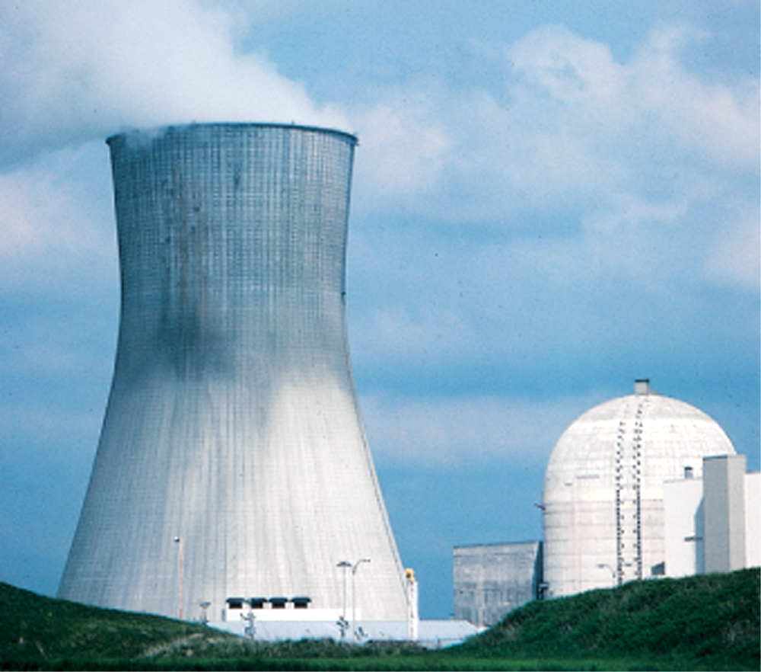
Nuclear reactors for energy
Fig. 11.16
The cooling tower at the Trojan nuclear power plant dominates the landscape. The nuclear reactor is housed in the dome-shaped enclosure.
© Albert J. Copley/Visuals Unlimited

Slide 27
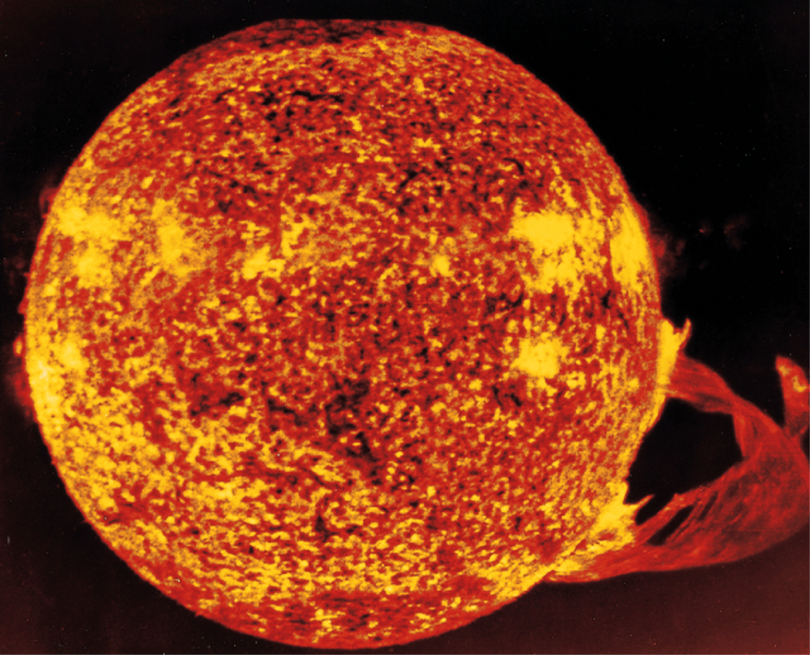
Fusion energy: Ultimate source of energy
Fig. 11.17
The process of nuclear fusion maintains the interior of the sun at the temperature of approximately 15 million degrees.
NASA

Slide 28
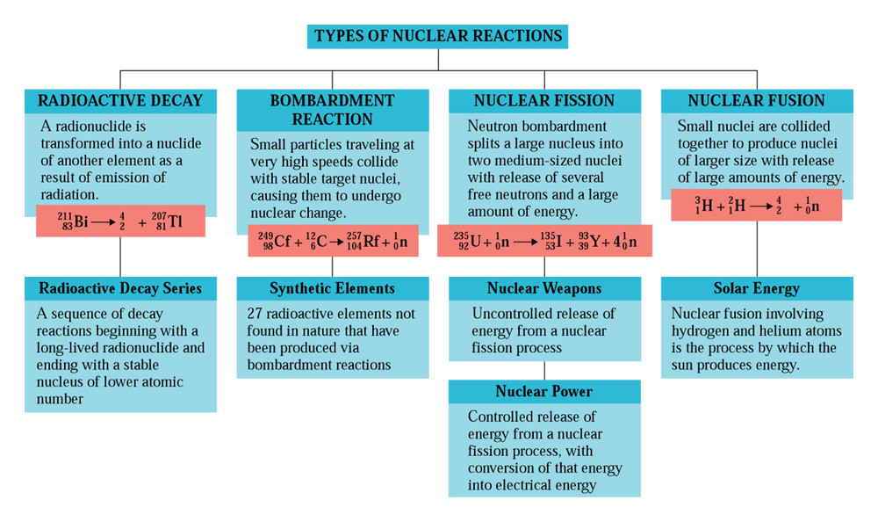
Types of nuclear reactions
CAG 11.2

Slide 29
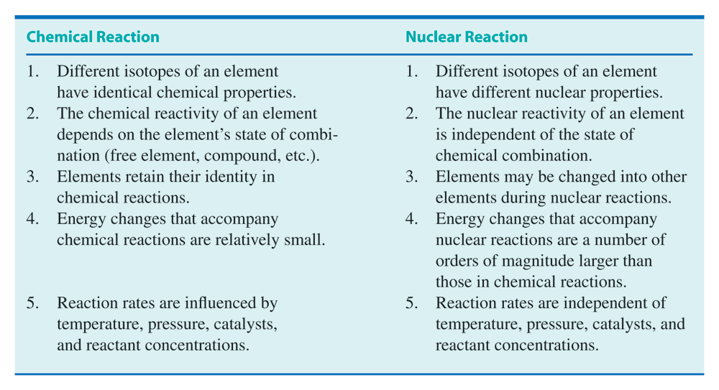
Comparing chemical and nuclear reactions
Table 11.6

