Slide 1
Chapter Ten
Acids, Bases, and Salts

Slide 2
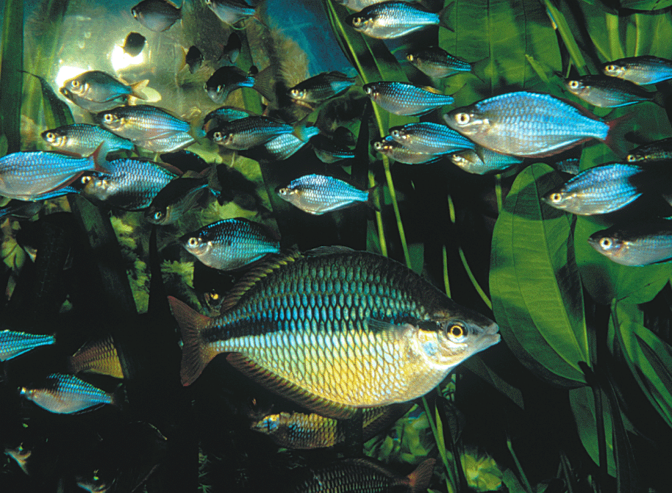
Acidity of the water matters
CO 10.1
Fish are very sensitive to the acidity of the water present in an aquarium.
© Bios/Yvette Tavernier/Peter Arnold Inc.

Slide 3
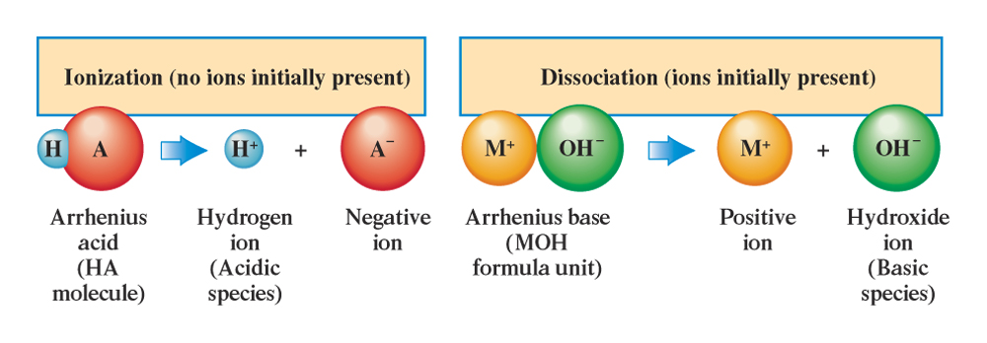
In water acids and bases dissociate
Fig. 10.1
The difference between the aqueous solution processes of ionization and dissociation.

Slide 4
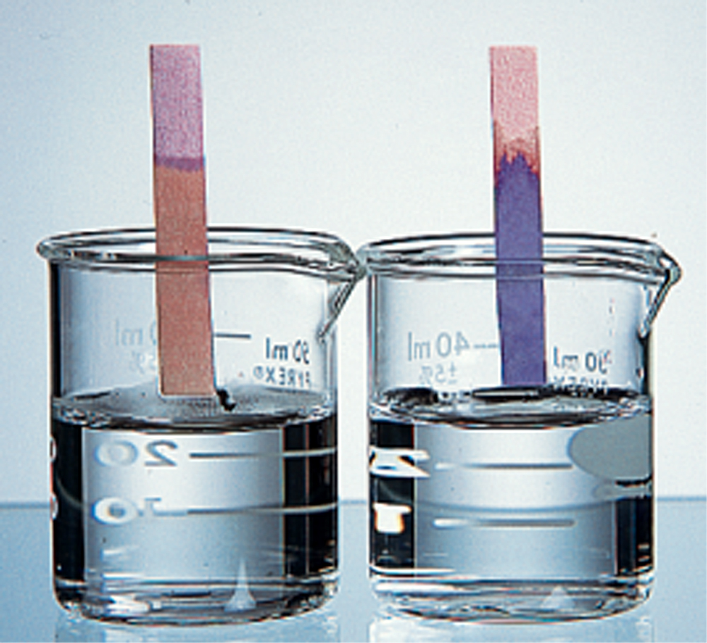
Litmus changed color in acids and bases
Fig. 10.2
Litmus is a vegetable dye obtained from certain lichens found principally in the Netherlands.

Slide 5
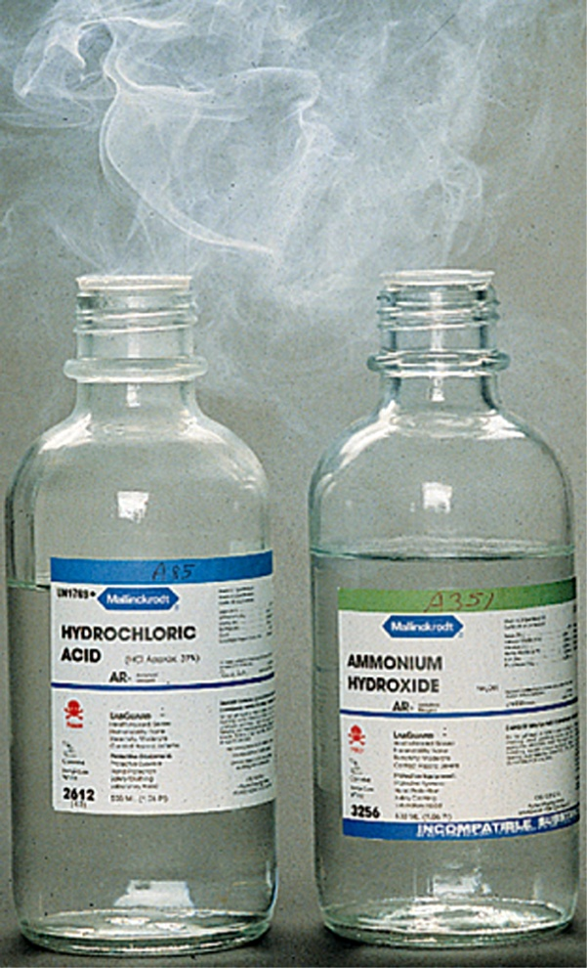
Some acids and bases reactions does not require water
Fig. 10.3
A white cloud of finely divided solid NH₄Cl is produced by the acid-base reaction that results when the colorless gases HCl and NH₃ mix.
Ken O’Donoghue © Houghton Mifflin Company

Slide 6
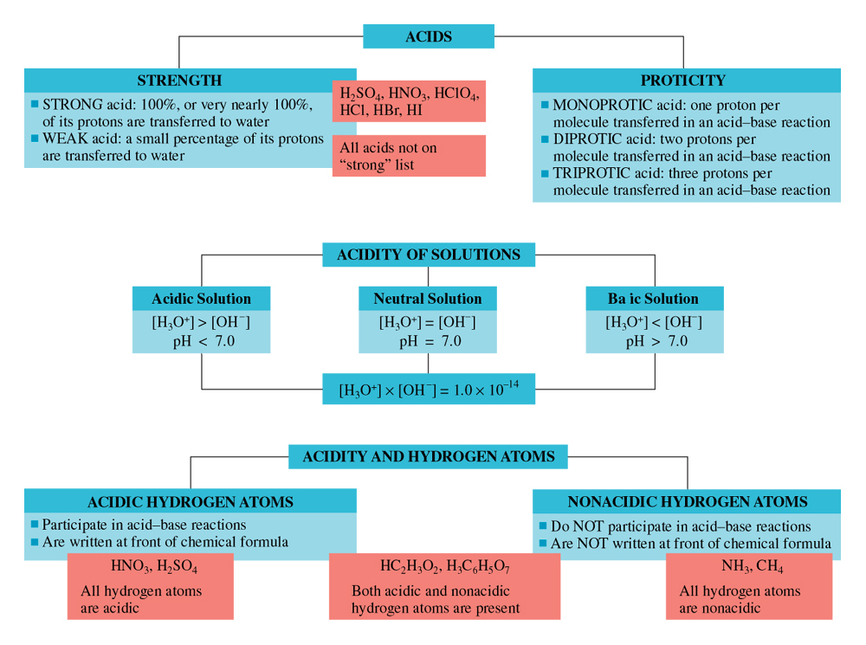
Acid and base strengths and pH
Table 10.1

Slide 7
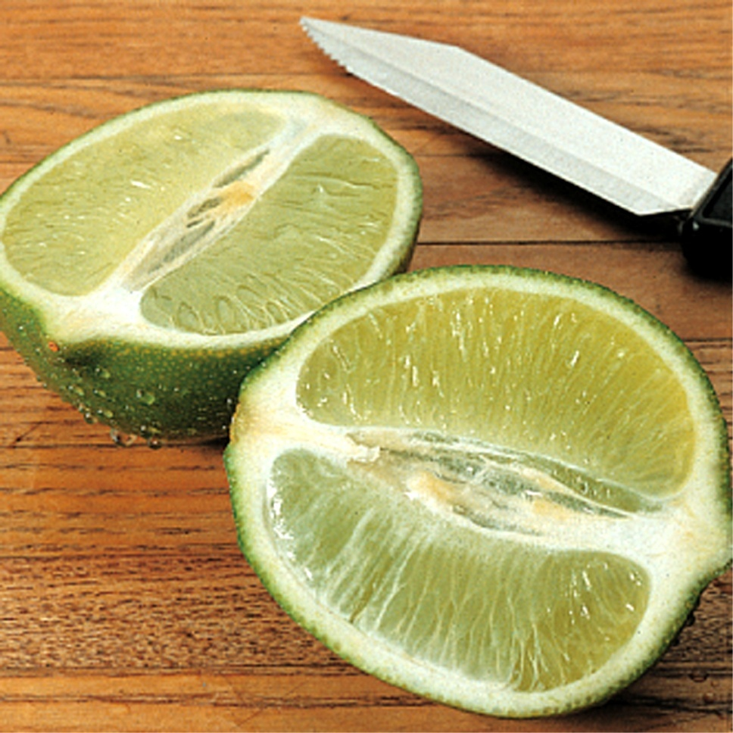
Acids tastes sour
Fig. 10.4
The sour taste of limes and other citrus fruit is due to the citric acid present in the fruit juice.

Slide 8
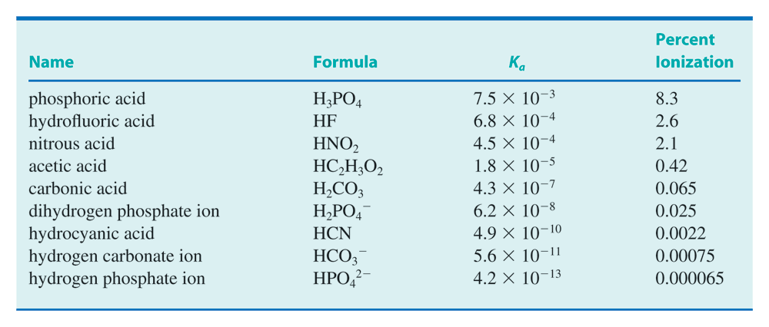
K_{a} for some acids and ions
Table 10.2

Slide 9
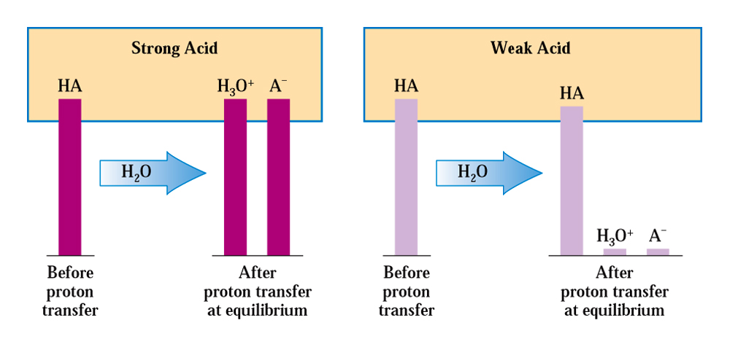
Weak acids have fewer ions
Fig. 10.5
A comparison of the number of acidic species present in strong acid and weak acid solutions of the same concentration.

Slide 10
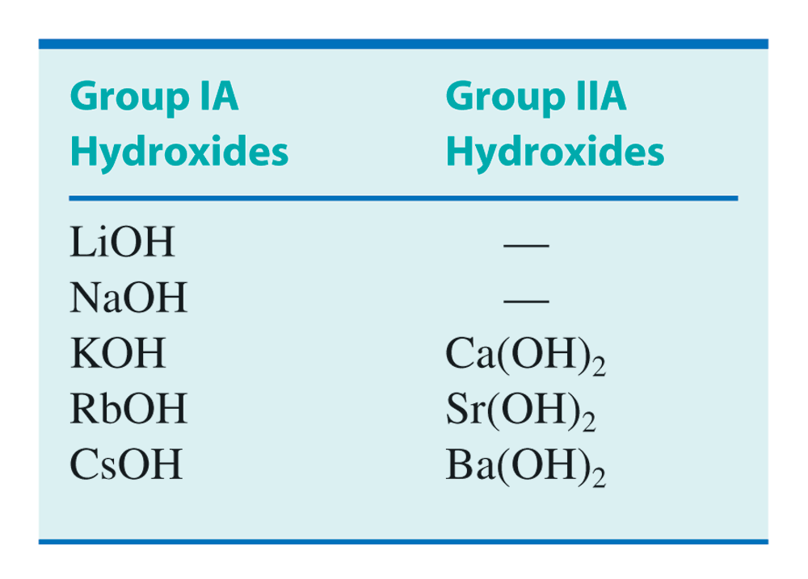
Hydroxy bases of group IA and IIA
Table 10.3

Slide 11
K_{a} and percent ionization
Table 10.4

Slide 12
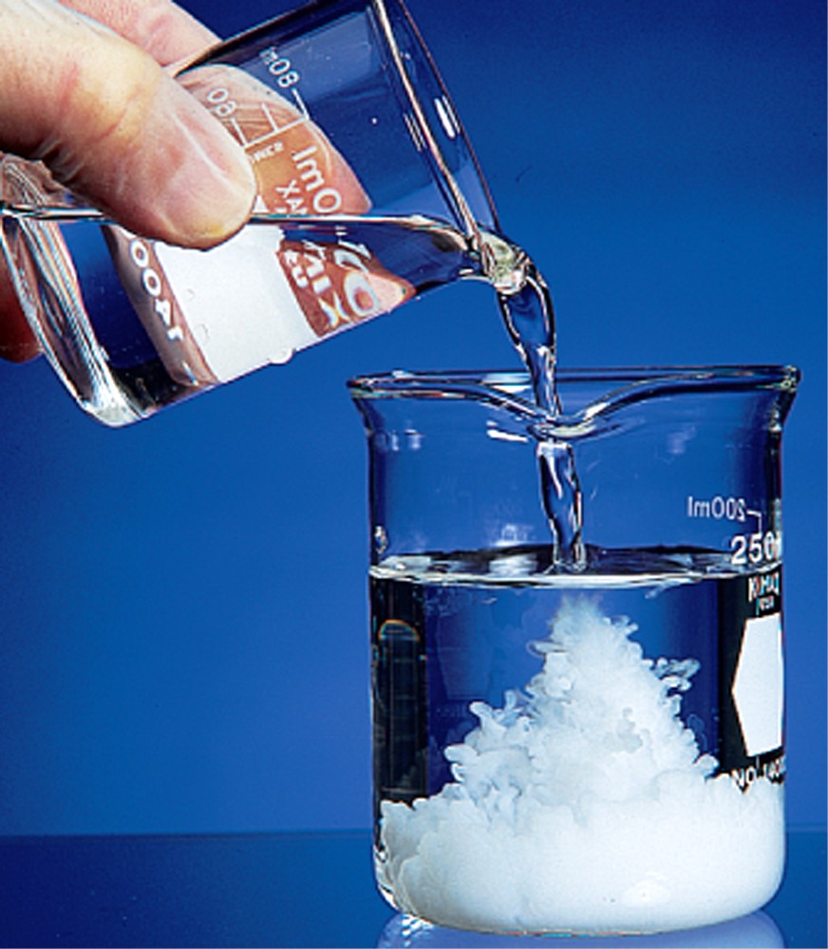
Acid and base reactions produce salts
Fig. 10.6
The acid-base reaction between sulfuric acid and barium hydroxide produces the insoluble salt barium sulfate.

Slide 13
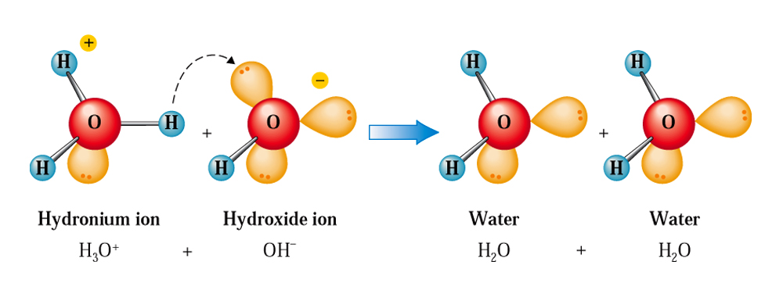
Neutralization is water formation
Fig. 10.7
Formation of water by the transfer of protons from H₃O+ ion to OH- ions.

Slide 14
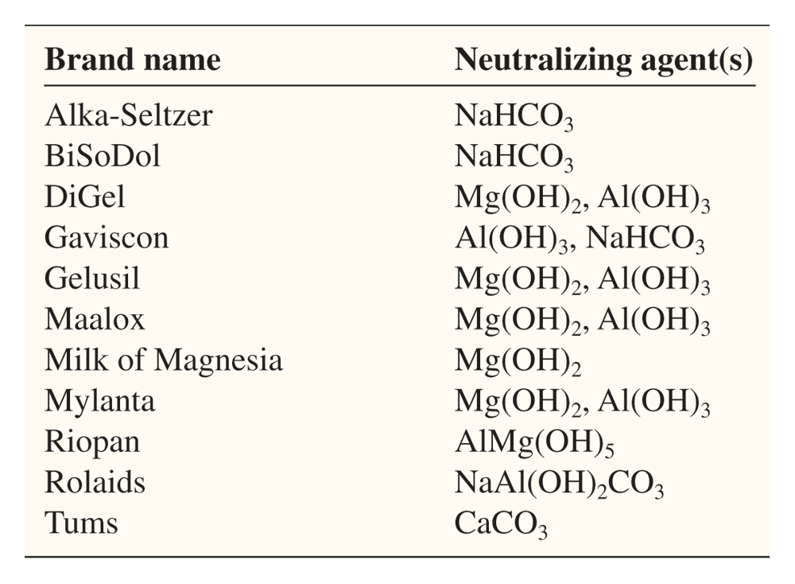
Common anti-acids
CC 10.1

Slide 15
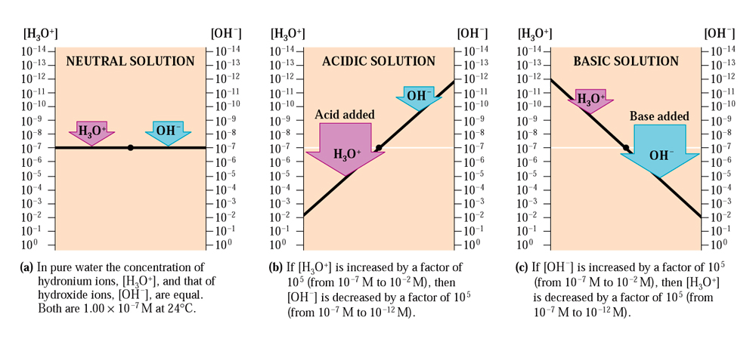
H₃O⁺ and OH⁻ ion concentrations flip-flop
Fig. 10.9
The relationship between H₃O+ and OH- in aqueous solution is an inverse proportion.

Slide 16
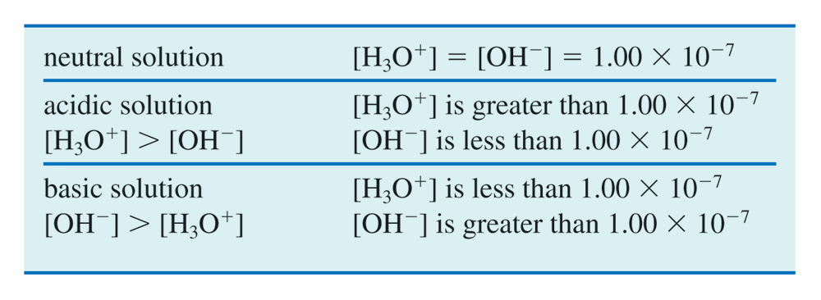
[H₃O⁺] and [OH⁻] ion product is constant
Table 10.5

Slide 17
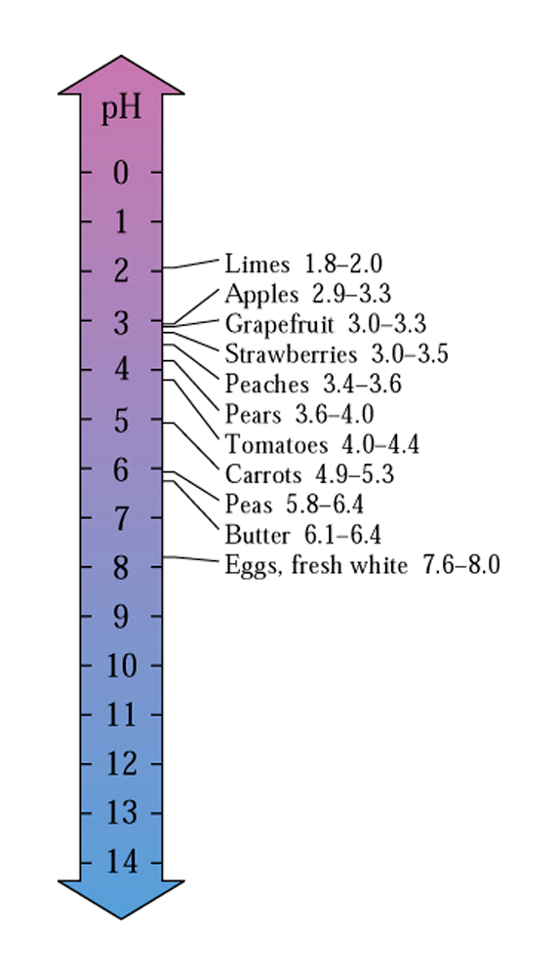
pH of aqueous solutions
Fig. 10.10
Most fruits and vegetable are acidic.

Slide 18
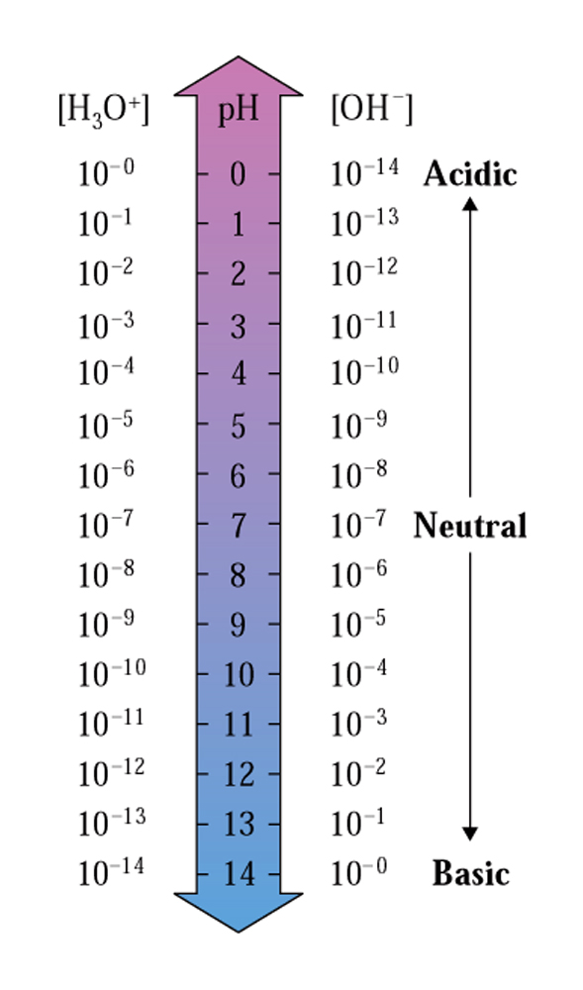
[H₃O⁺] and [OH⁻] ion concentrations
Fig. 10.11
Relationship among pH values, H₃O+ and OH- at 24 degrees Celsius .

Slide 19
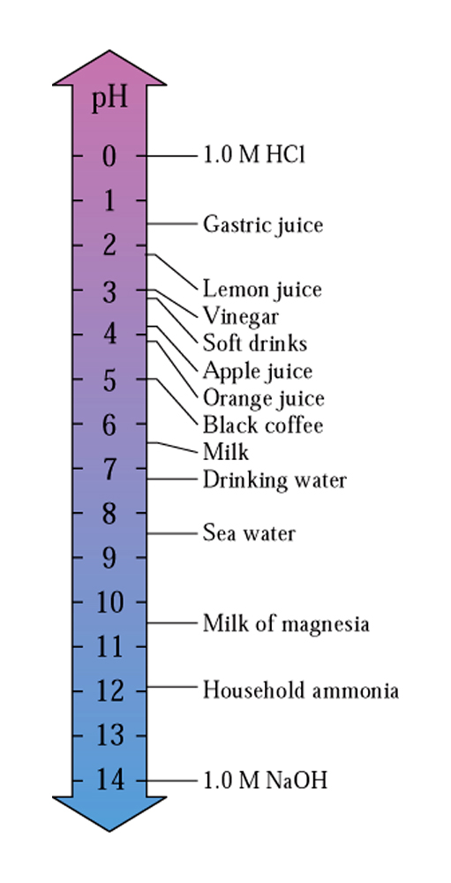
pH of different solutions
Fig. 10.12
pH values of selected common liquids.

Slide 20
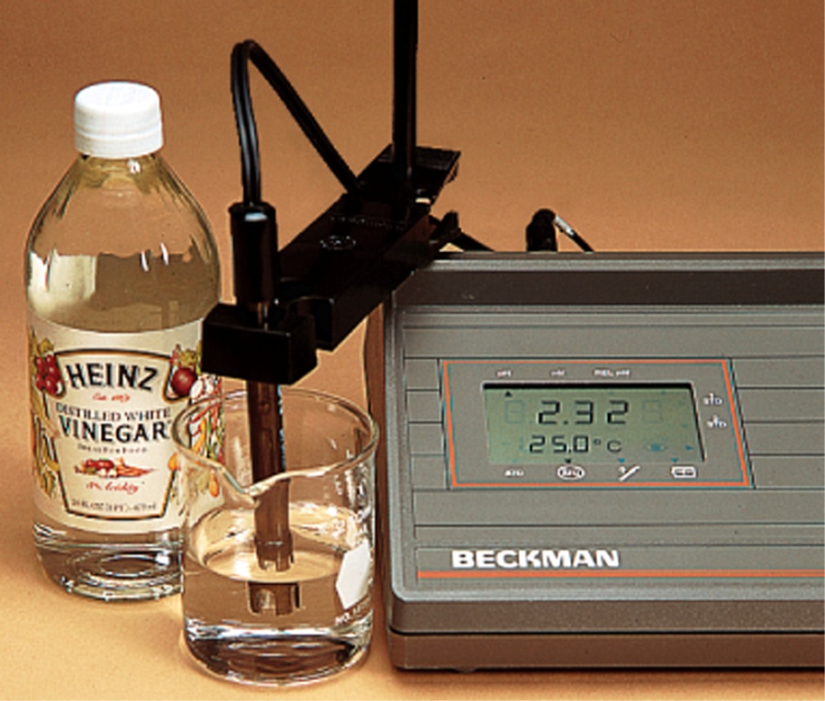
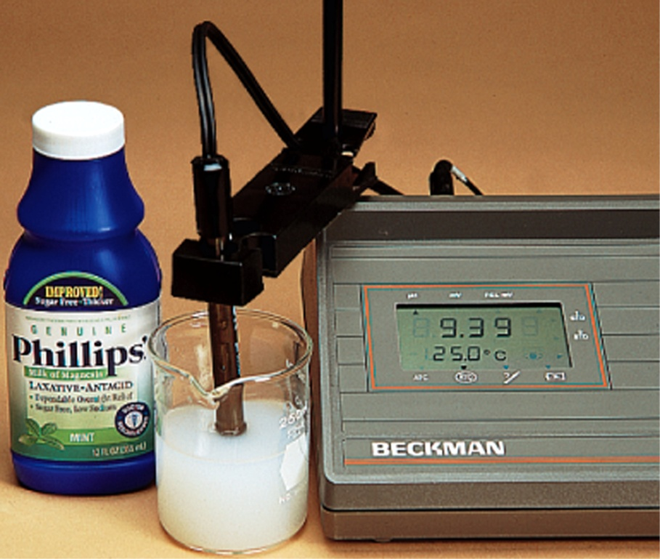
pH meter is helpful
Fig. 10.13
A pH meter gives an accurate measurement of pH values.

Slide 21
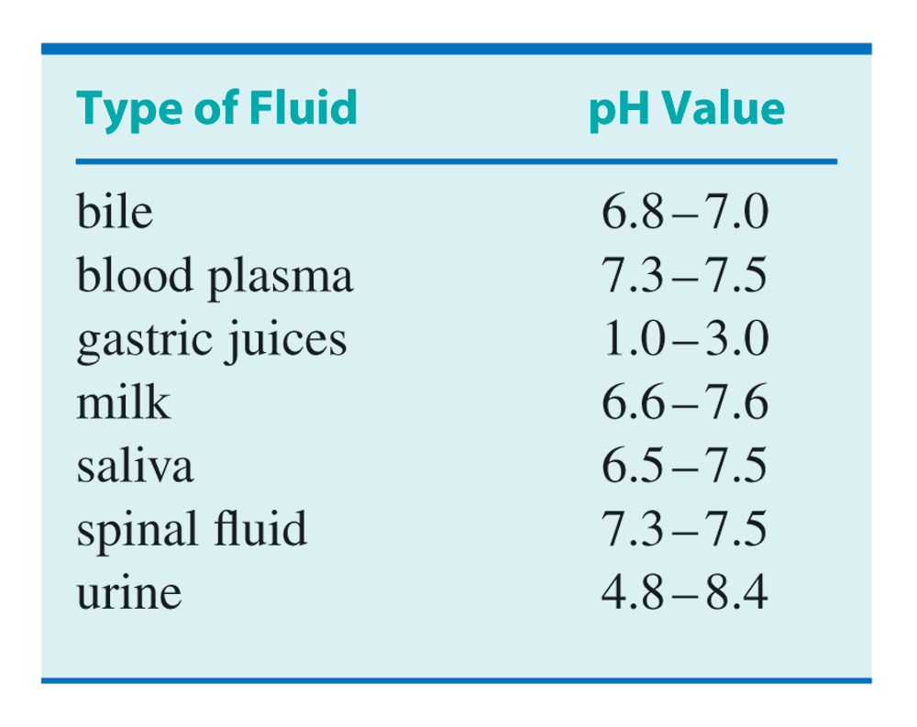
pH of body fluids
Table 10.6

Slide 22
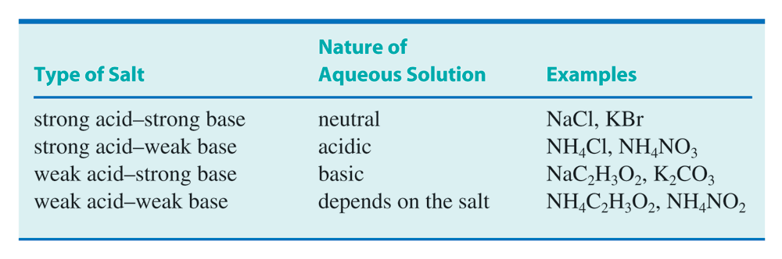
Acidity/basicity of salt solutions
Table 10.7

Slide 23
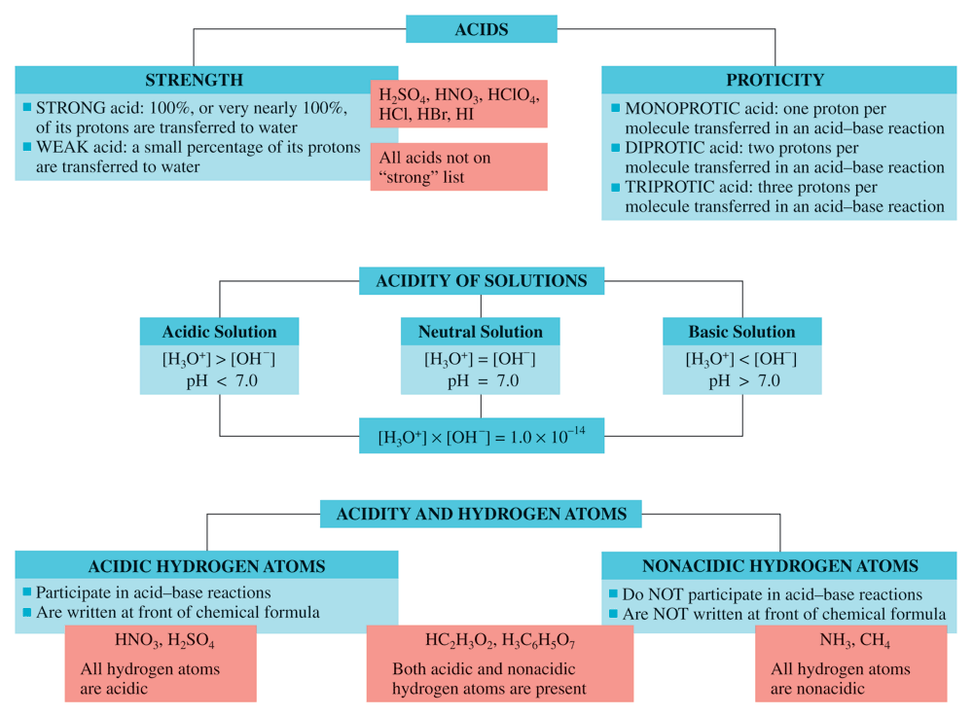
Summary of acids
CAG 10.1

Slide 24
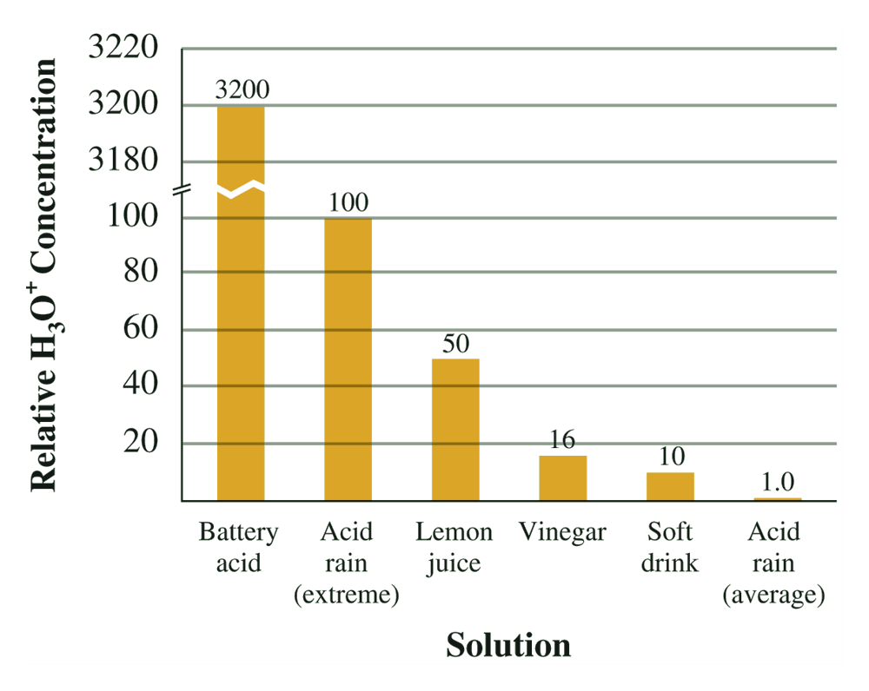
Acidity of various solutions
CC 10.2
Acid Rain

Slide 25
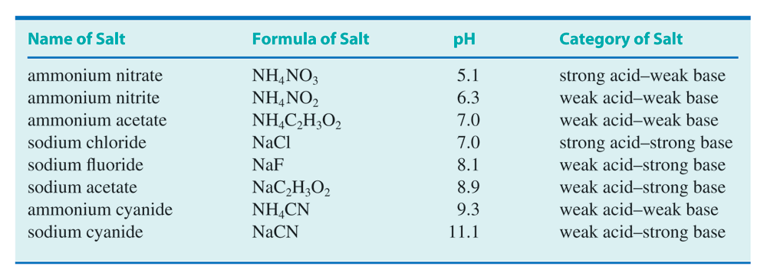
Predicting pH of salts solutions
Table 10.8

Slide 26
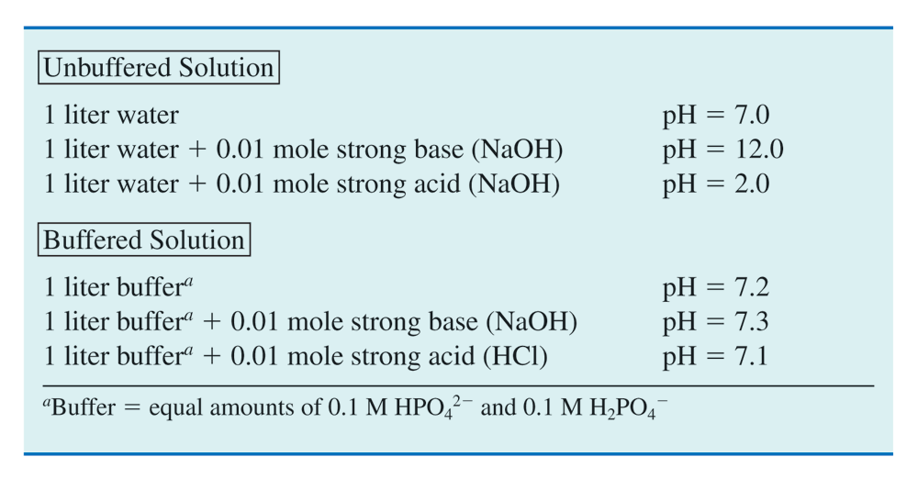
Buffers solutions compared to unbuffered
Table 10.9

Slide 27
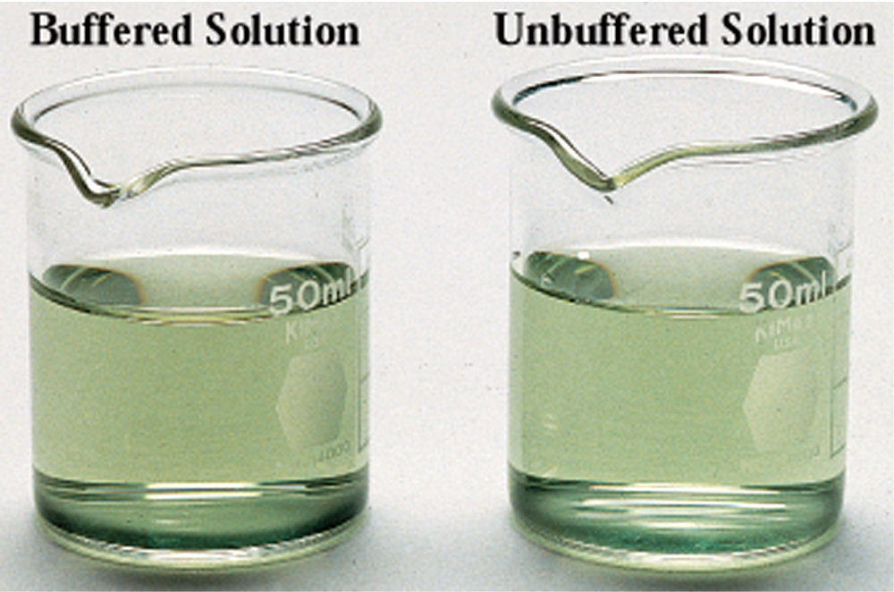
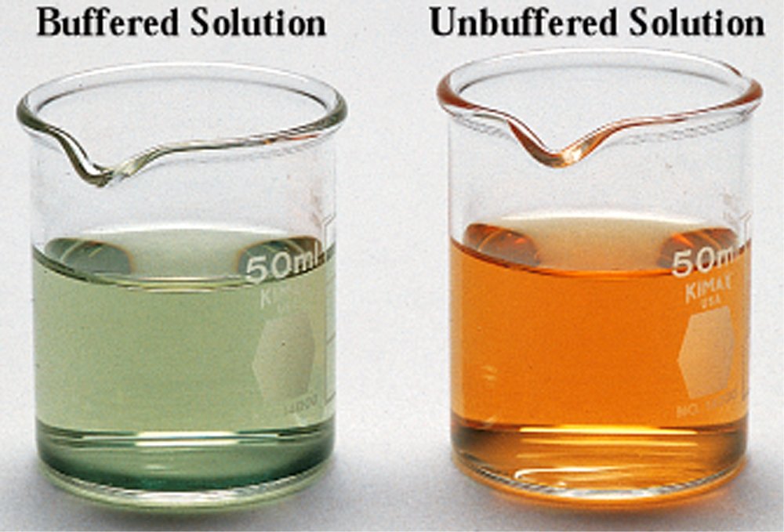
Buffers solutions compared to unbuffere
Ken O’Donoghue © Houghton Mifflin Company
Ken O’Donoghue © Houghton Mifflin Company
Fig. 10.14 (a) The buffered and unbuffered solutions have the same pH level.
Fig. 10.14 (b) After adding 1mL of a 0.01 M HCl solution, the pH of the buffered solution has not perceptibly changed, but the unbuffered solution has become acidic.

Slide 28
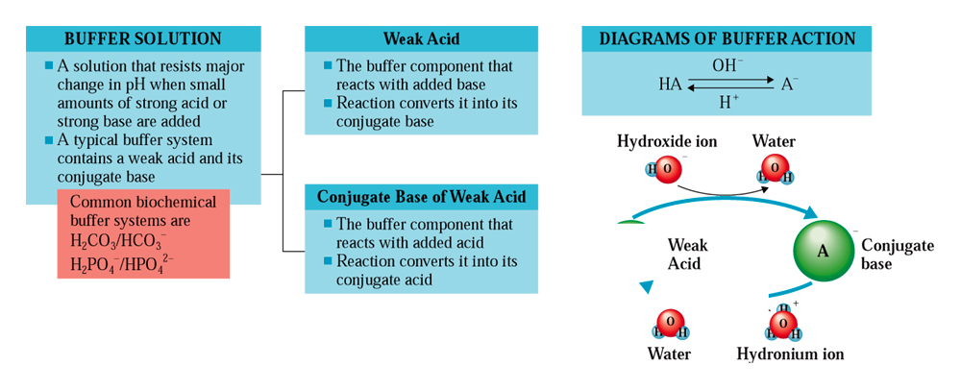
How buffers are made?
CAG 10.2

Slide 29
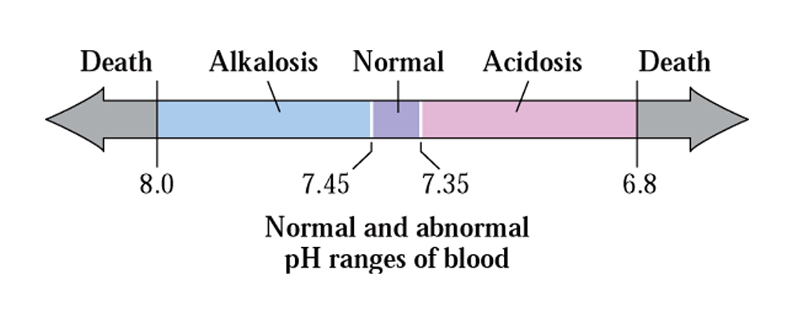
pH of blood. Does it matters?
CC 10.4

Slide 30
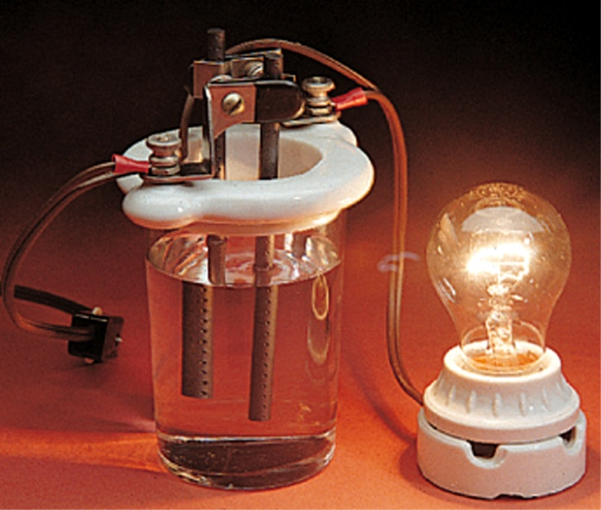
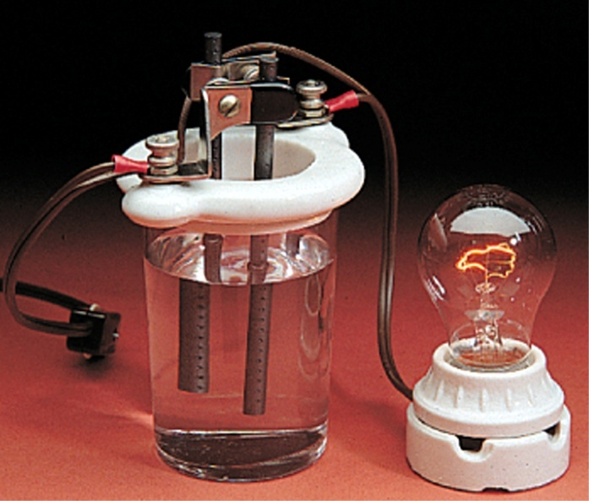
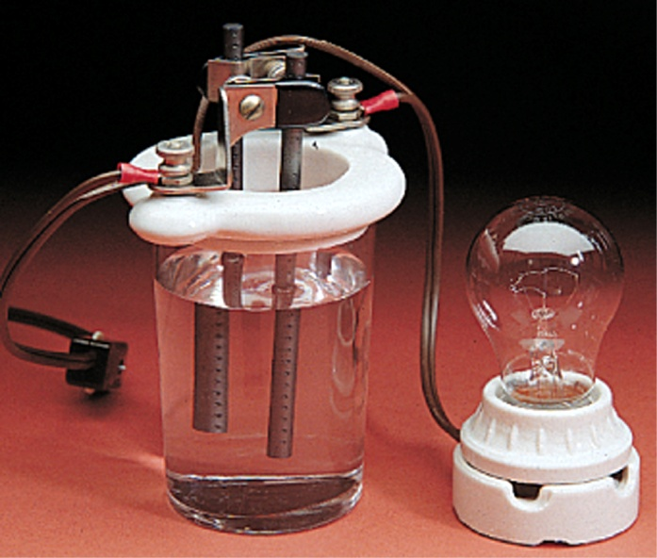
How you tell something is an electrolytes, weak electrolytes, or nonelectrolyte?
Fig. 10.15
This simple device can be used to distinguish among strong electrolytes, weak electrolytes, and nonelectrolytes.

Slide 31
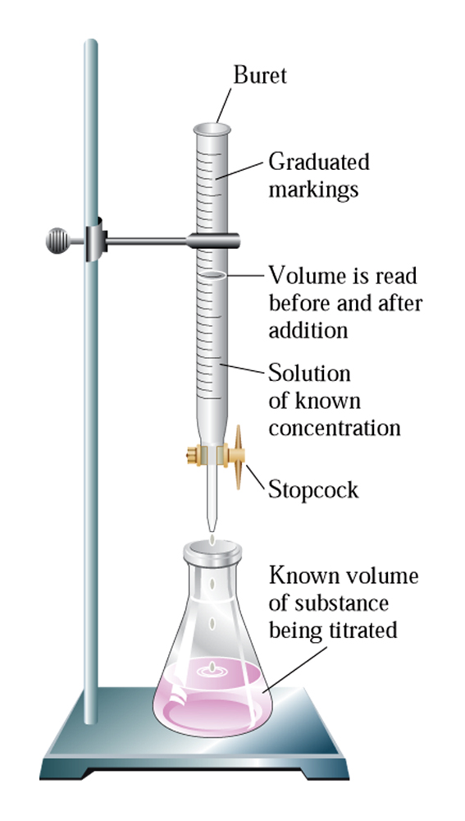
Acids/base titrations: How you do it?
Fig. 10.16
Diagram showing setup for titration procedures.

Slide 32
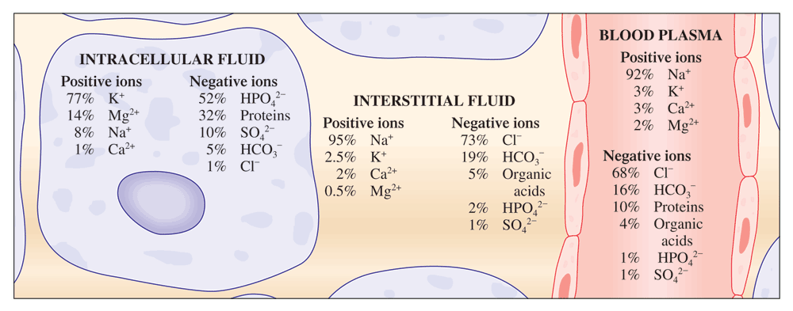
Electrolytes in Body Fluids
CC 10.5
Electrolyte and Body Fluids

Slide 33
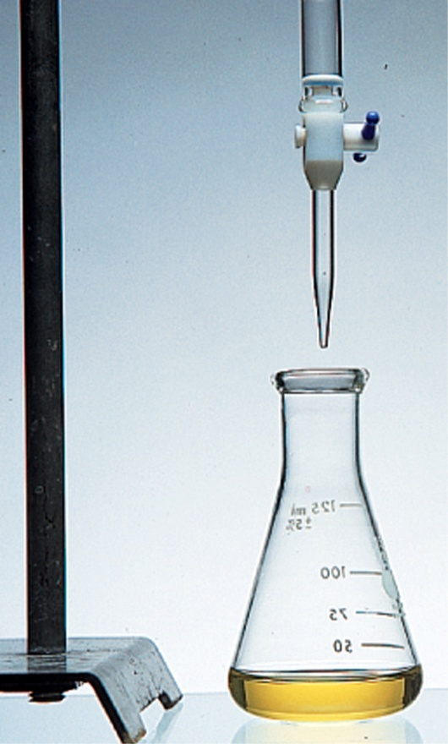
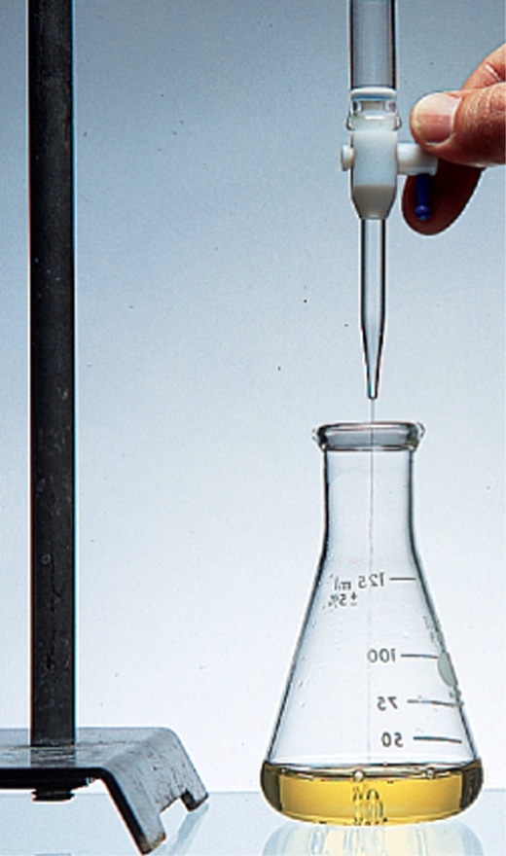
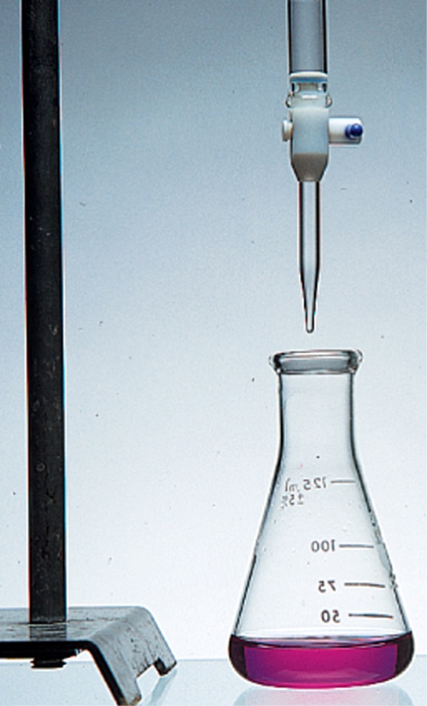
How does indicator show the end point?
Fig. 10.17
An acid-base titration using an indicator that is yellow in acidic solution and red in basic solution.

