Slide 1
Chapter One
Basic Concepts of Matter
Notes:
1

Slide 2
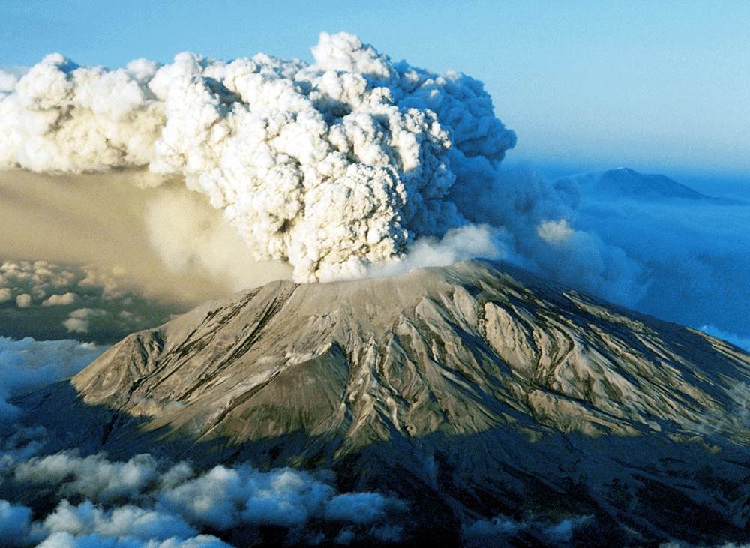
Basic Concepts of Matter
Volcano Burning
© Gary Braasch/CORBIS
Notes:
2

Slide 3
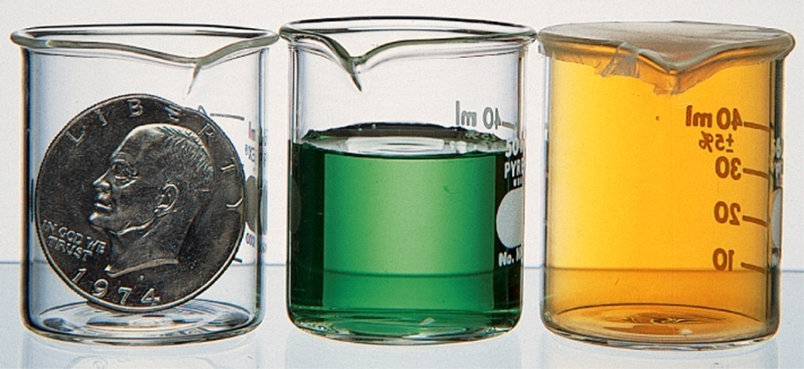
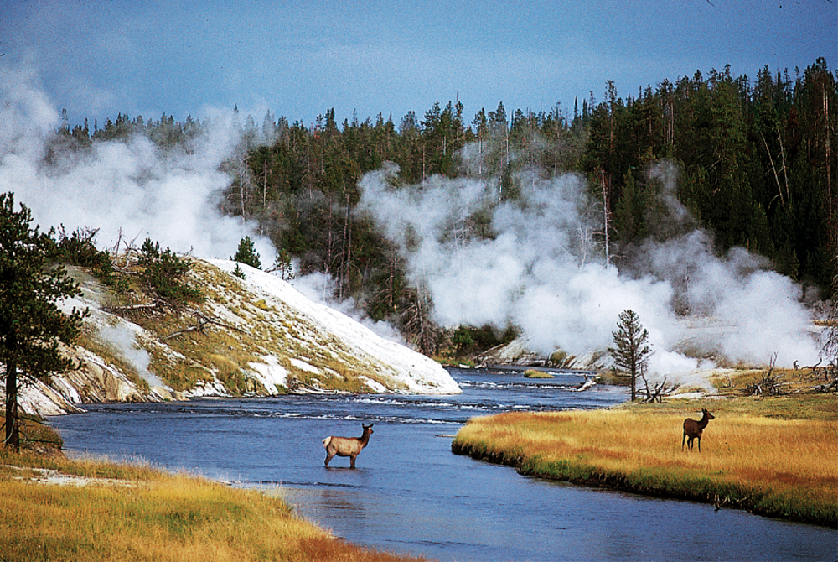
Three States of Matter
Solid, liquid, and gas states
Water can be found in the solid, liquid, and vapor (gaseous) forms simultaneously.
David Schultz/Getty Images
Notes:
3

Slide 4
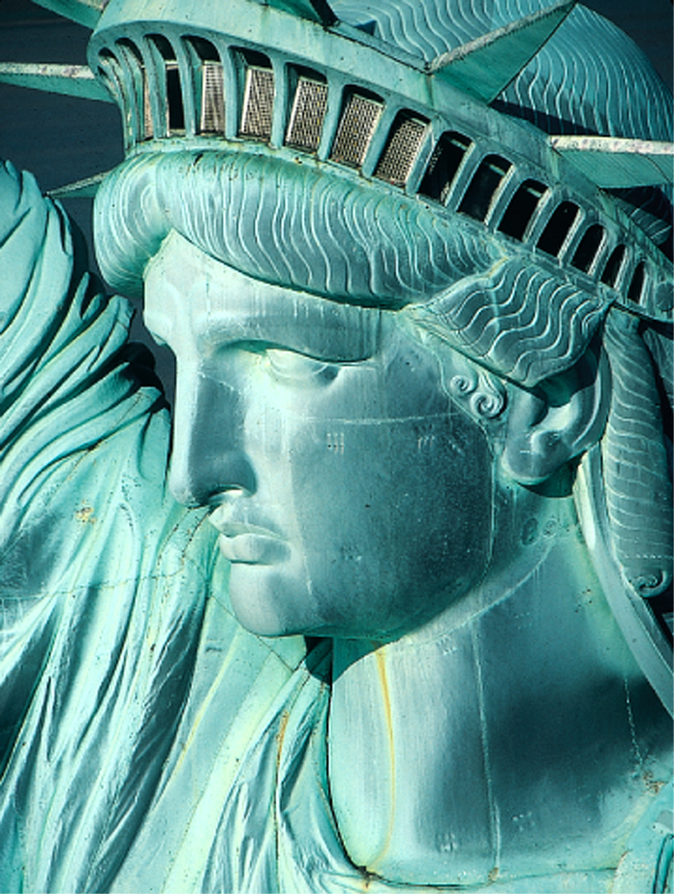
Chemical Reactions
Fig. 1.3
The green color of the Statue of Liberty results from the reaction of copper with the components of air.
Andy Levin/Photo Researchers
Notes:
4

Slide 5
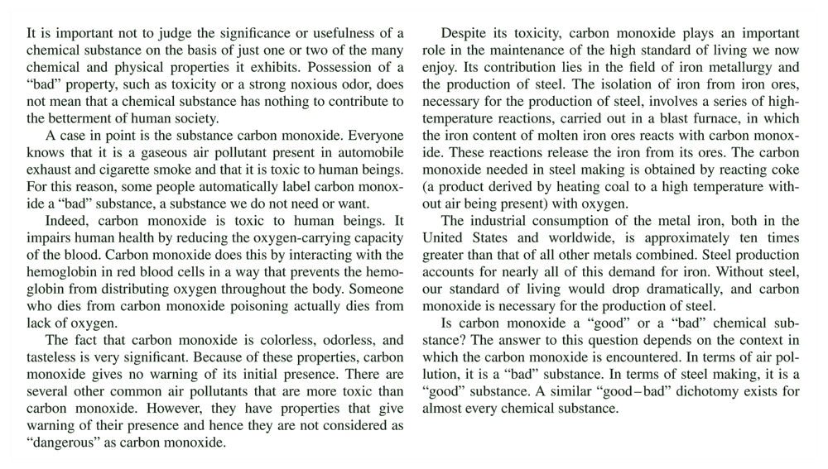
Chemical Substances
"Good" versus "Bad" Properties for a Chemical Substance
Notes:
5

Slide 6
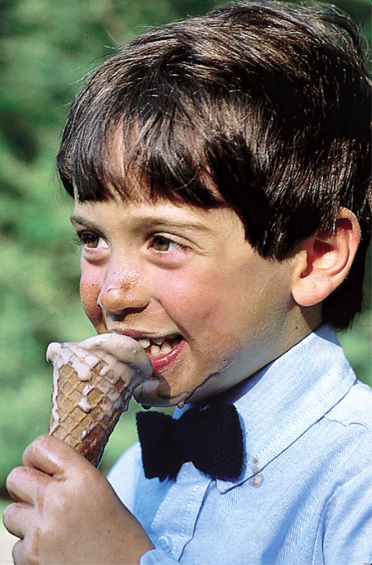
Changes of States
The melting of ice cream is a physical change involving a change of state; solid turns to liquid.
Notes:
6

Slide 7

Rusting is a chemical reaction
As a result of chemical change, bright steel girders become rusty when exposed to moist air.
Notes:
7

Slide 8
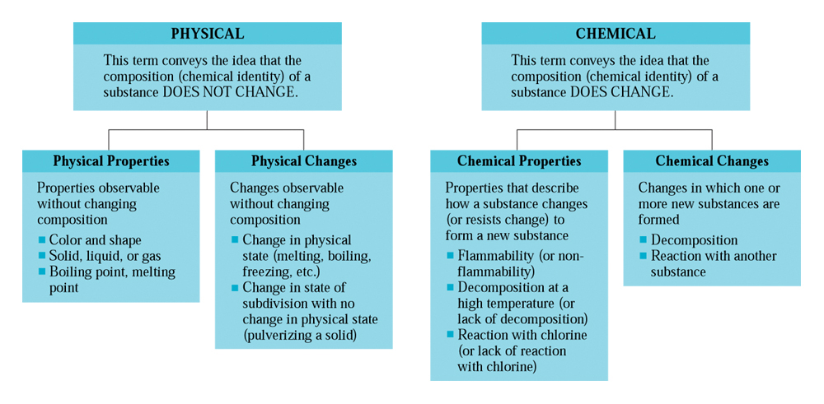
Physical Vs. Chemical changes
Notes:
8

Slide 9
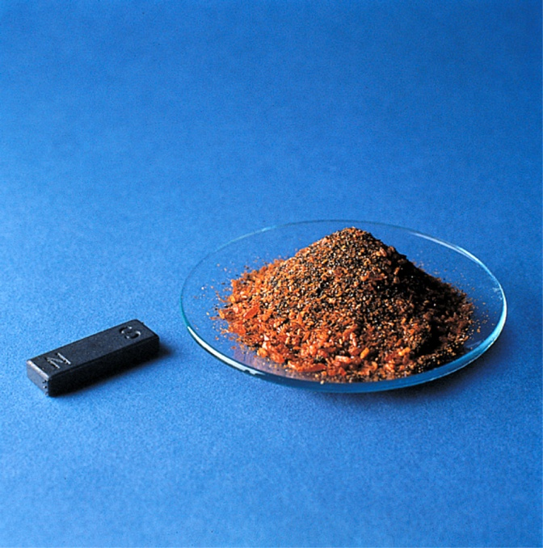
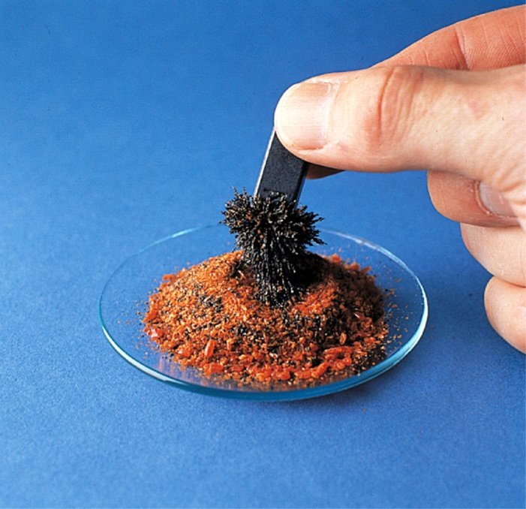
Magnetic separations
Fig. 1.6a
James Scherer
James Scherer
A magnet and a mixture consisting of potassium dichromate (orange crystals) and iron fillings.
(b) The magnet can be used to separate the iron fillings from the potassium dichromate.
Notes:
9

Slide 10
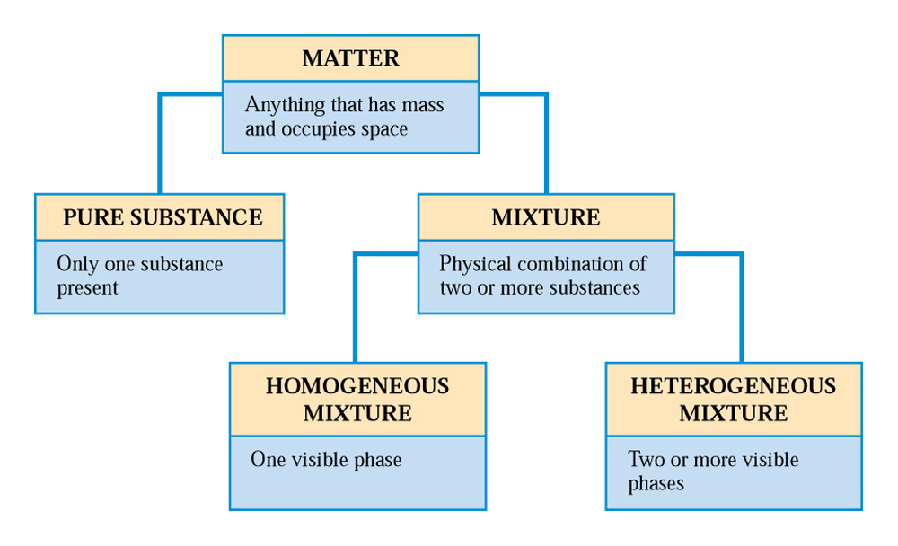
Classification of matter
Fig 1.7 Matter falls into two basic classes; pure substances and mixtures. Mixtures, in turn, may be homogeneous or heterogeneous.
Notes:
10

Slide 11
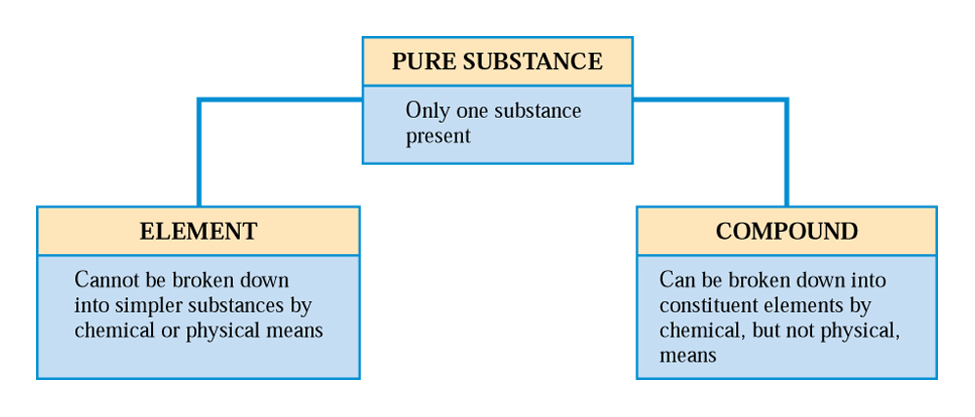
Pure substances
Fig 1.8 A pure substance can be either an element or a compound.
Notes:
11

Slide 12
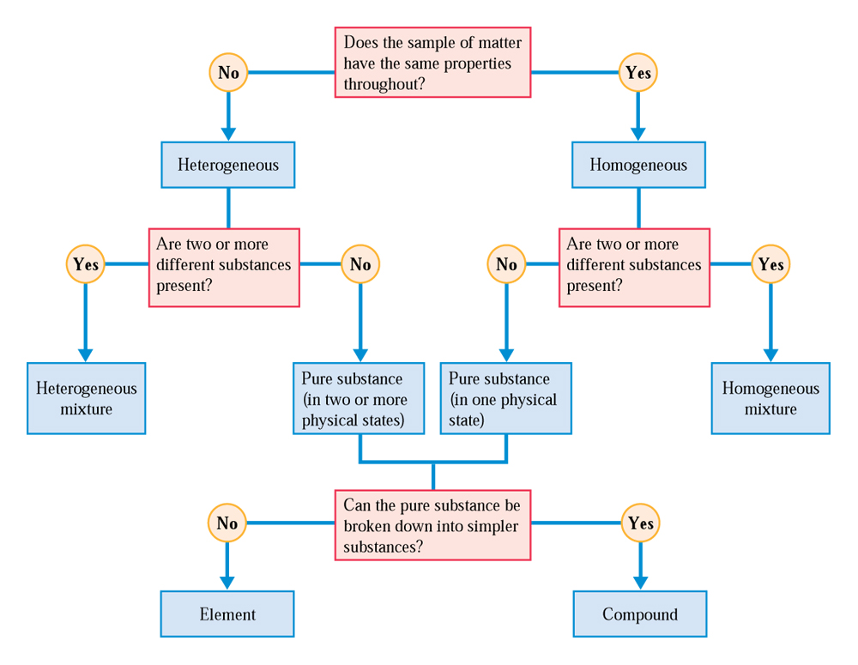
Classification of matter cont’d
Fig. 1.9
Questions used in classifying matter into various categories.
Notes:
12

Slide 13
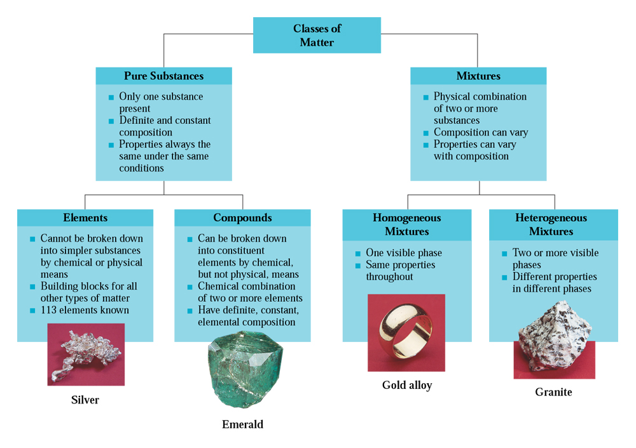
Classification of matter cont’d
CAG 1.2
Notes:
13

Slide 14
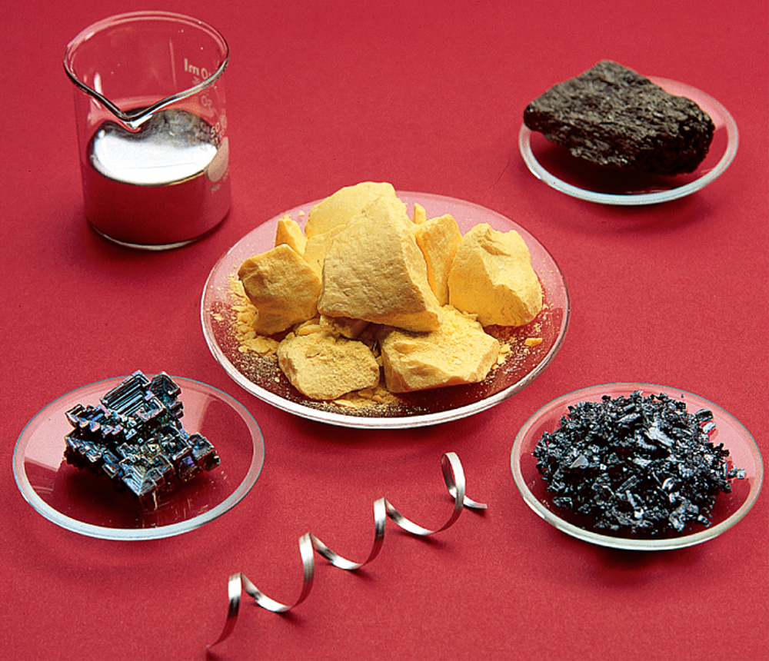
Elements and properties
Fig. 1.10
Outward physical appearance of naturally occurring elements
Notes:
14

Slide 15
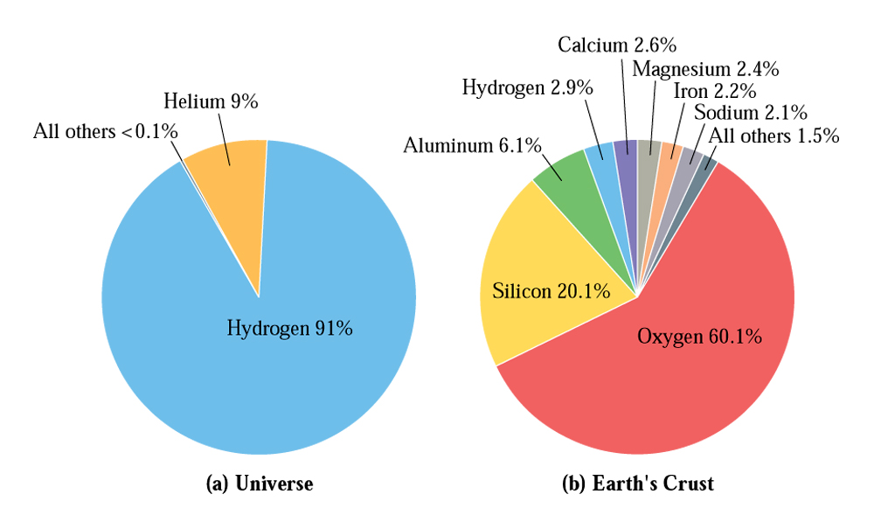
Abundance of Elements
Abundance of elements in the universe and in Earth’s crust (in atom percent)
Notes:
15

Slide 16
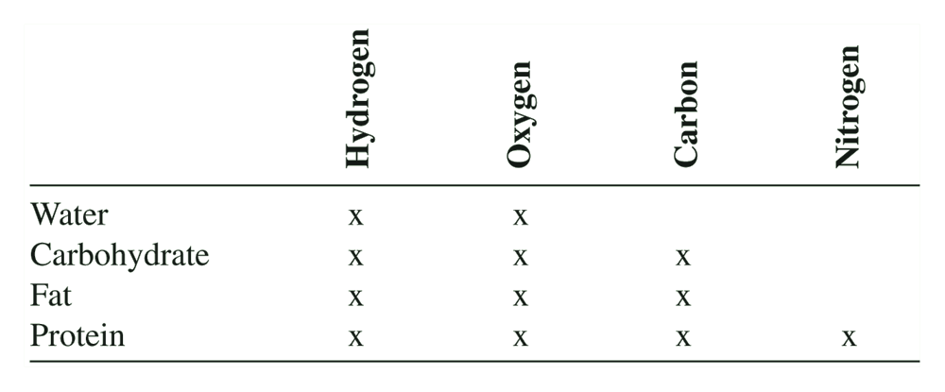
Elements of human body
C.C. 1.2 Elemental Composition of the Human Body
Notes:
16

Slide 17
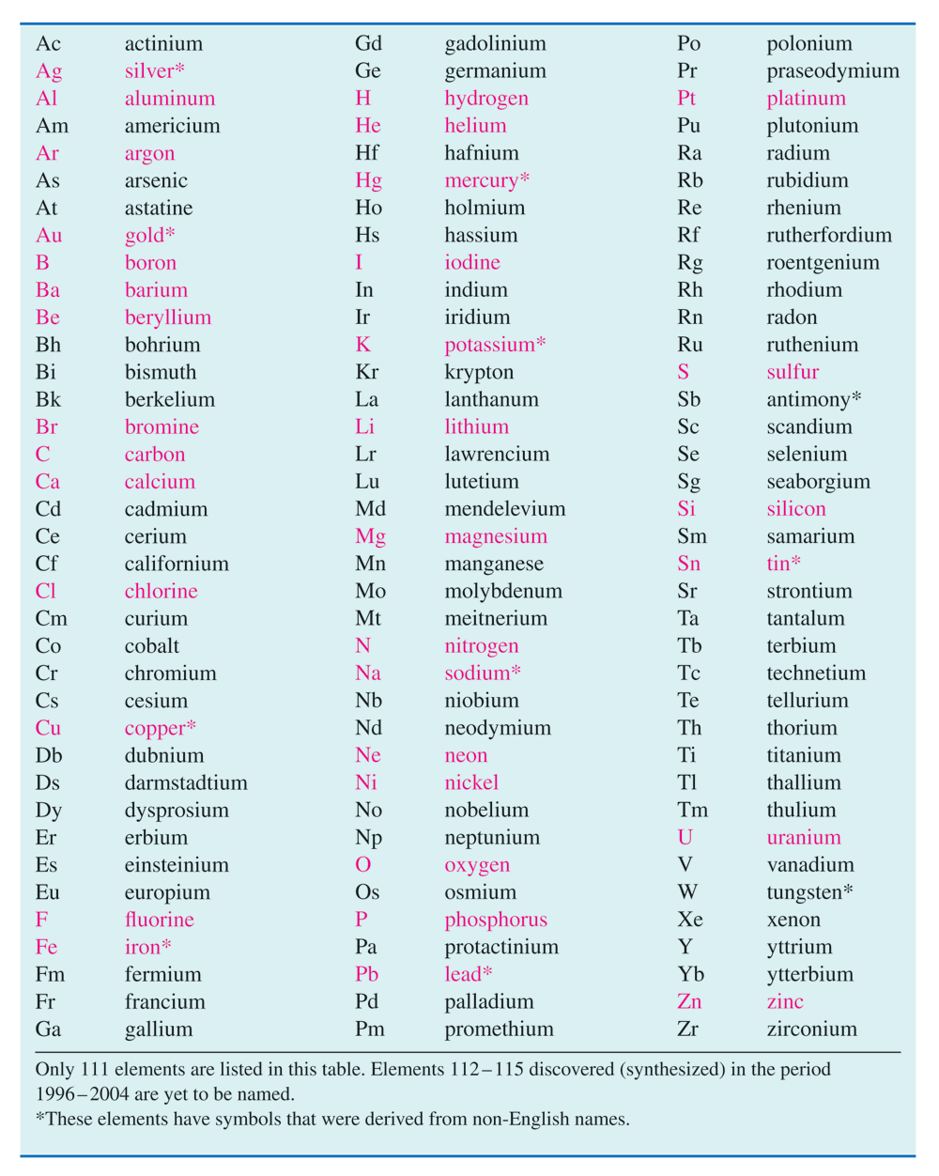
Naming elements
Table 1.1
Notes:
17

Slide 18
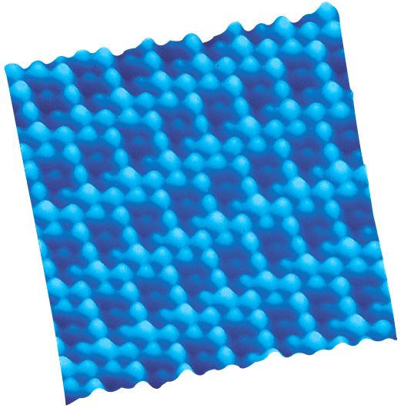
Can we see atoms?
Fig. 1.12 A computer reconstruction of the surface of a sample of graphite (carbon) as observed with a scanning tunneling microscope. The image reveals the regular pattern of individual carbon atoms. The color was added to the image by computer.
Image courtesy of Veeco Instruments Inc.
Notes:
18

Slide 19
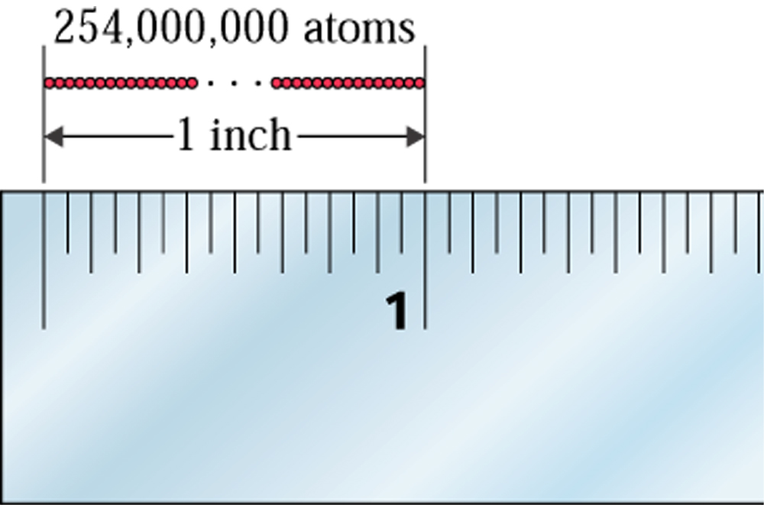
Size of atoms
Fig. 1.13
254 million atoms arranged in a straight line would extend a distance of approximately 1 inch.
Notes:
19

Slide 20
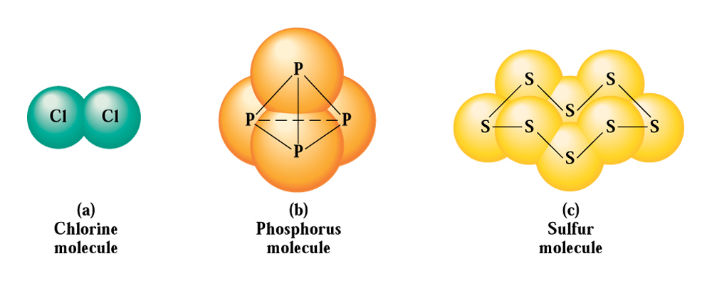
Molecular structure
Fig 1.14 Molecular structure of (a) chlorine, (b) phosphorus, and (c) sulfur
Notes:
20

Slide 21
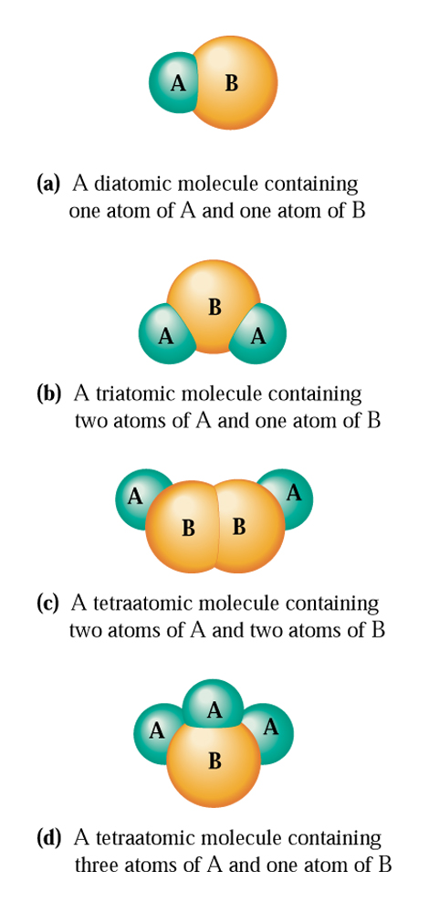
Basic Concepts of Matter cont’d
Fig. 1.15
Depictions of various simple heteroatomic molecules using models. Spheres of different sizes and colors represent different kinds of atoms.
Notes:
21

Slide 22
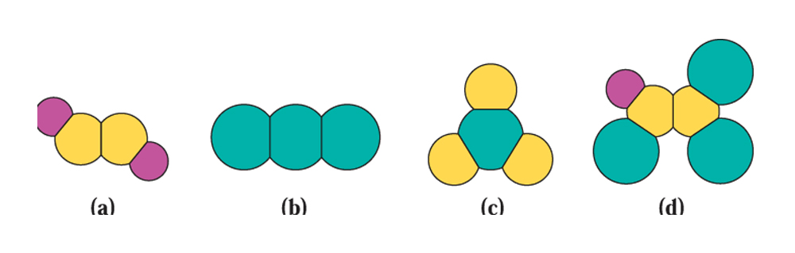
Homo- and heteo-atomic molecules
Example 1.2
Classify each of the following molecules as (1) diatomic, triatomic, etc. (2) homoatomic or heterotomic and (3) representing an element of a compound.
Notes:
22

Slide 23
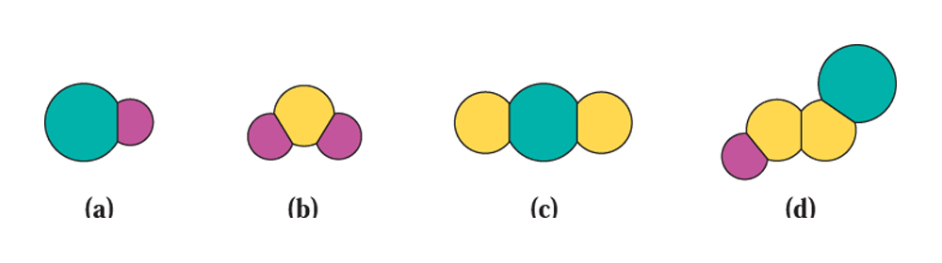
What type of molecules?
Practice Example 1.2
Classify each of the following molecules as (1) diatomic, triatomic, etc. (2) homoatomic or heterotomic and (3) representing an element of a compound.
Notes:
23

