Slide 1
Chapter 8. Solutions
Introduction to Inorganic Chemistry
Instructor Dr. Upali Siriwardane (Ph.D. Ohio State)
E-mail: upali@latech.edu
Office: 311 Carson Taylor Hall ; Phone: 318-257-4941;
Office Hours: MWF 8:00-9:00 and 11:00-12:00;
TR 10:00-12:00
Contact me trough phone or e-mail if you have questions
Online Tests on Following days
March 24, 2017: Test 1 (Chapters 1-3)
April 10, 2017 : Test 2 (Chapters 4-5)
April 28, 2017: Test 3 (Chapters 6,7 &8)
May 12, 2017 : Test 4 (Chapters 9, 10 &11)
May 15, 2017: Make Up Exam: Chapters 1-11)
.

Slide 2
8.1 Characteristics of Solutions
8.2 Solubility
8.3 Solution Formation
8.4 Solubility Rules
8.5 Solution Concentration Units
8.6 Dilution
8.7 Colloidal Dispersions and Suspensions
8.8 Colligative Properties of Solutions
8.9 Osmosis and Osmotic Pressure

Slide 3
What is a “Solution”?
A homogeneous mixture of two or more substances with each substance retaining its own chemical identity.
Components of a solution
  Solute – component of a solution that is present in a lesser amount relative to that of the solvent; substance being dissolved.
  Solute could be a gas, liquid or solid
  Solvent – component of a solution that is present in the greatest amount; liquid water.

Slide 4
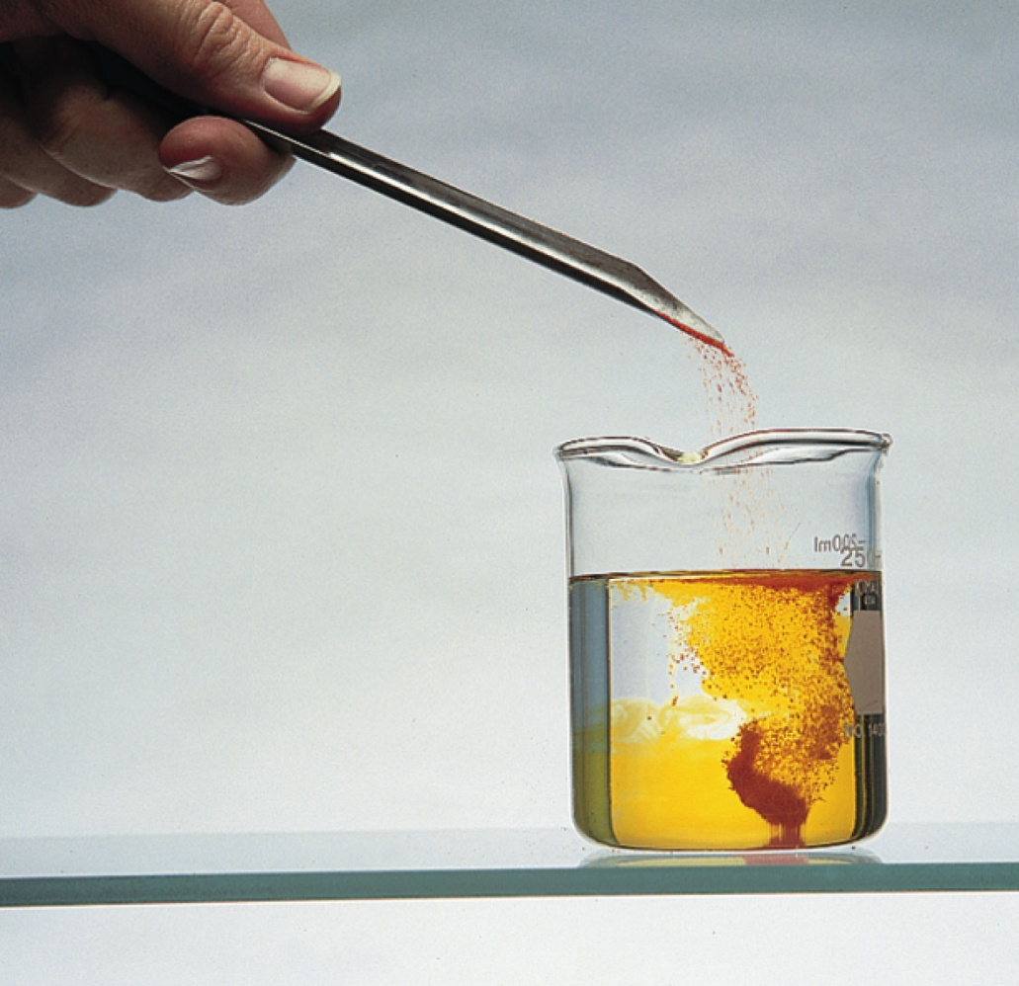
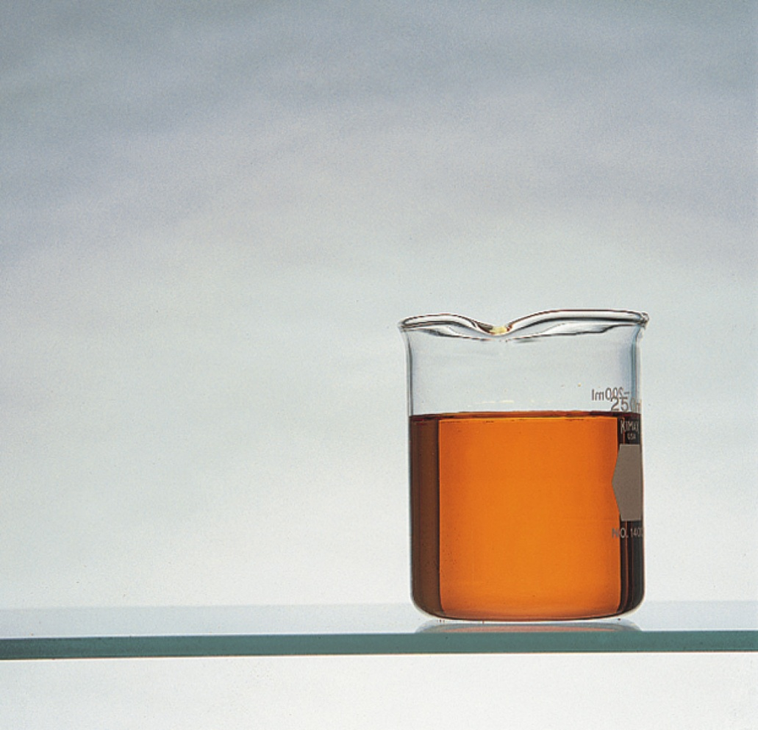
Colored Crystals (Solute-K₂Cr₂O₇) Mixed with Water (Solvent)

Slide 5
General Properties of a Solution
Contains 2 or more components.
Has variable composition.
Properties change as the ratio of solute to solvent is changed.
Dissolved solutes are present as individual particles (molecules, atoms, or ions).
Solutes remain uniformly distributed and will not settle out with time.
Solute generally can be separated from the solvent by physical means such as evaporation.

Slide 6
The maximum amount (g) of solute that will dissolve in a given amount of solvent (100 g) under a given set of conditions at certain temperature.

Slide 7
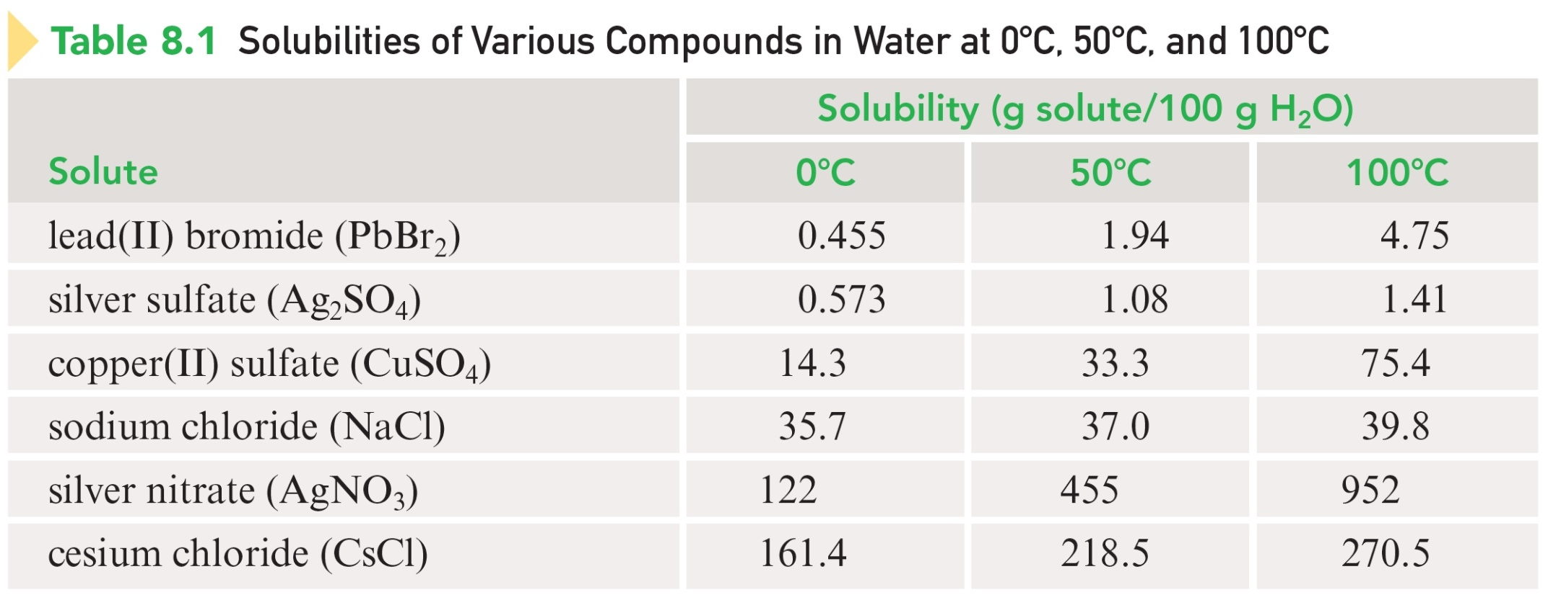
Effect of Temperature on Solubility
Most solids become more soluble in water with increasing temperature.

Slide 8
Effect of Temperature on Solubility compared to gases
In contrast, gas solubility in water decrease with increasing temperature.
Eg. Solubility of sugar (C₁₂H₂₂O₁₁) increases.
Eg. Solubility of CO₂ in water decreases.

Slide 9
Effect of Pressure on Solubility
Pressure has little effect on the solubility of solids and liquids in water.
Pressure has major effect on the solubility of gases in water.
Eg. Solubility of CO₂ in water increases with pressure.

Slide 10
Henry’s Law (for gas solubility in a liquid)
The amount of gas that will dissolve in a liquid (P) at a given temperature is directly proportional to the partial pressure (P_{x}) of the gas above the liquid.
S = K_{h} P_{x}
K_{h} = Henry’s constant for the system
As the pressure of a gas above the liquid increases, the solubility of the gas increases.
Eg. CO₂ in water (carbonated water)

Slide 11
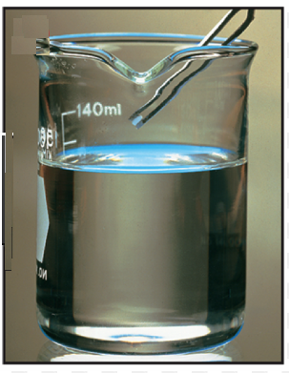
Unsaturated Solution
A solution that contains less than the maximum amount of solute that can be dissolved under the conditions at which the solution exists.
Most solutions we encounter fall into this category.

Slide 12
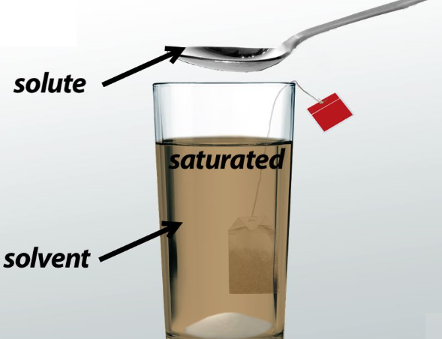
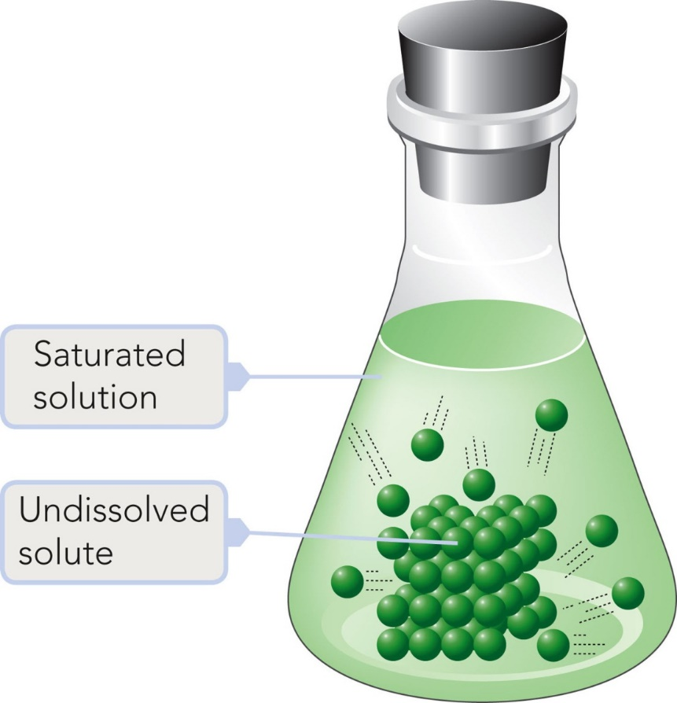
Saturated Solution
A stable solution that contains the maximum amount of solute that can be dissolved under the conditions at which the solution exists.

Slide 13
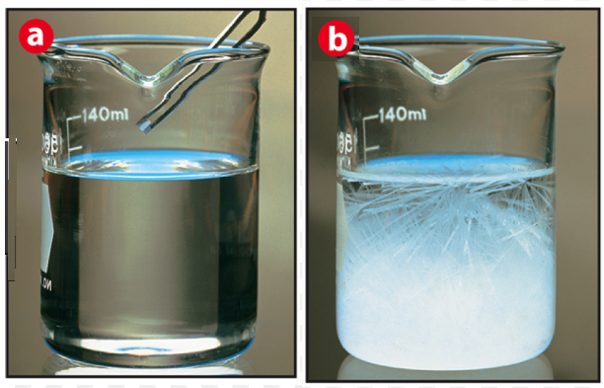
Supersaturated Solution
a) An unstable solution that temporarily contains more dissolved solute than that present in a saturated solution.
b) Will produce crystals rapidly, often in a dramatic manner, if it is slightly disturbed or if it is “seeded” with a tiny crystal of solute.
adding more solute by
heating A saturated solution
Then let the temperature reach
Normal and adding a seed crystal

Slide 14
Concentrated and Dilute Solutions
Concentrated Solution – a solution that contains a large amount of solute relative to the amount that could dissolve.
Dilute Solution – a solution that contains a small amount of solute relative to the amount that could dissolve.

Slide 15
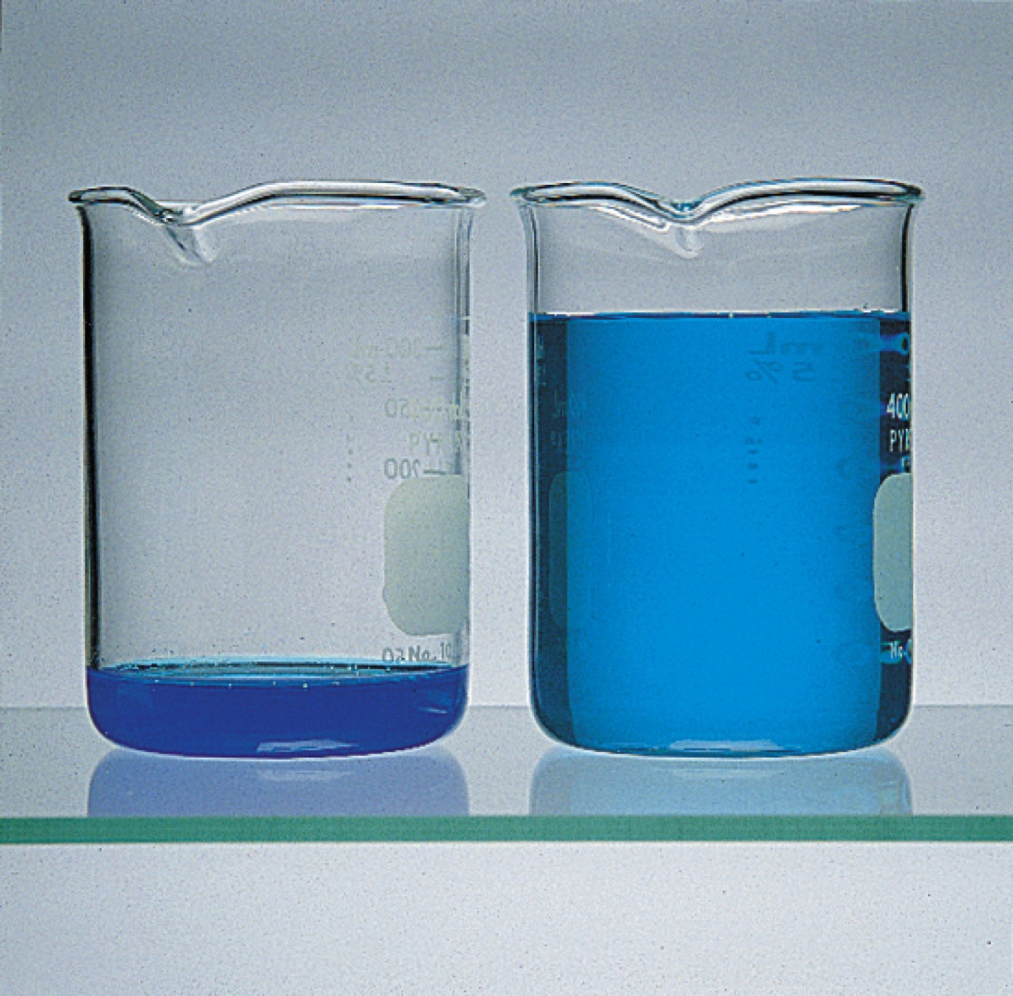
Concentrated and Dilute Solutions

Slide 16
Aqueous and Nonaqueous Solutions
Aqueous Solution – a solution in which water is the solvent.
Nonaqueous Solution – a solution in which a substance other than water is the solvent.
E.g. Ethanol (C₂H₅OH)

Slide 17
For a Solute to Dissolve in a Solvent
Two types of interparticle (molecules or ions) attractions must be overcome:
  Attractions between solute particles (solute-solute attractions).
  Attractions between solvent particles (solvent-solvent attractions).
New type of interaction forms:
  Attraction between solute and solvent particles (solute-solvent attractions.)

Slide 18
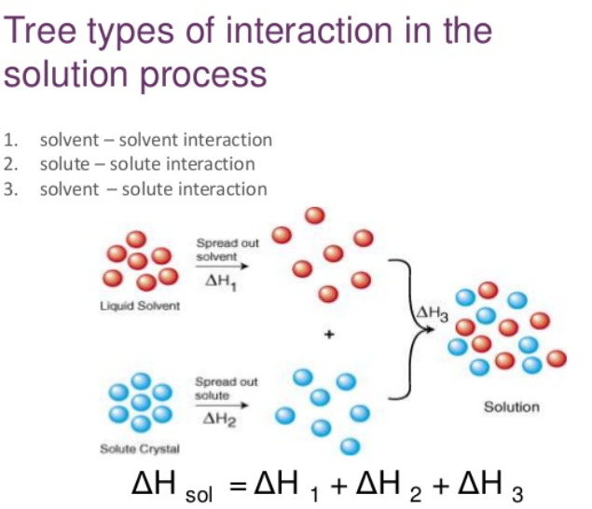
For a Solute to Dissolve in a Solvent

Slide 19
Dissolution of a Solid in a Liquid
https://www.youtube.com/watch?v=7PHhBBg-6X0
To play movie you must be in Slide Show Mode
PC Users: Please wait for content to load, then click to play
Mac Users: CLICK HERE

Slide 20
Factors Affecting the Rate of Solution Formation with solids
The state of subdivision (particle size) of the solute.
The degree of agitation during solution preparation.
The temperature of the solution components.

Slide 21
In general, it is found that the greater the difference in solute-solvent polarity (polar vs. non-polar), the less soluble is the solute.
Substances of like polarity (similar either polar or non-polar) tend to be more soluble in each other than substances that differ in polarity.
  “Like dissolves like” (for most covalent compounds)
  Use Solubility Guidelines for ionic compounds in water.

Slide 22
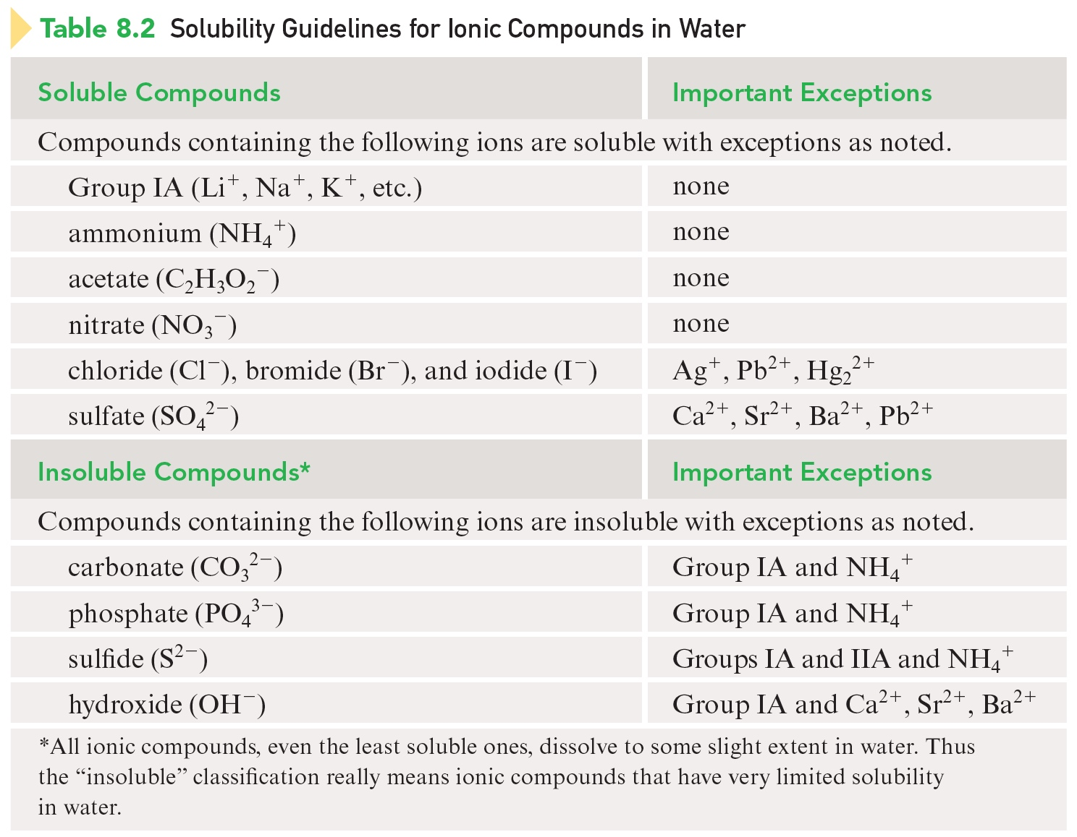
Solubility Guidelines for Ionic Compounds in Water

Slide 23

Concept Check
Which of the following ions form compounds with Pb²⁺ that are generally soluble in water?
  S^{2–}
  Cl–
  NO₃–
  SO₄^{2–}
  Na⁺
Notes:
a), b), and d) all form precipitates with Pb²⁺. A compound cannot form between Pb²⁺ and Na⁺.

Slide 24
Concept Check
Which of the following ions form compounds with Pb²⁺ that are generally soluble in water?
  S^{2–}
  Cl–
  NO₃–
  SO₄^{2–}
  Na⁺
Notes:
a), b), and d) all form precipitates with Pb²⁺. A compound cannot form between Pb²⁺ and Na⁺.

Slide 25
Concentration
The amount of solute present in a specified amount of solution.
Two Methods of Expressing Concentration:
  Percent Concentration
  Molarity

Slide 26
Percent Concentration
Three different ways of representing percent concentration:
  Percent by Mass
  Percent by Volume
  Mass-Volume Percent

Slide 27
Percent by Mass

Slide 28
Exercise
What is the percent-by-mass concentration of glucose in a solution made my dissolving 5.5 g of glucose in 78.2 g of water?
Notes:
[5.5 g / (5.5 g + 78.2 g)] × 100

Slide 29
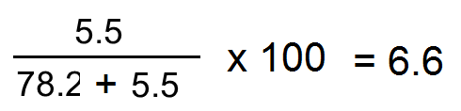
Exercise
What is the percent-by-mass concentration of glucose in a solution made my dissolving 5.5 g of glucose in 78.2 g of water?
6.6%
Notes:
[5.5 g / (5.5 g + 78.2 g)] × 100

Slide 30
Percent by Volume

Slide 31
Exercise
Calculate the volume percent of solute in 30.0 mL of methyl alcohol in enough water to give 435 mL of solution.
Notes:
[30.0 mL / 435 mL] × 100

Slide 32
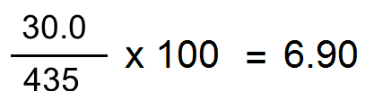
Exercise
Calculate the volume percent of solute in 30.0 mL of methyl alcohol in enough water to give 435 mL of solution.
6.90%
Notes:
[30.0 mL / 435 mL] × 100

Slide 33
Mass-Volume Percent

Slide 34
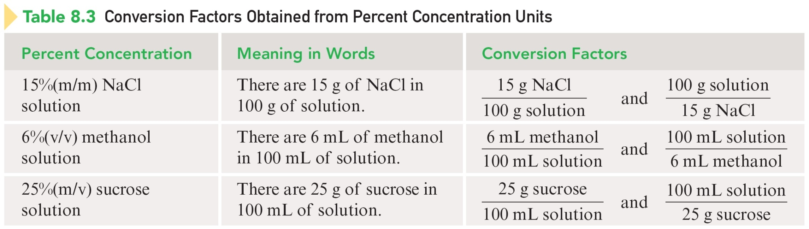
Conversion Factors Obtained From Percent Concentration Units

Slide 35
Molarity
Moles of solute in a solution divided by the liters of solution.

Slide 36
Exercise
You have 1.00 mol of sugar in 125.0 mL of solution. Calculate the concentration in units of molarity.
Notes:
1.00 mol / (125.0 / 1000)

Slide 37
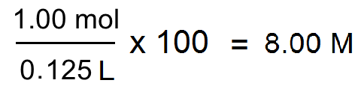
Exercise
You have 1.00 mol of sugar in 125.0 mL of solution. Calculate the concentration in units of molarity.
8.00 M
Notes:
1.00 mol / (125.0 / 1000)

Slide 38
Exercise
You have a 10.0 M sugar solution. What volume of this solution do you need to have 2.00 mol of sugar?
Notes:
2.00 mol / 10.0 M

Slide 39
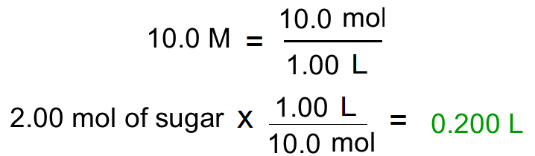
Exercise
You have a 10.0 M sugar solution. What volume of this solution do you need to have 2.00 mol of sugar?
0.200 L
Notes:
2.00 mol / 10.0 M

Slide 40
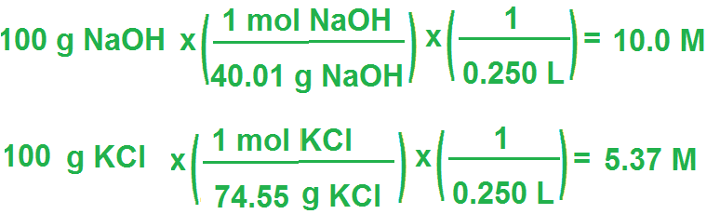
Exercise
Consider separate solutions of NaOH and KCl made by dissolving 100.0 g of each solute in 250.0 mL of solution. Calculate the concentration of each solution.
Notes:
[100.0 g NaOH / 39.998 g/mol] / [250.0 / 1000]
[100.0 g KCl / 74.55 g/mol] / [250.0 / 1000]

Slide 41
Exercise
Consider separate solutions of NaOH and KCl made by dissolving 100.0 g of each solute in 250.0 mL of solution. Calculate the concentration of each solution.
10.0 M NaOH
5.37 M KCl
Notes:
[100.0 g NaOH / 39.998 g/mol] / [250.0 / 1000]
[100.0 g KCl / 74.55 g/mol] / [250.0 / 1000]

Slide 42
The process in which more solvent is added to a solution in order to lower its concentration.
Dilution with water does not alter the numbers of moles of solute present.
Moles of solute before dilution = moles of solute after dilution

Slide 43
Dilution Calculations

Slide 44
Concept Check
A 0.50 M solution of sodium chloride sits on a lab bench. Which of the following would decrease the concentration of the salt solution?
  Add water to the solution.
  Pour some of the solution down the sink drain.
  Add more sodium chloride to the solution.
  Let the solution sit out in the open air for a couple of days.
  At least two of the above would decrease the concentration of the salt solution.
Notes:
For letter a), adding water to the solution will increase the total volume of solution and therefore decrease the concentration. For letter b), pouring some of the solution down the drain will not change the concentration of the salt solution remaining. For letter c), adding more sodium chloride to the solution will increase the number of moles of salt ions and therefore increase the concentration. For letter d), water will evaporate from the solution and decrease the total volume of solution and therefore increase the concentration. Therefore, since only letter a) would decrease the concentration, letter e) cannot be correct.

Slide 45
Concept Check
A 0.50 M solution of sodium chloride sits on a lab bench. Which of the following would decrease the concentration of the salt solution?
  Add water to the solution.
  Pour some of the solution down the sink drain.
  Add more sodium chloride to the solution.
  Let the solution sit out in the open air for a couple of days.
  At least two of the above would decrease the concentration of the salt solution.
Notes:
For letter a), adding water to the solution will increase the total volume of solution and therefore decrease the concentration. For letter b), pouring some of the solution down the drain will not change the concentration of the salt solution remaining. For letter c), adding more sodium chloride to the solution will increase the number of moles of salt ions and therefore increase the concentration. For letter d), water will evaporate from the solution and decrease the total volume of solution and therefore increase the concentration. Therefore, since only letter a) would decrease the concentration, letter e) cannot be correct.

Slide 46
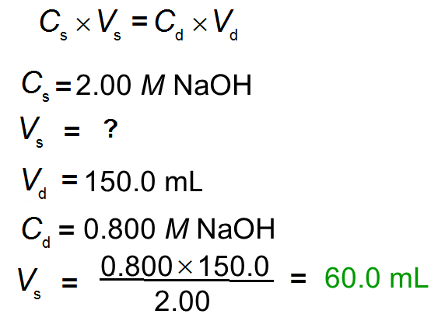
Exercise
What is the minimum volume of a 2.00 M NaOH solution needed to make 150.0 mL of a 0.800 M NaOH solution?
Notes:
The minimum volume needed is 60.0 mL. M₁V₁ = M₂V₂ (2.00 M)(V₁) = (0.800 M)(150.0 mL)

Slide 47
Exercise
What is the minimum volume of a 2.00 M NaOH solution needed to make 150.0 mL of a 0.800 M NaOH solution?
60.0 mL
Notes:
The minimum volume needed is 60.0 mL. M₁V₁ = M₂V₂ (2.00 M)(V₁) = (0.800 M)(150.0 mL)

Slide 48
Colloidal Dispersion
A homogeneous mixture that contains dispersed particles that are intermediate in size between those of a true solution and those of an ordinary heterogeneous mixture.
  Dispersed phase (like the solute)
  Dispersing medium (like the solvent (water))
  E.g. Milk

Slide 49
Tyndall Effect
The light-scattering phenomenon that causes the path of a beam of visible light through a colloidal dispersion to be observable.
  When we shine a beam of light through a true solution, we cannot see the track of the light.
  A beam of light passing through a colloidal dispersion can be observed because the light is scattered by the dispersed phase.

Slide 50
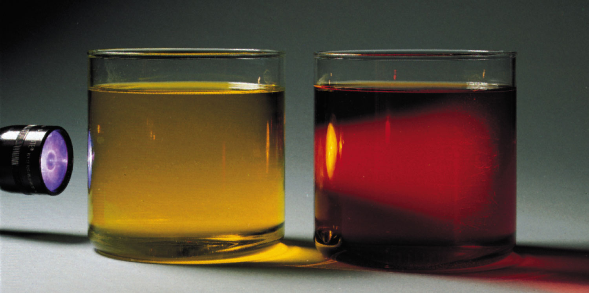
Yellow Solution (true) vs. Colloidal Dispersion in Red

Slide 51
Suspension
A heterogeneous mixture that contains dispersed particles that are heavy enough that they settle out under the influence of gravity.

Slide 52
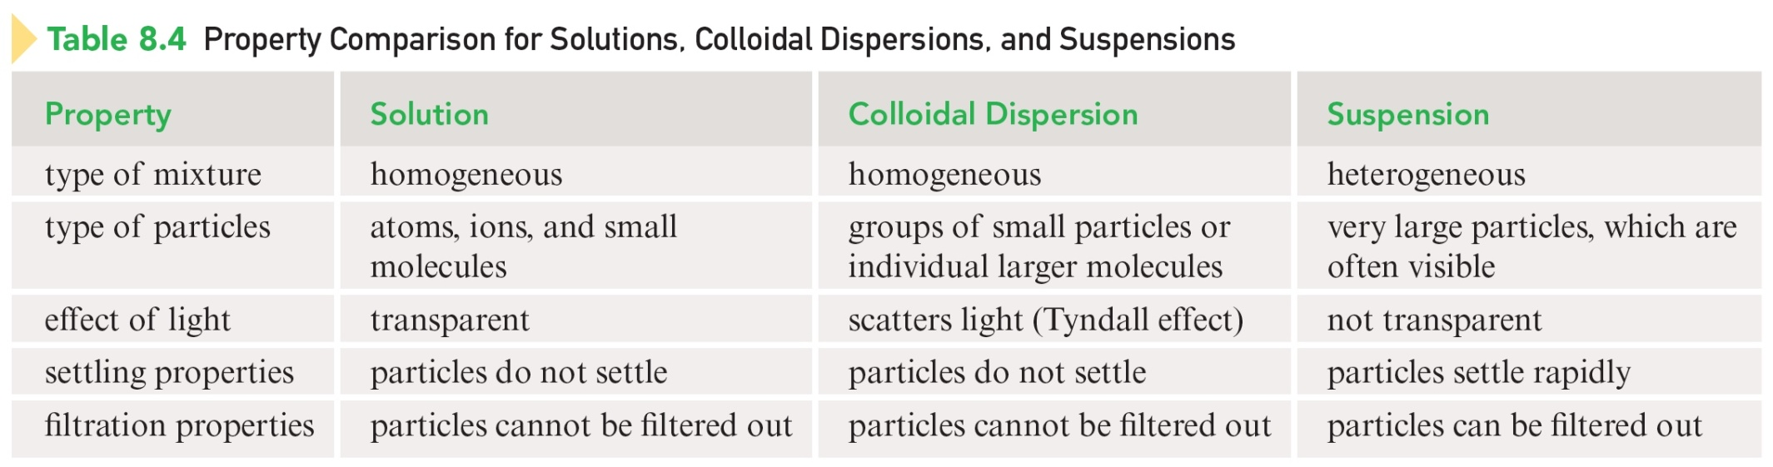
Property Comparison for Solutions, Colloidal Dispersions, and Suspensions

Slide 53
Colligative Property
A physical property of a solution that depends only on the number of solute particles (molecules or ions concentration) present in a given quantity of solvent and not on their chemical identities.
  Vapor-pressure lowering
  Boiling-point elevation
  Freezing-point depression
  Osmotic pressure

Slide 54
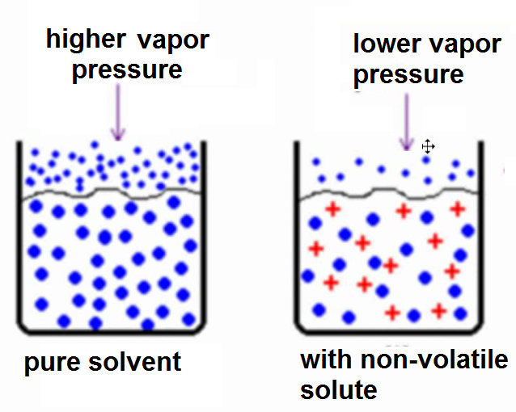
Vapor-Pressure Lowering
Adding a nonvolatile solute to a solvent lowers the vapor pressure of the resulting solution below that of the pure solvent at the same temperature.

Slide 55
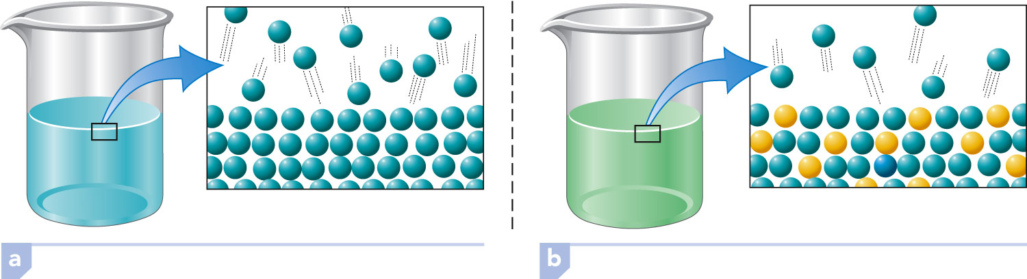
Vapor-Pressure Lowering

Slide 56
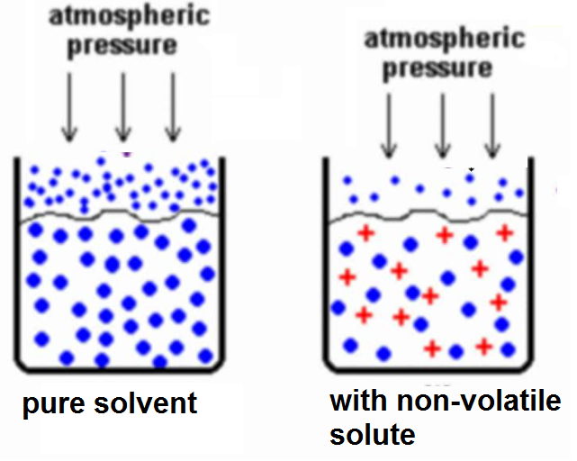
Boiling-Point Elevation
Adding a nonvolatile solute to a solvent raises the boiling point of the resulting solution above that of the pure solvent.

Slide 57
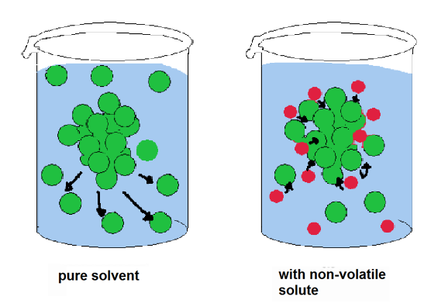
Freezing-Point Depression
Adding a nonvolatile solute to a solvent lowers the freezing point of the resulting solution below that of the pure solvent.

Slide 58
Osmosis
The passage of a solvent through a semipermeable membrane separating a dilute solution (or pure solvent) from a more concentrated solution.
  Semi-permeable membrane – a membrane that allows certain types of molecules (water) to pass through it but prohibits the passage of other types of molecules (sugar).

Slide 59
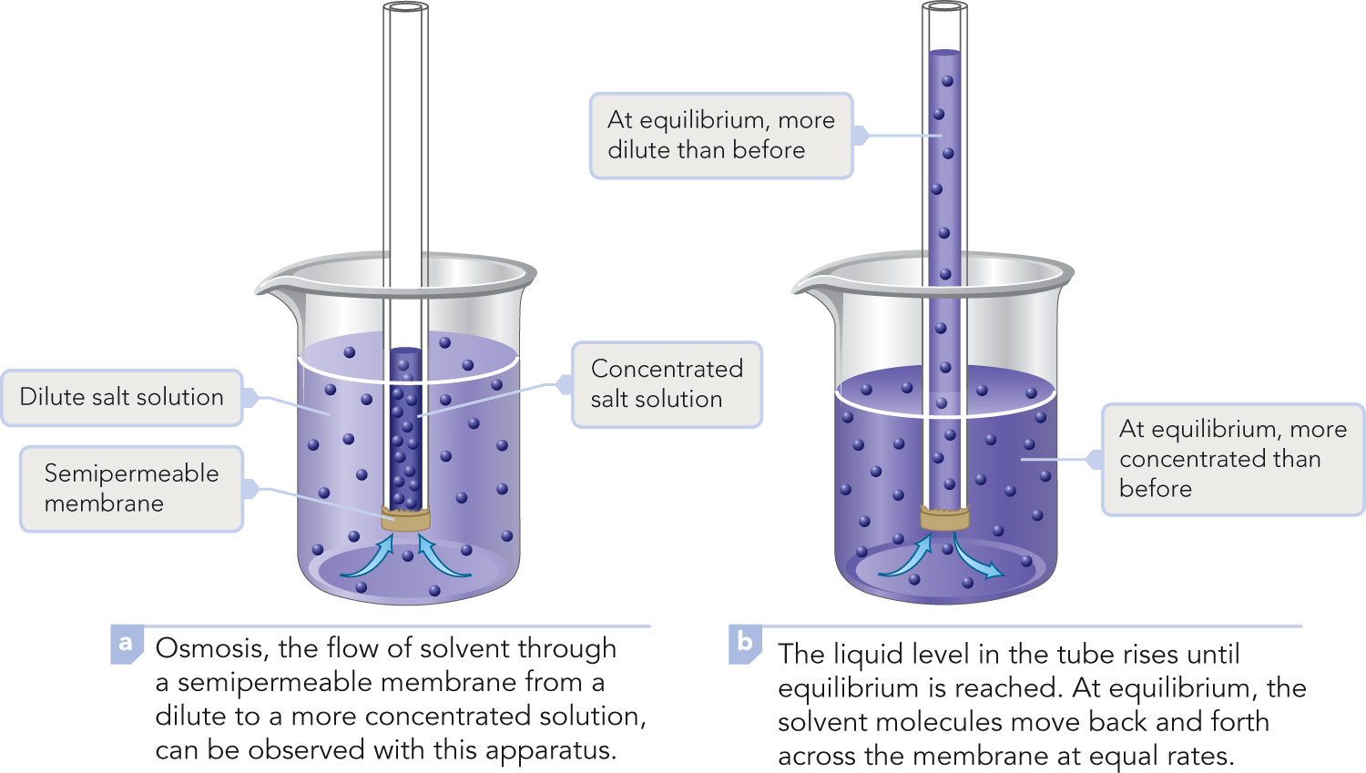
Osmosis

Slide 60
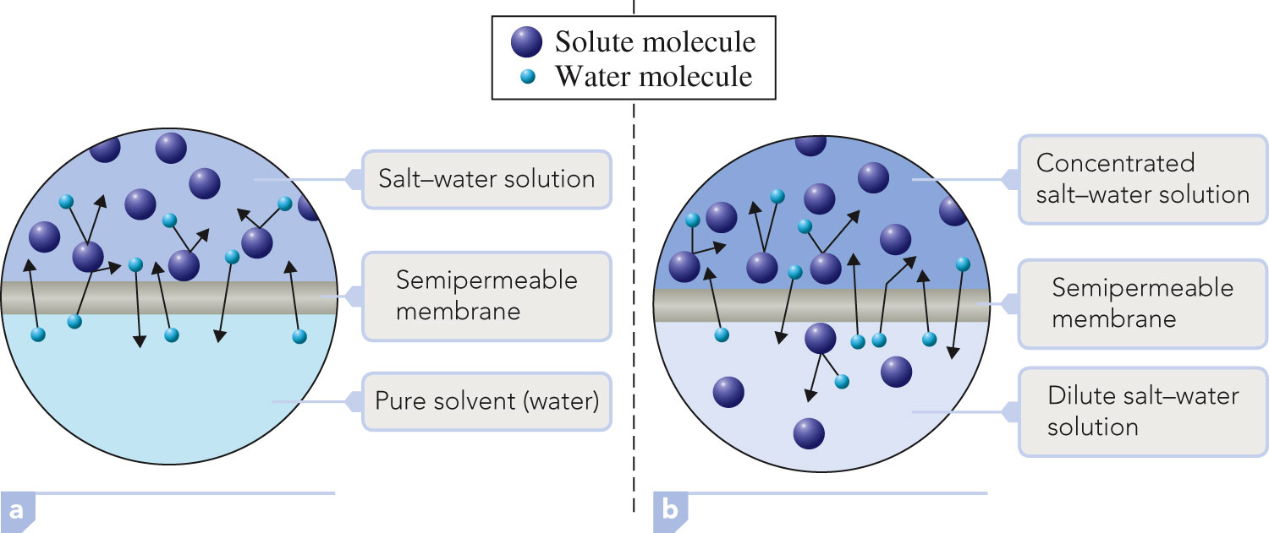
Semi-Permeable Membrane

Slide 61
Osmotic Pressure
The pressure that must be applied to prevent the net flow of solvent through a semipermeable membrane from a solution of lower solute concentration to a solution of higher solute concentration.

Slide 62
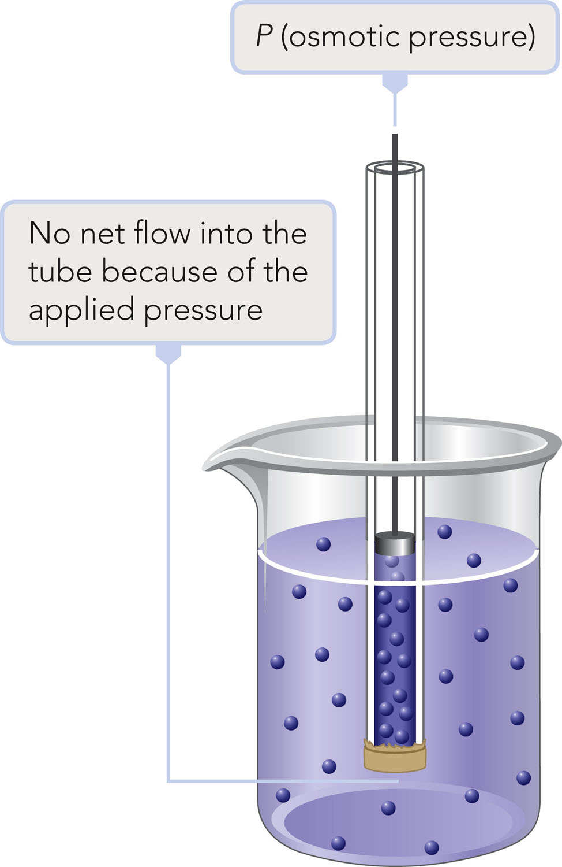
Osmotic Pressure

Slide 63
Osmolarity
Used to compare the osmotic pressures of solutions.
Osmolarity = Molarity × i
i is the number of particles produced from the dissociation of one formula unit of solute.
E.g. 1 M NaCl aqueous solution (i = 2)
Osmolarity = 1X 2 = 2 M

Slide 64

Exercise
What is the osmolarity of a 3 M NaCl solution?
Notes:
NaCl → Na⁺ + Cl– so i = 2.
Osmolarity = 3 M × 2 = 6 osmol

Slide 65
Exercise
What is the osmolarity of a 3 M NaCl solution?
6 osmol
Notes:
NaCl → Na⁺ + Cl– so i = 2.
Osmolarity = 3 M × 2 = 6 osmol

Slide 66
Hypotonic Solution
A solution with a lower osmotic pressure than that within cells.

Slide 67
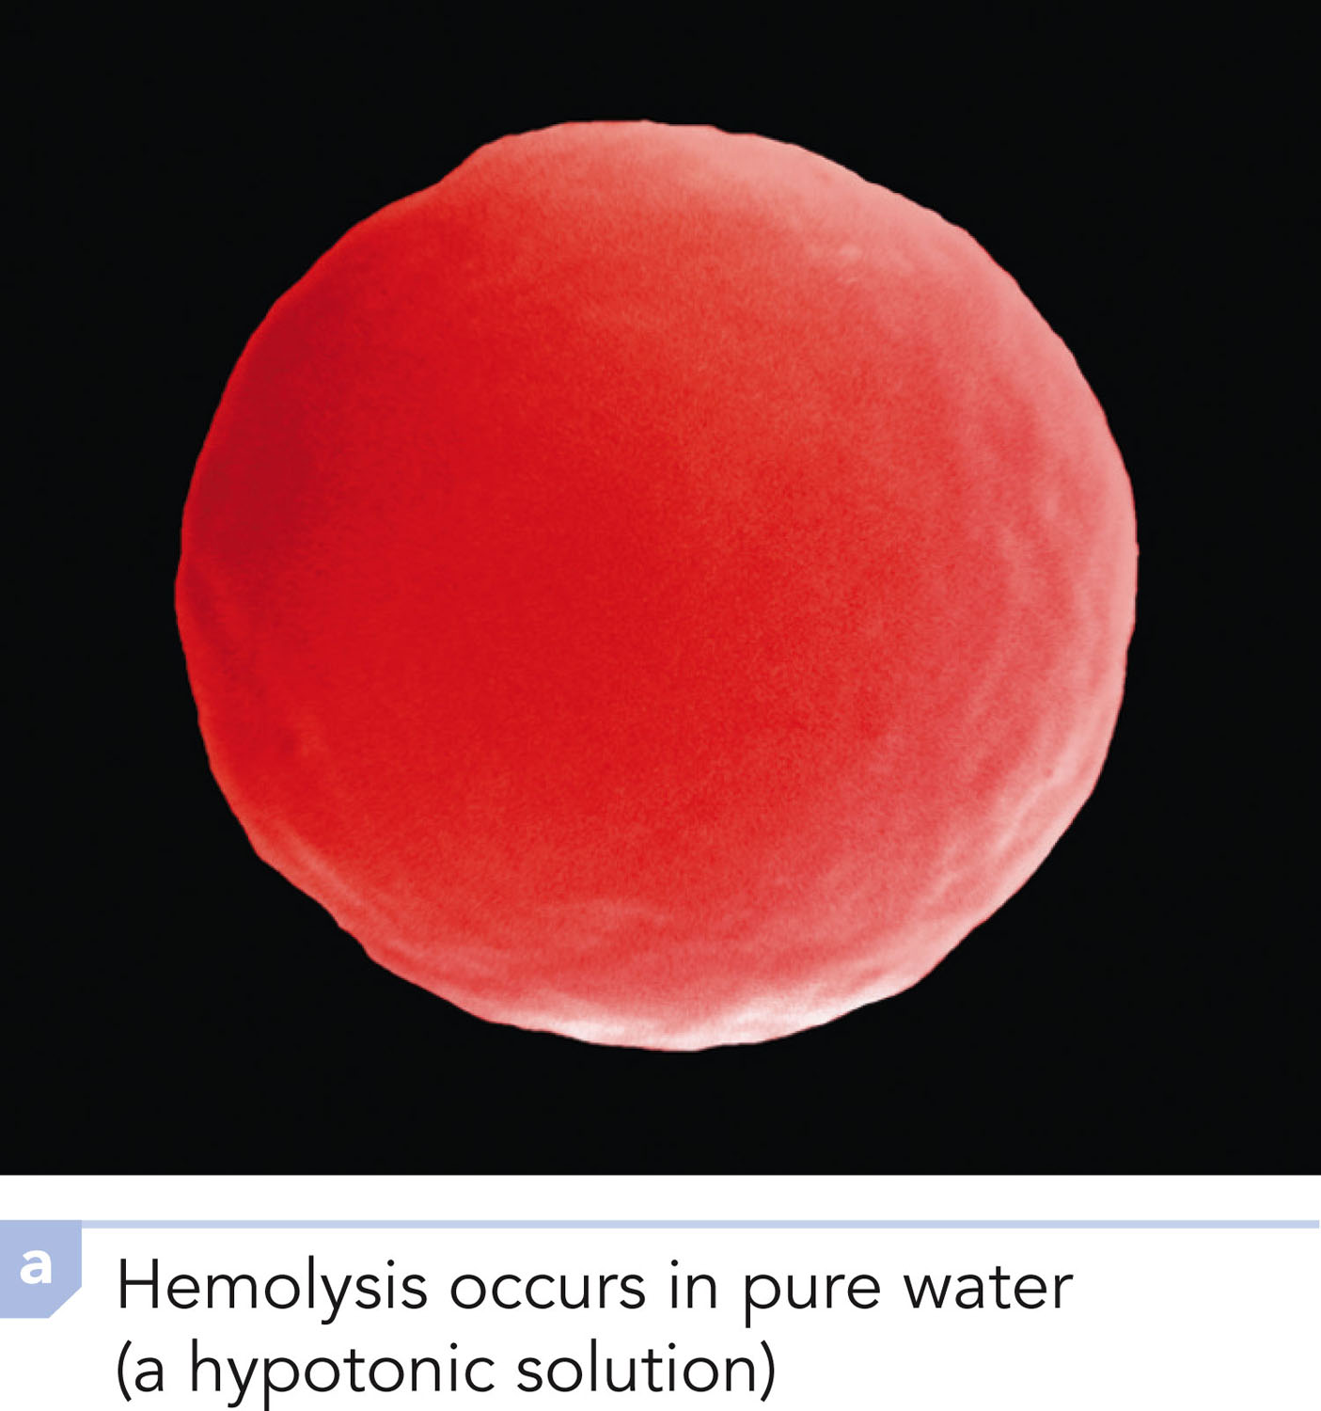
Hypotonic Solution: Hemolysis Occurs in Pure Water

Slide 68
Osmolality of solutions
Cell plasma have 0.23 mol/L
It is most commonly used as a sterile 9 g of salt per liter (0.93 % m/L) (~0.23 M) solution, known as normal saline.
43 g of glucose per liter (0.5 % m/L) (~0.23 M) solution.

Slide 69
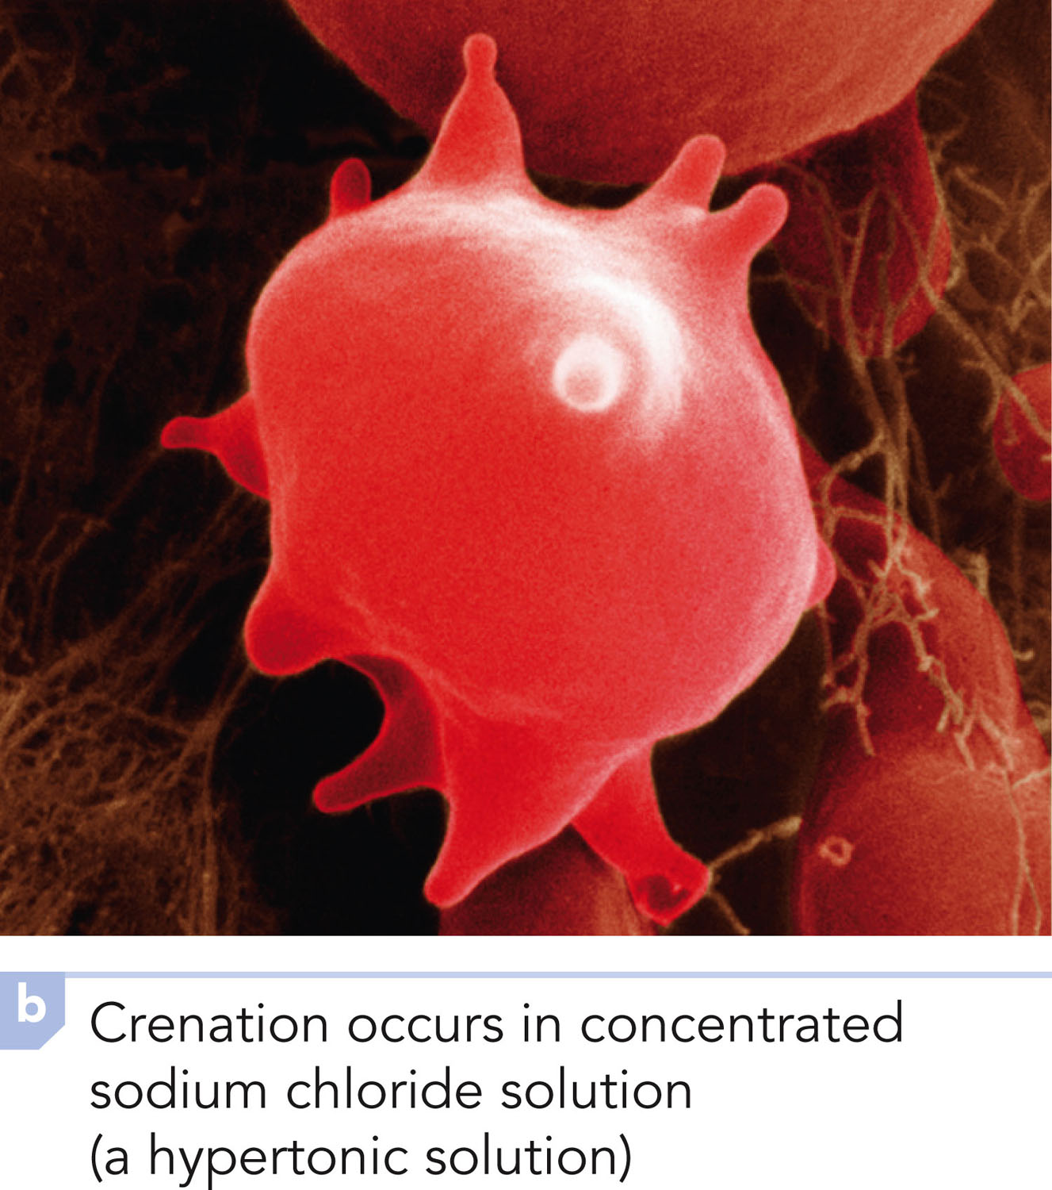
Hypertonic Solution: Crenation Occurs in NaCl

Slide 70
Isotonic Solution
A solution with an osmotic pressure that is equal to that within cells.

Slide 71
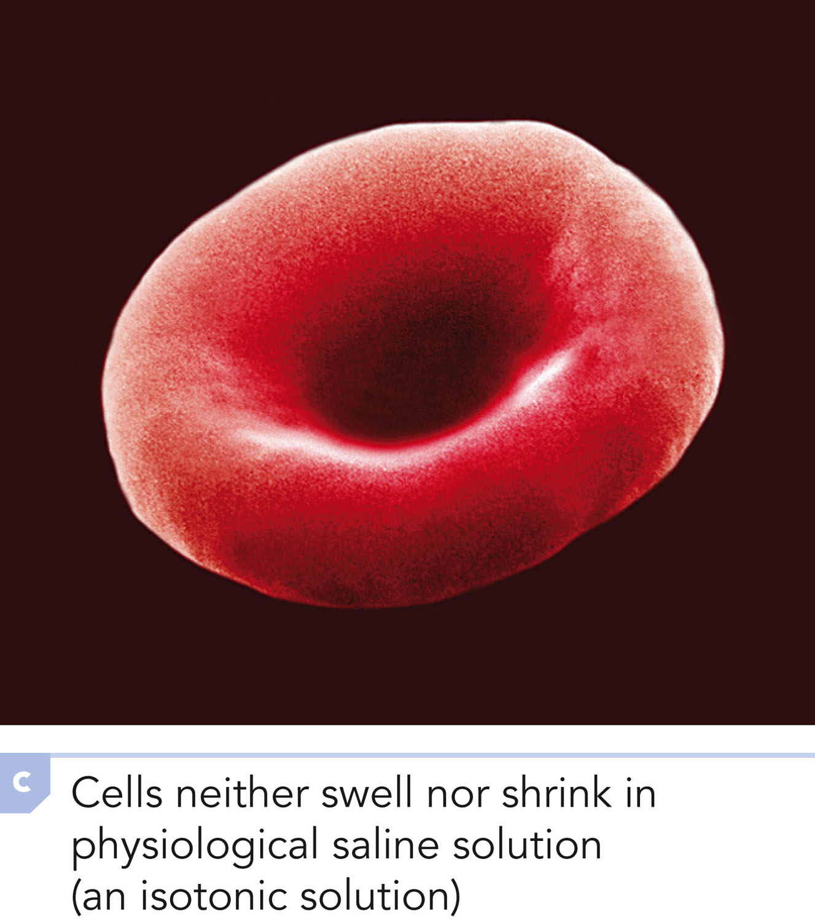
Isotonic Solution: Cells Neither Swell Nor Shrink in Saline Soln

Slide 72
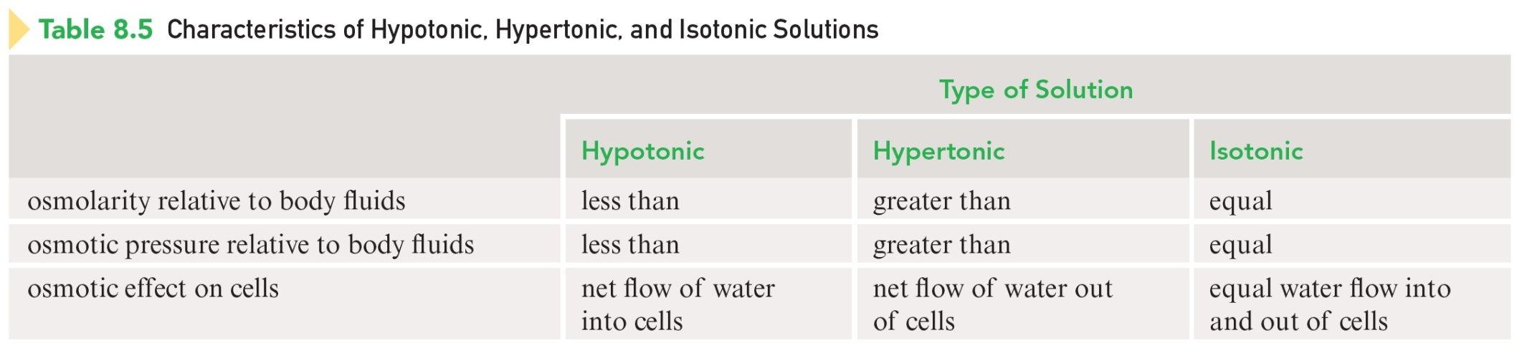
Characteristics of Hypotonic, Hypertonic, and Isotonic Solutions

