Slide 1
Chapter 7. Gases, Liquids, and Solids
Introduction to Inorganic Chemistry
Instructor Dr. Upali Siriwardane (Ph.D. Ohio State)
E-mail: upali@latech.edu
Office: 311 Carson Taylor Hall ; Phone: 318-257-4941;
Office Hours: MWF 8:00-9:00 and 11:00-12:00;
TR 10:00-12:00
Contact me trough phone or e-mail if you have questions
Online Tests on Following days
March 24, 2017: Test 1 (Chapters 1-3)
April 10, 2017 : Test 2 (Chapters 4-5)
April 28, 2017: Test 3 (Chapters 6,7 &8)
May 12, 2017 : Test 4 (Chapters 9, 10 &11)
May 15, 2017: Make Up Exam: Chapters 1-11)
.

Slide 2
7.1 The Kinetic Molecular Theory of Matter
7.2 Kinetic Molecular Theory and Physical States
7.3 Gas Law Variables
7.4 Boyle’s Law: A Pressure-Volume Relationship
7.5 Charles’s Law: A Temperature-Volume Relationship
7.6 The Combined Gas Law
7.7 The Ideal Gas Law
7.8 Dalton’s Law of Partial Pressures
7.9 Changes of State
7.10 Evaporation of Liquids
7.11 Vapor Pressure of Liquids
7.12 Boiling and Boiling Point
7.13 Intermolecular Forces in Liquids

Slide 3
Common Physical Properties of Matter
Volume and Shape
Density
Compressibility
Thermal Expansion
These properties are explained by(KMT)

Slide 4
Compressibility
A measure of the change in volume of a sample of matter resulting from a pressure change.

Slide 5
Thermal Expansion
A measure of the change in volume of a sample of matter resulting from a temperature change.

Slide 6
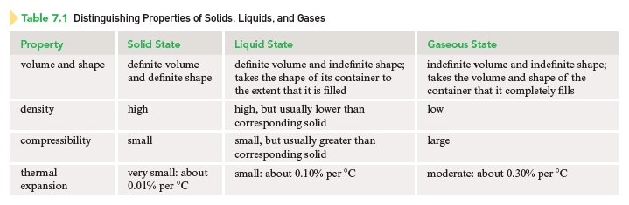
Distinguishing Properties of Solids, Liquids, and Gases

Slide 7
Kinetic Molecular Theory of Matter
Matter is composed of tiny particles (atoms, molecules, or ions) that have definite and characteristic sizes that do not change.

Slide 8
Kinetic Molecular Theory of Matter
The particles are in constant random motion and therefore possess kinetic energy.
  Kinetic energy – energy that matter possesses because of particle motion.

Slide 9
Kinetic Molecular Theory of Matter
The particles interact with one another through attractions and repulsions and therefore possess potential energy.
  Potential energy – stored energy that matter possesses as a result of its position, condition, and/or composition.
  Electrostatic interaction – an attraction or repulsion that occurs between charged particles (ultimately responsible for the origin of potential energy)

Slide 10
Kinetic Molecular Theory of Matter
The kinetic energy (velocity) of the particles increases as the temperature is increased.
  Kinetic energy of particles in a system depends on the temperature (increases with increase in temperature).

Slide 11
Kinetic Molecular Theory of Matter
The particles in a system transfer energy to each other through elastic collisions.

Slide 12
Differences Among Solids, Liquids, and Gases
Explained by the relative magnitudes of kinetic energy and potential energy (electrostatic attractions).
Kinetic energy is a disruptive force that tends to make the particles of a system increasingly independent of one another.
Potential energy is a cohesive force that tends to cause order and stability among the particles of a system.

Slide 13
Solid
The physical state characterized by a dominance of potential energy (cohesive forces) over kinetic energy (disruptive forces).
Particles in a solid are drawn close together in a regular pattern by the strong cohesive forces present.
Each particle occupies a fixed position, about which it vibrates because of disruptive kinetic energy.

Slide 14
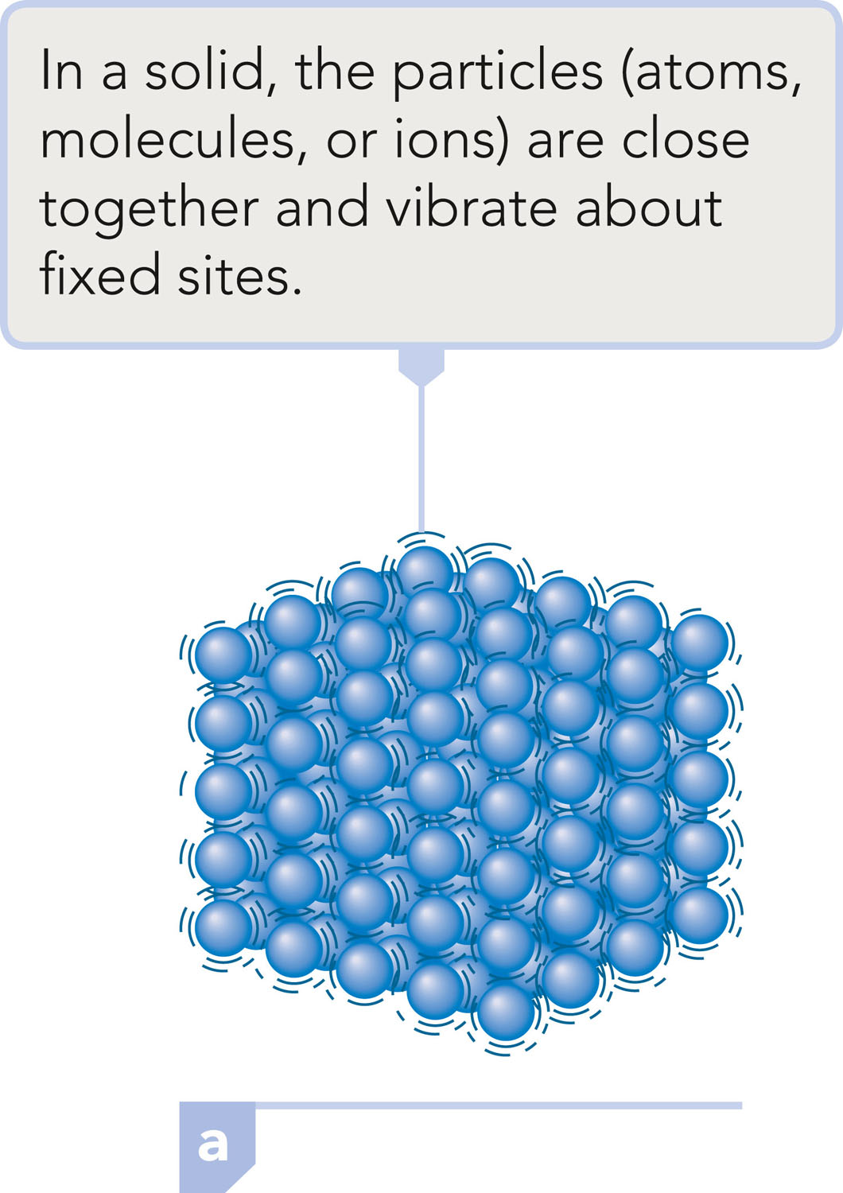
Solid

Slide 15
Definite Volume and Definite Shape
The strong, cohesive forces hold the particles in essentially fixed positions, resulting in definite volume and definite shape.

Slide 16
High Density
The constituent particles of solids are located as close together as possible (touching each other). Therefore, a given volume contains large numbers of particles, resulting in a high density.

Slide 17
Small Compressibility
Because there is very little space between particles, increased pressure cannot push the particles any closer together; therefore, it has little effect on the solid’s volume.

Slide 18
Very Small Thermal Expansion
An increased temperature increases the kinetic energy (disruptive forces), thereby causing more vibrational motion of the particles. Each particle occupies a slightly larger volume, and the result is a slight expansion of the solid. The strong, cohesive forces prevent this effect from becoming very large.

Slide 19
Liquid
The physical state characterized by potential energy (cohesive forces) and kinetic energy (disruptive forces) of about the same magnitude.
Particles that are randomly packed but relatively near one another.
The molecules are in constant, random motion; they slide freely over one another but do not move with enough energy to separate.

Slide 20
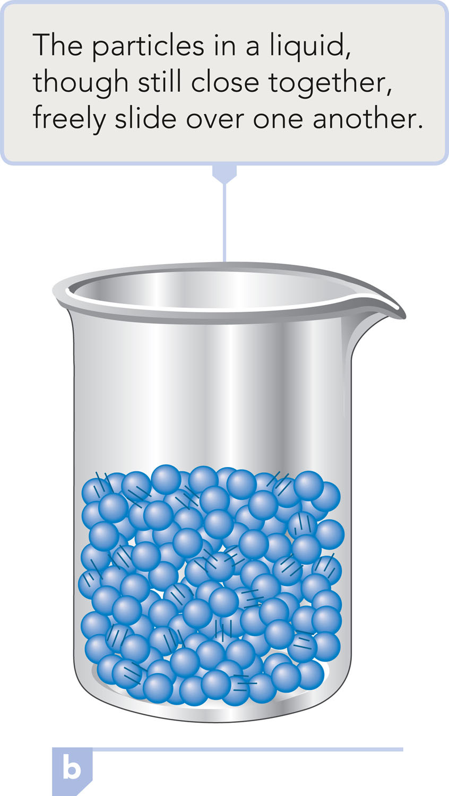
Liquid

Slide 21
Definite Volume and Indefinite Shape
The attractive forces are strong enough to restrict particles to movement within a definite volume. They are not strong enough to prevent the particles from moving over each other in a random manner that is limited only by the container walls.

Slide 22
High Density
The particles in a liquid are not widely separated; they are still touching one another. Therefore, there will be a large number of particles in a given volume – a high density.

Slide 23
Small Compressibility
Because the particles in a liquid are still touching each other, there is very little empty space. Therefore, an increase in pressure cannot squeeze the particles much closer together.

Slide 24
Small Thermal Expansion
Most of the particle movement in a liquid is vibrational because a particle can move only a short distance before colliding with a neighbor.
The increased particle velocity that accompanies a temperature increase results only in increased vibrational amplitudes.
The net effect is an increase in the effective volume a particle occupies, which causes a slight volume increase in the liquid.

Slide 25
Gas
The physical state characterized by a complete dominance of kinetic energy (disruptive forces) over potential energy (cohesive forces).
Attractive forces among particles are very weak and are considered to be zero.
The particles move essentially independently of one another in a totally random manner.

Slide 26
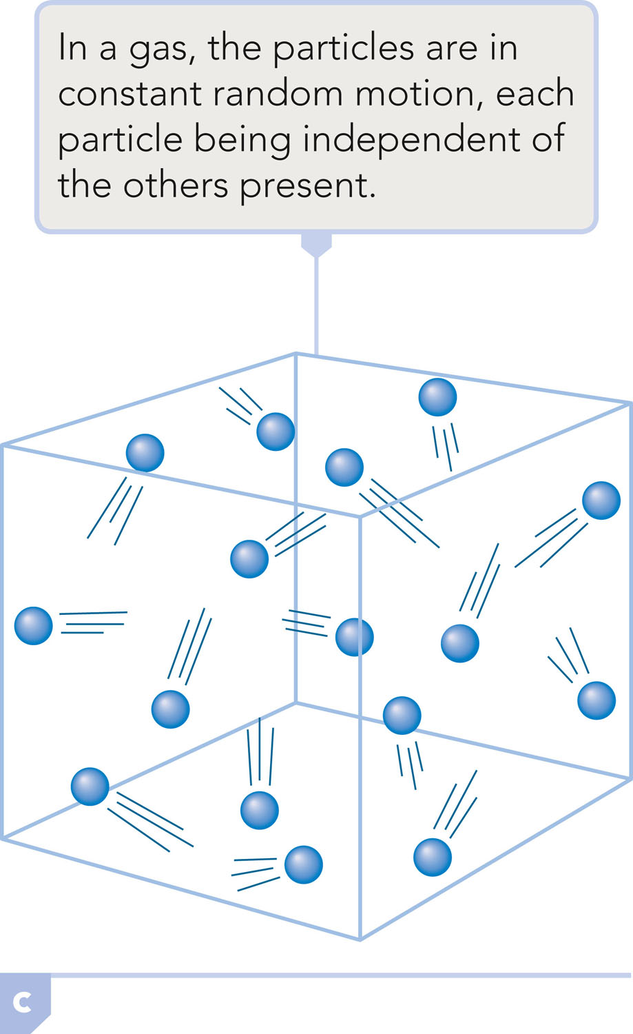
Gas

Slide 27
Indefinite Volume and Indefinite Shape
The attractive (cohesive) forces between particles have been overcome by high kinetic energy, and the particles are free to travel in all directions.
Particles completely fill their container and the shape of the gas is that of the container.

Slide 28
Low Density
The particles are widely separated.
There are relatively few particles in a given volume, which means little mass per volume.

Slide 29
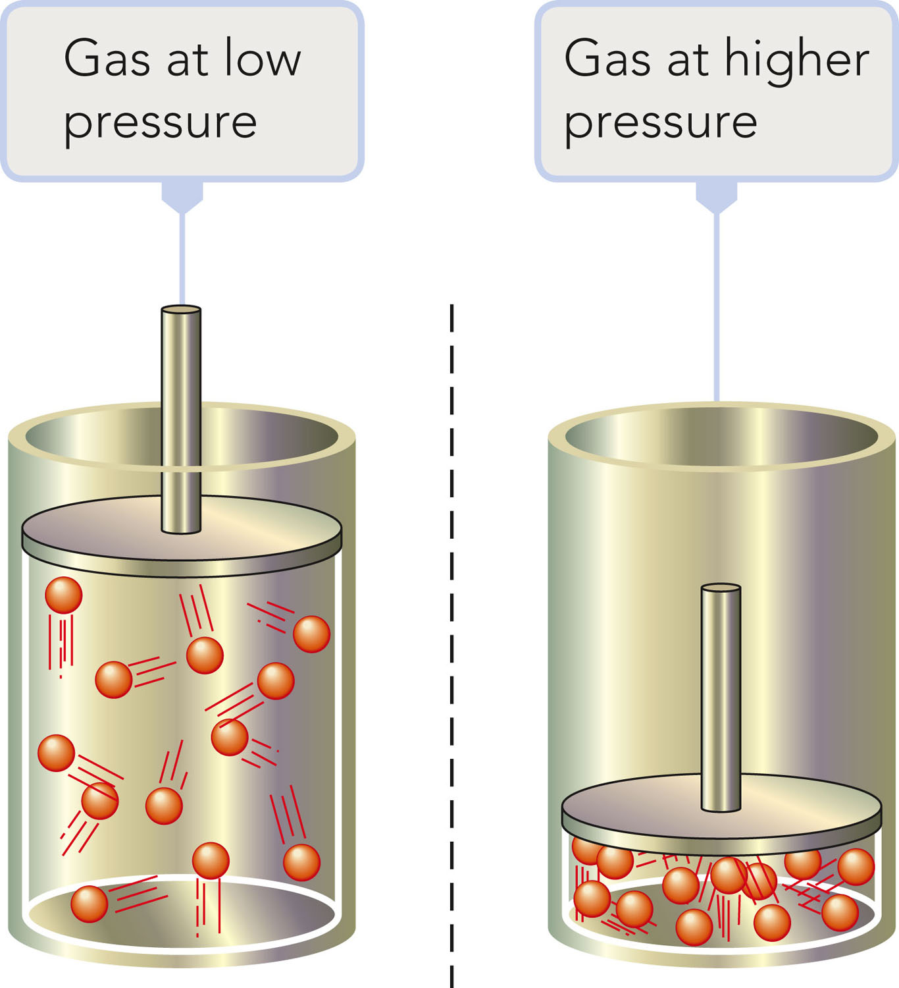
Large Compressibility
A gas is mostly empty space. When pressure is applied, the particles are easily pushed closer together, decreasing the amount of empty space and the volume of the gas.

Slide 30
Moderate Thermal Expansion
An increase in temperature means an increase in particle velocity.
The increased kinetic energy enables the particles to push back whatever barrier is confining them, and the volume increases - the space between the particles changes.

Slide 31
Gas Law
A generalization that describes in mathematical terms the relationships among the following properties of of a gas
Amount (n, moles)
Pressure (atm, mm Hg, psi)
Temperature (K)
Volume (L)

Slide 32
Pressure
The force applied per unit area on an object
1 atm = 760 mm Hg = 760 torr
1 atm = 14.7 psi

Slide 33
Pressure of a Gas
The force that creates pressure is that which is exerted by the gas molecules or atoms as they constantly collide with the walls of their container.

Slide 34
Barometer
A device used to measure atmospheric pressure.

Slide 35
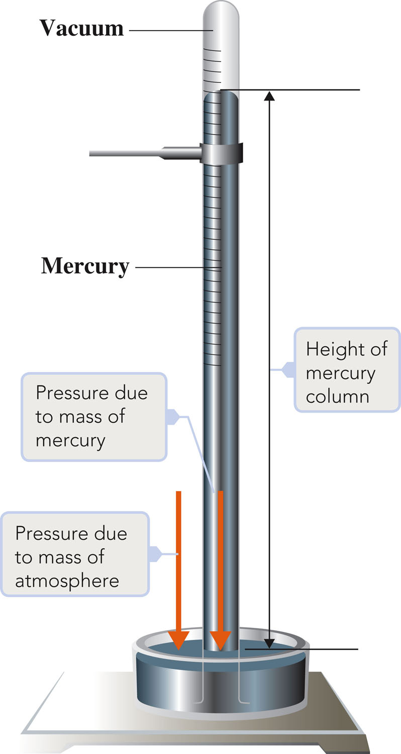
Barometer

Slide 36
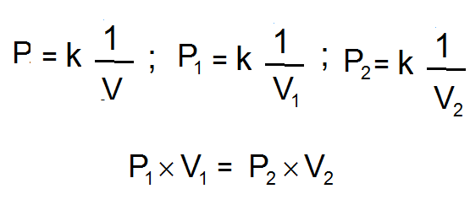
Boyle’s Law
Pressure and volume are inversely related (at constant T, temperature, and n, # of moles).

Slide 37
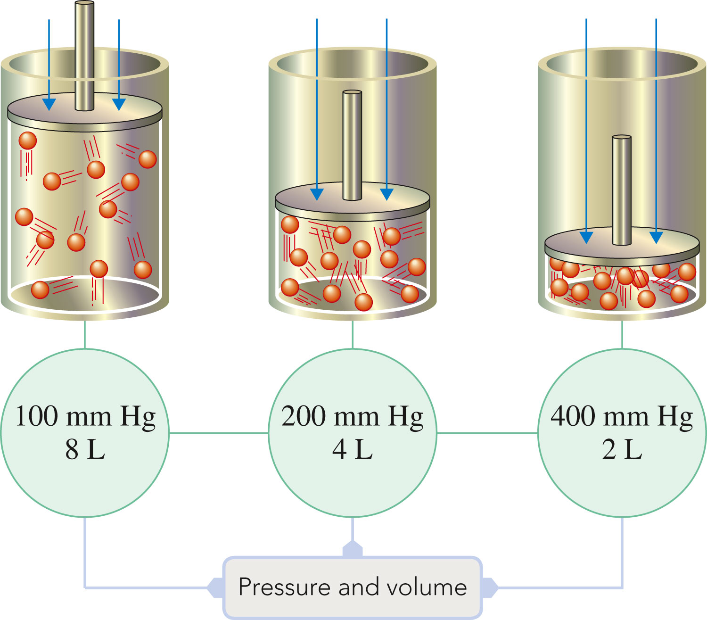
Boyle’s Law

Slide 38

Exercise
A sample of helium gas occupies 12.4 L at 23°C and 0.956 atm. What volume will it occupy at 1.20 atm assuming that the temperature stays constant?
Notes:
(0.956 atm)(12.4 L) = (1.20 atm)(V₂)
The new volume is 9.88 L.

Slide 39
Exercise
A sample of helium gas occupies 12.4 L at 23°C and 0.956 atm. What volume will it occupy at 1.20 atm assuming that the temperature stays constant?
Notes:
(0.956 atm)(12.4 L) = (1.20 atm)(V₂)
The new volume is 9.88 L.

Slide 40
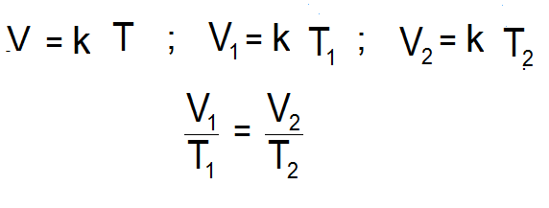
Charles’s Law
Volume and temperature (in Kelvin) are directly related (at constant P and n; # of moles).
K = °C + 273

Slide 41
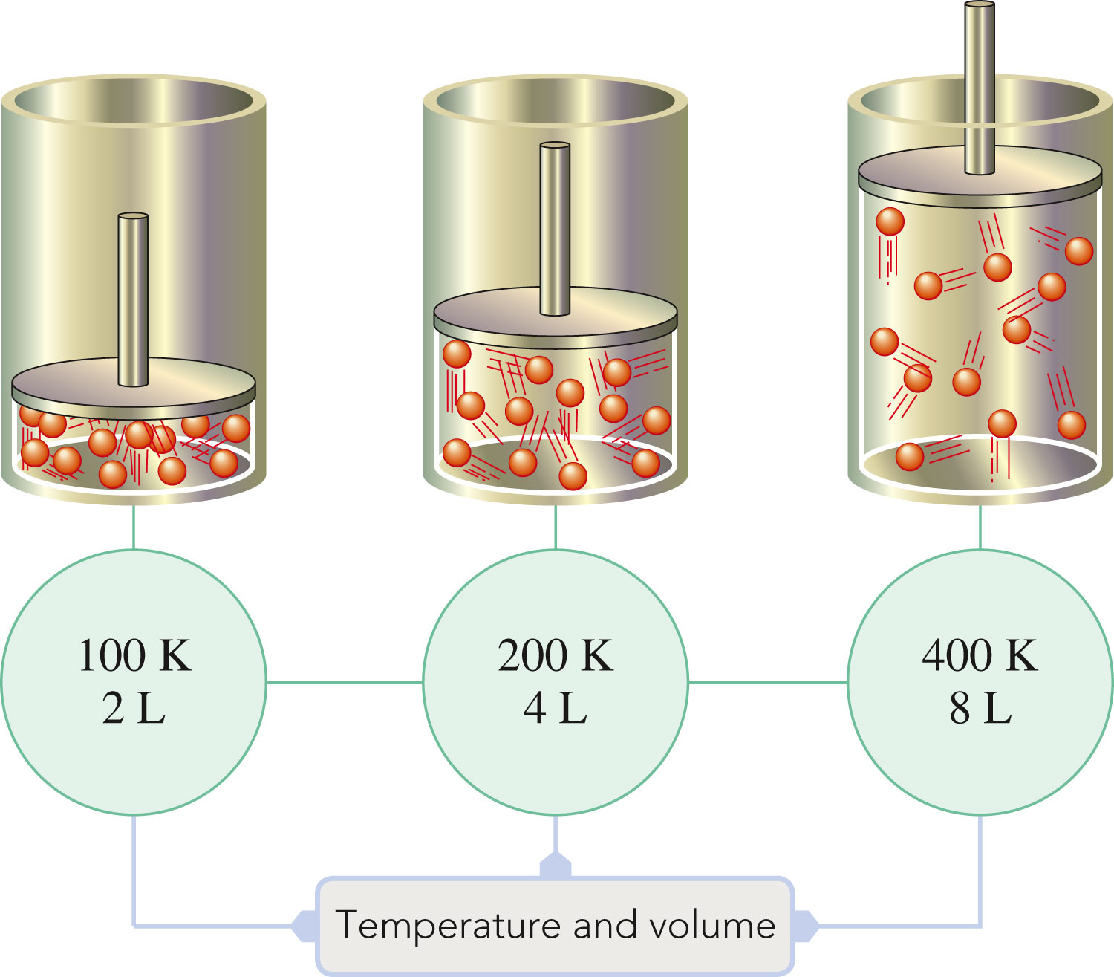
Charles’s Law

Slide 42
Exercise
Suppose a balloon containing 1.30 L of air at 24.7°C is placed into a beaker containing liquid nitrogen at –78.5°C. What will the volume of the sample of air become (at constant pressure)?
Notes:
The new volume will become 0.849 L. Remember to convert the temperatures to Kelvin.
(1.30 L) / (24.7+273) = V₂ / (-78.5 + 273)

Slide 43
Exercise
Suppose a balloon containing 1.30 L of air at 24.7°C is placed into a beaker containing liquid nitrogen at –78.5°C. What will the volume of the sample of air become (at constant pressure)?
Notes:
The new volume will become 0.849 L. Remember to convert the temperatures to Kelvin.
(1.30 L) / (24.7+273) = V₂ / (-78.5 + 273)

Slide 44
The product of the pressure and volume of a fixed amount of gas is directly proportional to its Kelvin temperature.

Slide 45
Exercise
At what temperature (in °C) does 121 mL of CO₂ at 27°C and 1.05 atm occupy a volume of 293 mL at a pressure of 1.40 atm?
Notes:
The new temperature is 696°C.
(1.05 atm)(121 mL) / (27+273) = (1.40 atm)(293 mL) / (T₂ + 273)

Slide 46
Exercise
At what temperature (in °C) does 121 mL of CO₂ at 27°C and 1.05 atm occupy a volume of 293 mL at a pressure of 1.40 atm?
Notes:
The new temperature is 696°C.
(1.05 atm)(121 mL) / (27+273) = (1.40 atm)(293 mL) / (T₂ + 273)

Slide 47
Describes the relationships among the four variables – temperature, pressure, volume and molar amount for a gaseous substance (one comprehensive law):
        PV = nRT
        (where R = 0.0821 L·atm/mol·K`

Slide 48
Exercise
An automobile tire at 23°C with an internal volume of 25.0 L is filled with air to a total pressure of 2.18 atm (32 pounds per square inch). Determine the number of moles of air in the tire.
Notes:
The number of moles of air is 2.24 mol.
(2.18 atm)(25.0 L) = n(0.0821)(23+273)

Slide 49
Exercise
An automobile tire at 23°C with an internal volume of 25.0 L is filled with air to a total pressure of 2.18 atm (32 pounds per square inch). Determine the number of moles of air in the tire.
Notes:
The number of moles of air is 2.24 mol.
(2.18 atm)(25.0 L) = n(0.0821)(23+273)

Slide 50
Exercise
What is the pressure in a 304.0 L tank that contains 5.670 kg of helium at 25°C?
Notes:
The pressure is 114 atm. Remember to convert kg of helium into moles of helium before using the ideal gas law.
(P)(304.0) = ([5.670×1000]/4.003)(0.0821)(25+273)

Slide 51
Exercise
What is the pressure in a 304.0 L tank that contains 5.670 kg of helium at 25°C?
Notes:
The pressure is 114 atm. Remember to convert kg of helium into moles of helium before using the ideal gas law.
(P)(304.0) = ([5.670×1000]/4.003)(0.0821)(25+273)

Slide 52
For a mixture of gases in a container,
P_{Total} = P₁ + P₂ + P₃ + . . .
The total pressure exerted by a mixture of gases is the sum of the partial pressures of the individual gases present.

Slide 53
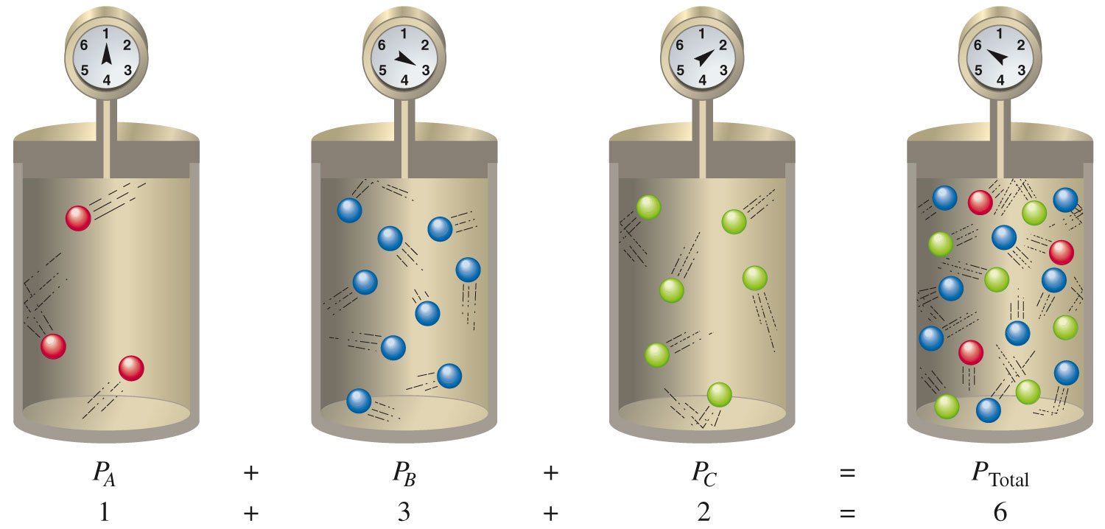

Slide 54
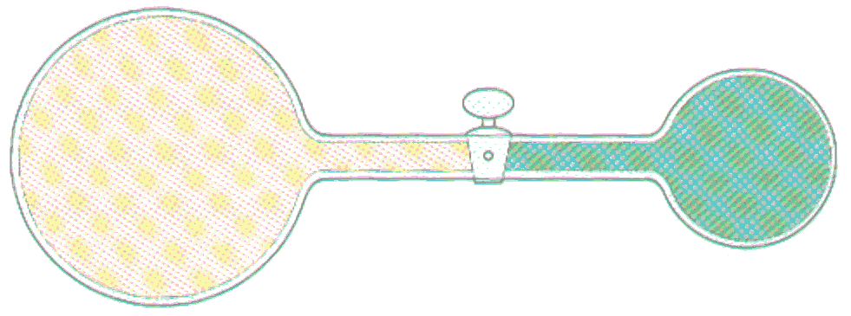
Exercise
Consider the following container of helium at 45°C. Initially the valve is closed.
  After the valve is opened, what is the pressure of the helium gas?
2.00 atm
9.00 L
3.00 atm
3.00 L
Notes:
The pressure is 2.25 atm. There are two ways to solve the problem:
1) Find the new pressure of the gas on the left side after the valve is opened (P₁V₁=P₂V₂). The pressure becomes 1.50 atm. Find the new pressure of the gas on the right side after the valve is opened (P₁V₁=P₂V₂). The pressure becomes 0.75 atm. The total pressure is therefore 1.50 + 0.75 = 2.25 atm.
2) Find the number of moles in each chamber separately (using PV = nRT), add the number of moles and volumes on each side, then use PV = nRT to solve for the new pressure.

Slide 55
Exercise
Consider the following container of helium at 45°C. Initially the valve is closed.
  After the valve is opened, what is the pressure of the helium gas?
  2.25 atm
2.00 atm
9.00 L
3.00 atm
3.00 L
Notes:
The pressure is 2.25 atm. There are two ways to solve the problem:
1) Find the new pressure of the gas on the left side after the valve is opened (P₁V₁=P₂V₂). The pressure becomes 1.50 atm. Find the new pressure of the gas on the right side after the valve is opened (P₁V₁=P₂V₂). The pressure becomes 0.75 atm. The total pressure is therefore 1.50 + 0.75 = 2.25 atm.
2) Find the number of moles in each chamber separately (using PV = nRT), add the number of moles and volumes on each side, then use PV = nRT to solve for the new pressure.

Slide 56
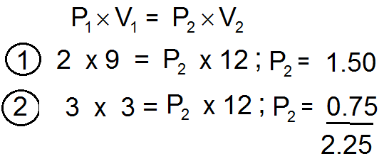
Exercise
Consider the following container of helium at 45°C. Initially the valve is closed.
  After the valve is opened, what is the pressure of the helium gas?
2.00 atm
9.00 L
3.00 atm
3.00 L
Boyel’s and Dalton’s
partial pressure laws
Notes:
The pressure is 2.25 atm. There are two ways to solve the problem:
1) Find the new pressure of the gas on the left side after the valve is opened (P₁V₁=P₂V₂). The pressure becomes 1.50 atm. Find the new pressure of the gas on the right side after the valve is opened (P₁V₁=P₂V₂). The pressure becomes 0.75 atm. The total pressure is therefore 1.50 + 0.75 = 2.25 atm.
2) Find the number of moles in each chamber separately (using PV = nRT), add the number of moles and volumes on each side, then use PV = nRT to solve for the new pressure.

Slide 57
A process in which a substance is transformed from one physical state to another physical state.
Usually accomplished by heating or cooling a substance, but pressure can also be a factor.
Changes of state are examples of physical changes.

Slide 58
Six Possible Processes Leading to Changes of State
Melting (Solid to liquid) Endothermic
Freezing (Liquid to solid) Exothermic
Evaporation (Liquid to gas) Endothermic
Condensation (Gas to liquid) Exothermic
Sublimation (Solid to gas) Endothermic
Deposition (Gas to solid) Exothermic

Slide 59
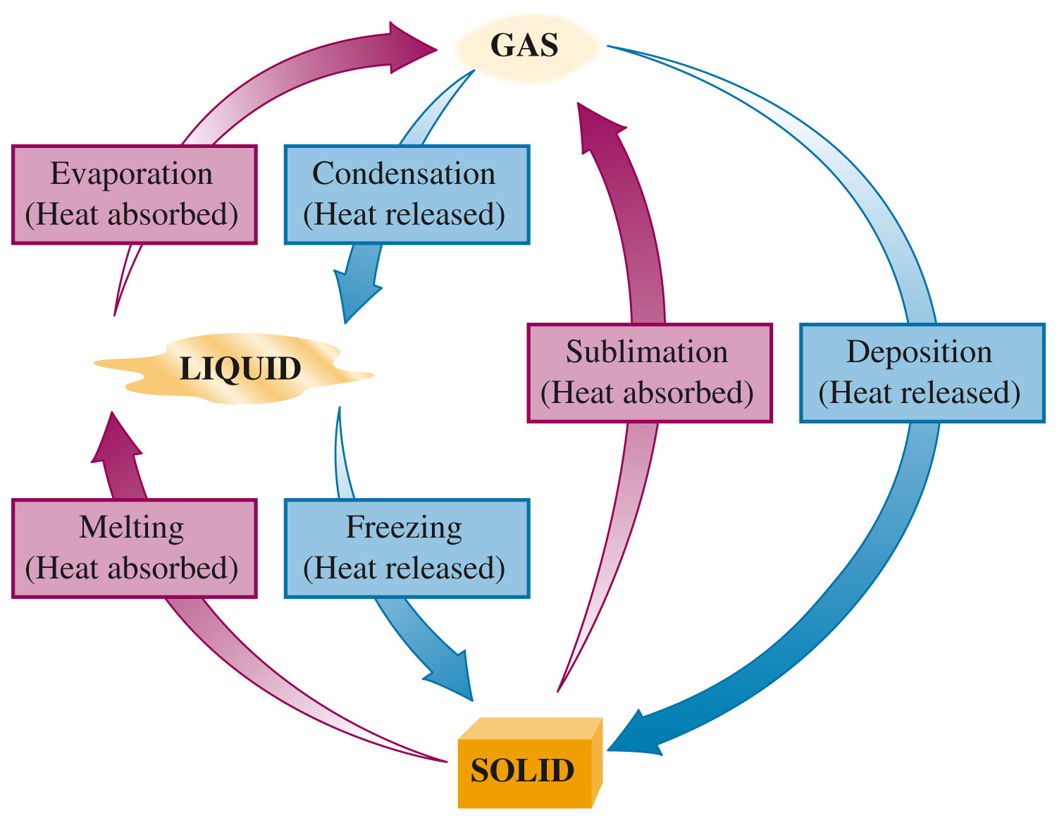
Six Possible Changes of State

Slide 60
Two Categories
Endothermic change of state – change of state in which heat energy is absorbed.
  Melting
  Sublimation
  Evaporation

Slide 61
Two Categories
Exothermic change of state – change of state in which heat energy is given off.
  Freezing
  Condensation
  Deposition

Slide 62
Process by which molecules escape from the liquid phase to the gas phase.
For a liquid to evaporate, its molecules must gain enough kinetic energy to overcome the attractive forces among them.

Slide 63
Rate of Evaporation
Increased surface area results in an increased evaporation rate because a greater fraction of the total molecules are on the surface (so they are not completely surrounded by other molecules with attractive forces).

Slide 64
Rate of Evaporation
Always increases as liquid temperature increases.
A cooling effect is produced in the liquid when evaporation occurs.
Vapor – A gas that exists at a temperature and pressure at which it ordinarily would be thought of as a liquid or solid.

Slide 65
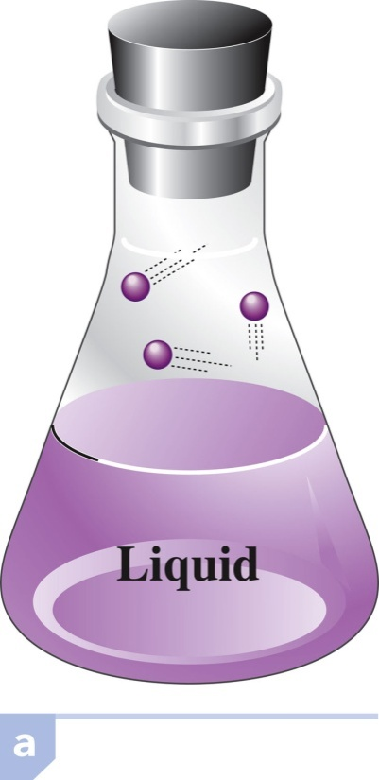
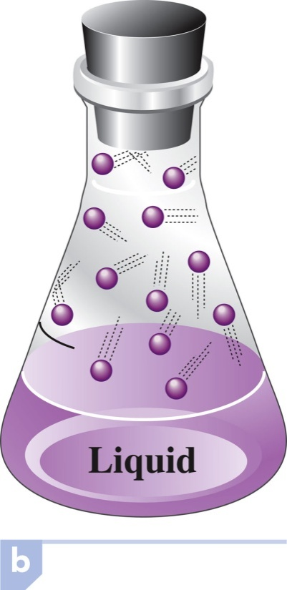
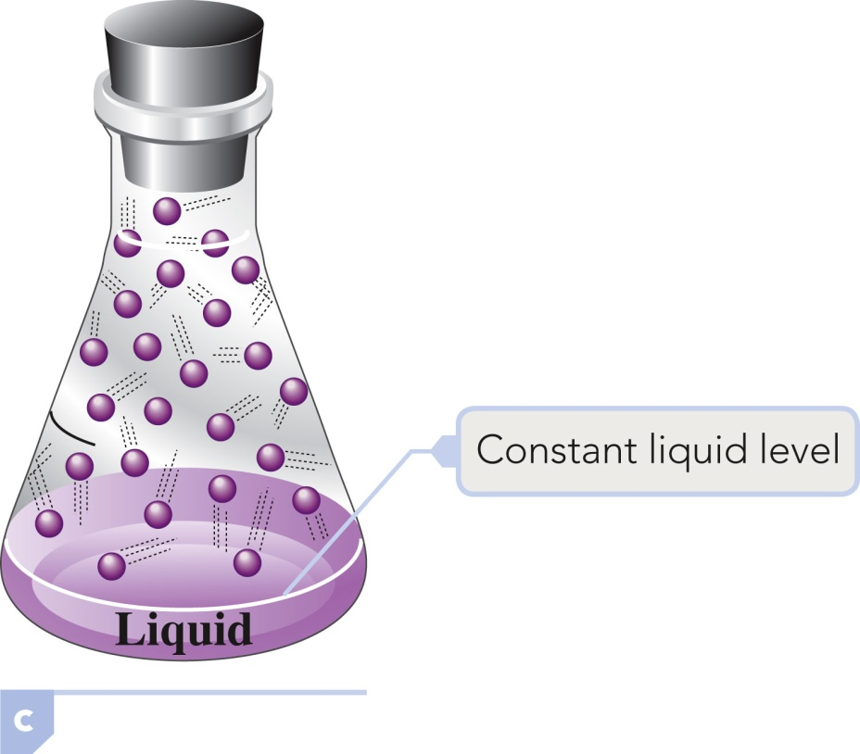
Evaporation of a Liquid in a Closed Container
The liquid level drops for a time.
Then becomes constant (ceases to drop).
Rate of evaporation equals the rate of condensation.

Slide 66
Equilibrium
A condition in which two opposite processes take place at the same rate.
No net macroscopic changes can be detected, but the system is dynamic.
Forward and reverse processes are occurring at equal rates.

Slide 67
Vapor Pressure
Pressure exerted by a vapor above a liquid when the liquid and vapor are in equilibrium with each other.
Magnitude of vapor pressure depends on the nature and temperature of the liquid.

Slide 68
Vapor Pressure
Liquids that have strong attractive forces between molecules have lower vapor pressures than liquids that have weak attractive forces between particles.

Slide 69
Vapor Pressure
Substances that have high vapor pressures evaporate readily – they are volatile.
  Volatile substance – a substance that readily evaporates at room temperature because of a high vapor pressure.

Slide 70
Boiling
A form of evaporation where conversion from the liquid state to the vapor state occurs within the body of the liquid through bubble formation.
Occurs when the vapor pressure of the liquid reaches a value equal to that of the prevailing external pressure on the liquid (for an open container it’s atmospheric pressure).

Slide 71
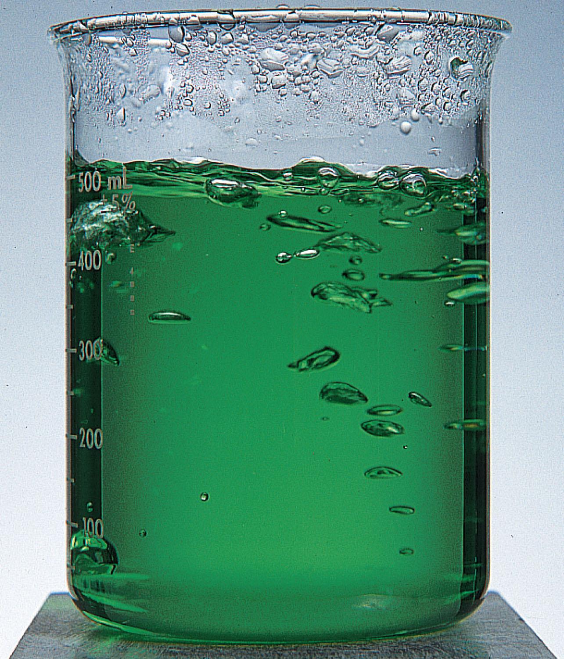
Boiling

Slide 72
Boiling Point
The temperature at which the vapor pressure of a liquid becomes equal to the external (atmospheric) pressure exerted on the liquid.
Normal boiling point – the temperature at which a liquid boils under a pressure of 760 mm Hg.
Boiling point changes with elevation.

Slide 73
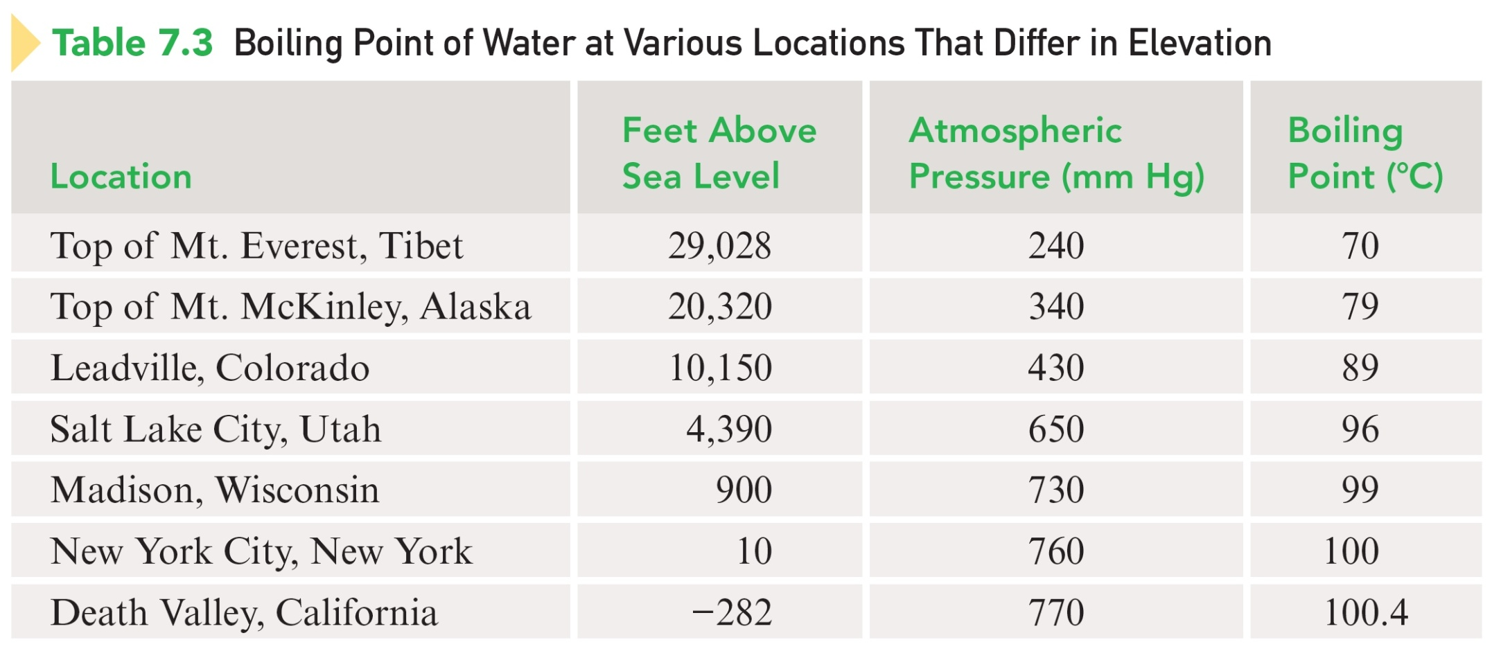
BP of Water at Various Locations That Differ in Elevation

Slide 74
Concept Check
What is the vapor pressure of water at 100°C? How do you know?
1 atm
Notes:
The vapor pressure of water at 100ºC is 1 atm. You know this because atmospheric pressure is 1 atm and this is the temperature at which we observe water to boil.

Slide 75
Intramolecular Forces
Forces “Within” molecules. Chemical bond keeping the molecule together are Intermolecular forces are strong. Eg. H₂O

Slide 76
Intermolecular Force
An attractive force that acts between a molecule and another molecule. Eg. Between two H₂O molecules.
Intermolecular forces are weak compared to intramolecular forces.

Slide 77
Three Main Types of Intermolecular Forces
Dipole-dipole interactions (between polar molecules)
Hydrogen bonds (between strongest polar molecules)
London forces (between non-polar molecules)

Slide 78
Dipole-Dipole Interactions
An IMF that occurs between polar molecules.
Molecules with dipole moments can attract each other electrostatically by lining up so that the positive and negative ends are close to each other. Eg. ClF
The greater the polarity of the molecules, the greater the strength of the dipole-dipole interactions.

Slide 79
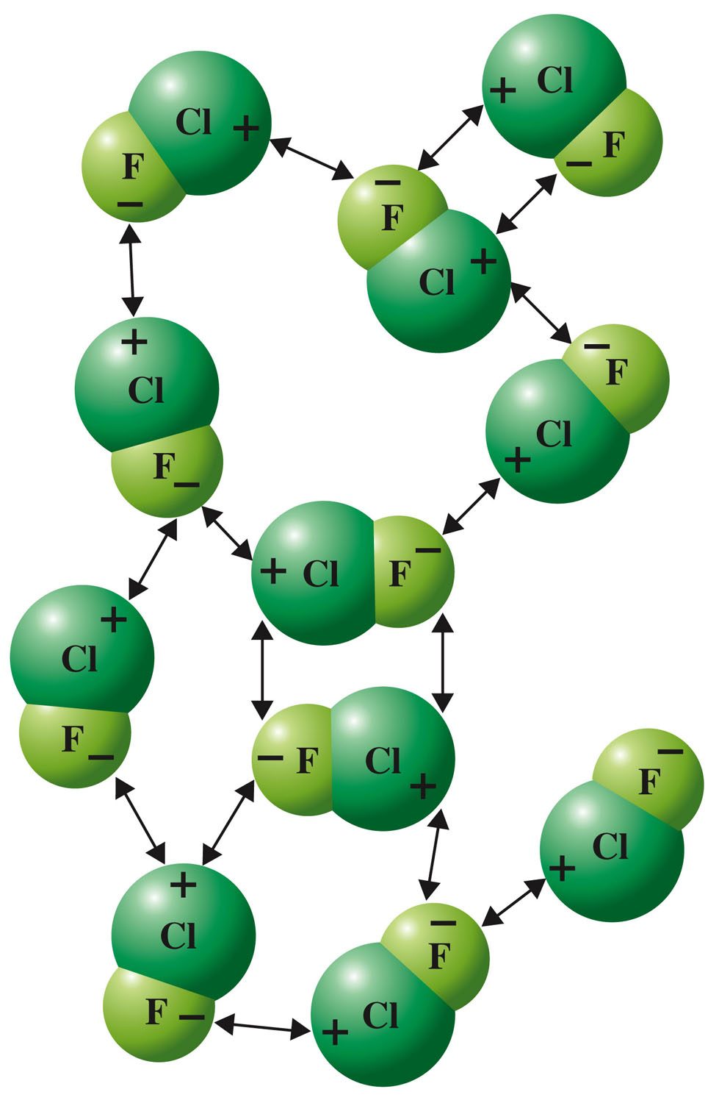
Dipole-Dipole Interactions Between ClF Molecules

Slide 80
Dipole-Dipole Interactions
To play movie you must be in Slide Show Mode
PC Users: Please wait for content to load, then click to play
Mac Users: CLICK HERE

Slide 81
Hydrogen Bonds
Unusually strong dipole-dipole interactions are observed among hydrogen-containing molecules in which hydrogen is covalently bonded to a highly electronegative element of small atomic size (fluorine, oxygen, and nitrogen).

Slide 82
Two Factors in H₂O molecules
The highly electronegative element (O) to which hydrogen is covalently bonded attracts the bonding electrons to such a degree that the hydrogen atom is left with a significant charge.
2. The small size of the “bare” hydrogen nucleus allows it to approach closely, and be strongly attracted to a lone pair of electrons on the electronegative atom of another molecule.

Slide 83
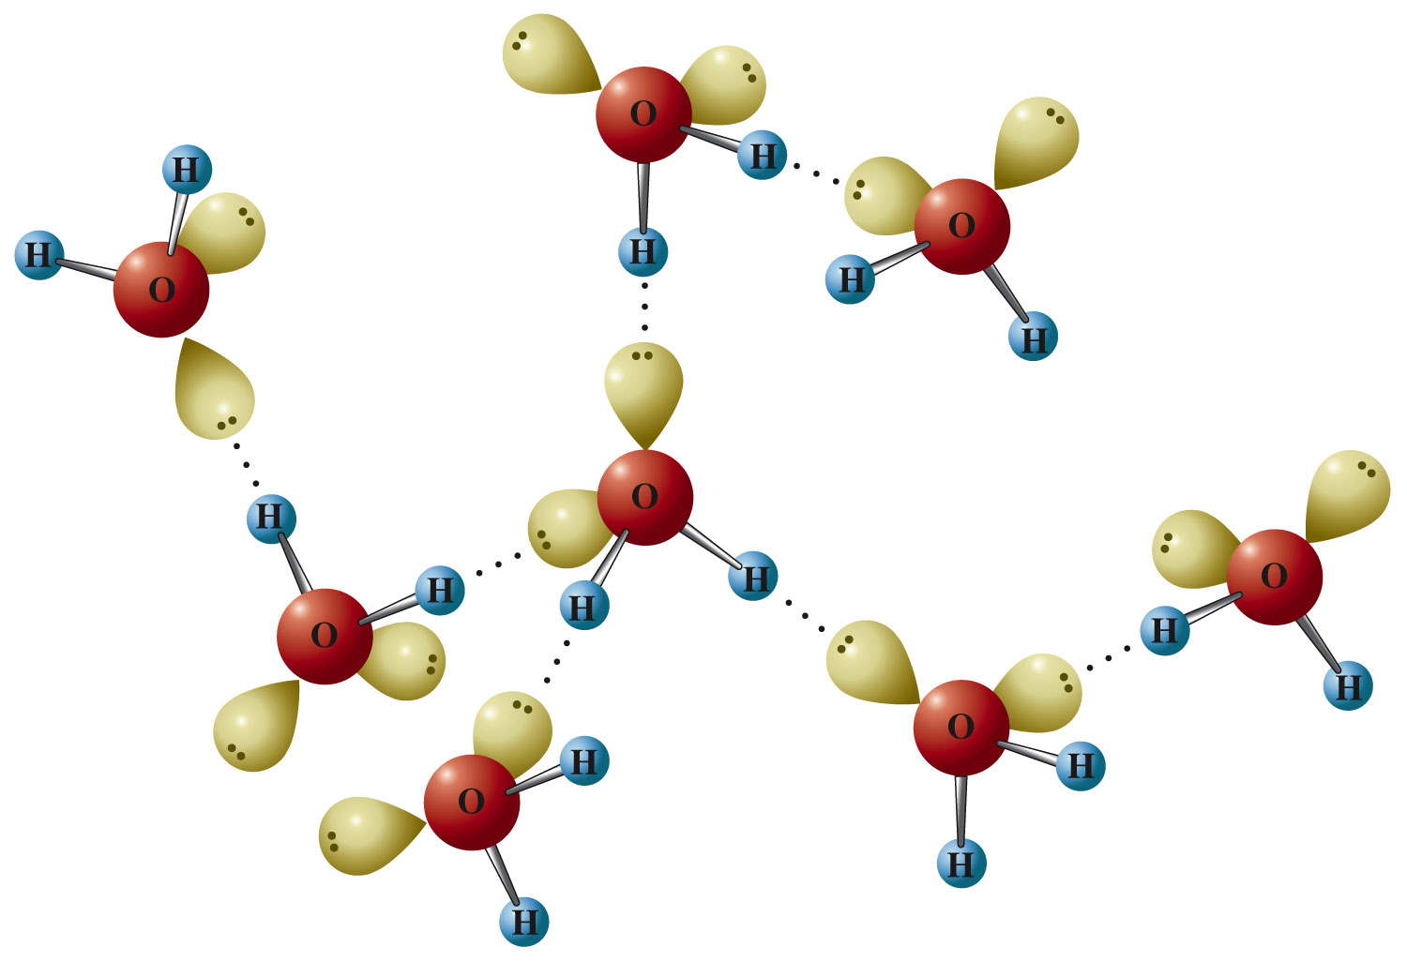
Hydrogen Bonding in Water

Slide 84
Hydrogen Bonding
To play movie you must be in Slide Show Mode
PC Users: Please wait for content to load, then click to play
Mac Users: CLICK HERE

Slide 85
The vapor pressures of liquids that have significant hydrogen bonding (N-H, O-H and F-H dipoles) are much lower than those of similar liquids wherein little or no hydrogen bonding occurs.

Slide 86
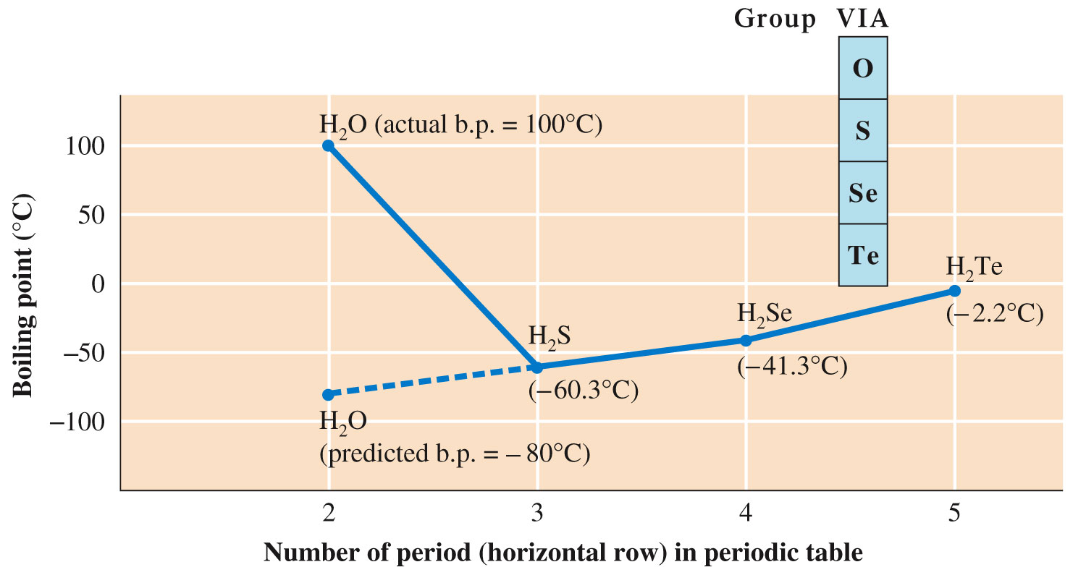

Slide 87
London Forces: CO₂)
To play movie you must be in Slide Show Mode
PC Users: Please wait for content to load, then click to play
Mac Users: CLICK HERE

Slide 88
London Forces
A weak temporary intermolecular force that occurs between an atom or molecule (polar or nonpolar) and another atom or molecule (polar or nonpolar).
Results from momentary uneven electron distributions in molecules.
Significant in large atoms/molecules.
Occurs in all molecules, including nonpolar ones.

Slide 89
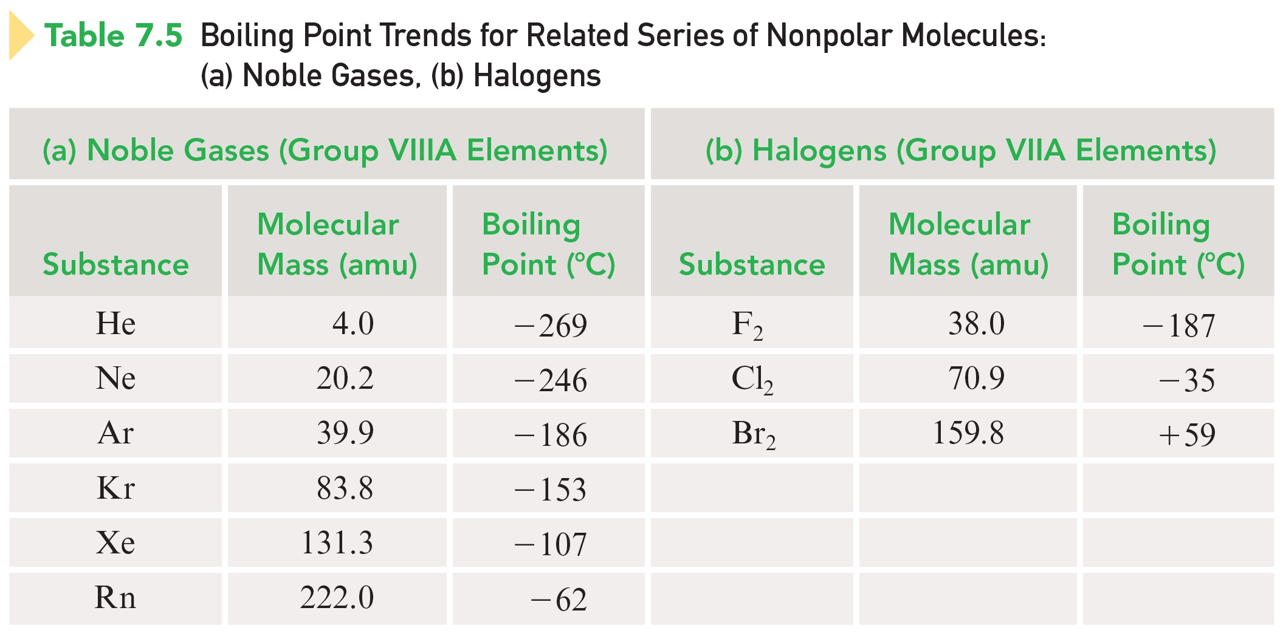
Boiling Point Trends for Related Series of Nonpolar Molecules

Slide 90
Concept Check
Which are stronger, intramolecular bonds or intermolecular forces?
How do you know?
Notes:
Intramolecular bonds are stronger because it would take a lot more energy to overcome covalent bonds and break apart the molecule than to overcome intermolecular forces in between the atoms (to make it become a liquid or gas).

Slide 91
Concept Check
Which are stronger, intramolecular bonds or intermolecular forces?
How do you know?
Notes:
Intramolecular bonds are stronger because it would take a lot more energy to overcome covalent bonds and break apart the molecule than to overcome intermolecular forces in between the atoms (to make it become a liquid or gas).

Slide 92
Concept Check
Which has the stronger intermolecular forces?
N₂ H₂O
(Boiling points -196 °C and 100 °C)
Explain.
N₂ non-polar H₂O polar
N₂ London H₂O Hydrogen bonding
Notes:
H₂O has the stronger intermolecular forces because it exhibits hydrogen bonding, whereas N₂ only exhibits London dispersion forces.

Slide 93
Concept Check
Which has the stronger intermolecular forces?
N₂ H₂O
Explain.
Notes:
H₂O has the stronger intermolecular forces because it exhibits hydrogen bonding, whereas N₂ only exhibits London dispersion forces.

Slide 94
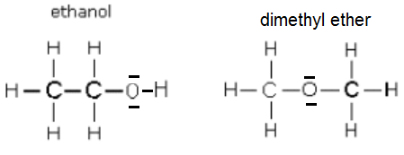
Concept Check
Draw two Lewis structures for the formula isomers of C₂H₆O; C₂H₅OH and CH₃OCH₃ and compare the boiling points of the two molecules.
[C₂H₅OH (78°C) and CH₃OCH₃ (–23 ºC)
Notes:
One Lewis structure could be ethanol and one Lewis structure could be dimethyl ether. Ethanol will have a higher boiling point than dimethyl ether because ethanol exhibits hydrogen bonding and dimethyl ether exhibits dipole-dipole interactions. Hydrogen bonding is an especially strong type of dipole-dipole interaction and will thus raise the boiling point of ethanol.

Slide 95
Concept Check
Which gas would behave more ideally at the same conditions of P and T?
CO or N₂
Why?
Ideally means no intermolecular attractions between gas molecules
CO (polar) or N₂ (non-polar) chapter 5
Notes:
N₂ would behave more ideally because it is nonpolar and only exhibits London dispersion forces, therefore the intermolecular forces between N₂ molecules are weak (and thus the collisions will be more “elastic”). CO also exhibits dipole-dipole interactions.

Slide 96
Concept Check
Which gas would behave more ideally at the same conditions of P and T?
CO or N₂
Why?
Notes:
N₂ would behave more ideally because it is nonpolar and only exhibits London dispersion forces, therefore the intermolecular forces between N₂ molecules are weak (and thus the collisions will be more “elastic”). CO also exhibits dipole-dipole interactions.

