Slide 1
Chapter 6. Chemical Calculations: Formula Masses,
Moles, and Chemical Equations
Introduction to Inorganic Chemistry
Instructor Dr. Upali Siriwardane (Ph.D. Ohio State)
E-mail: upali@latech.edu
Office: 311 Carson Taylor Hall ; Phone: 318-257-4941;
Office Hours: MWF 8:00-9:00 and 11:00-12:00;
TR 10:00-12:00
Contact me trough phone or e-mail if you have questions
Online Tests on Following days
March 24, 2017: Test 1 (Chapters 1-3)
April 10, 2017 : Test 2 (Chapters 4-5)
April 28, 2017: Test 3 (Chapters 6,7 &8)
May 12, 2017 : Test 4 (Chapters 9, 10 &11)
May 15, 2017: Make Up Exam: Chapters 1-11)
.

Slide 2
6.1 Formula Masses
6.2 The Mole: A Counting Unit for Chemists
6.3 The Mass of a Mole
6.4 Chemical Formulas and the Mole Concept
6.5 The Mole and Chemical Calculations
6.6 Writing and Balancing Chemical Equations
6.7 Chemical Equations and the Mole Concept
6.8 Chemical Calculations Using Chemical Equations

Slide 3
Atomic Mass of Cu 63.55 amu (g/mol)
Formula Mass of CaCl₂ = 110.98 amu (g/mol)
(2 × 35.45) + 40.08
Molecular Mass of H₂O = 18.02 amu (g/mol)
(2 × 12.01.45) + (6 x 1.008)

Slide 4
A Mole
The amount of a substance that contains as many elementary particles (atoms, molecules, or formula units) as there are atoms in exactly 12 grams of pure ¹²C.
1 mole of anything = 6.02 x 10²³ units of that thing (Avogadro’s number).
1 mole C = 6.022 x 10²³ C atoms = 12.01 g C

Slide 5
Molar Mass (g/mol)
[molecular or formula mass (weight)]
Mass in grams of one mole of the substance:
Molar Mass of N = 14.01 g/mol
Molar Mass of H₂O = 18.02 g/mol (molecular weight)
(2 × 1.008) + 16.00
Molar Mass of Ba(NO₃)₂ = 261.35 g/mol (Formula Weight)
137.33 + (2 × 14.01) + (6 × 16.00)

Slide 6
Exercise
Calculate the mass, in grams, of a 2.5-mole sample of ethane, C₂H₆.
Notes:
2.5 mol C₂H₆ × (30.068 g C₂H₆ / 1 mol C₂H₆) = 75 g C₂H₆

Slide 7
Exercise
Calculate the mass, in grams, of a 2.5-mole sample of ethane, C₂H₆.
Molecular weight of C₂H₆
(2 × 12.01.45) + (6 x 1.008) = 30.068 g/mol C₂H₆
Notes:
2.5 mol C₂H₆ × (30.068 g C₂H₆ / 1 mol C₂H₆) = 75 g C₂H₆

Slide 8
Exercise
Calculate the mass, in grams, of a 2.5-mole sample of ethane, C₂H₆.
75 g C₂H₆
Notes:
2.5 mol C₂H₆ × (30.068 g C₂H₆ / 1 mol C₂H₆) = 75 g C₂H₆

Slide 9
Exercise
Calculate the number of moles in 50.0 g of H₂O.
Notes:
50.0 g H₂O × (1 mol H₂O / 18.016 g H₂O) = 2.78 mol H₂O

Slide 10
Exercise
Calculate the number of moles in 50.0 g of H₂O.
Molecular weight of H₂O
(2 × 1.008) + 16.00 = 18.016 g/mol H₂O
Notes:
50.0 g H₂O × (1 mol H₂O / 18.016 g H₂O) = 2.78 mol H₂O

Slide 11
Exercise
Calculate the number of moles in 50.0 g of H₂O.
Molecular weight of H₂O = 18.016 g/mol
2.78 mol H₂O
Notes:
50.0 g H₂O × (1 mol H₂O / 18.016 g H₂O) = 2.78 mol H₂O

Slide 12
Chemical Formula – Microscopic View
The numerical subscripts in a chemical formula give the number of atoms of the various elements present in 1 formula unit of the substance.
  In one molecule of P₂O₅, two atoms of phosphorus and five atoms of oxygen are present.

Slide 13
Chemical Formula – Macroscopic View (mole)
Indicates the number of moles of atoms of each element present in one mole of a substance.
  In one mole of P₂O₅, two moles of phosphorus and five moles of oxygen are present.

Slide 14
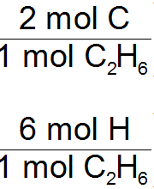


Exercise
How many moles of carbon atoms and hydrogen atoms are present in a 2.5-mole sample of ethane, C₂H₆?
Mole to atom conversion factor is used based on number of atoms in the formula
Then use
mole to atom conversion
to get number atoms
Notes:
Carbon: 2.5 mol C₂H₆ × (2 mol C / 1 mol C₂H₆) = 5.0 moles C atoms
Hydrogen: 2.5 mol C₂H₆ × (6 mol H / 1 mol C₂H₆) = 15 moles H atoms

Slide 15
Exercise
How many moles of carbon atoms and hydrogen atoms are present in a 2.5-mole sample of ethane, C₂H₆?
Notes:
Carbon: 2.5 mol C₂H₆ × (2 mol C / 1 mol C₂H₆) = 5.0 moles C atoms
Hydrogen: 2.5 mol C₂H₆ × (6 mol H / 1 mol C₂H₆) = 15 moles H atoms

Slide 16
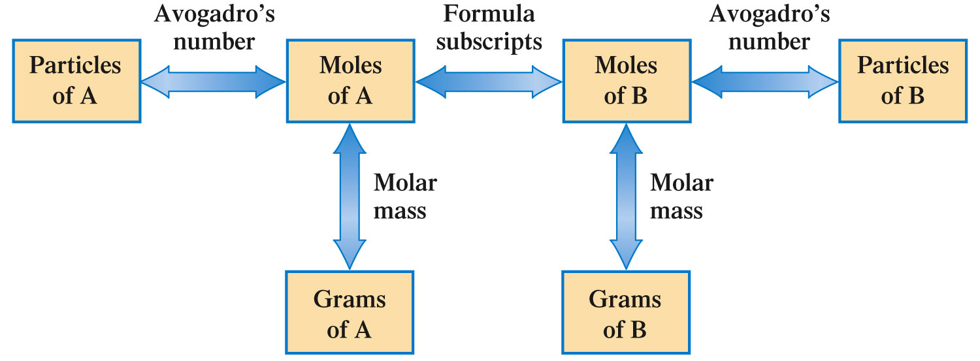
Let’s Put It All Together!

Slide 17


Concept Check
Which of the following is closest to the average mass of one atom of copper?
  63.55 g
  52.00 g
  58.93 g
  65.38 g
  1.055 x 10⁻²² g
Notes:
The correct answer is “e”. The mass of one atom of copper is going to be extremely small, so only letter “e” makes sense. The calculated solution is (1 Cu atom) × (1 mol Cu/6.02×10²³ Cu atoms) × (63.55 g Cu/1 mol Cu).

Slide 18
Concept Check
Which of the following is closest to the average mass of one atom of copper?
  63.55 g
  52.00 g
  58.93 g
  65.38 g
  1.055 x 10⁻²² g
Notes:
The correct answer is “e”. The mass of one atom of copper is going to be extremely small, so only letter “e” makes sense. The calculated solution is (1 Cu atom) × (1 mol Cu/6.02×10²³ Cu atoms) × (63.55 g Cu/1 mol Cu).

Slide 19
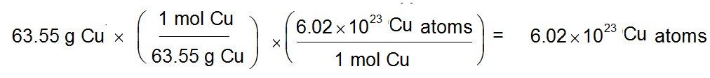
Concept Check
Calculate the number of copper atoms in a 63.55 g sample of copper.
Notes:
6.022×10²³ Cu atoms; 63.55 g of Cu is 1 mole of Cu, which is equal to Avogadro’s number.

Slide 20
Concept Check
Calculate the number of copper atoms in a 63.55 g sample of copper.
6.022×10²³ Cu atoms
Notes:
6.022×10²³ Cu atoms; 63.55 g of Cu is 1 mole of Cu, which is equal to Avogadro’s number.

Slide 21
Concept Check
Which of the following 100.0 g samples contains the greatest number of atoms?
  Magnesium
  Zinc
  Silver
Notes:
The correct answer is “a”. Magnesium has the smallest average atomic mass (24.31 amu). Since magnesium is lighter than zinc and silver, it will take more atoms to reach 100.0 g.

Slide 22
Concept Check
Which of the following 100.0 g samples contains the greatest number of atoms?
  Magnesium
  Zinc
  Silver
Notes:
The correct answer is “a”. Magnesium has the smallest average atomic mass (24.31 amu). Since magnesium is lighter than zinc and silver, it will take more atoms to reach 100.0 g.

Slide 23
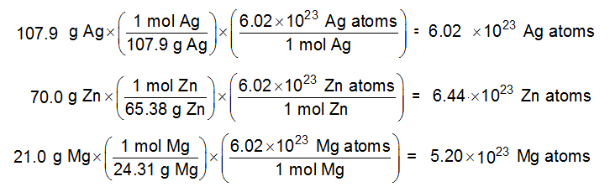
Exercise
Rank the following according to number of atoms (greatest to least):
  107.9 g of silver
  70.0 g of zinc
  21.0 g of magnesium
a)
b)
c)
Notes:
b, a, c; The greater the number of moles, the greater the number of atoms present. Zinc contains 1.07 mol, Ag contains 1.000 mol, and Mg contains 0.864 mol.

Slide 24
Exercise
Rank the following according to number of atoms (greatest to least):
  107.9 g of silver
  70.0 g of zinc
  21.0 g of magnesium
b) a) c)
Notes:
b, a, c; The greater the number of moles, the greater the number of atoms present. Zinc contains 1.07 mol, Ag contains 1.000 mol, and Mg contains 0.864 mol.

Slide 25
Exercise
Consider separate 100.0 gram samples of each of the following:
    H₂O, N₂O, C₃H₆O₂, CO₂
  Rank them from greatest to least number of oxygen atoms.
  H₂O = 18.02, N₂O = 46.01 , C₃H₆O₂= 74.09, CO₂ = 44.01 g/mol
  H₂O = 5.549, N₂O = 2.173 , C₃H₆O₂= 1.349, CO₂ = 2.272 mol
  O = 5.549, O = 2.173, C₃H₆O₂= 2.698, CO₂ = 4.544 mol O
Notes:
H₂O, CO₂, C₃H₆O₂, N₂O; The number of oxygen atoms in each is:
H₂O = 3.343×10²⁴
CO₂ = 2.737×10²⁴
C₃H₆O₂ = 1.626×10²⁴
N₂O = 1.368×10²⁴

Slide 26
Exercise
Consider separate 100.0 gram samples of each of the following:
    H₂O, N₂O, C₃H₆O₂, CO₂
  Rank them from greatest to least number of oxygen atoms.
  H₂O, CO₂, C₃H₆O₂, N₂O
  5.549 4.544 2.698 2.173 mol O
Notes:
H₂O, CO₂, C₃H₆O₂, N₂O; The number of oxygen atoms in each is:
H₂O = 3.343×10²⁴
CO₂ = 2.737×10²⁴
C₃H₆O₂ = 1.626×10²⁴
N₂O = 1.368×10²⁴

Slide 27
A Representation of a Chemical Reaction
A written statement that uses chemical symbols and chemical formulas to describe the changes that occur in a chemical reaction.
  C₂H₅OH + 3O₂ → 2CO₂ + 3H₂O
reactants products
Reactants are always placed on the left side of the arrow, products are always placed on the right side of the arrow.

Slide 28
C₂H₅OH + 3O₂ → 2CO₂ + 3H₂O
When the equation is balanced.
All atoms present in the reactants are accounted for in the products.
1 mole of ethanol reacts with 3 moles of oxygen to produce 2 moles of carbon dioxide and 3 moles of water.

Slide 29
Equation Coefficient
A number that is placed to the left of a chemical formula in a chemical equation; it changes the amount, but not the identity of the substance.
The coefficients in the balanced equation have nothing to do with the amount of each reactant that is used/given in the problem.

Slide 30
The balanced equation represents a ratio of reactants and products, not what actually “happens” during a reaction.
Use the coefficients in the balanced equation to calculate/decide the amount of each reactant that is used, and the amount of each product that is formed.

Slide 31
Guidelines for Balancing Chemical Equations
  Examine the equation and pick one element to balance first.
  Then pick a second element to balance, and so on.
  As a final check, count atoms on each side of the equation.

Slide 32
https://www.youtube.com/watch?v=oDVswHfZJzY
To play movie you must be in Slide Show Mode
PC Users: Please wait for content to load, then click to play
Mac Users: CLICK HERE

Slide 33
Exercise
Which of the following correctly balances the chemical equation given below?
    CaO + C → CaC₂ + CO₂
    I. CaO₂ + 3C → CaC₂ + CO₂
    II. 2CaO + 5C → 2CaC₂ + CO₂
    III. CaO + (2.5)C → CaC₂ + (0.5)CO₂
    IV. 4CaO + 10C → 4CaC₂ + 2CO₂
Notes:
II is correct.

Slide 34
Exercise
Which of the following correctly balances the chemical equation given below?
    CaO + C → CaC₂ + CO₂
    I. CaO₂ + 3C → CaC₂ + CO₂
    II. 2CaO + 5C → 2CaC₂ + CO₂
    III. CaO + (2.5)C → CaC₂ + (0.5)CO₂
    IV. 4CaO + 10C → 4CaC₂ + 2CO₂
Notes:
II is correct.

Slide 35
Concept Check
Which of the following are true concerning balanced chemical equations? There may be more than one true statement.
    The number of molecules is conserved.
    The coefficients tell you how much of each substance you have.
    Atoms are neither created nor destroyed. The coefficients indicate the mass ratios of the substances used.
    The sum of the coefficients on the reactant side equals the sum of the coefficients on the product side.
Notes:
Only III is correct.

Slide 36
Concept Check
Which of the following are true concerning balanced chemical equations? There may be more than one true statement.
    The number of molecules is conserved.
    The coefficients tell you how much of each substance you have.
    Atoms are neither created nor destroyed.
    The coefficients indicate the mass ratios of the substances used.
    The sum of the coefficients on the reactant side equals the sum of the coefficients on the product side.
Notes:
Only III is correct.

Slide 37
Notice
The number of atoms of each type of element must be the same on both sides of a balanced equation.
Subscripts must not be changed to balance an equation.
A balanced equation tells us the ratio of the number of molecules/units which react and are produced in a chemical reaction.
Coefficients can be fractions, although they are usually given as lowest integer multiples.

Slide 38
Coefficients in a Balanced Chemical Equation
  C₂H₅OH + 3O₂ → 2CO₂ + 3H₂O
One molecule of C₂H₅OH reacts with three molecules of O₂ to produce two molecules of CO₂ and three molecules of H₂O.
One mole of C₂H₅OH reacts with three moles of O₂ to produce two moles of CO₂ and three moles of H₂O.

Slide 39
Can Be Used to Generate mole Conversion Factors
  C₂H₅OH + 3O₂ → 2CO₂ + 3H₂O
1 mole of C₂H₅OH produces 2 moles of CO₂ and 3 moles of H₂O.

Slide 40
Can Be Used to Generate Conversion Factors
  C₂H₅OH + 3O₂ → 2CO₂ + 3H₂O
1 mole of C₂H₅OH reacts with 3 moles of O₂.
Conversion factors:
Are there more?

Slide 41
Stoichiometric Calculations
Chemical equations can be used to relate the masses of reacting chemicals through moles.

Slide 42
Calculating Masses of Reactants and Products in Reactions
  Balance the equation for the reaction.
  Convert the known mass of the reactant or product to moles of that substance.
  Use the balanced equation to set up the appropriate mole ratios or conversion factors.
  Use the appropriate mole ratios to calculate the number of moles of desired reactant or product.
  Convert from moles back to grams if required by the problem.

Slide 43
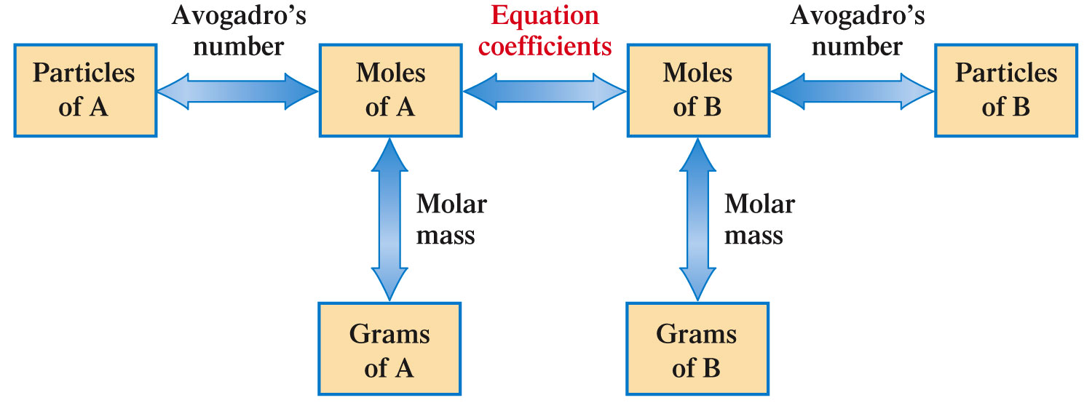
Calculating Masses of Reactants and Products in Reactions
g/MM
g/MM

Slide 44
Exercise (Part I)
Methane (CH₄) reacts with the oxygen in the air to produce carbon dioxide and water.
Ammonia (NH₃) reacts with the oxygen in the air to produce nitrogen monoxide and water.
  Write balanced equations for each of these reactions.
Notes:
CH₄ + 2O₂ → CO₂ + 2H₂O
4NH₃ + 5O₂ → 4NO + 6H₂O

Slide 45
Exercise (Part I)
Methane (CH₄) reacts with the oxygen in the air to produce carbon dioxide and water.
CH₄ + 2O₂ → CO₂ + 2H₂O
Ammonia (NH₃) reacts with the oxygen in the air to produce nitrogen monoxide and water.
4NH₃ + 5O₂ → 4NO + 6H₂O
  Write balanced equations for each of these reactions.
Notes:
CH₄ + 2O₂ → CO₂ + 2H₂O
4NH₃ + 5O₂ → 4NO + 6H₂O

Slide 46
Exercise (Part II)
Methane (CH₄) reacts with the oxygen in the air to produce carbon dioxide and water.
Ammonia (NH₃) reacts with the oxygen in the air to produce nitrogen monoxide and water.
  What mass of ammonia would produce the same amount of water as 1.00 g of methane reacting with excess oxygen?
Notes:
1.42 g of ammonia is required. Use the balanced equations from the previous exercise to start this problem. Determine the amount of water produced from 1.00 g of methane (which is 0.125 moles of water). Use the moles of water and the balanced equation to determine the amount of ammonia needed.
See the “Let’s Think About It” slide next to get the students going.

Slide 47
Let’s Think About It
Where are we going?
  To find the mass of ammonia that would produce the same amount of water as 1.00 g of methane reacting with excess oxygen.
How do we get there?
  We need to know:
    How much water (limiting reactant) is produced from 1.00 g of methane and excess oxygen.
    How much ammonia is needed to produce the amount of water calculated above.

Slide 48
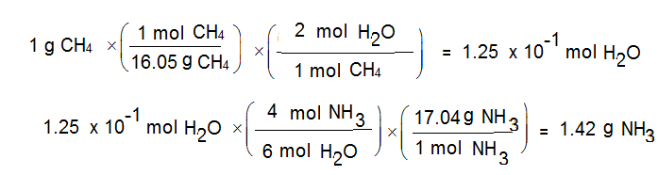
Exercise (Part II)
  Mole ratio:
1 mol CH₄ = 2 mol H₂O
4 mol NH₃ = 6 mol H₂O
  What mass of ammonia would produce the same amount of water as 1.00 g of methane reacting with excess oxygen? 1.42 g
Notes:
1.42 g of ammonia is required. Use the balanced equations from the previous exercise to start this problem. Determine the amount of water produced from 1.00 g of methane (which is 0.125 moles of water). Use the moles of water and the balanced equation to determine the amount of ammonia needed.
See the “Let’s Think About It” slide next to get the students going.

