Slide 1
Chapter 5. Chemical Bonding: The Covalent Bond Model
Introduction to Inorganic Chemistry
Instructor Dr. Upali Siriwardane (Ph.D. Ohio State)
E-mail: upali@latech.edu
Office: 311 Carson Taylor Hall ; Phone: 318-257-4941;
Office Hours: MWF 8:00-9:00 and 11:00-12:00;
TR 10:00-12:00
Contact me trough phone or e-mail if you have questions
Online Tests on Following days
March 24, 2017: Test 1 (Chapters 1-3)
April 7, 2017 : Test 2 (Chapters 4-5)
April 28, 2017: Test 3 (Chapters 6,7 &8)
May 12, 2017 : Test 4 (Chapters 9, 10 &11)
May 15, 2017: Make Up Exam: Chapters 1-11)
.

Slide 2
Chemical Bonding: The Covalent Bond Model
5.1 The Covalent Bond Model
5.2 Lewis Structures for Molecular Compounds
5.3 Single, Double, and Triple Covalent Bonds
5.4 Valence Electrons and Number of Covalent Bonds Formed
5.5 Coordinate Covalent Bonds
5.6 Systematic Procedures for Drawing Lewis Structures
5.7 Bonding in Compounds with Polyatomic Ions Present
5.8 Molecular Geometry
5.9 Electronegativity
5.10 Bond Polarity
5.11 Molecular Polarity
5.12 Naming Binary Molecular Compounds

Slide 3
Key Differences Between Ionic and Covalent Bonding
Ionic bonds form between a metal and nonmetal. Covalent bonds usually form between nonmetals.
Ionic bonds involve electron transfer. Covalent bonds involve electron sharing.
Ionic compounds do not contain discrete molecules. Covalent compounds has a molecule as its basic structural unit.

Slide 4
Key Differences Between Ionic and Covalent Bonding
All ionic compounds are solids at room temperature. Covalent compounds are varied exits as gases and liquids as well.
Soluble ionic solids form aqueous solutions that conduct electricity. Soluble covalent compounds usually produce a non-conducting aqueous solution.

Slide 5
Covalent Bond
A chemical bond resulting from two nuclei attracting the same shared electrons.

Slide 6
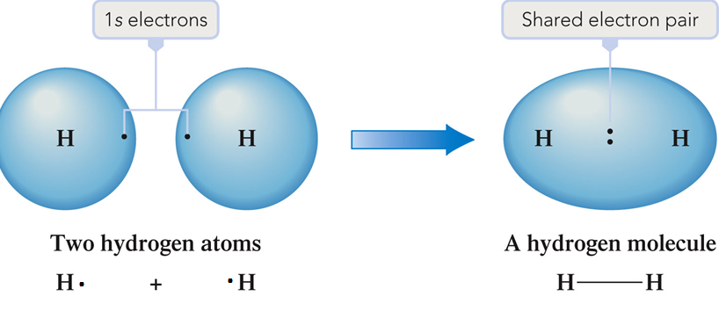
A Hydrogen Molecule
Electron sharing can occur only when electron orbitals from two different atomic orbitals overlap.
Produces increased stability.

Slide 7
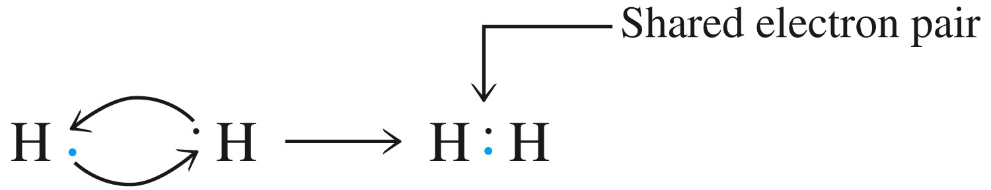
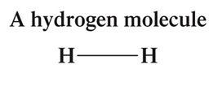
Lewis Notation
The two shared electrons do double duty, helping each hydrogen atom achieve a helium noble-gas configuration.
Line represent two electrons
Lewis Structure

Slide 8
Bonding Electrons
Pairs of valence electrons that are shared between atoms in a covalent bond.
Represent the shared electron pairs with dashes.

Slide 9
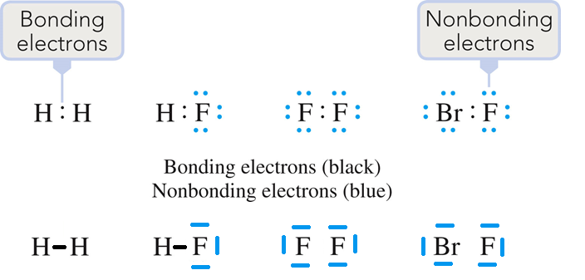
Nonbonding Electrons
Pairs of valence electrons on an atom that are not involved in electron sharing.
Also referred to as unshared electron pairs, lone electron pairs, or lone pairs.

Slide 10
Single Covalent Bond
A covalent bond in which two atoms share one pair of electrons.
H–H

Slide 11
Double Covalent Bond
A covalent bond in which two atoms share two pairs of electrons.
O=C=O

Slide 12
Triple Covalent Bond
A covalent bond in which two atoms share three pairs of electrons.

Slide 13

There is a strong tendency for atoms of nonmetallic elements to form a specific number of covalent bonds.
The number of bonds formed is equal to the number of electrons the nonmetallic atom must share to obtain an octet of electrons.

Slide 14

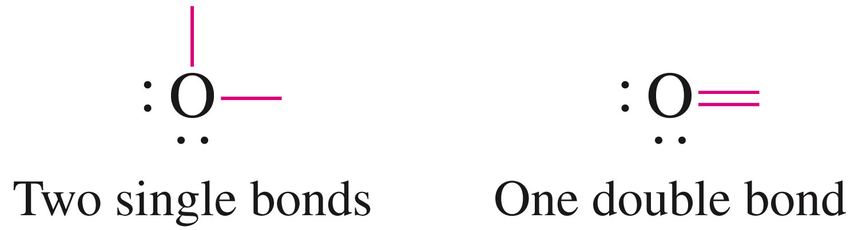
Oxygen (6 Valence Electrons, 2 Octet Vacancies)

Slide 15

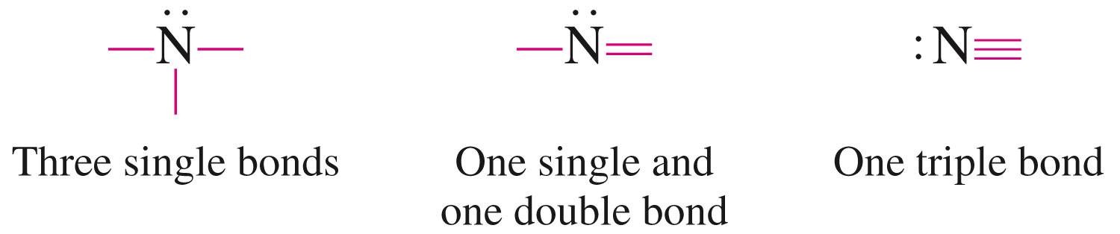
Nitrogen (5 Valence Electrons, 3 Octet Vacancies)

Slide 16

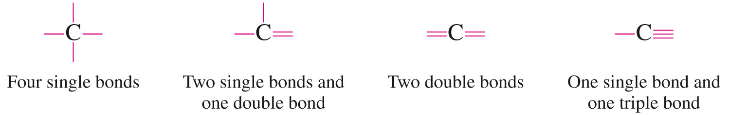
Carbon (4 Valence Electrons, 4 Octet Vacancies)

Slide 17
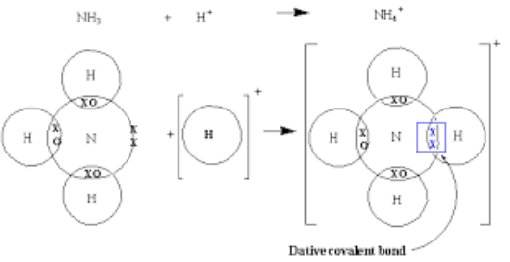
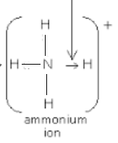
A covalent bond in which both electrons of a shared pair come from one of the two atoms involved in the bond is called Coordinate covalent bond.
Enables an atom that has two or more vacancies in its valence shell to share a pair of nonbonding electrons that are located on another atom.
Coordinate covalent bond

Slide 18
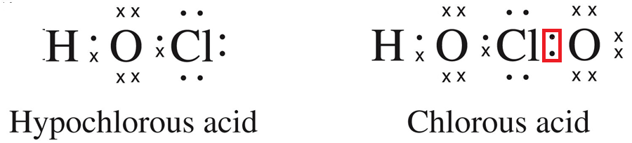
Comparison of HOCl and HClO₂
Coordinate covalent bond
In HOCl, all the bonds are “ordinary” covalent bonds.
In HClO₂, the “new” chlorine-oxygen bond is a coordinate covalent bond.

Slide 19
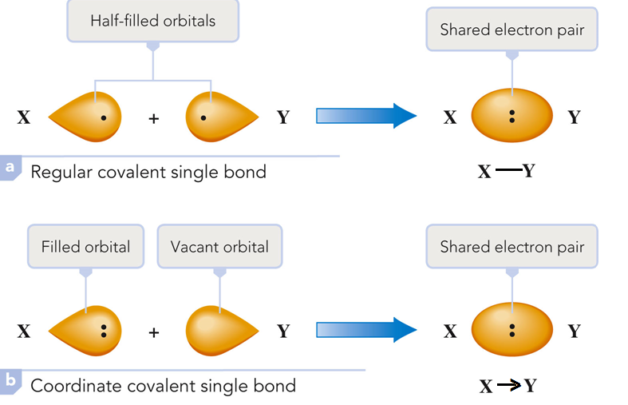
Formation of a “Regular” Covalent Bond vs a Coordinate Covalent Bond

Slide 20
Atoms participating in coordinate covalent bonds generally do not form their normal number of covalent bonds.
Once a coordinate covalent bond forms, it is indistinguishable from other covalent bonds in a molecule.
Coordinate covalent bond
5 Valence Electrons, 3 Octet Vacancies

Slide 21
Steps for Writing Lewis Structures
Calculate the total number of valence electrons available in the molecule by adding together the valence electron counts for all atoms in the molecule. (Use the periodic table.)
Example: H₂O
2 (1 e–) + 6 e– = 8 e– total

Slide 22
Steps for Writing Lewis Structures
Write the chemical symbols of the atoms in the molecule in the order in which they are bonded to one another, and then place a single covalent bond, involving two electrons, between each pair of bonded atoms.
  Determine central atom – usually atom that appears only once in the formula or bigger atom.
Example: H₂O

Slide 23
Steps for Writing Lewis Structures
Add nonbonding electron pairs to the structure such that each atom bonded to the central atom has an octet of electrons. Remember that for hydrogen, an “octet” is only 2 (“duet”) electrons.
Examples: H₂O and PBr₃

Slide 24
Steps for Writing Lewis Structuresa
Place any remaining electrons on the central atom of the structure.
Example: PBr₃ = 26 valence e–

Slide 25
Steps for Writing Lewis Structures
If there are not enough electrons to give the central atom an octet, then use one or more pairs of nonbonding electrons on the terminal atoms bonded to the central atom to form double or triple bonds.
Example: HCN

Slide 26
Steps for Writing Lewis Structures
6. Count the total number of electrons in the completed Lewis structure to make sure it is equal to the total number of valence electrons available for bonding, as calculated in Step 1. (Serves as a double-check.)

Slide 27

Concept Check
Draw a Lewis structure for each of the following molecules:
  H₂
  F₂
  HF

Slide 28
Concept Check
Draw a Lewis structure for each of the following molecules:
  H₂
  F₂
  HF

Slide 29
Concept Check
Draw a Lewis structure for each of the following molecules:
NH₃
CO₂
CCl₄

Slide 30
Concept Check
Draw a Lewis structure for each of the following molecules:
NH₃
CO₂
CCl₄

Slide 31
Ionic Compounds Containing Polyatomic Ions
Covalent bonding exists within the polyatomic ion and ionic bonding exists between it and ions of opposite charge.

Slide 32
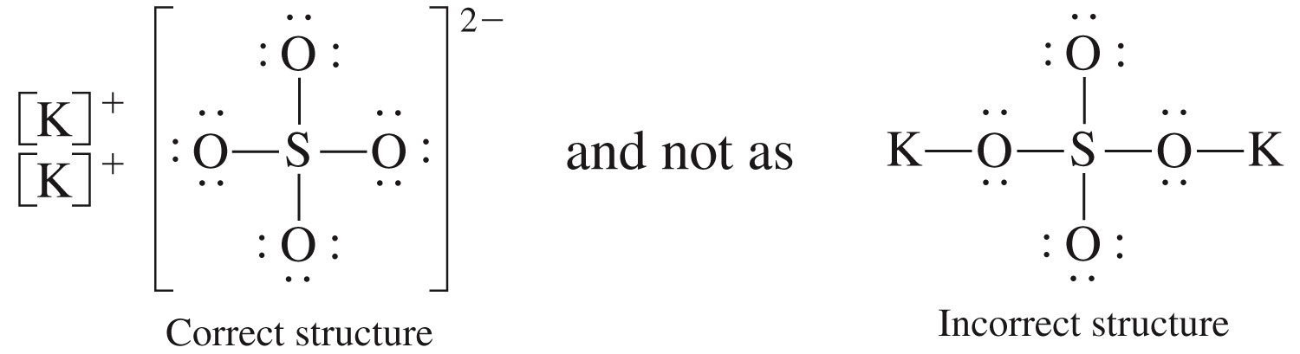
Lewis Structure of Potassium Sulfate
Polyatomic ion charge is not localized on a particular atom but rather is associated with the ion as a whole.
It is customary to use brackets and show ionic charge outside the brackets.

Slide 33
A description of the three-dimensional arrangement of atoms within a molecule.
An important factor in determining the physical and chemical properties of a substance.

Slide 34
VSEPR Theory
VSEPR: Valence Shell Electron-Pair Repulsion.
A set of procedures for predicting the molecular geometry of a molecule using the information contained in the molecule’s Lewis structure.
The structure around a given atom is determined principally by minimizing electron pair repulsions.

Slide 35
VSEPR Electron Group
A collection of valence electrons present in a localized region about the central atom in a molecule.
The four electrons in a double bond or the six electrons in a triple bond are localized in the region between two bonded atoms in a manner similar to the two electrons of a single bond.

Slide 36
Steps to Apply the VSEPR Model
Draw the a Lewis structure for the molecule and identify the specific atom for which geometrical information is desired (usually central atom).

Slide 37
Steps to Apply the VSEPR Model
Determine the number of VSEPR electron groups present about the central atom.
  No distinction is made between bonding and nonbonding electron groups. Both are counted.
  Single, double, and triple bonds are all counted equally as “one electron group” because each takes up only one region of space about a central atom.

Slide 38
Steps to Apply the VSEPR Model
3. Predict the VSEPR electron group arrangement about the atom by assuming that the electron groups orient themselves in a manner that minimizes repulsions.

Slide 39
VSEPR: Two Electron Pairs
To play movie you must be in Slide Show Mode
PC Users: Please wait for content to load, then click to play
Mac Users: CLICK HERE

Slide 40
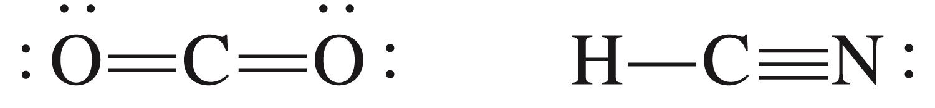
VSEPR: Two Electron Groups
VSEPR electron group arrangement on central atom
2
2
linear
linear

Slide 41
VSEPR: Three Electron Pairs
To play movie you must be in Slide Show Mode
PC Users: Please wait for content to load, then click to play
Mac Users: CLICK HERE

Slide 42
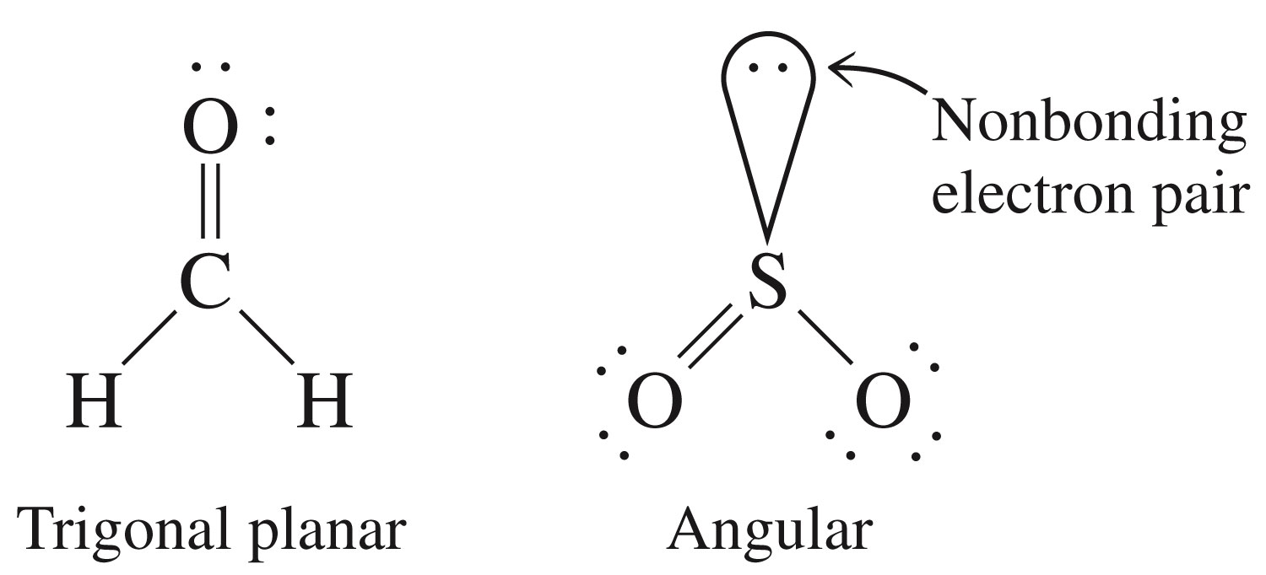
VSEPR: Three Electron Groups
VSEPR electron group arrangement on central atom
3
3

Slide 43
VSEPR: Four Electron Pairs
To play movie you must be in Slide Show Mode
PC Users: Please wait for content to load, then click to play
Mac Users: CLICK HERE

Slide 44
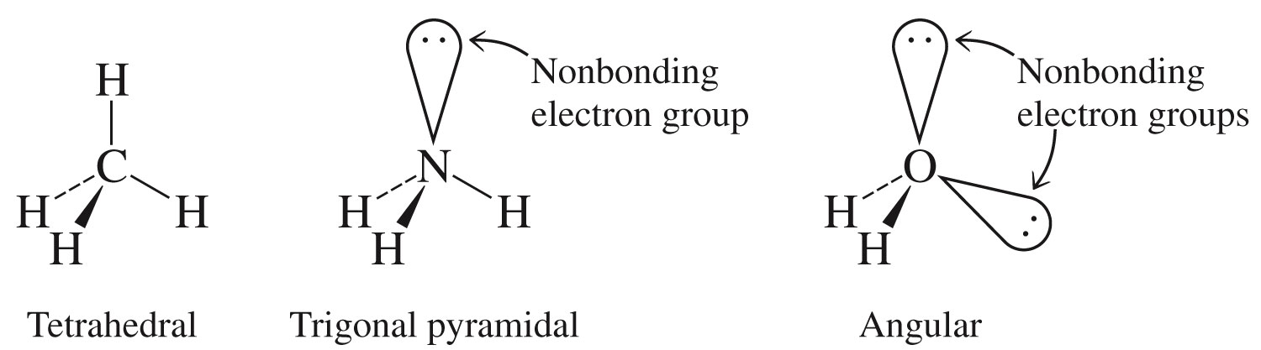
VSEPR: Four Electron Groups
VSEPR electron group arrangement on central atom
4
4
4

Slide 45
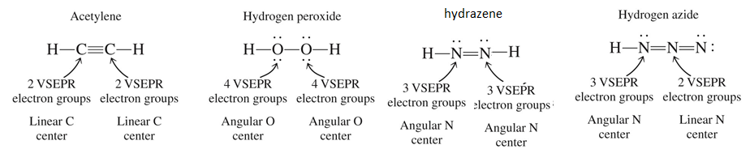
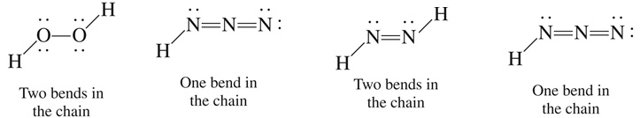
Molecules with More Than One Central Atom
The molecular shape of molecules that contain more than one central atom can be obtained by considering each central atom separately and then combining the results.

Slide 46
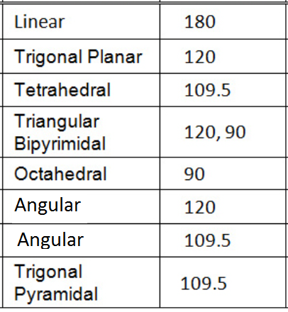
Molecular Geometries and Angles
Notes:
HCN – linear, 180º
PH₃ – trigonal pyramid, 107º
O₃ – bent, 120º

Slide 47
Concept Check
Determine the shape for each of the following molecules, and include bond angles:
HCN
PH₃
O₃
Notes:
HCN – linear, 180º
PH₃ – trigonal pyramid, 107º
O₃ – bent, 120º

Slide 48
Concept Check
Determine the shape for each of the following molecules, and include bond angles:
HCN – linear, 180°
PH₃ – trigonal pyramid, 107°
O₃ – bent, 120°
Notes:
HCN – linear, 180º
PH₃ – trigonal pyramid, 107º
O₃ – bent, 120º

Slide 49
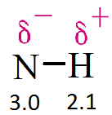
The ability of an atom in a molecule to attract shared electrons to itself.
A measure of the relative attraction that an atom has for the shared electrons in a bond.
On the periodic table, electronegativity generally increases across a period and decreases down a group.

Slide 50
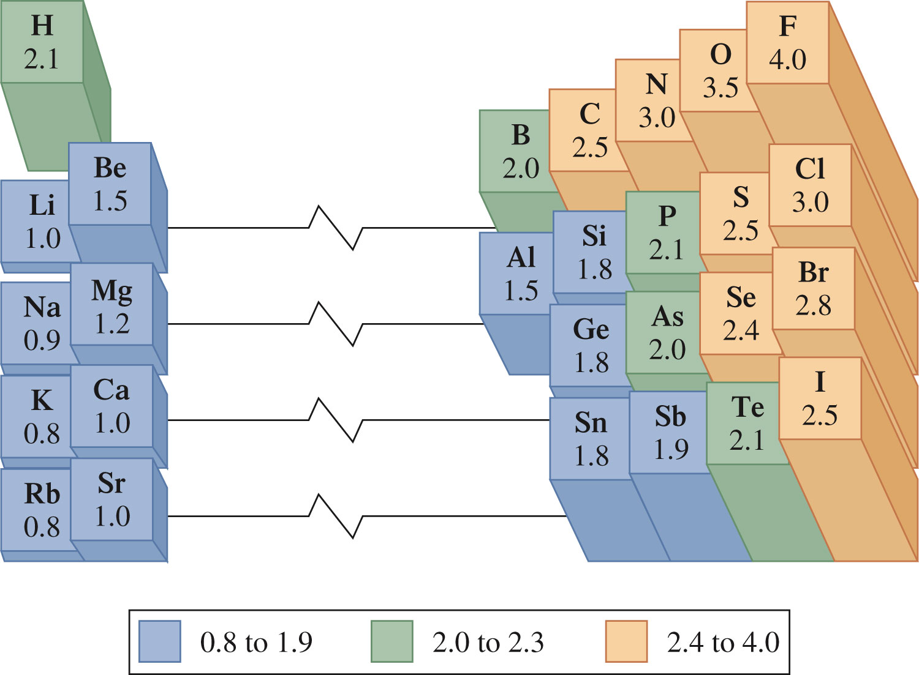
Pauling Electronegativity Values

Slide 51
Concept Check
What is the general trend for electronegativity across rows and down columns on the periodic table?
Explain the trend.
Notes:
Generally speaking, the electronegativity increases in going from left to right across a period because the number of protons increases which increases the effective nuclear charge. The electronegativity decreases going down a group because the size of the atoms increases as you go down so when other electrons approach the larger atoms, the effective nuclear charge is not as great due to shielding from the current electrons present.

Slide 52
Concept Check
If lithium and fluorine react, which has more attraction for an electron? Why?
In a bond between fluorine and iodine, which has more attraction for an electron? Why?
Notes:
The fluorine has more attraction for an electron than does lithium. Both have valence electrons in the same principal energy level (the 2nd), but fluorine has a greater number of protons in the nucleus. Electrons are more attracted to a larger nucleus (if the principal energy level is the same).
The fluorine also has more attraction for an electron than does iodine. In this case the nuclear charge of iodine is greater, but the valence electrons are at a much higher principal energy level (and the inner electrons shield the outer electrons).

Slide 53
Concept Check
If lithium and fluorine react, which has more attraction for an electron? Why?
In a bond between fluorine and iodine, which has more attraction for an electron? Why?
Notes:
The fluorine has more attraction for an electron than does lithium. Both have valence electrons in the same principal energy level (the 2nd), but fluorine has a greater number of protons in the nucleus. Electrons are more attracted to a larger nucleus (if the principal energy level is the same).
The fluorine also has more attraction for an electron than does iodine. In this case the nuclear charge of iodine is greater, but the valence electrons are at a much higher principal energy level (and the inner electrons shield the outer electrons).

Slide 54
Nonpolar Covalent Bond in Homo-nuclear
A covalent bond in which there is equal sharing of electrons between two atoms.
H₂: H – H
N₂: N N

Slide 55
Polar Covalent Bond in Hetero-nuclear
A covalent bond in which there is unequal sharing of electrons between two atoms.
H-Cl, C≡O
Electronegativity Cl = 3.0 H = 2.1 O = 2.5
Electronegativity difference 0.9 0.4

Slide 56
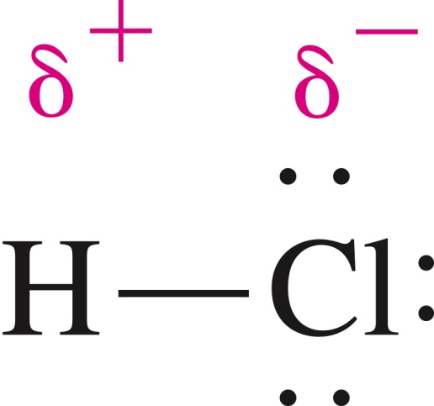
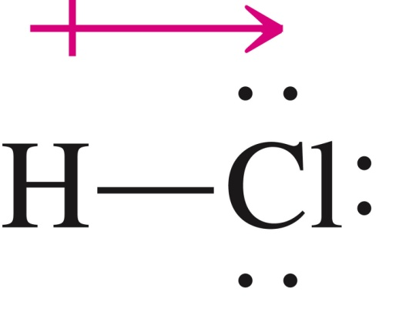
Polar Covalent Bond
It creates fractional positive and negative charges on atoms.
Electrons spend more time near the more electronegative atom of the bond and less time near the less electronegative atom of the bond.

Slide 57
Bond Polarity
A measure of the degree of inequality in the sharing of electrons between two atoms in a chemical bond.
The greater the electronegativity difference between the two bonded atoms, the greater the polarity of the bond.

Slide 58
Bond Polarity
Bond Type | Electronegativity Difference
Nonpolar Covalent | 0.4 or less
Polar Covalent | Greater than 0.4 to 1.5
Polar Covalent | Between 1.5 and 2.0 (between nonmetals)
Ionic | Between 1.5 and 2.0 (metal and nonmetal)
Ionic | Greater than 2.0

Slide 59
Exercise
Arrange the following bonds from most to least polar:
a) N-F O-F C-F
b) C-F N-O Si-F
c) Cl-Cl B-Cl S-Cl
Notes:
The greater the electronegativity difference between the atoms, the more polar the bond.
C-F, N-F, O-F
Si-F, C-F, N-O
B-Cl, S-Cl, Cl-Cl

Slide 60
Exercise
Arrange the following bonds from most to least polar:
a) N-F O-F C-F
a) C-F, N-F, O-F
b) C-F N-O Si-F
` b) Si-F, C-F, N-O
c) Cl-Cl B-Cl S-Cl
c) B-Cl, S-Cl, Cl-Cl
Notes:
The greater the electronegativity difference between the atoms, the more polar the bond.
C-F, N-F, O-F
Si-F, C-F, N-O
B-Cl, S-Cl, Cl-Cl

Slide 61
Concept Check
Which of the following bonds would be the least polar yet still be considered polar covalent?
Mg-O C-O O-O Si-O N-O
Notes:
The correct answer is N-O. To be considered polar covalent, unequal sharing of electrons must still occur. Choose the bond with the least difference in electronegativity yet there is still some unequal sharing of electrons.

Slide 62
Concept Check
Which of the following bonds would be the least polar yet still be considered polar covalent?
Mg-O C-O O-O Si-O N-O
Notes:
The correct answer is N-O. To be considered polar covalent, unequal sharing of electrons must still occur. Choose the bond with the least difference in electronegativity yet there is still some unequal sharing of electrons.

Slide 63
Concept Check
Which of the following bonds would be the most polar without being considered ionic?
Mg-O C-O O-O Si-O N-O
Notes:
The correct answer is Si-O. To not be considered ionic, generally the bond needs to be between two nonmetals. The most polar bond between the nonmetals occurs with the bond that has the greatest difference in electronegativity.

Slide 64
Concept Check
Which of the following bonds would be the most polar without being considered ionic?
Mg-O C-O O-O Si-O N-O
Notes:
The correct answer is Si-O. To not be considered ionic, generally the bond needs to be between two nonmetals. The most polar bond between the nonmetals occurs with the bond that has the greatest difference in electronegativity.

Slide 65
A measure of the degree of inequality in the attraction of bonding electrons to various locations within a molecule.
Polar molecule – a molecule in which there is an unsymmetrical distribution of electron charge.
Nonpolar molecule – a molecule in which there is a symmetrical distribution of electron charge.

Slide 66
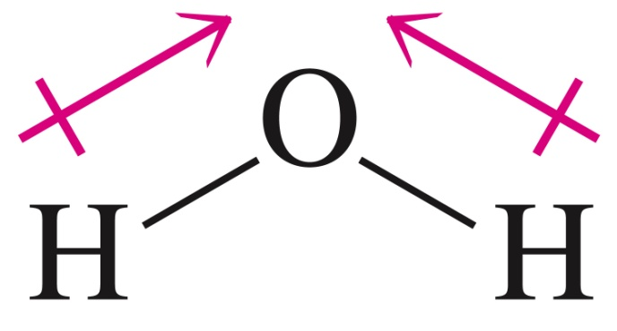
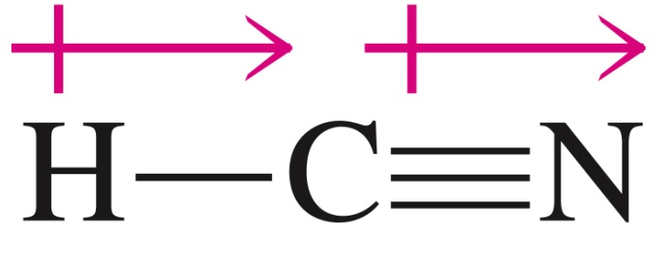
Polar Molecules: H₂O and HCN
For H₂O, the bond polarities associated with the two hydrogen-oxygen bonds do not cancel one another because of the nonlinearity of the molecule.
For HCN, nitrogen is more electronegative than hydrogen.

Slide 67
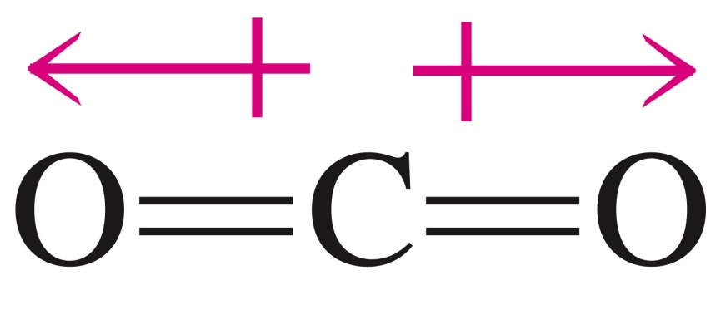
Nonpolar Molecule: CO₂
The effects of the two polar bonds are canceled as a result of the oxygen atoms being arranged symmetrically around the carbon atom.

Slide 68
Concept Check
True or false:
A molecule that has polar bonds will always be polar.
  If true, explain why.
  If false, provide a counter-example.
Notes:
False, a molecule may have polar bonds (like CO₂) but the individual dipoles might cancel out so that the net dipole moment is zero.

Slide 69
Concept Check
True or false:
A molecule that has polar bonds will always be polar.
  If true, explain why.
  If false, provide a counter-example.
Notes:
False, a molecule may have polar bonds (like CO₂) but the individual dipoles might cancel out so that the net dipole moment is zero.

Slide 70
Let’s Think About It
Draw the Lewis structure for SiO₂.
Does SiO₂ contain polar bonds?
Is the molecule polar or nonpolar overall? Why?

Slide 71
Concept Check
Which of the following molecules are polar?
  F₂
  HF
  NH₃
  SO₂
  CCl₄
Notes:
HF, NH₃, SO₂

Slide 72
Concept Check
Which of the following molecules are polar?
  F₂
  HF
  NH₃
  SO₂
  CCl₄
Notes:
HF, NH₃, SO₂

Slide 73
Binary Molecular Compound
A molecular compound in which only two nonmetallic elements are present.
The full name of the nonmetal of lower electronegativity is given first, followed by a separate word containing the stem of the name of the more electronegative nonmetal and the suffix –ide.
Numerical prefixes, giving numbers of atoms, precede the names of both nonmetals.

Slide 74
Binary Covalent Compounds
Examples:
CO₂ Carbon dioxide
SF₆ Sulfur hexafluoride
N₂O₄ Dinitrogen tetroxide

Slide 75
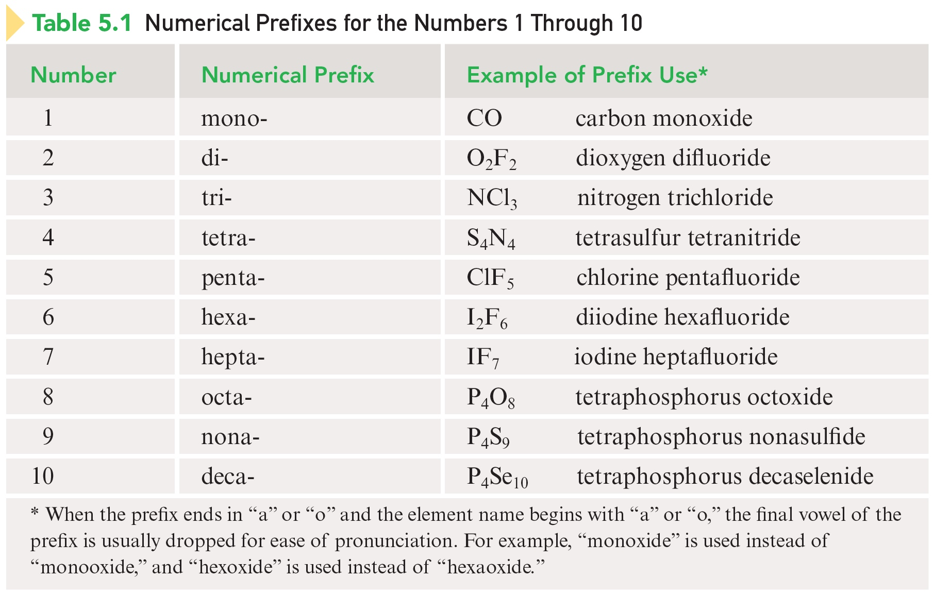
Common Numerical Prefixes

Slide 76
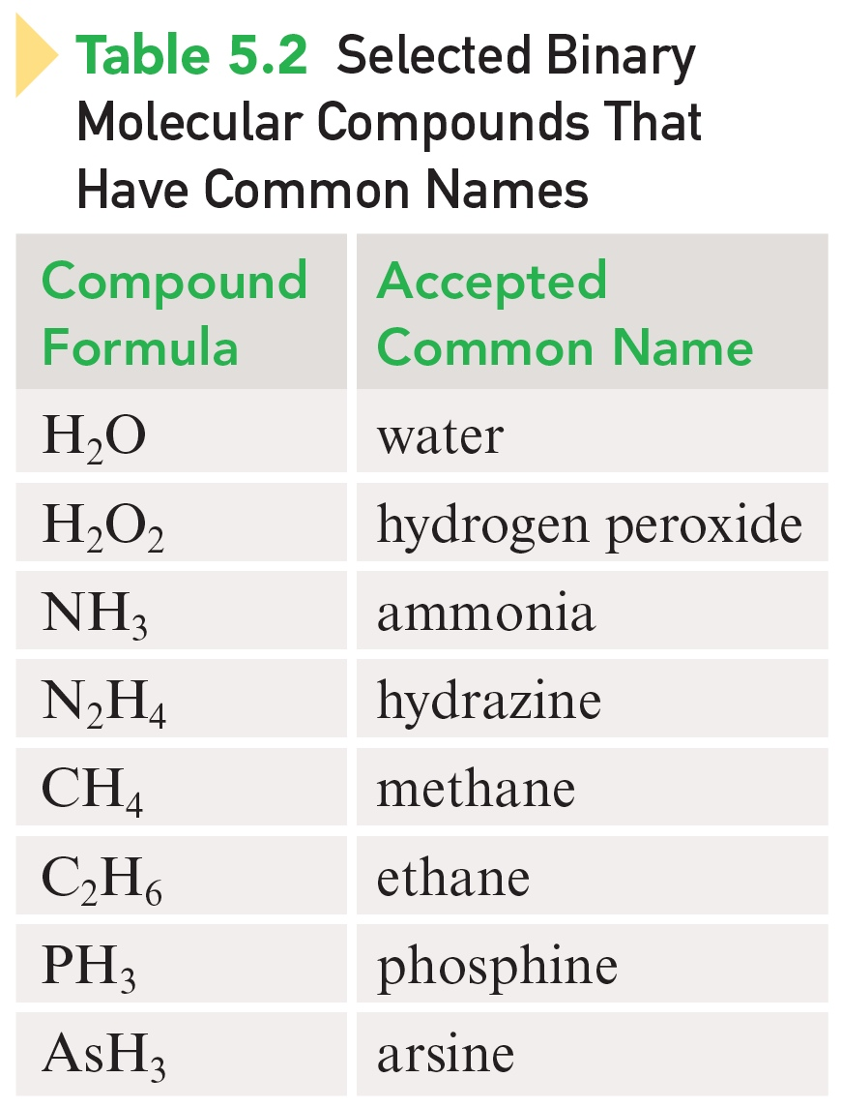
Some Binary Molecular Compounds That Have Common Names

Slide 77
Exercise
Which of the following compounds is named incorrectly?
NO₂ nitrogen dioxide
P₂O₅ phosphorus pentoxide
PCl₃ phosphorus trichloride
SO₃ sulfur trioxide
ICl iodine monochloride
Notes:
The correct name for P₂O₅ is diphosphorus pentoxide.

Slide 78
Exercise
Which of the following compounds is named incorrectly?
NO₂ nitrogen dioxide
P₂O₅ phosphorus pentoxide
PCl₃ phosphorus trichloride
SO₃ sulfur trioxide
ICl iodine monochloride
Notes:
The correct name for P₂O₅ is diphosphorus pentoxide.

