Slide 1
Chapter 4. Chemical Bonding: The Ionic Bond Model
Introduction to Inorganic Chemistry
Instructor Dr. Upali Siriwardane (Ph.D. Ohio State)
E-mail: upali@latech.edu
Office: 311 Carson Taylor Hall ; Phone: 318-257-4941;
Office Hours: MWF 8:00-9:00 and 11:00-12:00;
TR 10:00-12:00
Contact me trough phone or e-mail if you have questions
Online Tests on Following days
March 24, 2017: Test 1 (Chapters 1-3)
April 7, 2017 : Test 2 (Chapters 4-5)
April 28, 2017: Test 3 (Chapters 6,7 &8)
May 12, 2017 : Test 4 (Chapters 9, 10 &11)
May 15, 2017: Make Up Exam: Chapters 1-11)
.

Slide 2
Chemical Bonding: The Ionic Bond Model
4.1 Chemical Bonds
4.2 Valence Electrons and Lewis Symbols
4.3 The Octet Rule
4.4 The Ionic Bond Model
4.5 The Sign and Magnitude of Ionic Charge
4.6 Lewis Structures for Ionic Compounds
4.7 Chemical Formulas for Ionic Compounds
4.8 The Structure of Ionic Compounds
4.9 Recognizing and Naming Binary Ionic Compounds
4.10 Polyatomic Ions
4.11 Chemical Formulas and Names for Ionic Compounds Containing Polyatomic Ions

Slide 3
A Chemical Bond
Attractive force that holds two atoms together in a more complex unit.
Form as a result of interactions between electrons found in the combining atoms.

Slide 4
Two Types of Chemical Bonds
Ionic Bonds (metal + non-metal) Chapter 4
Covalent Bonds (non-metal + non-metal) Chapter 5
Metallic Bonds (metal + metal) (not discussed)

Slide 5
Ionic Bond
Chemical bond formed through the transfer of one or more electrons from one (metal) atom or group of atoms to another (non-metal) atom or group of atoms.
Ionic Compound
  A compound in which ionic bonds are present due to charged attractions between cations and anions.

Slide 6
Covalent Bond
Chemical bond formed through the sharing of one or more pairs of electrons between two non-metal atoms.
Molecular Compound (Covalent Compound)
  A compound in which atoms are joined through covalent bonds.

Slide 7
Metallic Bond
Chemical bond formed through the sharing of one or more pairs of electrons between all atoms in a solid.
Metals: Metallic elements
Metallic properties are due to metallic bonding
Alloys (Metallic compounds)
  A compound in which atoms are joined through metallic bonds.

Slide 8
Bonding
Most bonds are not 100% ionic or 100% covalent.
Most bonds have some degree of both ionic and covalent character.

Slide 9
Two Fundamental Concepts
Not all electrons in an atom participate in bonding. Those that participate are called valence electrons.
Certain arrangements of electrons are more stable than others, as is explained by the octet rule.

Slide 10
Valence Electron
An electron in the outermost electron shell of a representative element or noble-gas element.
In these representative elements or nobel gases the valence electrons are found in either s or p subshells.

Slide 11
Lewis Symbol
Chemical symbol of an element surrounded by dots equal in number to the number of valence electrons present in atoms of the element.

Slide 12
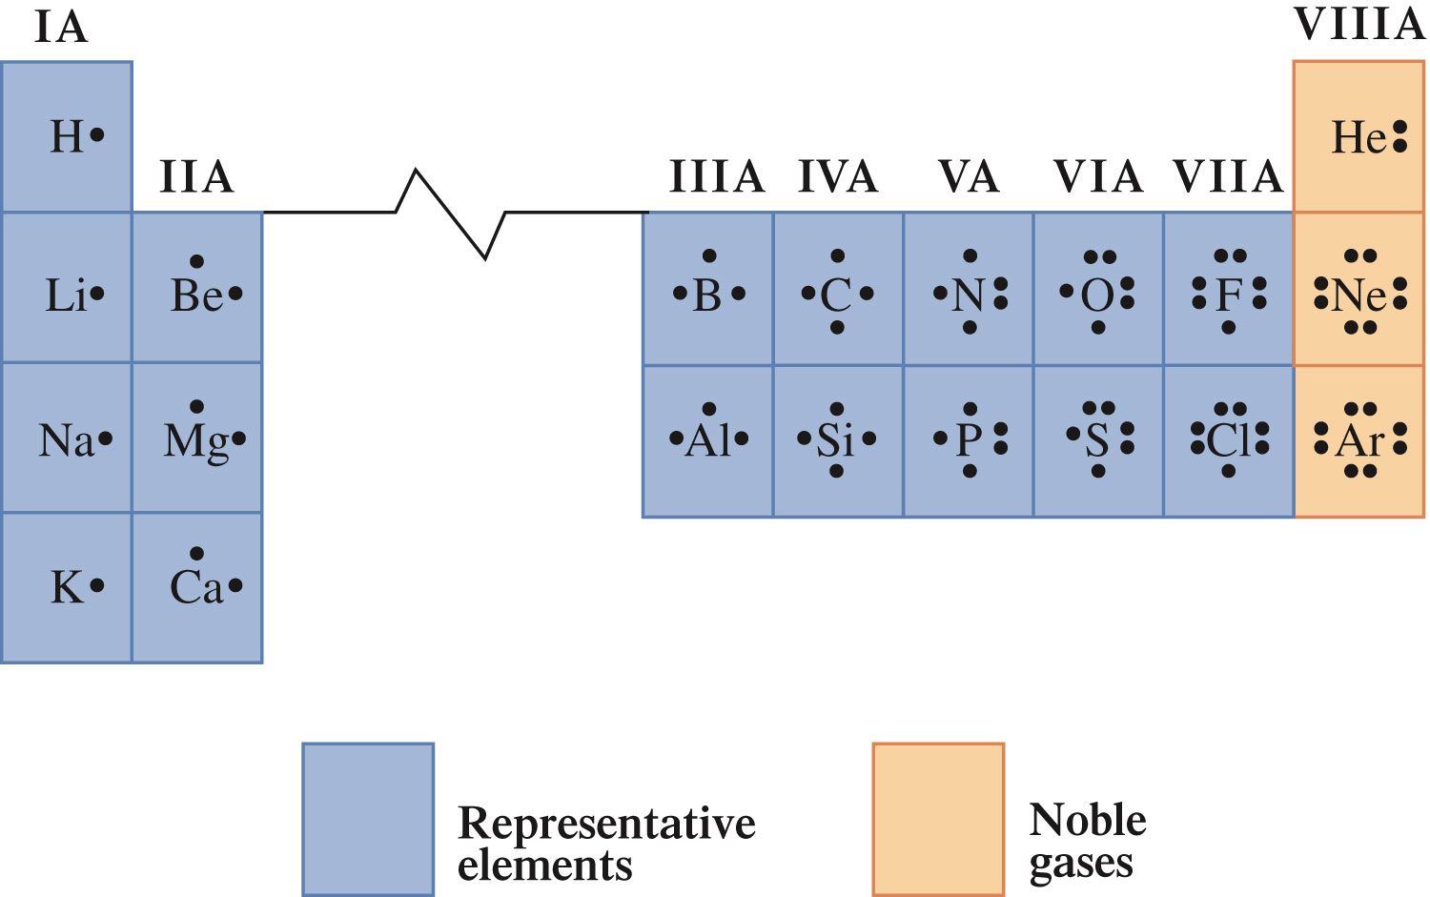
Lewis Symbols for Selected Representative and Noble-Gas Elements

Slide 13

Concept Check
Determine the number of valence electrons in each of the following elements:
  Ca
  Se
  C
Notes:
Ca: 2 valence electrons (4s²)
Se: 6 valence electrons (4s²4p⁴)
C: 4 valence electrons (2s²2p²)

Slide 14
Concept Check
Determine the number of valence electrons in each of the following elements:
  Ca
  2 valence electrons (4s²)
  Se
  6 valence electrons (4s²4p⁴)
  C
  4 valence electrons (2s²2p²)
Notes:
Ca: 2 valence electrons (4s²)
Se: 6 valence electrons (4s²4p⁴)
C: 4 valence electrons (2s²2p²)

Slide 15
Three Important Generalizations About Valence Electrons
Representative elements in the same group have the same number of valence electrons.
The number of valence electrons for representative elements is the same as the Roman numeral periodic-table group number.
The maximum number of valence electrons for any element is eight.

Slide 16
Concept Check
Write Lewis symbols for the following elements:
  O
  P
  F

Slide 17
Concept Check
Write Lewis symbols for the following elements:
  O
  P
  F

Slide 18
Certain arrangements of valence electrons are more stable than others.
The valence electron configurations of the noble gases are considered the most stable of all valence electron configurations.

Slide 19
Octet Rule (G.N. Lewis)
In forming compounds, atoms of elements lose, gain, or share electrons in such a way as to produce a noble-gas electron configuration for each of the atoms involved.

Slide 20
Ion
An atom (or group of atoms) that is electrically charged as a result of the loss or gain of electrons.
If an atom gains one or more electrons, it becomes a negatively charged ion (anion).
If an atom loses one or more electrons, it becomes a positively charged ion (cation).

Slide 21
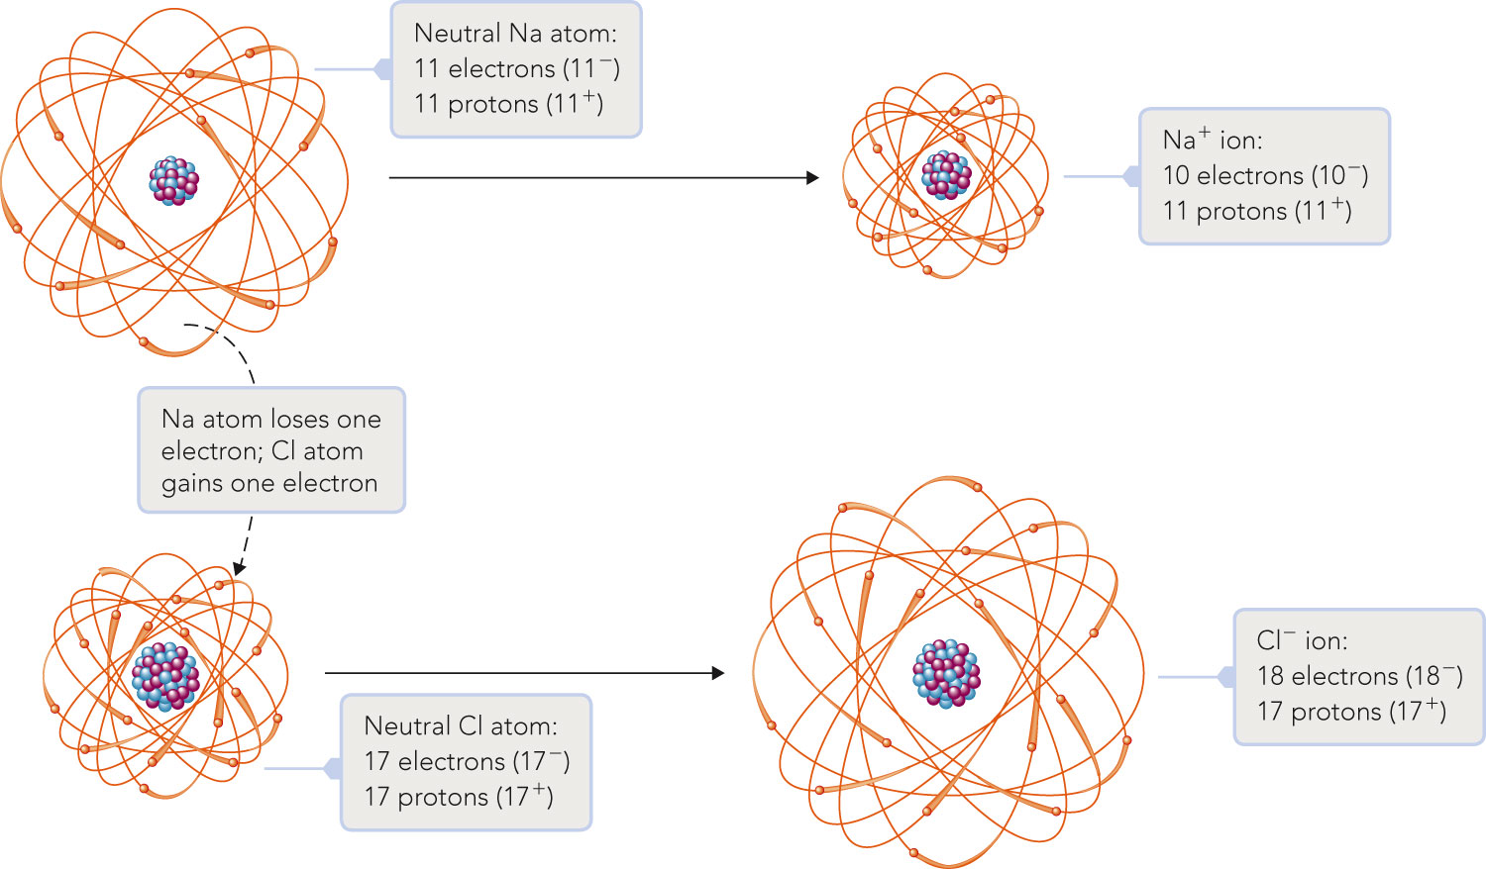
Isoelectronic to Ne
Isoelectronic to Ar

Slide 22
Concept Check
Give the chemical symbol for each of the following ions.
  The ion formed when a potassium atom loses one electron.
  The ion formed when a sulfur atom gains two electrons.
Notes:
When potassium loses an electron, there are 19 protons and 18 electrons. Therefore, 19p⁺ + (-18e⁻) = +1. The ion is K⁺.
When sulfur gains two electrons, there are 16 protons and 18 electrons. Therefore, 16p⁺ + (-18e⁻) = -2. The ion is S²⁻.

Slide 23
Concept Check
Give the chemical symbol for each of the following ions.
  The ion formed when a potassium atom loses one electron.
  K⁺
  The ion formed when a sulfur atom gains two electrons.
  S^{2–}
Notes:
When potassium loses an electron, there are 19 protons and 18 electrons. Therefore, 19p⁺ + (-18e⁻) = +1. The ion is K⁺.
When sulfur gains two electrons, there are 16 protons and 18 electrons. Therefore, 16p⁺ + (-18e⁻) = -2. The ion is S²⁻.

Slide 24
Atoms tend to gain or lose electrons until they have obtained an electron configuration that is the same as that of a noble gas.
  Example: K⁺ (1s²2s²2p⁶3s²3p⁶)
    Lost one electron to obtain electron configuration for Ar (1s²2s²2p⁶3s²3p⁶).

Slide 25
Metal atoms containing one, two, or three valence electrons tend to lose electrons to acquire a noble-gas electron configuration.
+ charge = group #
Group | Charge
IA | 1+
IIA | 2+
IIIA | 3+

Slide 26
2. Nonmetal atoms containing five, six, or seven valence electrons tend to gain electrons to acquire a noble-gas electron configuration.
- charge = 8 – group #
Group | Charge
VIIA | 1–
VIA | 2–
VA | 3–

Slide 27
Elements in Group IVA occupy unique positions relative to the noble gases (could gain or lose four electrons).
Eg. C and Si

Slide 28
Isoelectronic Species
A series of ions/atoms containing the same number and configuration of electrons.
O²⁻, F⁻, Ne, Na⁺, Mg²⁺, and Al³⁺
1s²2s²2p⁶

Slide 29
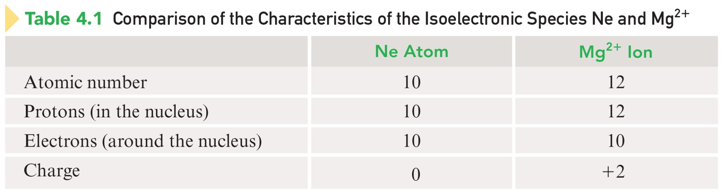
Isoelectronic Species Mg²⁺ and Ne

Slide 30
Concept Check
Choose an alkali metal, an alkaline earth metal, a noble gas, and a halogen so that they constitute an isoelectronic series when the metals and halogen are written as their most stable ions.
What is the electron configuration for each species?
Determine the number of electrons for each species.
Determine the number of protons for each species.
Notes:
One example could be:
K⁺, Ca²⁺, Ar, and Cl⁻
The electron configuration for each species is 1s²2s²2p⁶3s²3p⁶.
The number of electrons for each species is 18.
K⁺ has 19 protons, Ca²⁺ has 20 protons, Ar has 18 protons, and Cl⁻ has 17 protons.

Slide 31
Formation of an Ionic Compound
Ion formation requires the presence of two elements:
  A metal that can donate electrons.
  A non-metal that can accept electrons.
The electrons lost by the metal are the same ones gained by the nonmetal.
The positive and negative ions simultaneously formed from such electron transfer attract one another.

Slide 32
Lewis Structure
Combination of Lewis symbols that represents either the transfer or the sharing of electrons in chemical bonds.

Slide 33
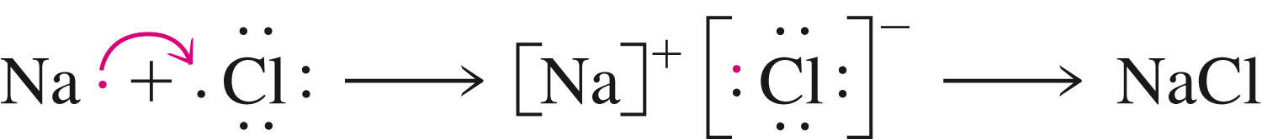
The Reaction Between Sodium and Chlorine
Core
[ Ne] [Ar]

Slide 34
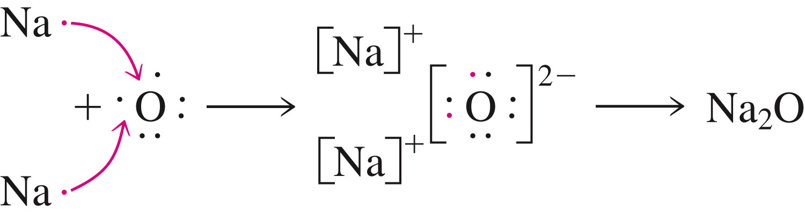
The Reaction Between Sodium and Oxygen

Slide 35
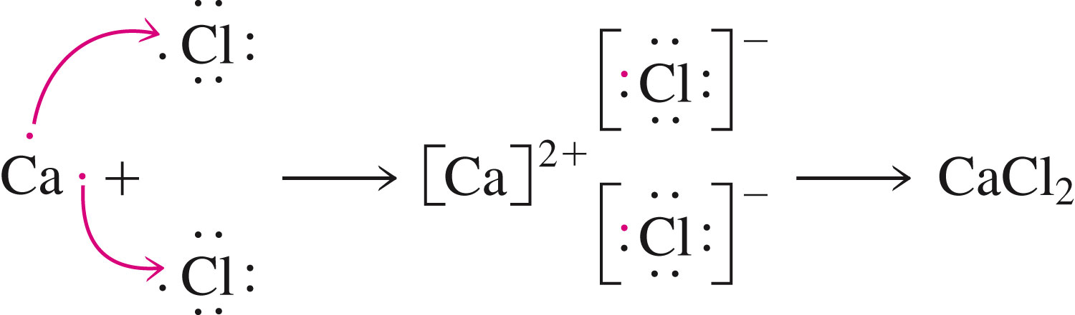
The Reaction Between Calcium and Chlorine

Slide 36
Ionic compounds are always neutral; no net charge is present.
The ratio in which positive and negative ions combine is the ratio that achieves charge neutrality for the resulting compound.
Charges on ions determines the subscripts in the formula
Eg. Na¹⁺ O²⁻ gives Na₂O

Slide 37
Writing Chemical Formulas for Ionic Compounds
The symbol for the positive ions is always written first.
The charges on the ions that are present are not shown in the formula.
The subscripts in the formula give the combining ratio for the ions.

Slide 38
Example
Compound formed between Li⁺ and O^{2–}
  Need two Li⁺ to balance out the 2- charge on oxygen.
Formula is Li₂O.

Slide 39
Concept Check
Determine the chemical formula for the compound that is formed when each of the following pairs of ions interact.
  Ba²⁺ and Cl–
  Fe³⁺ and O^{2–}
  Pb⁴⁺ and O^{2–}
Notes:
BaCl₂
Fe₂O₃
PbO₂

Slide 40
Concept Check
Determine the chemical formula for the compound that is formed when each of the following pairs of ions interact.
  Ba²⁺ and Cl–
  BaCl₂
  Fe³⁺ and O^{2–}
  Fe₂O₃
  Pb⁴⁺ and O^{2–}
  PbO₂
Notes:
BaCl₂
Fe₂O₃
PbO₂

Slide 41
Solid Ionic Compounds (ionic lattices).
Consists of positive and negative ions arranged in such a way that each ion is surrounded by nearest neighbors of the opposite charge.
Any given ion is bonded by electrostatic attractions to all the other ions of opposite charge immediately surrounding it.

Slide 42
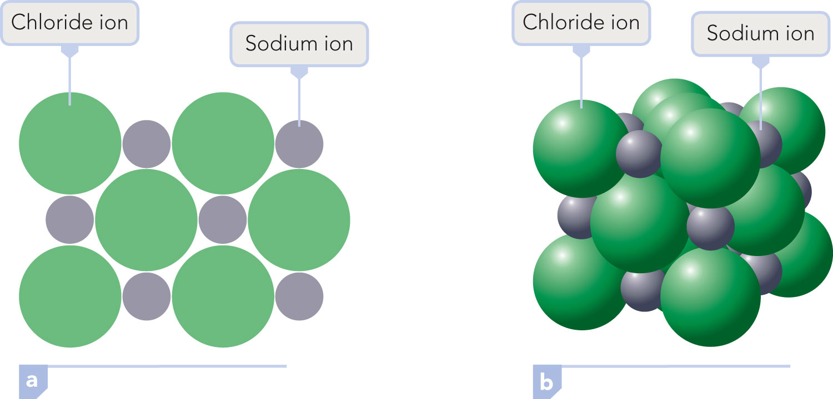
Sodium Chloride (NaCl)

Slide 43
Formula Unit
Smallest whole-number repeating ratio of ions present in an ionic compound that results in charge neutrality.
Chemical formulas for ionic compounds represent the simplest ratio of ions present.
Eg. Ca²⁺ O²⁻ gives Ca₂O₂ becomes CaO

Slide 44
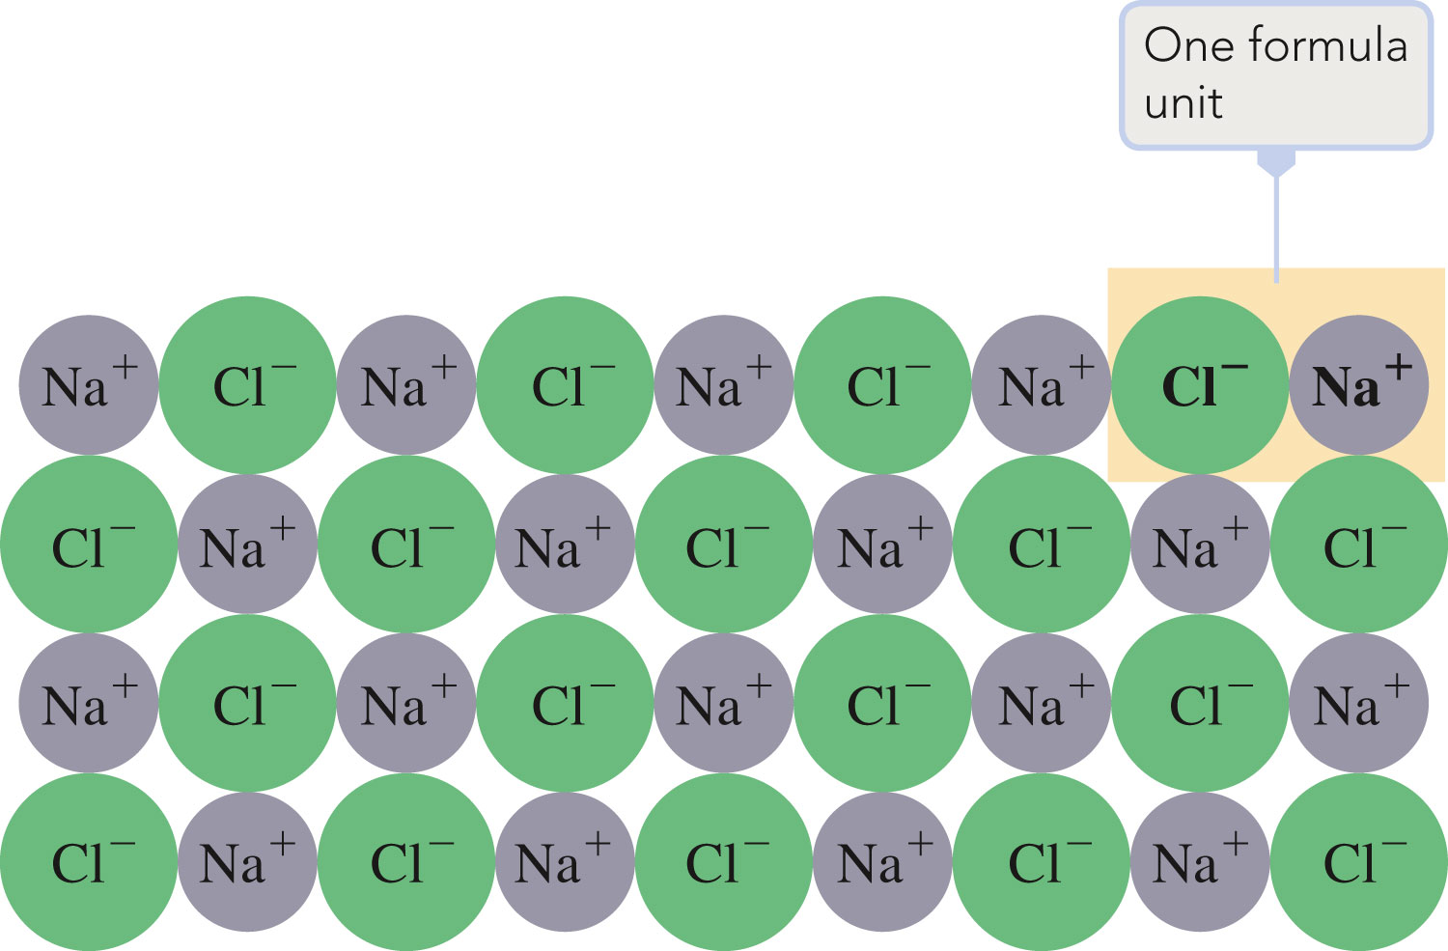
Cross-Section of NaCl

Slide 45
Naming Compounds
Binary Compounds:
  Composed of two elements
  Ionic and covalent compounds included
Binary Ionic Compounds:
  Metal-nonmetal
  Metal is always present as the positive ion, and the nonmetal is always present as the negative ion.

Slide 46
Naming Ionic Compounds
The full name of the metallic element is given first, followed by a separate word containing the stem of the nonmetallic element name and the suffix –ide.

Slide 47
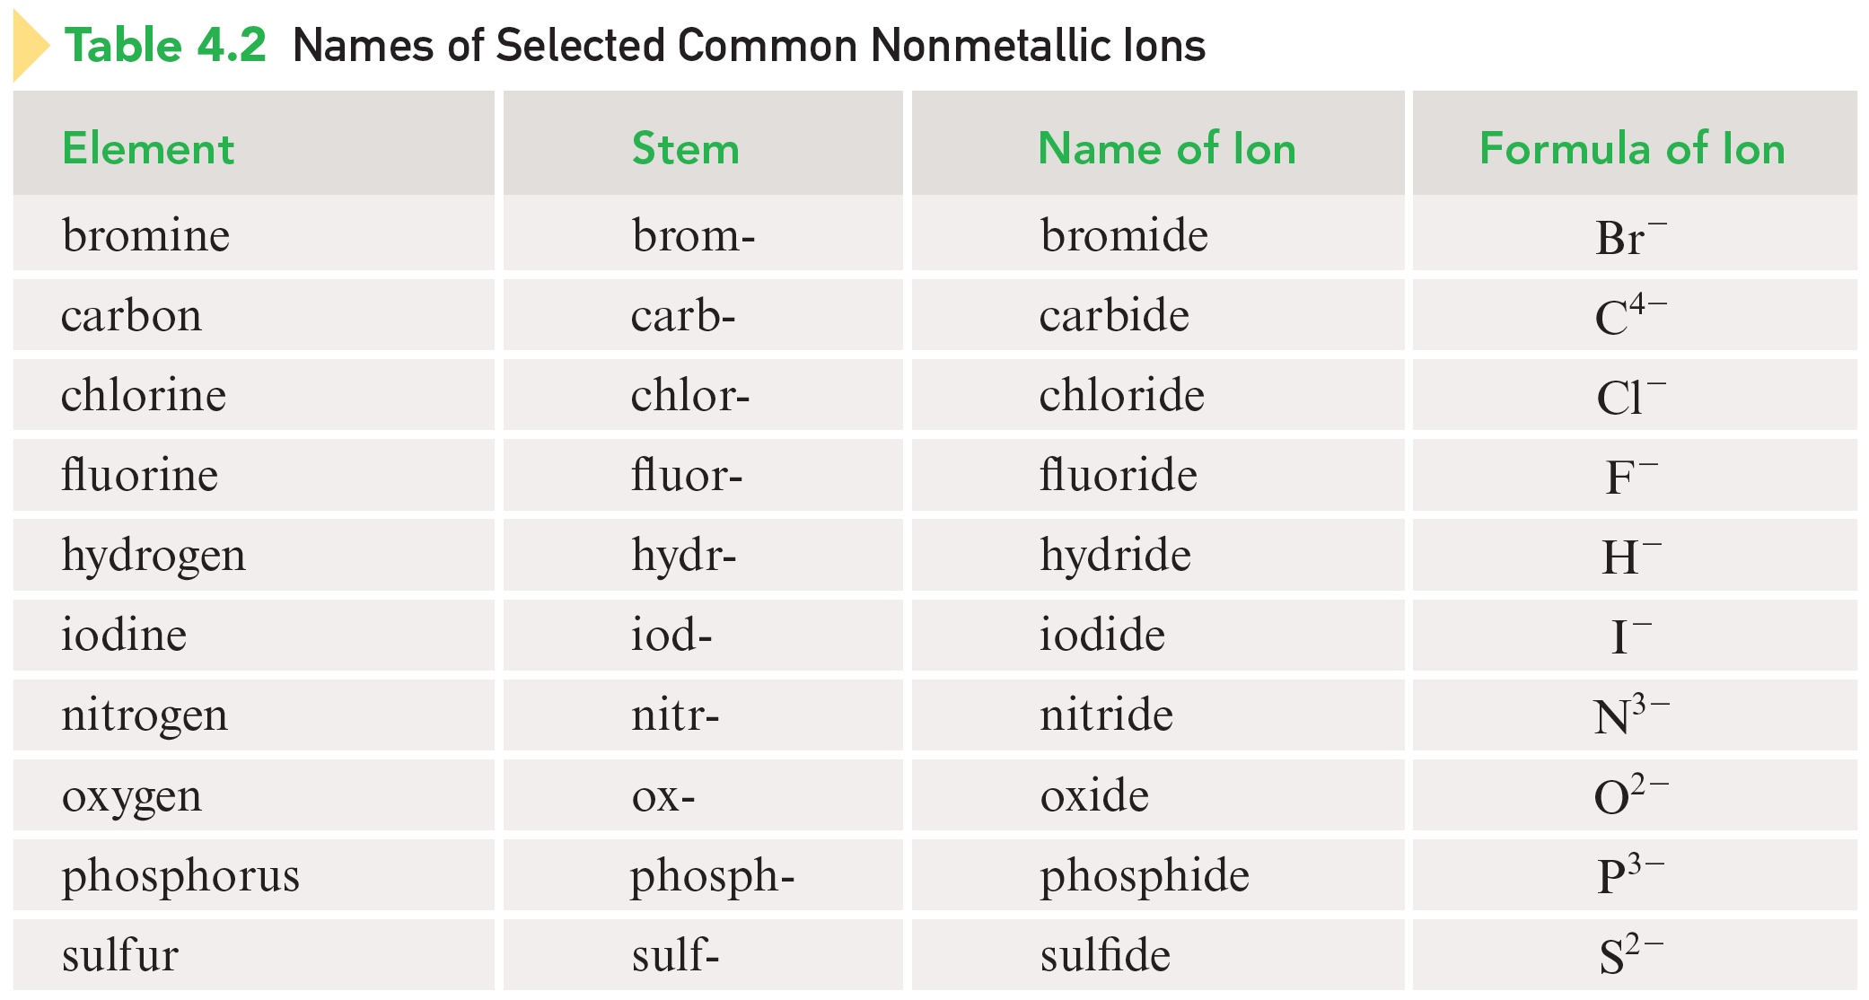
Names of Selected Common Nonmetallic Ions

Slide 48
Examples
KCl Potassium chloride
MgBr₂ Magnesium bromide
CaO Calcium oxide

Slide 49
Naming Ionic Compounds (for Metals with Variable Charges)
Metals in these compounds form more than one type of positive charge.
Charge on the metal ion must be specified.
Roman numeral indicates the charge of the metal cation (positively charged ion).
Transition metal cations usually require a Roman numeral.

Slide 50
Examples
CuBr Copper(I) bromide
FeS Iron(II) sulfide
PbO₂ Lead(IV) oxide

Slide 51
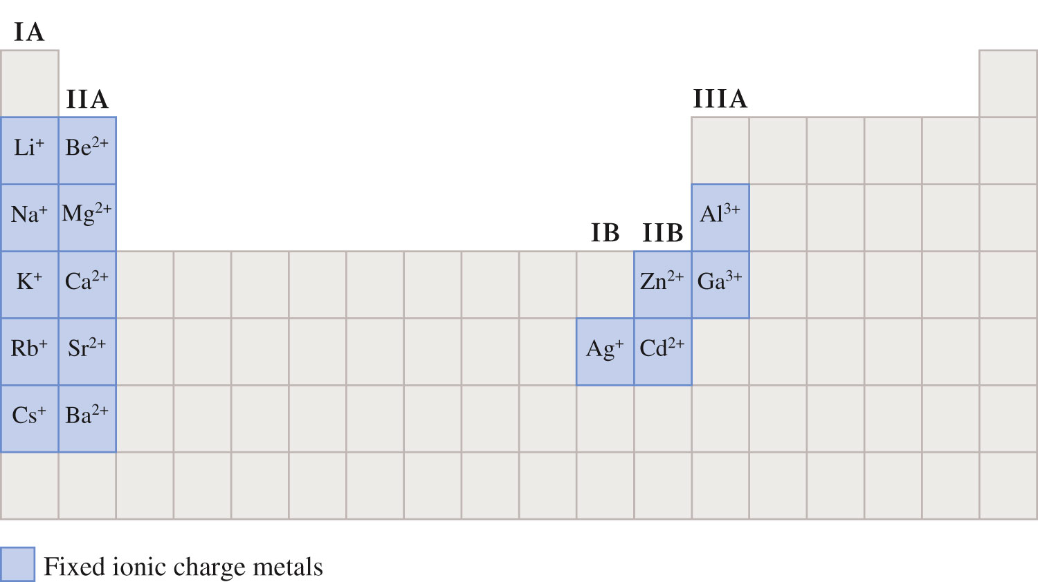
Metallic Elements with a Fixed Ionic Charge

Slide 52
Exercise
Name each of the following compounds:
K₂S
Fe₂O₃
CoCl₂
Notes:
potassium sulfide
iron(III) oxide
cobalt(II) chloride

Slide 53
Exercise
Name each of the following compounds:
K₂S
potassium sulfide
Fe₂O₃
iron(III) oxide
CoCl₂
cobalt(II) chloride
Notes:
potassium sulfide
iron(III) oxide
cobalt(II) chloride

Slide 54
Polyatomic Ion
Ion formed from a group of atoms (held together by covalent bonds) through loss or gain of electrons.

Slide 55
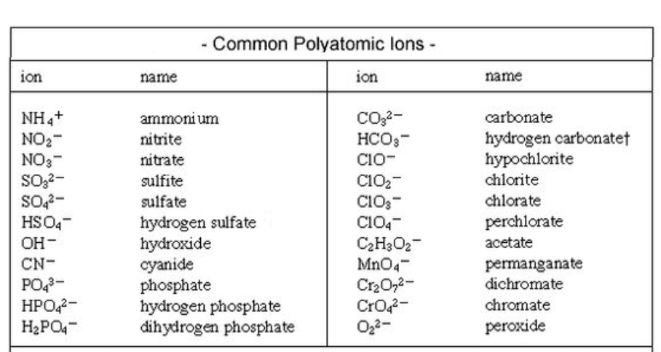
Polyatomic Ion
.

Slide 56
Polyatomic Ions
Must be memorized (see Table 4.3 on pg. 99 in text).
Examples of compounds containing polyatomic ions:
NaOH Sodium hydroxide
Mg(NO₃)₂ Magnesium nitrate
(NH₄)₂SO₄ Ammonium sulfate

Slide 57
Generalizations
Most of the polyatomic ions have a negative charge.
Two of the negatively charged polyatomic ions, OH– and CN–, have names ending in –ide and the rest of them have names ending in either –ate or –ite.

Slide 58
Generalizations
A number of –ate, –ite pairs of ions exist. The –ate ion always has one more oxygen atom than the –ite ion. Both the –ate and –ite ions of a pair carry the same charge.
A number of pairs of ions exist wherein one member of the pair differs from the other by having a hydrogen atom present. In such pairs, the charge on the ion that contains hydrogen is always 1 less than that on the other ion.

Slide 59
Determined in the same way as those for ionic compounds that contain monatomic ions.
The positive and negative charges present must add to zero.
  Na⁺ and OH– form NaOH.
  Mg²⁺ and NO₃– form Mg(NO₃)₂.
  NH₄⁺ and SO₄^{2–} form (NH₄)₂SO₄.

Slide 60
Exercise
Which of the following compounds is named incorrectly?
KNO₃ potassium nitrate
TiO₂ titanium(II) oxide
Sn(OH)₄ tin(IV) hydroxide
(NH₄)₂SO₃ ammonium sulfite
CaCrO₄ calcium chromate
Notes:
The correct answer is “b”. The charge on oxygen is -2. Since there are two oxygen atoms, the overall charge is -4. Therefore, the charge on titanium must be +4 (not +2 as the Roman numeral indicates).

Slide 61
Exercise
Which of the following compounds is named incorrectly?
KNO₃ potassium nitrate
TiO₂ titanium(II) oxide
Sn(OH)₄ tin(IV) hydroxide
(NH₄)₂SO₃ ammonium sulfite
CaCrO₄ calcium chromate
titanium(IV) oxide
Notes:
The correct answer is “b”. The charge on oxygen is -2. Since there are two oxygen atoms, the overall charge is -4. Therefore, the charge on titanium must be +4 (not +2 as the Roman numeral indicates).

