Slide 1
CHEM 120 Spring 2017
Introduction to Inorganic Chemistry
Instructor Dr. Upali Siriwardane (Ph.D. Ohio State)
E-mail: upali@latech.edu
Office: 311 Carson Taylor Hall ; Phone: 318-257-4941;
Office Hours: MWF 8:00-9:00 and 11:00-12:00;
TR 10:00-12:00
Contact me trough phone or e-mail if you have questions
Online Tests on Following days
March 24, 2017: Test 1 (Chapters 1-3)
April 7, 2017 : Test 2 (Chapters 4-5)
April 28, 2017: Test 3 (Chapters 6,7 &8)
May 12, 2017 : Test 4 (Chapters 9, 10 &11)
May 15, 2017: Make Up Exam: Chapters 1-11)
.

Slide 2
Atomic Structure and the Periodic Table
3.1 Internal Structure of an Atom
3.2 Atomic Number and Mass Number
3.3 Isotopes and Atomic Masses
3.4 The Periodic Law and the Periodic Table
3.5 Metals and Nonmetals
3.6 Electron Arrangements Within Atoms
3.7 Electron Configurations and Orbital Diagrams
3.8 The Electronic Basis for the Periodic Law and the Periodic Table
3.9 Classification of the Elements

Slide 3
Subatomic Particle
A very small particle that is a building block for atoms.

Slide 4
Three Types of Subatomic Particles
The atom contains:
  Electrons – found outside the nucleus; possesses a negative electrical charge; smallest mass.
  Protons – found in the nucleus; positive charge equal in magnitude to the electron’s negative charge.
  Neutrons – found in the nucleus; no charge; virtually same mass as a proton.

Slide 5
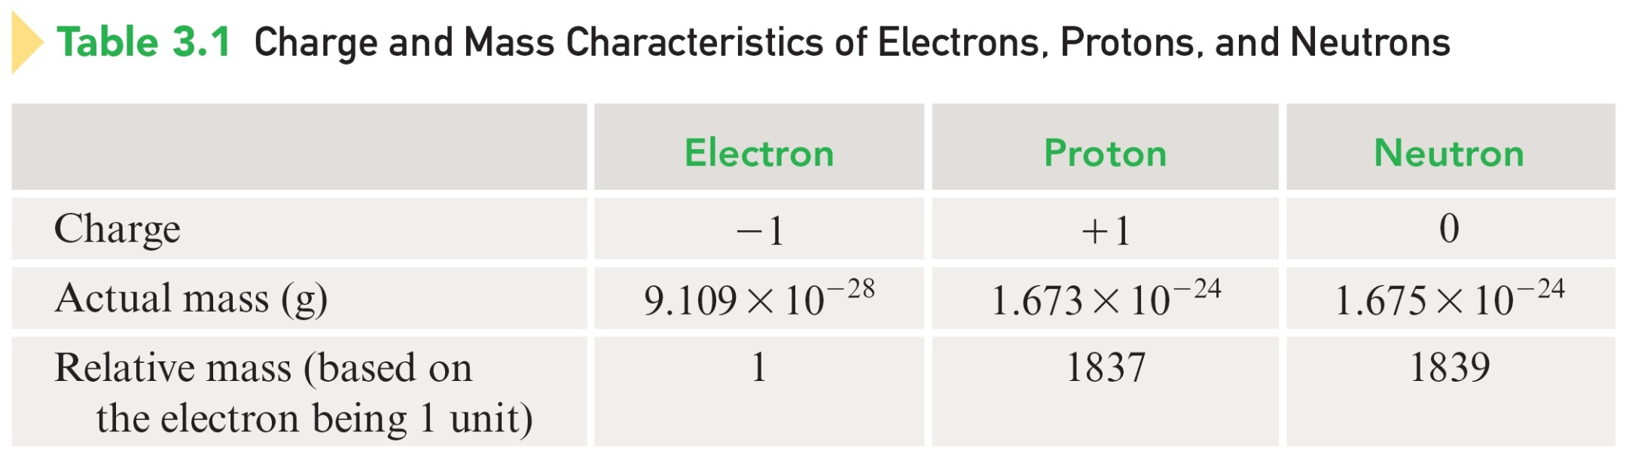
Charge and Mass Characteristics

Slide 6
The nucleus is:
  Small compared with the overall size of the atom.
  Extremely dense; accounts for almost all of the atom’s mass.
  Positively charged center of an atom.

Slide 7
Charge Neutrality of an Atom
An atom as a whole is electrically neutral (no net electrical charge).
# of Protons = # of Electrons

Slide 8
Atomic Number (Z) – # of protons in the nucleus of an atom.
Mass Number (A) – sum of the # of protons and the # of neutrons in the nucleus of an atom.

Slide 9
Complete Chemical Symbol Notation
Mass number
A
Symbol
Chemical symbol
Atomic number
Z

Slide 10
Element
A pure substance in which all atoms present have the same atomic number.
All atoms with the same atomic number have the same chemical properties and are atoms of the same element.

Slide 11
Isotopes
Atoms of an element that have the same number of protons and the same number of electrons but different numbers of neutrons.
Show almost identical chemical properties; chemistry of atom is due to its electrons.
Physical properties are often slightly different because they have different masses.
In nature most elements contain mixtures of isotopes.

Slide 12
Two Isotopes of Sodium
Number of Protons = 11
Mass number = 23
Number of Neutrons = 12
Number of Protons = 11
Mass number = 24
Number of Neutrons = 13

Slide 13

Exercise
A certain isotope X contains 23 protons and 28 neutrons.
What is the mass number of this isotope?
Identify the element.
Notes:
The mass number is 51. Mass Number = # protons + # neutrons. Mass Number = 23 + 28 = 51. The element is vanadium.
Note: Add animation to the red boxes to assist in explaining how to solve the problem.

Slide 14

Exercise
A certain isotope X contains 23 protons and 28 neutrons.
What is the mass number of this isotope?
51
Identify the element.
Vanadium
Notes:
The mass number is 51. Mass Number = # protons + # neutrons. Mass Number = 23 + 28 = 51. The element is vanadium.
Note: Use the red box animation to assist in explaining how to solve the problem.

Slide 15
Atomic Masses
Elements occur in nature as mixtures of isotopes.
Carbon = 98.89% ¹²C
1.11% ¹³C
<0.01% ¹⁴C
Calculated average mass for the isotopes of an element expressed on a scale where
serves as the reference point.

Slide 16
Average Atomic Mass for Carbon
98.89% of 12 amu + 1.11% of 13.0034 amu =
(0.9889)(12 amu) + (0.0111)(13.0034 amu) =
12.01 amu

Slide 17
Exercise
An element consists of 62.60% of an isotope with mass 186.956 amu and 37.40% of an isotope with mass 184.953 amu.
Calculate the average atomic mass and identify the element.
(62.60% of 186.956 amu + 37.40% of 184.953)/100
(0.6260)(186.956 amu) + (0.0111)(184.953 amu) = 186.207 amu
Notes:
Average Atomic Mass = (0.6260)(186.956 amu) + (0.3740)(184.953 amu) = 186.207 amu
The element is rhenium (Re).

Slide 18
Exercise
An element consists of 62.60% of an isotope with mass 186.956 amu and 37.40% of an isotope with mass 184.953 amu.
Calculate the average atomic mass and identify the element.
Average Atomic Mass = 186.207 amu
The element is rhenium (Re).
Notes:
Average Atomic Mass = (0.6260)(186.956 amu) + (0.3740)(184.953 amu) = 186.207 amu
The element is rhenium (Re).

Slide 19
Periodic Law – When elements are arranged in order of increasing atomic number, elements with similar chemical properties occur at periodic (regularly recurring) intervals.
Periodic Table – Tabular arrangement of the elements in order of increasing atomic number such that elements having similar chemical properties are positioned in vertical columns.

Slide 20
The Periodic Table
Periods – horizontal rows of elements
Groups – elements in the same vertical columns; have similar chemical properties

Slide 21
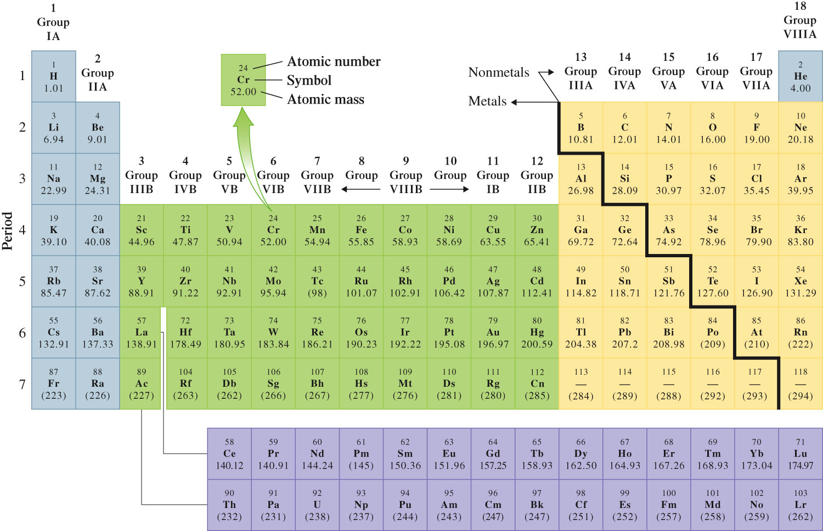
The Periodic Table

Slide 22
Groups
Table of common charges formed when creating ionic compounds.
Group | Charge
Alkali Metals (1A) | 1+
Alkaline Earth Metals (2A) | 2+
Halogens (7A) | 1-
Noble Gases (8A) | 0

Slide 23
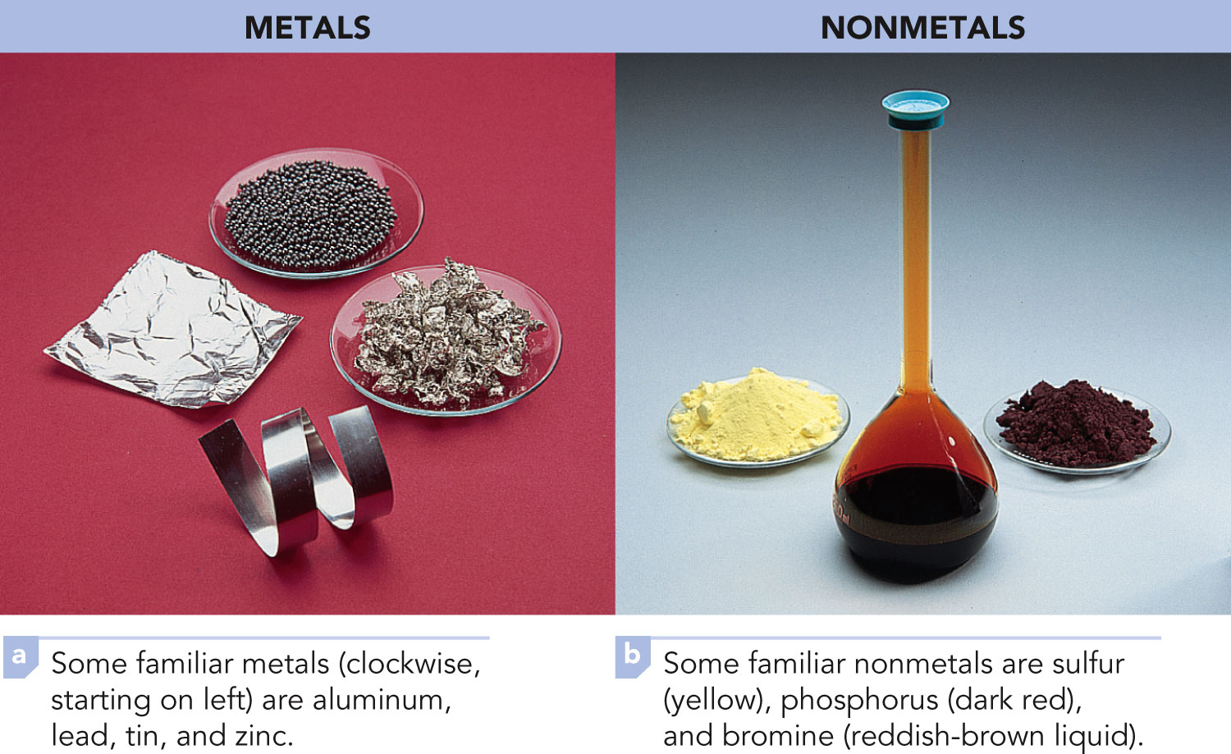
Metal
An element that has the characteristic properties of luster, thermal conductivity, electrical conductivity, and malleability.

Slide 24
Nonmetal
An element characterized by the absence of the properties of luster, thermal conductivity, electrical conductivity, and malleability.

Slide 25
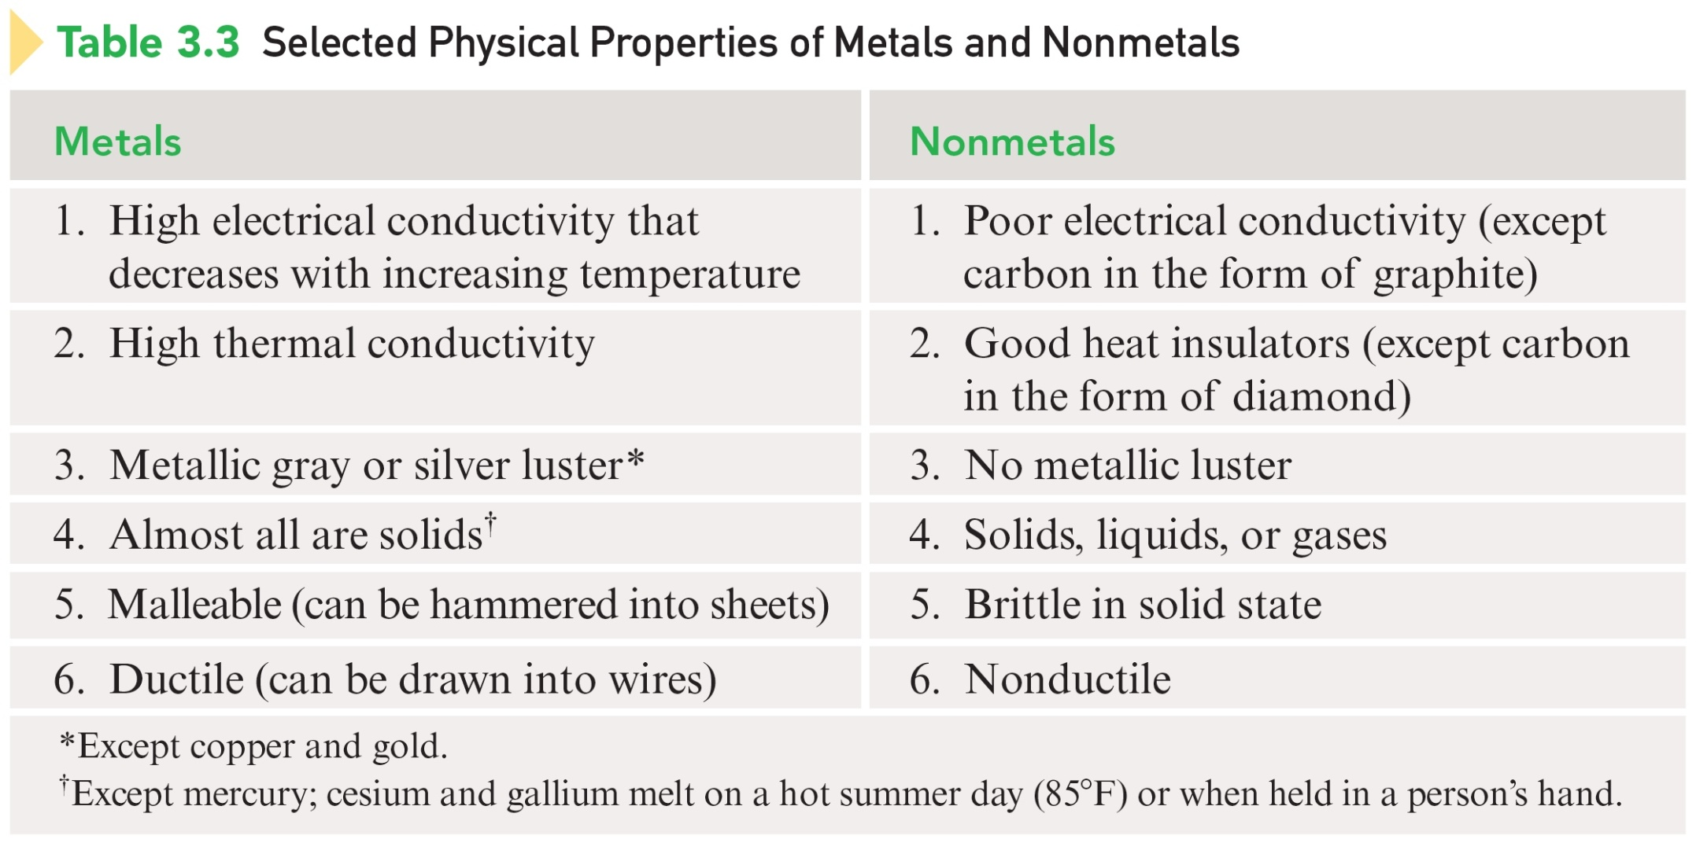
Selected Physical Properties of Metals and Nonmetals

Slide 26
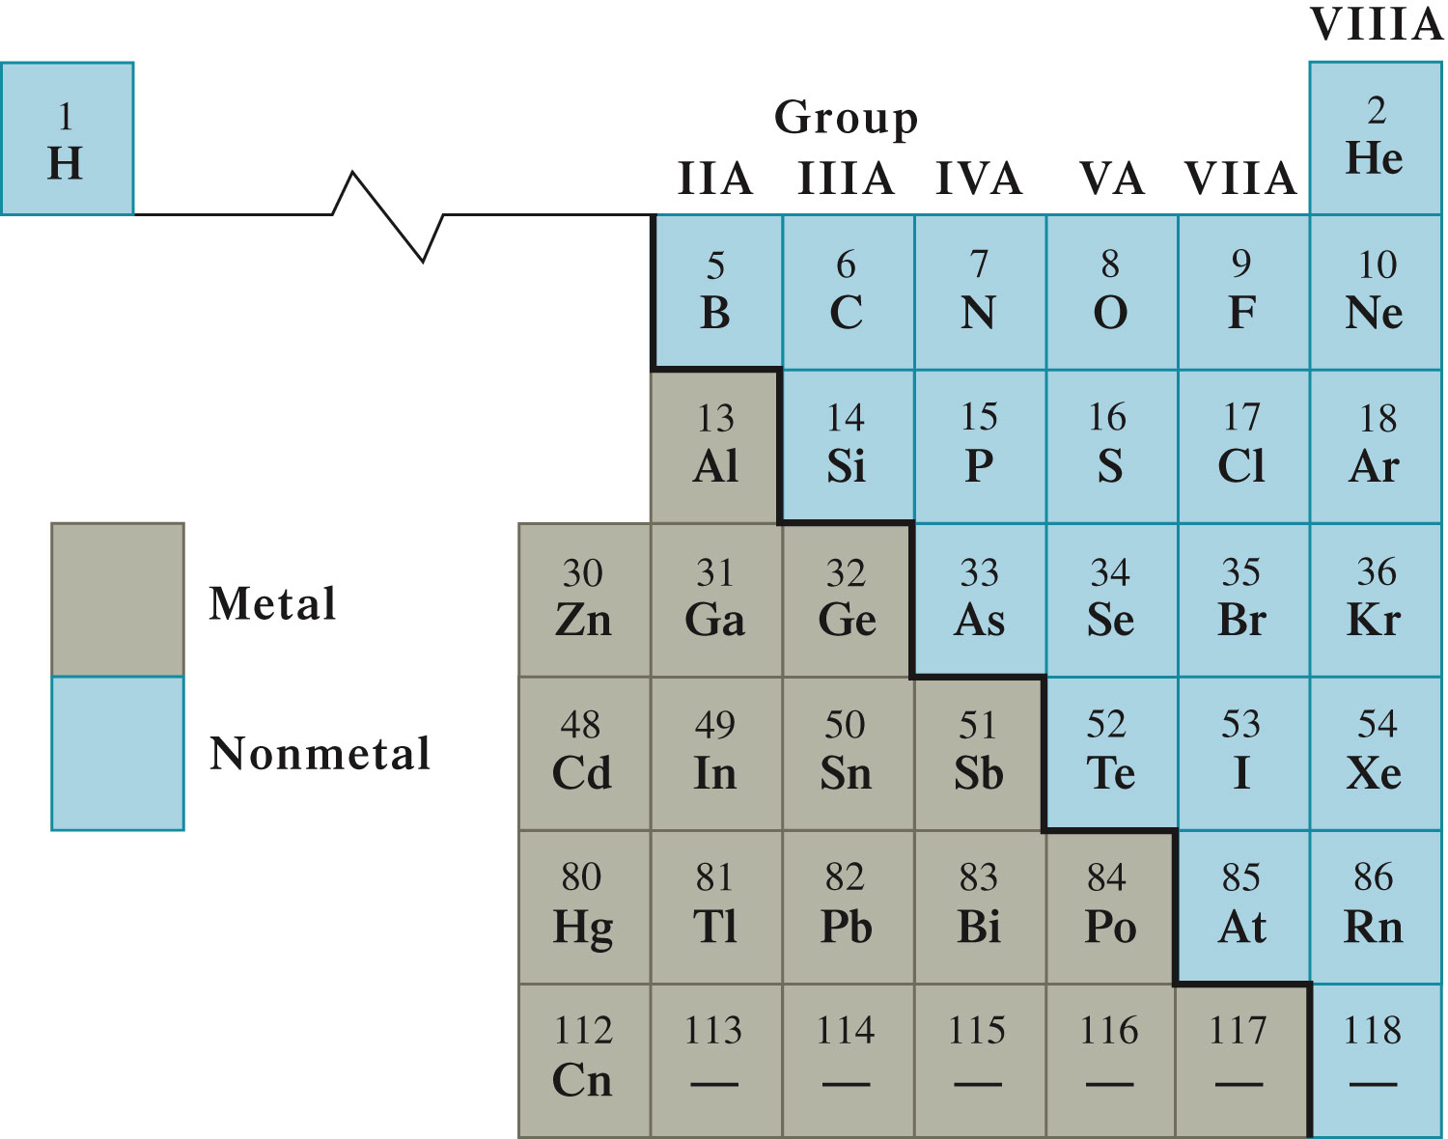
Dividing Line Between Metals and Nonmetals

Slide 27
Electron Shells
A region of space about a nucleus that contains electrons that have approximately the same energy and that spend most of their time approximately the same distance from the nucleus.
Electrons that occupy the first electron shell are closer to the nucleus and have a lower energy than electrons in the second electron shell.

Slide 28
Electron Subshells
A region of space within an electron shell that contains electrons that have the same energy.
Subshell | Number of Electrons
s | 2
p | 6
d | 10
f | 14

Slide 29
Electron Orbitals
A region of space within an electron subshell where an electron with a specific energy is most likely to be found.
An electron orbital can accommodate a maximum of 2 electrons.

Slide 30
Electron Orbitals
Subshell | Number of Orbitals
s | 1
p | 3
d | 5
f | 7

Slide 31
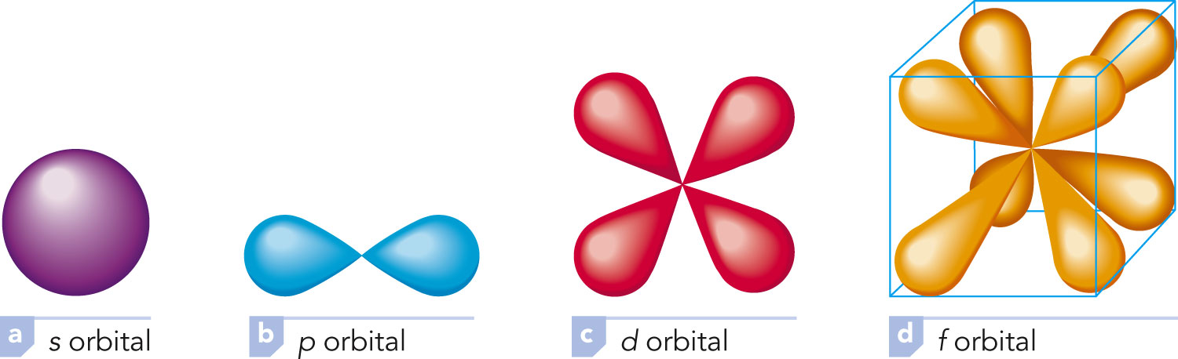
Electron Orbitals

Slide 32
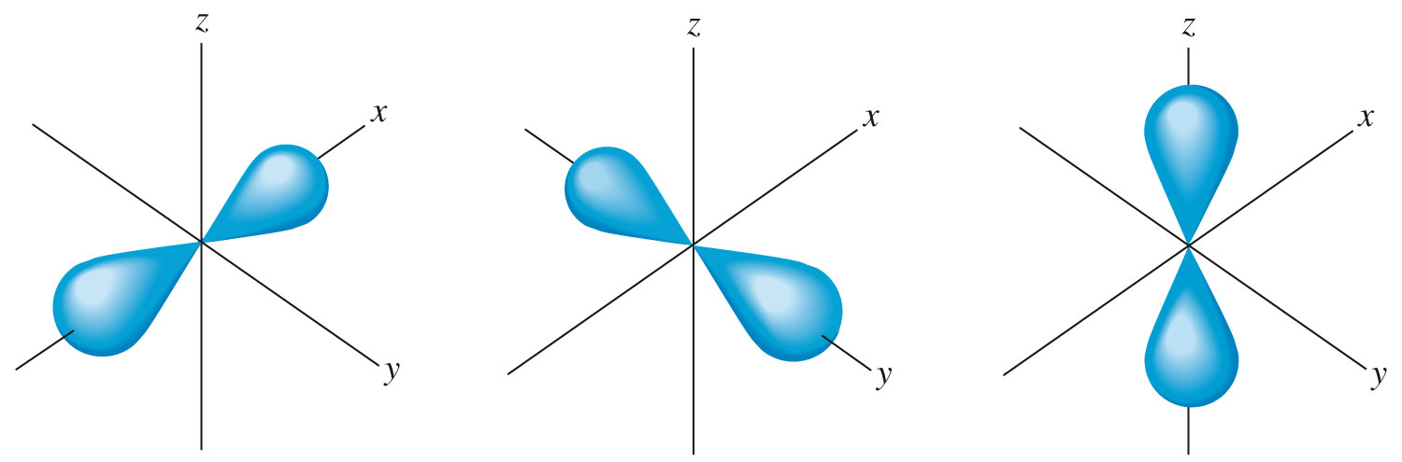
Orbitals Within the Same Subshell Differ in Orientation

Slide 33
Electron Spin
As an electron “moves about” within an orbital, it spins on its own axis in either a clockwise or a counterclockwise direction.
When two electrons are present in an orbital, they always have opposite spins.

Slide 34
Rules for Assigning Electrons to Various Shells, Subshells, and Orbitals
Electron subshells are filled in order of increasing energy.
Electrons occupy the orbitals of a subshell such that each orbital acquires one electron before any orbital acquires a second electron. All electrons in such singly occupied orbitals must have the same spin.
No more than two electrons may exist in a given orbital – and then only if they have opposite spins.

Slide 35
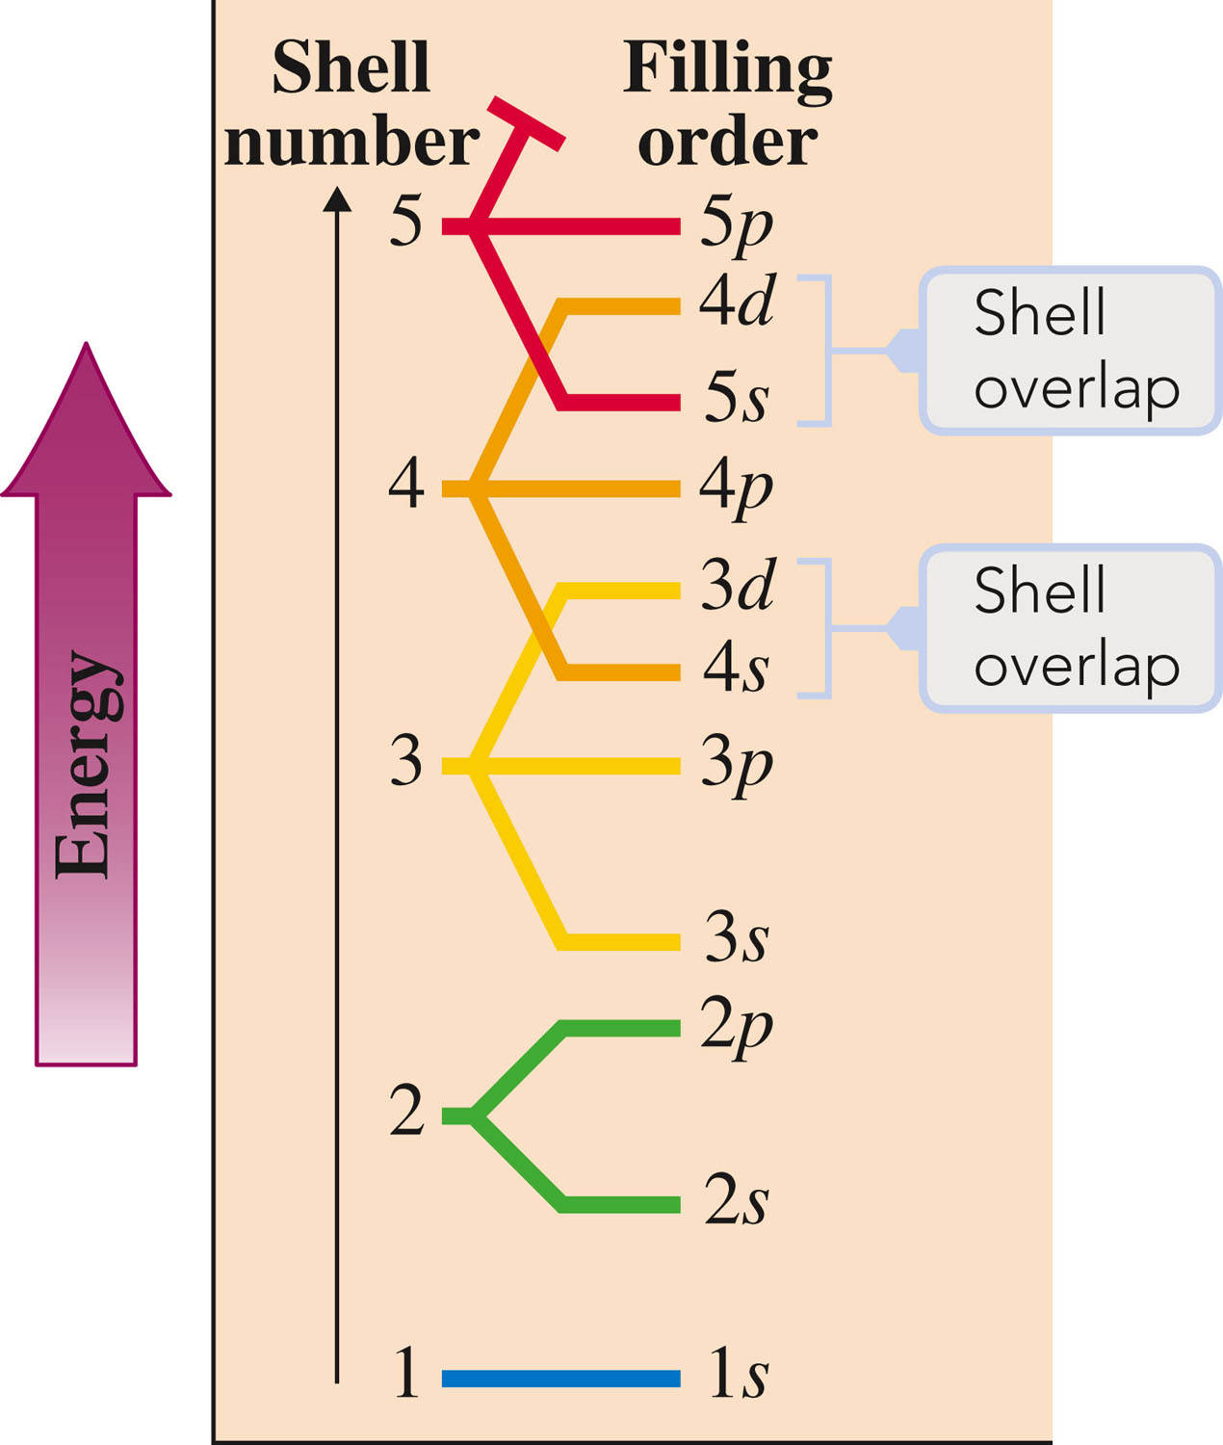
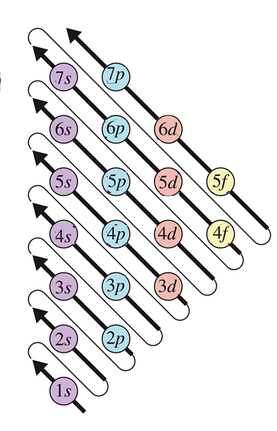
Electron Configurations

Slide 36
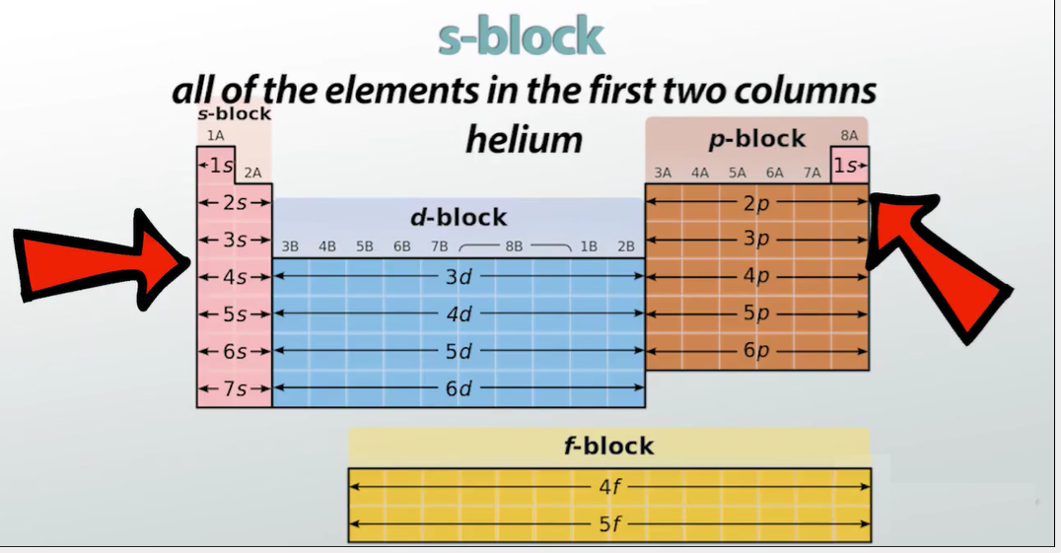
Electron Configurations

Slide 37
Electron Configurations
A statement of how many electrons an atom has in each of its electron subshells.
An oxygen atom as an electron arrangement of two electrons in the 1s subshell, two electrons in the 2s subshell, and four electrons in the 2p subshell.
Oxygen: 1s²2s²2p⁴

Slide 38
Orbital Diagrams
A notation that shows how many electrons an atom has in each of its occupied electron orbitals.
Oxygen: 1s²2s²2p⁴
Oxygen: 1s 2s 2p

Slide 39
Exercise
Determine the expected electron configurations for each of the following.
S
Ba
Notes:
a) 1s²2s²2p⁶3s²3p⁴
b) 1s²2s²2p⁶3s²3p⁶4s²3d¹⁰4p⁶5s²4d¹⁰5p⁶6s²

Slide 40
Exercise
Determine the expected electron configurations for each of the following.
S
1s²2s²2p⁶3s²3p⁴
Ba
1s²2s²2p⁶3s²3p⁶4s²3d¹⁰4p⁶5s²4d¹⁰5p⁶6s²
Notes:
a) 1s²2s²2p⁶3s²3p⁴
b) 1s²2s²2p⁶3s²3p⁶4s²3d¹⁰4p⁶5s²4d¹⁰5p⁶6s²

Slide 41
The electron arrangement in the outermost shell is the same for elements in the same group.
This is why elements in the same group have similar chemical properties.
  Group 1A – very reactive
Li: 1s²2s¹
Na: 1s²2s²2p⁶3s¹
K: 1s²2s²2p⁶3s²3p⁶4s¹

Slide 42
Electron Configurations and the Periodic Table

Slide 43
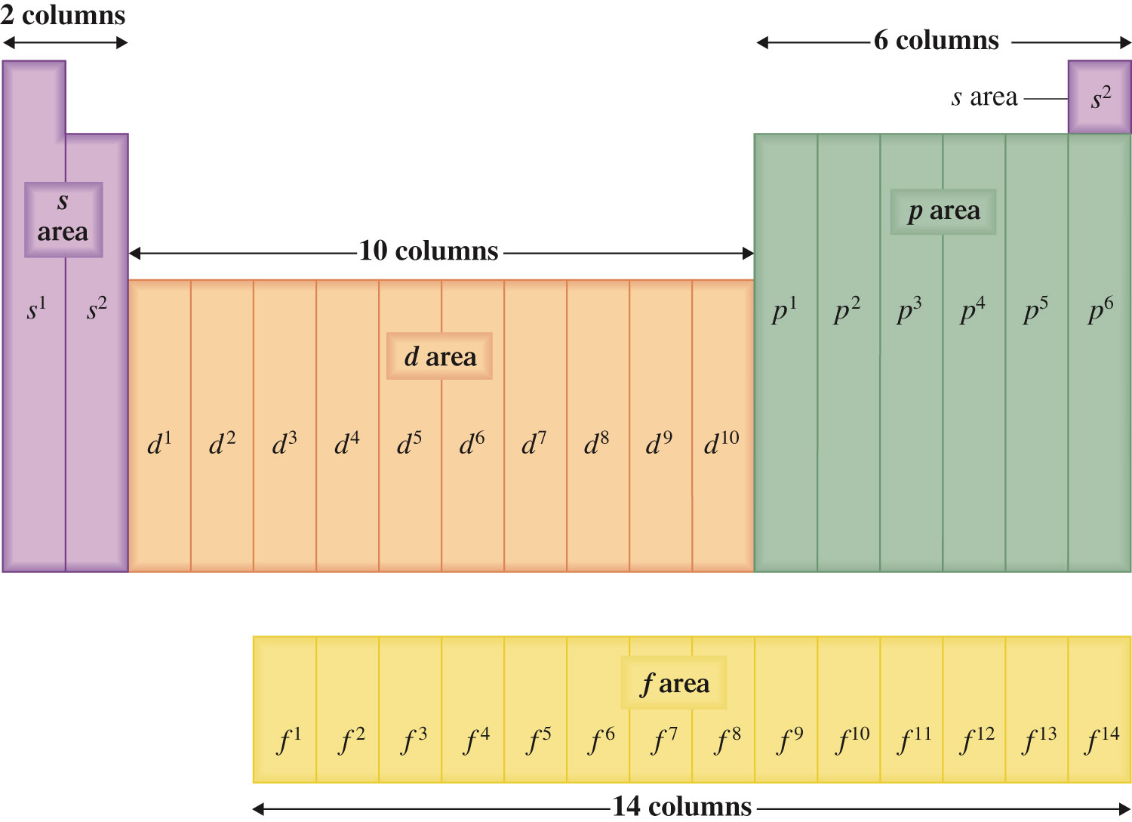
Electron Configurations and the Periodic Table

Slide 44
Distinguishing Electron
Last electron added to the electron configuration for an element when electron subshells are filled in order of increasing energy.
This last electron is the one that causes an element’s electron configuration to differ from that of an element immediately preceding it in the periodic table.

Slide 45
A system based on selected physical properties of the elements, in which they are described as metals or nonmetals.
A system based on the electron configurations of the elements, in which elements are described as noble-gas, representative, transition, or inner transition elements.

Slide 46
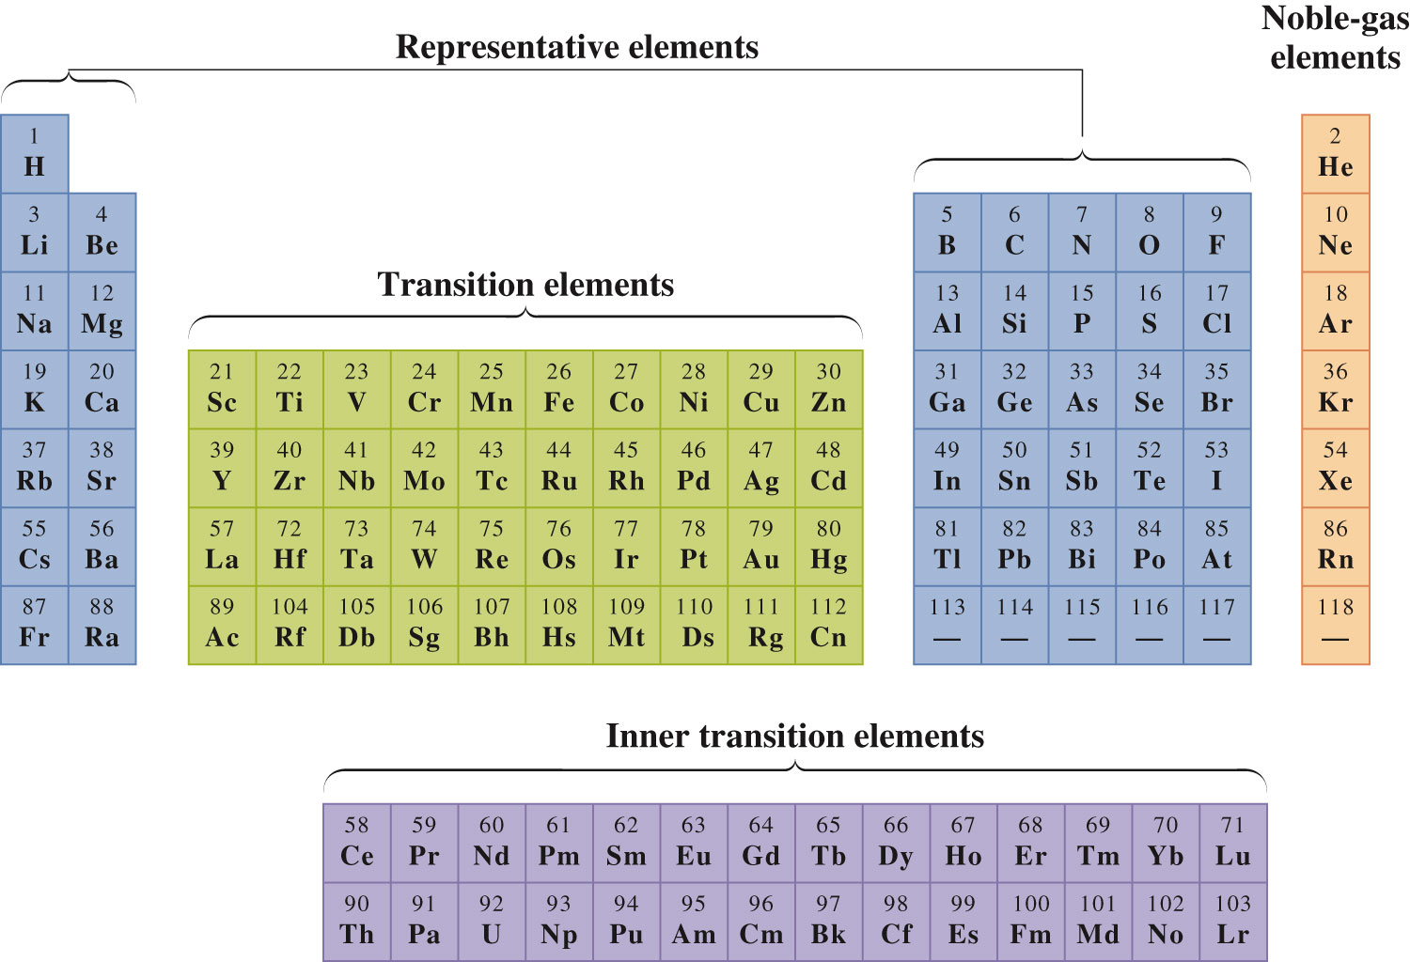
Classification Scheme on the Periodic Table

