Slide 1
Chemistry 120 Spring 17
Introduction to Inorganic Chemistry
Instructor Dr. Upali Siriwardane (Ph.D. Ohio State)
E-mail: upali@latech.edu
Office: 311 Carson Taylor Hall ; Phone: 318-257-4941;
Office Hours: MWF 8:00-9:00 and 11:00-12:00;
TR 10:00-12:00
Contact me trough phone or e-mail if you have questions
Online Tests on Following days
March 24, 2017: Test 1 (Chapters 1-3)
April 7, 2017 : Test 2 (Chapters 4-5)
April 28, 2017: Test 3 (Chapters 6,7 &8)
May 12, 2017 : Test 4 (Chapters 9, 10 &11)
May 15, 2017: Make Up Exam: Chapters 1-11)
.

Slide 2
Measurements in Chemistry
2.1 Measurement Systems
2.2 Metric System Units
2.3 Exact and Inexact Numbers
2.4 Uncertainty in Measurement and Significant Figures
2.5 Significant Figures and Mathematical Operations
2.6 Scientific Notation
2.7 Conversion Factors
2.8 Dimensional Analysis
2.9 Density
2.10 Temperature Scales

Slide 3
Scientific Method
The scientific method has five steps
Observation.
Formulation of a question (hypothesis)
Pattern recognition, summarizing information (scientific laws)
Developing theories. (Hypothesis and eventfully theory)
Further Experimentation and loosing to first step to keep it improving as we discover more and more.

Slide 4
Scientific Method
The scientific method has five steps
Observation involves qualitative or quantitative
measurements
Formulation of a question (hypothesis)
Summarizing information, Pattern recognition, (scientific laws) involves measurements.
Developing theories. (Hypothesis and eventfully theory)
Further Experimentation and loosing to first step to keep it improving as we discover more and more.
Two types of measurements qualitative or quantitative

Slide 5
Qualitative Measurement
The determination of the dimensions, capacity, quantity, or extent of something.
Common types measurements made in the laboratory:
  Mass
  Volume
  Temperature
  Pressure
  concentration

Slide 6
Systems of Measurement
English System (commerce):
  inch, foot, pound, quart, and gallon
Metric System (scientific work):
  gram, meter, and liter
  More convenient to use (decimal unit system).

Slide 7
There is one base unit for each type of measurement (length, mass, volume, etc.).
Add prefixes to the base unit to indicate the size of the unit.
The prefix is independent of the base unit and always remains constant.

Slide 8
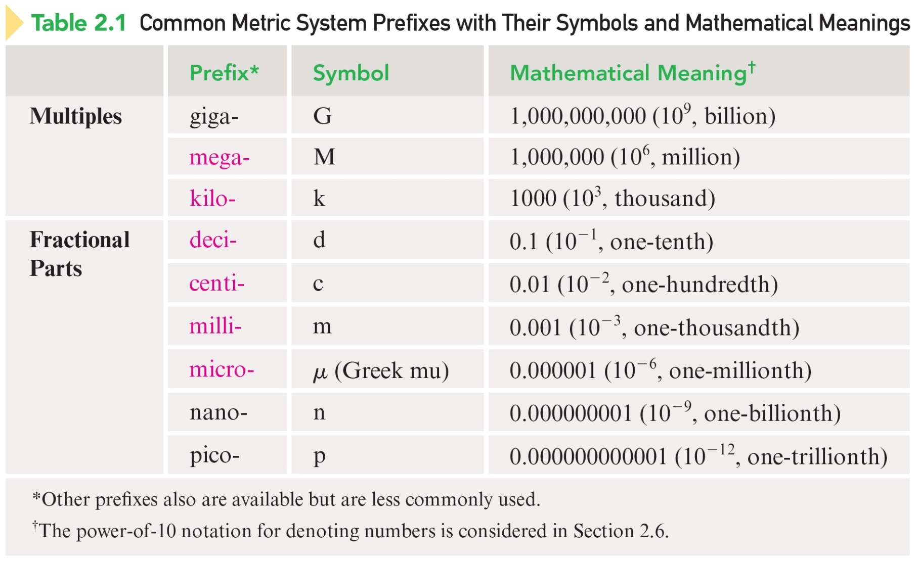
Common Metric System Prefixes

Slide 9
Metric Length Units
Meter (m):
  Base unit of length in the metric system.
Length is measured by determining the distance between two points.

Slide 10
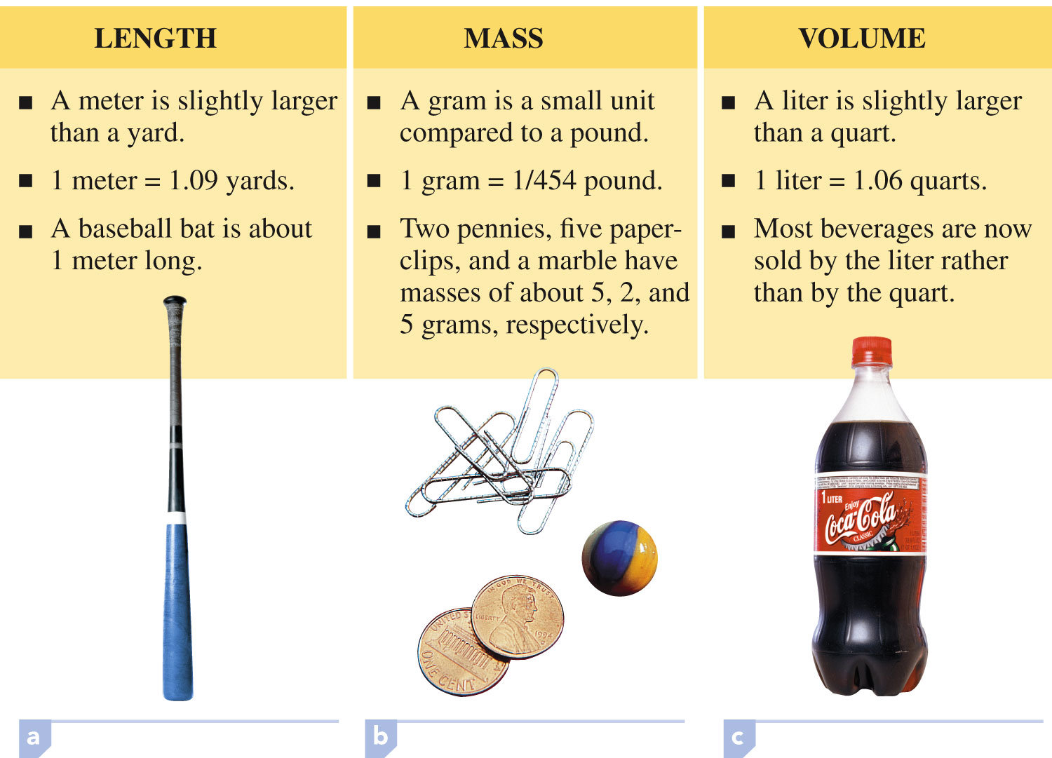
Comparison of the Base Unit of Length (Meter)

Slide 11
Metric Mass Units
Gram (g):
  Base unit of mass in the metric system.
Mass is measured by determining the amount of matter in an object.
  Mass – measure of the total quantity of matter in an object
  Weight – measure of the force exerted on an object by gravitational forces

Slide 12
Comparison of the Base Unit of Mass (Gram)

Slide 13
Metric Volume Units
Liter (L):
  Base unit of volume in the metric system.
Volume is measured by determining the amount of space occupied by a three-dimensional object.
1 liter = 1000 cm³
1 mL = 1 cm³
mL generally used for liquids and gases.
cm³ used for solids

Slide 14
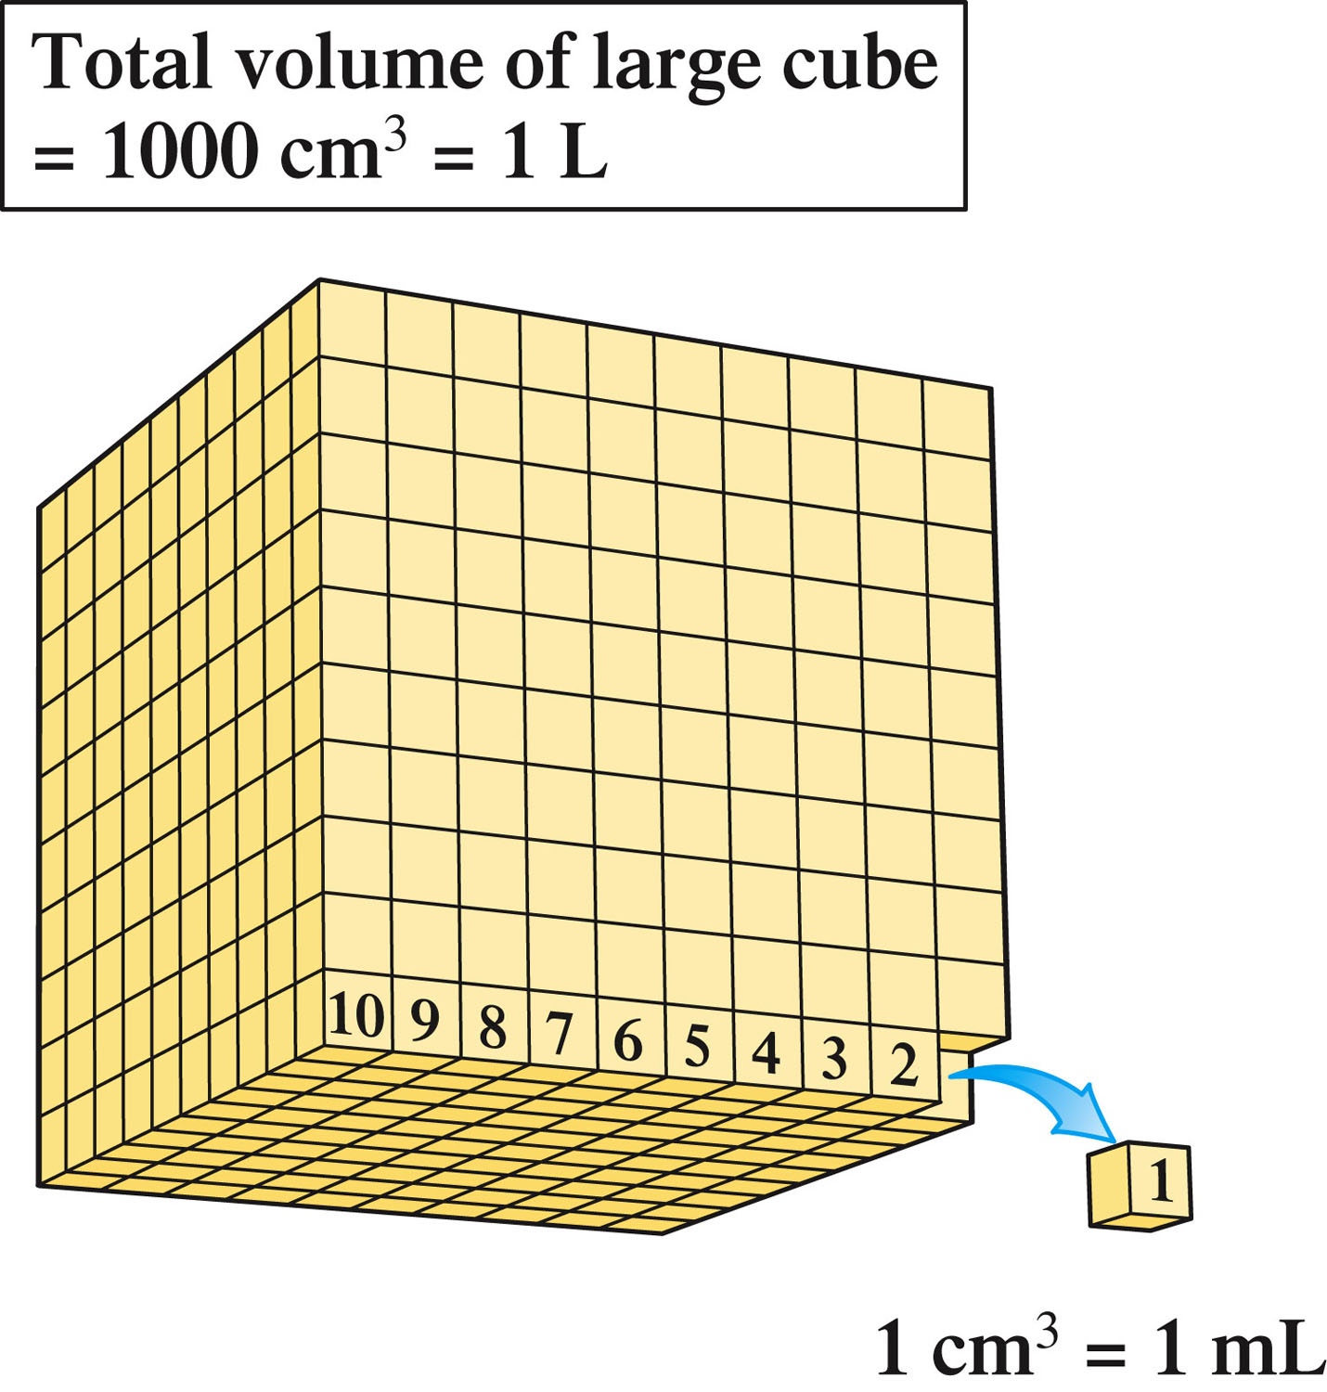

Slide 15
Comparison of the Base Unit of Volume (Liter)

Slide 16
Exact Number
A number whose value has no uncertainty associated with it – that is, it is known exactly.
  Definitions – 12 objects in a dozen
  Counting – 15 pretzels in a bowl
  Simple fractions – ½ or ¾

Slide 17
Inexact Number
A number whose value has a degree of uncertainty associated with it.
Results any time a measurement is made.

Slide 18
Uncertainty in Measurements
A digit that must be estimated is called uncertain.
A measurement always has some degree of uncertainty.
Record the certain digits and the first uncertain digit (the estimated number).

Slide 19
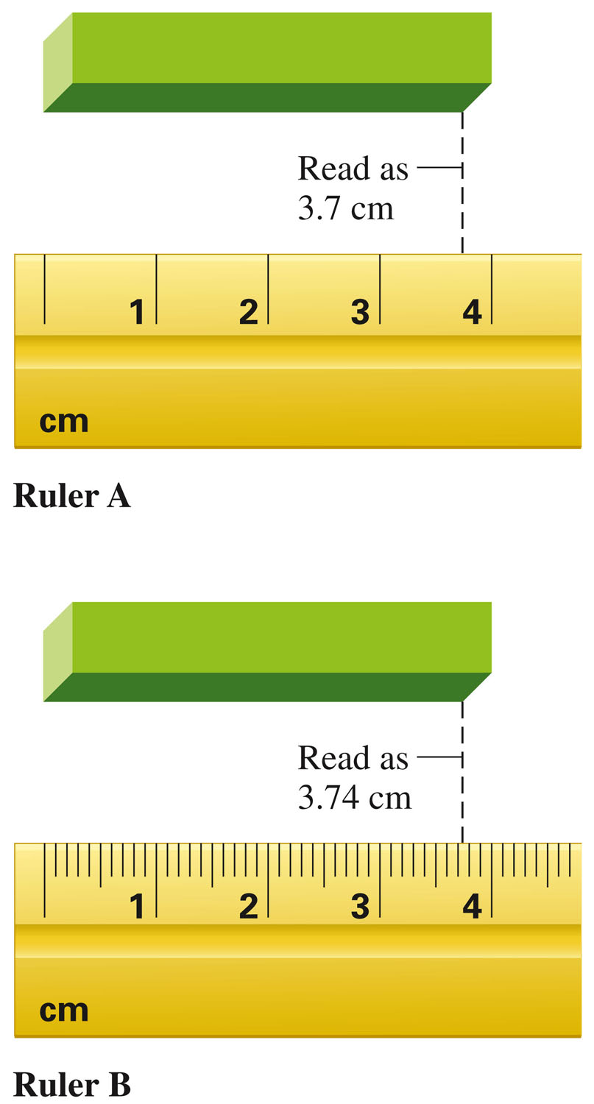
Consider These Rulers
Measurements made with ruler A will have greater uncertainty than those made with ruler B.
Ruler B is more precise than Ruler A.

Slide 20
Significant Figures
Digits in a measurement that are known with certainty plus one digit that is estimated.
  # Sig Figs = all certain digits + one estimated digit

Slide 21
Guidelines for Determining Significant Figures
In any measurement, all nonzero digits are significant.
  3456 has 4 sig figs.

Slide 22
Guidelines for Determining Significant Figures
There are three classes of zeros.
Leading zeros are zeros that are at the beginning of a number. These do not count as significant figures.
  0.048 has 2 sig figs.

Slide 23
Guidelines for Determining Significant Figures
Confined zeros are zeros between nonzero digits. These always count as significant figures.
  16.07 has 4 sig figs.

Slide 24
Guidelines for Determining Significant Figures
Trailing zeros are zeros at the right end of the number. They are significant only if the number contains a decimal point.
  9.300 has 4 sig figs.

Slide 25
Guidelines for Determining Significant Figures
Trailing zeros are zeros at the right end of the number. They are not significant if the number lacks an explicitly shown decimal point.
  150 has 2 sig figs.

Slide 26
Rounding Off Numbers
Process of deleting unwanted (nonsignificant) digits from calculated numbers.
  If the first digit to be deleted is 4 or less, simply drop it and all the following digits.
    5.83298 becomes 5.83 (for 3 sig figs).
  If the first digit to be deleted is 5 or greater, that digit and all that follow are dropped, and the last retained digit is increased by one.
    7.86541 becomes 7.87 (for 3 sig figs).

Slide 27
Operational Rules
In multiplication and division, the number of significant figures in the answer is the same as the number of significant figures in the measurement that contains the fewest significant figures.
  1.342 × 5.5 = 7.381 → 7.4

Slide 28
Operational Rules
In addition and subtraction, the answer has no more digits to the right of the decimal point than are found in the measurement with the fewest digits to the right of the decimal point.
23.445
+
7.83
Corrected
31.28
31.275
⎯⎯⎯⎯→

Slide 29

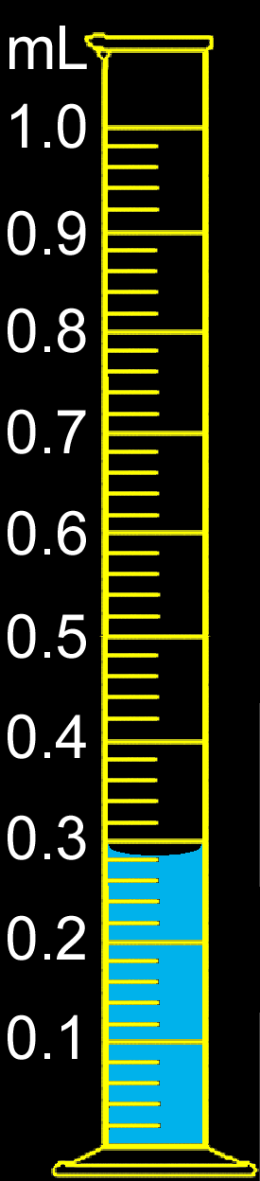
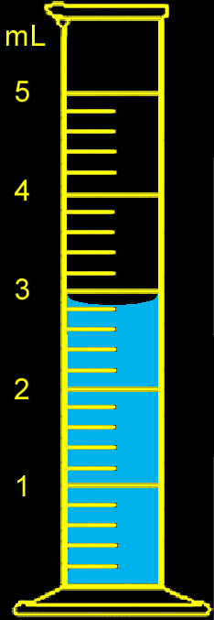
Concept Check
You have water in each graduated cylinder shown. You then add both samples to a beaker.
How would you write the number describing the total volume?
What limits the precision of this number?
2.80
+
0.280
= 3.080
Notes:
The total volume is 3.1 mL. The first graduated cylinder limits the precision of this number with a volume of 2.8 mL. The second graduated cylinder has a volume of 0.28 mL. Therefore, the final volume must be 3.1 mL since the first volume is limited to the tenths place.

Slide 30
Concept Check
You have water in each graduated cylinder shown. You then add both samples to a beaker.
How would you write the number describing the total volume?
3.08 mL
What limits the precision of this number?
Notes:
The total volume is 3.1 mL. The first graduated cylinder limits the precision of this number with a volume of 2.8 mL. The second graduated cylinder has a volume of 0.28 mL. Therefore, the final volume must be 3.1 mL since the first volume is limited to the tenths place.

Slide 31
Exact Numbers
Because exact numbers have no uncertainty associated with them, they possess an unlimited number of significant figures.
  1 inch = 2.54 cm, exactly.
  9 pencils (obtained by counting).
Exact numbers never limit the number of significant figures in a computational answer.

Slide 32
Exponential Notation
A numerical system in which numbers are expressed in the form A × 10^{n} where A is a number with a single nonzero digit to the left of the decimal place and n is a whole number.
  A is the coefficient
  n is a whole number
Coefficient
Exponent
1.07 × 104
Multiplication sign
Exponential term

Slide 33
Converting from Decimal to Scientific Notation
The decimal point in the decimal number is moved to the position behind (to the right of) the first nonzero digit.
The exponent for the exponential term is equal to the number of places the decimal point has moved.
  300. written as 3.00 × 10² (three sig figs)
  0.004890 written as 4.890 × 10^{–3} (four sig figs)

Slide 34
Multiplication and Division in Scientific Notation
To multiply exponential terms, add the exponents.
To divide exponential terms, subtract the exponents.

Slide 35
A ratio that specifies how one unit of measurement is related to another unit of measurement.
To convert from one unit to another, use the equivalence statement that relates the two units.
1 ft = 12 in.
The two conversion factors are:

Slide 36
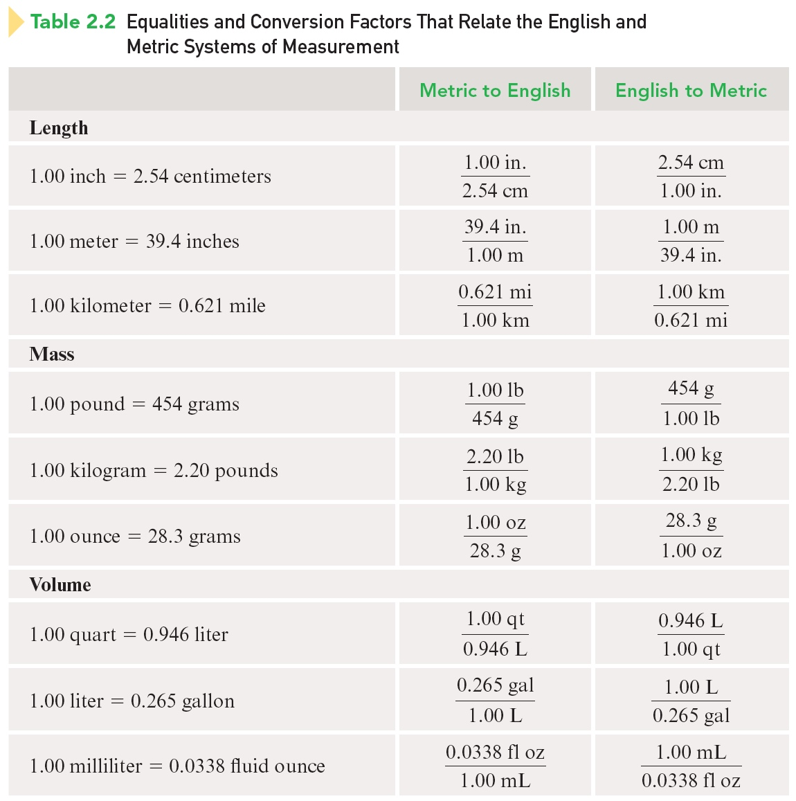
Equalities and Conversion Factors for Length

Slide 37
Equalities and Conversion Factors for Mass

Slide 38
Equalities and Conversion Factors for Volume

Slide 39
Steps for Using Dimensional Analysis
Use when converting a given result from one system of units to another:
  Identify the known or given quantity (both numerical value and units) and the units of the new quantity to be determined.
  Multiply the given quantity by one or more conversion factors in such a manner that the unwanted (original) units are canceled, leaving only the desired units.
  Perform the mathematical operations indicated by the conversion factor setup.

Slide 40
Example #1
  A golfer putted a golf ball 6.8 ft across a green. How many inches does this represent?
Identify the known or given quantity (both numerical value and units) and the units of the new quantity to be determined.
  6.8 ft = ? in.

Slide 41
Example #1
  A golfer putted a golf ball 6.8 ft across a green. How many inches does this represent?
Multiply the given quantity by one or more conversion factors in such a manner that the unwanted (original) units are canceled, leaving only the desired units.
The two conversion factors are:

Slide 42
Example #1
  A golfer putted a golf ball 6.8 ft across a green. How many inches does this represent?
Multiply the given quantity by one or more conversion factors in such a manner that the unwanted (original) units are canceled, leaving only the desired units.

Slide 43
Example #1
  A golfer putted a golf ball 6.8 ft across a green. How many inches does this represent?
Perform the mathematical operations indicated by the conversion factor setup.

Slide 44
Example #2
  An iron sample has a mass of 4.50 lb. What is the mass of this sample in grams?
  (1 kg = 2.2046 lbs; 1 kg = 1000 g)

Slide 45
Example # 3
Speed of light is 3.00 x 10⁸ m s⁻¹. Convert the speed of light to miles per year.
Conversion factors;
6.21 x 10⁻⁴ mile = 1 m; mile 1 = 1.61 km; 1 km = 10³ m;
60 s = 1 min; 60 min= 1 hr; 24 hr =1 day; 365 day= 1yr
60 s | 60 min | 24 hr | 365 days | = | 31536000 s
1 min | 1 hr | 1 day | 1 yr |  | 1 yr
3.00 x 10⁸ m | 6.21 x 10⁻⁴ mile | 31536000 s | = | 5.87 x 10¹² mile/yr
1 s | 1 m | 1 yr

Slide 46
Concept Check
What data would you need to estimate the money you would spend on gasoline to drive your car from New York to Chicago? Provide estimates of values and a sample calculation.
Notes:
This problem requires that the students think about how they will solve the problem before they can plug numbers into an equation. A sample answer is:
Distance between New York and Los Angeles: 3200 miles
Average gas mileage: 25 miles per gallon
Average cost of gasoline: $2.75 per gallon
(3200 mi) × (1 gal/25 mi) × ($2.75/1 gal) = $352
Total cost = $350

Slide 47
Ratio of the mass of an object to the volume occupied by that object.
Common units are g/cm³ (for solids) or g/mL (for liquids).

Slide 48
Example #1
  A certain mineral has a mass of 17.8 g and a volume of 2.35 cm3. What is the density of this mineral?

Slide 49
Example #2
  What is the mass of a 49.6 mL sample of a liquid, which has a density of 0.85 g/mL?

Slide 50
Three Systems for Measuring Temperature
Celsius
Kelvin
Fahrenheit

Slide 51
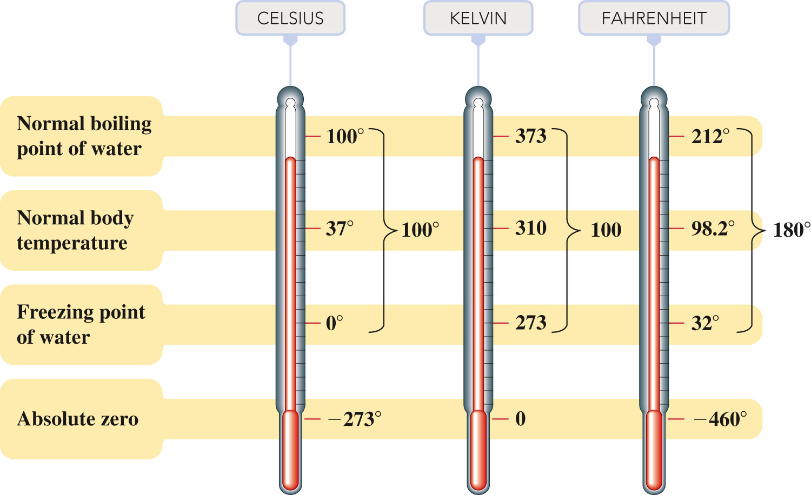
The Three Major Temperature Scales

Slide 52
Converting Between Scales

Slide 53
Exercise
At what temperature does °C = °F?
Notes:
The answer is -40. Since °C equals °F, they both should be the same value (designated as variable x). Use one of the conversion equations such as °C = (°F-32)(5/9), and substitute in the value of x for both °C and °F. Solve for x.

Slide 54
Solution
Since °C equals °F, they both should be the same value (designated as variable x).
Use one of the conversion equations such as:
Substitute in the value of x for both °C and °F. Solve for x.

Slide 55
Solution

Slide 56
Temperature Reading and Significant figures
Standard operating procedure: Read a thermometer to estimate the temperature to the closest degree (uncertainty is in ones place).
  Example: 10.oC or 10.oF has 2 sig figs and 100.oC or 100.oF has 3 sig figs

Slide 57
Exercise
Human body temperature is 98.6 °F. Convert this temperature to °C and K scale.
ºF → ºC ; ºC = 5/9 (ºF - 32)= 5/9 (98.6 - 32) = 5/9 (66.6) = 37.0
ºC → K ; K = ºC + 273.15 = 37.0 ºC + 273 = 310.0 K
Notes:
The answer is -40. Since °C equals °F, they both should be the same value (designated as variable x). Use one of the conversion equations such as °C = (°F-32)(5/9), and substitute in the value of x for both °C and °F. Solve for x.

