Slide 1
Chemistry 120 Fall 2016
Instructor: Dr. Upali Siriwardane
e-mail: upali@latech.edu
Office: CTH 311
Phone 257-4941
Office Hours: M,W,F 9:30-11:30 am T,R 8:00-10:00 am or by appointment;
Test Dates:
September 23, 2016 (Test 1): Chapter 1,2 &3
October 13, 2016 (Test 2): Chapter 4 & 5
October 31, 2016 (Test 3): Chapter 6, 7 & 8
November 15, 2016 (Test 4): Chapter 9, 10 & 11
November 17, 2016 (Make-up test) comprehensive:
Chapters 1-11

Slide 2
Chapter 9. Chemical Reactions
9-1 Types of Chemical Reactions
    Combination Reactions
    Decomposition Reactions
    Displacement Reactions
    Exchange Reactions
    Combustion Reactions
9-2 Redox and Nonredox Chemical Reactions
9-3 Terminology Associated with Redox Processes
  Oxidizing Agents and Reducing Agents
9-4 Collision Theory and Chemical Reactions
    Molecular Collisions
    Activation Energy
    Collision Orientation

Slide 3
Chapter 9. Chemical Reactions
9-5 Exothermic and Endothermic Chemical Reactions
9-6 Factors That Influence Chemical Reaction Rates
    Physical Nature of Reactants
    Reactant Concentrations
    Reaction Temperature
    Presence of Catalysts
9-7 Chemical Equilibrium
9-8 Equilibrium Constants
    Temperature Dependence of Equilibrium Constants
    Equilibrium Constant Values and Reaction Completeness
9-9 Altering Equilibrium Conditions: Le Châtelier’s Principle
    Concentration Changes
    Temperature Changes
    Pressure Changes
    Addition of Catalysts

Slide 4
Topics we’ll be looking at in this chapter
Types of chemical reactions
Redox and non-redox reactions
Terminology associated with redox processes
Collision theory and chemical reactions
Exothermic and endothermic reactions
Factors that influence chemical reaction rates
Chemical equilibrium
Equilibrium constants
Altering equilibrium conditions: Le Chatelier

Slide 5
Types of chemical reactions
A chemical reaction is a process in which at least one new substance is produced as a result of a chemical change.
Chemical reactions usually take the form of one the following basic types:
  Combination reactions
  Decomposition reactions
  Single-replacement reactions
  Double-replacement reactions
  Combustion reactions

Slide 6
Types of chemical reactions
A combination reaction is a chemical reaction in which a single product is produced from two (or more) reactants.
X + Y → XY
Real examples:
  Ca + S → CaS
  N₂ + 3H₂ → 2NH₃
  2Na + O₂ → Na₂O₂
  SO₃ + H₂O → H₂SO₄
  2NO + O₂ → 2NO₃
  2NO₂ + H₂O₂ → 2HNO₃
Examples involving the combination of
two elements to yield a single product
Examples involving the combination of
two compounds to yield a single product

Slide 7
Types of chemical reactions
A decomposition reaction is a chemical reaction in which a single reactant is converted into two or more products (these can be elements or compounds)
XY → X + Y
Decomposition to elements tends to occur at very high temperatures:
  2CuO → 2Cu + O₂
  2H₂O → 2H₂ + O₂
At lower temperatures, decomposition to other compounds tends to occur
  CaCO₃ → CaO + CO₂
  2KClO₃ → 2KCl + 3O₂
  4HNO₃ → 4NO₂ + 2H₂O + O₂
Elements generated by decomposition
Stable compounds may also be
produced, generally at lower
temperatures

Slide 8
Types of chemical reactions
Single-replacement reactions are reactions in which an atom or molecule replaces another atom or group of atoms from a second reactant
X + YZ → Y + XZ
Fe + CuSO₄ → Cu + FeSO₄
Mg + Ni(NO₃)₂ → Ni + Mg(NO₃)₂
Cl₂ + NiI₂ → I₂ + NiCl₂
4PH₃ + Ni(CO)₄ → 4CO + Ni(PH₃)₄
Elements replacing
other elements
Compound replacing
a group of atoms

Slide 9
Types of chemical reactions
Double-replacement reactions are chemical reactions in which two substances exchange parts with one another, forming two different substances
AX + BY → AY + BX
In most cases, at least one of the products is formed in a different physical state (e.g. a solid formed after mixing two solutions)
AgNO₃(aq) + KCl(aq) → KNO₃(aq) + AgCl(s)
2KI(aq) + Pb(NO₃)₂(aq) → 2KNO(aq) + PbI₂(s)
One of the
products is
a solid

Slide 10
Types of chemical reactions
Combustion reactions occur between substances and oxygen, producing an oxide product in addition to other product(s). Usually, they give off heat (sometimes light).
Hydrocarbons (compounds that only have carbon and hydrogen in their chemical formulas) react in combustion reactions to produce CO₂ and H₂O:
  2C₂H₂ + 5O₂ → 4CO₂ + 2H₂O
  C₃H₈ + 5O₂ → 3CO₂ + 4H₂O
  C₄H₈ + 6O₂ → 4CO₂ + 4H₂O

Slide 11
Types of chemical reactions
Many examples of combustion reactions exist where the reactant is not a hydrocarbon:
  CS₂ + 3O₂ → CO₂ + 2SO₂
  2H₂S + 3O₂ → 2SO₂ + 2H₂O
  4NH₃ + 5O₂ → 4NO + 6H₂O
  2ZnS + 3O₂ → 2ZnO + 2SO₂
Magnesium ribbon burning
Combustion of red phosphorus

Slide 12
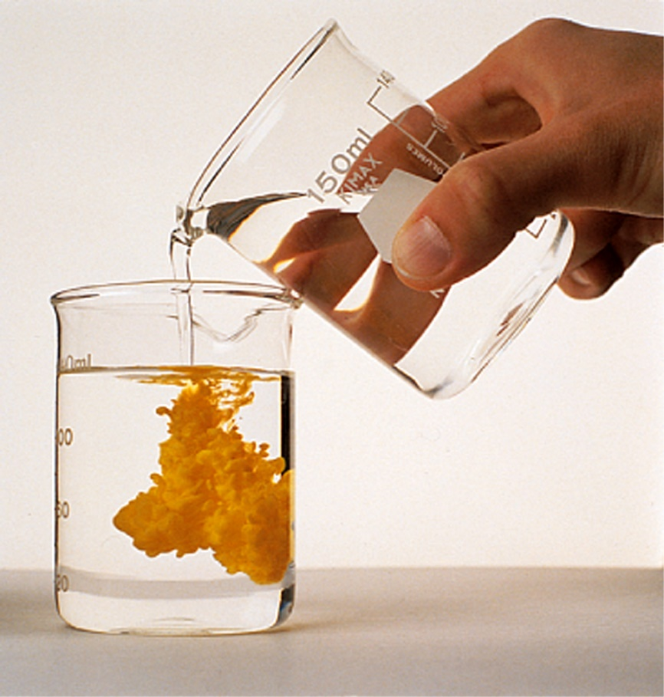
Indicators of chemical reactions
Sometimes, it is difficult to determine whether a chemical reaction has happened or not. There are several indicators for this:
  Production of a solid, liquid, or gas
  Generation/consumption of heat
  Color change
  Production of light

Slide 13
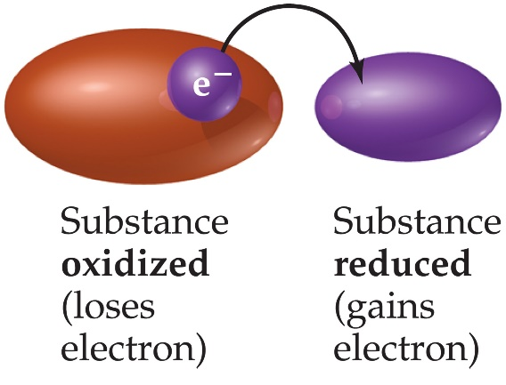
Redox and non-redox chemical reactions
The term, redox, comes from reduction-oxidation. These reactions involve the transfer of electrons from one reactant to another. In the course of this process:
one reactant becomes oxidized (loses electron(s))
one reactant becomes reduced (gains electron(s))
Can’t have one without the other. The reactant that is oxidized
(loses one or more electrons) loses them to the reactant that becomes
reduced (gains one or more electrons)

Slide 14
Redox and non-redox chemical reactions
Redox reactions involve the transfer of electrons between reactants. Non-redox reactions do not involve electron-transfer.
We can keep track of where electrons are moving using a bookkeeping system called oxidation numbers
Oxidation numbers represent the charges that atoms appear to have when the electrons in each bond it is participating in are assigned to the more electronegative of the two atoms involved in the bond

Slide 15
Redox and non-redox chemical reactions
Rules for assigning oxidation numbers
Oxidation numbers are determined for elements in formulas using a series of rules:
The oxidation number of an element in its elemental state is always zero
The oxidation number of a monatomic ion is equal to the charge of the ion
Oxidation numbers of group 1A and 2A elements are always +1 and +2, respectively
The oxidation number of hydrogen is +1 in most hydrogen-containing compounds
The oxidation number of oxygen is -2 in most oxygen-containing compounds
In binary molecular compounds, the more electronegative element is assigned a negative oxidation number, equal to its charge in binary ionic compounds
  In binary ionic compounds, the oxidation number of halogens (F, Cl, Br) is -1.
For a compound, the sum of the oxidation numbers is equal to zero; for a polyatomic ion, the sum of the oxidation numbers is equal to the charge of the polyatomic ion
Try these:
S in H₂S Fe in Fe³⁺ N in HNO₃ Cl in ClO₃⁻ Oxygen in O₂

Slide 16
Redox and non-redox chemical reactions
To determine whether a reaction is redox or not, you need to check the oxidation numbers of the elements involved. If the oxidation number of any element changes in going from reactants-to-products, the reaction is a redox reaction
E.g.,
FeO + CO → Fe + CO₂
Fe is reduced
+2
-2
+2
-2
0
+4
-2
C is oxidized

Slide 17
Redox and non-redox chemical reactions
If the oxidation numbers don’t change, the reaction isn’t redox (would be called non-redox)
  CaCO₃ → CaO + CO₂
+2
+4
-2
+2
-2
+4
-2

Slide 18

Terminology associated with redox processes
When a redox reaction occurs, one reactant loses electrons to a second reactant.
We can say that the first reactant becomes oxidized and the second reactant becomes reduced.
Another way of looking at this is that the reactant that is reduced has taken electrons from the reactant that has been oxidized
The reactant that takes electrons is enabling the oxidation of the other one. We can call this reactant the oxidizing agent.
Could also say that the reactant that gets oxidized is enabling the reduction of the second reactant, and thus it is sometimes called the reducing agent.
this
oxidizes
this

Slide 19
Terminology associated with redox processes
Example:
FeO + CO → Fe + CO₂
Oxidizing agent
Reducing agent
+2
-2
+2
-2
0
+4
-2
Since iron (in FeO) gets reduced, FeO is the oxidizing agent (it took electrons
from carbon in CO.
Since carbon in CO gets oxidized, CO is the reducing agent (it gave electrons
to iron in FeO

Slide 20
Collision theory and chemical reactions
What causes chemical reactions to take place? There are three requirements that must be met for a chemical reaction to occur:
  Molecular collisions: reactant particles must interact with one another before a reaction can occur
  Activation energy: molecules must collide with a certain, minimum energy, in order for the reaction to take place
  Collision orientation: in many cases, collisions need to involve specific regions (groups of atoms) for a successful reaction to result

Slide 21
Collision theory and chemical reactions
Molecular collisions
Collisions must occur in order for two or more chemical species to react with each other (reactants can’t react if they are separated from each other).
The collisions involve a transfer of energy, and this energy can be used to break bonds during reactions.
The greater the frequency of collisions the faster the rate.
and
The more molecules present, the greater the probability of collision and the faster the
rate (concentration)

Slide 22
Collision theory and chemical reactions
Activation energy
Activation energy: the energy barrier (kinetic) that must be overcome during the chemical transformation of reactants to products.
Activation energy varies from reaction to reaction.
Slow reactions typically have high activation energies (only a small proportion of the molecules in the reaction container have adequate kinetic energy to react).
Higher activation energy barriers yield slower chemical reactions

Slide 23
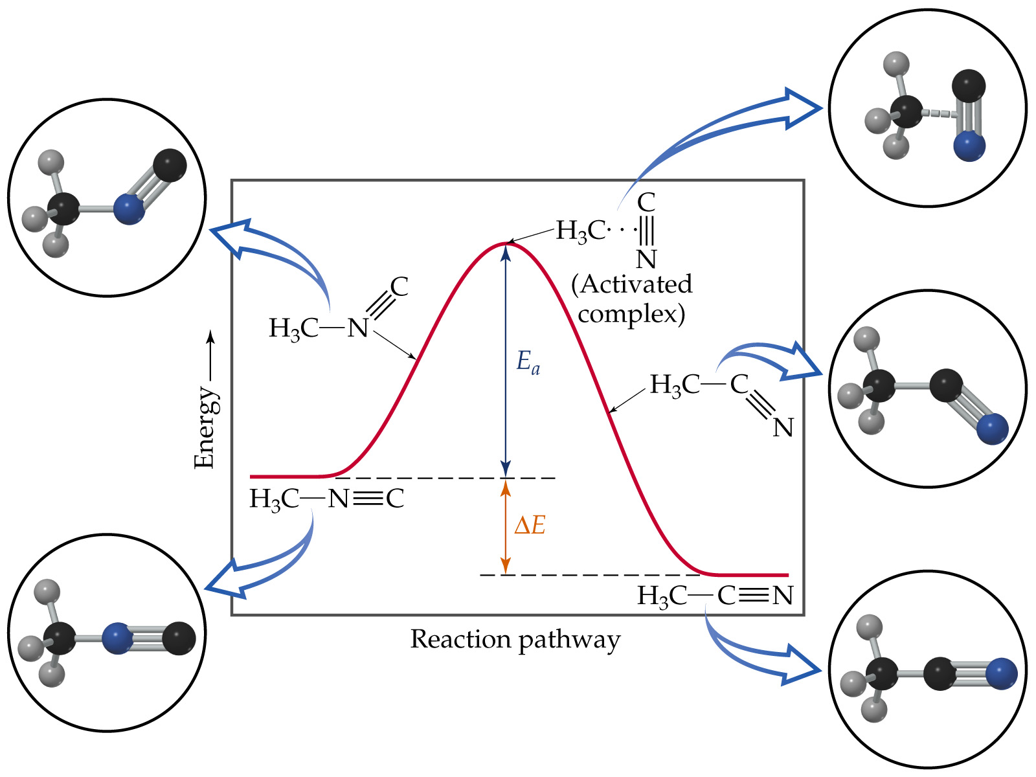
CH₃NC → CH₃CN
methyl isonitrile
acetonitrile
Activation energy

Slide 24
Collision theory and chemical reactions
Collision orientation
Bonds are broken and new bonds are formed when reactions occur. New bonds are formed between atoms, and the bonds result from sharing of electrons between those atoms.
The atoms that are involved in these new bonds formed must participate in the collision/contact.
Reactions that have strict orientation requirements tend to be slow

Slide 25
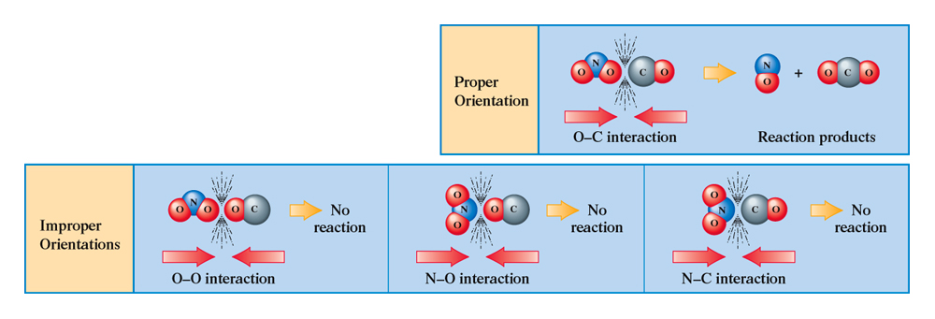
Collision theory and chemical reactions

Slide 26
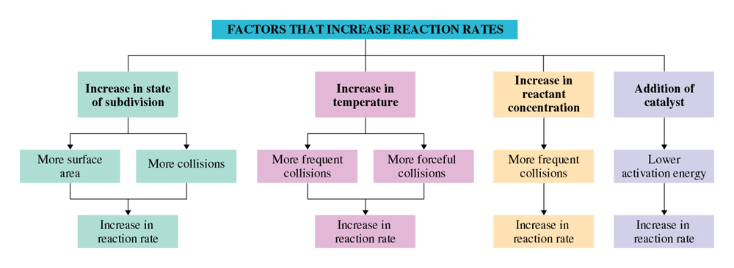
Factors that influence reaction rates

Slide 27
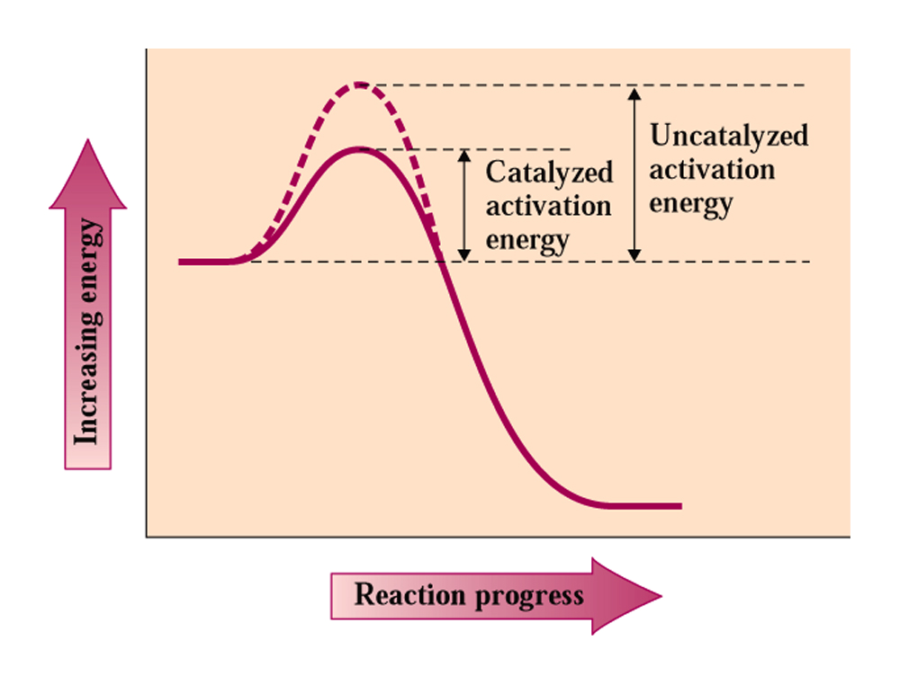
Factors that influence reaction rates
How catalysts affect reaction rates
Catalyzed:
C + Y → CY
X + CY → XY + C
Instead of X + Y → XY
1)
2)

Slide 28
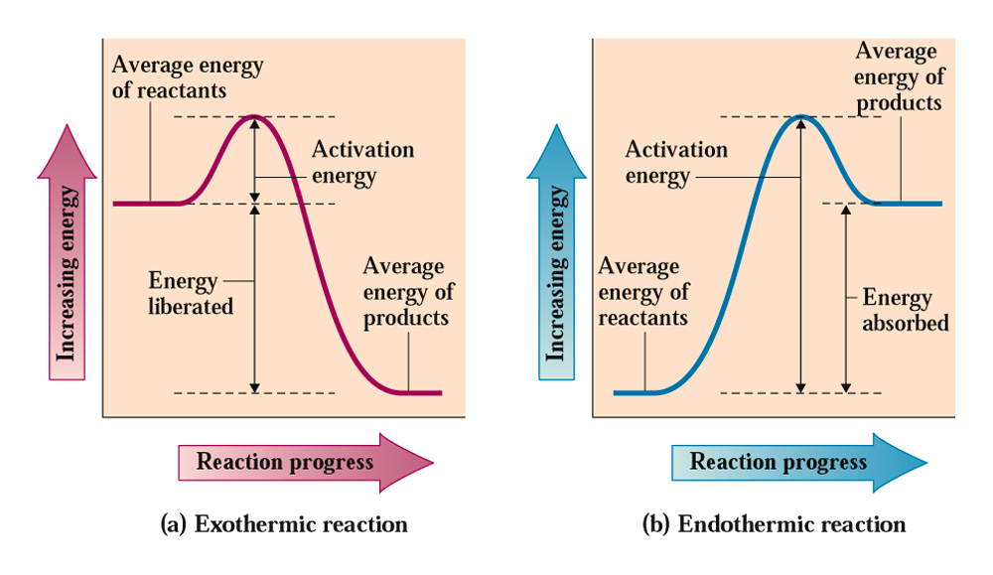
Exothermic and endothermic reactions
Chemical reactions will produce or consume heat.
Reactions that consume heat as they occur are called endothermic; reactions that produce heat as they occur are called exothermic

Slide 29
Exothermic and endothermic reactions
When chemical reactions occur, bonds must be broken in the reactant molecules and new ones created is the products are formed.
If the bonds in the reactant molecules are stronger (more stable) than those in the products, the reaction will be endothermic
If the bonds in the products are more stable than those of the reactants, the reaction will be exothermic
Heat absorbed or released is proportional to
[Total energy of bonds broken] – [Total energy of bonds formed]
reactants
products

Slide 30
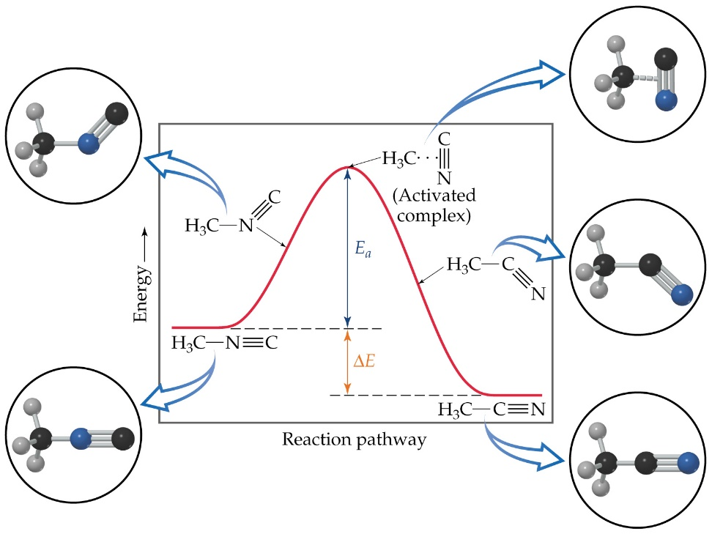
Chemical equilibrium
Chemical reactions do not go to “completion” – some of them result in essentially complete consumption of reactants, but even in these cases, there is always at least some small portion of the reactant that remains*
The reason for this is that reactions can go in both forward and reverse directions
* assuming reaction is carried
out in a closed container

Slide 31
Chemical equilibrium
Consider a chemical reaction like the following one:
H₂ + I₂ → 2HI
If we start with pure H₂ and I₂, then this reaction is initially fast (rates are proportional to the concentration of the reactants) and then begins to slow down as the reactant gets consumed.
As the reaction occurs, product (HI) begins to build up. The following reaction begins to get faster as the amount of HI builds up:
H₂ + I₂ ← 2HI

Slide 32
Chemical equilibrium
The two, simultaneous reactions can be described by the following equation:
H₂ + I₂ D 2HI
As the reactions continue, the “forward” reaction (left-to-right) slows down, and the “reverse” reaction (right-to-left) speeds up until their rates become equal.
At this time (and all times after) the reaction has reached a state of chemical equilibrium (opposed chemical reactions occurring at equal rates)

Slide 33
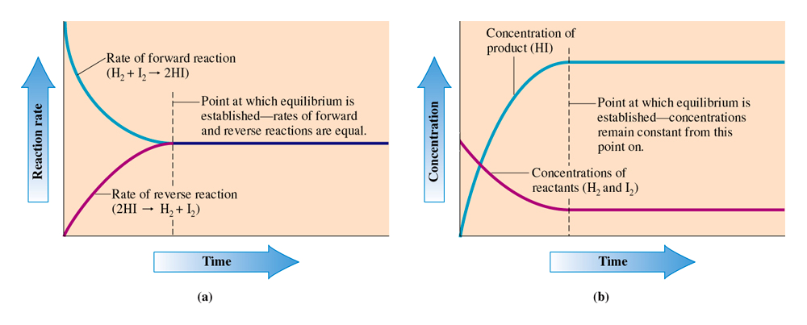
Chemical equilibrium
Amounts of product and reactant
are constant after equilibrium reached
Rates
Concentrations

Slide 34
Equilibrium constants
The amounts of product and reactant that exist once chemical equilibrium is established can be described by a number called an equilibrium constant
The equilibrium constant is a numerical value that characterizes the relationship between the concentrations of reactants and products in a system at equilibrium
For some general equilibrium reaction:
wA + xB D yC + zD

Slide 35
Equilibrium constants
Equilibrium constant expressions basically indicate the ratio of products to reactants at equilibrium (the concentration of each being raised to the power of its coefficient in the balanced chemical equation)
wA + xB D yC + zD
Square brackets indicate
concentration in molarity
coefficients
become
exponents
Only solution species (concentrations) and gases are entered into the equilibrium
constant expression. Solids and pure liquids are not considered.

Slide 36
Equilibrium constants
Example, for the reaction
2Cl₂(g) + 2H₂O(g) D 4HCl(g) + O₂(g)
The equilibrium constant expression would be written as:

Slide 37
Equilibrium constants
If concentrations for reactants and products are available, a numerical value for the equilibrium constant can be determined.
Example: for N_{2(g)} + 3H_{2(g)} D 2NH_{3(g)}, the following concentrations were determined at equilibrium:
N₂: 0.079 M
H₂: 0.12M
NH₃: 0.0051 M

Slide 38
Equilibrium constants
Another example: write an expression for K_{eq} for the following reaction, and calculate K_{eq} if the following concentrations are present at equilbrium:
AgCl_{(s)} D Ag⁺_{(aq)} + Cl⁻_{(aq)}
At equilibrium
Ag⁺_{(aq)} = 1.3 x 10⁻⁵ M
Cl⁻_{(aq)} = 1.3 x 10⁻⁵ M

Slide 39
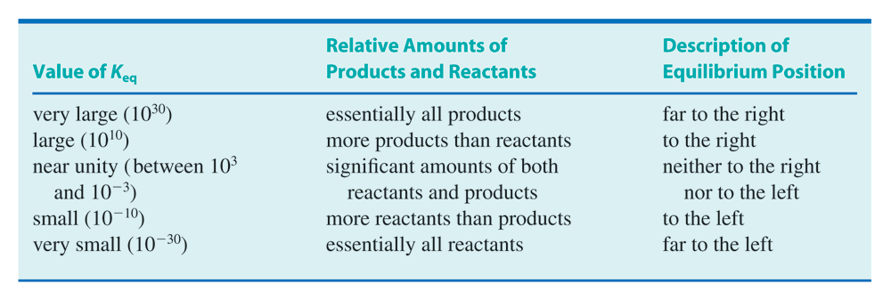
Equilibrium constants
The size of K_{eq} (size of the number) gives a picture of what the reaction has
produced (and what reactants are left) once equilibrium has been reached

Slide 40
Altering equilibrium conditions: Le Chatelier’s principle
Chemical equilibrium is a balancing act that exists under a certain set of conditions. If the conditions are changed, equilibrium can be upset
When this occurs, the chemical reaction responds in a way that takes it back to equilibrium (though the final “picture” will probably look a little different than what it looked like before equilibrium was upset)

Slide 41
Altering equilibrium conditions: Le Chatelier’s principle
Consider the following reaction:
N_{2(g)} + 3H_{2(g)} D 2NH_{3(g)}
If this reaction has reached equilibrium, what happens if we add some more H_{2(g)}?
N_{2(g)} + 3H_{2(g)} → 2NH_{3(g)}
The concentrations of the
reactants for this reaction
have been increased.
N_{2(g)} + 3H_{2(g)} ← 2NH_{3(g)}

Slide 42
Altering equilibrium conditions: Le Chatelier’s principle
The reaction will respond in a way that will take it back to equilibrium. It does this by minimizing the stress that has been applied to the system
N_{2(g)} + 3H_{2(g)} D 2NH_{3(g)}
Stress here is too much H₂. Reaction will “shift-to-the-right”
to consume the extra H₂

Slide 43
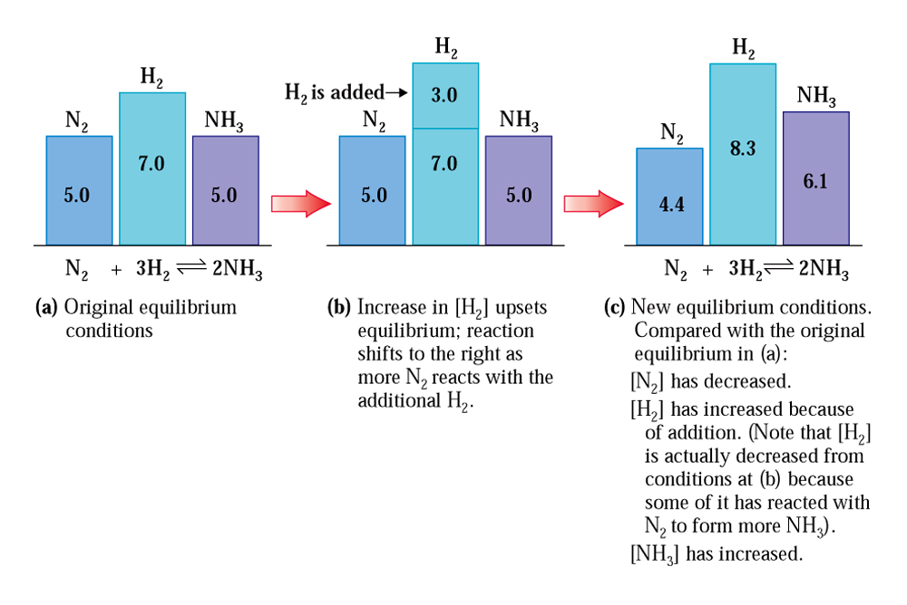
Altering equilibrium conditions: Le Chatelier’s principle
N_{2(g)} + 3H_{2(g)} D 2NH_{3(g)}
after
before

Slide 44
Altering equilibrium conditions: Le Chatelier’s principle
Another way that equilibrium can be influenced: removal of product or reactant.
N_{2(g)} + 3H_{2(g)} D 2NH_{3(g)}
If you were to remove NH_{3(g)} as it gets formed, you could drive
this reaction completely to the right (consume all reactants)

Slide 45
Altering equilibrium conditions: Le Chatelier’s principle
Temperature changes
Temperature changes can also affect chemical equilibria.
Exothermic reactions will “shift-to-the-left” when they are heated, and “shift-to-the-right” when they are cooled
H_{2(g)} + F_{2(g)} D 2HF_{(g)} + heat
(an example of an exothermic reaction)

Slide 46
Altering equilibrium conditions: Le Chatelier’s principle
Temperature changes
Endothermic reactions will “shift-to-the-right” when they are heated, and “shift-to-the-left” when they are cooled
heat + 2CO_{2(g)} D 2CO_{(g)} + O_{2(g)}
(an example of an endothermic reaction)

Slide 47
Altering equilibrium conditions: Le Chatelier’s principle
For reactions involving gaseous reactants or products, the pressure exerted on the reaction may influence the position of an equilibrium
2H_{2(g)} + O_{2(g)} D 2H₂O_{(g)}
Important: for pressure to have an influence, the following must be true:
-there must be unequal numbers of product and reactant gas molecules
in the balanced equation
-a pressure change must be brought about by a volume change, not by
the addition of some other, unreactive gas that is not involved in the
balanced equation

Slide 48
Altering equilibrium conditions: Le Chatelier’s principle
Example: how will the gas-phase equilibrium shown below react to the following changes:
CO_{(g)} + 3H_{2(g)} D CH_{4(g)} + H₂O_{(g)} + heat
Removal of CH₄(g)
Addition of H₂O(g)
Decrease in the temperature
Decrease in the volume of the container

