Slide 1
Chapter 9. Chemical Reactions
Introduction to Inorganic Chemistry
Instructor Dr. Upali Siriwardane (Ph.D. Ohio State)
E-mail: upali@latech.edu
Office: 311 Carson Taylor Hall ; Phone: 318-257-4941;
Office Hours: MWF 8:00-9:00 and 11:00-12:00;
TR 10:00-12:00
Contact me trough phone or e-mail if you have questions
Online Tests on Following days
March 24, 2017: Test 1 (Chapters 1-3)
April 10, 2017 : Test 2 (Chapters 4-5)
May 1, 2017: Test 3 (Chapters 6,7 &8)
May 12, 2017 : Test 4 (Chapters 9, 10 &11)
May 15, 2017: Make Up Exam: Chapters 1-11)
.

Slide 2
9.1 Types of Chemical Reactions
9.2 Redox and Nonredox Chemical Reactions
9.3 Terminology Associated with Redox Processes
9.4 Collision Theory and Chemical Reactions
9.5 Exothermic and Endothermic Chemical Reactions
9.6 Factors That Influence Chemical Reaction Rates
9.7 Chemical Equilibrium
9.8 Equilibrium Constants
9.9 Altering Equilibrium Conditions: Le Châtelier’s Principle

Slide 3
Chemical Reaction
Process in which at least one new substance is produced as a result of chemical change.
Major types of chemical reactions
  Combination
  Decomposition
  Displacement (single)
  Exchange (double)
  Combustion

Slide 4
Oxidation-Reduction (Redox) Reaction
  A chemical reaction in which there is a transfer of electrons from one reactant to another reactant.
Nonoxidation-Reduction (Nonredox) Reaction
  A chemical reaction in which there is no transfer of electrons from one reactant to another reactant.

Slide 5
Combination Reaction
A chemical reaction in which a single product is produced from two (or more) reactants.
X + Y → XY (redox)
2H₂ + O₂ → 2H₂O

Slide 6
Decomposition Reaction
A chemical reaction in which a single reactant is converted into two (or more) simpler substances (elements or compounds).
XY → X + Y (redox)
2H₂O → 2H₂ + O₂

Slide 7
Displacement Reaction
A chemical reaction in which an atom or molecule displaces an atom or group of atoms from a compound.
X + YZ → Y + XZ (redox)
Zn + 2HCl → ZnCl₂ + H₂

Slide 8
Exchange Reaction (double displacement)
A chemical reaction in which two substances exchange parts with another and form two different substances.
AX + BY → AY + BX (non-redox)
Na₂SO₄(aq) + Pb(NO₃)₂(aq) → 2NaNO₃(aq) + PbSO₄(s)

Slide 9
Combustion Reaction
A chemical reaction between a substance and oxygen (usually from air) that proceeds with the evolution of heat and light (usually from a flame).
C₃H₈ + 5O₂ → 3CO₂ + 4H₂O (redox)

Slide 10

Concept Check
Classify each of the following chemical reactions as a combination, decomposition, displacement, exchange, or combustion reaction.
  Mg(s) + 2HCl(aq) → MgCl₂(aq) + H₂(g)
  HCl(g) + NH₃(g) → NH₄Cl(s)
  4NH₃ + 5O₂ → 4NO + 6H₂O
Notes:
a), b), and d) all form precipitates with Pb²⁺. A compound cannot form between Pb²⁺ and Na⁺.

Slide 11
Concept Check
Classify each of the following chemical reactions as a combination, decomposition, displacement, exchange, or combustion reaction.
  Mg(s) + 2HCl(aq) → MgCl₂(aq) + H₂(g)
  displacement
  HCl(g) + NH₃(g) → NH₄Cl(s)
  combination
  4NH₃ + 5O₂ → 4NO + 6H₂O
  combustion
Notes:
a), b), and d) all form precipitates with Pb²⁺. A compound cannot form between Pb²⁺ and Na⁺.

Slide 12
Oxidation Number (Oxidation State)of an Element
A number that represents the charge that an atom appears to have when the electrons in each covalent/ionic bond it is participating in are assigned to the more electronegative of the two atoms involved in the bond.
E.g. NaCl made up of Na⁺ and Cl⁻
H₂O has H-O-H
1+
2-
1+

Slide 13
Rules for Assigning Oxidation Numbers
Oxidation # of an element in its elemental state = 0.
Oxidation # of a monatomic ion = charge on ion.
Group 1A = +1; Group IIA = +2.
Hydrogen = +1 in covalent compounds.
Oxygen = −2 in covalent compounds (except in peroxides where it = −1).
In binary molecular compounds, the more electronegative element is assigned a negative oxidation # equal to its charge in binary ionic compounds. H O H
Sum of oxidation states = 0 in compounds;
Sum of oxidation states of an ion = charge of the ion.
1+
2-
1+

Slide 14
Exercise
Find the oxidation numbers for each of the elements in each of the following compounds:
    K₂Cr₂O₇
    CO₃²⁻
    MnO₂
    PCl₅
    SF₄
Notes:
K₂Cr₂O₇; K = +1; Cr = +6; O = -2
CO₃²⁻; C = +4; O = -2
MnO₂; Mn = +4; O = -2
PCl₅; P = +5; Cl = -1
SF₄; S = +4; F = -1

Slide 15
Exercise
Find the oxidation numbers for each of the elements in each of the following compounds:
    K₂Cr₂O₇
    CO₃²⁻
    MnO₂
    PCl₅
    SF₄
K = +1; Cr = +6; O = –2
C = +4; O = –2
Mn = +4; O = –2
P = +5; Cl = –1
S = +4; F = –1
Notes:
K₂Cr₂O₇; K = +1; Cr = +6; O = -2
CO₃²⁻; C = +4; O = -2
MnO₂; Mn = +4; O = -2
PCl₅; P = +5; Cl = -1
SF₄; S = +4; F = -1

Slide 16
To determine whether a reaction is a redox reaction or a nonredox reaction, look for changes in the oxidation # of elements involved in the reaction.
Changes in oxidation # mean a transfer of electrons = redox reaction.

Slide 17
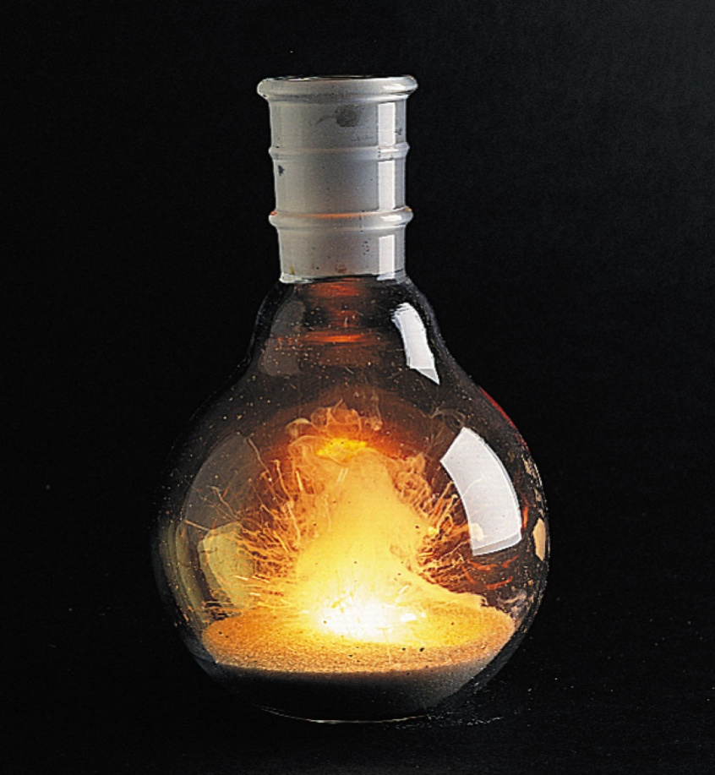
Reaction Between Calcium Metal and Chlorine Gas
Ca + Cl₂ → CaCl₂
0 0 +2 –1

Slide 18
Redox Characteristics
In a redox reaction, one reactant undergoes oxidation, and another reactant undergoes reduction.
Oxidation – a reactant loses one or more electrons; reducing agent.
Reduction – a reactant gains one or more electrons; oxidizing agent.

Slide 19
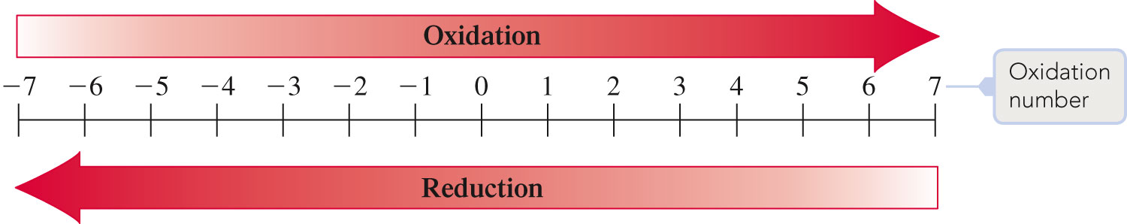

Slide 20
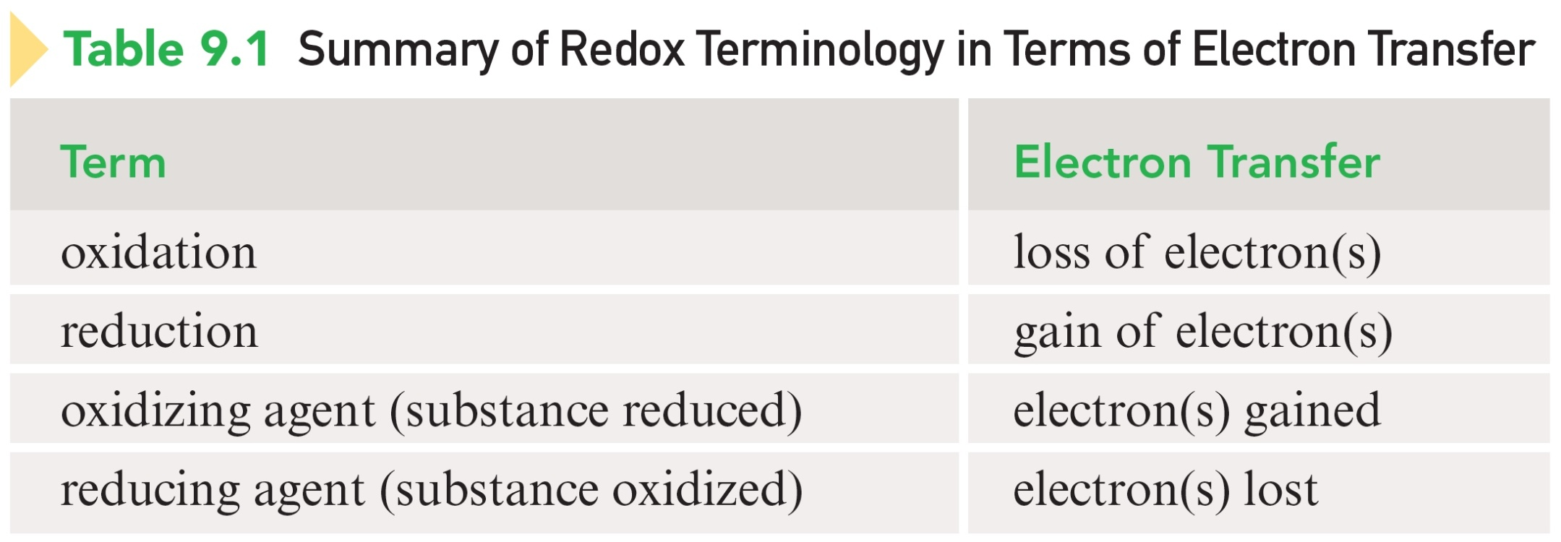

Slide 21
Concept Check
Which of the following are oxidation-reduction reactions? Identify the oxidizing agent and the reducing agent.
  Zn(s) + 2HCl(aq) → ZnCl₂(aq) + H₂(g)
  Cr₂O₇²⁻(aq) + 2OH⁻(aq) → 2CrO₄²⁻(aq) + H₂O(l)
  2CuCl(aq) → CuCl₂(aq) + Cu(s)
Notes:
Zn – reducing agent; HCl – oxidizing agent
c) CuCl acts as the reducing and oxidizing agent

Slide 22
Concept Check
Which of the following are oxidation-reduction reactions? Identify the oxidizing agent and the reducing agent.
  Zn(s) + 2HCl(aq) → ZnCl₂(aq) + H₂(g)
  Cr₂O₇²⁻(aq) + 2OH⁻(aq) → 2CrO₄²⁻(aq) + H₂O(l)
  2CuCl(aq) → CuCl₂(aq) + Cu(s)
  a) Zn – reducing agent; HCl – oxidizing agent
  c) CuCl acts as the reducing and oxidizing agent.
Notes:
Zn – reducing agent; HCl – oxidizing agent
c) CuCl acts as the reducing and oxidizing agent

Slide 23
Collision Theory
Molecular Collisions
Activation Energy
Collision Orientation

Slide 24
Molecular Collisions
The reactant molecules, ions, or atoms must come in contact (collide) with one another in order for any chemical change to occur.

Slide 25
Activation Energy
Minimum combined kinetic energy that colliding reactant particles must possess in order for their collision to result in a chemical reaction.

Slide 26
Collision Orientation
Reaction rates are sometimes very slow because reactant molecules must be orientated in a certain way in order for collisions to lead successfully to products.

Slide 27
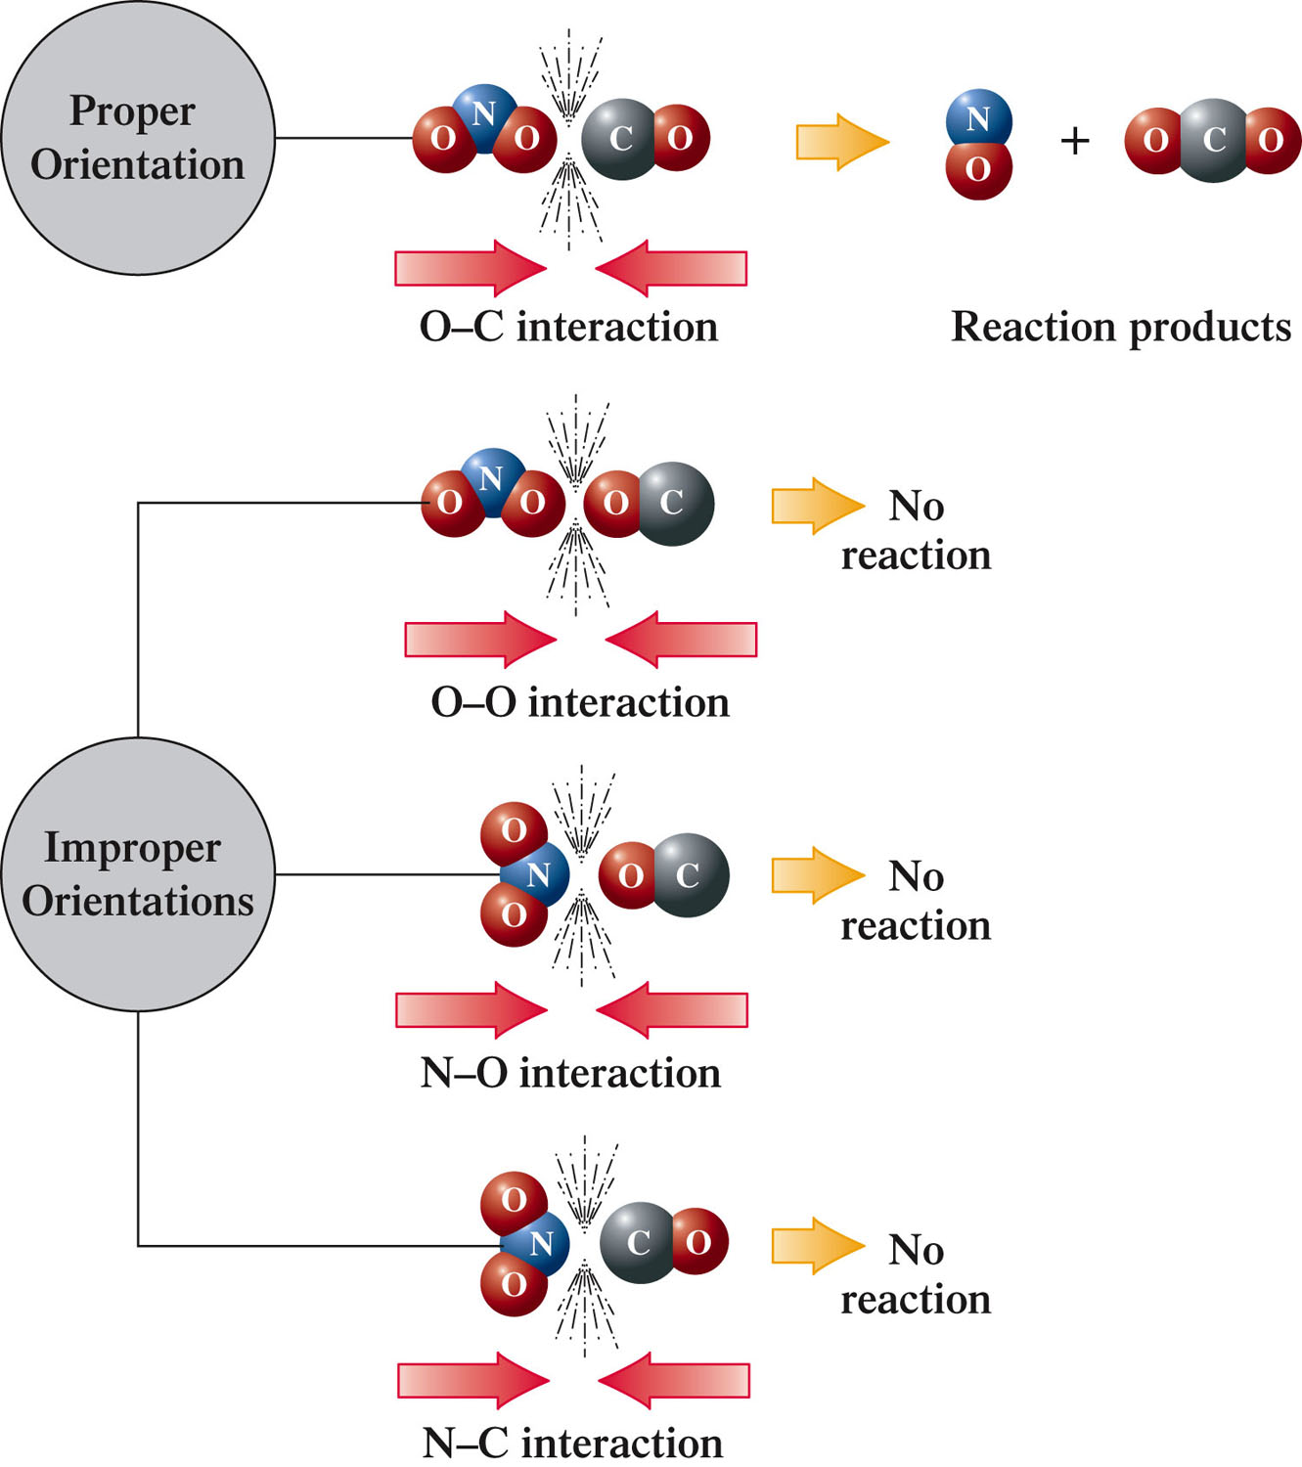
Reaction of NO₂ and CO to Produce NO and CO₂

Slide 28
Exothermic Reaction
A chemical reaction in which energy is released as the reaction occurs.
Energy is a “product” of the chemical reaction.
  Example – burning of a fuel

Slide 29
Exothermic Reaction
Occurs when the energy required to break bonds in the reactants is less than the energy released by bond formation in the products.

Slide 30
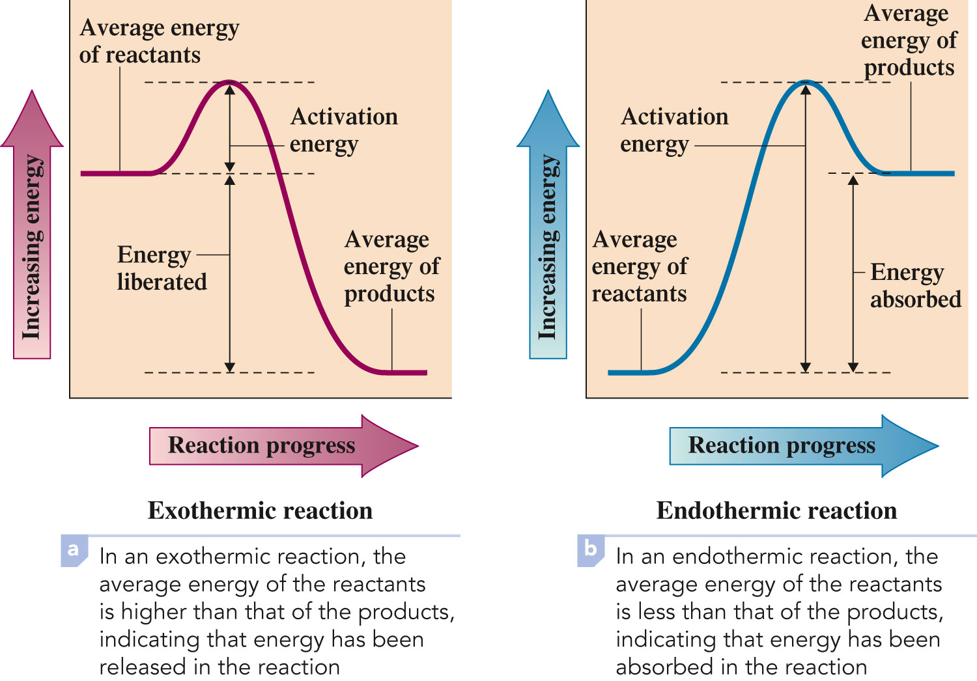
Exothermic Reaction

Slide 31
Endothermic Reaction
A chemical reaction in which a continuous input of energy is needed for the reaction to occur.
Energy is a “reactant” of the chemical reaction.
  Example – photosynthesis in plants

Slide 32
Endothermic Reaction
Occurs when the energy required to break bonds in the reactants is more than the energy released by bond formation in the products.
Additional energy must be supplied from external sources as the reaction proceeds.

Slide 33
Endothermic Reaction

Slide 34
Chemical Reaction Rate
The rate at which reactants are consumed or products produced in a given time period in a chemical reaction.

Slide 35
Four Factors That Affect Reaction Rate
Physical nature of the reactants
Reactant concentrations
Reaction temperature
Presence of catalysts

Slide 36
Physical Nature of Reactants
Includes the physical state of each reactant (s, l, or g) and the particle size.
When reactants are all the same physical state, reaction rate is generally faster between liquid-state reactants than between solid-state reactants and is fastest between gaseous-state reactants.

Slide 37
Physical Nature of Reactants
For reactants in the solid state, reaction rate increases as subdivision of the solid increases.
When the particle size of a solid is extremely small, reaction rates can be so fast than an explosion results.

Slide 38
Reactant Concentrations
An increase in the concentration of a reactant causes an increase in the rate of the reaction.
There are more molecules of that reactant present in the reaction mixture; thus collisions between this reactant and other reactant particles are more likely.

Slide 39
Reaction Temperature
Reaction rate increases as the temperature of the reactants increases.
The increased molecular speed causes more collisions to take place in a given time.

Slide 40
Presence of Catalysts
Catalyst – a substance that increases a chemical reaction rate without being consumed in the chemical reaction.
Increases reaction rates by providing alternative reaction pathways that have lower activation energies than the original, uncatalyzed pathway.
Enzymes are the catalysts in the human body.

Slide 41
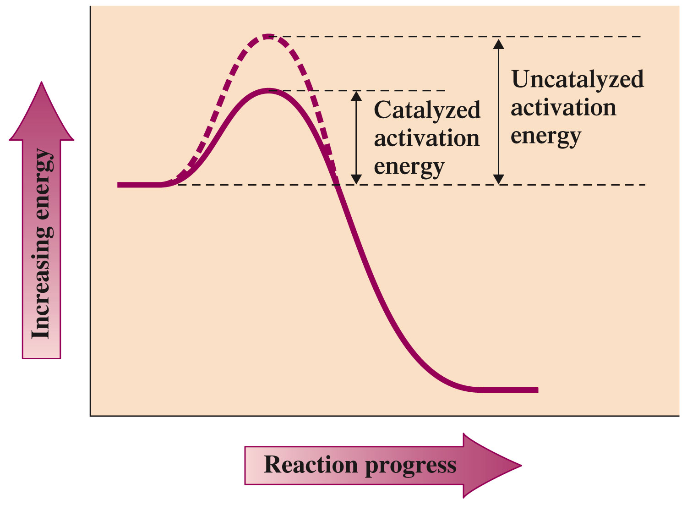
Presence of Catalysts

Slide 42
Chemical Equilibrium
The state in which forward and reverse chemical reactions occur simultaneously at the same rate.
The concentrations of reactants and products no longer change (but do not have to be equal).
On the molecular level, there is frantic activity. Equilibrium is not static, but is a highly dynamic situation.

Slide 43
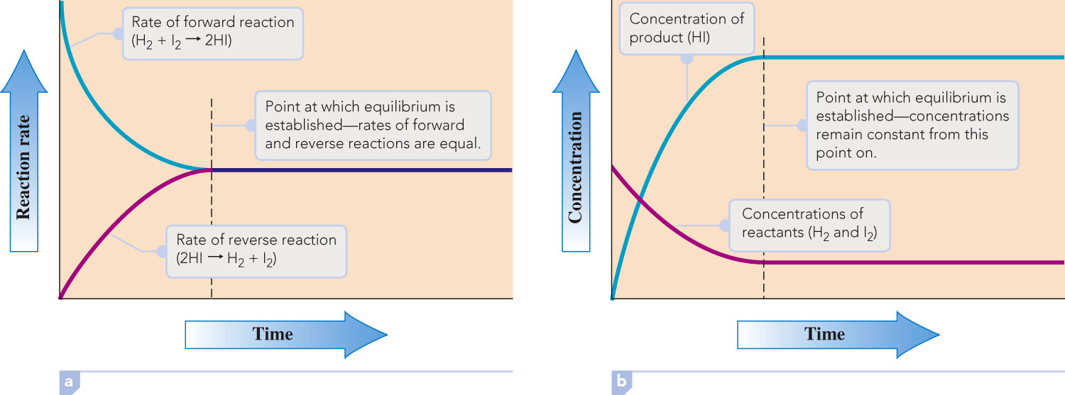
H₂ + I₂  2HI

Slide 44
H₂ + I₂  2HI

Slide 45
Reversible Reaction
A chemical reaction in which the conversion of reactants to products (the forward reaction) and the conversion of products to reactants (the reverse reaction) occur at the same time.
All reactions are reversible (can go in either direction).

Slide 46
Concept Check
Consider an equilibrium mixture in a closed vessel reacting according to the equation:
H₂O(g) + CO(g) H₂(g) + CO₂(g)
You add more H₂O to the flask. How does the concentration of each chemical compare to its original concentration after equilibrium is reestablished? Justify your answer.
Notes:
The concentrations of each product will increase, the concentration of CO will decrease, and the concentration of water will be higher than the original equilibrium concentration, but lower than the initial total amount.
Students may have many different answers (hydrogen goes up, but carbon dioxide in unchanged, etc.) Let them talk about this for a while – do not go over the answer until each group of students has come up with an explanation. This question also sets up LeChâtelier’s principle for later.

Slide 47
Concept Check
Consider an equilibrium mixture in a closed vessel reacting according to the equation:
H₂O(g) + CO(g) H₂(g) + CO₂(g)
You add more H₂ to the flask. How does the concentration of each chemical compare to its original concentration after equilibrium is reestablished? Justify your answer.
Notes:
This is the opposite scenario of the previous slide. The concentrations of water and CO will increase. The concentration of carbon dioxide decreases and the concentration of hydrogen will be higher than the original equilibrium concentration, but lower than the initial total amount.

Slide 48
Equilibrium Constant
A numerical value that characterizes the relationship between the concentrations of reactants and products in a system at chemical equilibrium.

Slide 49
wA + xB yC + zD
[C]
y
[D]
z
=
K_{eq}
[A]
w
[B]
x

Slide 50
Conclusions About the Equilibrium Expression
Square brackets refer to molar concentrations.
Product concentrations are always placed in the numerator.
Reactant concentrations are always placed in the denominator.
The coefficients in the balanced chemical equation determine the powers to which the concentrations are raised.
K_{eq} is used to denote an equilibrium constant.

Slide 51
Conclusions About the Equilibrium Expression
Only concentrations of gases and substances in solution are written in an equilibrium expression.
The concentrations of pure liquids and pure solids, which are constants, are never included in an equilibrium expression.

Slide 52
Temperature Dependence
K_{eq} always has the same value at a given temperature regardless of the amounts of reactants or products that are present initially.
If the temperature changes, the value of K_{eq} also changes.
For reactions where the forward reaction is exothermic, K_{eq} decreases with increasing T.
For reactions where the forward reaction is endothermic, K_{eq} increases with increasing T.

Slide 53
Reaction Completeness
If K_{eq} is large, the equilibrium system contains more products than reactants.
If K_{eq} is small, the equilibrium system contains more reactants than products.

Slide 54
Equilibrium Position
Qualitative indication of the relative amounts of reactants and products present when a chemical reaction reaches equilibrium.

Slide 55
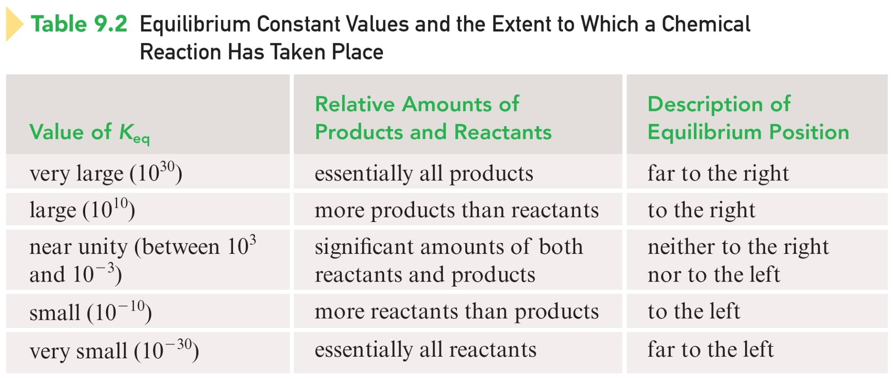
K_{eq} and the Extent to Which a Chemical Reaction Has Taken Place

Slide 56
Le Châtelier’s Principle
If a stress is applied to a system in equilibrium, the system will readjust in the direction that best reduces the stress imposed on the system.
If more products have been produced as a result of the disruption, the equilibrium is said to have shifted to the right.
When disruption causes more reactants to form, the equilibrium has shifted to the left.

Slide 57
Effects of Changes on the System
Concentration Changes: The system will shift away from the added component. If a component is removed, the opposite effect occurs.

Slide 58
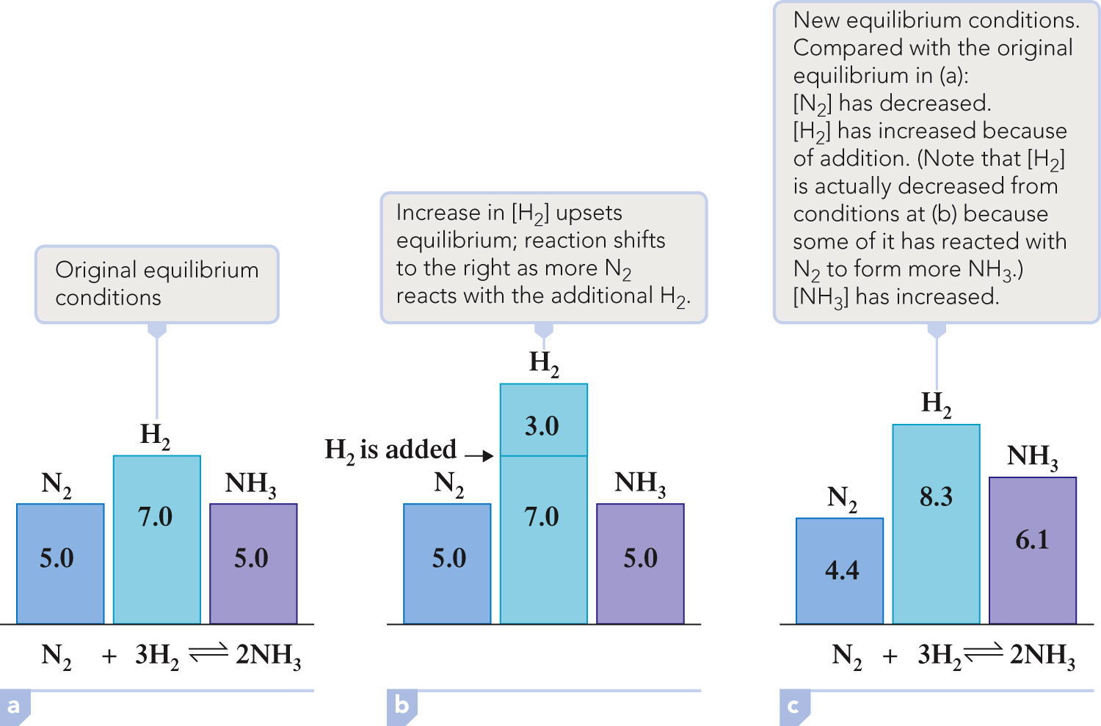
Concentration Changes

Slide 59
Effects of Changes on the System
2. Temperature: K_{eq} will change depending upon the temperature (endothermic – energy is a reactant; exothermic – energy is a product).

Slide 60
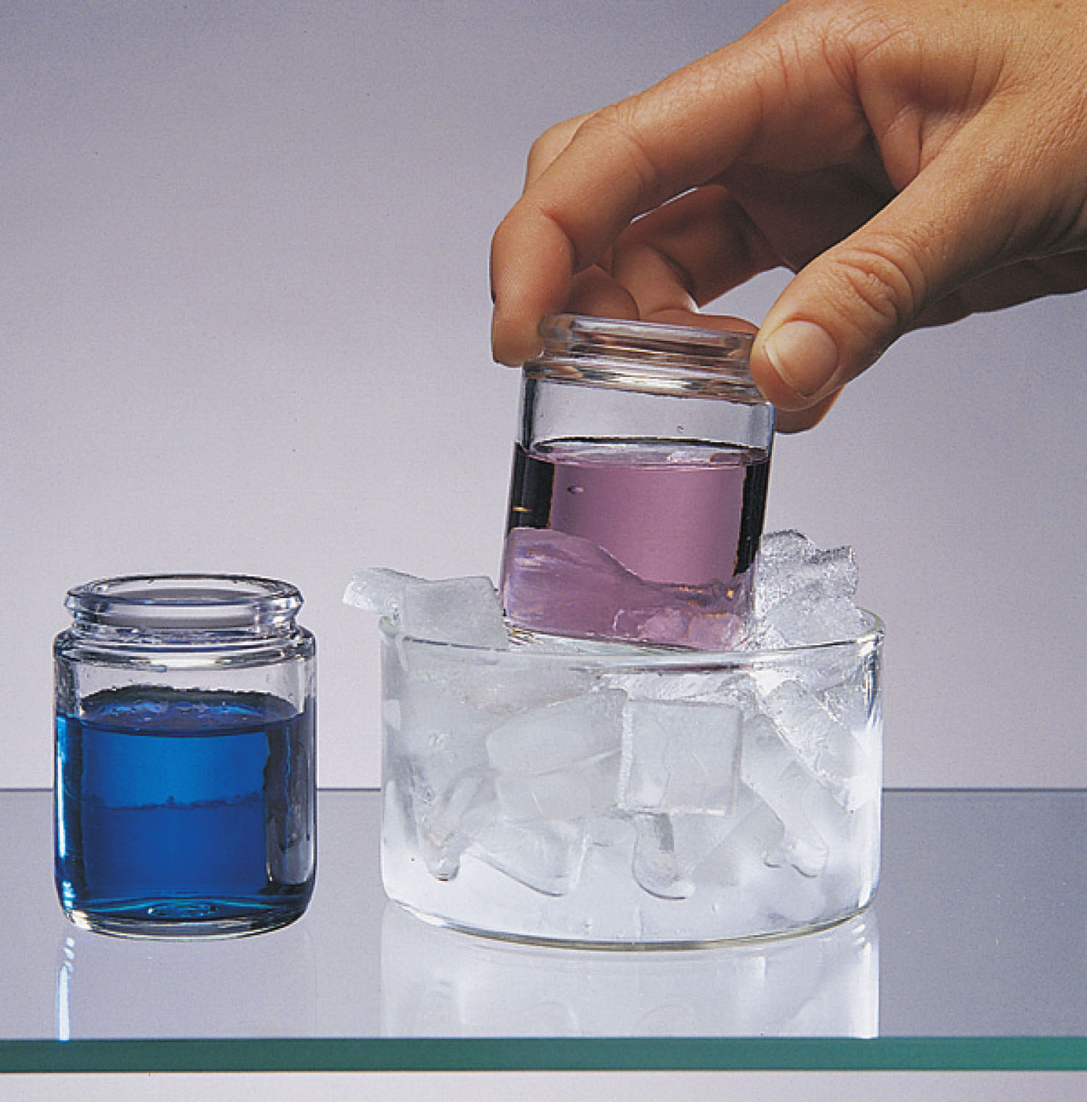
Effect of Temperature Change on an Equilibrium Mixture

Slide 61
Effects of Changes on the System
Pressure:
  The system will shift away from the added gaseous component. If a component is removed, the opposite effect occurs.
  Addition of inert gas does not affect the equilibrium position.
  Decreasing the volume shifts the equilibrium toward the side with fewer moles of gas.

Slide 62
Effects of Changes on the System
4. Addition of Catalysts: Do not change the position of an equilibrium; although equilibrium is established more quickly.

Slide 63

To play movie you must be in Slide Show Mode
PC Users: Please wait for content to load, then click to play
Mac Users: CLICK HERE

Slide 64

Equilibrium Decomposition of N₂O₅
To play movie you must be in Slide Show Mode
PC Users: Please wait for content to load, then click to play
Mac Users: CLICK HERE

