Slide 1
Chemistry 120 Fall 2016
Instructor: Dr. Upali Siriwardane
e-mail: upali@latech.edu
Office: CTH 311
Phone 257-4941
Office Hours: M,W,F 9:30-11:30 am T,R 8:00-10:00 am or by appointment;
Test Dates:
September 23, 2016 (Test 1): Chapter 1,2 &3
October 13, 2016 (Test 2): Chapter 4 & 5
October 31, 2016 (Test 3): Chapter 6, 7 & 8
November 15, 2016 (Test 4): Chapter 9, 10 & 11
November 17, 2016 (Make-up test) comprehensive:
Chapters 1-11

Slide 2
Chapter 8. Solutions.
8-1 Characteristics of Solutions
8-2 Solubility
  Effect of Temperature on Solubility
  Effect of Pressure on Solubility
  Saturated, Supersaturated, and Unsaturated Solutions
  Aqueous and Nonaqueous Solutions
8-3 Solution Formation
  Factors Affecting the Rate of Solution Formation
8-4 Solubility Rules
8-5 Percent Concentration Units
  Percent Concentration
  Using Percent Concentrations as Conversion Factors
  Clinical Laboratory Concentration Units

Slide 3
Chapter 8. Solutions.
8-6 Molarity Concentration Unit
  Using Molarity as a Conversion Factor
8-7 Dilution
8-8 Colloidal Dispersions and Suspensions
8-9 Colligative Properties of Solutions
  Vapor-Pressure Lowering
  Boiling-Point Elevation
  Freezing-Point Depression
8-10 Osmosis and Osmotic Pressure
  Osmosis
  Osmotic Pressure
  Osmolarity
  Hypotonic, Hypertonic, and Isotonic Solutions
Concentration Units for Isotonic Solutions

Slide 4
Characteristics of solutions
Solutions are homogeneous mixtures of two or more substances, within which each component retains its chemical identity (i.e. no chemical reaction occurs between components)
They may be found as
  Liquids (e.g. saline solution, Kool-aid)
  Gases (e.g. air)
  Solids (e.g. brass, bronze)
Solutions are usually described in terms of two basic components:
  Solvent (the component present in the greatest quantity)
  One or more solutes: present in a lower quantity than the solvent.
The solutes are dissolved in the solvent.

Slide 5
Characteristics of solutions
Solutions contain two or more components (solvent and one or more solutes)
Solutions can have variable composition (can vary the solute(s)-solvent ratio)
The properties of a solution will change as the solute(s)-solvent ratio is changed
Dissolved solutes are present as individual particles that “mingle” with the solvent particles (through intermolecular forces of attraction)
Solutes are uniformly distributed within the solution and do not settle out over time
Solvents can generally be evaporated by physical means to obtain the solvent in its original form

Slide 6

Solubility
It is not possible to dissolve infinite amounts of solute in some solvent. Consider what happens when NaCl is dissolved in water. As more and more NaCl is dissolved, eventually, a point is reached where no more will dissolve.
The maximum amount of solute that can be dissolved in a given volume of solvent is called the solubility of that solute. This is usually expressed as grams of solute per liter (or 100 mL) of solvent.
Some solids (and liquids) are soluble in water. Some aren’t very soluble.
  The solubility of NaCl in water is about 360 g/L.*
  AgCl is not very soluble in water. It would take about the volume of water in an 18’ x 36’ swimming pool to dissolve around 1 mg of AgCl.*
* At 20ºC

Slide 7
Solubility
When the maximum amount of solute that can be dissolved in the solvent has been dissolved, the solution is said to be saturated. Saturated solutions often have some undissolved solute present.
Up until this amount of solute has been dissolved, the solution is called unsaturated (meaning it can still dissolve more solute)
Saturated solutions of a solid(s) dissolved in a liquid can be made to dissolve more solute if:
  more solvent is added, or
  the temperature of the solution is increased
If more solute is dissolved in a saturated solution through heating, the resulting solution can be cooled to yield an unstable solution, called a supersaturated solution. This kind of solution will yield solid crystals of solute if it is disturbed (scratch the inside surface or add a “seed crystal” of the solute.
supersaturated solution

Slide 8
Solubility
The solubility of a solid solute in water can be increased by increasing the temperature of the mixture.
If the solution consists of a gas dissolved in a liquid, the gas’s solubility will decrease with increasing temperature.
The solubility of a gas in a liquid can be increased by increasing the partial pressure of the gas above the liquid:
  Henry’s Law: the solubility of a gas in a liquid is directly proportional to the partial pressure of the gas above the liquid

Slide 9
Solubility
Solutions in which the solvent is water are called aqueous solutions (as we talked about in chapter 6 – in a balanced chemical equation, these species are indicated with (aq) after them)
Solutions for which the solvent is not water are called non-aqueous solutions (for example, some solutions employ ethanol as a solvent

Slide 10
Solution formation
When a solvent dissolves a solute, there are several forces that must be overcome:
  Intermolecular attractions between solute particles
  Intermolecular attractions between solvent molecules
When these have been overcome, solvent-solute interactions can lead to solution formation

Slide 11
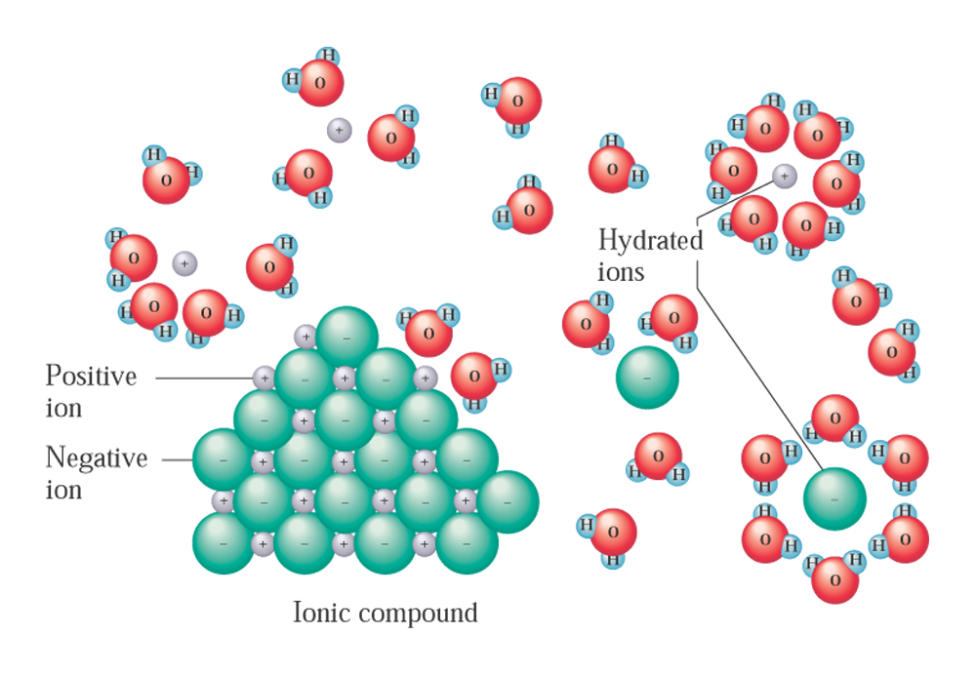
Solution formation

Slide 12
Solution formation
When an ionic solid dissolves in water, water molecules orient themselves in a way that their positive dipoles will interact with anions (negatively charged ions) and their negative dipoles will interact with cations (positively charged ions). These are ion-dipole interactions
After an ion becomes surrounded in this way by water molecules, it is called hydrated (When the solvent isn’t water, the term “solvated” is used.)

Slide 13
Factors affecting the rate of solution formation
The state of subdivision of the solute (the greater the exposed surface area of the solute, the faster it will dissolve)
The degree of agitation during solution preparation (solutes will dissolve faster when the mixture is stirred, as particles are dispersed, increasing the likelihood of solute-solvent interactions)
The temperature of the components (solution formation is faster as the temperature is raised, since the components will possess more kinetic energy)

Slide 14
Solubility rules
As mentioned earlier, AgCl is not very water-soluble.
In general, as the polarity of the solvent and solute become less alike, the less favorable will be interactions between the solute and the solvent.
Substances of like polarity tend to be more soluble in each other than substances whose polarities differ
This rule is very good at predicting solubilities of gases and liquids in liquid solvents. For solid-liquid mixtures, the results for ionic solids are not always in agreement, because:
  Ion-ion interactions are influenced by both ion size and charge

Slide 15
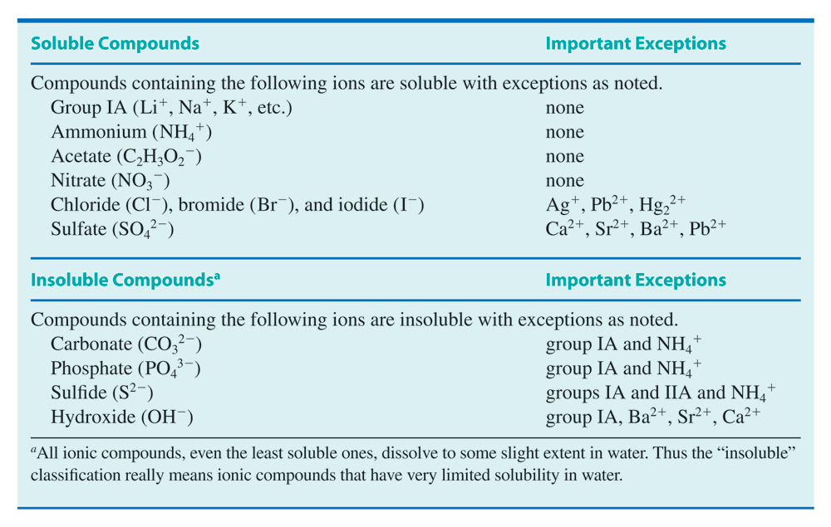
Solubility rules

Slide 16
Solubility rules
With the help of the solubility table, predict the solubility of each of the following solutes in the solvents indicated:
  NO₂ (a polar gas) in water
  CCl₄ (non-polar liquid) in benzene (a non-polar liquid)
  NaBr in water
  MgCO₃ (an ionic solid) in water
  (NH₄)₃PO₄ (an ionic solid) in water

Slide 17
Solution concentration units
The composition of a solution is expressed in terms of its concentration. Concentration indicates the amount of solute that is dissolved in a given quanitity of solution.
Concentration is commonly expressed in one of two ways:
  Percent concentration
  Molarity

Slide 18
Solution concentration units
Percentage concentrations
Three different ways that percent concentrations are expressed are as follows:
  Percent by mass - or mass-mass percent, %(m/m)
  Percent by volume- or volume-volume percent, %(v/v)
  Mass-volume percent, %(m/v)

Slide 19
Solution concentration units
Percent by mass, %(m/m)
Percent by mass is used to express the mass of solute that is dissolved in a total mass of solution. (It is calculated as the mass of solute divided by the total solution mass, multiplied by 100):
A solution that is 5% by mass (or “5%(m/m)”) contains 5 g of solute
for every 100 g of solution (that is, 5 g of solute plus 95 g of solvent)

Slide 20
Solution concentration units
Percent by mass, %(m/m)
Mass-mass percent concentrations are a commonly used figures, since it is easy to measure out the mass of a solid solute and weigh a solution after it is made up.

Slide 21
Solution concentration units
Percent by mass, %(m/m)
Example: what is the percent by mass, %(m/m) concentration of Na₂SO₄ in a solution that is made up by dissolving 7.6g of Na₂SO₄ in enough water to give 87.3g of solution?

Slide 22
Solution concentration units
Percent by mass, %(m/m)
What is the percent by mass of sucrose in a solution that is made up by dissolving 7.6g of sucrose in 83.4g of water?
The total solution mass here would be 7.6g solute + 83.4g solvent = 91g

Slide 23
Solution concentration units
Percent by volume, %(v/v)
Percent-by-volume figures are useful when liquids are dissolved into other liquids.
A 5%(v/v) solution would involve 5 ml of solute per 100 mL of solution.

Slide 24
Solution concentration units
Percent by volume, %(v/v)
Calculate the volume percent of solute in a solution that has 20.0 mL of ethanol dissolved in enough water to make up 475 mL of solution.

Slide 25
Solution concentration units
Percent by volume, %(v/v)
Unfortunately, because volumes are not usually additive when mixtures of two different substances are made, the total volume of solution in these problems is not always easy to determine. (So, the above, 5%(v/v) solution likely doesn’t have 95mL of solvent in it.)

Slide 26
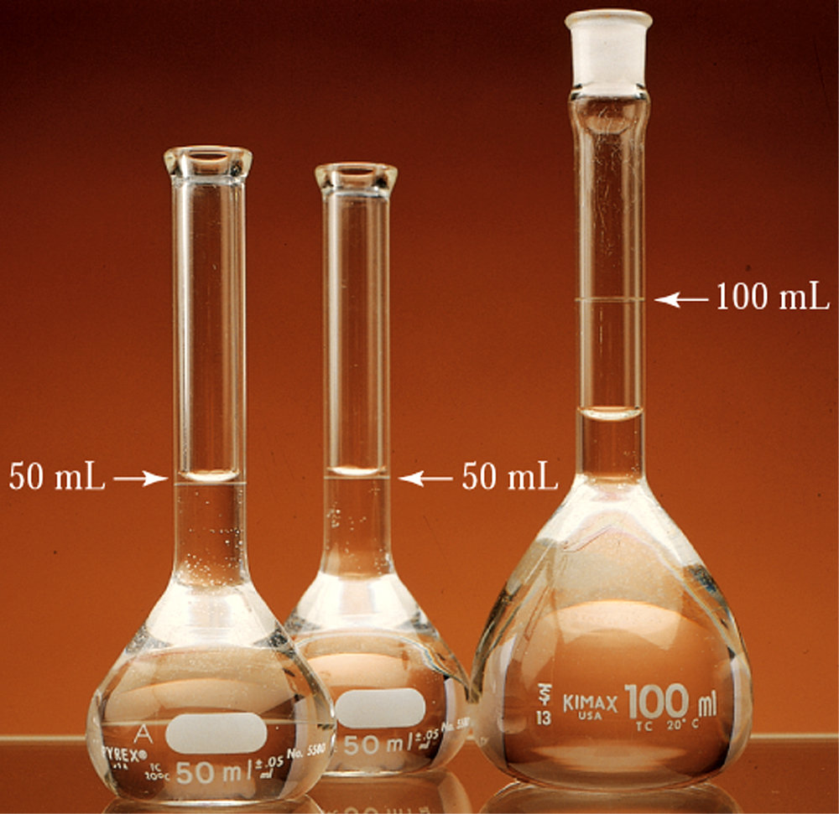
Solution concentration units
50.00 mL ethanol
50.0 mL H₂O
+
50.0 mL ethanol
= 96.5 mL?
50.00 mL H₂O

Slide 27
Solution concentration units
Mass-volume percent, %(m/v)
Mass-volume percent, %(m/v), calculations show the mass of solute (g) that is dissolved in a given volume (mL) of solution.
This unit is most often encountered in clinical settings (mass is easily measured as is solution volume).
A 5%(m/v) solution would have 5g of solute in 100 mL of solution.

Slide 28
Solution concentration units
Mass-volume percent, %(m/v)
How many grams of glucose must be added to prepare 500.0 mL of a 4.50%(m/v) glucose-water solution?

Slide 29
Solution concentration units
Using percent concentrations as conversion factors
It is often necessary to prepare solution of a specific percent concentration. To do this, you’ll need some knowledge of the amount of solute needed and/or the final volume of the solution (or, in this case, the ratio)
How many grams of sucrose must be added to 375g of water to prepare a 2.75%(m/m) solution of sucrose?

Slide 30
Solution concentration units
Using percent concentrations as conversion factors
How many grams of sucrose must be added to 375g of water to prepare a 2.75%(m/m) solution of sucrose?
Don’t know the solution mass here. If we did, we could just plug things into:
…and then solve for the mass of sucrose.
Since we don’t know the total solution mass, we have to determine the mass
of water that is in a 2.75%(m/m) solution. Do this assuming 100 g solution:
100g of solution – 2.75g of sucrose = 97.25 g of water

Slide 31
Solution concentration units
Using percent concentrations as conversion factors
Now, we can make a conversion factor to determine the mass of sucrose needed to be added to the 375g of water
The last calculation tells us that each 2.75g of sucrose needs
to be added to 97.5g of water to make up this solution:

Slide 32
Solution concentration units
Molarity, M
Molarity (M) is more commonly used in labs. Concentration in molarity expresses the amount of solute (in moles, mol) divided by the volume of solution (in liters, L)
A solution that contains one mole of KBr dissolved into a total solution
volume of 1L has a concentration of 1M (it is called a 1 molar solution”)

Slide 33
Solution concentration units
Molarity, M
In order to find the concentration of a solution in molarity, the solution volume needs to be known and the number of moles of solute as well. This may involve a prior calculation if the mass of solute is given instead.

Slide 34
Solution concentration units
Molarity, M
Q: What is the concentration (M) of a solution that is made up by dissolving
12.5g of NaCl in enough water to make up 175 mL of solution?
A: First, how many moles of NaCl is 12.5g of NaCl?...need the molar mass for NaCl
From the periodic table:Na+Cl → 22.99 + 35.45 = 58.44
1 mol NaCl = 58.44g NaCl
need volume in liters!!

Slide 35
Solution concentration units
Molarity, M
How many grams of sucrose (C₁₂H₂₂O₁₁) are present in 185 mL of a 2.50 M solution of sucrose?
Can’t determine this directly from the concentration (it gives moles of
sucrose per liter of solution)
Could determine the number of moles of sucrose in 185 mL of the solution, then
multiply that quantity by the molar mass for sucrose to get mass
Molar mass: 1 mol C₁₂H₂₂O₁₁ = 342.34g C₁₂H₂₂O₁₁

Slide 36
Dilution
Dilution is a technique that permits making a less concentrated solution from a more concentrated one (called a “stock” solution), through the addition of more solvent.
Many medicinal solutions are prepared from stock solutions (It’s easier to prepare a solution of known concentration this way than weighing and dissolving a solute into a solution whose mass or volume must then be measured)
You can use this dilution formula (with any units – must be same on both sides, obviously):
C_{s}V_{s} = C_{d}V_{d}
Concentration of stock solution
Volume of diluted solution
Volume of stock solution
Concentration of diluted solution

Slide 37
Dilution
Here’s a problem that concerns the dilution of a solution whose concentration is given in percent mass-volume:
A nurse wants to prepare a 1%(m/v) silver nitrate solution from 24 mL of a
3%(m/v) stock solution. How many mL of water should be added to the
24 mL of stock solution?
This will be the diluted (final)
volume of the resulting solution.
Thus, the amount of water that
Needs to be added is
72 mL – 24 mL = 48 mL

Slide 38
Dilution
What is the molarity of the solution prepared by diluting 65 mL of 0.95 M Na₂SO₄ solution to a final volume of 135 mL?

Slide 39
Colligative and colloidal properties
Solutions are homogeneous mixtures made by dissolving a solute into a solvent
Dispersions are homogeneous mixtures that contain dispersed particles that are intermediate is size between those of a true solution and those of an ordinary heterogeneous mixture
The terms solute and solvent don’t apply for colloidal dispersions. Instead, the terms dispersed phase (like a solute) and dispersing medium (like a solvent) are used

Slide 40
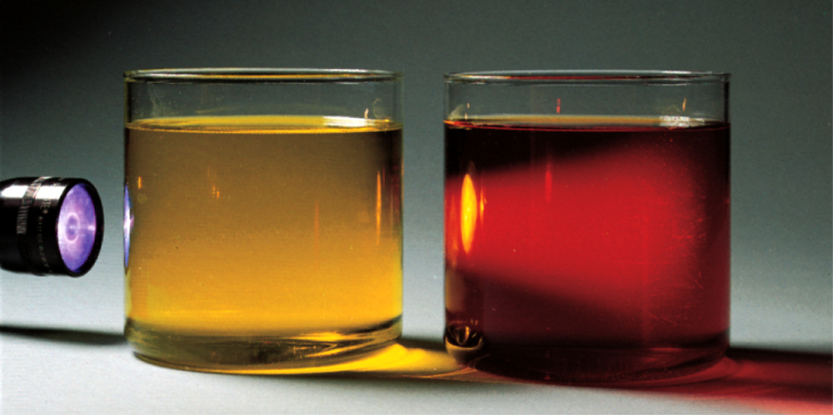
Colligative and colloidal properties
For colloidal dispersions, the situation is similar. Particles are very small, so small that
  They don’t settle out over time under the influence of gravity
  They aren’t able to be detected by the naked eye
  They can’t be filtered using filter paper that has relatively large pores
On the other hand, the presence of the dispersed phase causes the path of a light beam to be discernible
Light beam is scattered
by the dispersed phase.
Called Tyndall scattering
Tyndall effect: the light-scattering phenomenon that causes the path of a beam of light
through a colloidal dispersion to be visible.

Slide 41
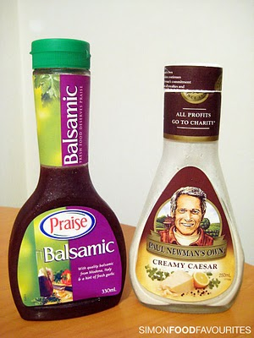
Colligative and colloidal properties
In a dispersion, dissolved particles have sizes of the order of 10⁻⁷cm to 10⁻⁵ cm (nm to hundreds of nm range)
Dissolved ions in solutions, by comparison, have diameters less than 10⁻⁷ cm
In mixtures that have particles of diameters that are greater than 10⁻⁵ cm, the particles tend to settle out over time. Such mixtures are called suspensions, and a good example of a suspension is muddy water (though another example would be salad dressing)

Slide 42
Colligative properties of solutions
When a solute is added to a solvent, the physical properties of the resulting solution are different that the pure solvent.
Colligative properties are physical properties of solutions that depend on the number (concentration) of solute particles (molecules or ions) in a given quantity of solvent, and not on their chemical identities.
Colligative properties of solutions:
  Vapor pressure
  Boiling point elevation
  Freezing point depression
  Osmotic pressure

Slide 43
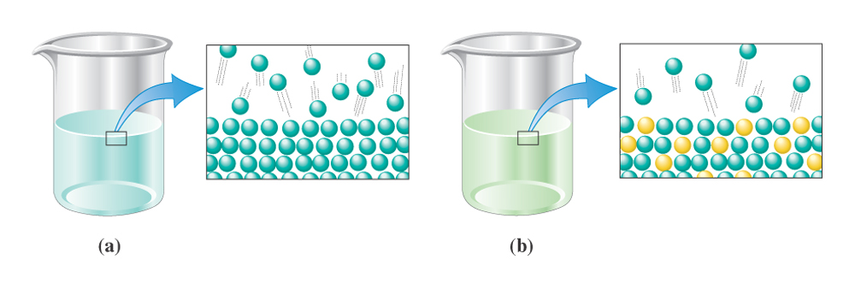
Colligative properties of solutions
Effect of adding solute on vapor pressure
When a non-volatile solute is added to a solvent, the vapor pressure of that solvent decreases.
Solute particles can occupy surface position in the mixture.
This lowers the number of solvent particles at the surface and reduces the amount
of evaporation that can occur.
As the number (concentration) of solute particles increases, the vapor pressure of the
resulting solutions become lower and lower

Slide 44
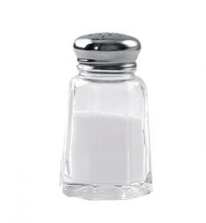
Colligative properties of solutions
Effect of adding solute on boiling point
By the same effect, since the vapor pressure of a solvent becomes lowered as non-volatile solutes are added, the boiling points of solvents become increased with the addition of non-volatile solutes.
As the vapor pressure of a solvent becomes lowered with the addition of more and more solute, more thermal energy is required to make the vapor pressure of the resulting solution equal to the external pressure (i.e. the point at which boiling occurs)
The addition of table salt to water results in a solution
that has a higher boiling point than pure water

Slide 45
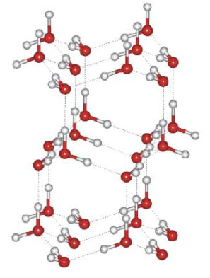
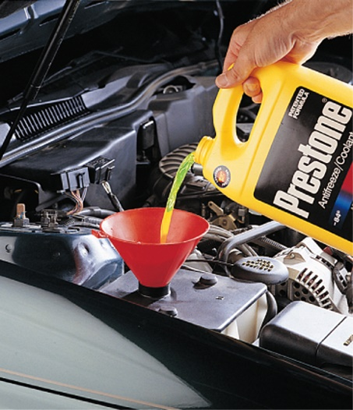
Colligative properties of solutions
Effect of adding solute on freezing point
The addition of solutes to a pure solvent also has the effect of lowering the solvent freezing point.
The added solute particles interfere with the solvent molecules’ ability to form regular, crystalline structures.
Consequently, lower temperatures must be used to drive the freezing process.

Slide 46
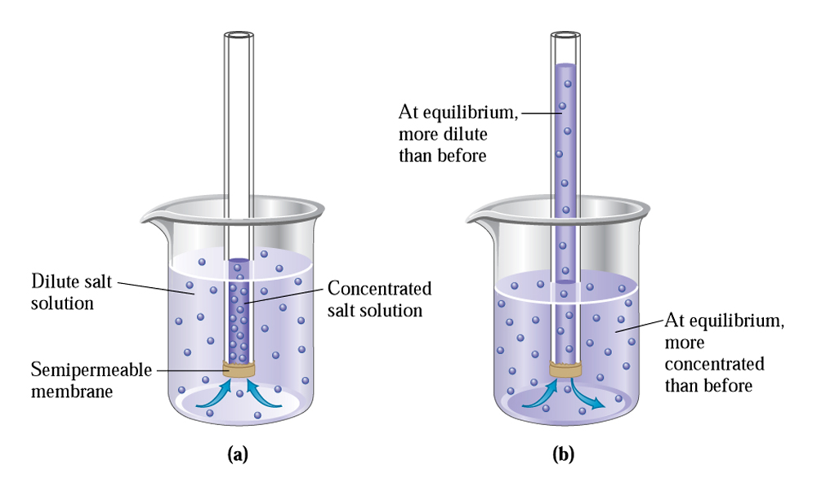
Osmosis and osmotic pressure
Osmosis
Osmosis is the passage of solvent through a semi-permeable membrane that separates a dilute solution from one that is more concentrated.

Slide 47
Osmosis and osmotic pressure
Osmosis
Solvent molecules can move through the membrane (the pores of the membrane are larger than the size of water molecules, assuming an aqueous mixture)
The figure shows two solution zones: one has a higher solute concentration (inside the tube) than the other
The solvent molecules tend to move through the semi-permeable membrane, causing the solution level in the tube to rise (and cause it to drop in the beaker)

Slide 48
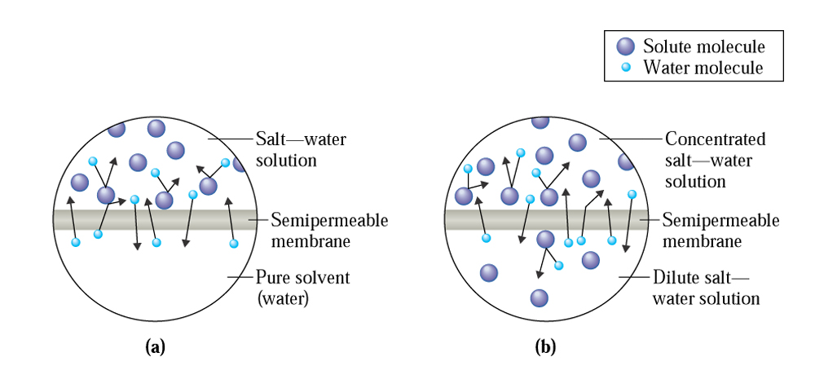
Osmosis and osmotic pressure
Osmosis
On a molecular level, the rate of solvent flow into the tube is greater than the rate flowing in the other direction because on the side that has the higher solute concentration, solute molecules block the outward movement of the solvent.
On the other side, there are fewer solute molecules getting in the way, so the movement of solvent molecules in this direction (into the tube) is less impeded
Transfer of solvent molecules across membrane occurs until either; 1) the concentrations
of solute on both sides are equal or, 2) the hydrostatic pressure in the column becomes
too high to allow further movement of solvent molecules into the tube

Slide 49
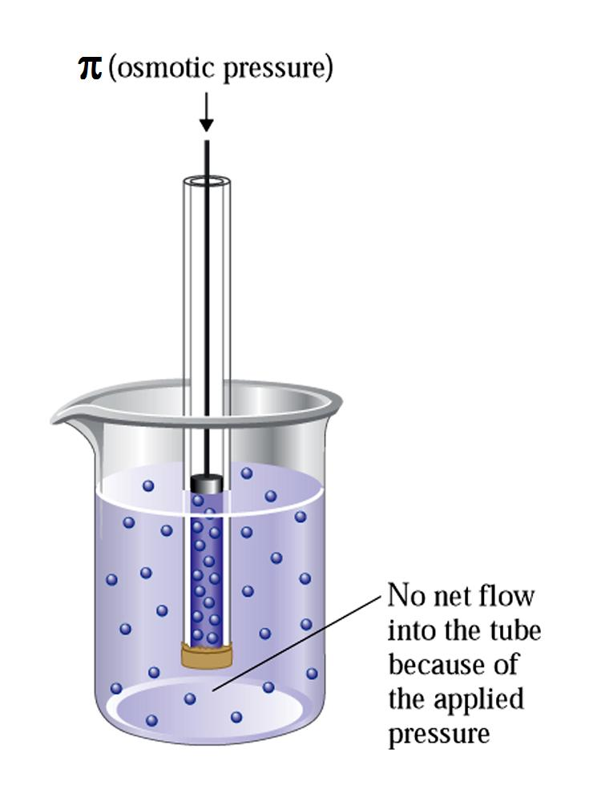
Osmosis and osmotic pressure
Osmotic pressure
Osmotic pressure is the pressure that must be applied to prevent the net flow of solvent through a semi-permeable membrane from a more dilute solution to a more concentrated one.
Osmotic pressure could be measured using an apparatus like the one shown.

Slide 50
Osmosis and osmotic pressure
Osmotic pressure and osmolarity
Osmolarity is a concentration unit that can be used to predict osmotic pressure. It is the product of a solute’s molarity and the number of solute particles produced per formula unit of dissolved solute
Osmolarity=(molarity) x (i)
For example, if you were to compare the osmotic pressures of a 1M NaCl solution and a 1M glucose solution, the NaCl solution would exhibit twice as high an osmotic pressure.
Units = “osmol”

Slide 51
Osmosis and osmotic pressure
Hypotonic, hypertonic, and isotonic solutions
The terms, hypotonic, hypertonic, and isotonic solutions refer to osmotic-type phenomena that occur in the human body
Usually these terms are referenced to the osmotic pressure of cells (e.g., red blood cells)
Hypotonic solutions are solutions that exert a lower osmotic pressure than the solution contained inside cells
Hypertonic solutions exert a higher osmotic pressure than cellular solutions
Isotonic solutions have the same osmotic pressure as cellular solutions

Slide 52
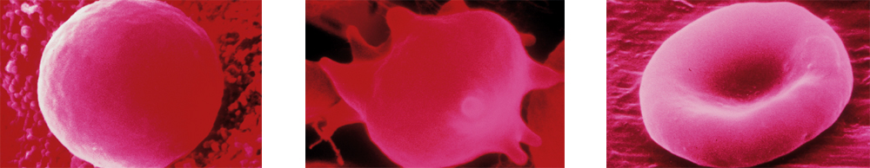
Osmosis and osmotic pressure
When red blood cells are placed in hypotonic solutions (e.g. pure water), water moves through the cell membrane into the cell and results in an increase in cell volume, which results in the cells finally rupturing. The process is known as hemolysis.
Hemolysis

Slide 53
Osmosis and osmotic pressure
When red blood cells are placed an a hypertonic solution, the opposite effect results. NaCl solutions having greater than 0.9%(m/v) NaCl are hypertonic.
Water leaves the cell and the cell structure is again adversely affected (“crenation”)
Crenation

Slide 54
Osmosis and osmotic pressure
Isotonic solutions exert the same osmotic pressure as the cell solution, so there is no net outward or inward migration of solvent molecules.
Red blood cells places in isotonic solutions (e.g. 5%(m/v) glucose) are stable.
Intravenous solutions will often use isotonic solutions for the introduction of nutrients to the body.
in an isotonic solution

Slide 55
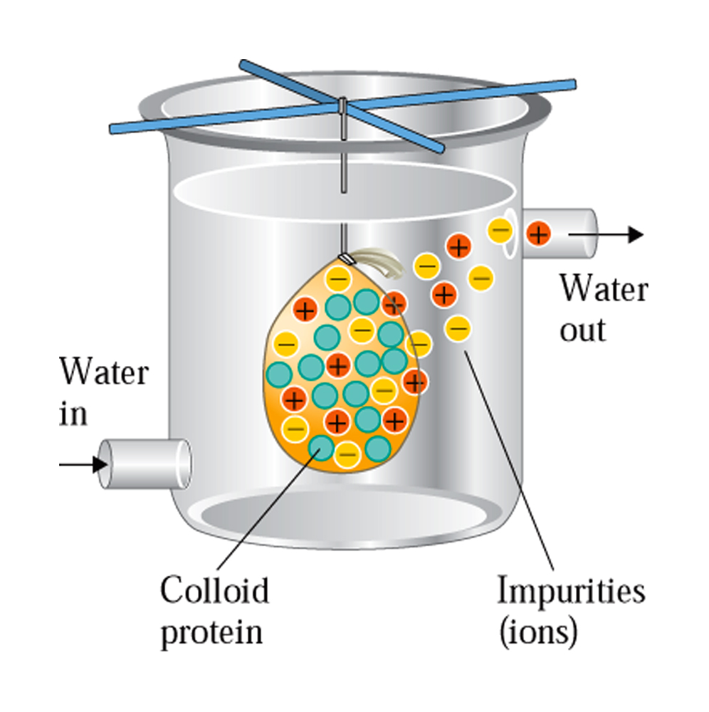
Dialysis

