Slide 1
Chemistry 120 Fall 2016
Instructor: Dr. Upali Siriwardane
e-mail: upali@latech.edu
Office: CTH 311
Phone 257-4941
Office Hours: M,W,F 9:30-11:30 am T,R 8:00-10:00 am or by appointment;
Test Dates:
September 23, 2016 (Test 1): Chapter 1,2 &3
October 13, 2016 (Test 2): Chapter 4 & 5
October 31, 2016 (Test 3): Chapter 6, 7 & 8
November 15, 2016 (Test 4): Chapter 9, 10 & 11
November 17, 2016 (Make-up test) comprehensive:
Chapters 1-11

Slide 2
Chapter 7. Gases, Liquids, and Solids
7-1 The Kinetic Molecular Theory of Matter
7-2 Kinetic Molecular Theory and Physical States
7-3 Gas Law Variables
  Pressure Readings and Significant Figures
7-4 Boyle’s Law: A Pressure–Volume Relationship
7-5 Charles’s Law: A Temperature–Volume Relationship
7-6 The Combined Gas Law
7-7 The Ideal Gas Law
7-8 Dalton’s Law of Partial Pressures
7-9 Changes of State

Slide 3
Chapter 7. Gases, Liquids, and Solids
7-10 Evaporation of Liquids
  Rate of Evaporation and Temperature
7-11 Vapor Pressure of Liquids
7-12 Boiling and Boiling Point
  Conditions That Affect Boiling Point
7-13 Intermolecular Forces in Liquids
  Dipole–Dipole Interactions
  Hydrogen Bonds
London Forces

Slide 4
Chapter 7
Gases, liquids, and solids

Slide 5
The kinetic molecular theory of matter
It is easy to distinguish solids, liquids, and gases, using the following characteristics:
  Volume/shape (see chapter 1)
  Density (chapter 1)
  Compressibility: a measure of the change in the volume of a sample of matter resulting from a pressure change
  Thermal expansion: a measure of the change in volume of a sample of matter resulting from a temperature change

Slide 6
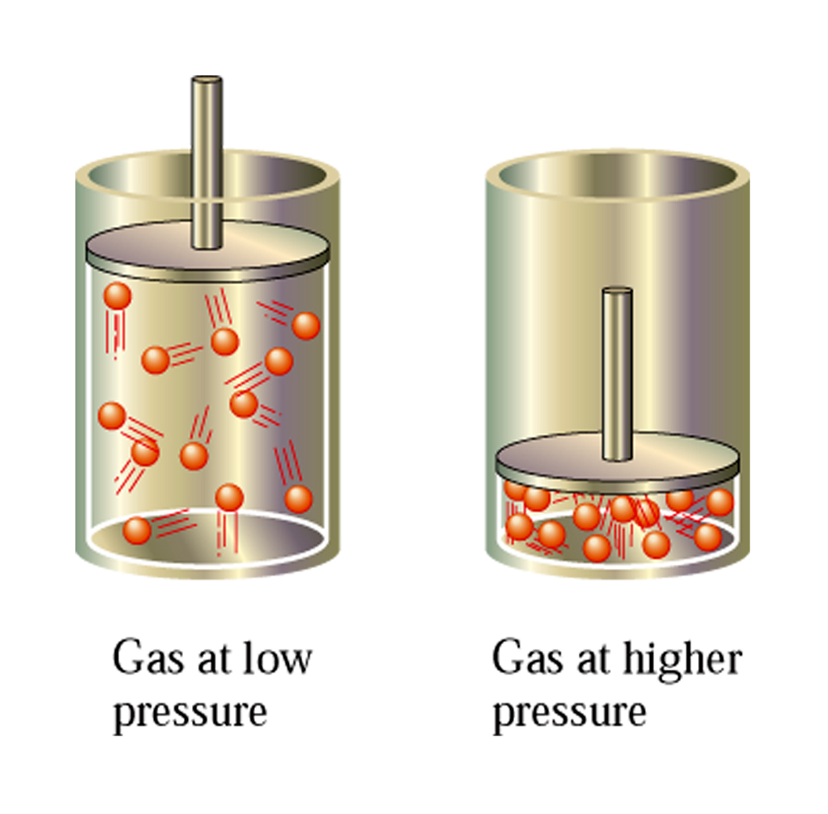
Compressibility of a gas

Slide 7
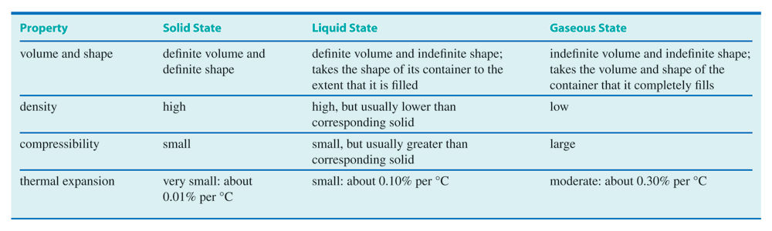
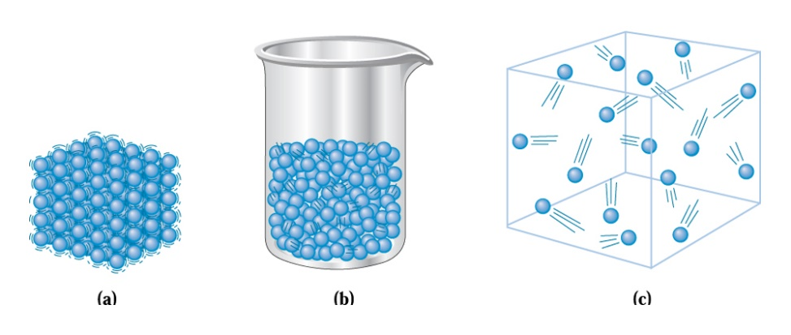
The kinetic molecular theory of matter

Slide 8
The kinetic molecular theory of matter
The physical behavior of the three states of matter (solids, liquids, gases) can be explained by a set of five statements, called kinetic molecular theory, the basic idea being that particles that make up any substance are continually in random motion.
  1) Matter is composed of tiny particles (atoms, ions, or molecules) that have definite and characteristic sizes (volume, mass) that do not change
  2) The particles in a substance are in constant, random motion, and therefore possess kinetic energy (the energy an object possesses because of its motion)
  3) Particles interact with one another through attractions and repulsions, and therefore possess potential energy (the energy that matter possesses by virtue of its position, condition, and/or composition). The most significant potential energy we’ll consider in most exercises is electrostatic attraction.
  4) The kinetic energy of the particles in a substance increase in proportion to an increase in the absolute temperature
  5) Particles in a substance transfer energy to other particles in the substance through elastic collisions

Slide 9
The kinetic molecular theory of matter
Potential and kinetic energies of the particles that make up a substance are what determines the physical state of that substance (solid, liquid, or gas)
  Kinetic energy results from particles’ motions and can be thought of as a disruptive force that tends to cause particles to behave increasingly independently
  Potential energy that exists between particles can be thought of as cohesive, yielding more ordered systems
The physical state of the substance is results from a competition between these forces. Kinetic energy is temperature-dependent, so as temperature increases, the particles that make up a substance tend to move increasingly independently.

Slide 10
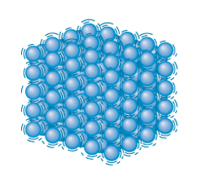
Kinetic molecular theory and physical states
Particles in solids are dominated by the cohesive forces that exist between them. This draws the particles close together so that they occupy fixed positions (can still vibrate as a result of kinetic energy).
Properties of solids:
  Definite volume and shape
  High density
  Small compressibility
  Very small thermal expansion

Slide 11
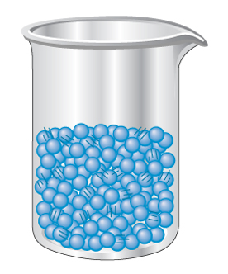
Kinetic molecular theory and physical states
In liquids, disruptive (kinetic energy) and cohesive (potential energy) forces are of about the same magnitude. Particles (molecules, atoms, ions) remain closely packed, but are capable of motion (random), moving past other particles but not with enough energy to become separated from other particles nearby.
Properties:
  Definite volume and indefinite shape
  High density
  Small compressibility
  Small thermal expansion

Slide 12
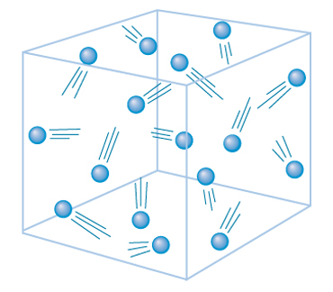
Kinetic molecular theory and physical states
Gases are characterized by complete dominance of disruptive forces (kinetic energy) over cohesive (potential energy) forces, resulting in a state in which the particles behave independently of one another. Attractive forces here are very weak.
Properties:
  Indefinite volume and indefinite shape
  Low density
  Large compressibility
  Moderate thermal expansion

Slide 13
Gas law variables
Gas behavior is described reasonably well by simple quantitative relationships called gas laws, which describe, in mathematical terms, relationships between the pressure and temperature that a gas is subjected to, as well as the volume the gas occupies.
The gas laws will involve the use of conversion factors that will typically involve combinations of the following units:
  Moles, mol
  Liters, L (milliliters, mL)
  Kelvin, K
  Millimeters of mercury in a barometer (mm Hg, also called torr)
Four variables are needed to completely discuss a gas:
pressure, temperature, volume, and amount of gas

Slide 14
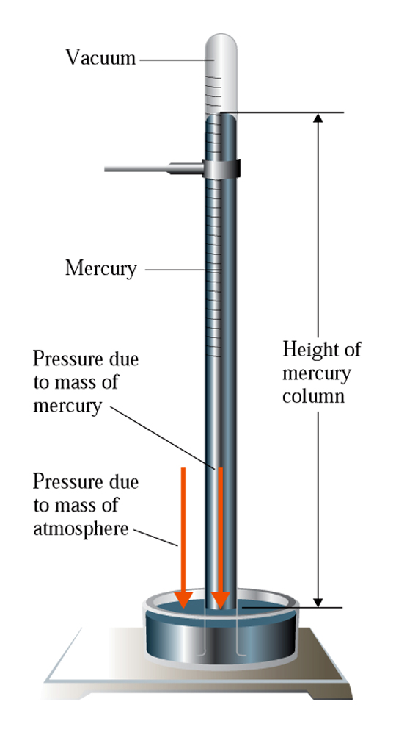
Gas law variables
Pressure is a key descriptor of a gas. The pressure that a gas generates results from collisions of gas molecule with the walls of the container the gas occupies.
These collisions create a force, which is distributed over a surface area:
1mm Hg = 1 torr
760 mm Hg = 1 atm = 14.7 psi
(pounds-per-
square-inch)
At sea-level, atmospheric pressure is 760 mm Hg (or 1 atmosphere

Slide 15
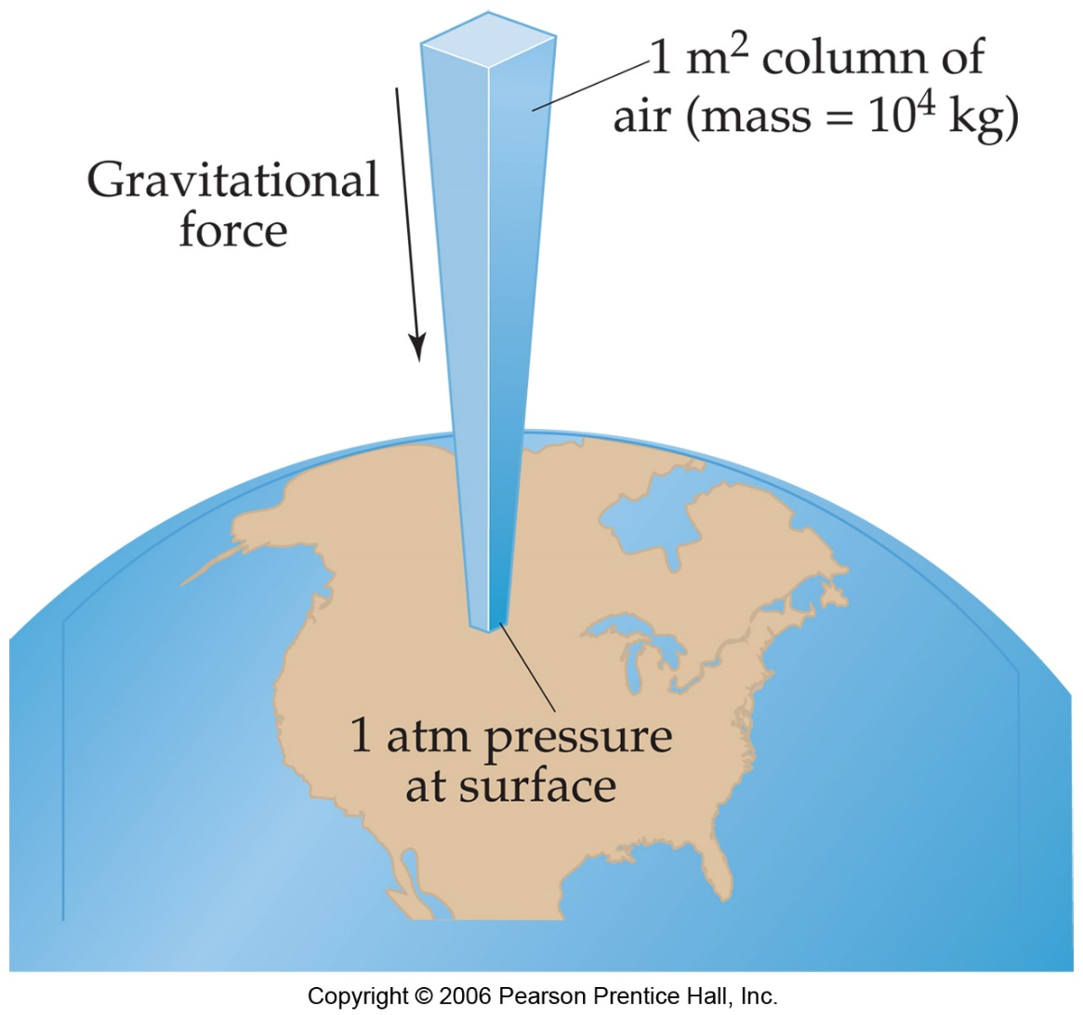
Gas law variables

Slide 16
Gas law variables
Standard procedure for reporting pressures reading barometers is to record the pressure to the nearest mm Hg. Thus, when you see pressures reported in the text as 750 mm Hg or 700 mm Hg, the uncertainty in the number is in the “ones column”
These figures are understood to have three significant digits.

Slide 17
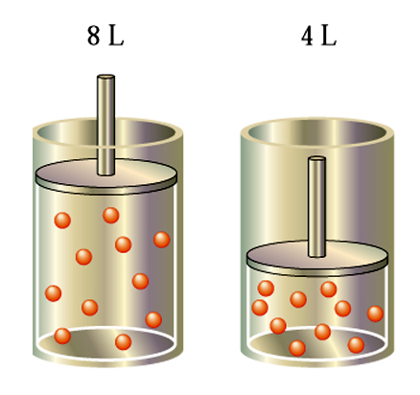
Boyle’s law: a pressure-volume relationship
Boyle’s law states that the volume of a fixed amount of gas (at constant temperature) is proportional to the pressure applied to it.
Example: a gas in an 8 L container has a pressure of 5 atm. If the volume of the container is changed to 4 L (half the initial volume) then the pressure of the gas will double (it will become 10 atm), provided the temperature of the gas is held constant.
P = 5 atm
P = 10 atm

Slide 18
Boyle’s law: a pressure-volume relationship
The equation that expresses Boyles law is:
Equation holds as long as T (temperature) is constant
P₁ = pressure of the gas under the first set of conditions
V₁ = volume of the gas under the first set of conditions
P₂ = pressure of the gas under the second set of conditions
V₂ = volume of the gas under the second set of conditions

Slide 19
Boyle’s law: a pressure-volume relationship
A sample of H₂ gas occupies a volume of 2.25 L at a pressure of 628 mm Hg and a temperature of 35ºC. What volume will it occupy (L) if the pressure is decreased to 428 mm Hg while the temperature is held constant?
Sets of conditions:
Pressure = 628 mm Hg; V = 2.25 L
Pressure = 428 mm Hg, V = ?

Slide 20
Charles’s law: a temperature-volume relationship
Charles’s law tells us that the volume of a fixed amount of gas is proportional to the absolute (Kelvin) temperature of the gas, provided the pressure of the gas is held constant.
V₁ = volume of gas in first set of conditions
T₁ = temperature of gas (in K), first set of conditions
V₂ = volume of gas, second set of conditions
T₂ = temperature of gas (in K), second set of conditions

Slide 21
Charles’s law: a temperature-volume relationship
A sample of dry air with a volume of 125 mL at a temperature of 53ºC is heated at a constant pressure to 95ºC. What is the new volume (mL) of the sample?
Conditions:
Volume = 125 mL; temperature = 53ºC (= 326K)
Volume = ?; temperature = 95ºC (= 368K)
Going from the first set of conditions
to the second, the temperature increased.
Charles’s law tells us that the volume will
increase in proportion to the increase in
the absolute temperature of the gas.

Slide 22
Combined gas law
Boyle’s law tells us that the volume occupied by a gas is inversely proportional to the pressure of the gas (constant T and n)
Charles’s law tells us that the volume of a gas is directly proportional to the temperature of the gas (constant P and n)
If both pressure and temperature vary, the volume of a gas can be calculated using the combined gas law:

Slide 23
Combined gas law
A helium-filled balloon, when released, has a volume of 10.0 L at 27ºC and a pressure of 663 mm Hg. What volume, in liters, will the balloon occupy at an altitude where the pressure is 96 mm Hg and the temperature -30.0ºC?
Conditions:
Volume = 10.0 L; temperature = 27ºC (= 300K); pressure = 663 mm Hg
Volume = ?; temperature = -30.0ºC (= 243K); pressure = 96 mm Hg

Slide 24
The ideal gas equation
The ideal gas equation describes the relationships between pressure, volume, temperature, and amount of gas (moles).
A constant, R, permits conversion of units. Its value depends on the units of pressure and volume used:

Slide 25
The ideal gas equation
Calculate the volume (L) occupied by 3.25 moles of Cl₂(g) at 1.54 atm pressure and a temperature of 213ºC.
213ºC + 273 = 486K

Slide 26
Dalton’s law of partial pressures
The collisions of gas molecules with the container walls creates gas pressure.
It doesn’t matter what kind of gas molecule creates this pressure.
Thus, in a mixture of gases, the total pressure exerted by the gas mixture is the sum of the pressures exerted by each of the gases in the mixture.
P_{total} = P_{A} + P_{B} + P_{C} + …

Slide 27
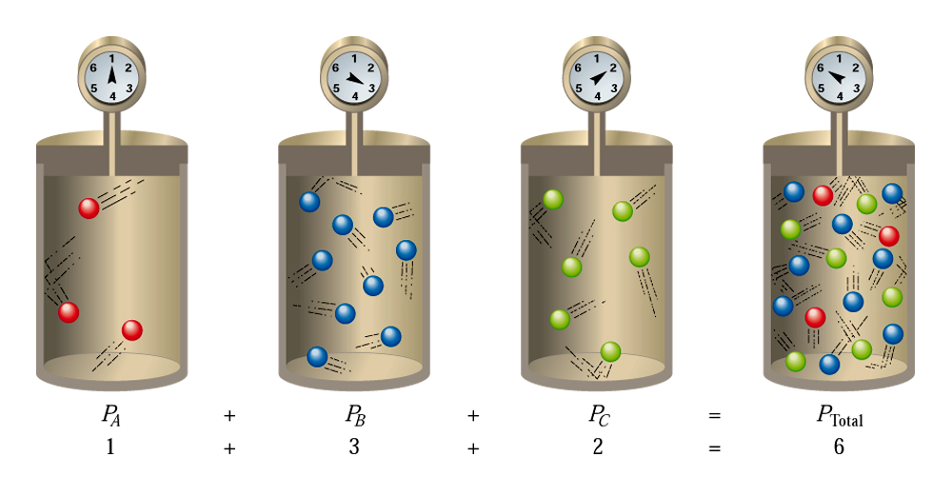
Dalton’s law of partial pressures
The pressures exerted by each gas in the mixture are called partial pressures.
The partial pressure of a gas is the pressure that would be exerted by a gas in a mixture of gases if it were present alone under the same conditions

Slide 28
Dalton’s law of partial pressures
In this week’s lab, you’ll collect H₂(g) over water (makes it easier to determine the volume of gas).
Water evaporates at temperatures above 0ºC. Thus, in the experiment, the pressure of the gas you’ll collect will partially be due to H₂(g), and partially due to H₂O(g)
P_{total} = P_{H2} + P_{H2O}

Slide 29
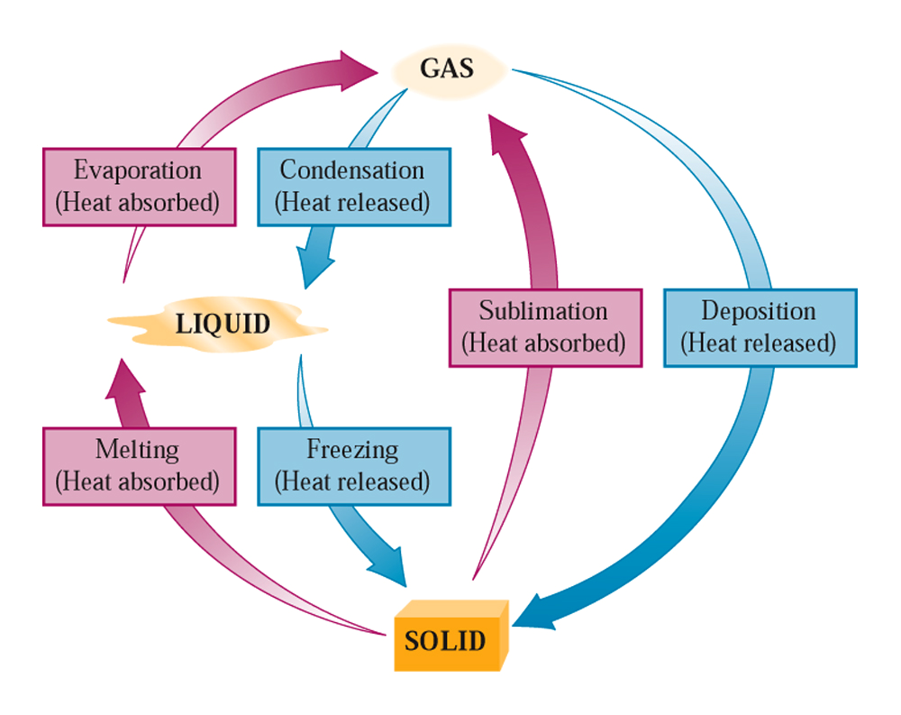
Changes of state
Endothermic: heat is absorbed by a substance (or reaction) as some process happens
Exothermic: heat is released by a substance (or reaction) as some process occurs

Slide 30
Evaporation of liquids
Evaporation is the process by which liquids escape from the liquid state to the gas state
Molecules in the liquid state must acquire enough kinetic energy to overcome their attractions to other molecules in the liquid. They can obtain this energy from heat (and collisions with other molecules)
Evaporation happens at the interface of a liquid and a gas (at the surface) – there are fewer attractions to other liquid molecules at the surface

Slide 31
Evaporation of liquids
Evaporation cools a liquid. As the most energetic molecules of the liquid (the ones at the highest temperature) exit to the gas phase, the temperature of the liquid drops.
Vapor is a gas that exists as a liquid at temperatures and pressures at which it would normally be thought of as a liquid (or solid)

Slide 32
Vapor pressure of liquids
A glass of water left on a countertop overnight will slowly evaporate. We know this because the level of the water in the glass drops with time
In a closed container, evaporation still happens, but the gas molecules formed cannot leave the container. They can be re-captured by the liquid phase and brought back into that phase
A cycle of evaporation-condensation occurs.
Initially, the rate of evaporation is fast (and condensation is slow), but as more gas is formed, collisions between the gas molecules and the surface of the liquid are more frequent, resulting in an increasing rate of condensation
At some point, these rates become equal (equilibrium)
Equilibrium: a condition in which two opposed processes have the same rate

Slide 33
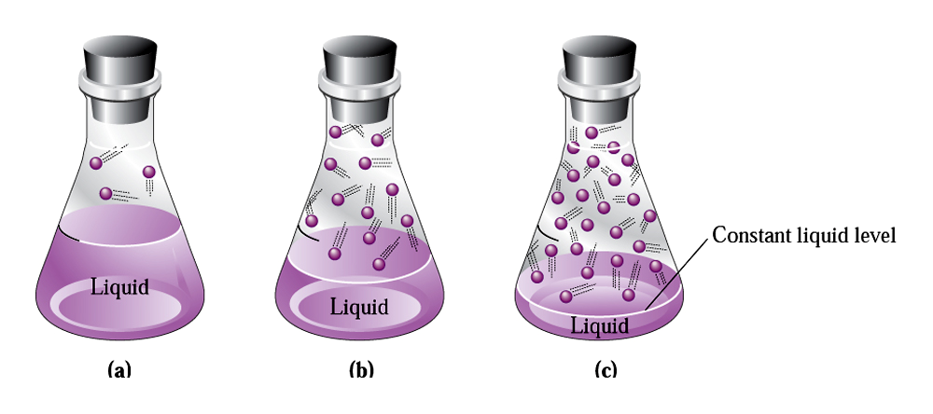
Vapor pressure of liquids
- The pressure exerted by a vapor in equilibrium with a liquid in a closed container
is constant and is called the vapor pressure.
- Vapor pressure is influenced by temperature and also by the nature of the liquid.
- Some liquids consist of molecules that have very weak attractive forces between them.
- These liquids evaporate easily. They have high vapor pressures (called volatile)

Slide 34
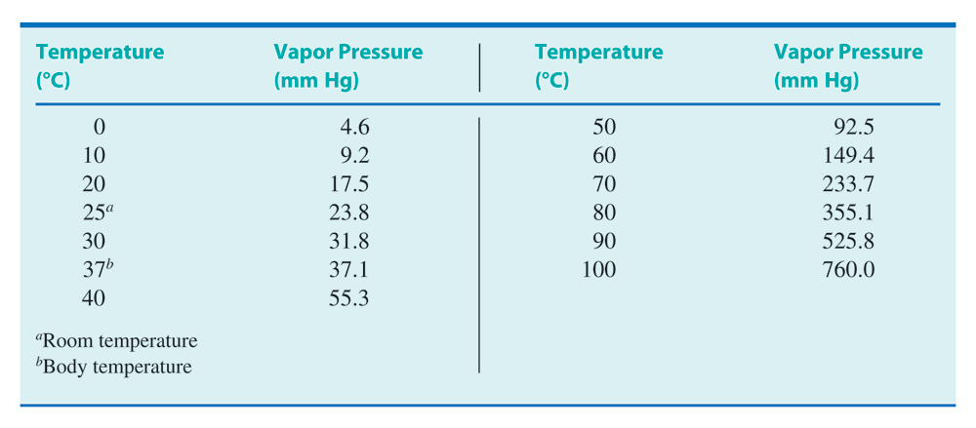
Vapor pressure of liquids
Vapor pressure increases with increasing temperature

Slide 35
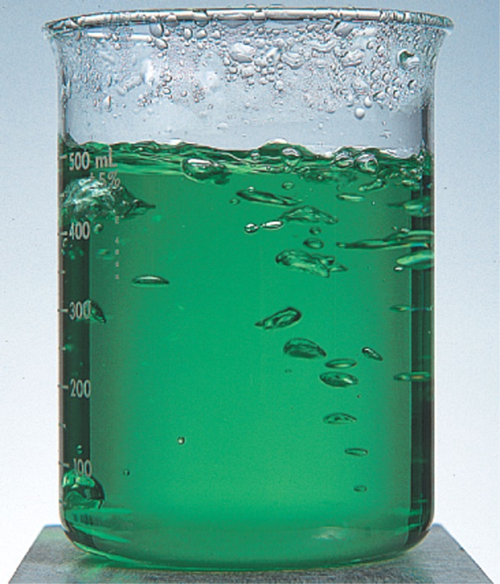
Boiling and boiling point
Evaporation occurs at the air-liquid interface.
If the temperature of the liquid is made high enough, evaporation from the interior of the liquid can be made to occur (in bubbles)
Boiling is a kind of evaporation in which the liquid-to-gas change of state occurs within the body of the liquid
This transformation happens when the vapor pressure of the liquid becomes equal to the external (room) pressure above the liquid
The boiling point is the temperature at which the liquid’s vapor pressure equals the external pressure

Slide 36
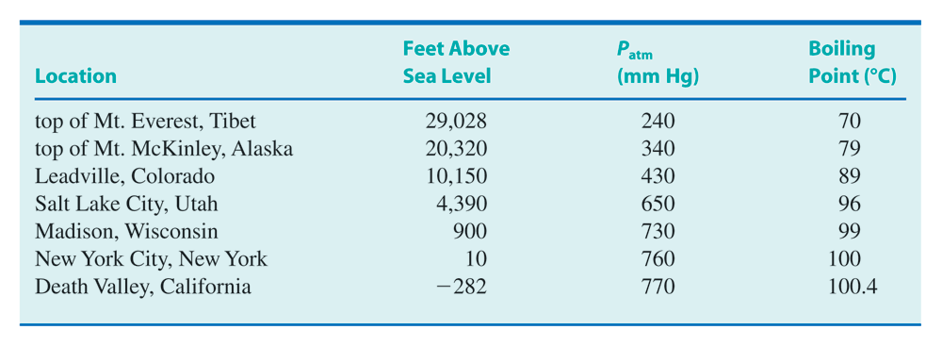
Boiling and boiling point
The factor that has the greatest influence on a liquid’s boiling point is the external pressure.
Increasing the external pressure causes the boiling point to increase, while decreasing it will lower the boiling point.

Slide 37
Intermolecular forces in liquids
Intermolecular forces are attractive forces that operate between molecules. They consist of:
  Dipole-dipole forces
  Hydrogen bonding
  London forces
  Ion-dipole forces (we won’t examine these)
Intramolecular forces operate within a single molecule. We already looked at one of these (covalent bonding)
In terms of relative strengths, intramolecular forces are usually much stronger than intermolecular forces

Slide 38
Intermolecular forces in liquids
Intermolecular forces are cohesive forces – they hold molecules close to each other. Therefore, if the intermolecular forces in a liquid are strong, it is difficult for these molecules to evaporate
For these liquids, boiling points are high (and they are considered to be non-volatile)

Slide 39
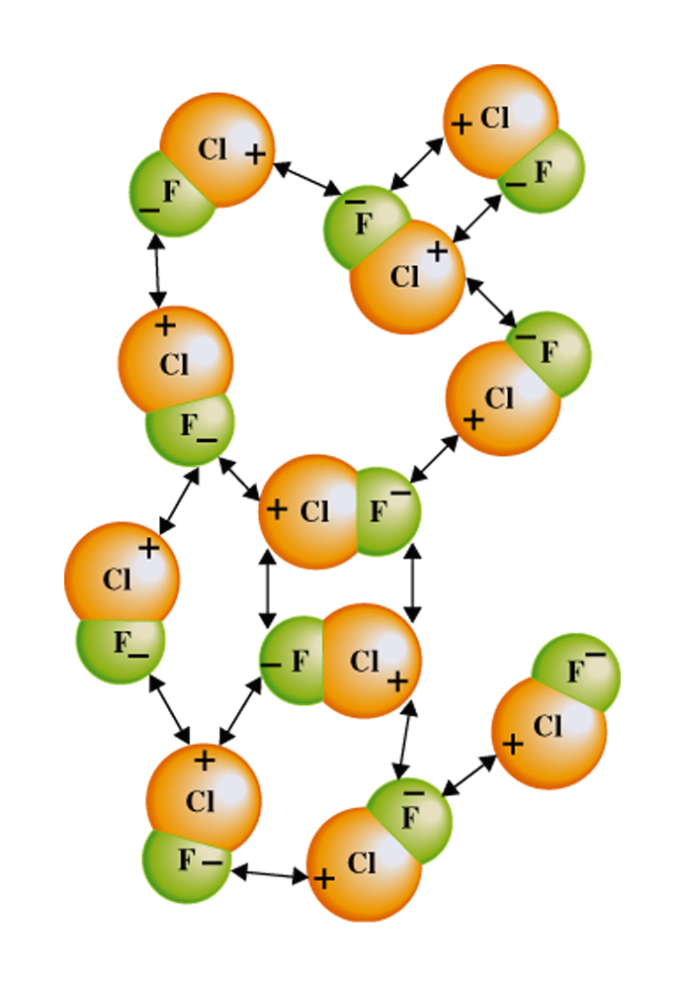
Intermolecular forces in liquids
Dipole-dipole interactions are intermolecular forces that result from interactions between polar molecules
The negative “pole” of a polar molecule interacts with the positive “pole” of a second molecule. (The resulting electrostatic attraction is the dipole-dipole interaction)
The more polar the molecule, the stronger are the dipole-dipole forces
To have dipole-dipole forces, molecules of the liquid must be polar

Slide 40
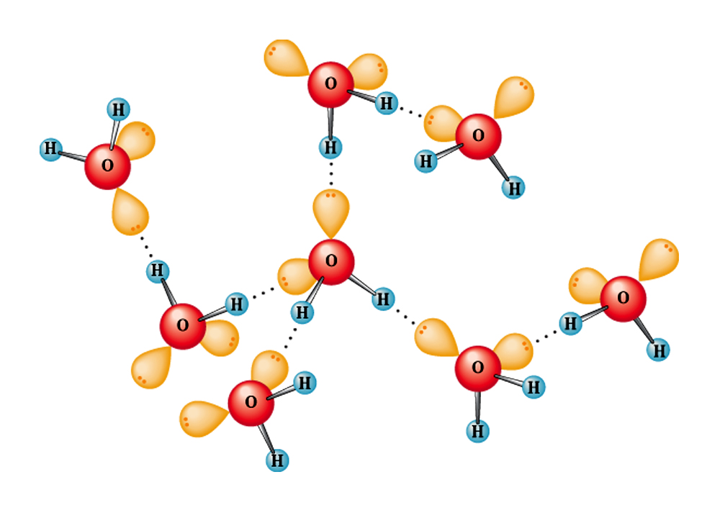
Intermolecular forces in liquids
Hydrogen bonding is a special case of dipole-dipole interaction, occurring in hydrogen-containing molecules where hydrogen is bonded to either O, N, or F (all very electronegative atoms)
This makes for a very polar bond in which the hydrogen side is essentially a bare nucleus
The H-atom inn such a bond can interact very strongly with the non-bonding pairs on O, N, and F-atoms of other molecules
H-bonding is the strongest intermolecular force
To exhibit H-bonding, molecules must possess H-X bonds, where X = O, N, or F.

Slide 41
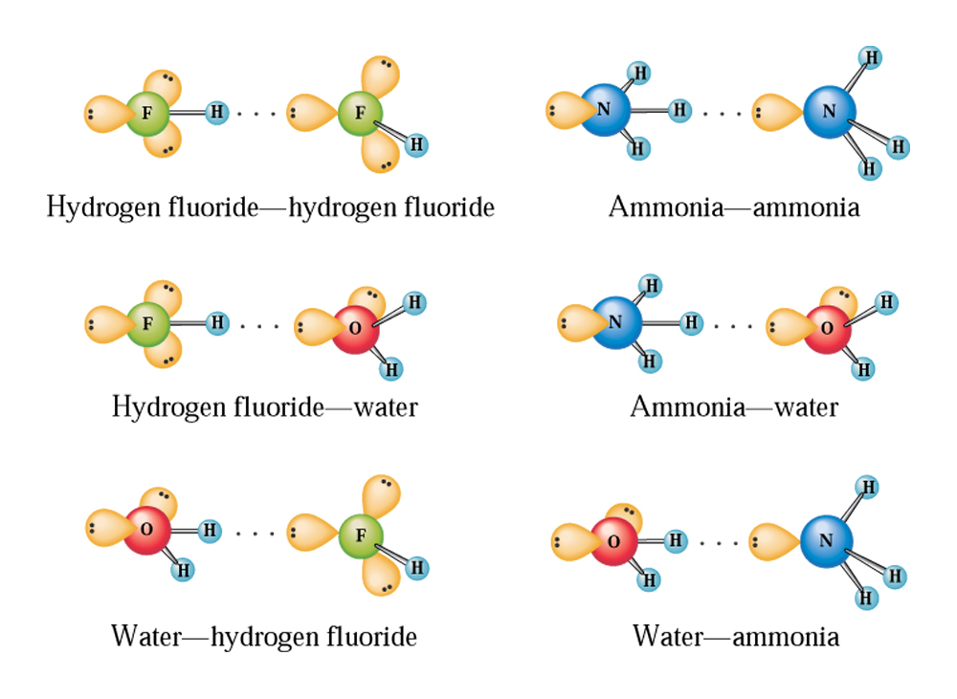
Intermolecular forces in liquids
H-bonding doesn’t need to occur between atoms of the same type. The H-bond just needs to involve:
  A H-atom bonded to O, N, or F
  A non-bonding pair of electrons on a second O, N, or F-atom

Slide 42
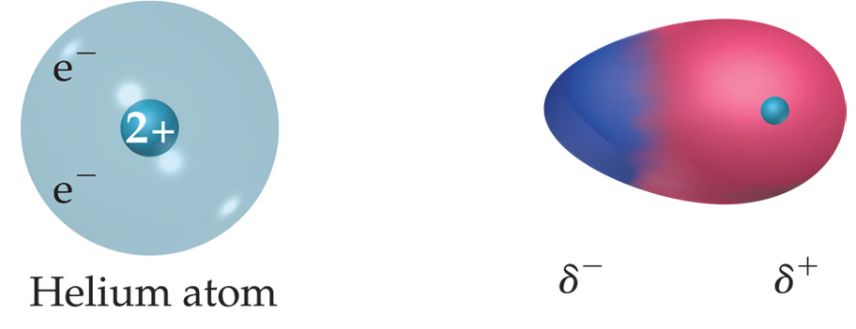
Intermolecular forces in liquids
London forces are the weakest type of intermolecular force (and the most difficult to understand)
The movement of electrons around nuclei in atoms and molecules can create a
very brief (temporary) dipole.

Slide 43
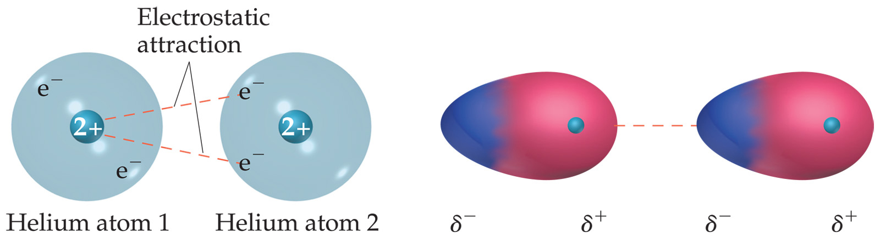
Intermolecular forces in liquids
These “instantaneous dipoles” can cause other molecules around them to become polar for an instant. The resulting interaction is attractive (London force)
“instantaneous
dipole”
“induced
dipole”

Slide 44
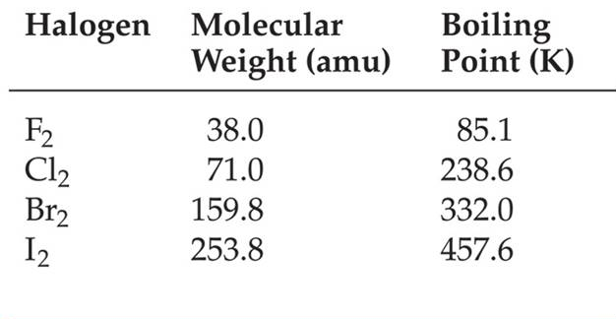
Intermolecular forces in liquids
London forces are stronger between larger atoms. Thus London forces become stronger with increasing molar mass.
London forces are present in all molecules

Slide 45
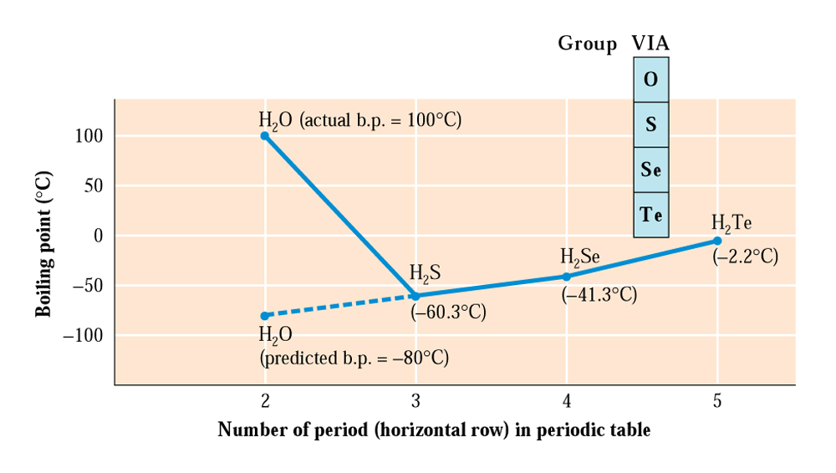
Intermolecular forces in liquids
of central atom (O, S, Se, Te)

