Slide 1
Chemistry 120 Fall 2016
Instructor: Dr. Upali Siriwardane
e-mail: upali@latech.edu
Office: CTH 311
Phone 257-4941
Office Hours: M,W,F 9:30-11:30 am T,R 8:00-10:00 am or by appointment;
Test Dates:
September 23, 2016 (Test 1): Chapter 1,2 &3
October 13, 2016 (Test 2): Chapter 4 & 5
October 31, 2016 (Test 3): Chapter 6, 7 & 8
November 15, 2016 (Test 4): Chapter 9, 10 & 11
November 17, 2016 (Make-up test) comprehensive:
Chapters 1-11

Slide 2
Chapter 6. Chemical Calculations:
Chapter Introduction
6-1 Formula Masses
6-2 The Mole: A Counting Unit for Chemists
6-3 The Mass of a Mole
6-4 Chemical Formulas and the Mole Concept
6-5 The Mole and Chemical Calculations
6-6 Writing and Balancing Chemical Equations
Conventions Used in Writing Chemical Equations
Guidelines for Balancing Chemical Equations
6-7 Chemical Equations and the Mole Concept
6-8 Chemical Calculations Using Chemical Equations
6-9 Yields: Theoretical, Actual, and Percent

Slide 3
Chapter 6
Chemical calculations, formula masses, moles, and chemical equations

Slide 4
Formula masses
The sum of the atomic masses of all of the atoms represented in the chemical formula of a substance is the formula mass.
Example: for H₂O
Formula mass = 18.02 amu

Slide 5
Formula masses
The elemental masses that are used to determine the formula mass are found in the periodic table.
Another example: glucose, C₆H₁₂O₆
Formula mass = 180.18 amu

Slide 6
The mole: a counting unit for chemists
The quantity of material in a sample can be counted in units of mass or units of amount.
Example:
  15 pounds of nails
  70 dozen nails
Counting by mass
Counting by amount

Slide 7

The mole: a counting unit for chemists
Masses need to be specified with their associated units. Otherwise, the quantity is meaningless.
Example: Mr. Powers, you’ve got eight to get out of the building before it explodes…
Would be nice to know if this
is eight seconds or minutes.

Slide 8
The mole: a counting unit for chemists
Since atoms are so small, we routinely deal with enormous numbers of them in our everyday experiences.
  A spoon of sugar for your coffee has around 3 x 10²¹ sugar molecules in it.
  A cup of water is about 8 x 10²⁴ water molecules.
It is convenient to count things by amounts in chemistry, and the quantity used is the mole.

Slide 9
The mole: a counting unit for chemists
Avogadro’s number
One mole is 6.02 x 10²³ objects. This quantity should be treated in the same way that other amount figures are used (e.g. a dozen objects is twelve objects).
A dozen eggs would be 12 eggs. Half a dozen eggs would be 6 eggs.
A mole of eggs would be 6.02 x 10²³ eggs. Half a mole of eggs would be 3.01 x 10²³ eggs.
Conversion factors that will often be used are

Slide 10
The mole: a counting unit for chemists
Using dimensional analysis, it is easy to determine the number of molecules, atoms, etc. that are present in some sample.
Example: how many molecules of water are in 0.25 moles of water? How many hydrogen atoms are in 0.25 moles of water?
This conversion factor is based on the fact that there are two H atoms in each
H₂O molecule

Slide 11
Mass of a mole
The mass of a mole of some chemical substance is the numerically the same as the substance’s formula mass. Instead of units of amu, the mole has mass units of grams.
  The mass of a molecule of H₂O is 18.02 amu
  The mass of a mole of H₂O is 18.02 g
This quantity is called the “molar mass’ of water

Slide 12
Mass of a mole
A molar mass itself is a conversion factor:
Converting between grams and moles is straightforward using dimensional analysis.
How much does 4.0 moles of water weigh?
1 mole H₂O = 18.02 g H₂O
Desired unit
Given unit
Given unit

Slide 13
Mass of a mole
Avogadro’s number (6.02 x 10²³) is the number of atoms of ¹²C in an isotopically pure sample of ¹²C that weighs exactly 12g.

Slide 14
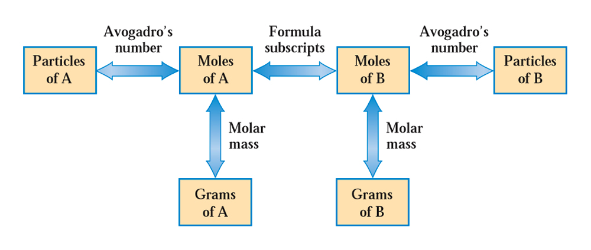
The mole and chemical calculations
As we saw a few slides ago, it is possible to use a chemical formula to
create a conversion factor that allows us to determine the number of atoms
of some element is a sample. We also know that 1 mole means Avogadro’s
number of objects (molecules, atoms, etc.)
e.g. 1) How many C₆H₁₂O₆ molecules are in 1.0 g of C₆H₁₂O₆?
2) How many H atoms are in 1.0 g of C₆H₁₂O₆?

Slide 15
The mole and chemical calculations
1)Work out the molar mass for C₆H₁₂O₆ first:
Then use known conversion factors to change g C₆H₁₂O₆ to molecules of C₆H₁₂O₆
Avogadro’s number:
1 mole = 6.02 x 10²³ objects
= 3.3x10²¹ C₆H₁₂O₆ molecules

Slide 16
The mole and chemical calculations
2) From the formula (C₆H₁₂O₆) you can see that there are 12 H atoms in each C₆H₁₂O₆ molecule. Make another conversion factor to change molecules C₆H₁₂O₆ to atoms of H:
= 4.0x10²² H atoms

Slide 17
The mole and chemical calculations
This can be done all at once, too:
= 4.0x10²² H atoms

Slide 18
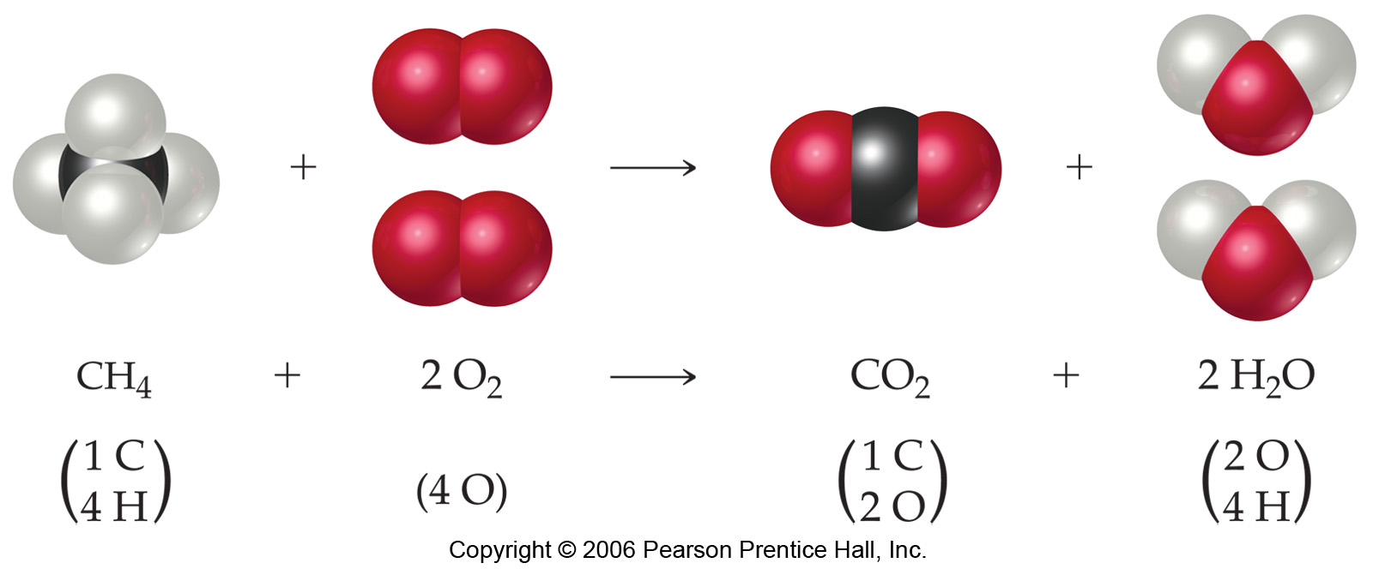
Writing and balancing chemical equations
A chemical equation is a statement that expresses what changes occur in a chemical reaction (i.e. what is reacting and what is created)
beginning of reaction
end of reaction

Slide 19
Writing and balancing chemical equations
CH_{4 (g)} + 2 O_{2 (g)} CO_{2 (g)} + 2 H₂O _{(g)}
Reactants appear on the left side of the equation.

Slide 20
Writing and balancing chemical equations
CH_{4 (g)} + 2 O_{2 (g)} CO_{2 (g)} + 2 H₂O _{(g)}
Products appear on the right side of the equation.

Slide 21
Writing and balancing chemical equations
CH_{4 (g)} + 2 O_{2 (g)} CO_{2 (g)} + 2 H₂O _{(g)}
The states of the reactants and products are written in parentheses to the right of each compound.
(s) = solid
(l) = liquid
(g) = gas
(aq) = aqueous
solution

Slide 22
Writing and balancing chemical equations
CH_{4 (g)} + 2 O_{2 (g)} CO_{2 (g)} + 2 H₂O _{(g)}
In this reaction, the reactants and products are said to be “balanced” – there
are equal numbers of atoms of each element on the reactant and product sides
of the equation.
A balanced equation contains the lowest possible whole number coefficients

Slide 23
Writing and balancing chemical equations
CH_{4 (g)} + 2 O_{2 (g)} CO_{2 (g)} + 2 H₂O _{(g)}
Coefficients are inserted to balance the equation.

Slide 24
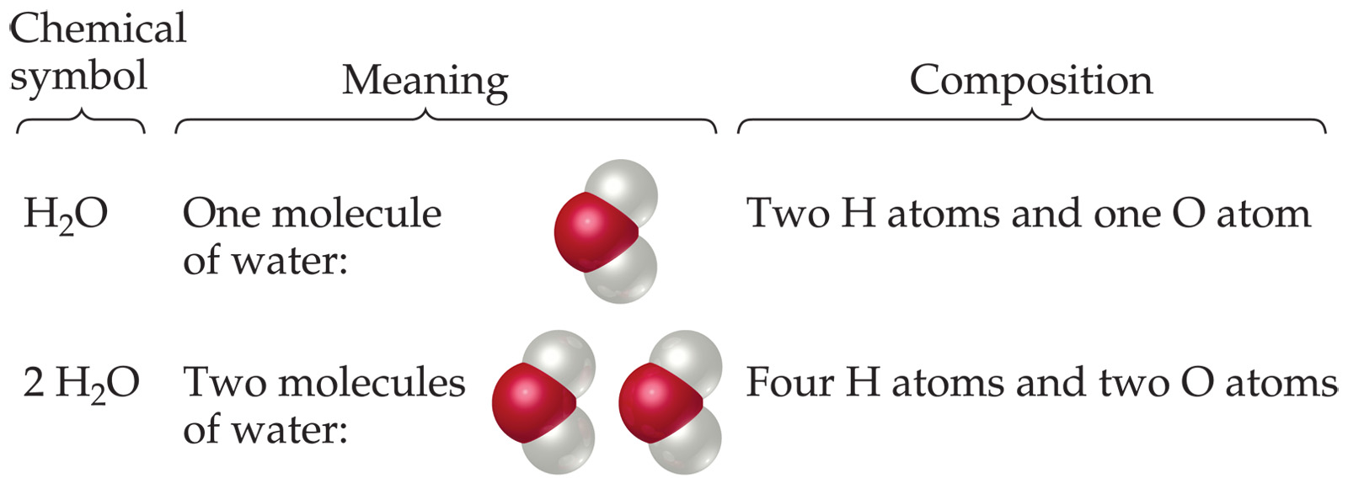
Subscripts and Coefficients Give Different Information
Subscripts tell the number of atoms of each element in a molecule

Slide 25
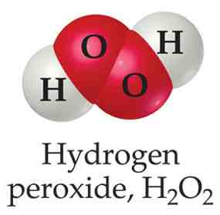
Subscripts and Coefficients Give Different Information
Subscripts tell the number of atoms of each element in a molecule
Coefficients tell the number of molecules

Slide 26
Writing and balancing chemical equations
One of the fundamental laws of nature is that matter and energy can’t be created or destroyed. In chemical equations, this is reflected in the need for equations to be balanced.
There must be equal numbers of atoms of each element on both sides of the equation.
NH₃ + O₂ → N₂ + H₂O
4
3
2
6

Slide 27
Writing and balancing chemical equations
Balancing a chemical equation is probably best accomplished by starting with an element that occurs in only one formula on each side of the equation:
C₃H₆O + O₂ → CO₂ + H₂O
Could start with carbon (C) or (H). I’ll start with C.
There are 3 C atoms on the reactant side and only one on the product side.
Write a coefficient of “3” in front of CO₂ to balance the carbon atoms
in the equation

Slide 28
Writing and balancing chemical equations
Balancing a chemical equation is probably best accomplished by starting with an element that occurs in only one formula on each side of the equation:
C₃H₆O + O₂ → CO₂ + H₂O
3
Hydrogen occurs in only one formula on each side. Let’s balance H next by
putting a “3” in front of H₂O.

Slide 29
Writing and balancing chemical equations
Balancing a chemical equation is probably best accomplished by starting with an element that occurs in only one formula on each side of the equation:
C₃H₆O + O₂ → CO₂ + H₂O
3
3
Now, C and H are balanced in the above equation. Can see that there are
unequal numbers of O atoms on each side (3 and 9). By putting a “4” in
front of O₂, we balance the equation.

Slide 30
Writing and balancing chemical equations
Balancing a chemical equation is probably best accomplished by starting with an element that occurs in only one formula on each side of the equation:
C₃H₆O + O₂ → CO₂ + H₂O
4
3
3
Check: reactants products
C: 3 3
H: 6 6
O: 9 9

Slide 31
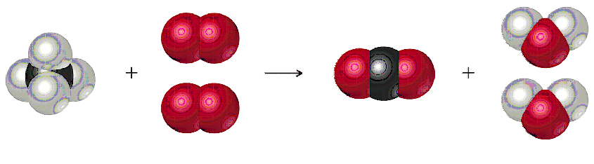
Chemical equations and the mole concept
The coefficients in a balanced chemical equation tell us the molar ratios that exist between the substances consumed on the reactant side and the substances made (the product side)
CH_{4 (g)} + 2 O_{2 (g)} CO_{2 (g)} + 2 H₂O _{(g)}

Slide 32
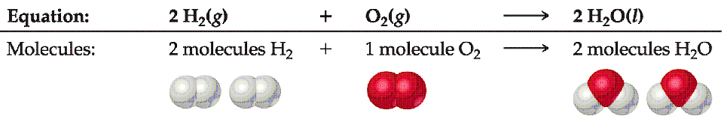
Chemical equations and the mole concept
The following equation gives us these conversion factors:
  Two H₂ molecules are needed in this reaction with O₂ to produce two H₂O molecules
  Two moles of H₂ are needed in this reaction with O₂ to produce two moles of H₂O

Slide 33
Chemical equations and the mole concept
The following equation gives us these conversion factors:
Between H₂ and H₂O
Between H₂ and O₂
Between O₂ and H₂O

Slide 34
Chemical calculations using chemical equations
Using the molar relationship between a substance in a balanced chemical equation and some other reactant or product, you can determine the moles (or mass) of product that can be made starting with a certain mass (or number of moles) of reactant.
C₆H₁₂O₆ + 6 O₂ → 6 CO₂ + 6 H₂O
How many grams of water will the body produce via this reaction if a
person consumes a candy bar containing 14.2 g of glucose?
Consider the molar relationship between C₆H₁₂O₆ and H₂O. For
every mole of C₆H₁₂O₆ consumed, 6 moles of H₂O will be produced.

Slide 35
Chemical calculations using chemical equations
We’ll need to:
  Convert 14.2g of C₆H₁₂O₆ using the molar mass for glucose (180.18 g = 1 mole)
  Use the molar relationship that exists between C₆H₁₂O₆ and H₂O to convert moles of C₆H₁₂O₆ to moles of H₂O
  Use the molar mass for H₂O (18.02 g = 1 mole)
Molar mass of C₆H₁₂O₆
Molar mass of H₂O
Molar ratio between C₆H₁₂O₆ and H₂O

Slide 36
Chemical calculations using chemical equations
There are a number of questions that may be asked in these types of problems:
  How much of a product is made from a certain amount of a reactant?
  How much of a second reactant is consumed when a given amount of the other reactant is involved?
  How many molecules of a product are created, given a certain mass of reactant used?
  How many grams of an element are present in a certain amount of product?
C₆H₁₂O₆ + 6 O₂ → 6 CO₂ + 6 H₂O
If 14.2g of C₆H₁₂O₆ are reacted, how many grams of O are present in the water
that is produced?
Molar mass
C₆H₁₂O₆
Molar mass
O
14.2g C₆H₁₂O₆
mol C₆H₁₂O₆
mol H₂O
mol O (in H₂O)
g O in H₂O

Slide 37
Chemical calculations using chemical equations
C₆H₁₂O₆ + 6 O₂ → 6 CO₂ + 6 H₂O
If 14.2g of C₆H₁₂O₆ are reacted, how many grams of O are present in the water
that is produced?
Molar mass
C₆H₁₂O₆
Molar mass
O
14.2g C₆H₁₂O₆
mol C₆H₁₂O₆
mol H₂O
mol O (in H₂O)
g O in H₂O
=7.57g of O

