Slide 1
Chemistry 120 Fall 2016
Instructor: Dr. Upali Siriwardane
e-mail: upali@latech.edu
Office: CTH 311
Phone 257-4941
Office Hours: M,W,F 9:30-11:30 am T,R 8:00-10:00 am or by appointment;
Test Dates:
September 23, 2016 (Test 1): Chapter 1,2 &3
October 13, 2016 (Test 2): Chapter 4 & 5
October 31, 2016 (Test 3): Chapter 6, 7 & 8
November 15, 2016 (Test 4): Chapter 9, 10 & 11
November 17, 2016 (Make-up test) comprehensive:
Chapters 1-11

Slide 2
Chapter 5. Chemical Bonding: The Covalent Bond Model
5-1 The Covalent Bond Model
5-2 Lewis Structures for Molecular Compounds
5-3 Single, Double, and Triple Covalent Bonds
5-4 Valence Electrons and Number of Covalent Bonds Formed
5-5 Coordinate Covalent Bonds
5-6 Systematic Procedures for Drawing Lewis Structures
5-7 Bonding in Compounds with Polyatomic Ions Present
5-8 Molecular Geometry
        Electron Groups
        Molecules with Two VSEPR Electron Groups
        Molecules with Three VSEPR Electron Groups
        Molecules with Four VSEPR Electron Groups
        Molecules with More Than One Central Atom
5-9 Electronegativity
5-10 Bond Polarity
  Bond Polarity and Fractional Charges
  Bond Classification Based on Electronegativity Difference
5-11 Molecular Polarity
5-12 Recognizing and Naming Binary Molecular Compounds

Slide 3
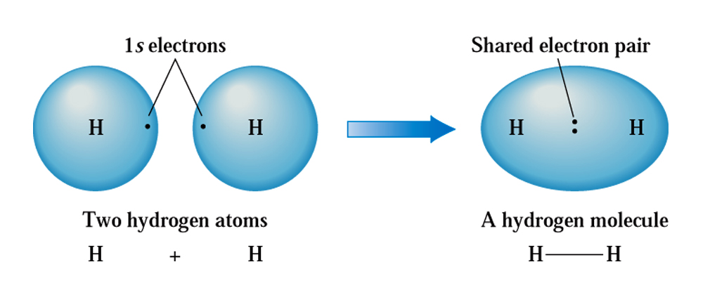

The covalent bond model
Covalent bonds result from the sharing of electrons between atoms. These electron pairs (bonds) act like a glue to hold atoms together.
Covalent bonds result between hydrogen atoms
when the 1s orbitals of two atoms overlap
in Lewis notation

Slide 4

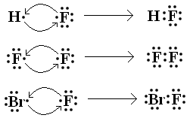
Lewis structures for molecular compounds
Usually, we represent shared electron pairs with lines (1 line = 1 covalent bond)
When counting electrons around an atom in Lewis structures,
each covalent bond counts as 2 electrons

Slide 5

Lewis structures for molecular compounds
Electrons that aren’t involved in bonds are called “non-bonding electrons”
(labeled in red in the above diagrams)

Slide 6
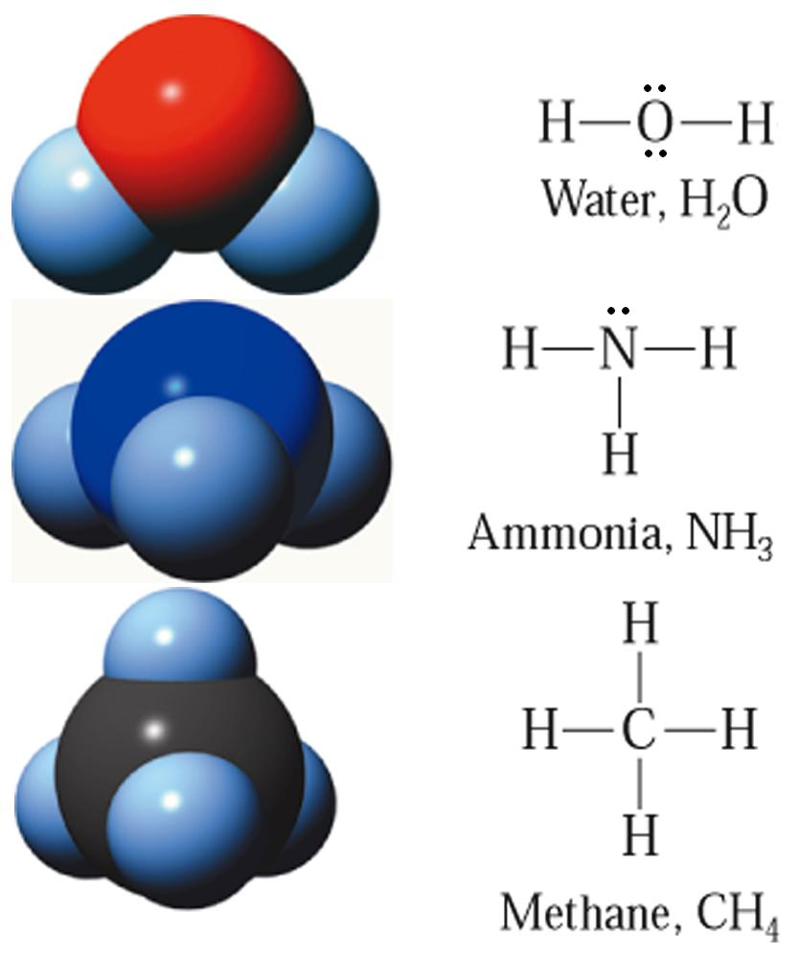
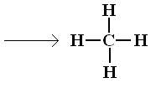


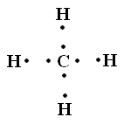
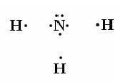
Lewis structures for molecular compounds
Lewis structures are not
meant to convey anything
about shape

Slide 7



Single, double, and triple covalent bonds
In single bonds, atoms share a pair of electrons; the electron pair that is shared exists in the space between the two atoms’ nuclei.
In certain cases, atoms must share more than just a pair of electrons to explain the bonding between them. For example, in O₂, sharing just one pair leaves each oxygen atom with only 7 electrons around it…but sharing another pair gives each of them 8 electrons.
This is called a double covalent bond

Slide 8

Single, double, and triple covalent bonds
Another example is N₂ (nitrogen). In this case, two N atoms need to share three pairs of electrons for each N atom to gain an octet.
A triple bond

Slide 9
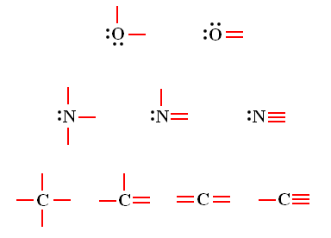
Valence electrons and the number of covalent bonds formed
To predict how many bonds an atom will form to obtain an octet, consider the number of valence electrons it possesses.
Oxygen: group 6A; needs
to form two bonds to get octet
Nitrogen: group 5A; needs
to form three bonds to get octet
Carbon: group 4A; needs
to form four bonds to get octet

Slide 10
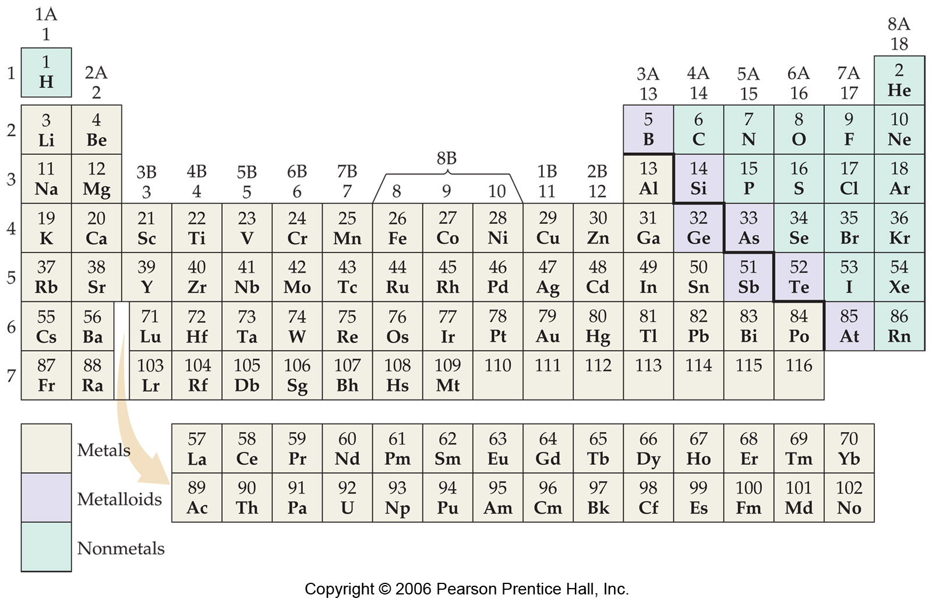

Slide 11
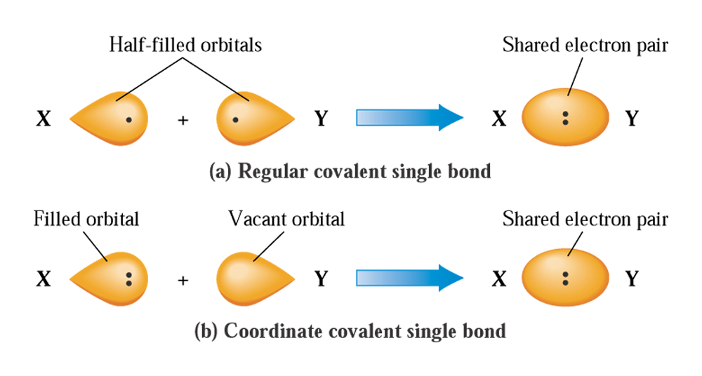

Coordinate covalent bonds
In some cases, atoms may donate both electrons that are used to form a bond. Examples:
CO
N₂O

Slide 12
Systematic rules for drawing Lewis structures
Step 1: Find the sum of valence electrons of all atoms in the polyatomic ion or molecule.
Step 2: Draw the atoms in the order in which they occur*, connecting them with single bonds. Bonds “cost” 2 electrons each.
Step 3: Add electrons around the non-central (outside) atoms until they each have an octet.**
Step 4: If any electrons remain left over at this point, use them to complete the octet on the central atom.
*See page 115 to predict which atom is central in a formula. Neither hydrogen
nor fluorine is ever a central atom. If C is present, it usually is the central atom, and
in binary compounds (e.g. NH₃), the “single-atom element” is usually the central atom.
** Remember, hydrogen atoms can accommodate only 2 electrons (i.e. not an octet).

Slide 13
Systematic rules for drawing Lewis structures
Step 5: If there are not enough electrons on the central atom for an octet, make multiple bonds between the central atom and another atom to give it an octet.
Step 6: Double-check the total number of electrons in the Lewis structure at this point to be sure that there are no more present than the total number you counted in Step 1.
Examples: SO₂, HCN, CO₂

Slide 14
Bonding in polyatomic ions and ionic compounds containing polyatomic ions
The rules for drawing Lewis structures for polyatomic ions are similar to the six steps we just covered.
Ions carry charges, so the total number of electrons calculated in Step 1 must be adjusted to account for the ion’s charge.
  Positive charged ions: deduct one electron from the total number counted for each positive charge.
  Negatively charged ions: add one electron to the total number for each negative charge.
  In the end, surround the Lewis structure with square brackets and indicate charge as for Lewis structures for ionic compounds
Examples: SO₄²⁻,K₂SO₄, CO₃²⁻

Slide 15
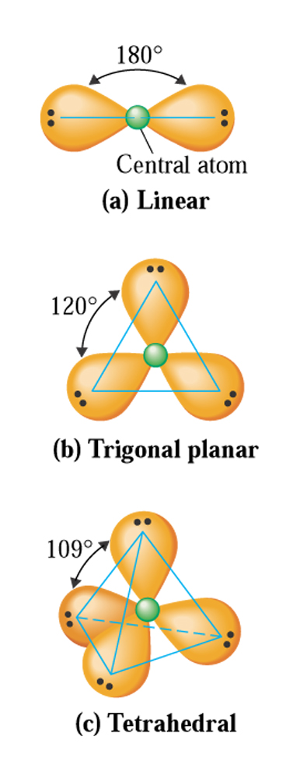
VSEPR theory
Looking at a Lewis structure, one might expect that all molecules are flat; Lewis structures convey no information (by themselves) about the shape of molecules.
VSEPR theory (Valence Shell Electron-Pair Repulsion) is used to predict molecular shape, and is based on the repulsion that exists between charges of the same sign.
Shape of a molecule is normally given with respect to the central atom.

Slide 16
VSEPR theory
Consider the electron pairs that are found on the central atom in a molecule of HCN
On one side of the central carbon atom is a C-H single bond, and on the other, a C-N triple bond. Thus, there are two “VSER electron groups” around the carbon.
These bonds consist of electrons, and are repulsive toward each other. The bonds prefer to be as far apart from each other as possible, yielding a linear arrangement.
VSEPR electron groups = single bond, double bond, triple bond, or a non-bonding
pair of electrons (all are negatively charged)

Slide 17





VSEPR theory
The number of VSEPR electron groups on the central atom is what determines the structure’s geometry. As these groups are repelled by each other, and move as far apart as they can, they drag with them the outer atoms.
Two VSEPR electron groups on the central atom yields a linear arrangement of these electron groups.
Three VSEPR electron groups yields a trigonal planar arrangement of electron groups.
Four VSEPR electron groups on the central atom yields a tetrahedral arrangement of electron groups.

Slide 18
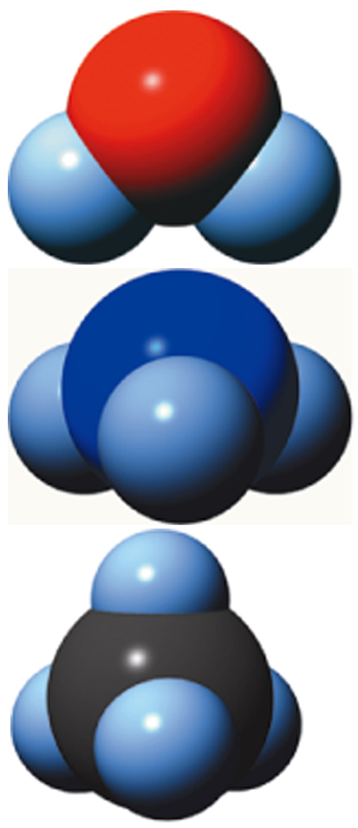
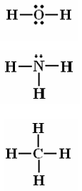
VSEPR theory
All of these Lewis structures have four
electron domains on the central atom
In many cases, at least one of the VSEPR electron groups on the central atom is a non-bonding pair.
The shape of the molecule is determined by the arrangement of atoms around the central atom.
angular
trigonal
pyramidal
tetrahedral

Slide 19
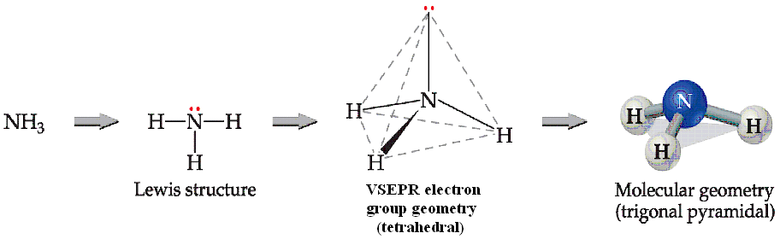
VSEPR theory

Slide 20
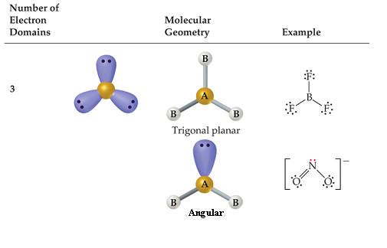
VSEPR theory
There are two molecular geometries for 3 electron domains:
  Trigonal planar, if all the electron domains are bonding
  Angular, if one of the domains is a nonbonding pair.
Examples: CO₃²⁻, O₃, NO₂⁻

Slide 21
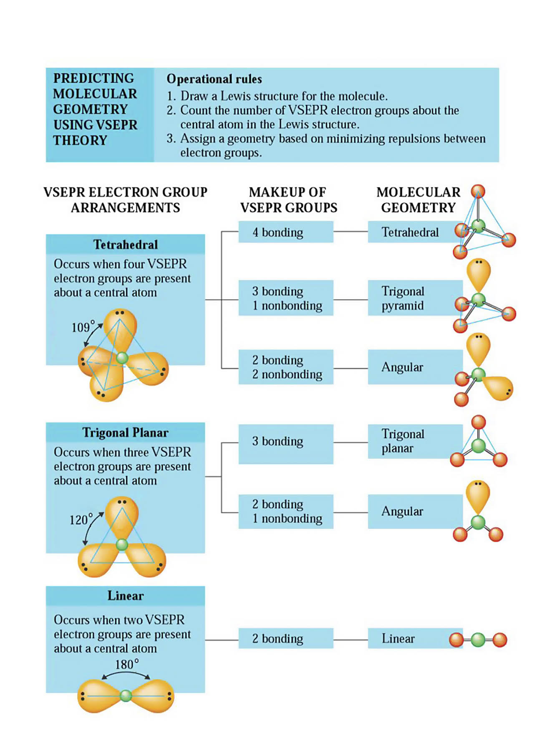

Slide 22
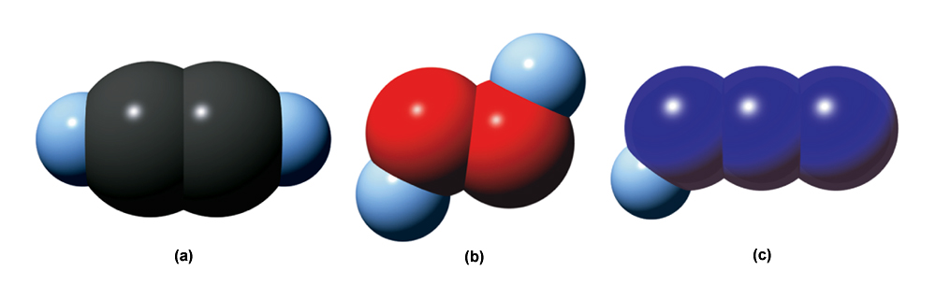

Molecules with more than one central atom
For molecules that contain more than one central atom, a local molecular shape can be described (describing the geometry around a central atom).
angular
angular
linear
angular
linear
linear

Slide 23
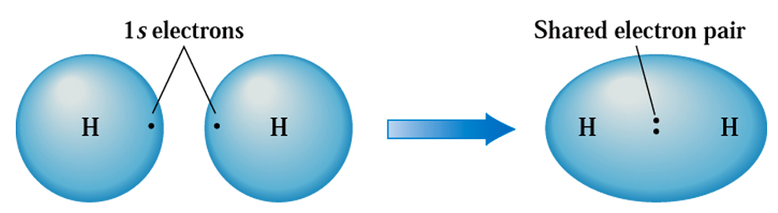
Electronegativity
Atoms that are involved in bonds share electron with other atoms to obtain octet of electrons around themselves.
When two identical atoms share electrons to form bonds, the electrons in the bond(s) are shared equally between the two atoms (e.g. H₂, O₂, N₂, and between the two carbon atoms of C₂H₂ – see last slide).

Slide 24
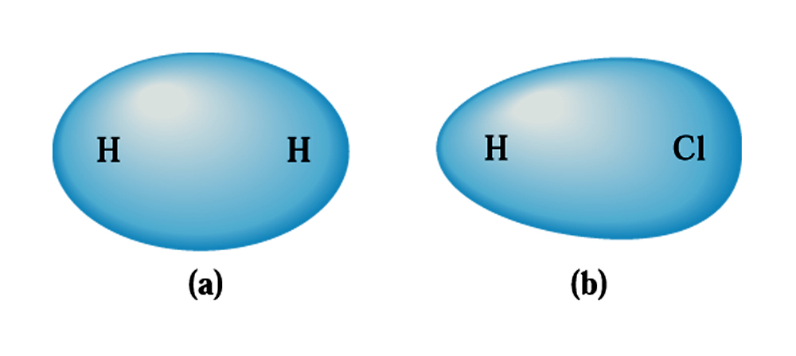


Electronegativity
In many covalent bonds, the electron pair (or pairs, in multiple bonds) are not equally shared, as different elements have differing abilities to attract electrons in bonds toward themselves.
The electronegativity of an element reflects how strongly an atom of that element can pull bonding electrons toward itself.
This bond is called a polar covalent bond
Chlorine is more electronegative
than hydrogen, so the electrons
in the H-Cl bond spend more time
near Cl than H
This bond is a non-polar covalent bond

Slide 25
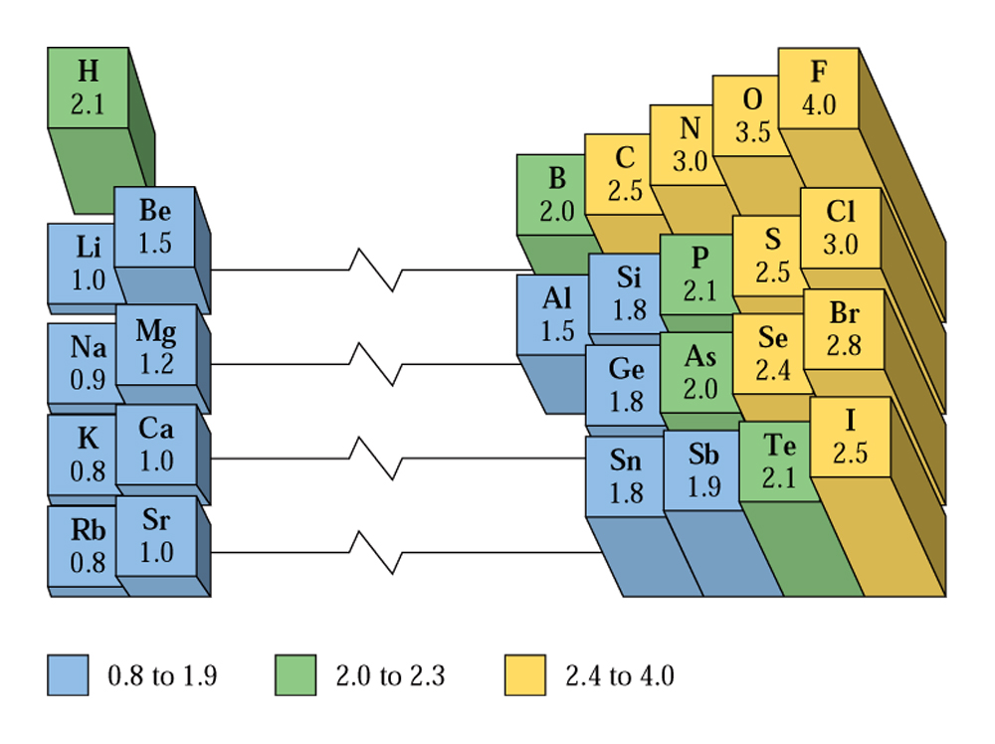
Electronegativity
Consistent with the idea that
elements on the left-hand side
of the periodic table lose electrons
in forming ionic compounds,
while those on the right-hand
side gain electrons
Sidebar: in a Lewis
structure, the central
atom is the least
electronegative atom
(except if the least
electronegative atom
is hydrogen)
…remember N₂O on
slide 10
Electronegativity increases left-to-right across a period and bottom-to-top in a group.

Slide 26
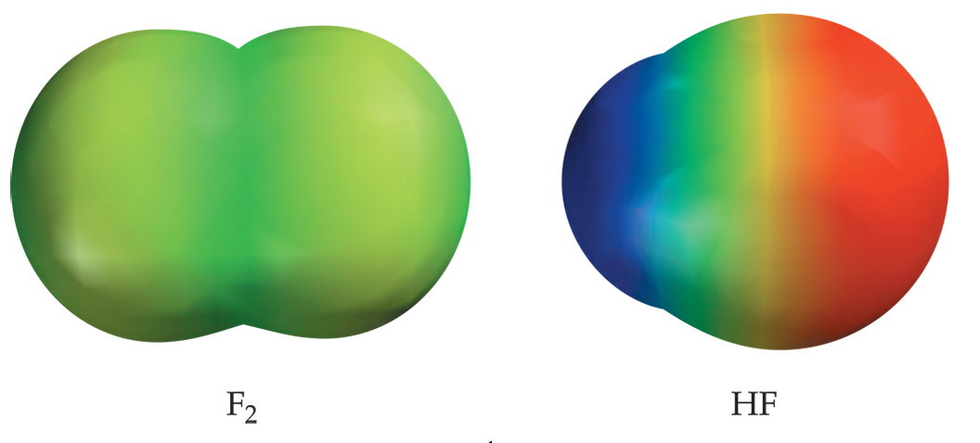


Bond polarity
Polar covalent bonds have an unsymmetrical distribution of electrons between the two atoms involved in the bond.
The electrons in these bonds spend more time on one side of the bond (the side with the more electronegative atom) than the other.
This creates a bonding picture that looks a bit like an ionic bond; however, no electron transfer has happened here (electrons are still shared, just unequally).
homonuclear
heteronuclear
Non-polar covalent bond
Polar covalent bond
The bigger the difference in the electronegativity of the two atoms in the covalent
bond, the more polar the bond.

Slide 27



Bond polarity
Polar bonds are somewhere in-between non-polar covalent bonds and ionic bonds
Non-polar covalent
Ionic bonds
Equal sharing of electrons in bonds
Complete transfer of electron(s) from
one atom to the other (no sharing)
partial charges
δ+
δ−
Polar covalent bonds
Unequal sharing of bonding electrons; endows
one end of bond with partial negative charge and
the other with a partial positive charge

Slide 28
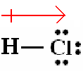
Bond polarity
Because the bonding electrons between H and Cl spend more time on the Cl end, that end of the bond carries a partial negative charge (and the other end a partial positive charge)
This can also be represented with a “crossed arrow”
In this notation, the arrow points toward side of the bond that carries the partial negative charge and the “+” sign is on the side that carries the partial positive charge.
δ+
δ−

Slide 29
Bond polarity
In some cases, bonds that have low polarity are considered to be non-polar.
Use the following guideline to determine whether a bond is non-polar, polar, or ionic:
  If the two atoms involved in a bond have an electronegativity difference of 0.4 or less, the bond is considered to be non-polar covalent.
  If the electronegativity difference for the two atoms of a bond is between 0.4 and 1.5, it is considered to be a polar covalent bond.
  Bonds that have an electronegativity difference of greater than 2.0 are ionic.
  If the electronegativity difference for a bond lies in the 1.5-2.0 range, it is considered to be ionic if it involves a metal and non-metal. It is considered to be polar covalent if two non-metals are involved
H-H
C-H
H-Cl
H-F
Na-Cl
non-polar covalent
non-polar covalent
polar covalent
polar covalent
ionic

Slide 30
Molecular polarity
Entire molecules can have unequal distributions of electronic charge. In these cases, the molecule is said to be polar.
An easy-to-see case for this is in a H-F molecule. The bond is polar and there is only one bond in the molecule. Thus the entire molecule is polar.
Molecules may be polar as a result of a combination of
  their molecular geometry
  the presence of polar bonds in the molecule

Slide 31
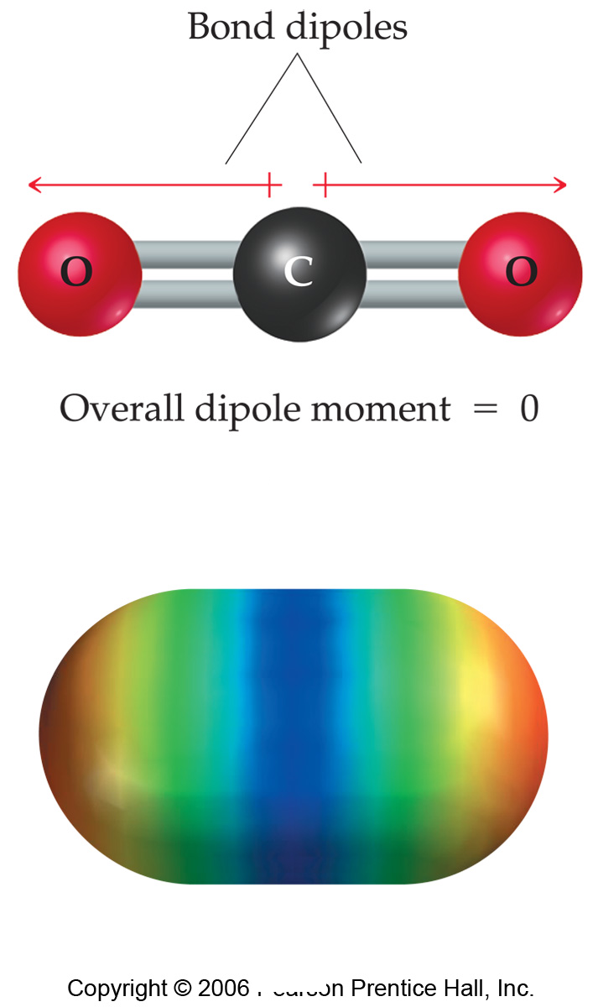
Molecular polarity
non-polar
covalent
polar
covalent
“partial”
charges
δ+
δ−
δ−
δ+
δ−
Just because a molecule possesses polar bonds does not mean the molecule as a whole will be polar.

Slide 32



Molecular polarity
Unlike CO₂ (triatomic, linear, and symmetric), H₂O is not linear (angular), and so the direction of its polar bonds describes an H₂O molecule that has a partial negative charge on the oxygen side, and a partial positive charge on the hydrogen side.
For HCN, it is easier to see why the molecule is polar

Slide 33
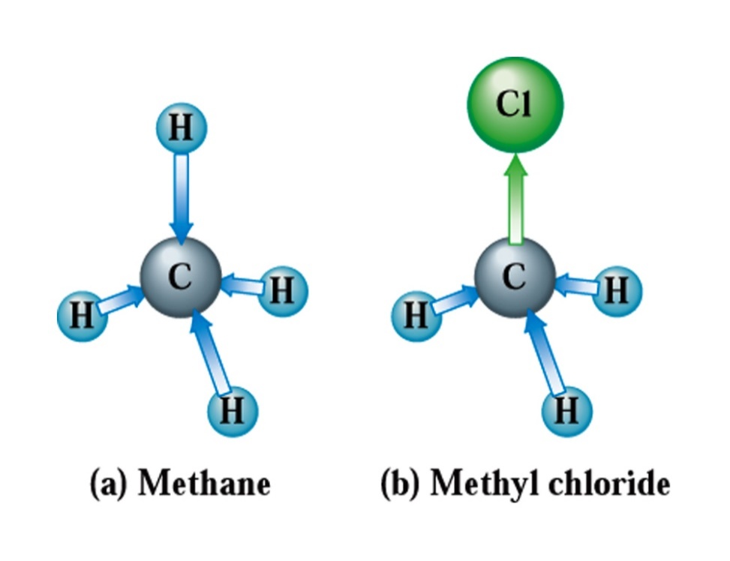
Molecular polarity
For more complicated molecules (e.g. CH₄, CH₃Cl), the symmetry of the molecule needs to be considered to predict whether the molecule is polar or not.

Slide 34
Naming binary molecular compounds
Binary molecular compounds contain only two non-metallic elements.
In naming binary molecular compounds, the non-metal of lower electronegativity is presented first, followed by the non-metal having the higher electronegativity. The non-metal’s name is suffixed as it was for binary ionic compounds (“-ide”).
  HF: hydrogen fluoride
For compounds with more than one atom of an element, prefixes are used to indicate the numbers of these atoms*:
  N₂O₄: dinitrogen tetroxide
  NO₂: nitrogen dioxide
Exception: if the first element is hydrogen , then the prefix is not used.
Example, H₂S is just “hydrogen sulfide”

