Slide 1
Chemistry 120 Fall 2016
Instructor: Dr. Upali Siriwardane
e-mail: upali@latech.edu
Office: CTH 311
Phone 257-4941
Office Hours: M,W,F 9:30-11:30 am T,R 8:00-10:00 am or by appointment;
Test Dates:
September 23, 2016 (Test 1): Chapter 1,2 &3
October 13, 2016 (Test 2): Chapter 4 & 5
October 31, 2016 (Test 3): Chapter 6, 7 & 8
November 15, 2016 (Test 4): Chapter 9, 10 & 11
November 17, 2016 (Make-up test) comprehensive:
Chapters 1-11

Slide 2
Chapter 3. Atomic Structure and the Periodic Table
3-1 Internal Structure of an Atom
  Arrangement of Subatomic Particles Within an Atom
  Charge Neutrality of an Atom
  Size Relationships Within an Atom
3-2 Atomic Number and Mass Number
  Electrons and Chemical Properties
3-3 Isotopes and Atomic Masses
  Isotopes
  Atomic Masses
3-4 The Periodic Law and the Periodic Table
  Groups and Periods of Elements
  The Shape of the Periodic Table
3-5 Metals and Nonmetals
  Periodic Table Locations for Metals and Nonmetals
3-6 Electron Arrangements Within Atoms
  Electron Shells
  Electron Subshells
  Electron Orbitals
  Electron Spin

Slide 3
Chapter 3. Atomic Structure and the Periodic Table
3-7 Electron Configurations and Orbital Diagrams
  Subshell Energy Order
  Writing Electron Configurations and Orbital Diagrams
3-8 The Electronic Basis for the Periodic Law and the Periodic Table
  Electron Configurations and the Periodic Law
  Electron Configurations and the Periodic Table
3-9 Classification of the Elements

Slide 4
What’s covered in this chapter?
• Structure of an atom
• Atomic number and mass number
• Isotopes and (average) atomic masses
• Periodic table
• How are electrons arranged in atoms?
• How to describe electron arrangements for each element
• Metals, non-metals, and metalloids

Slide 5
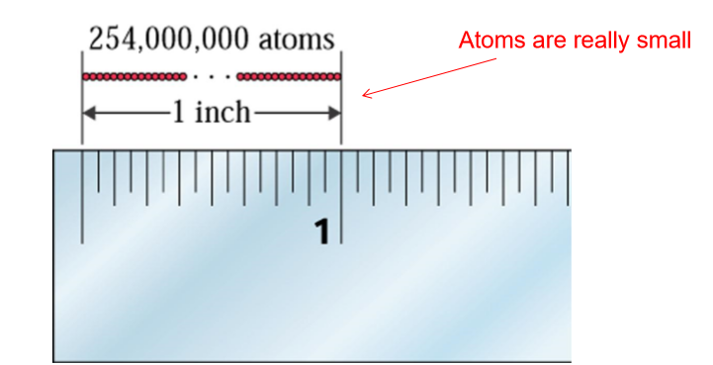
Atoms
What are atoms?
– Chapter 1: the smallest particle of an element that can exist and retain all of the properties of the element

Slide 6
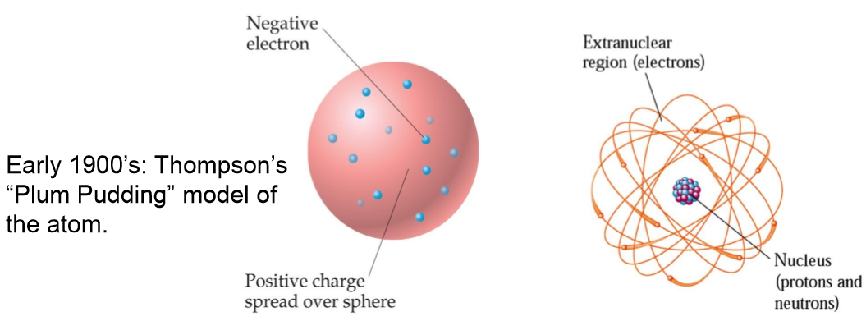
The Nuclear Atom
The current model of the atom predicts a very small, dense nucleus with the electrons around the outside of the atom.
Most of the volume of the atom is empty space.

Slide 7
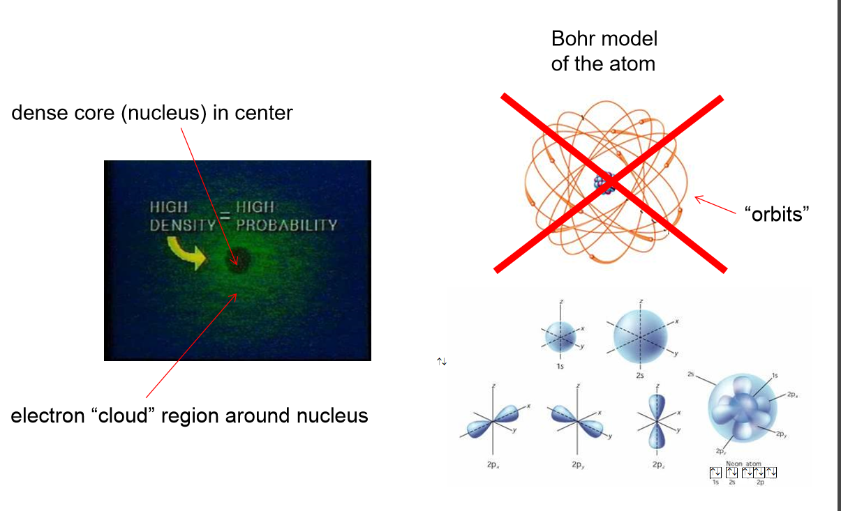
Atomic Structure

Slide 8
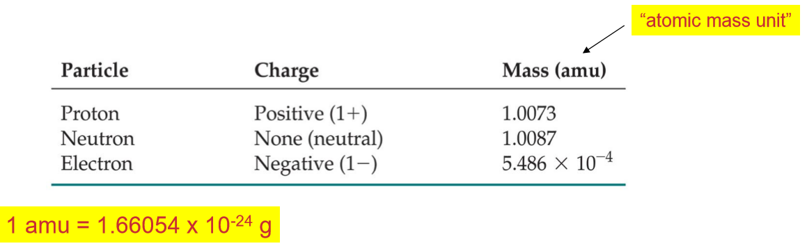
Subatomic Particles
Atoms are made of three types of subatomic particles: protons, electrons, and neutrons.
• Protons (+) and electrons (-) are the only particles that have a charge.
• Protons and neutrons are found in the nucleus (core); electrons reside outside of the nucleus. Thus protons and neutrons are sometimes called “nucleons”

Slide 9
Subatomic Particles
Atoms are made of three types of subatomic particles: protons, electrons, and neutrons.
• Protons (+) and electrons (-) are the only particles that have a charge.
• Protons and neutrons are found in the nucleus (core); electrons reside outside of the nucleus. Thus protons and neutrons are sometimes called “nucleons”

Slide 10
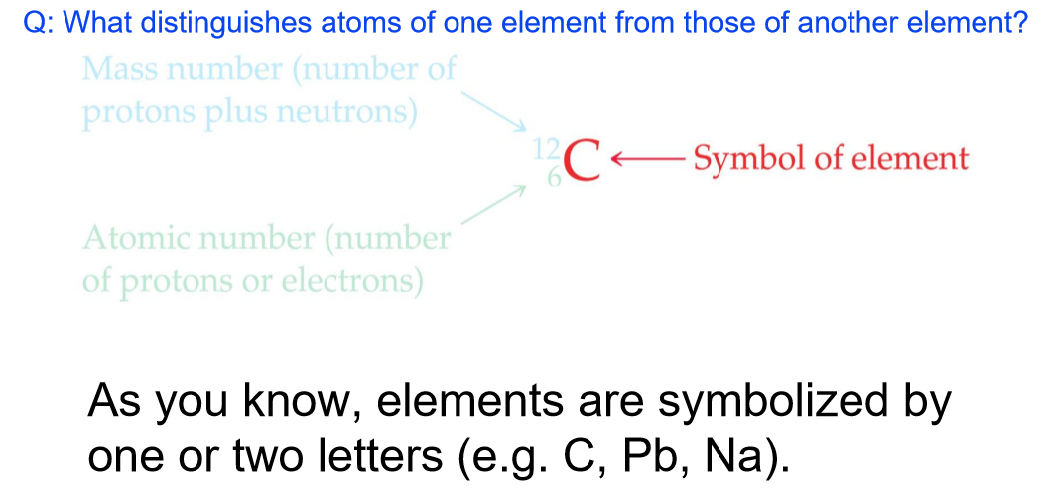
Symbols of Elements
An element’s symbol gives information about the number of protons, neutrons, and electrons in an atom or ion
Q: What distinguishes atoms of one element from those of another element?

Slide 11
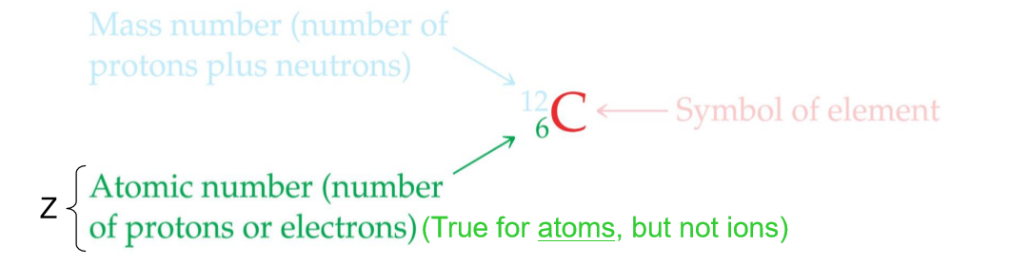
Atomic Number
All atoms (and as we’ll see later, ions) of the same element have the same number of protons. The atomic number (Z) represents the number of protons in the nucleus of an atom of some element.

Slide 12
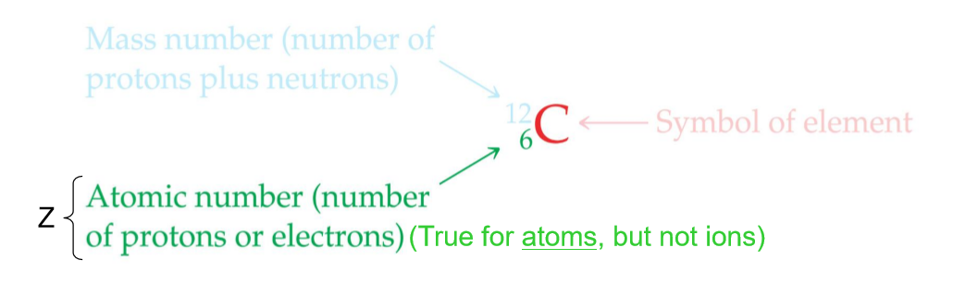
Mass Number
The mass of an atom in atomic mass units (amu) is the sum of the number of protons and neutrons (i.e. total number of nucleons) in the atom. The mass number for an element is given the symbol, “A”
An element’s atomic number and mass number can be found in the periodic table

Slide 13
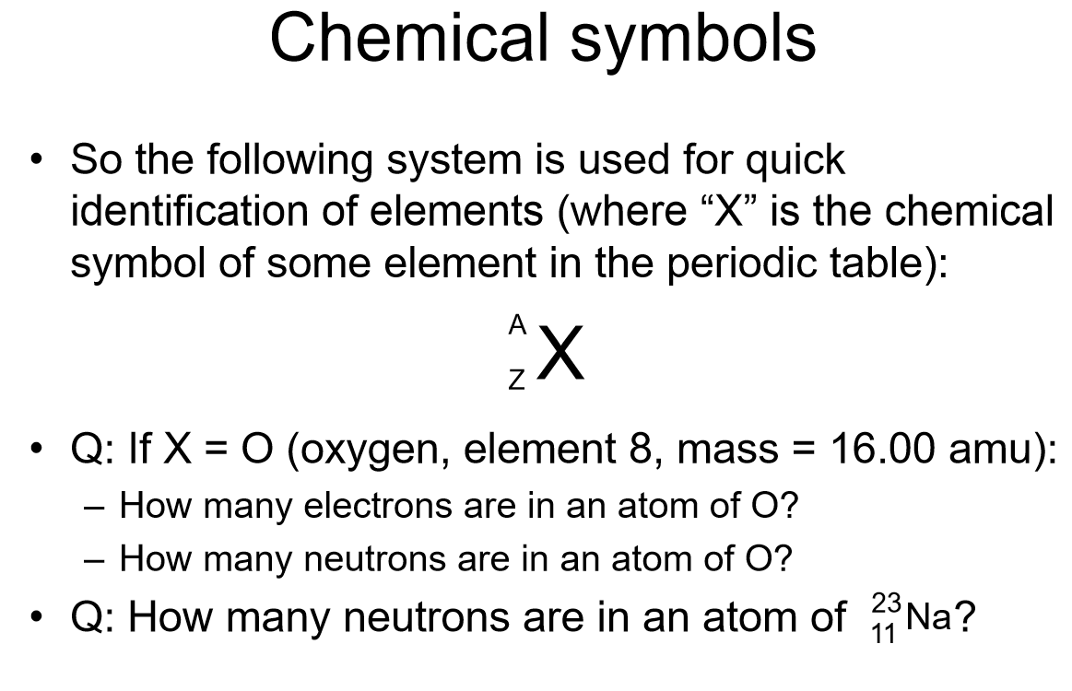

Slide 14
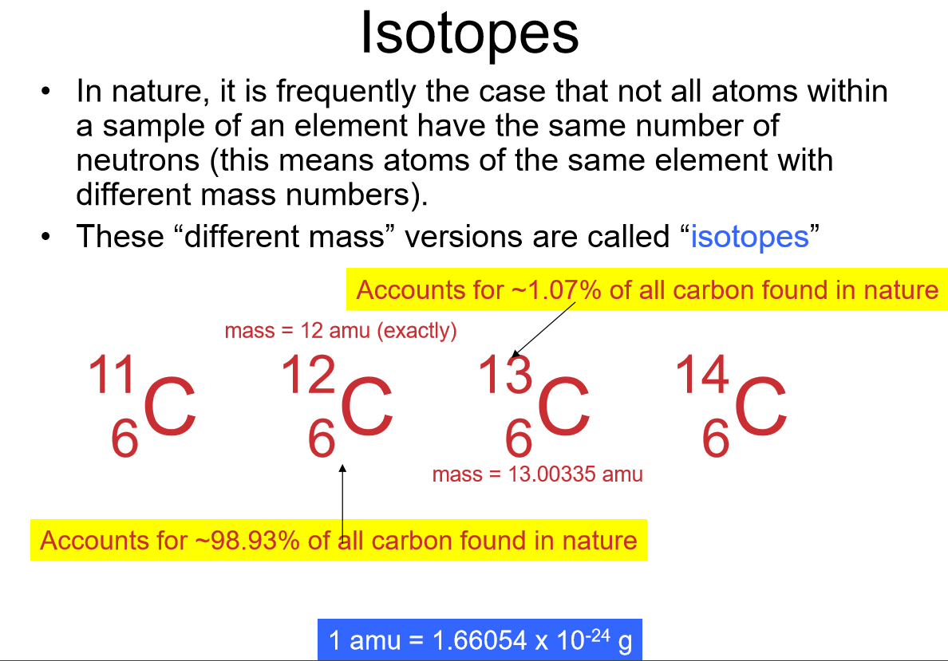

Slide 15
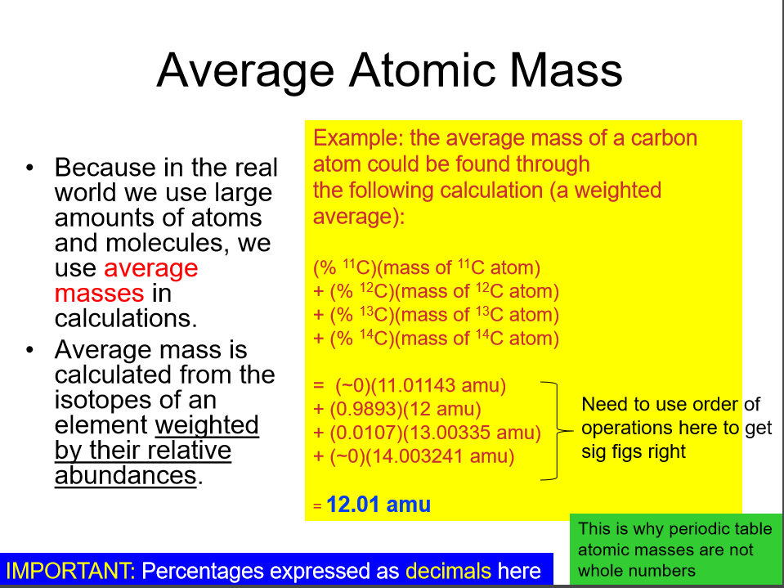

Slide 16
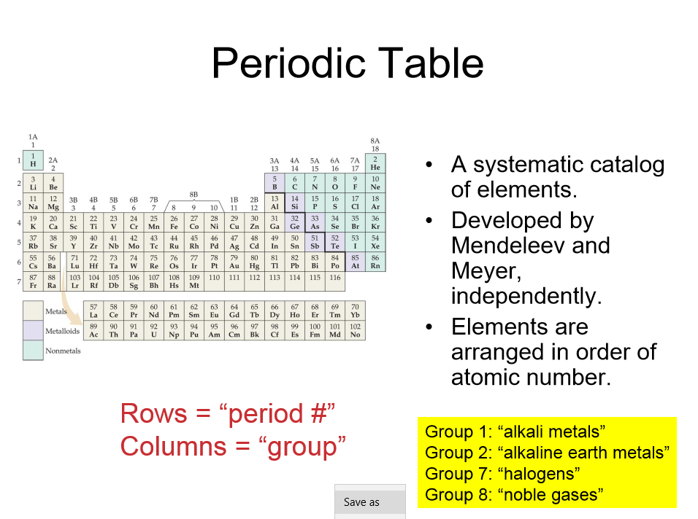

Slide 17
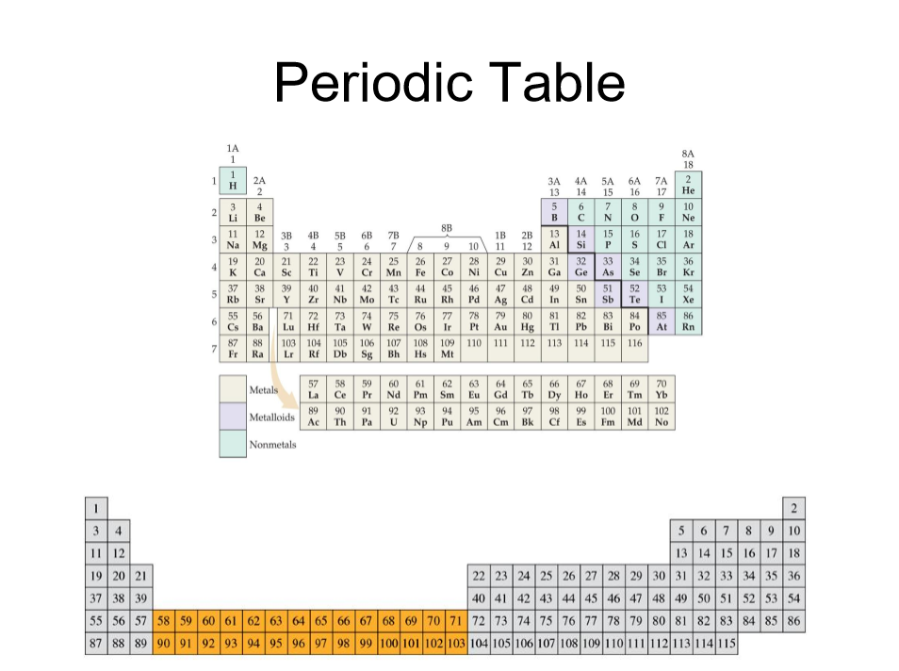

Slide 18
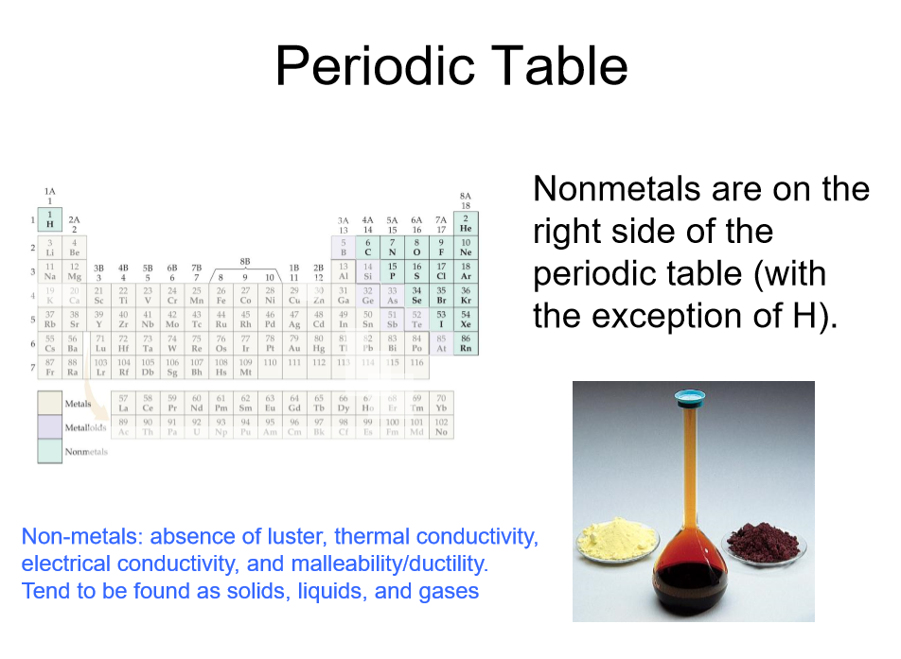

Slide 19
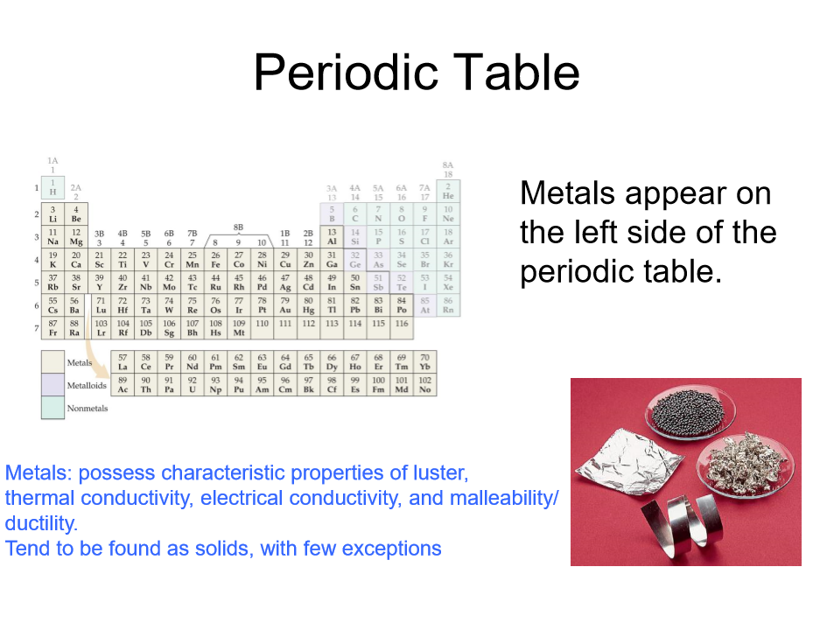

Slide 20
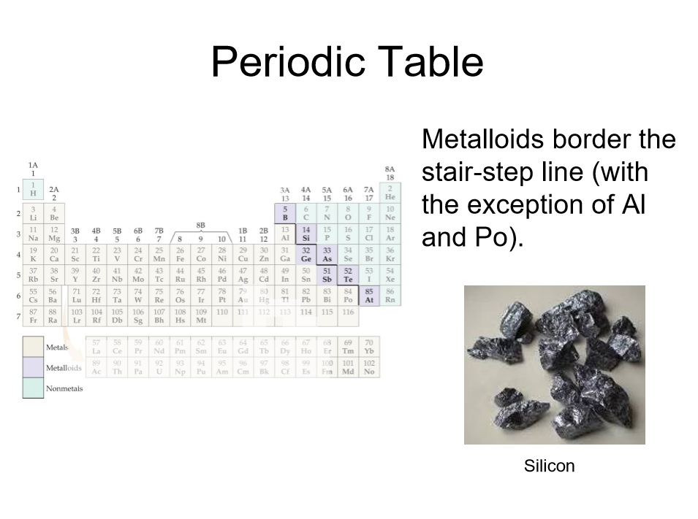

Slide 21
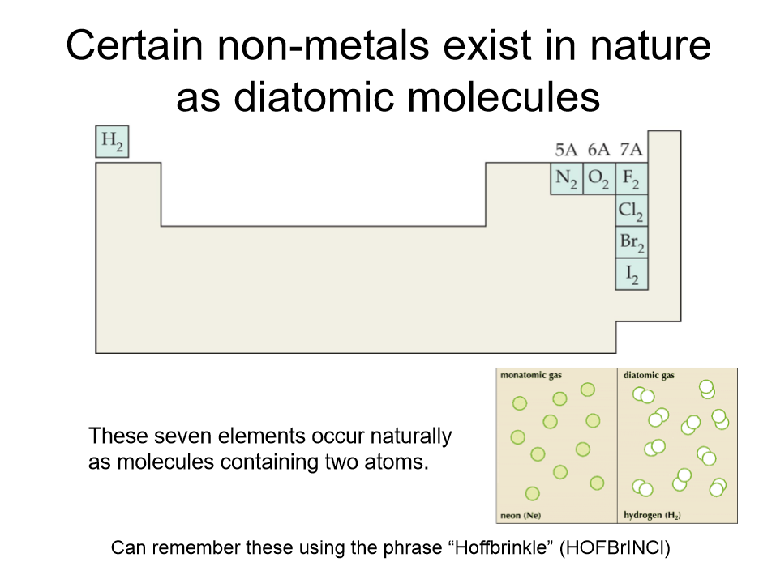

Slide 22
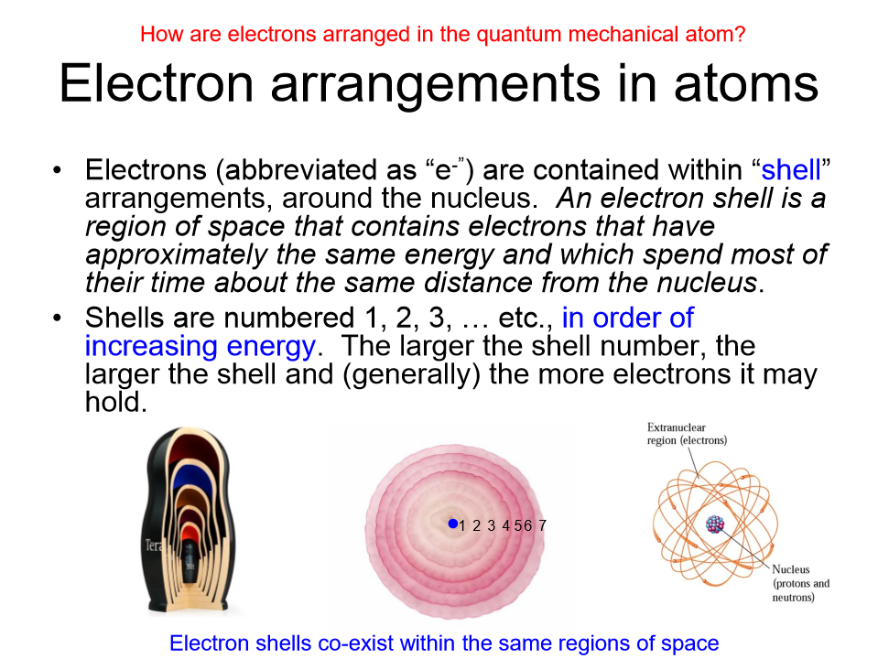

Slide 23
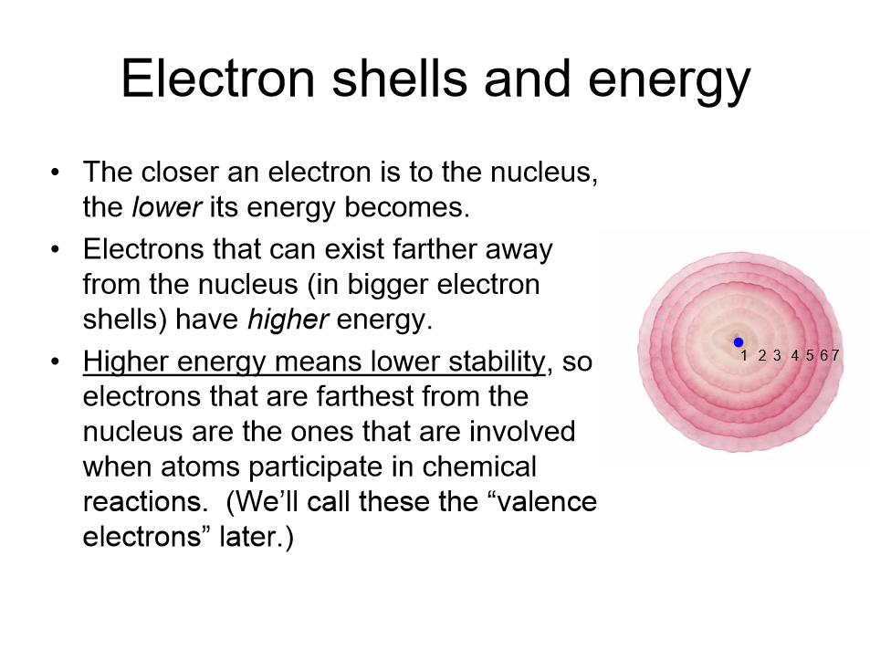

Slide 24
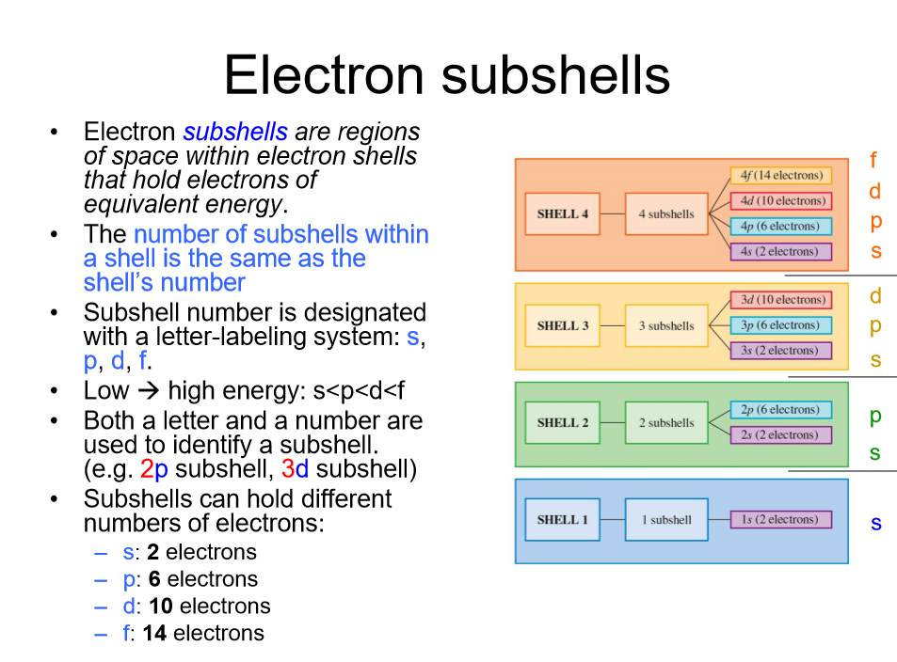

Slide 25
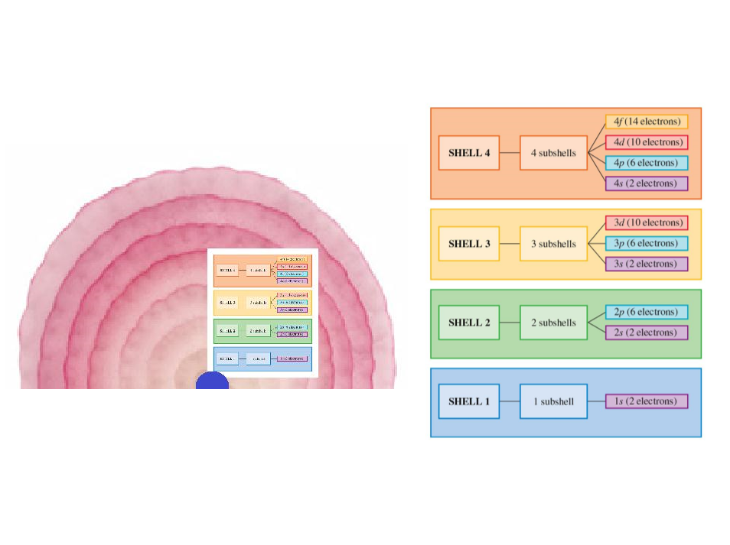

Slide 26
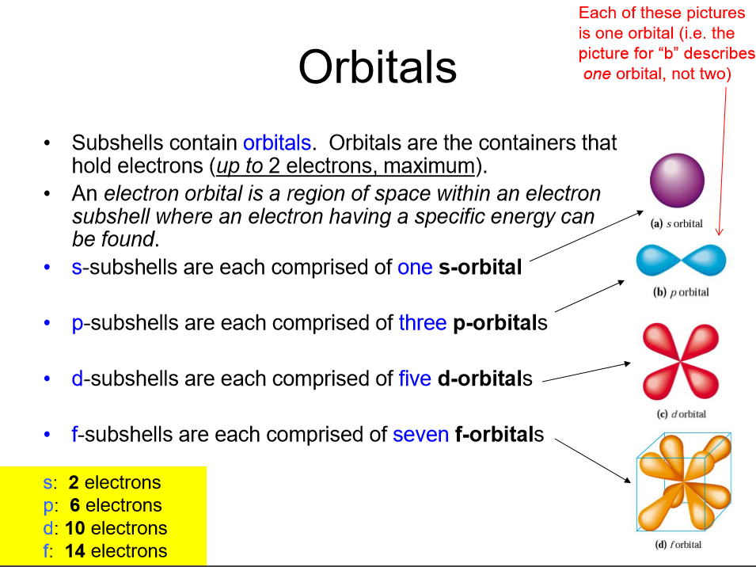

Slide 27
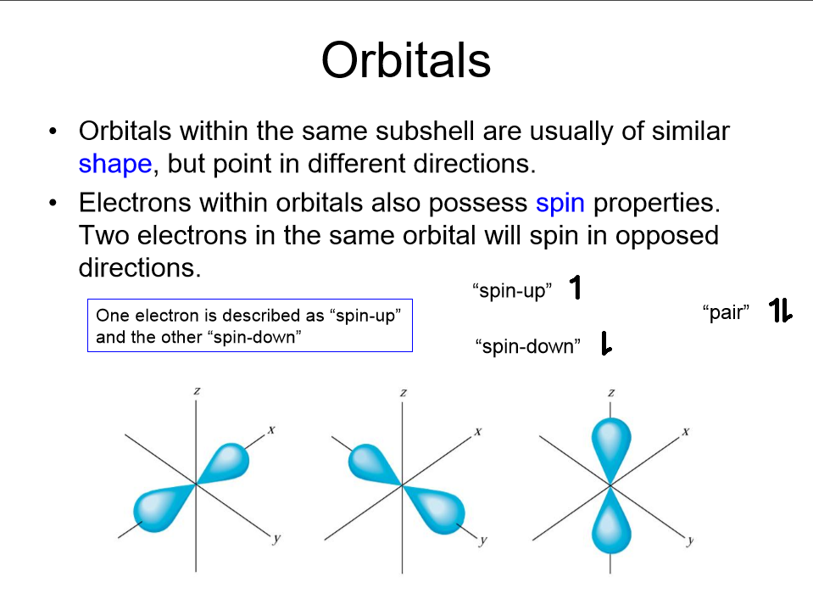

Slide 28
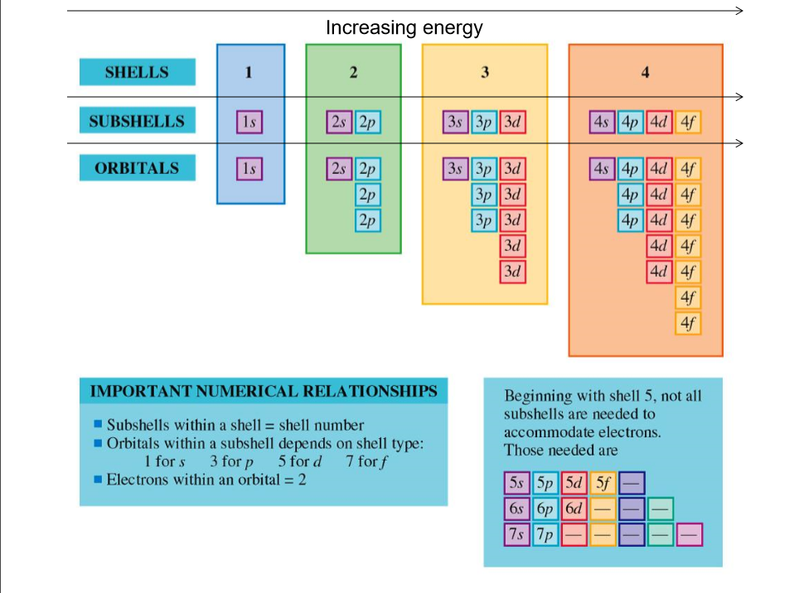

Slide 29
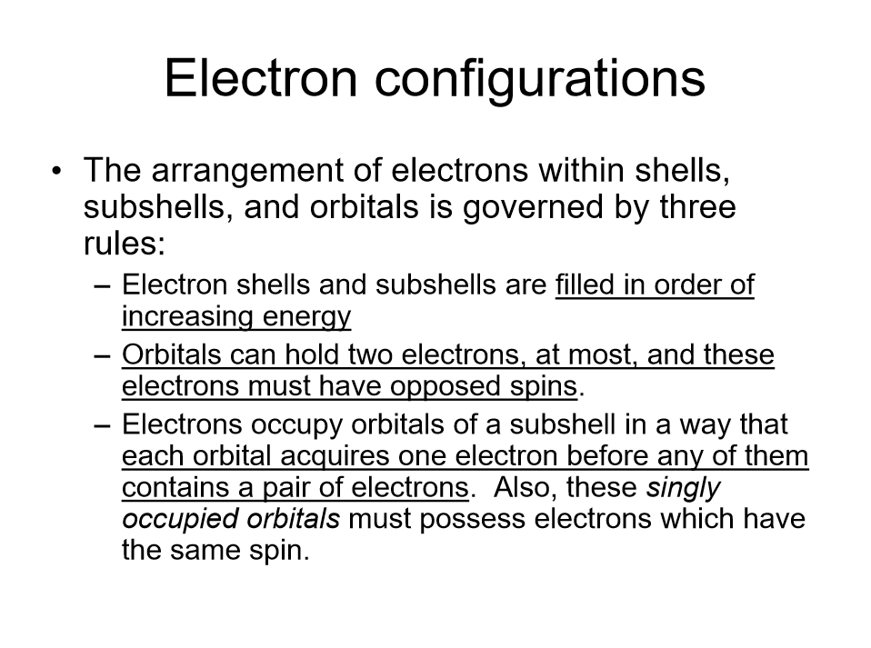

Slide 30
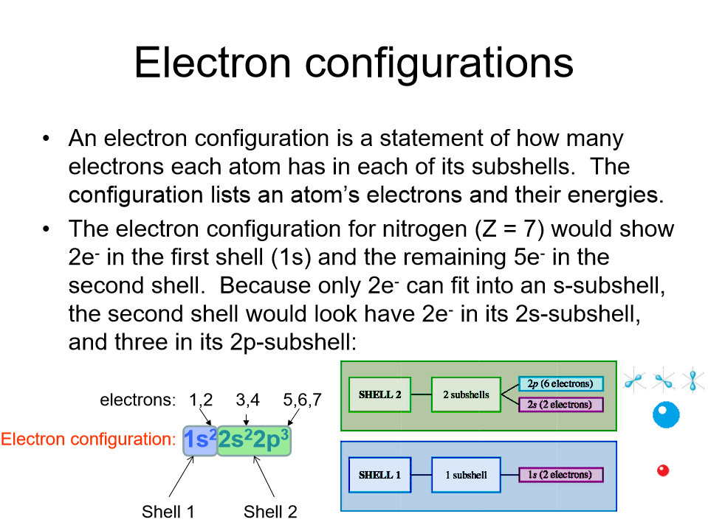

Slide 31
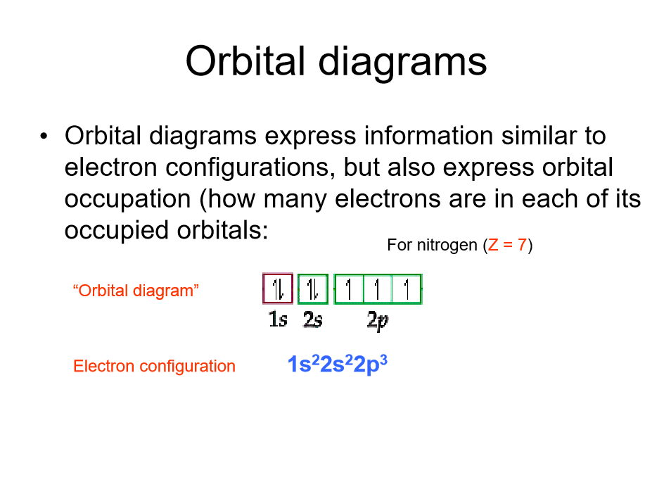

Slide 32
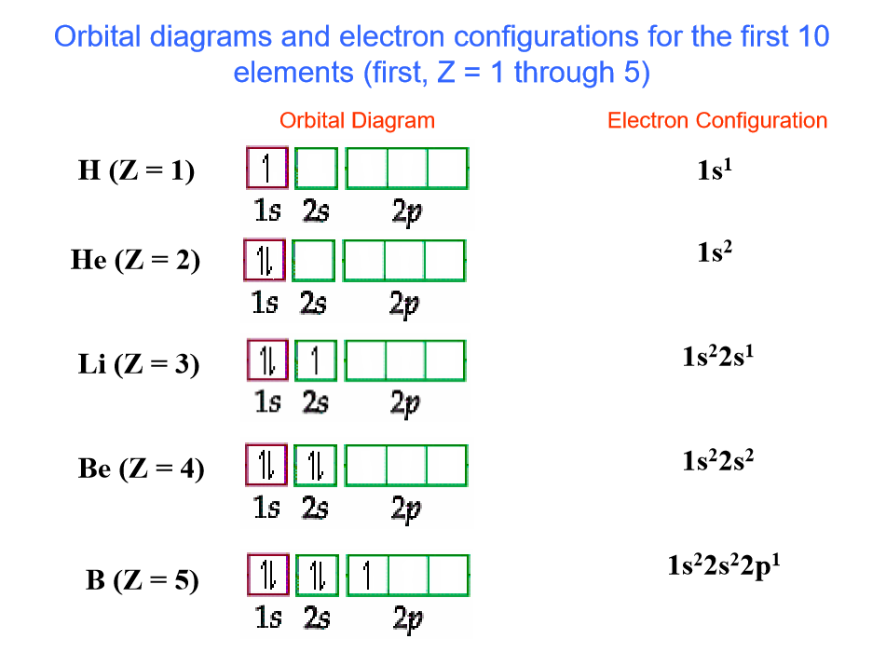

Slide 33
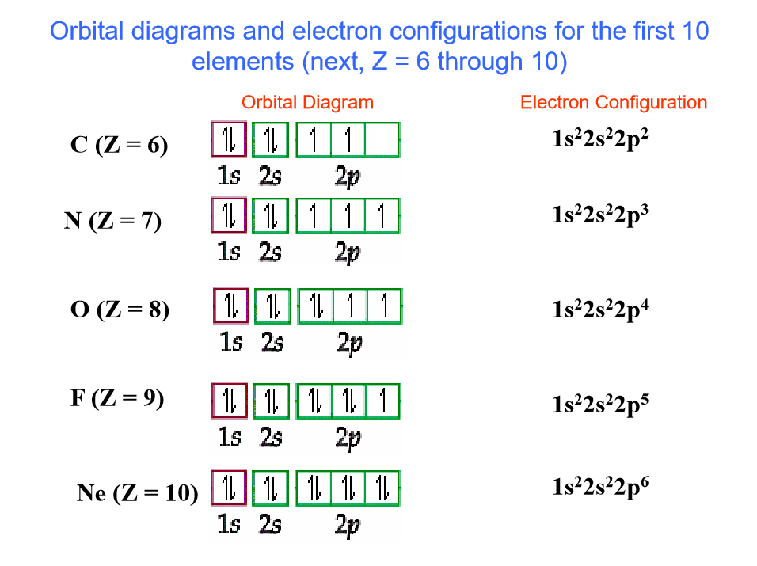

Slide 34
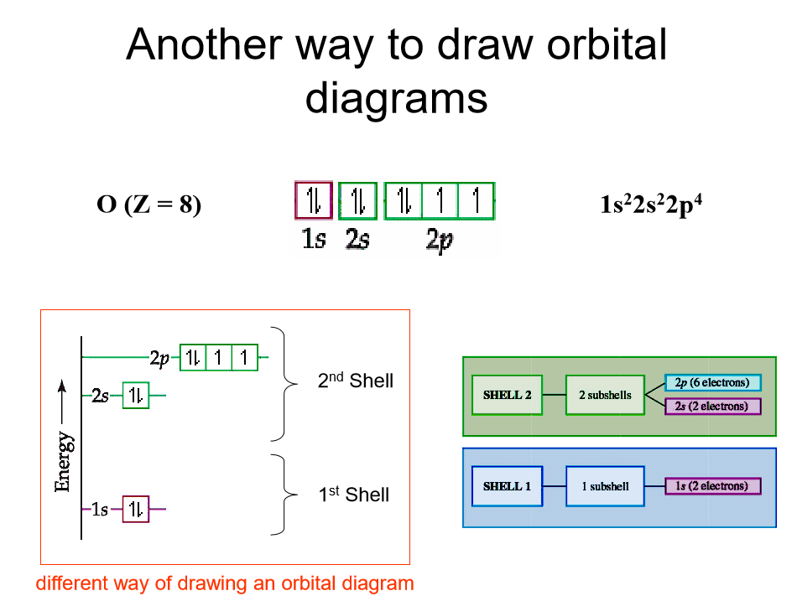

Slide 35
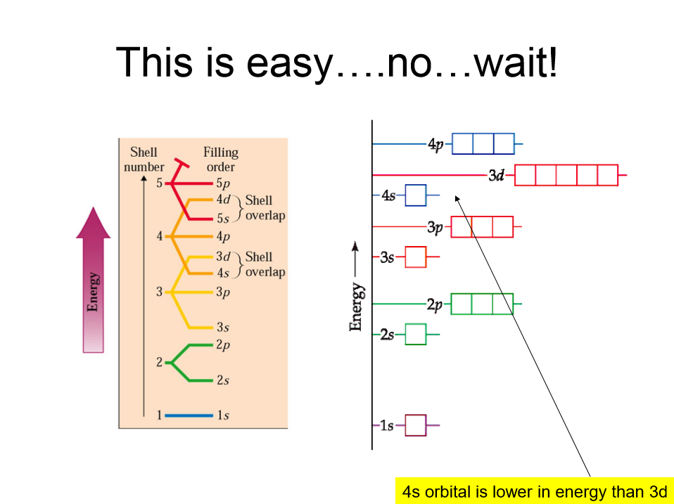

Slide 36
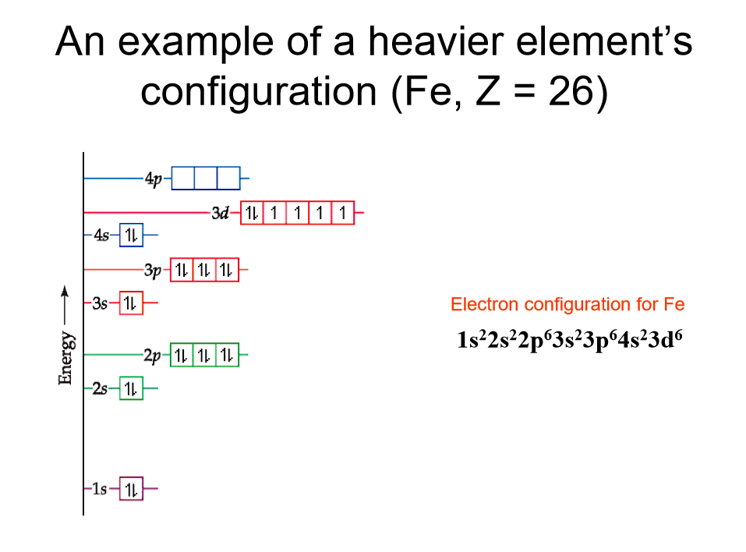

Slide 37
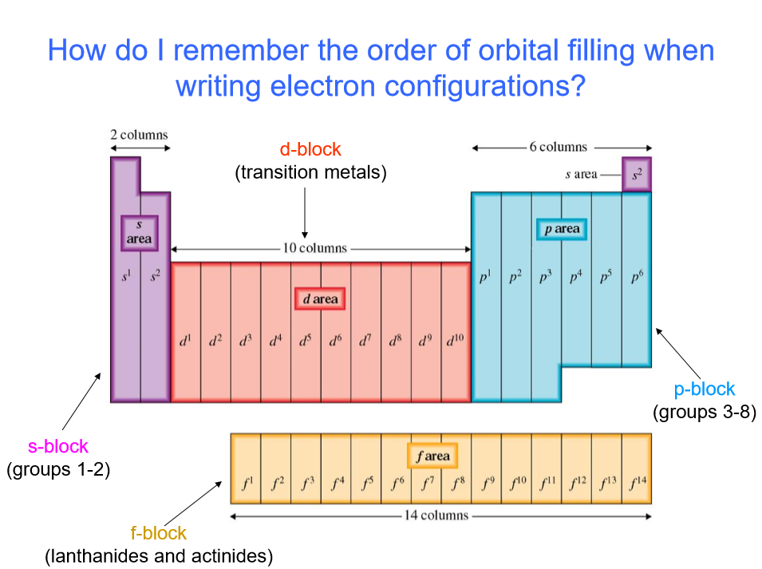

Slide 38
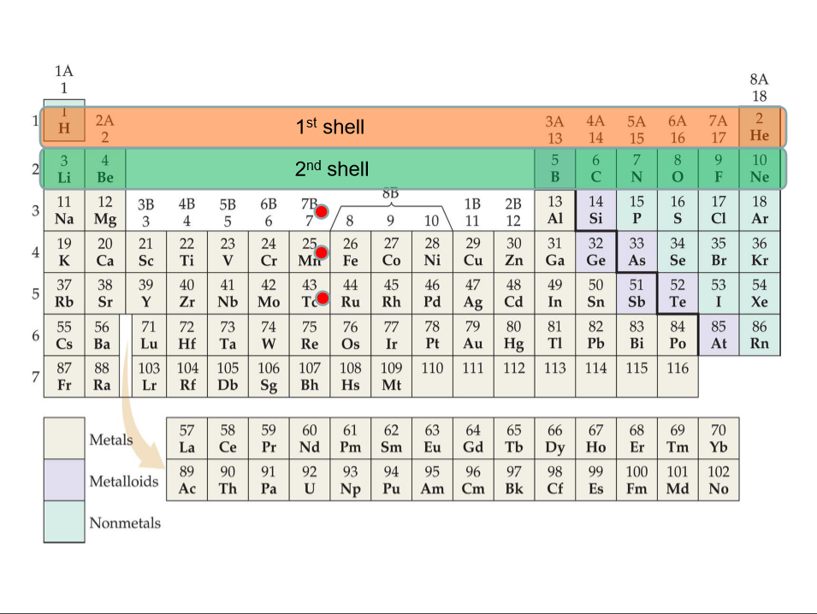

Slide 39
