Slide 1
Chemistry 120 Fall 2016
Instructor: Dr. Upali Siriwardane
e-mail: upali@latech.edu
Office: CTH 311
Phone 257-4941
Office Hours: M,W,F 9:30-11:30 am T,R 8:00-10:00 am or by appointment;
Test Dates:
September 23, 2016 (Test 1): Chapter 1,2 &3
October 13, 2016 (Test 2): Chapter 4 & 5
October 31, 2016 (Test 3): Chapter 6, 7 & 8
November 15, 2016 (Test 4): Chapter 9, 10 & 11
November 17, 2016 (Make-up test) comprehensive:
Chapters 1-11

Slide 2
Chapter 2. Measurements in Chemistry
2-1 Measurement Systems
2-2 Metric System Units
      Metric Length Units
      Metric Mass Units
      Metric Volume Units
2-3 Exact and Inexact Numbers
2-4 Uncertainty in Measurement and Significant Figures
Origin of Measurement Uncertainty
Guidelines for Determining Significant Figures
2-5 Significant Figures and Mathematical Operations
      Rounding Off Numbers
      Operational Rules
2-6 Scientific Notation
  Converting from Decimal to Scientific Notation
  Significant Figures and Scientific Notation
  Multiplication and Division in Scientific Notation
  Calculators and Scientific Notation
  Uncertainty and Scientific Notation

Slide 3
Chapter 2. Measurements in Chemistry
2-7 Conversion Factors
Conversion Factors Within a System of Units
Conversion Factors between Systems of Units
2-8 Dimensional Analysis
2-9 Density
    Density as a Conversion Factor
2-10 Temperature Scales
Conversions Between Temperature Scales
Temperature Readings and Significant Figures

Slide 4
What’s covered in this chapter?
Science and the scientific method
Measurements – what they are and what do the numbers really mean?
Units – metric system and imperial system
Numbers – exact and inexact
Significant figures and uncertainty
Scientific notation
Dimensional anaylsis (conversion factors)

Slide 5
The scientific method
In order to be able to develop explanations for phenomena.
After defining a problem
  Experiments must be designed and conducted
  Measurements must be made
  Information must be collected
  Guidelines are then formulated based on a pool of observations
Hypotheses (predictions) are made, using this data, and then tested, repeatedly.
Hypotheses eventually evolve to become laws and these are modified as new data become available
An objective point of view is crucial in this process. Personal biases must not surface.
METHOD

Slide 6
The scientific method
At some level, everything is based on a model of behavior.
Even scientific saws change because there are no absolutes.

Slide 7
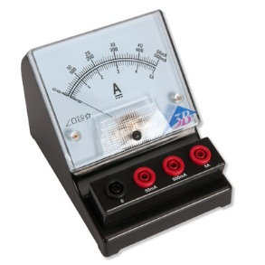
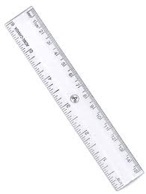
Measurements
An important part of most experiments involves the determination (often, the estimation) of quantity, volume, dimensions, capacity, or extent of something – these determinations are measurements
In many cases, some sort of scale is used to determine a value such as this. In these cases, estimations rather than exact determinations need to be made.

Slide 8
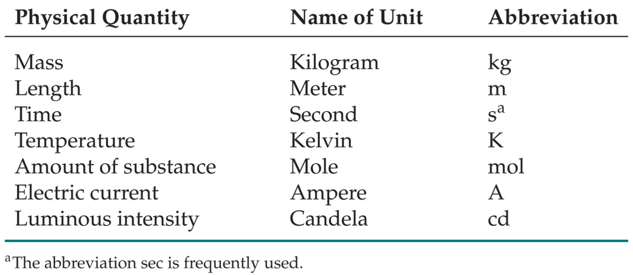
SI Units
Système International d’Unités

Slide 9
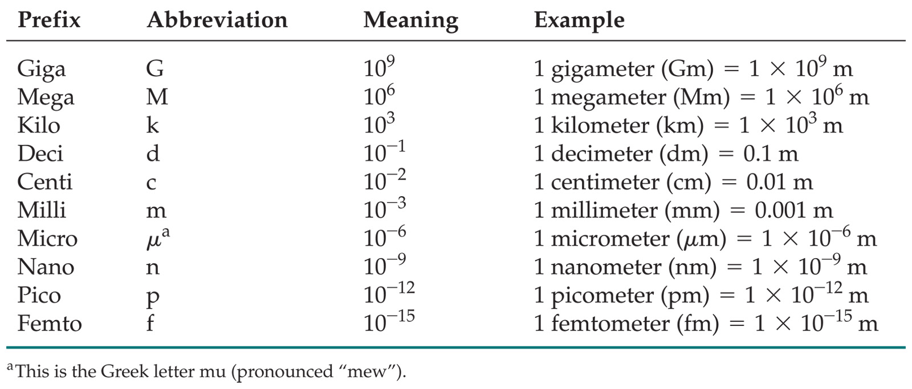
Prefix-Base Unit System
Prefixes convert the base units into units that are appropriate for the item being measured.
Know these prefixes and conversions
3.5 Gm = 3.5 x 10⁹ m = 3500000000 m
and 0.002 A = 2 mA
So,

Slide 10
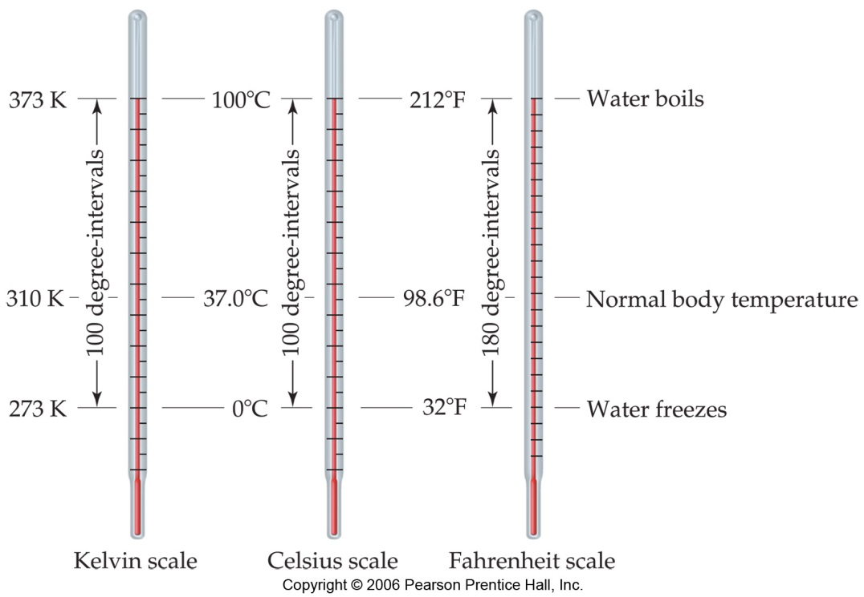
Temperature:
A measure of the average kinetic energy of the particles in a sample.
Kinetic energy is the energy an object possesses by virtue of its motion
As an object heats up, its molecules/atoms begin to vibrate in place. Thus the temperature of an object indicates how much kinetic energy it possesses.
Farenheit: ºF = (9/5)(ºC) + 32 ºF

Slide 11
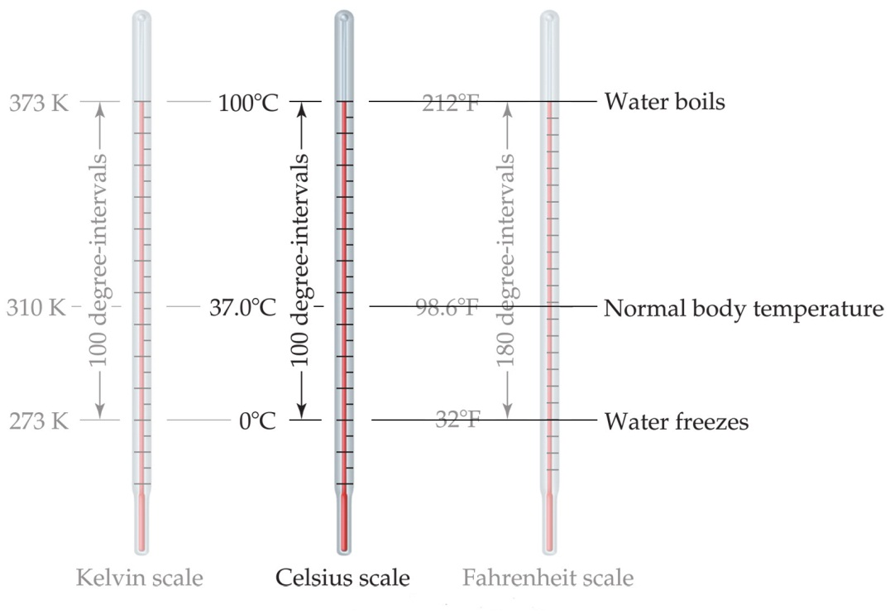
Temperature
In scientific measurements, the Celsius and Kelvin scales are most often used.
The Celsius scale is based on the properties of water.
  0°C is the freezing point of water.
  100°C is the boiling point of water.

Slide 12
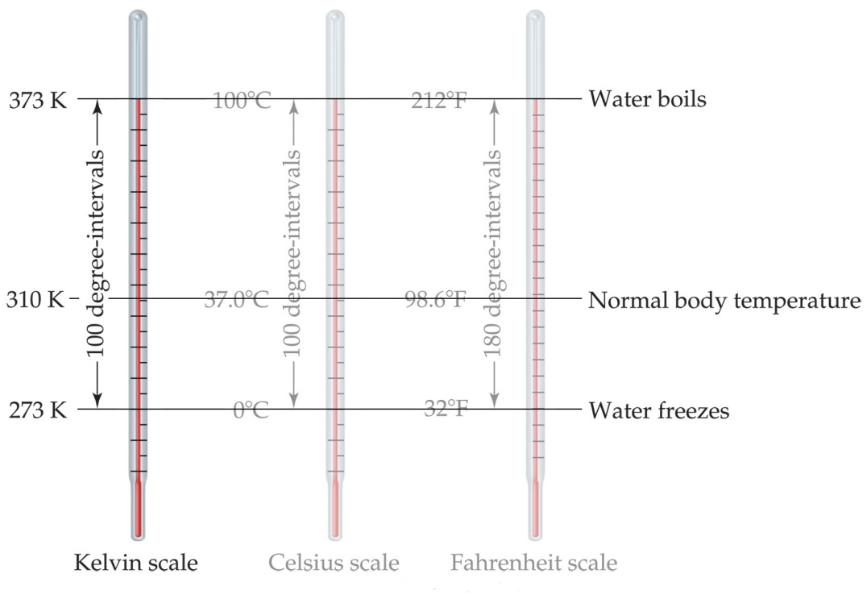
Temperature
The Kelvin is the SI unit of temperature.
It is based on the properties of gases.
There are no negative Kelvin temperatures.
K = °C + 273
0 (zero) K = absolute zero = -273 ºC

Slide 13
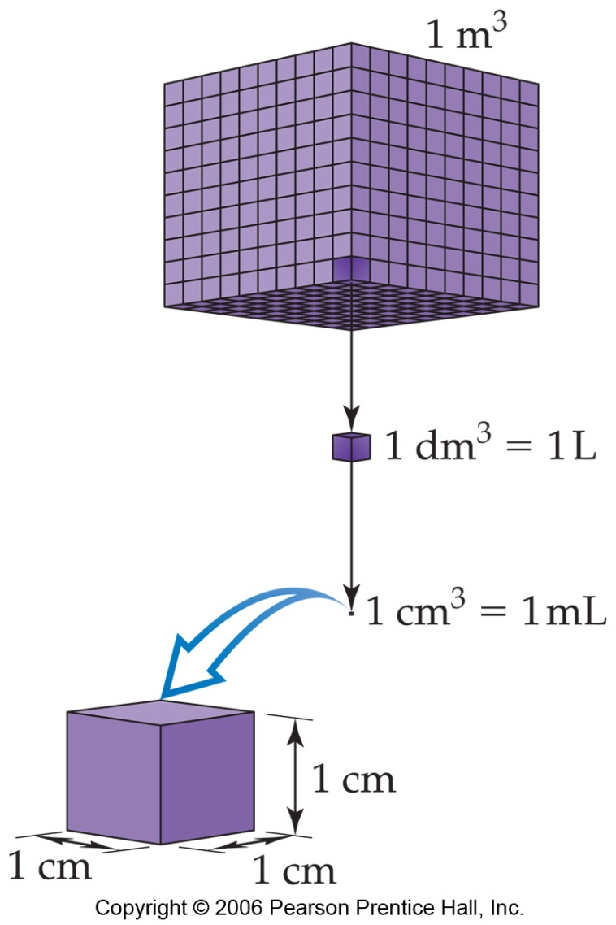
Volume
The most commonly used metric units for volume are the liter (L) and the milliliter (mL).
  A liter is a cube 1 dm long on each side.
  A milliliter is a cube 1 cm long on each side.
1 m = 10 dm
(1 m)³ = (10 dm)³
1 m³ = 1000 dm³
or
0.001 m³ = 1 dm³
1 dm = 10 cm
(1 dm)³ = (10 cm)³
1 dm³ = 1000 cm³
or
0.001 dm³ = 1 cm³
These are conversion factors
1 m = 10 dm = 100 cm
Incidentally, 1 m³ = 1x10⁶ cm³

Slide 14
Density:
Another physical property of a substance – the amount of mass per unit volume
m
V
mass
Density does not have an
assigned SI unit – it’s a
combination of mass and
length SI components.
d=
volume
e.g. The density of water at room temperature (25ºC) is ~1.00 g/mL; at 100ºC = 0.96 g/mL

Slide 15
Density:
Density is temperature-sensitive, because the volume that a sample occupies can change with temperature.
Densities are often given with the temperature at which they were measured. If not, assume a temperature of about 25ºC.

Slide 16
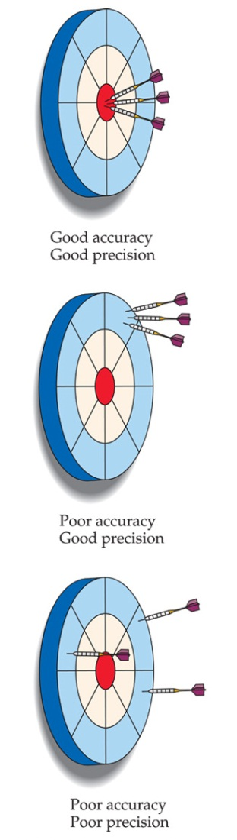
Accuracy versus Precision
Accuracy refers to the proximity of a measurement to the true value of a quantity.
Precision refers to the proximity of several measurements to each other (Precision relates to the uncertainty of a measurement).
For a measured quantity, we can generally improve its accuracy by making more
measurements

Slide 17
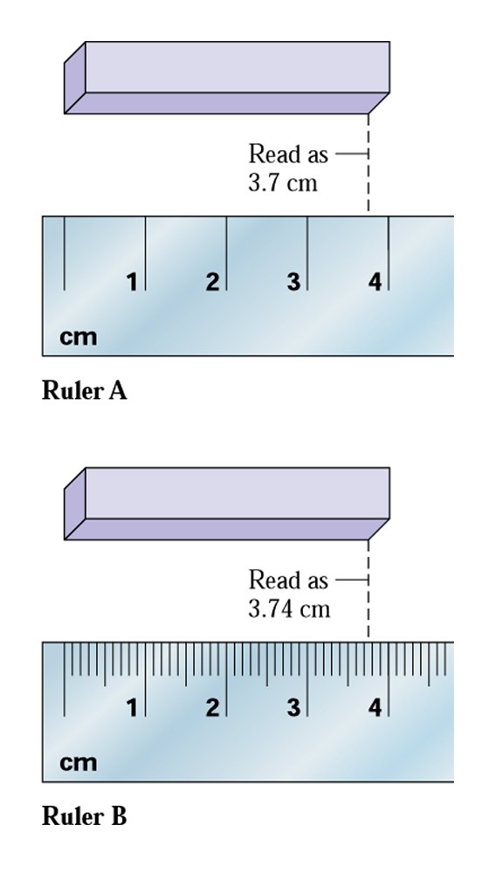
Measured Quantities and Uncertainty
The measured quantity, 3.7, is an estimation;
however, we have different degrees of confidence
in the 3 and the 7 (we are sure of the 3, but not
so sure of the 7).
Whenever possible, you should estimate a
measured quantity to one decimal place
smaller than the smallest graduation on a scale.

Slide 18
Uncertainty in Measured Quantities
When measuring, for example, how much an apple weighs, the mass can be measured on a balance. The balance might be able to report quantities in grams, milligrams, etc.
Let’s say the apple has a true mass of 55.51 g. The balance we are using reports mass to the nearest gram and has an uncertainty of +/- 0.5 g.
The balance indicates a mass of 56 g
The measured quantity (56 g) is true to some extent and misleading to some extent.
The quantity indicated (56 g) means that the apple has a true mass which should lie within the range 56 +/- 0.5 g (or between 55.5 g and 56.5 g).

Slide 19
Significant Figures
The term significant figures refers to the meaningful digits of a measurement.
The significant digit farthest to the right in the measured quantity is the uncertain one (e.g. for the 56 g apple)
When rounding calculated numbers, we pay attention to significant figures so we do not overstate the accuracy of our answers.
In any measured quantity, there will be some uncertainty associated
with the measured value. This uncertainty is related to limitations of the
technique used to make the measurement.

Slide 20
Exact quantities
In certain cases, some situations will utilize relationships that are exact, defined quantities.
  For example, a dozen is defined as exactly 12 objects (eggs, cars, donuts, whatever…)
  1 km is defined as exactly 1000 m.
  1 minute is defined as exactly 60 seconds.
Each of these relationships involves an infinite number of significant figures following the decimal place when being used in a calculation.
Relationships between metric units are exact (e.g. 1 m = 1000 mm, exactly)
Relationships between imperial units are exact (e.g. 1 yd = 3 ft, exactly)
Relationships between metric and imperial units are not exact (e.g. 1.00 in = 2.54 cm)

Slide 21
Significant Figures
When a measurement is presented to you in a problem, you need to know how many
of the digits in the measurement are actually significant.
All nonzero digits are significant. (1.644 has four significant figures)
Zeroes between two non-zero figures are themselves significant. (1.6044 has five sig figs)
Zeroes at the beginning (far left) of a number are never significant. (0.0054 has two sig figs)
Zeroes at the end of a number (far right) are significant if a decimal point is written in the number. (1500. has four sig figs, 1500.0 has five sig figs)
(For the number 1500, assume there are two significant figures, since this number could be written as 1.5 x 10³.)

Slide 22
Rounding
Reporting the correct number of significant figures for some calculation you carry out often requires that you round the answer to the correct number of significant figures.
Rules: round the following numbers to 3 sig figs
  5.483
  5.486
  (this would round to 5.48, since 5.483 is closer to 5.48 than it is to 5.49)
(this would round to 5.49)
If calculating an answer through more than one step,
only round at the final step of the calculation.

Slide 23
Significant Figures
When addition or subtraction is performed, answers are rounded to the least significant decimal place.
When multiplication or division is performed, answers are rounded to the number of digits that corresponds to the least number of significant figures in any of the numbers used in the calculation.
Example: 20.4 + 1.332 + 83 = 104.732 = 105
“rounded”
Example: 6.2/5.90 = 1.0508… = 1.1

Slide 24
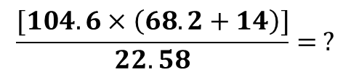
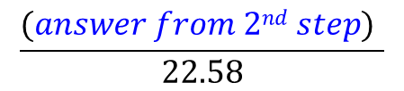
Significant Figures
If both addition/subtraction and multiplication/division are used in a problem, you need to follow the order of operations, keeping track of sig figs at each step, before reporting the final answer.
1) Calculate (68.2 + 14). Do not round the answer, but keep in mind how many sig figs
the answer possesses.
2) Calculate [104.6 x (answer from 1st step)]. Again, do not round the answer yet, but
keep in mind how many sig figs are involved in the calculation at this point.
3) , and then round the answer to the correct sig figs.

Slide 25
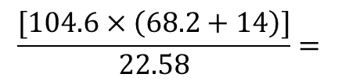
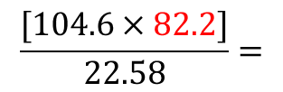
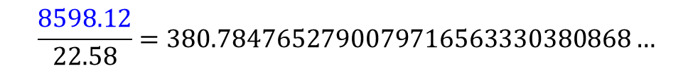

Significant Figures
If both addition/subtraction and multiplication/division are used in a problem, you need to follow the order of operations, keeping track of sig figs at each step, before reporting the final answer.
Despite what our calculator
tells us, we know that this
number only has 2 sig figs.
Despite what our calculator
tells us, we know that this
number only has 2 sig figs.
Our final answer should
be reported with 2 sig figs.

Slide 26
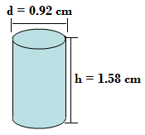
An example using sig figs
In the first lab, you are required to measure the height and diameter of a metal cylinder, in order to get its volume
Sample data:
  height (h) = 1.58 cm
  diameter = 0.92 cm; radius (r) = 0.46 cm
Volume = πr²h = π(0.46 cm)²(1.58 cm)
= 1.050322389 cm³
V = πr²h
2 sig figs
3 sig figs
If you are asked to
report the volume,
you should round your
answer to 2 sig figs
Only operation here
is multiplication
Answer = 1.1 cm³

Slide 27
Calculation of Density
If your goal is to report the density of the cylinder (knowing that its mass is 1.7 g), you would carry out this calculation as follows:
Then round the answer to the proper
number of sig figs
Please keep in mind that although the “non-rounded”
volume figure is used in this calculation, it is still understood
that for the purposes of rounding in this problem, it contains
only two significant figures (as determined on the last slide)
Use the non-rounded volume figure for the calculation of the density. If a rounded volume
of 1.1 cm³ were used, your answer would come to 1.5 g/cm³

Slide 28
Dimensional Analysis
(conversion factors)
The term, “dimensional analysis,” refers to a procedure that yields the conversion of units, and follows the general formula:
conversion factor

Slide 29
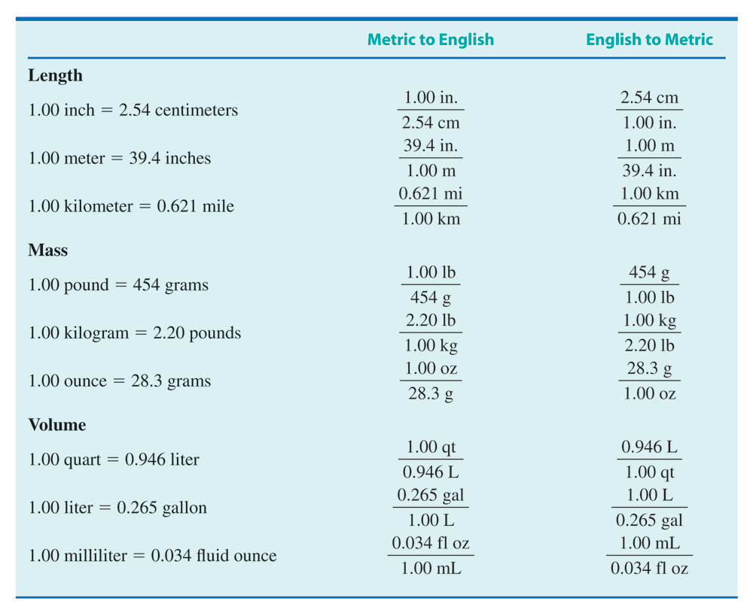
Some useful conversions
This chart shows all metric – imperial
(and imperial – metric) system
conversions. They each involve a
certain number of sig figs.
Metric - to – metric and imperial –
to – imperial conversions are exact
quantities.
Examples:
16 ounces = 1 pound
1 kg = 1000 g
exact
relationships

Slide 30
Sample Problem
A calculator weighs 180.5 g. What is its mass, in kilograms?
“given units” are grams, g
“desired units” are kilograms. Make a ratio that involves both units.
Since 1 kg = 1000g
conversion factor is made using this relationship
Both 1 kg and 1000 g are exact numbers
here (1 kg is defined as exactly 1000 g);
assume an infinite number of decimal
places for these
The mass of the calculator has four sig figs.
(the other numbers have many more sig figs)
The answer should be reported with four sig figs

Slide 31
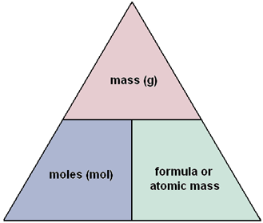
Dimensional Analysis
Advantages of learning/using dimensional analysis for problem solving:
  Reinforces the use of units of measurement
  You don’t need to have a formula for solving most problems
How many moles of H₂O are present in 27.03g H₂O?

Slide 32
Sample Probelm

Slide 33
Sample Problem
A car travels at a speed of 50.0 miles per hour (mi/h). What is its speed in units of meters per second (m/s)?
Two steps involved here:
  Convert miles to meters
  Convert hours to seconds
a measured quantity
0.621 mi = 1.00 km
1 km = 1000 m
1 h = 60 min
1 min = 60 s
should be 3 sig figs

