Slide 1
Chapter 11
Nuclear Chemistry

Slide 2
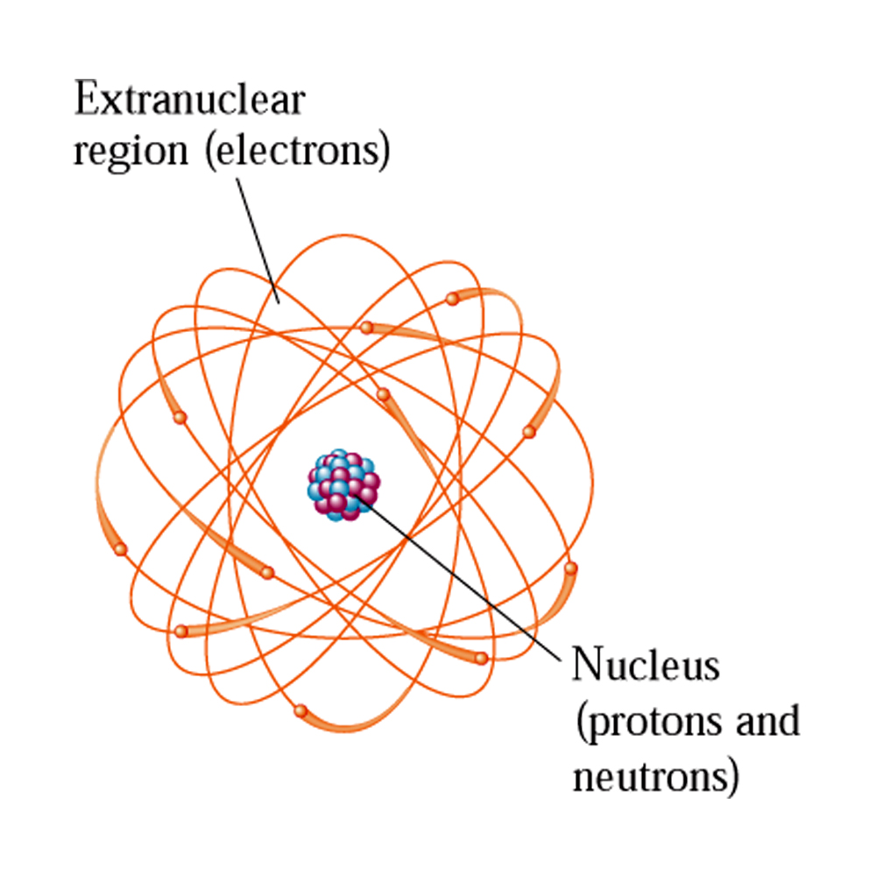
Nuclear Chemistry

Slide 3
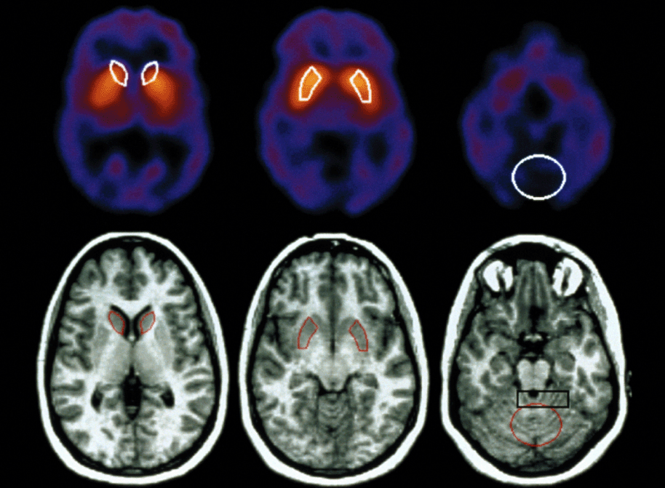

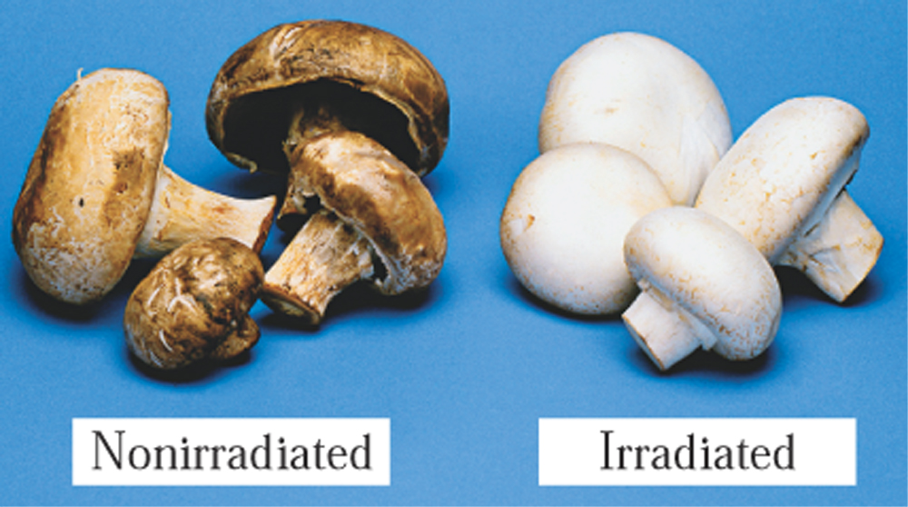

Slide 4
Summary
Stable and unstable nuclides
The nature of radioactive emissions
Equations for radioactive decay
Rate of radioactive decay
Transmutation and bombardment reactions
Radioactive decay series
Chemical effects of radiation
Biochemical effects of radiation
Detection of radiation
Sources of radiation exposure
Nuclear medicine
Nuclear fission and nuclear fusion
Nuclear and chemical reactions compared

Slide 5
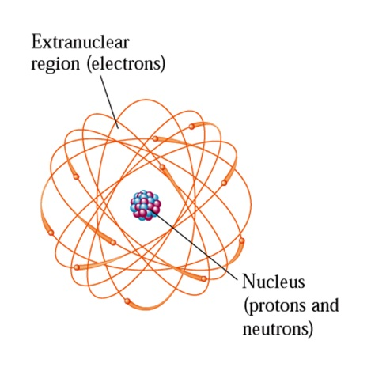
Stable and unstable nuclides
In the reactions we’ve considered so far, where chemical bonds are broken and new ones formed, it is electrons which are gained and lost (or move, at least).
Nuclear reactions involve changes in the number of nucleons of atoms. Thus the changes occur in the nucleus of an atom.
Nucleons are subatomic particles that reside in the nucleus of the atom.
  protons
  neutrons

Slide 6
Stable and unstable nuclides
Some terms we’ll be using:
  Nuclide: a nuclide is an atom with a specific mass number and atomic number
  ¹²C is a nuclide. Each ¹²C nuclide has 6 protons and 6 neutrons. To contrast, C is an element, and a C atom may have a mass number of 12, or may not.

Slide 7
Stable and unstable nuclides
Isotopes are atoms of the same element that have different mass numbers:
  ¹²C and ¹³C are both carbon atoms (i.e. they each have 6 protons), but they have different numbers of neutrons.

Slide 8
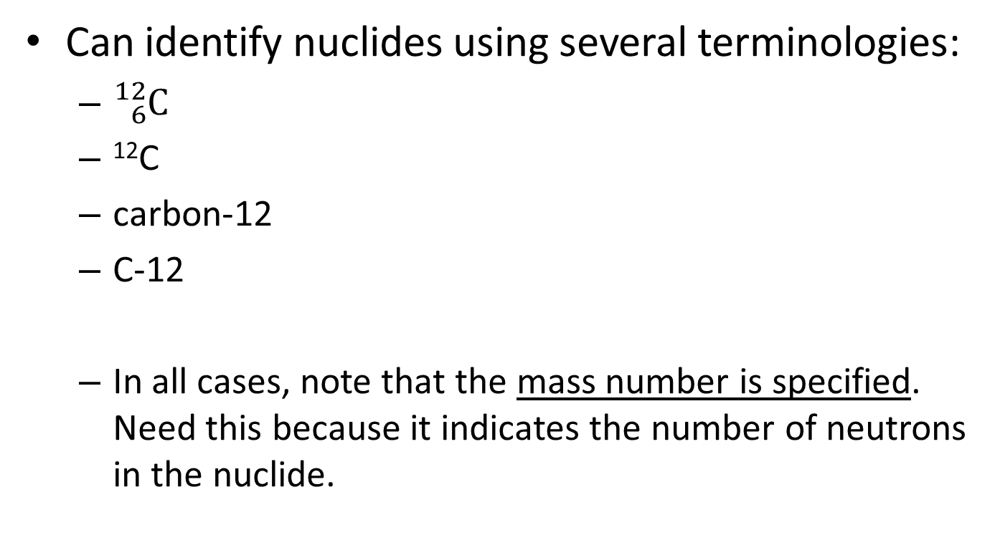
Stable and unstable nuclides

Slide 9
Stable and unstable nuclides
Nuclides are divided into two basic categories of reactivity, based on their stabilities:
  Stable nuclide: possesses a nucleus that does not readily undergo changes
  Unstable nuclide: undergoes spontaneous changes in the nucleus. The changes involve the emission of radiation, after which, the nucleus becomes more stable.

Slide 10
Stable and unstable nuclides
Radioactivity is the spontaneous emission of radiation from a nucleus undergoing changes.
Nuclides which possess unstable nuclei are said to be radioactive. Radioactive nuclides are sometimes called radionuclides.
Naturally occurring radionuclides are known for 29 elements; however, all stable nuclei can be made unstable (e.g. through nuclear bombardment processes).

Slide 11
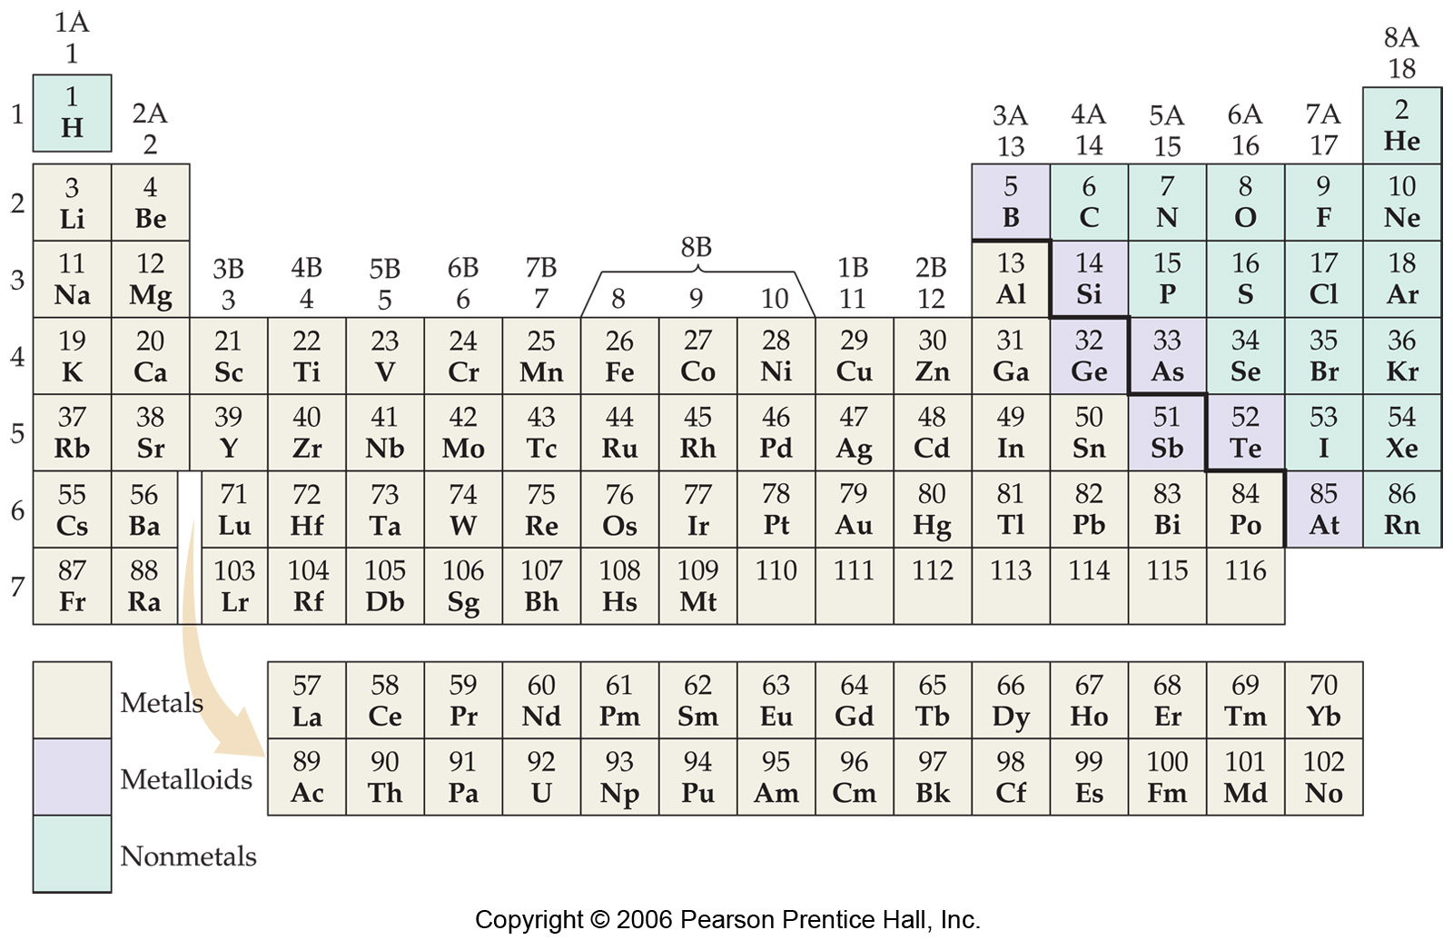

Slide 12
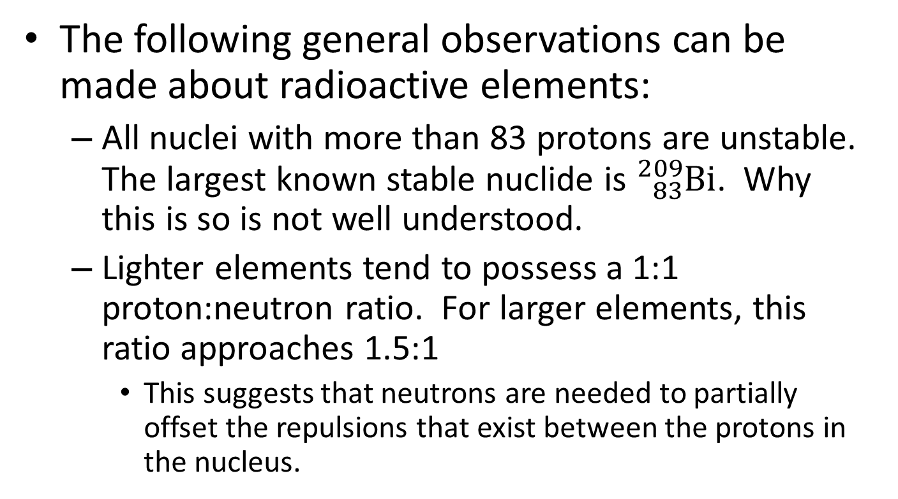
Stable and unstable nuclides

Slide 13
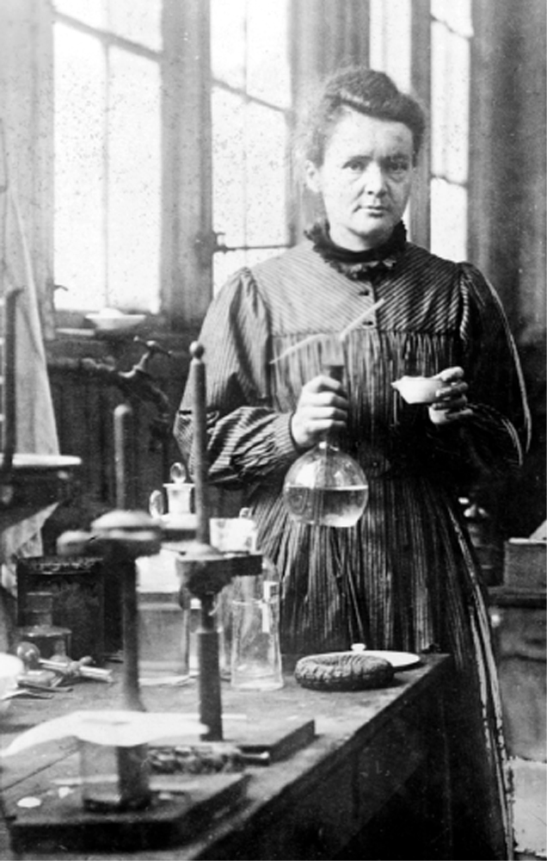
The nature of radioactive emissions
Timeline:
  Spontaneous emission of radiation was discovered by Becquerel in 1896
  Marie and Pierre Curie carried out investigations on the nature of radiation (~ 1898-1906). Marie Curie continued this work after her husband’s death in 1906. M. Curie coined the term, “radioactivity”
  Rutherford determined that radiation consists of up to three components (1898-1899)

Slide 14
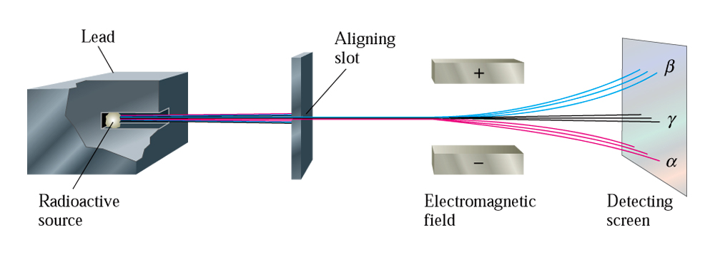
The nature of radioactive emissions

Slide 15
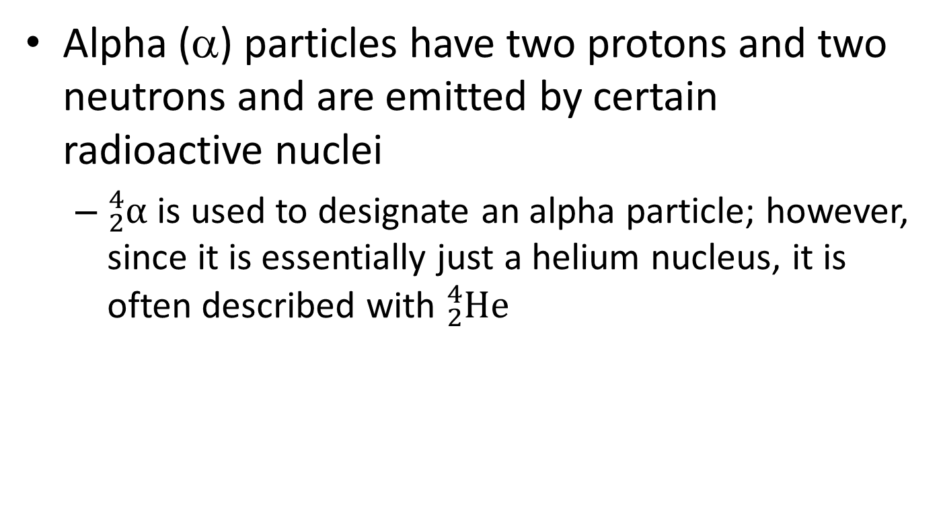
The nature of radioactive emissions

Slide 16
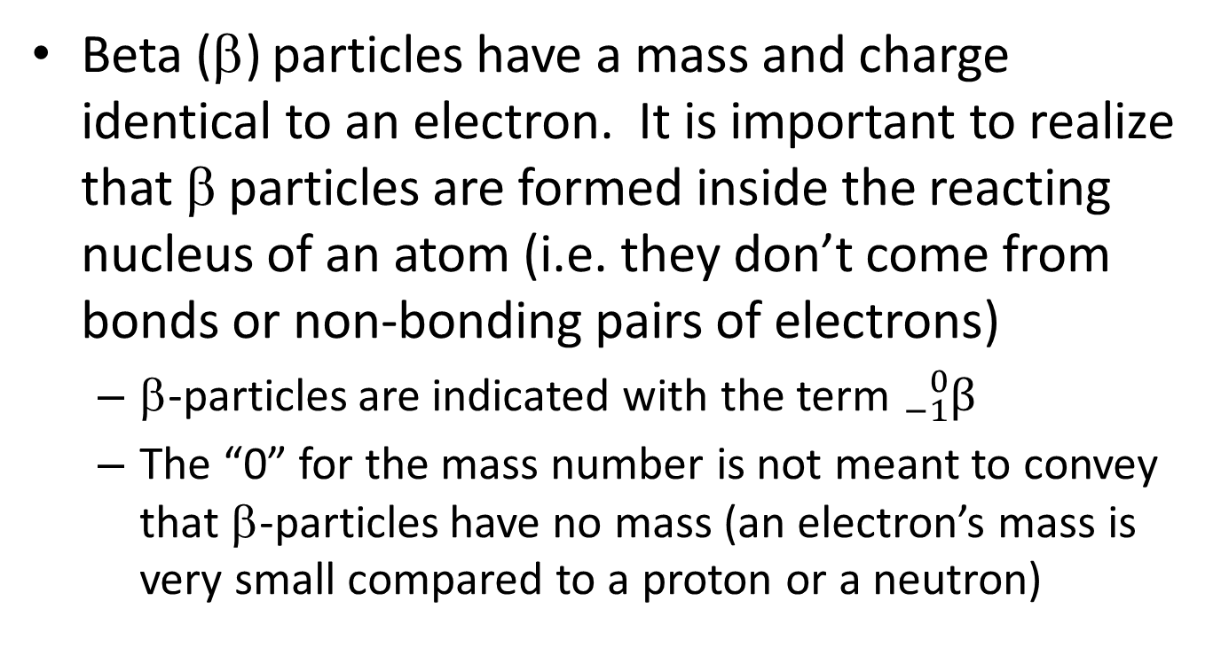
The nature of radioactive emissions

Slide 17
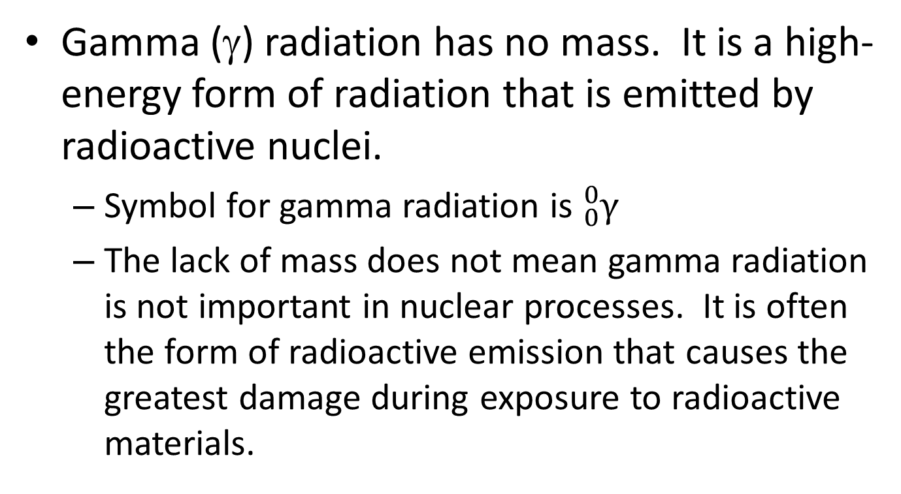
The nature of radioactive emissions

Slide 18
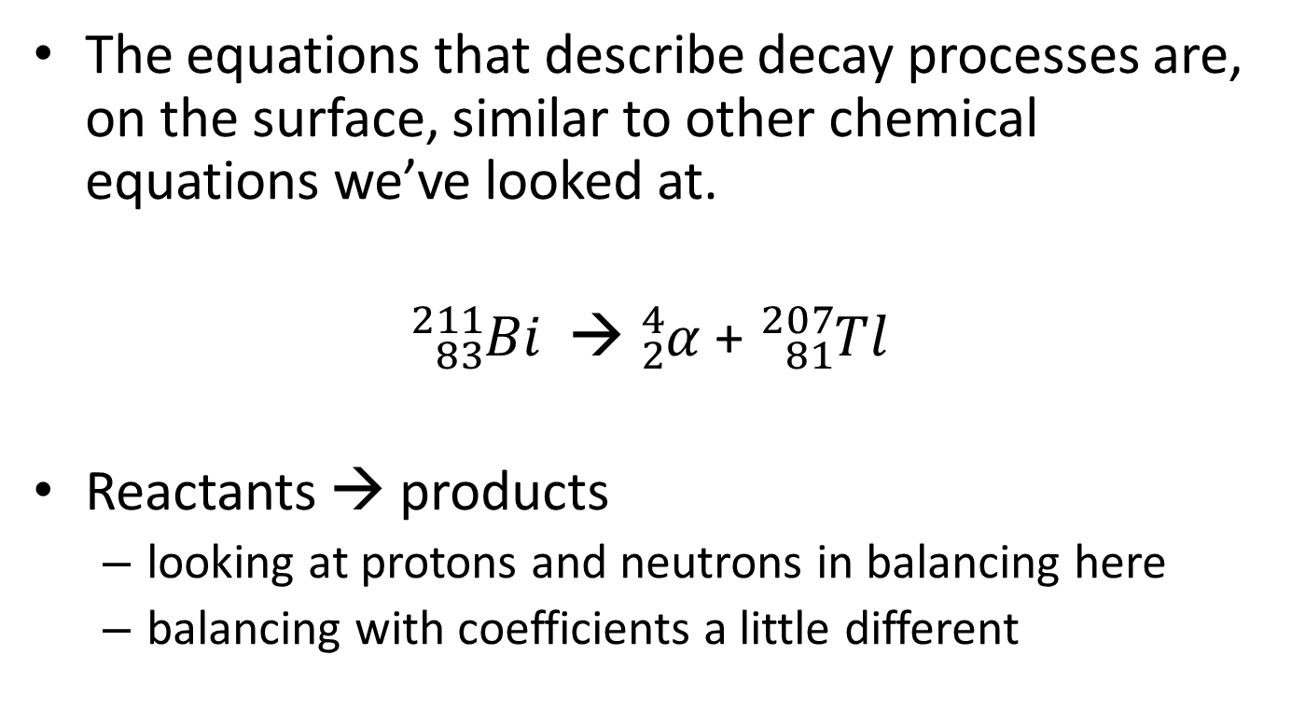
Equations for radioactive decay
“Parent nuclide”
“Daughter nuclide”

Slide 19
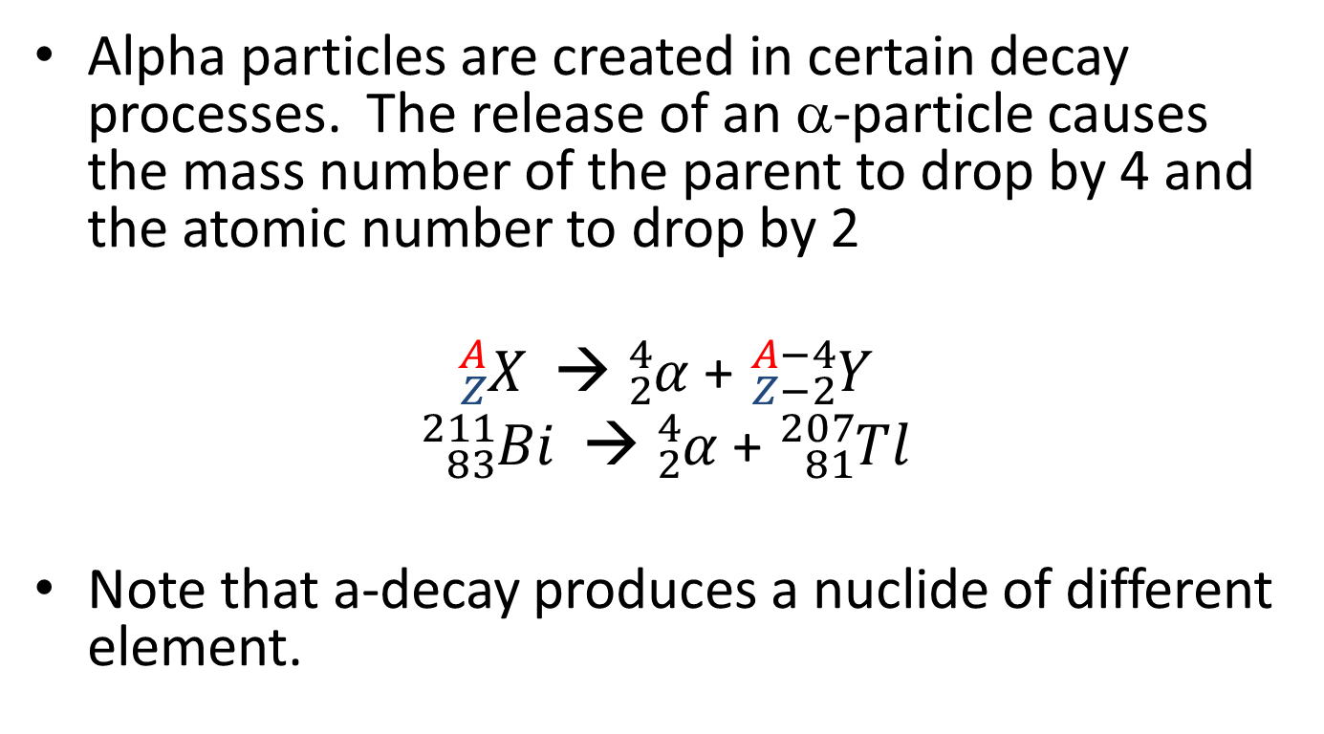
Equations for radioactive decay

Slide 20
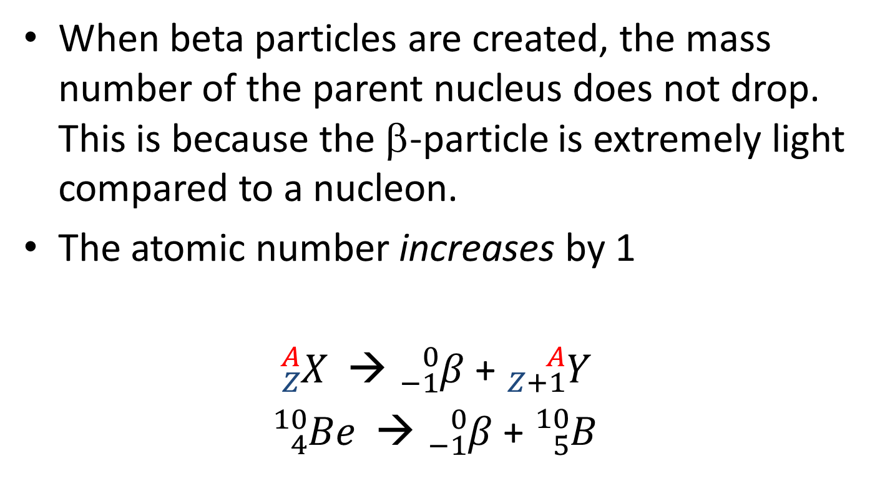
Equations for radioactive decay

Slide 21
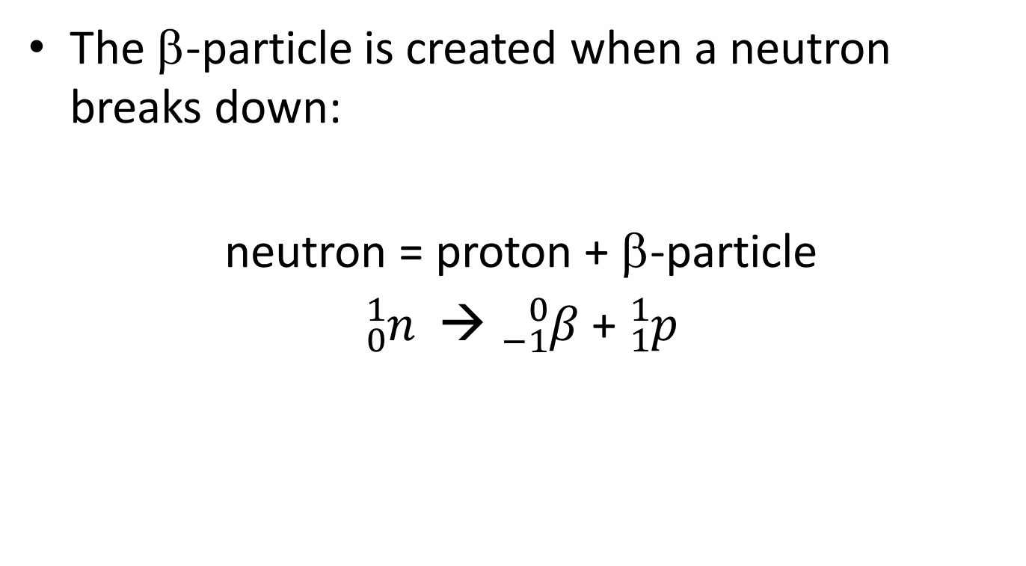
Equations for radioactive decay

Slide 22
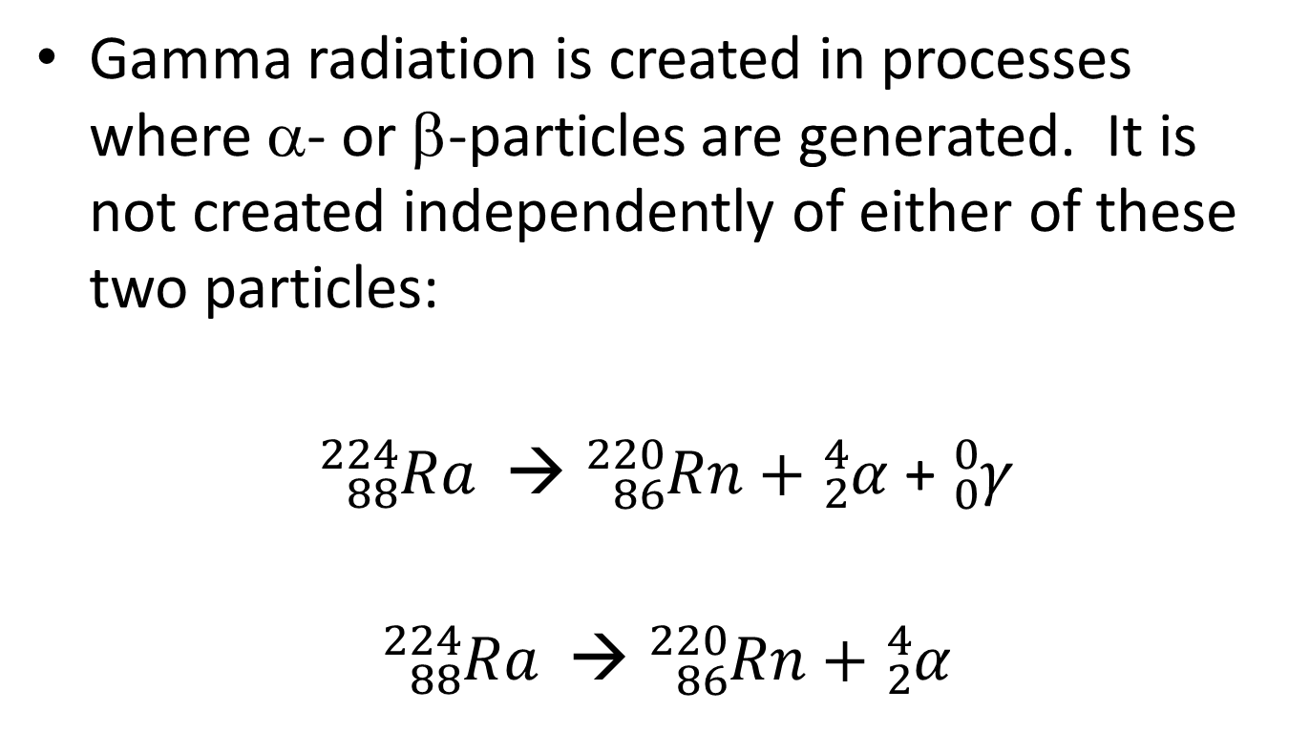
Equations for radioactive decay
Often, will see the equation written like this

Slide 23
Rates of radioactive decay
The rate at which nuclides decay is indicated by the term, half-life. The half-life of a radionuclide is the amount of time it takes for ½ of the amount of the nuclide to undergo radioactive decay.
For an 80.0 g sample of a radioactive nuclide, after one half-life, there will be 40.0 g remaining.
After a second half-life passes, there will be 20.0 g of the nuclide remaining.
After a third half life, there will be 10.0 g remaining, etc.

Slide 24
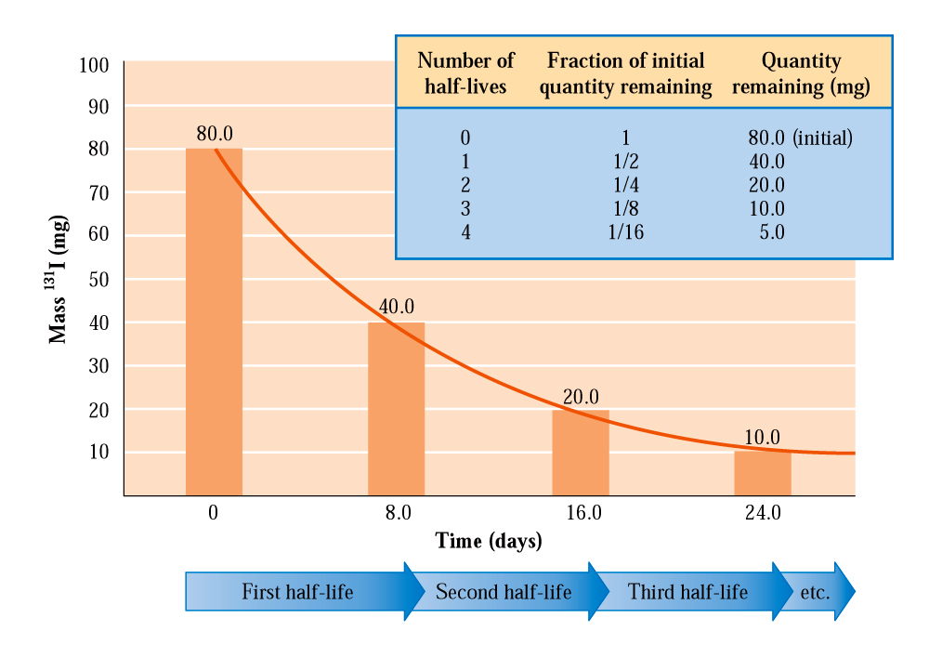
Rates of radioactive decay

Slide 25
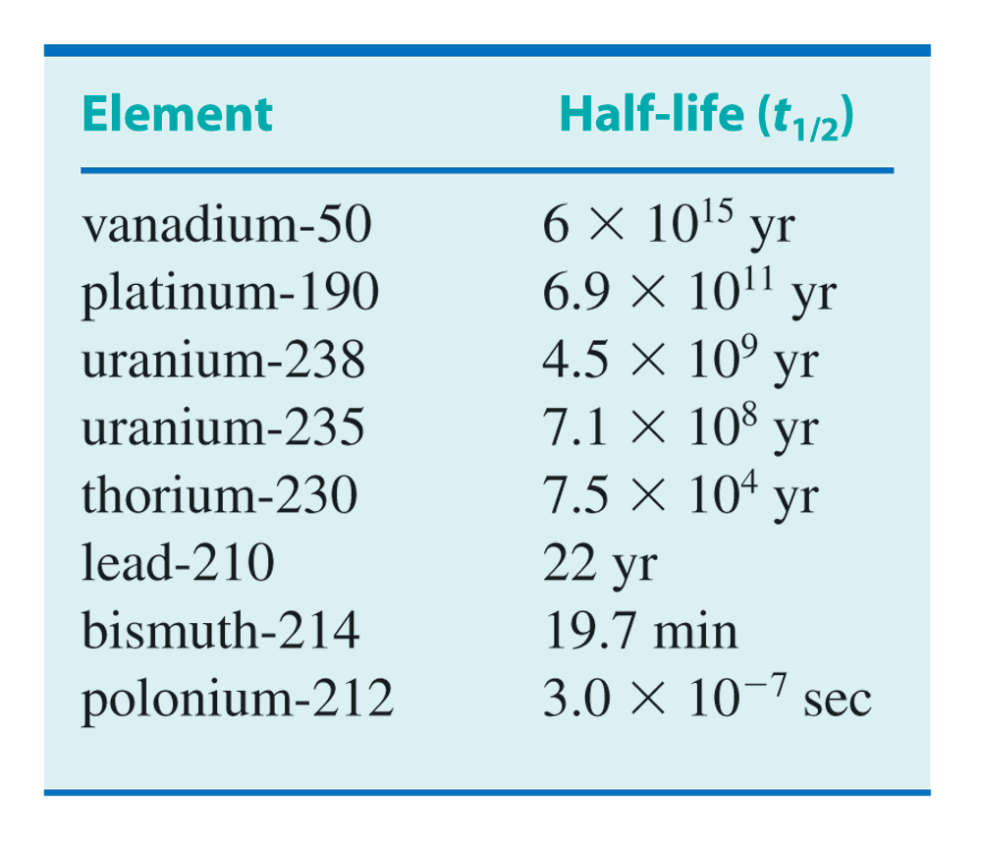
Rates of radioactive decay
A short half-life means the nuclide decays quickly.

Slide 26
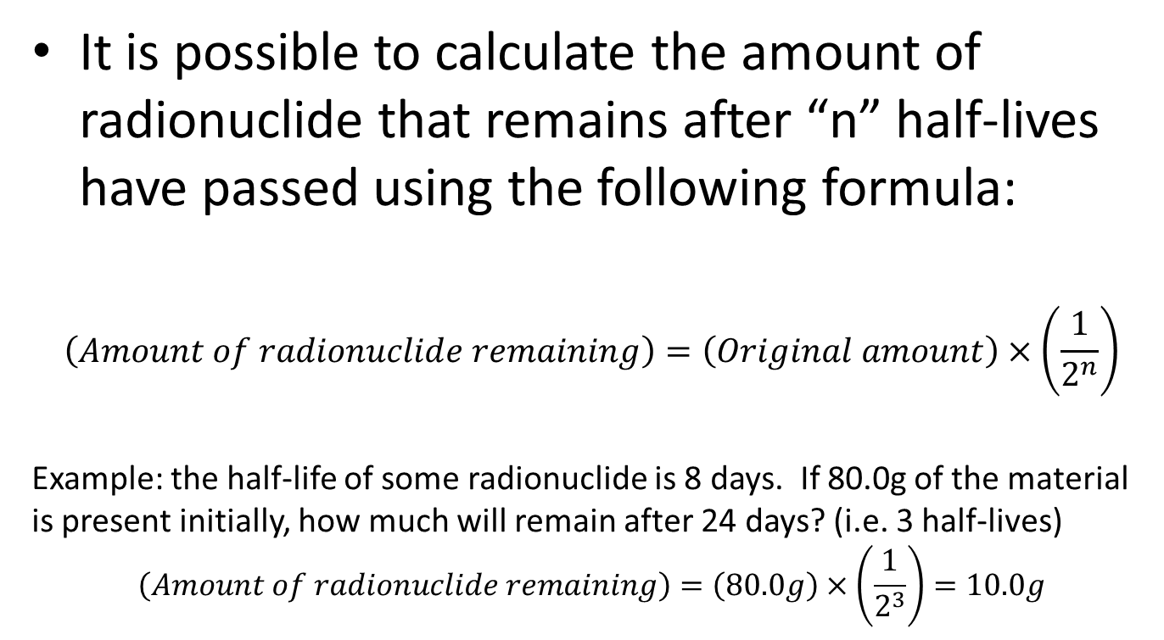
Rates of radioactive decay

Slide 27
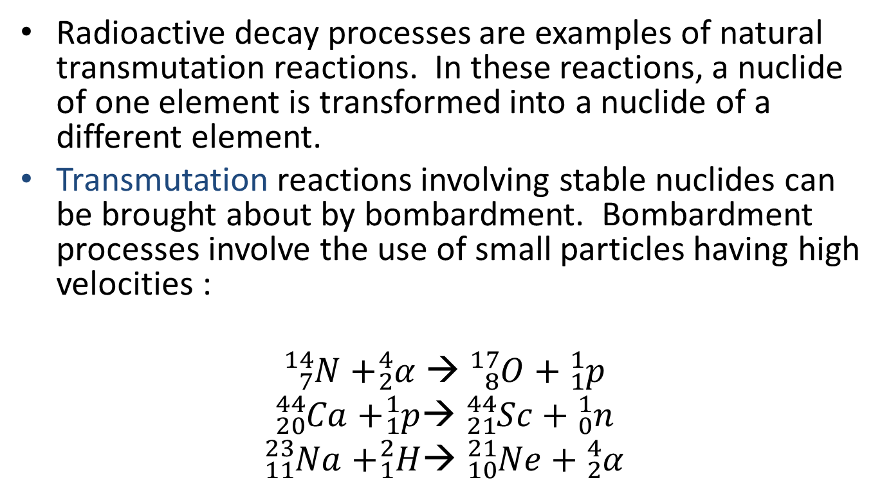
Transmutation and bombardment
Bombardment with:
alpha particles
protons
deuterium

Slide 28
Transmutation and bombardment
Bombardment reactions produce nuclei that are different than the parent nuclide. This means that it can be used to synthesize elements (on a small scale)
Four elements (Tc, Pm, At, and Fr) were created in this way between 1937 and 1941.
All elements after Z = 92 (Uranium) were also created in this manner. Elements 93 -118 are called the transuranium elements

Slide 29
Radioactive decay series
When radionuclides break down, in many cases, the daughter nuclide is also radioactive. These nuclides then continue to decay and produce other daughter nuclides.
The sequence of decay processes beginning with a long-lived radionuclide and ending with a stable nuclide is called a radioactive decay series.

Slide 30
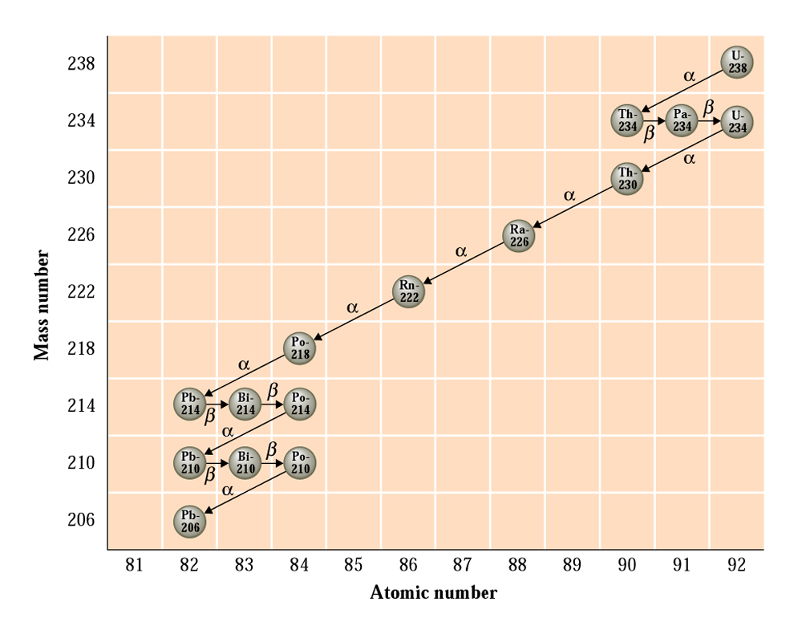
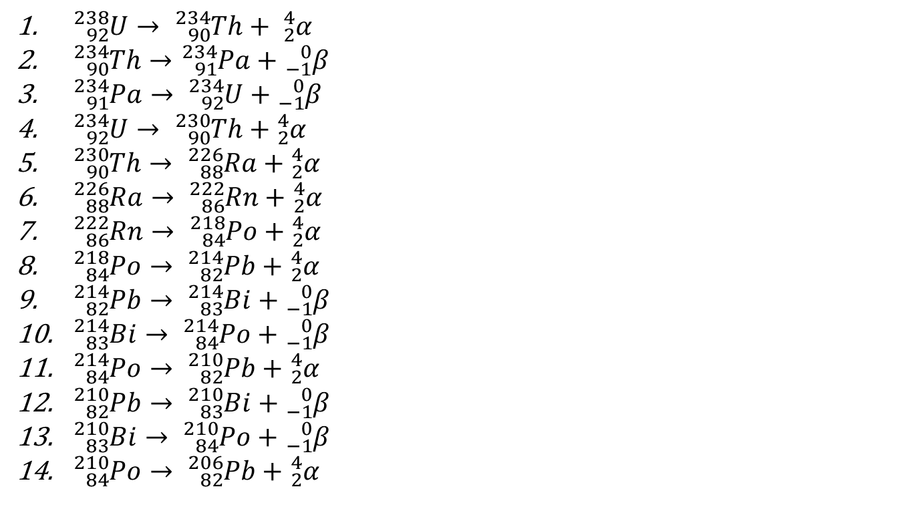
Radioactive decay series

Slide 31
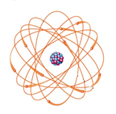
Chemical effects of radiation
The particles/energy emitted in nuclear decay processes are of very high energy. These decay products release their energy through interactions with matter.
Two things may happen when matter is exposed to these high-energy emissions:
  Ionization: when the decay product hits a molecule or atom, it knocks off an electron, producing an ion
  Excitation: the decay product transfers energy to atoms/molecules, causing electrons to jump into unoccupied orbitals

Slide 32
Chemical effects of radiation
Non-ionizing radiation: radiation does not have sufficient energy to result in the removal of an electron from an atom/molecule e.g. (radio waves, infrared energy, microwaves, visible light)
Ionizing radiation: radiation has enough energy to cause electrons to become completely removed from atom/molecule (e.g. cosmic rays, X-rays, ultraviolet light, gamma rays)

Slide 33
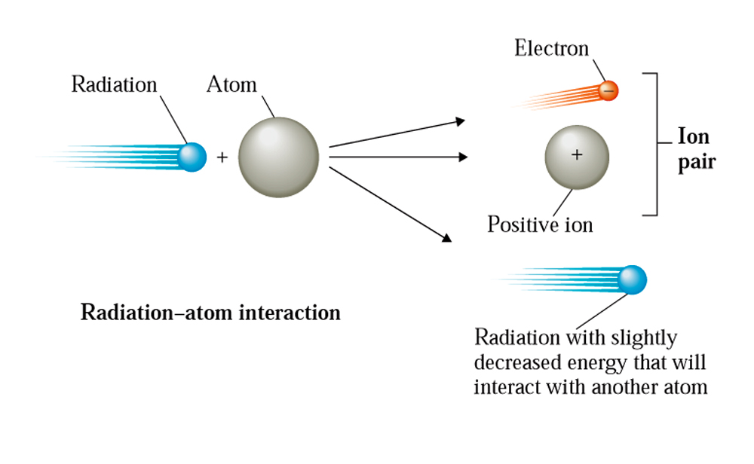
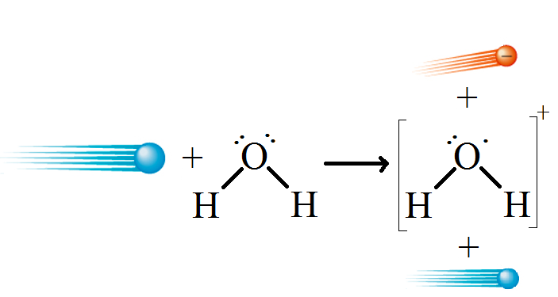
Chemical effects of radiation
When ionizing radiation interacts with matter to remove electrons, ion pairs are formed. The ion pair consists of the electron that was removed and the positive ion.
Example:

Slide 34
Chemical effects of radiation
The species with an odd number of electrons is very reactive and called a (free) radical.
Radicals react with other molecules, often in a chain-reaction mechanism (the result is a large number of reactions initiated by each radical).

Slide 35
Chemical effects of radiation
The ionization of water yields H₂O⁺ (not the same thing as H₃O⁺), which can react with a water molecule to yield another radical:
H₂O^{. +} + H₂O → H₃O⁺ + OH.
OH. is called hydroxyl radical (not OH⁻, hydroxide)

Slide 36
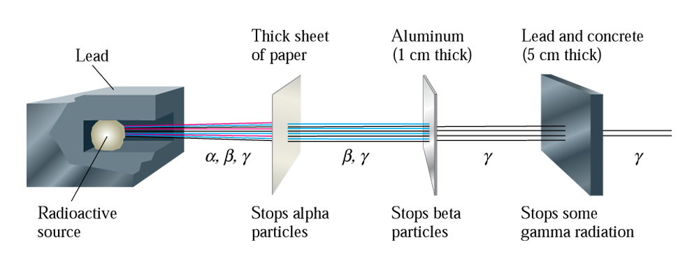
Biochemical effects of radiation
The effects of radiation on biochemical compounds depends on the nature of the radiation, as α-particles, β-particles, and γ-rays are able to penetrate matter to different degrees.

Slide 37
Biochemical effects of radiation
α-particles are the slowest form of radiation, moving t about 1/10th the speed of light (c = 3.0 x 10⁸ m/s).
All of the α-particles emitted by a source have the same energy (and velocity); however, different radionuclides produce α-particles of different energies.
α-particles are not able to penetrate the body’s outer layers of skin; most damage caused by α-particles is localized at the skin’s surface (unless ingested)

Slide 38
Biochemical effects of radiation
β-particles move more quickly than α-particles (9/10 x c), but have much lower mass, so they don’t tend to ionize molecules as well as α-particles. They do penetrate deeper than α-particles, causing severe skin burns for prolonged exposure.
Comparison:
  α-particles travel around 6 cm in air, creating 40,000 ion pairs
  β-particles travel around 1,000 cm in air, creating 2,000 ion pairs

Slide 39
Biochemical effects of radiation
γ-radiation travels around the speed of light. It has high penetrating power and readily penetrates skin, bone, organs, etc.

Slide 40
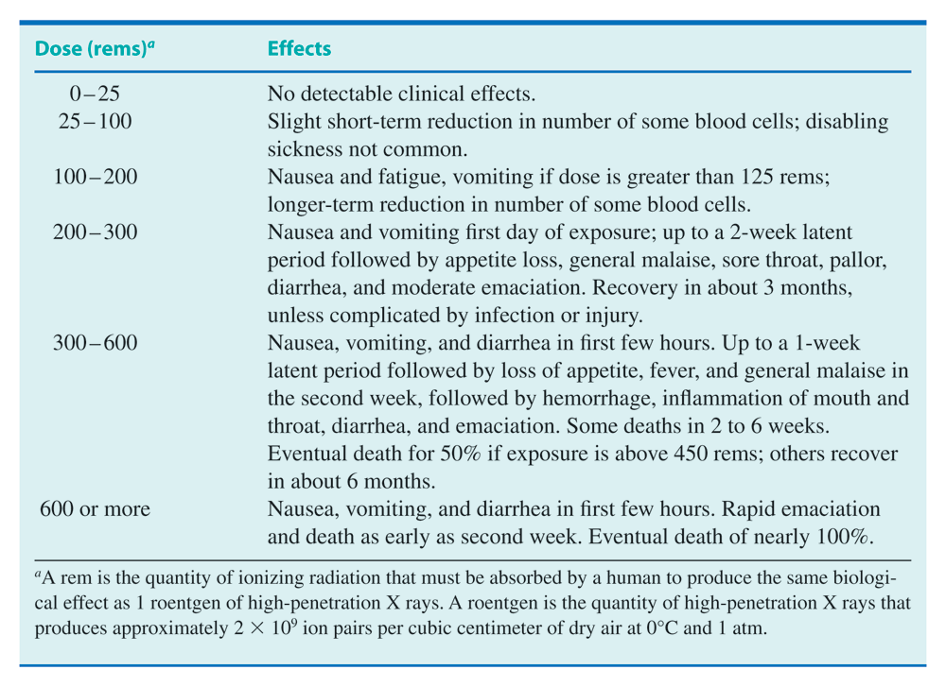

Slide 41
Detection of radiation
Two basic means of detecting radiation:
  Photographic plates: radiation affects these similar to light. Can determine the level of exposure to radiation with badges composed of film plates.
  Geiger counters: electric circuits that are surrounded by an ionizable gas. Radiation creates ions which complete the circuit and register a signal (count) in proportion to the amount of radiation.

Slide 42
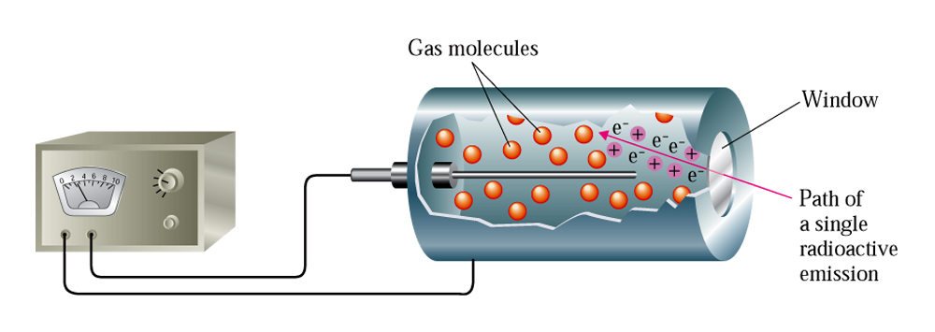

Slide 43
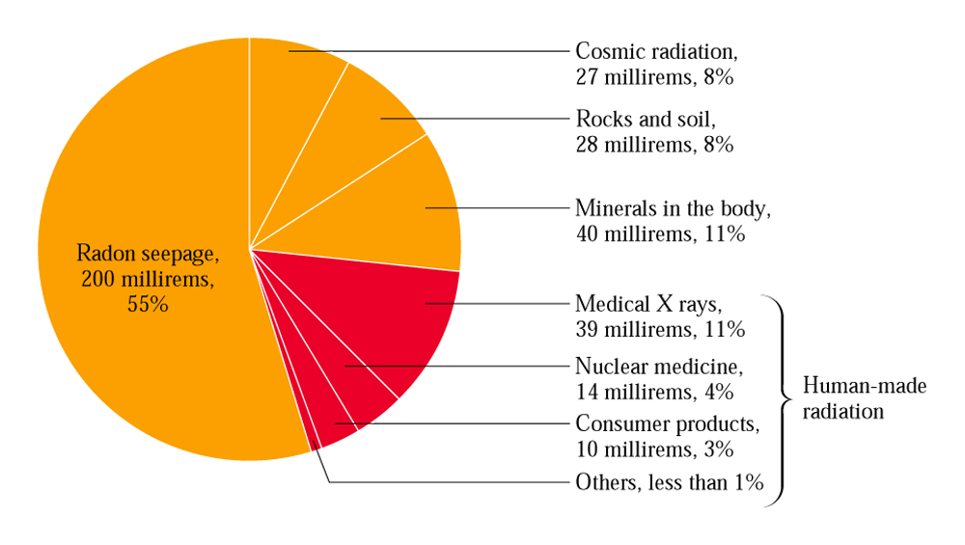
Sources of radiation exposure

Slide 44
Nuclear medicine
In medicine, radioisotopes can find use in
  Diagnoses – radiation emitted by the radionuclide is detected, yielding various information
  Therapy – radiation is used to effect changes in the body (e.g. tumor tissue destruction)

Slide 45
Nuclear medicine
Diagnostic treatments
Radioactive nuclides have the same chemical properties as non-radioactive forms. Thus, they may be introduced in small quantities and their detection can yield useful information
Requirements:
  Radoisotope must be detectable by instruments outside the body (γ-emitters) at low concentrations
  Short half-life so that exposure time is limited; also so that it is possible to emit a high-enough intensity for detection
  Must have a known mechanism for elimination from the body
  Must be compatible with body tissue and be able to be delivered to the site of interest

Slide 46
Nuclear medicine
Determination of blood volume (Cr-51)
Location of sites of infection (Ga-67)*
Diagnosis of impaired heart muscle (Tl-201)
Location of impaired circulation (Na-24)
Assessment of thyroid activity (I-123)
Determination of tumor size and shape (Tc-99m)*
* Introduced as part of a larger molecule

Slide 47
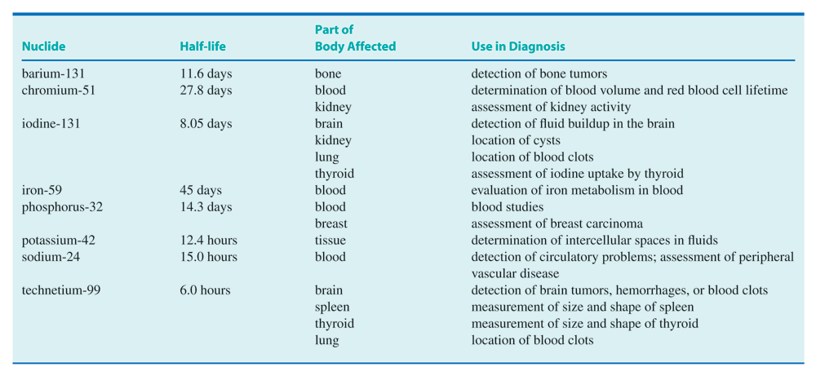

Slide 48
Nuclear medicine
Therapeutic uses
Therapeutic uses for radioisotopes are targeted at the selective destruction of cells. For treatments that involve placing the radionuclide inside the body, α- or β-emitters are used.
Most times, the radionuclide is introduced into the body; however, external application (e.g. Co-60 radiation) is sometimes used.

Slide 49
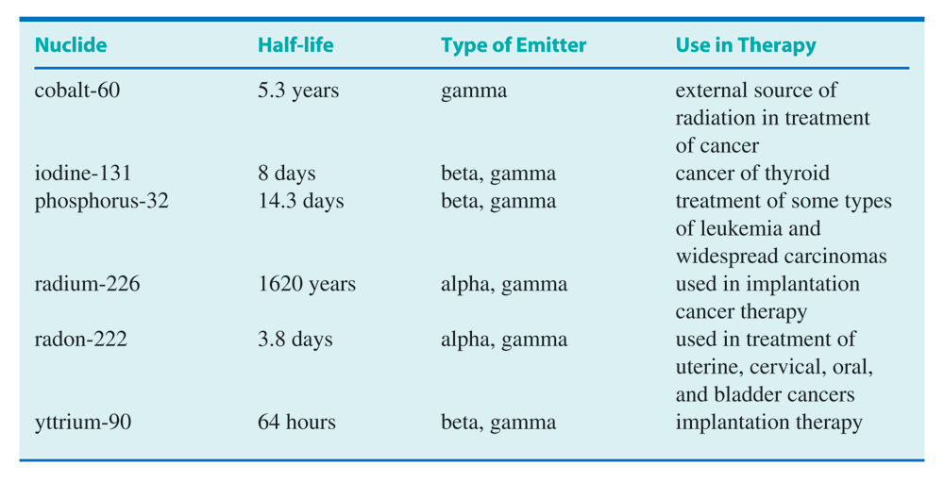

Slide 50
Nuclear fission and fusion
As important as nuclear processes are to medicine, their promise as energy providers is equally as important.
  Nuclear fission
  Nuclear fusion

Slide 51
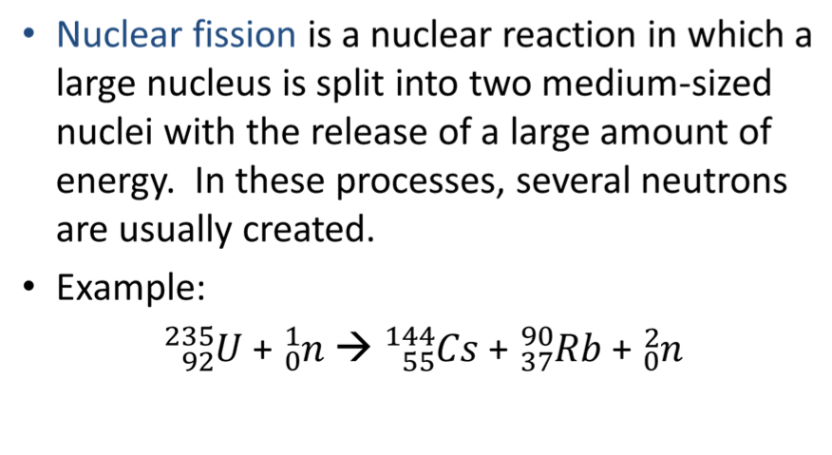
Nuclear fission and fusion

Slide 52
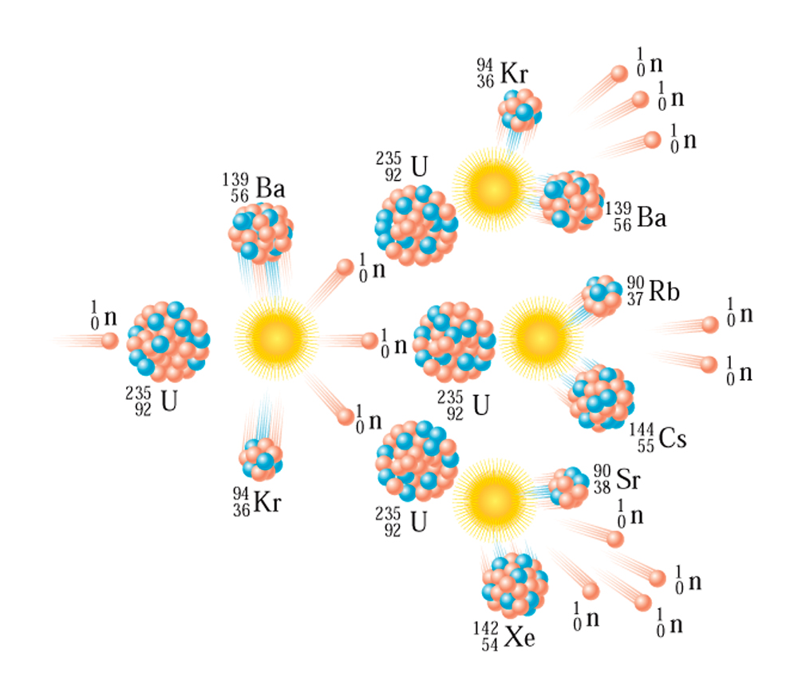
Nuclear fission and fusion
Bombardment reactions are used to induce fission reactions

Slide 53
Nuclear fission and fusion
Characteristics of the fission reaction:
  There is no unique way in which ²³⁵U splits
  Very large amounts of nuclear energy are released in the fission reaction
  The number of neutrons released in the reaction is between 2 to 4, and is 2.4 on average. The more neutrons that are released, the more fission reactions they can induce (chain-reaction)

Slide 54
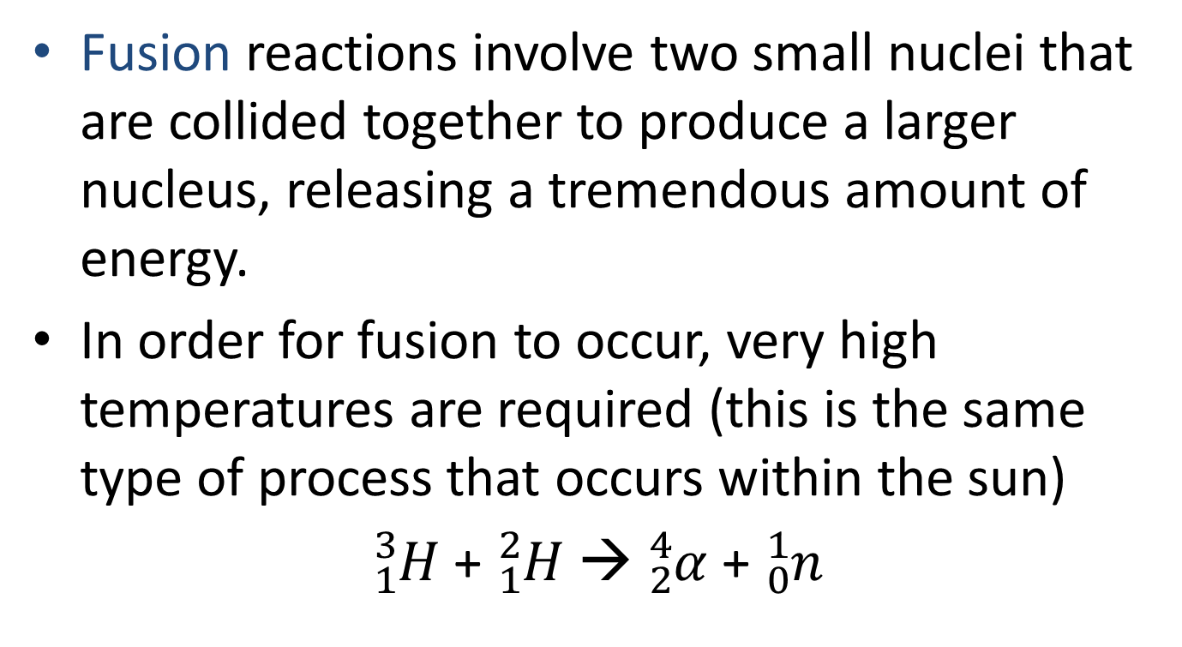
Nuclear fission and fusion

Slide 55
Nuclear fission and fusion
There are several advantages to using fusion in a controlled manner for energy:
  The by-products of the reaction are stable nuclides (no radioactive waste)
  The major fuel involved is deuterium (²H), which can be readily extracted from the ocean (0.015% abundance); 0.005 km³ of ocean water could supply the US energy demands for a year

Slide 56
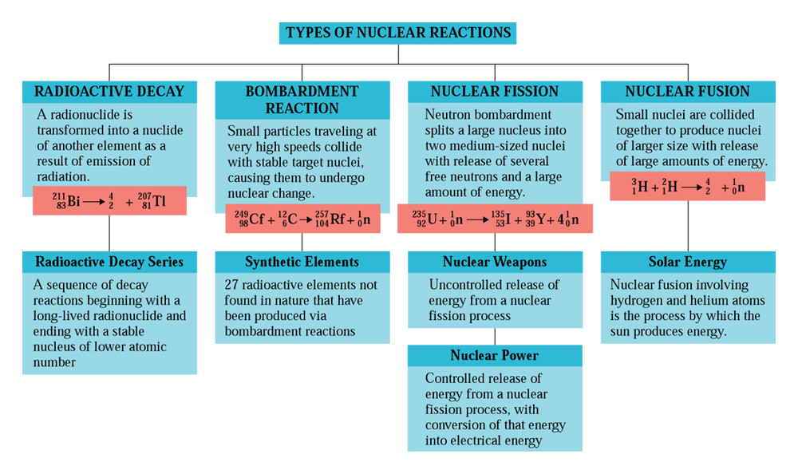

Slide 57
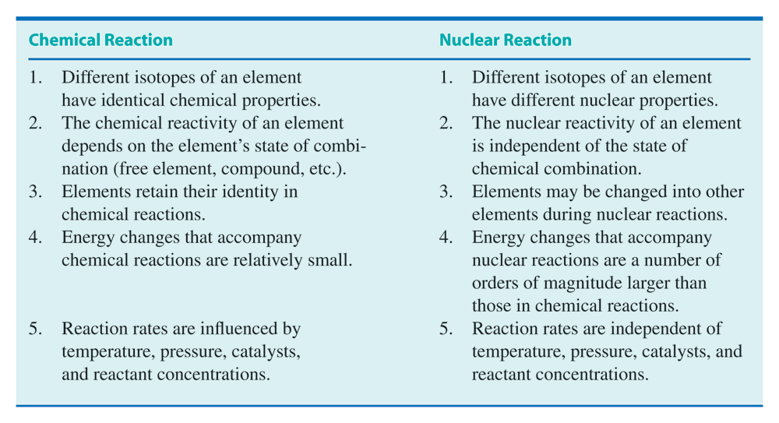
Nuclear and chemical reactions compared

