Slide 1
Chapter 11. Nuclear Chemistry
Introduction to Inorganic Chemistry
Instructor Dr. Upali Siriwardane (Ph.D. Ohio State)
E-mail: upali@latech.edu
Office: 311 Carson Taylor Hall ; Phone: 318-257-4941;
Office Hours: MWF 8:00-9:00 and 11:00-12:00;
TR 10:00-12:00
Contact me trough phone or e-mail if you have questions
Online Tests on Following days
March 24, 2017: Test 1 (Chapters 1-3)
April 10, 2017 : Test 2 (Chapters 4-5)
April 28, 2017: Test 3 (Chapters 6,7 &8)
May 12, 2017 : Test 4 (Chapters 9, 10 &11)
May 15, 2017: Make Up Exam: Chapters 1-11)
.

Slide 2
11.1 Stable and Unstable Nuclides
11.2 The Nature of Radioactive Emissions
11.3 Equations for Radioactive Decay
11.4 Rate of Radioactive Decay
11.5 Transmutation and Bombardment Reactions
11.6 Radioactive Decay Series
11.7 Detection of Radiation
11.8 Chemical Effects of Radiation
11.9 Biochemical Effects of Radiation
11.10 Sources of Radiation Exposure
11.11 Nuclear Medicine
11.12 Nuclear Fission and Nuclear Fusion
11.13 Nuclear and Chemical Reactions Compared

Slide 3
Nuclear Reaction
A reaction in which changes occur in the nucleus of an atom (not ordinary chemical reactions).
Nuclide – an atom with a specific atomic number and a specific mass number.
Atomic Number (Z) – number of protons
Mass Number (A) – sum of protons and neutrons

Slide 4
Stable nuclide – nuclide with a stable nucleus; does not readily undergo change.
Unstable nuclide – nuclide with an unstable nucleus; spontaneously undergoes change.

Slide 5
Radioactivity
Radiation spontaneously emitted from an unstable nucleus.
Radioactive nuclide (radionuclide) – a nuclide with an unstable nucleus from which radiation is spontaneously emitted.

Slide 6
Radioactive Stability
There is a correlation between nuclear stability and the total # of nucleons found in a nucleus.
Nuclides with 84 or more protons are unstable.

Slide 7
Radioactive Stability
There is a correlation between nuclear stability and neutron-to-proton ratio in a nucleus.
Light nuclides are stable when Z equals A – Z (neutron/proton ratio is 1).
For heavier elements the neutron/proton ratio required for stability is greater than 1 and increases with Z.

Slide 8
Understanding Radioactivity
Certain nuclides possess unstable nuclei.
Nuclides with unstable nuclei spontaneously emit energy (radiation).

Slide 9
Alpha Particle
A particle in which two protons and two neutrons are present that is emitted by certain radioactive nuclei.

Slide 10
Beta Particle
Particle whose charge and mass are identical to those of an electron that is emitted by certain radioactive nuclei.

Slide 11
Gamma Ray
Form of high-energy radiation without mass or charge that is emitted by certain radioactive nuclei.

Slide 12
Radioactive Decay
Process by whereby a radionuclide is transformed into a nuclide of another element as a result of the emission of radiation from its nucleus.
Parent nuclide – nuclide that undergoes decay
Daughter nuclide – nuclide that is produced

Slide 13
How Nuclear Equations Differ From Chemical Equations
The symbols in nuclear equations stand for nuclei rather than atoms.
Mass numbers and atomic numbers (nuclear charge) are always specifically included in nuclear equations.
The elemental symbols on both sides of the equation frequently are not the same in nuclear equations.

Slide 14
Alpha Particle Decay (α):

Slide 15
Beta Particle Decay (β):

Slide 16
Gamma Ray Emission (γ):

Slide 17

Concept Check
Which of the following produces a β particle?
Notes:
The correct answer is d.

Slide 18
Concept Check
Which of the following produces a β particle?
Notes:
The correct answer is d.

Slide 19
Half-Life
Time required for one-half of a given quantity of a radioactive substance to undergo decay.
The greater the decay rate for a radionuclide, the shorter its half-life.

Slide 20
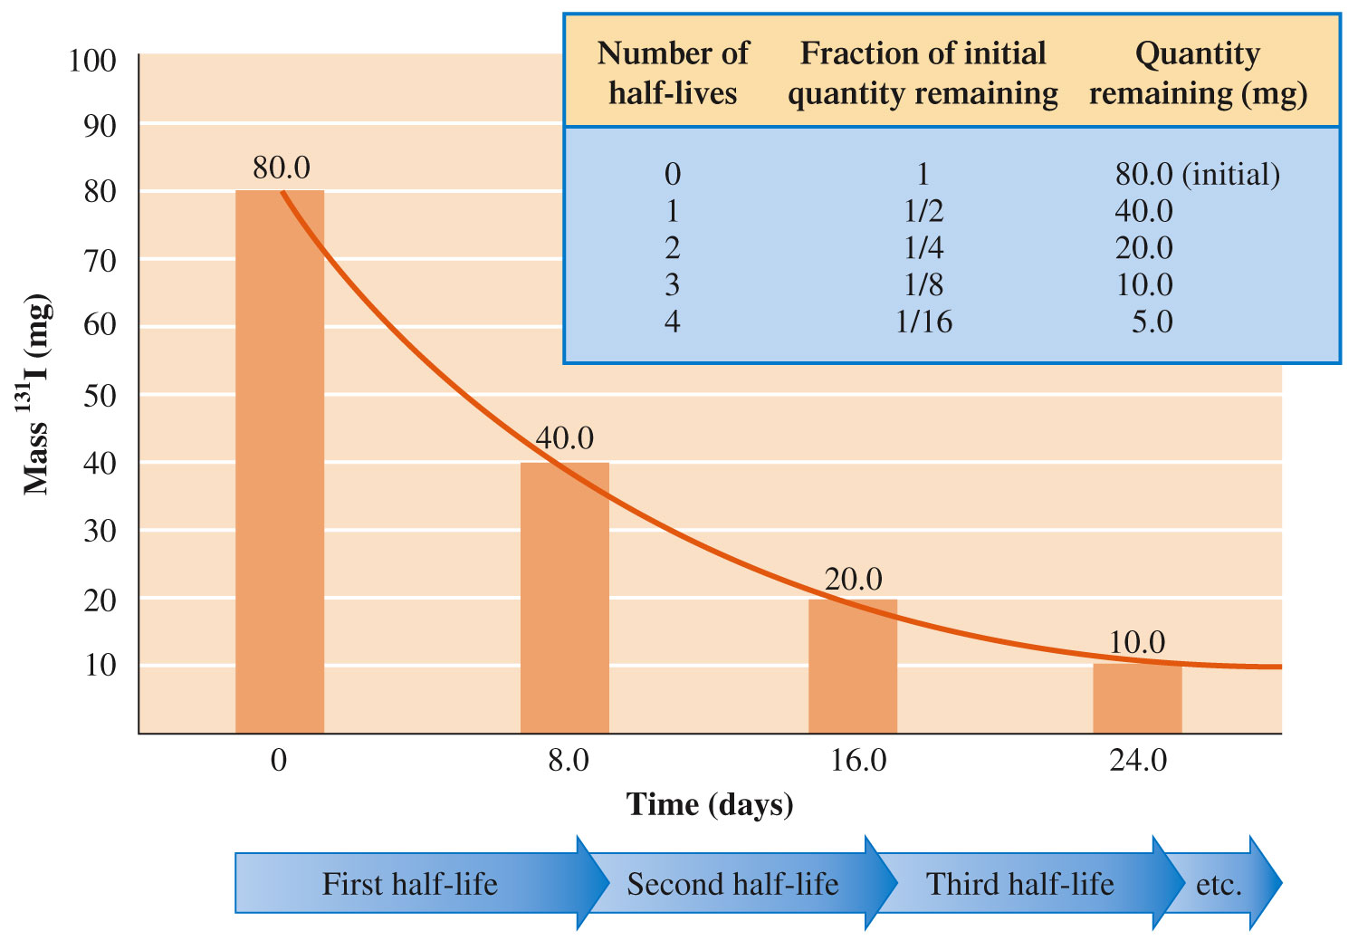
Decay of 80.0 mg of ¹³¹I

Slide 21

Half-Life of Nuclear Decay
To play movie you must be in Slide Show Mode
PC Users: Please wait for content to load, then click to play
Mac Users: CLICK HERE

Slide 22
Half-Life (n)
Amount of radionuclide original amount
undecayed after n half-live of radionuclide

Slide 23
Exercise
The half-life of technetium-99 is 5.98 hours. How much, in grams, of a 0.75-g sample of technetium-99 will remain undecayed after a period of 16 hours?
Notes:
(16 hours)(1 half-life / 5.98 hours) = 2.68 half-lives
(0.75 g)(1 / 2^{2.68}) = 0.12 g

Slide 24
Exercise
The half-life of technetium-99 is 5.98 hours. How much, in grams, of a 0.75-g sample of technetium-99 will remain undecayed after a period of 16 hours?
0.12 g
Notes:
(16 hours)(1 half-life / 5.98 hours) = 2.68 half-lives
(0.75 g)(1 / 2^{2.68}) = 0.12 g

Slide 25
Transmutation Reaction
A nuclear reaction in which a nuclide of one element is changed into a nuclide of another element.

Slide 26
Bombardment Reaction
A nuclear reaction brought about by bombarding stable nuclei with small particles traveling at very high speeds.
  Always two reactants and two products.

Slide 27
Synthetic Elements
Over 2000 bombardment-produced radionuclides are known.
Transuranium elements – occur right after uranium on the periodic table (elements 93 to 118).
All nuclides of all elements beyond bismuth (Z = 83) in the periodic table are radioactive.

Slide 28
A series of radioactive decay processes beginning with a long-lived radionuclide and ending with a stable nuclide of lower atomic number.

Slide 29
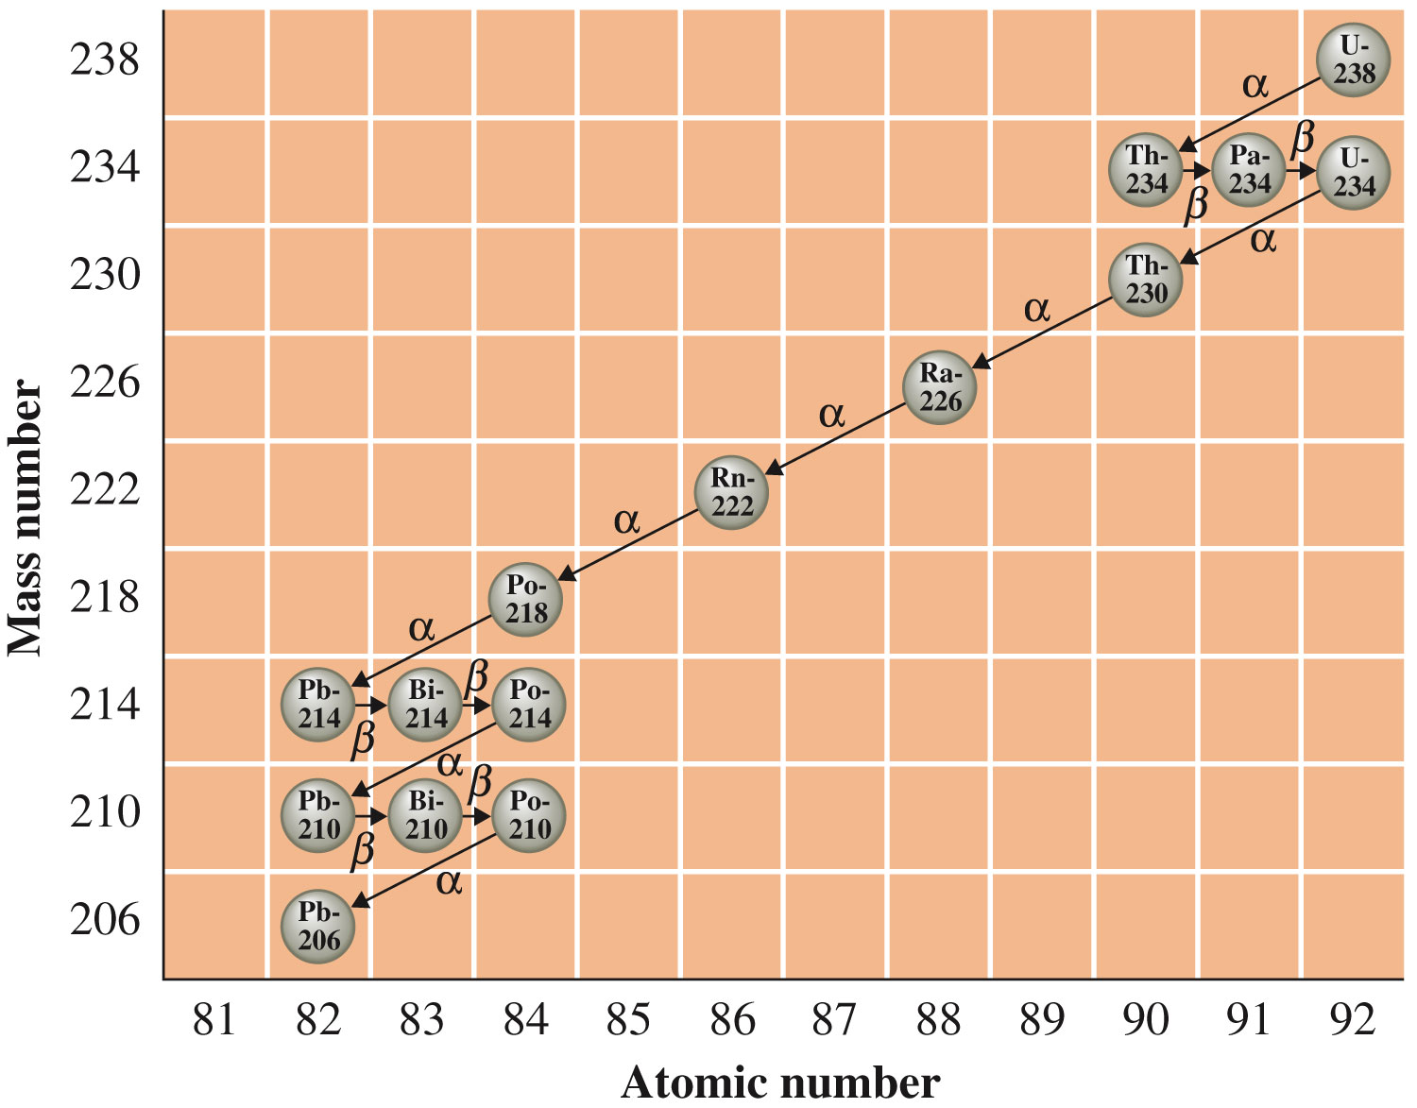
Radioactive Decay Series Example

Slide 30
Photographic plates
Geiger counter

Slide 31
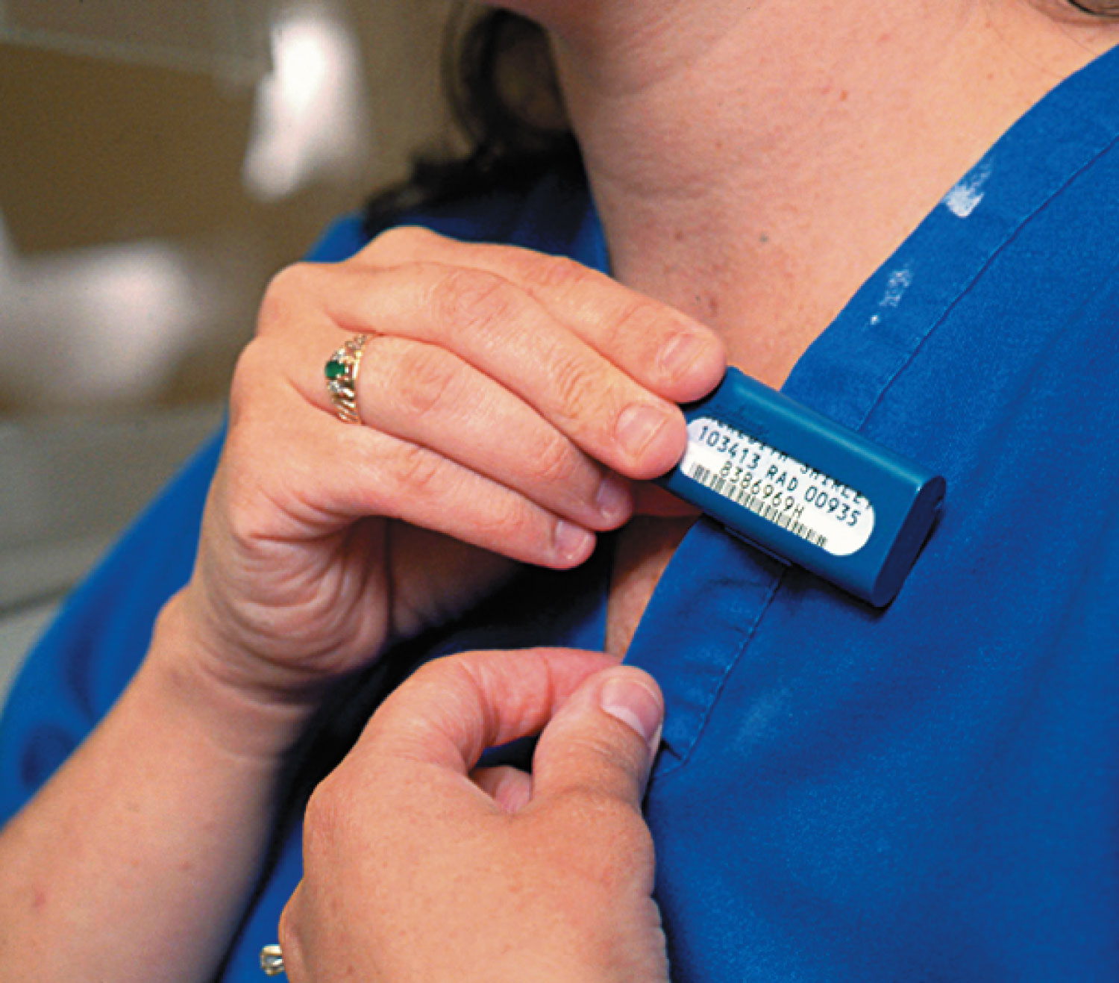
Film Badges Are Used to Determine a Person’s Exposure to Radiation

Slide 32
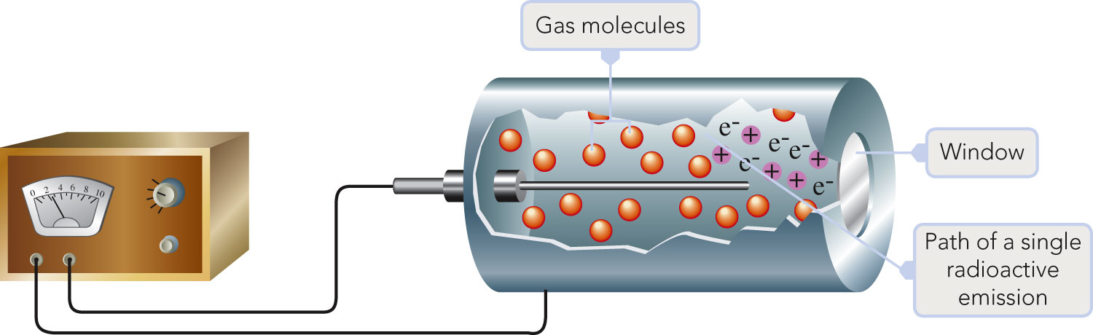
Geiger Counter

Slide 33
Two Things Can Happen to an Electron Subjected to Radiation
Excitation – occurs when radiation, through energy release, excites an electron from an occupied orbital into an empty, higher-energy orbital.
Ionization –occurs when the radiation carries enough energy to remove an electron from an atom or molecule.

Slide 34
Nonionizing Radiation vs. Ionizing Radiation
Nonionizing radiation – radiation with insufficient energy to remove an electron from an atom or molecule.
  Examples: radiowaves, microwaves, infrared light, and visible light
Ionizing radiation – radiation with sufficient energy to remove an electron from an atom or molecule.
  Examples: cosmic rays, X rays, and UV light

Slide 35
Ion Pair Formation
Incoming radiation transfers sufficient energy into a molecule to knock an electron out of it, converting the molecule into a positive ion.
  H₂O⁺, e–

Slide 36
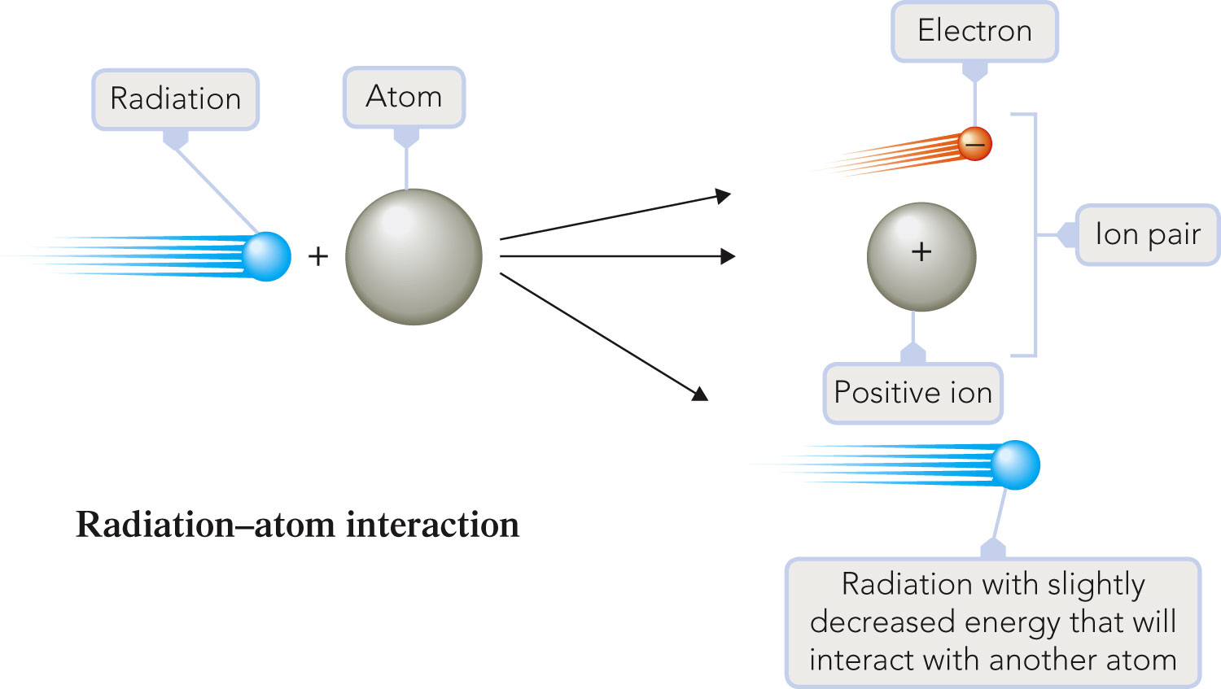
Ion Pair Formation

Slide 37
Free Radical Formation
Usually accompanies ion pair formation.
Free radical – an atom, molecule, or ion that contains an unpaired electron; usually a very reactive species.
  • H₂O⁺ or • OH

Slide 38
Alpha Particle Effects
Have low penetrating power and cannot penetrate the body’s outer layers of skin.
Major damage occurs when alpha-emitting radionuclides are ingested (contaminated food).

Slide 39
Beta Particle Effects
Can penetrate much deeper than alpha particles and can cause severe skin burns if their source remains in contact with the skin for an appreciable amount of time.
Internal exposure to beta radiation is as serious as internal alpha exposure.

Slide 40
Gamma Radiation Effects
Readily penetrate deeply into organs, bone, and tissue.

Slide 41
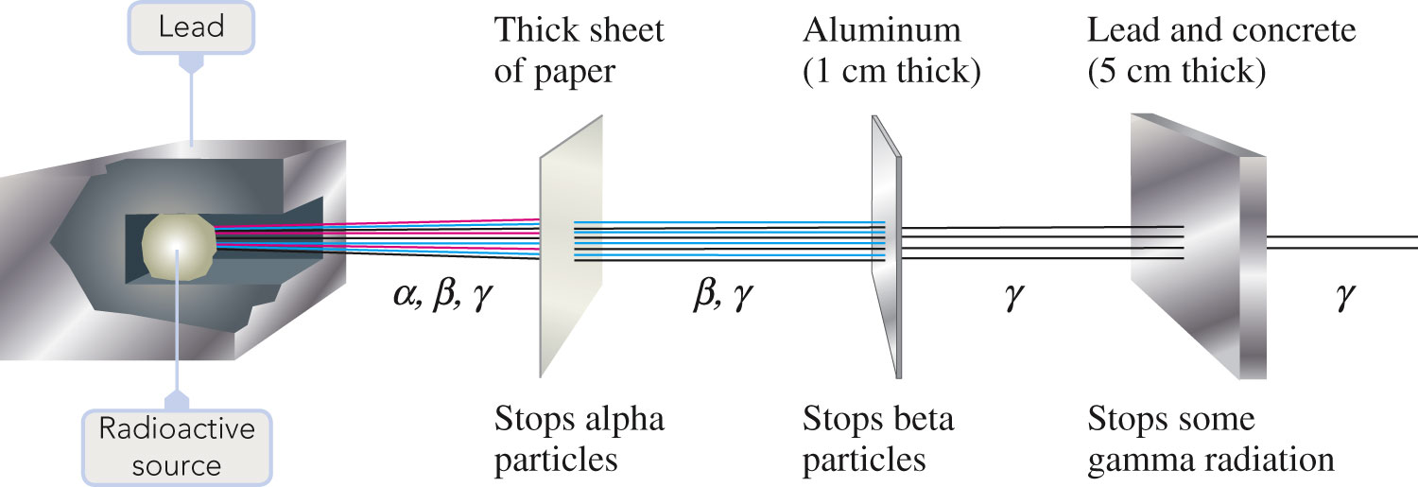
Alpha, Beta, and Gamma Radiation Differ in Penetrating Ability

Slide 42
Background Radiation
Radiation that comes from natural sources to which living organisms are exposed on a continuing basis.

Slide 43
Sources of Background Radiation
Cosmic radiation
Rocks and minerals
Food and drink
Radon seepage in buildings

Slide 44
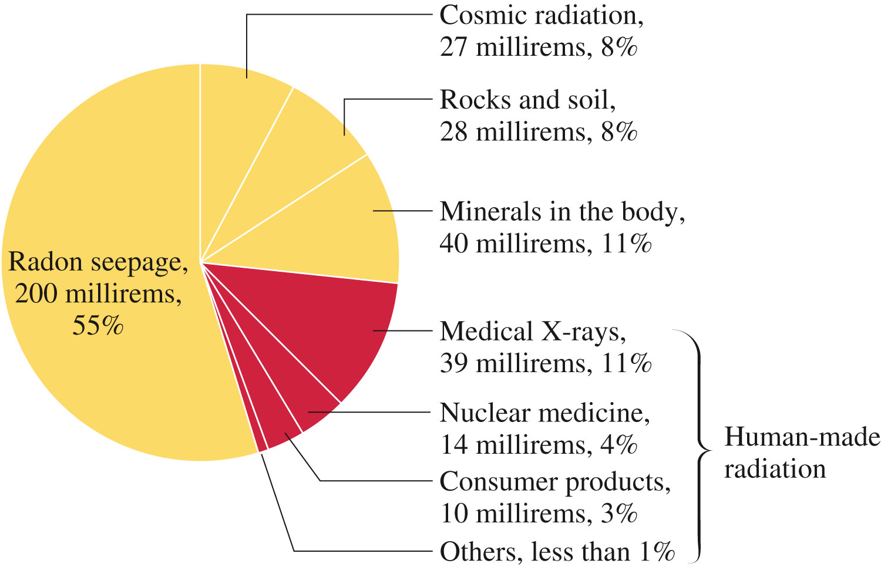
Components of the Estimated Annual Radiation Exposure

Slide 45
A field of medicine in which radionuclides are used for diagnostic and therapeutic purposes.

Slide 46
Criteria Used in Selecting Radionuclides
At low concentrations, the radionuclide must be detectable by instrumentation placed outside the body.
Radionuclide must have a short half-life.
Radionuclide must have a known mechanism for elimination from the body.
The chemical properties of the radionuclide must be such that it is compatible with normal body chemistry.

Slide 47
Diverse Uses of Radionuclides in the Human Body
Determination of blood volume.
Location of sites of infection.
Diagnosis of impaired heart muscle.
Location of impaired circulation.
Assessment of thyroid activity.
Determination of tumor size and shape.

Slide 48
Therapeutic Uses for Radionuclides
Selectively destroy abnormal (usually cancerous) cells.
The radionuclide is often, but not always, placed within the body.

Slide 49
Fission Reactions
A nuclear reaction in which a large nucleus (high atomic number) splits into two medium-sized nuclei with the release of several free neutrons and a large amount of energy.
Basis for operation of nuclear power plants.
  Uranium-235

Slide 50
Characteristics of the U-235 Fission Reaction
There is no unique way in which the U-235 nucleus splits.
Very large amounts of energy are emitted during this process.
Neutrons, which are reactants in the fission process, are also produced as products.

Slide 51
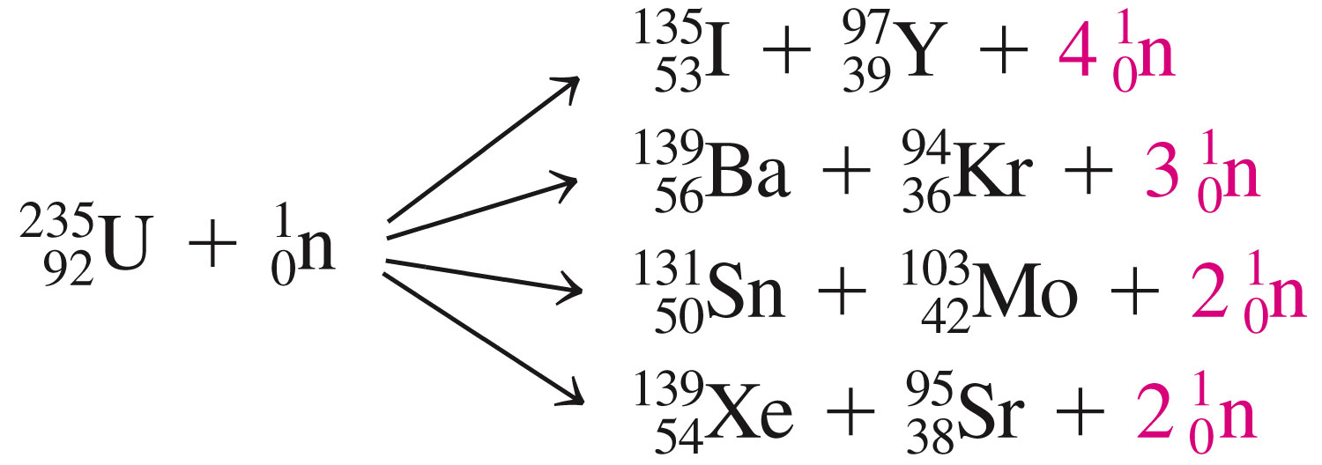

Slide 52
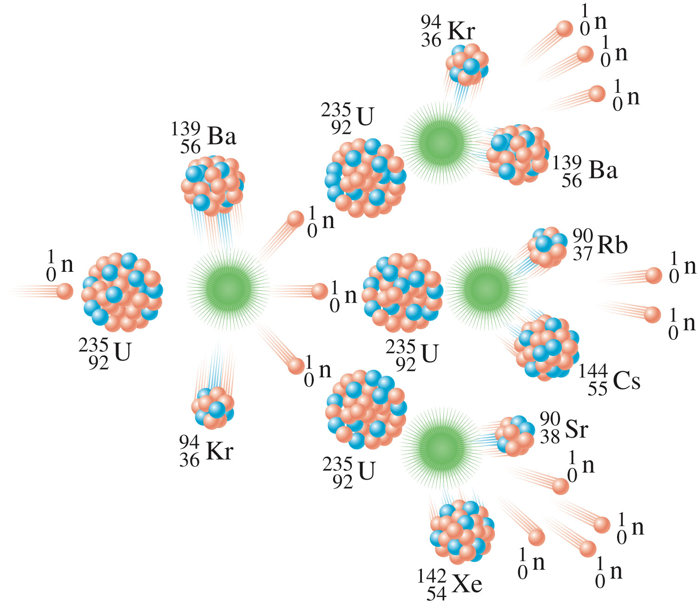
A Fission Chain Reaction

Slide 53
Fusion Reactions
A nuclear reaction in which two small nuclei are collided together to produce a larger nucleus and a large amount of energy.
Opposite of nuclear fission.
How the sun generates its energy.

Slide 54
