Slide 1
Chemistry 120 Fall 2016
Instructor: Dr. Upali Siriwardane
e-mail: upali@latech.edu
Office: CTH 311
Phone 257-4941
Office Hours: M,W,F 9:30-11:30 am T,R 8:00-10:00 am or by appointment;
Test Dates:
September 23, 2016 (Test 1): Chapter 1,2 &3
October 13, 2016 (Test 2): Chapter 4 & 5
October 31, 2016 (Test 3): Chapter 6, 7 & 8
November 15, 2016 (Test 4): Chapter 9, 10 & 11
November 17, 2016 (Make-up test) comprehensive:
Chapters 1-11

Slide 2
Chapter 10. Acids, Bases, and Salts
10-1 Arrhenius Acid–Base Theory
10-2 Brønsted–Lowry Acid–Base Theory
  Generalizations about Brønsted–Lowry Acids and Bases
  Conjugate Acid–Base Pairs
  Amphiprotic Substances
10-3 Mono-, Di-, and Triprotic Acids
10-4 Strengths of Acids and Bases
10-5 Ionization Constants for Acids and Bases
10-6 Salts
10-7 Acid–Base Neutralization Chemical Reactions
  Balancing Acid–Base Neutralization Equations
10-8 Self-Ionization of Water
  Ion Product Constant for Water
  Acidic, Basic, and Neutral Solutions

Slide 3
Chapter 10. Acids, Bases, and Salts
10-9 The pH Concept
  Integral pH Values
  Nonintegral pH Values
  pH Values and Hydronium Ion Concentration
  Interpreting pH Values
  pH Values for Human Body Tissues and Acid Rain
10-10 The pK_{a} Method for Expressing Acid Strength
10-11 The pH of Aqueous Salt Solutions
  Types of Salt Hydrolysis
  Chemical Equations for Salt Hydrolysis Reactions
10-12 Buffers
10-13 The Henderson–Hasselbalch Equation
10-14 Electrolytes
10-15 Equivalents and Milliequivalents of Electrolytes
  Equivalent and Milliequivalent Concentration Units
  Charge Balance in Electrolytic Solutions
10-16 Acid–Base Titrations

Slide 4
Topics we’ll be looking at in this chapter
Arrhenius theory of acids and bases
Bronsted-Lowry acid-base theory
Mono-, di- and tri-protic acids
Strengths of acids and bases
Ionization constants for acids and bases
Salts
Acid-base neutralization reactions
Self-ionization of water
pH
pK_{a} and acid strength
pH of aqueous salt solutions
Buffers
The Henderson-Hasselbach equation
Electrolytes
Equivalents and milliequivalents of electrolytes
Acid-base titrations

Slide 5
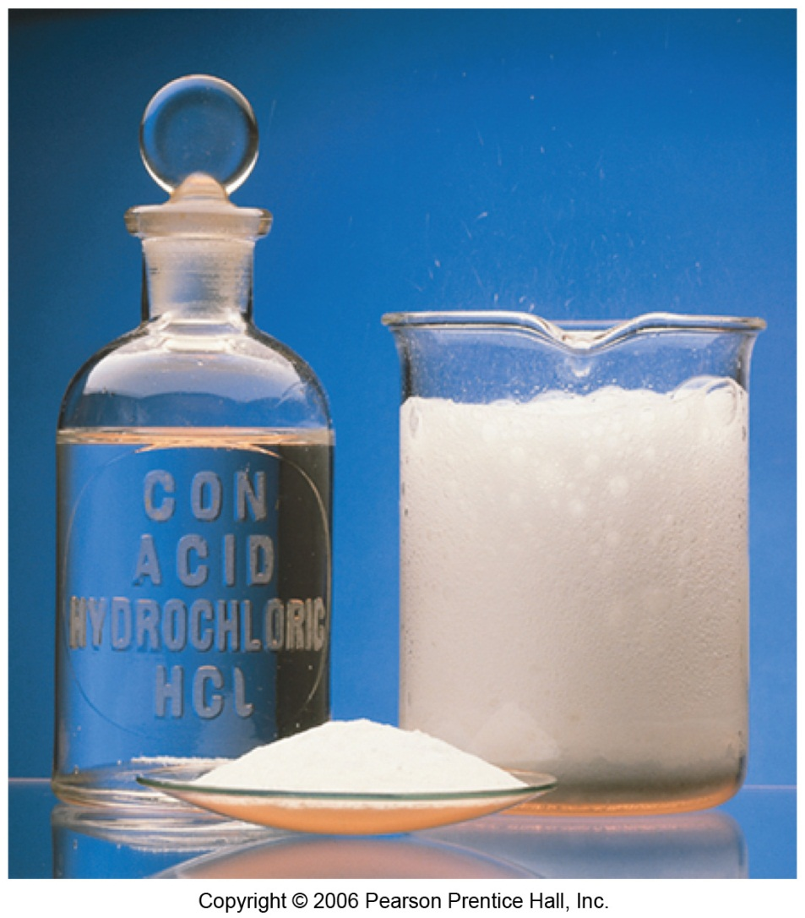
Arrhenius theory of acids and bases
Arrhenius acids are substances that increase the concentration of H⁺ (or H₃O⁺) when dissolved in water
H₂O
HCl_{(g)} → H⁺_{(aq)} + Cl⁻_{(aq)}
HNO_{3(l)} → H⁺_{(aq)} + NO₃⁻_{(aq)}
H₂O
Recognize acid formulas: H is at the beginning of the formula

Slide 6
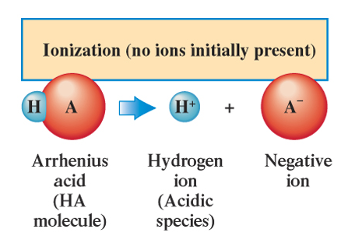
Arrhenius theory of acids and bases
When acids and bases are dissolved in water, they ionize (break apart into their constituent ions)
Ionization is a process in which individual positive and negative ions are produced from a molecular compound that is dissolved in solution
The acids listed are all molecular compounds. Acids ionize when they are dissolved in water
like ionic
compounds
Most molecular compounds don’t ionize. The exceptions are acids and bases.

Slide 7
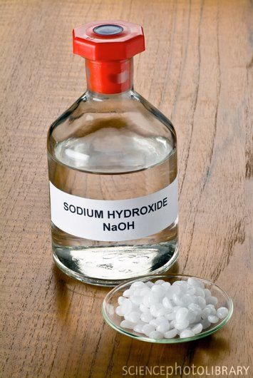
Arrhenius theory of acids and bases
Arrhenius bases are hydroxide (OH⁻) containing substances that increase the concentration of OH⁻ when dissolved in water
H₂O
NaOH → Na⁺ + OH⁻
Ca(OH)₂ → Ca²⁺ + 2OH⁻
H₂O
Arrhenius bases contain hydroxide (OH⁻) in their formulas

Slide 8
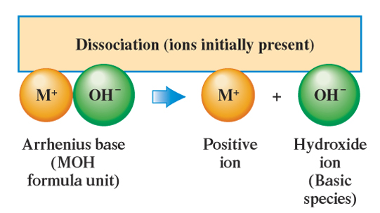
Arrhenius theory of acids and bases
In contrast to Arrhenius acids, Arrhenius bases are ionic compounds.
When bases (and salts) are dissolved in water, they dissociate.
Dissociation is the process by which individual positive and negative ions are released from an ionic compound that is dissolved in water

Slide 9
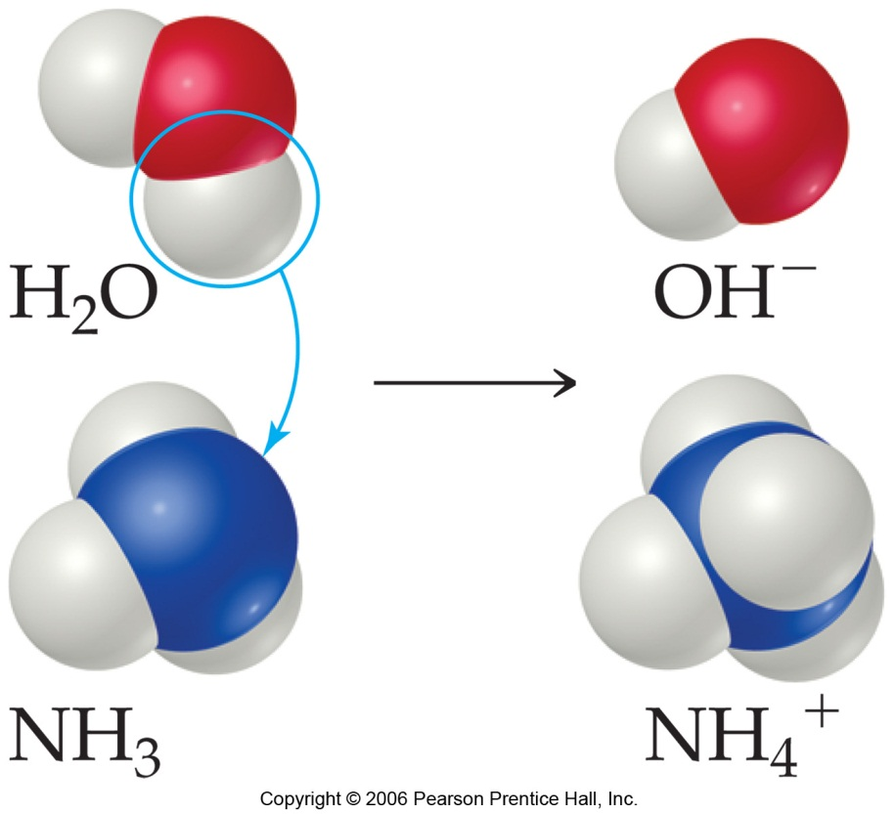
Bronsted-Lowry acid-base theory
Arrhenius theory is limited to aqueous solutions. Bases are limited to hydroxide-containing compounds which ionize in water
NH₃ also produces OH⁻ ions when dissolved in water…but by the Arrhenius definition, it is not a base
Bronsted and Lowry defined bases as H⁺ (proton) acceptors
Acids are H⁺ (proton) donors
NH_{3(aq)} + H₂O_{(l)} D NH₄⁺_{(aq)} + OH⁻_{(aq)}
H⁺
Arrhenius acid/base: H⁺ (proton) transfer

Slide 10
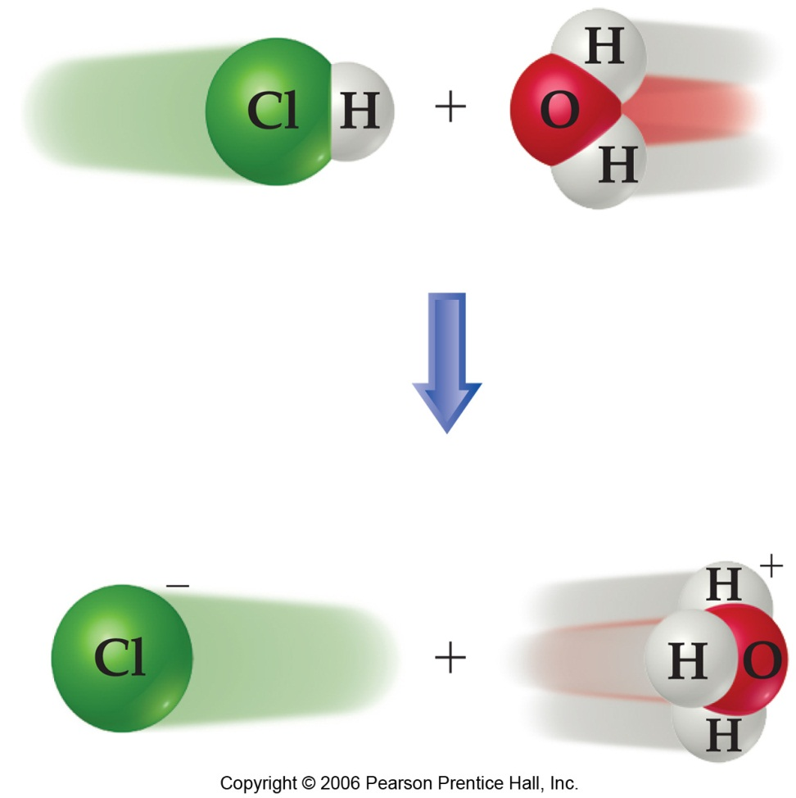
Bronsted-Lowry acid-base theory
In Bronsted-Lowry theory, H⁺ ions do not exist in the free state in aqueous solutions, but instead, as H₃O⁺ ions
In this reaction, the acid (HCl) has donated a proton to H₂O.
Water is acting as a B.L. base, since it accepts the proton
hydrochloric acid
chloride ion
“hydronium”

Slide 11

Bronsted-Lowry acid-base theory
acid
base
When water takes a proton (H⁺) from hydrochloric acid, two new things are formed in solution (Cl⁻ and H₃O⁺)
The products are related (by their formulas) to a reactant – each differing by one H⁺ ion from one of the reactants
HCl_{(aq)} + H₂O_{(l)} → Cl⁻_{(aq)} + H₃O⁺_{(aq)}

Slide 12
Bronsted-Lowry acid-base theory
acid
base
When water takes a proton (H⁺) from hydrochloric acid, two new things are formed in solution (Cl⁻ and H₃O⁺)
The products are related (by their formulas) to a reactant – each differing by one H⁺ ion from one of the reactants
HCl_{(aq)} + H₂O_{(l)} → Cl⁻_{(aq)} + H₃O⁺_{(aq)}

Slide 13
Bronsted-Lowry acid-base theory
acid
base
When water takes a proton (H⁺) from hydrochloric acid, two new things are formed in solution (Cl⁻ and H₃O⁺)
The products are related (by their formulas) to a reactant – each differing by one H⁺ ion from one of the reactants
HCl_{(aq)} + H₂O_{(l)} → Cl⁻_{(aq)} + H₃O⁺_{(aq)}

Slide 14
Bronsted-Lowry acid-base theory
acid
base
Two species that differ from each other by one H⁺ are called conjugate pairs
The partner that has the extra H⁺ is called the acid and the other is called the base
conjugate pair
HCl_{(aq)} + H₂O_{(l)} → Cl⁻_{(aq)} + H₃O⁺_{(aq)}
chloride ion is the
conjugate base of HCl
H₃O⁺ is the conjugate
acid of water
conjugate pair
Conjugate acid/base pairs always differ by one proton in their formulas

Slide 15
Bronsted-Lowry acid-base theory
Some practice problems:
NO₃⁻ HF
OH⁻ H₂SO₄
C₂H₃O₂⁻ H₂O
NH₃ H₃PO₄
What are the conjugate
acids of these?
What are the conjugate
bases of these?

Slide 16
Bronsted-Lowry acid-base theory
Amphiprotic substances
Some substances can either gain or lose protons, depending on their environment.
When water encounters something that is a better proton donor than itself, it acts as a B.L. base
When water encounters something that is a better base than itself, it acts as a B.L. acid
H₂O(l) + H₂SO₄(aq) → H₃O⁺(aq) + HSO₄-(aq)
H₂O(l) + NH₃(aq) D OH⁻(aq) + NH₄⁺(aq)
Water can act as with an acid or a base – it is amphiprotic

Slide 17
Bronsted-Lowry acid-base theory
Mono-, di-, and triprotic acids
Many acids are capable of donating more than one proton during acid-base reactions:
Carbonic acid:
H₂CO₃(aq) + H₂O(l) D HCO₃⁻(aq) + H₃O⁺(aq)
HCO₃⁻(aq) + H₂O(l) D CO₃²⁻(aq) + H₃O⁺(aq)
Phosphoric acid
H₃PO₄(aq) + H₂O(l) D H₂PO₄⁻(aq) + H₃O⁺(aq)
H₂PO₄⁻(aq) + H₂O(l) D HPO₄²⁻(aq) + H₃O⁺(aq)
HPO₄²⁻(aq) + H₂O(l) D PO₄³⁻(aq) + H₃O⁺(aq)
H₂CO₃ is diprotic
H₃PO₄ is triprotic
Just because a molecule has hydrogen in its formula does not mean that compound is
an acid. Need to look at the molecule’s Lewis structure to see if any H-atoms are acidic.

Slide 18
Strengths of acids and bases
Some acids (e.g. HCl) ionize almost completely when they are dissolved into water. These acids transfer essentially 100% of their protons to water:
HCl_{(aq)} + H₂O_{(l)} → H₃O⁺_{(aq)} + Cl⁻_{(aq)}
For many acids, only a small portion of the acid transfers protons to water. For example, in vinegar, acetic acid (HC₂H₃O₂) is 95% non-ionized:
HC₂H₃O_{2(aq)} + H₂O_{(l)} D H₃O⁺_{(aq)} + C₂H₃O₂⁻_{(aq)}
HCl is a strong acid
This “equilibrium” lies “far to the right”
Hydrochloric acid in
water looks like this
Acetic acid in water
mostly looks like this
This equilibrium lies “far to the left”
HC₂H₃O₂ is a weak acid

Slide 19
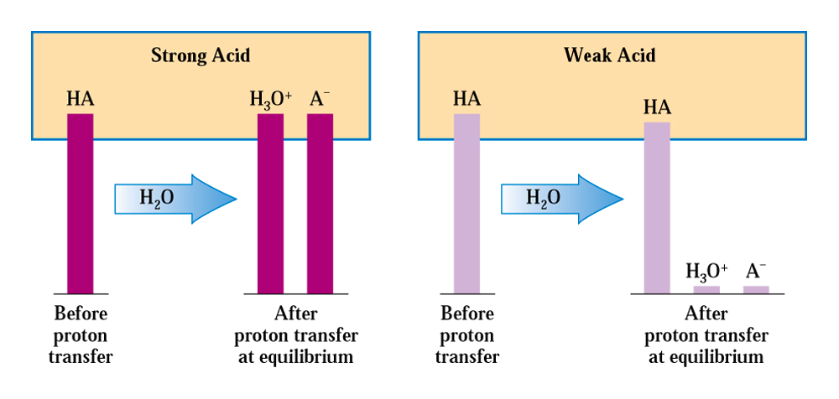
Strengths of acids and bases
(e.g. HCl)
(e.g. HC₂H₃O₂)

Slide 20
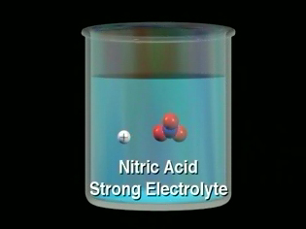
Strengths of acids and bases
There are only seven strong acids:
  Hydrochloric (HCl)
  Hydrobromic (HBr)
  Hydroiodic (HI)
  Nitric (HNO₃)
  Sulfuric (H₂SO₄)
  Chloric (HClO₃)
  Perchloric (HClO₄)
memorize these

Slide 21
Strengths of acids and bases
Some bases dissociate almost completely.
For example, when NaOH is dissolved in water, essentially all of the NaOH is transformed into Na⁺_{(aq)} + OH⁻_{(aq)}
Others, like ammonia, react only partially:
NH_{3(aq)} + H₂O_{(l)} D OH⁻_{(aq)} + NH₄⁺_{(aq)}
This equilibrium lies “far to the left”
NH₃ is a weak base

Slide 22
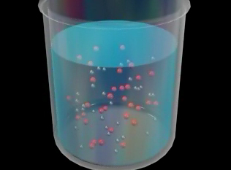
Strengths of acids and bases
The strong bases are the soluble salts of hydroxide ion:
LiOH
NaOH
KOH
RbOH
CsOH
memorize
Ca(OH)₂
Sr(OH)₂
Ba(OH)₂
…and
All group I hydroxides
Certain group II hydroxides
Need to memorize these

Slide 23
Strengths of acids and bases
An acid’s strength can be reported in terms of an equilibrium constant. The acid ionization constant, K_{a}, is calculated as follows:
HA_{(aq)} + H₂O_{(l)} D H₃O⁺_{(aq)} + A⁻_{(aq)}
- The size of K_{a} depends on the ratio of [products]/[reactants]. The more an
acid ionizes, the higher will be [products] and the lower will be [reactants]
- Acids that only weakly ionize will have small K_{a} values
- Strong acids will have very large K_{a} values

Slide 24
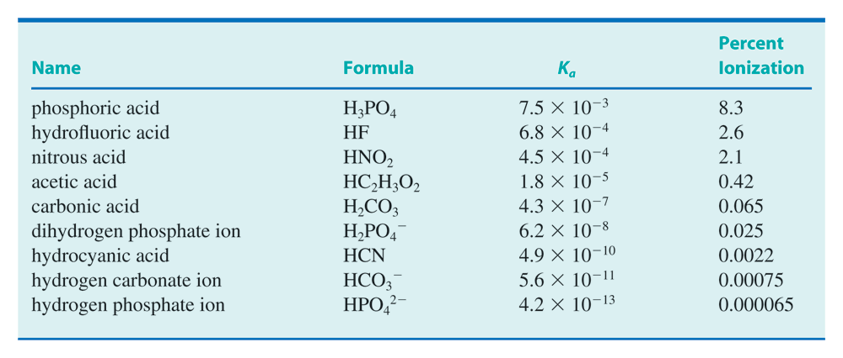
Acid ionization constants
Acid strength decreasing
All of the acids shown in this table are considered to be weak acids

Slide 25
Strengths of acids and bases
It’s possible to determine the value of an acid ionization equilibrium constant if you know the amounts of products and reactants at equilibrium:
Data: for a weak acid (HA), the equilibrium concentrations of products and reactants are:
  [HA] = 0.0085 M
  [A⁻] = 0.0015 M
  [H₃O⁺] = 0.0015 M
HA_{(aq)} + H₂O_{(l)} D H₃O⁺_{(aq)} + A⁻_{(aq)}

Slide 26
Strengths of acids and bases

Slide 27
Strengths of acids and bases
You can also determine an acid ionization constant if you know the extent to which an acid of a given concentration ionizes
A 0.100 M solution of an acid is 6.0% ionized. Calculate the acid ionization constant.
HA_{(aq)} + H₂O_{(l)} D H₃O⁺_{(aq)} + A⁻_{(aq)}

Slide 28
Strengths of acids and bases
To solve this problem:
  Determine what amount of A⁻ is formed when 0.100M HA ionizes by 6.0% (this is the amount of A⁻ that is formed when the reaction reaches equilibrium)
  Determine the amount of HA that is left over after equilibrium is established
  The amount of H₃O⁺ that is formed when the reaction reaches equilibrium will be the same amount as A⁻
  Knowing these three quantities, solve for K_{a}
HA_{(aq)} + H₂O_{(l)} D H₃O⁺_{(aq)} + A⁻_{(aq)}

Slide 29
Strengths of acids and bases
Base ionization constants (K_{b}) can be determined similarly:
B_{(aq)} + H₂O_{(l)} D BH⁺_{(aq)} + OH⁻_{(aq)}
Example:
NH_{3(aq)} + H₂O_{(l)} D NH₄⁺_{(aq)} + OH⁻_{(aq)}

Slide 30
Salts
Salts can often influence the acidity/basicity of a solution.
Salt is a term that means an ionic compound that consists of a metal or polyatomic positive ion and a non-metal or polyatomic ion as the negative ion.
Salts are not always water-soluble, but the amount that does dissolve will always dissociate (will always break apart and form ions)
e.g. NaCl, KC₂H₃O₂, MgCO₃, NH₄NO₃
We’ll look at these in examples later in this chapter

Slide 31
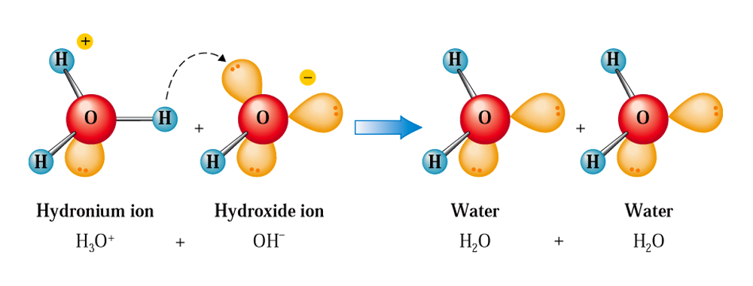
Acid-base neutralization reactions
When an acid and a hydroxide base react, the products are a salt and water:
HCl_{(aq)} + KOH_{(aq)} → KCl_{(aq)} + H₂O_{(l)}
When an acid is completely reacted by a base, a “neutralization” reaction occurs.
hydroxide
base
acid
In many neutralization reactions the resulting solution is not neutral
(i.e. some will result in acidic solutions and some in basic solutions)

Slide 32
Acid-base neutralization reactions
When a diprotic acid is involved, two “equivalent amounts” of NaOH are needed for the neutralization:
H₂SO_{4(aq)} + 2NaOH_{(aq)} → Na₂SO_{4(aq)} + 2H₂O_{(l)}
Triprotic acid:
H₃PO_{4(aq)} + 3NaOH_{(aq)} → Na₃PO_{4(aq)} + 3H₂O_{(l)}
Basically, the hydroxide formed by the base is what reacts with the H₃O⁺/H⁺ formed by the acid:
For H₂SO₄ reacting with NaOH:
2H⁺_{(aq)} + 2OH⁻_{(aq)} → 2H₂O_{(l)}
the “real” reaction for H₂SO₄ + 2NaOH

Slide 33
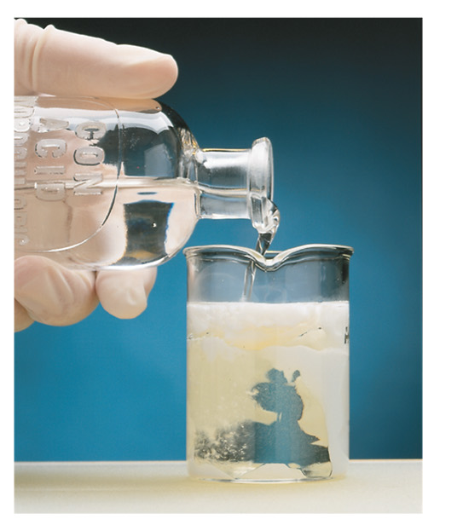
Neutralization Reactions
An example of acid-base neutralization in the body: antacids
in water:
Mg(OH)_{2(s)} D Mg²⁺_{(aq)} + 2OH⁻_{(aq)}
Mg(OH)_{2(s)} + 2HCl_{(aq)} → MgCl_{2(aq)} + 2H₂O_{(l)}
Mg(OH)₂ is almost insoluble in water (i.e. in the body), but in the presence of acid, it
reacts in an acid-base neutralization reaction.

Slide 34
Self-ionization of water
As we have seen, water is amphiprotic.
Even in the presence of other water molecules, water can accept or donate protons.
This is referred to as self-ionization.
this one acts
as an acid
H₂O(l) + H₂O(l)
H₃O⁺(aq) + OH⁻(aq)
this one acts
as a base
“autoionization”
The concentration of H₃O⁺ and OH⁻ ions in water is very small; at 25ºC, in “pure” water,
[H₃O⁺] = [OH⁻] = 1.00 x 10⁻⁷ M

Slide 35
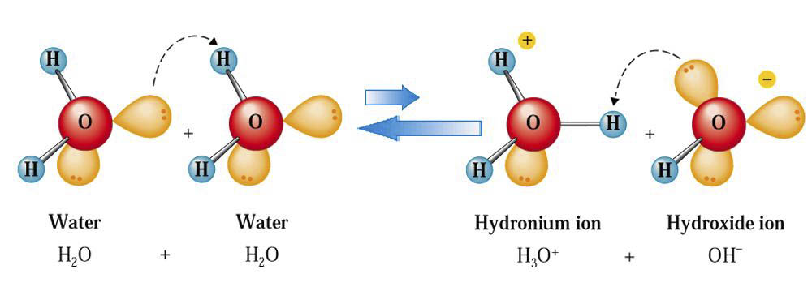
Self-ionization of water
this one acts
as an acid
H₂O(l) + H₂O(l)
H₃O⁺(aq) + OH⁻(aq)
this one acts
as a base
The H₂O on the left uses an e⁻ pair to form
a new bond to H⁺ ion from the H₂O on the right.

Slide 36
Ion-product constant for water
The self-ionization reaction of water occurs to a very small extent (equilibrium lies far to the left). We can calculate a value for the equilibrium constant (K_{w}) using the following:
Ion-product constant for H₂O

Slide 37
Ion-product constant for water
At 25ºC, [H₃O⁺] = [OH⁻] = 1.00 x 10⁻⁷ M, thus the value of K_{w} at 25ºC is:

Slide 38
Ion-product constant for water
At 25ºC, the product of the concentrations of H₃O⁺ and OH⁻ must be 1.00 x 10⁻¹⁴.
This is true even if some solute is added which changes the amount of H₃O⁺ or OH⁻.
This means that as [H₃O⁺]
increases, [OH⁻] decreases
(as a solution becomes more
acidic, it becomes less basic)
acid species
base species
Because K_{w} is a constant, as [H₃O⁺] increases, [OH⁻] decreases

Slide 39
Ion-product constant for water
Example: An acidic solute is added to water in an amount that increases [H₃O⁺] to 5.7 x 10⁻⁶ M. What is [OH⁻] in this solution?
Notice: we’ve made [H₃O⁺] greater than what it
would be under neutral conditions (1.0 x 10⁻⁷ M).
This makes [OH⁻] less than it would be under
neutral conditions 1.0 x 10⁻⁷ M)

Slide 40
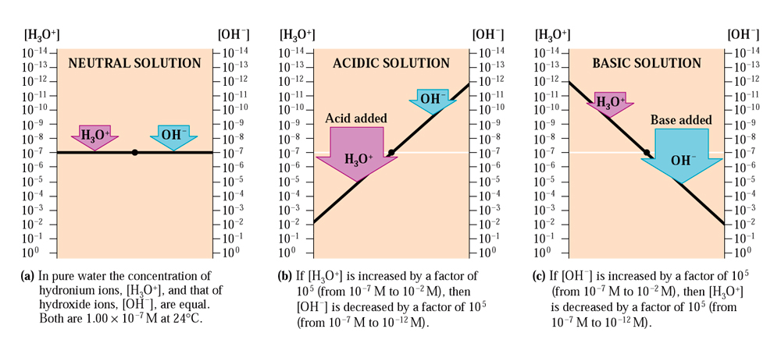
Ion-product constant for water

Slide 41
Acidic, basic, and neutral solutions
The relative amounts of H₃O⁺ and OH⁻ in a solution determine whether the solution is acidic, basic, or neutral.
An acidic solution has a higher concentration of H₃O⁺ than OH⁻.
A basic solution has a higher concentration of OH⁻ than H₃O⁺.
Neutral solutions have equal concentrations of H₃O⁺ and OH⁻

Slide 42
pH
Because H₃O⁺ and OH⁻ concentrations occur over such a large range (typically between 10⁻¹ to 10⁻¹⁴ M in water), it is more convenient to report [H₃O⁺] as a logarithmic value.
pH = -log[H₃O⁺]
To calculate the pH of a solution for a known [H₃O⁺], take the logarithm of [H₃O⁺]
and multiply the answer by -1

Slide 43
pH
For cases where the concentration of H₃O⁺ expressed in scientific notation has a coefficient of 1.0, the pH is just the negative value of the exponent (integral pH value)
Example: a solution has [H₃O⁺] = 1.0 x 10⁻⁶ M. What is the pH of this solution?
[H₃O⁺] = 1.0 x 10⁻⁶
pH = 6.00
# of sig figs in concentration = # of decimal places in pH figure

Slide 44
pH
Calculate the pH of a solution whose [OH⁻] is 1.0 x 10⁻⁴ M.
Use K_{w} to get [H₃O⁺], then get pH:
…or, use
pH + pOH = pK_{w} = 14.00 (at 25ºC)

Slide 45
pH
When [H₃O⁺] (or [OH⁻] values) don’t have coefficients of 1.0, the pH values calculated are non-integral.
Calculate the pH of a solution that has [H₃O⁺] = 7.23 x 10⁻⁸ M

Slide 46
pH values and [H₃O⁺]
If a solution’s pH is known, [H₃O⁺] can be calculated by taking the antilog of the pH
(antilog x = 10^{x})
Example, a solution has a pH of 3.44. What is [H₃O⁺] in this solution?

Slide 47
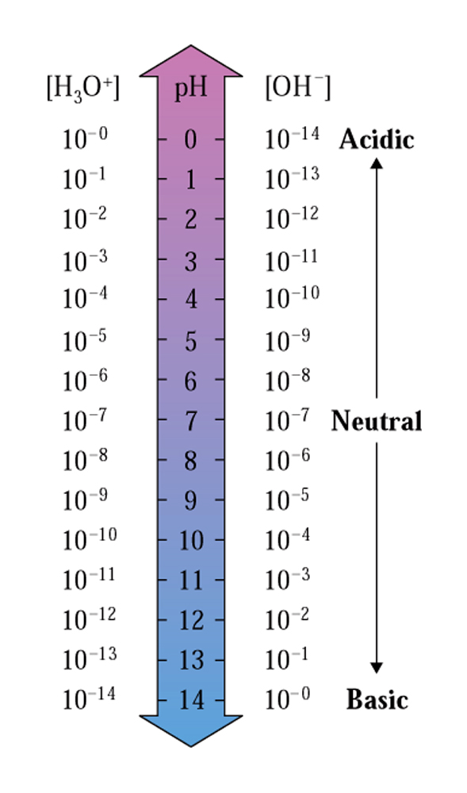
Interpreting pH values
Aqueous solutions that are acidic have
[H₃O⁺] > 10⁻⁷ M.
These solutions have a pH lower than 7
A neutral solution has [H₃O⁺] = 10⁻⁷M,
so it has a pH of 7
Aqueous solutions that are basic have
[H₃O⁺] < 10⁻⁷ M.
These solutions have a pH higher than 7
A change of one pH unit corresponds to a change in [H₃O⁺] by a factor of ten

Slide 48
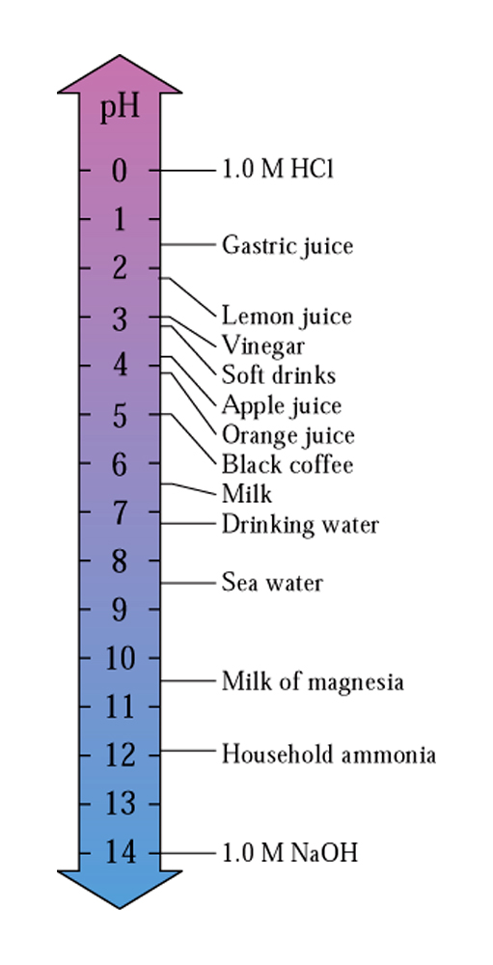
Interpreting pH values

Slide 49
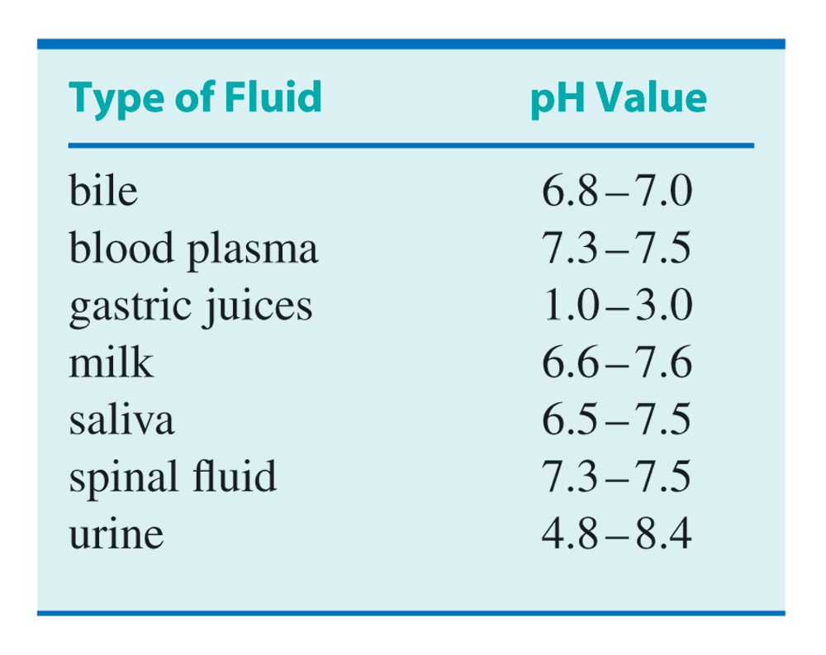
Interpreting pH values

Slide 50
pK_{a} and acid strength
We know that an acid’s strength can be reported by means of the acid ionization constant, K_{a}.
The stronger the acid, the greater the value of K_{a}.
Can also report K_{a} like we do for pH (as pK_{a}), since K_{a} values are often very small.
The weaker the acid, the greater will be the value of pK_{a}.

Slide 51
Acid ionization constants
pK_{a}
2.12
3.17
3.35
4.74
6.37
7.21
9.31
10.25
12.38
Acid strength decreasing

Slide 52
The pH of aqueous salt solutions
Sometimes (most times), the salt of an acid-base neutralization reaction can influence the acid/base properties of water.
NaCl dissolved in water: pH = 7
NaC₂H₃O₂ dissolved in water: pH > 7 (basic)
NH₄Cl dissolved in water: pH < 7 (acidic)
To determine whether a salt will make water acid, basic, or not influence the pH at all, we need to look at the type of reactions that make them.

Slide 53
The pH of aqueous salt solutions
When an acid-base neutralization reaction occurs, a salt and water are produced:
HCl_{(aq)}+ NaOH_{(aq)} → NaCl_{(aq)} + H₂O_{(l)}
The reaction above shows what happens when a strong acid and strong base react.
The salt of a strong acid-strong base neutralization reaction has no acid/base properties (the resulting solution would have a pH of 7)
NaCl in water = Na⁺_{(aq)} + Cl⁻_{(aq)}
When a strong acid/strong base reacts with any other base/acid, reaction goes “all the way to the right”

Slide 54
The pH of aqueous salt solutions
When a weak acid is reacted with a strong base, a salt and water are produced:
HC₂H₃O_{2(aq)}+ NaOH_{(aq)} → NaC₂H₃O_{2(aq)} + H₂O_{(l)}
The resulting solution would be basic (pH > 7), even though a “neutralization reaction” has occurred.
NaC₂H₃O₂ in water = Na⁺_{(aq)} + C₂H₃O₂⁻_{(aq)}
C₂H₃O₂⁻ is the conjugate base of a weak acid
(means that C₂H₃O₂⁻ is a weak base)
If you made up a solution by dissolving NaC₂H₃O₂ in water, the solution would be basic.

Slide 55
The pH of aqueous salt solutions
When a strong acid and a weak base are reacted in a neutralization reaction, the resulting solution is acidic (pH < 7):
HCl_{(aq)} + NH_{3(aq)} → NH₄Cl_{(aq)}
NH₄Cl in water = NH₄⁺_{(aq)} + Cl⁻_{(aq)}
NH₄⁺ is the conjugate
acid of a weak base
(means NH₄⁺ is a weak acid)
If you made up a solution by dissolving NH₄Cl in water, the solution would be acidic.

Slide 56
The pH of aqueous salt solutions
Let’s look at why this is so…
Salt of a strong acid and a strong base:
Both the strong acid and strong base would ionize/dissociate completely if put in water
HCl_{(aq)} → H⁺_{(aq)} + Cl⁻_{(aq)}
NaOH_{(aq)} → Na⁺_{(aq)} + OH⁻_{(aq)}
The one-way arrows here imply that the reverse reactions do not occur to any significant extent (Cl⁻_{(aq)} is a really bad base and Na⁺_{(aq)} is a really bad acid)
The conjugate base of a strong acid has no base properties in water
The conjugate acid of a strong base has no acid properties in water

Slide 57
The pH of aqueous salt solutions
Salt of a strong acid and a weak base:
HCl_{(aq)} + NH_{3(aq)} → NH₄Cl_{(aq)}
When NH₃ (a weak base) is dissolved in water, an equilibrium results:
NH_{3(aq)} + H₂O_{(l)} D NH₄⁺_{(aq)} + OH⁻_{(aq)}
If NH₄⁺ is a weak acid, then when a salt containing NH₄⁺ (e.g. NH₄Cl) is dissolved in water, the resulting solution will be acidic
Resulting
solution
is acidic
Conjugate acid of a weak base has
some acid properties in water
Conjugate acid of a weak base has acid properties in water

Slide 58
The pH of aqueous salt solutions
Salt of a weak acid and a strong base:
HC₂H₃O_{2aq)} + NaOH_{(aq)} → NaC₂H₃O_{2(aq)} + H₂O_{(l)}
When HC₂H₃O₂ (a weak acid) is dissolved in water, an equilibrium results:
HC₂H₃O_{2(aq)} + H₂O_{(l)} D H₃O⁺_{aq)} + C₂H₃O₂⁻_{(aq)}
If C₂H₃O₂⁻ is a weak base, then when a salt containing C₂H₃O₂⁻ (e.g. NaC₂H₃O₂) is dissolved in water, the resulting solution will be basic
Resulting
solution
is basic
Conjugate base of a weak acid has
some base properties in water
Conjugate base of a weak acid has base properties in water

Slide 59
Chemical equations for salt hydrolysis reactions
You can recognize salts that will influence the pH of water from the positive and negative ions in the formula for the salt:
+
NaCl (Na⁺, Cl⁻)
NaC₂H₃O₂ (Na⁺, C₂H₃O₂⁻)
KF (K⁺, F⁻)
NH₄Cl (NH₄⁺, Cl⁻)
-

Slide 60
Chemical equations for salt hydrolysis reactions
The positive ion might be acidic and the negative ion might be basic.
+
NaCl (Na⁺, Cl⁻)
NaC₂H₃O₂ (Na⁺, C₂H₃O₂⁻)
KF (K⁺, F⁻)
NH₄Cl (NH₄⁺, Cl⁻)
-

Slide 61
Chemical equations for salt hydrolysis reactions
If the cation (positive ion) of the salt is NH₄⁺, dissolving the salt into water will produce an acidic solution
If the anion (negative ion) is the conjugate base of a weak acid, the salt will make the solution basic
Cases involving NH₄⁺ with weak base anions won’t be considered
conjugate
bases
Cl⁻
Br⁻
I⁻
NO₃⁻
SO₄^{2-*}
ClO₃⁻
ClO₄⁻
  The strong acids
  Hydrochloric (HCl)
  Hydrobromic (HBr)
  Hydroiodic (HI)
  Nitric (HNO₃)
  Sulfuric (H₂SO₄)
  Chloric (HClO₃)
  Perchloric (HClO₄)
these anions
are not basic
* Conjugate base of H₂SO₄ is HSO₄⁻, but SO₄²⁻ is not basic; HSO₄⁻ is basic

Slide 62
Chemical equations for salt hydrolysis reactions
So, for example:
  Will NH₄NO₃ make a solution acidic, basic, or have no effect?
  NH₄⁺ will make the solution acidic. NO₃⁻ is the conjugate base of a strong acid (HNO₃), so it is not basic.
  The resulting solution will be acidic, according to the following chemical equation:
  NH₄⁺ + H₂O D NH₃ + H₃O⁺
NH₄⁺ is acidic – a H⁺ donor

Slide 63
Chemical equations for salt hydrolysis reactions
Another example:
  Will LiF make a solution acidic, basic, or neutral?
  The cation isn’t NH₄⁺, so it’s not acidic.
  The anion is F⁻. The conjugate acid is HF (not one of the strong acids, so F- is a weak base)
  F⁻ + H₂O D HF + OH⁻
F⁻ is basic – a H⁺ acceptor

Slide 64
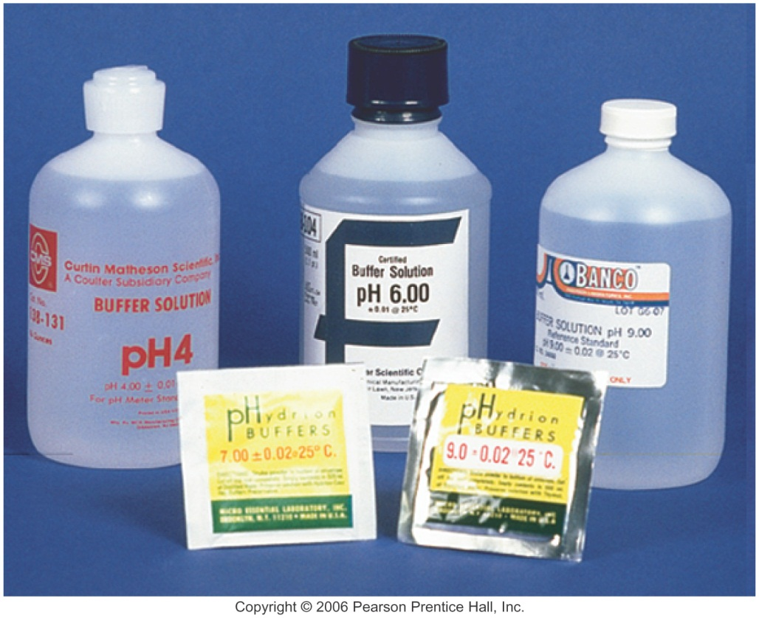
Buffers
Buffers are mixtures of weak acid/conjugate base pairs that are able to resist
significant changes in pH when small quantities of acids or bases are added.
They are particularly resistant to changes in pH, when small amounts of a strong acid or base is added.
Example
  When 0.02 mol of NaOH is added to 1L of water, the pH jumps from 7.0 to 12.3 (5.3 units)
  When 0.02 mol of NaOH is added to 1L of 0.3 M HC₂H₃O₂/0.3 M NaC₂H₃O₂ buffer, the pH jumps just 0.06 units
Buffers resist changes in pH

Slide 65
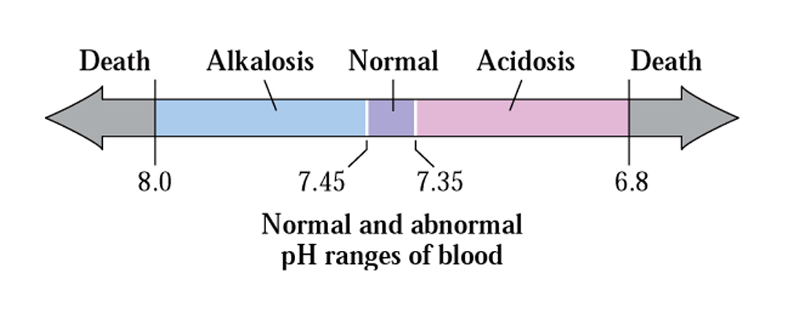
Buffers in everyday life
Because so many chemical reactions (including ones that occur in our body) produce/consume H⁺, pH regulation is essential
Our blood is buffered (HCO₃⁻/CO₃²⁻) to a pH of 7.4.
Many metabolic reactions produce H⁺ and CO₂. pH is extremely important in cellular reaction (e.g. many enzymes will work only near pH = 7.4)
The body needs to regulate pH within a narrow range (keep it very close to 7.4). Below pH = 6.8 and above pH = 7.8, cell death occurs

Slide 66
Buffers
Since buffers contain both acid and base components, they are able to offset small quantities of another acid or base added to them.
  The addition of an acid to a buffer consumes some of the acid that is already present in the buffer
  The addition of a base consumes some of the acid that is already present in the buffer

Slide 67
Buffers
As an example, consider a buffer that is made up from the following weak acid/conjugate base pair:
Acid = HF
Conj. base = F⁻ (in the form of NaF)

Slide 68
Buffers
Acid = HF
Base = F⁻ (in the form of NaF)
If HCl is added to this mixture, it will react with the base component of the buffer:
H⁺ + F⁻ → HF
Buffer mixture
Remember, Cl⁻ has no influence on the pH of solutions
The reaction of an acid with the buffer consumes a bit of the buffer’s base
and makes more of the buffer’s acid.

Slide 69
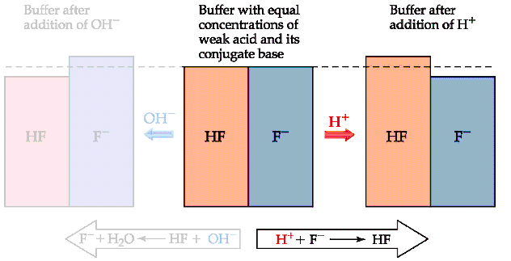
Buffers

Slide 70
Buffers
Acid = HF
Base = F⁻ (in the form of NaF)
If NaOH is added to this mixture, it will react with the acid component of the buffer:
OH⁻ + HF → F⁻ + H₂O
Buffer mixture
The reaction of a base with the buffer consumes a bit of the buffer’s acid
and makes more of the buffer’s base.

Slide 71
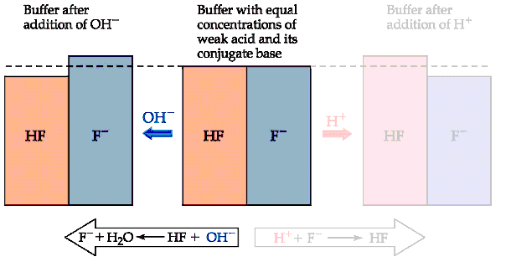
Buffers

Slide 72
The Henderson-Hasselbalch equation
The Henderson-Hasselbalch equation provides a means of calculating the pH of a buffer, provided the amounts of weak acid and conjugate base are known (or, more importantly, the ratio of their concentrations)
concentration of weak
base in buffer
concentration of weak
acid in buffer
K_{a} is the acid ionization constant for the weak acid/base pair

Slide 73
The Henderson-Hasselbalch equation
For example, a buffer is made up by adding 2.0 mol of HC₂H₃O₂ and 1.0 mol of NaC₂H₃O₂ to enough water to make up 1L of solution. If K_{a} for HC₂H₃O₂ is 1.8 x 10⁻⁵, what is the pH of the resulting solution?

Slide 74
The Henderson-Hasselbalch equation

Slide 75
The Henderson-Hasselbalch equation
It can be seen that if the amounts of weak acid and conjugate base in the buffer are equal, the pH will be pK_{a}

Slide 76
The Henderson-Hasselbalch equation
Some hints on the use of logarithms and the H.H. equation:
  log of a ratio less than 1 is a negative #
  log of a ratio greater than 1 is a positive #
  log of 1 = 0

Slide 77
The Henderson-Hasselbalch equation
If a buffer contained 1000 times as much base as conjugate acid, the pH of the buffer would be pK_{a} + 3 (for the acetic acid/acetate buffer we just looked at, pH would be 7.74 (4.74 + 3)
ratio log(ratio)
1000 3
100 2
10 1
1 0
0.1 -1
0.01 -2
0.001 -3

Slide 78
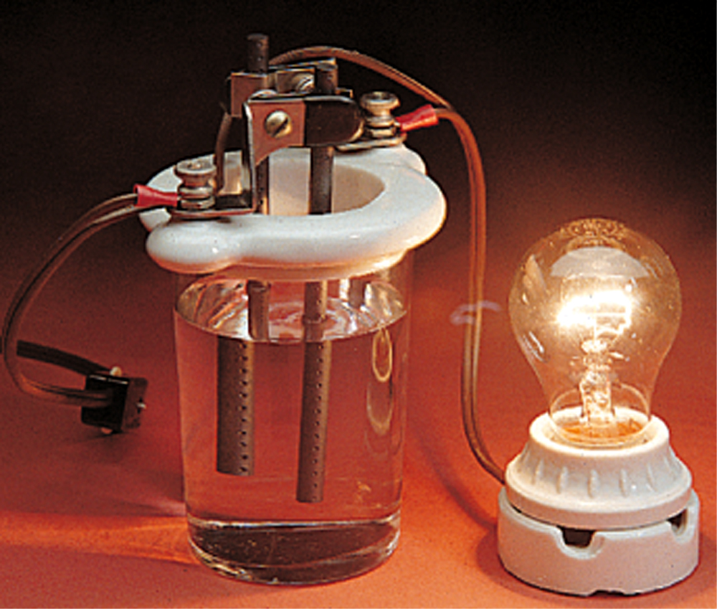
Electrolytes
An electrolyte is a substance whose solution conducts electricity.
Electrolytes produce ions (by dissociation of an ionic compound or ionization of an acid) in water. Salts are a typical example of an electrolyte.
Non-electrolytes do not ionize when put into water. Glucose and isopropyl alcohol are examples of non-electrolytes.

Slide 79
Electrolytes
Some electrolytes are able to (essentially) completely ionize/dissociate in water.
  Strong acids
  Strong bases
  Soluble salts
Some electrolytes produce equilibrium mixtures of ionized and non-ionized forms
  Weak acids
  Weak bases
called “strong electrolytes”
called “weak electrolytes”

Slide 80
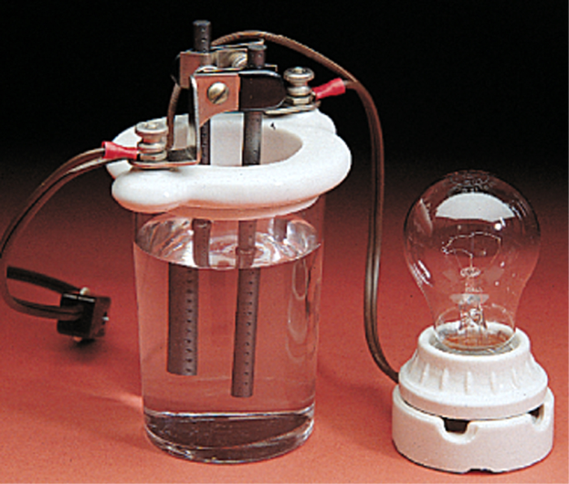
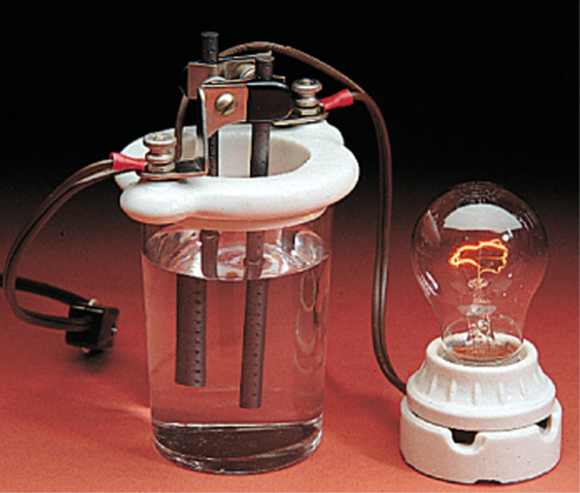

Electrolytes
non-electrolyte
weak electrolyte
strong electrolyte

Slide 81
Equivalents and milliequivalents
An equivalent (Eq) is the molar amount of that ion needed to supply one mole of positive or negative charge.
One mole of NaCl supplies
  one mole of + charge ions (Na⁺)
  one mole of – charge ions (Cl⁻)
1 mole of Cl⁻ = 1 Eq
1 mole of Ca²⁺ = 2 Eq
1 mole of PO₄³⁻ = 3 Eq
Each of these is considered
to be one equivalent (1 Eq)
Equivalents are units used like moles. They express the amount of ions (charge).
Just like M (mol/L), concentrations can be expressed with equivalents, as Eq/L

Slide 82
Equivalents and milliequivalents
Because the concentrations of ions in body fluids is usually low, the term, milliequivalents, is often seen.
1 mEq = 0.001 Eq
1000 mEq = 1 Eq

Slide 83
Equivalents and milliequivalents
Example problem: the concentration of Na⁺ in blood is 141 mEq/L. How many moles of Na⁺ are present in 1 L of blood?
1 mol Na⁺ = 1 Eq = 1000 mEq
volume
of blood
concentration
of Na⁺
Eq → mol

Slide 84
Equivalents and milliequivalents
Another example: The concentration of Ca²⁺ ion present in a blood sample is found to be 4.3 mEq/L. How many mg of Ca²⁺ are present in 500 mL of blood?
1 mol Ca²⁺ = 2 Eq = 2000 mEq
volume
of blood
conc.
of Ca²⁺
mol → g
g → mg
mL → L
Eq → mol

Slide 85
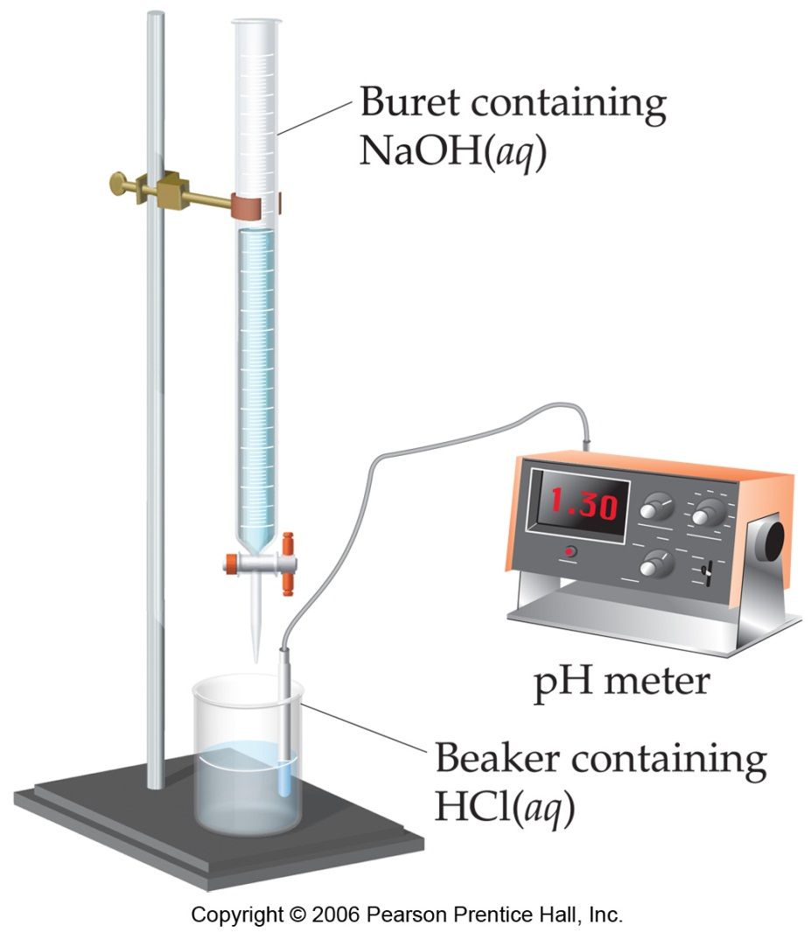
Acid-Base Titrations
Titrations are experiments in which two solutions are made to react together (a balanced equation for the reaction must be known).
In an acid-base titration, a known volume and concentration of base (or acid) is slowly added to a known volume of acid (or base).
An indicator is often used to find the endpoint in acid-base titration experiments.
titrant
analyte
Using C₁V₁ = C₂V₂, the concentration
of the analyte can be determined
(also need to consider coefficients)

Slide 86
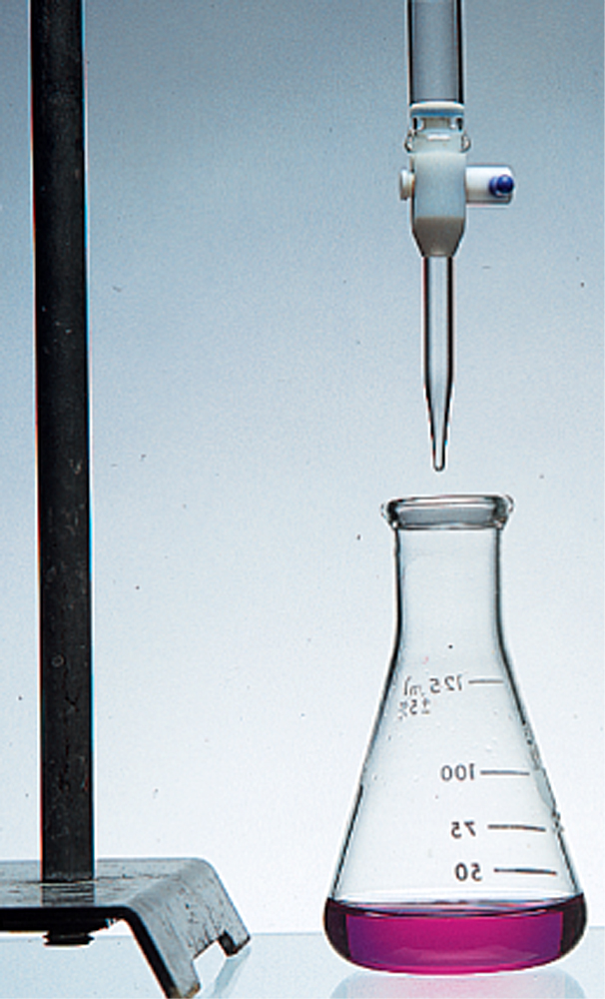
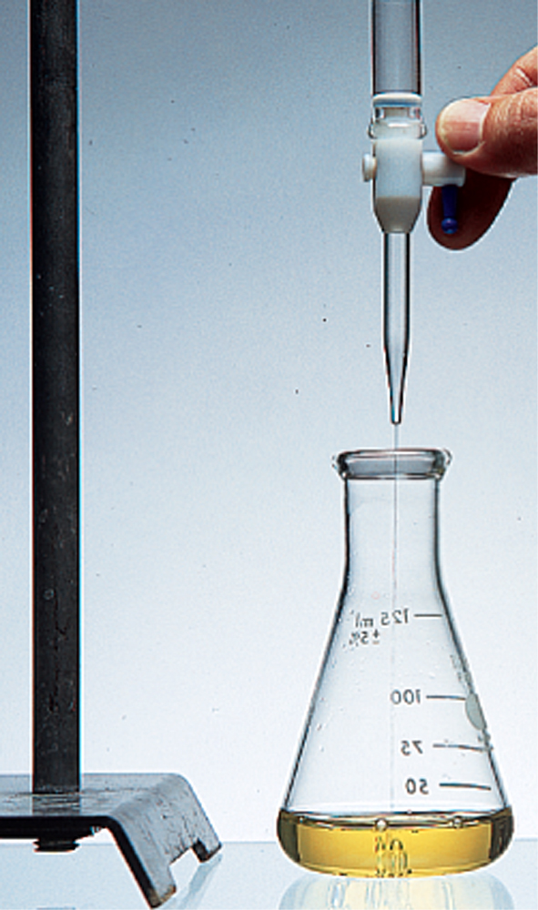
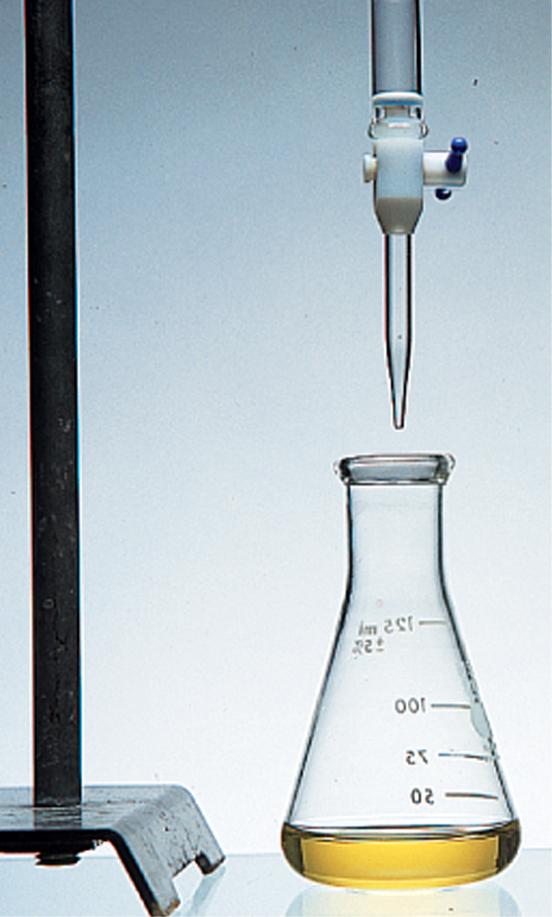
Acid-Base Titrations
Before endpoint
(acidic)
After endpoint
(basic)
acid has been neutralized

Slide 87
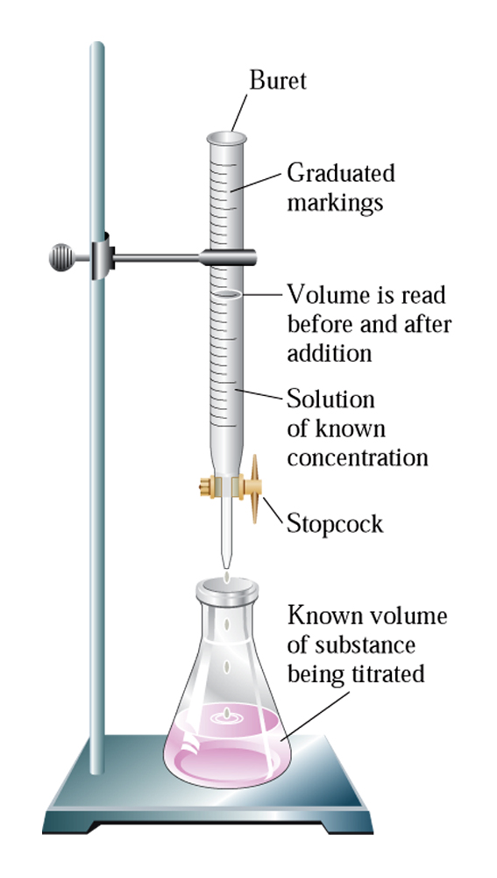
Acid-Base Titrations
Know the concentration of this solution
and can measure the volume needed to
reach endpoint (example, this could be
0.100 M NaOH)
Know the volume of this solution,
but not the concentration (example,
this could be 25.00 mL of HNO₃)

Slide 88
Acid-Base Titrations
Example:
It takes 21.09 mL of 0.100 M NaOH to
neutralize 25.00 mL of HNO₃. What is
the concentration of HNO₃?
NaOH + HNO₃ → NaNO₃ + H₂O
At endpoint:
# of moles of NaOH added = # of moles of HNO₃
C_{NaOH}V_{NaOH} = C_{HNO3}V_{HNO3}

Slide 89
Acid-Base Titrations

Slide 90
Acid-Base Titrations
In a sulfuric acid-sodium hydroxide titration, 17.3 mL of 0.126 M NaOH is needed to neutralize 25.0 mL of H₂SO₄ of unknown concentration. Find the molarity of the H₂SO₄ solution.

