Slide 1
Chapter 10. Acids, Bases, and Salts
Introduction to Inorganic Chemistry
Instructor Dr. Upali Siriwardane (Ph.D. Ohio State)
E-mail: upali@latech.edu
Office: 311 Carson Taylor Hall ; Phone: 318-257-4941;
Office Hours: MWF 8:00-9:00 and 11:00-12:00;
TR 10:00-12:00
Contact me trough phone or e-mail if you have questions
Online Tests on Following days
March 24, 2017: Test 1 (Chapters 1-3)
April 10, 2017 : Test 2 (Chapters 4-5)
May 1, 2017: Test 3 (Chapters 6,7 &8)
May 12, 2017 : Test 4 (Chapters 9, 10 &11)
May 15, 2017: Make Up Exam: Chapters 1-11)
.

Slide 2
10.1 Arrhenius Acid-Base Theory
10.2 Brønsted-Lowry Acid-Base Theory
10.3 Mono-, Di-, and Triprotic Acids
10.4 Strengths of Acids and Bases
10.5 Ionization Constants for Acids and Bases
10.6 Salts
10.7 Acid-Base Neutralization Reactions
10.8 Self-Ionization of Water
10.9 The pH Concept
10.10 The pKa Method for Expressing Acid Strength
10.11 The pH of Aqueous Salt Solutions
10.12 Buffers
10.13 The Henderson-Hasselbalch Equation
10.14 Electrolytes
10.15 Equivalents and Milliequivalents of Electrolytes
10.16 Acid-Base Titrations

Slide 3
Arrhenius acid: hydrogen-containing compound that produces H⁺ ions in solution.
  Example: HNO₃ → H⁺ + NO₃–
Arrhenius base: hydroxide-containing compound that produces OH– ions in solution.
  Example: NaOH → Na⁺ + OH–

Slide 4
Ionization
The process in which individual positive and negative ions are produced from a molecular compound that is dissolved in solution.
  Arrhenius acids
  Example: HCl → H⁺ + Cl–

Slide 5
Dissociation
The process in which individual positive and negative ions are released from an ionic compound that is dissolved in solution.
  Arrhenius Bases
  Example: KOH → K⁺ + OH–

Slide 6
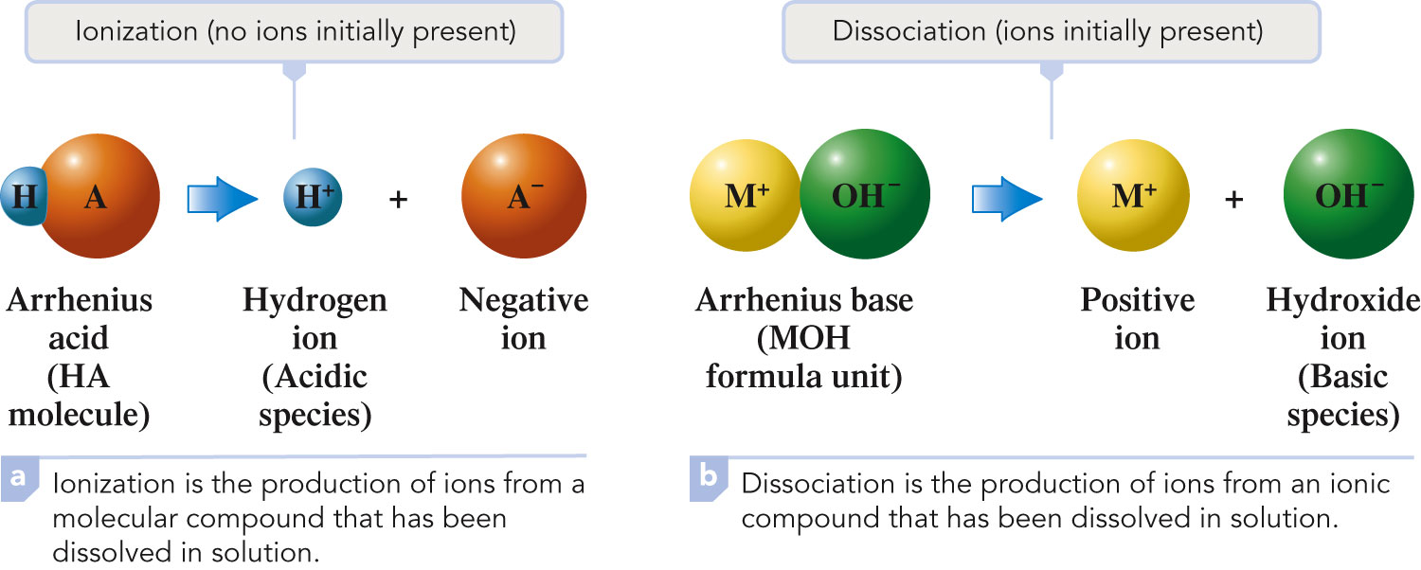
Difference Between Ionization and Dissociation

Slide 7
Brønsted-Lowry acid: substance that can donate a proton (H⁺ ion) to some other substance; proton donor.
Brønsted-Lowry base: substance that can accept a proton (H⁺ ion) from some other substance; proton acceptor.
HCl + H₂O → Cl⁻ + H₃O⁺
acid base

Slide 8
Brønsted-Lowry Reaction
To play movie you must be in Slide Show Mode
PC Users: Please wait for content to load, then click to play
Mac Users: CLICK HERE

Slide 9
Acid in Water
HA(aq) + H₂O(l) H₃O⁺(aq) + A⁻(aq)
acid base conjugate conjugate acid base

Slide 10
Acid dissociation Equilibrium
HC₂H₃O₂(aq) + H₂O(l) H₃+O(aq) + C₂H₃O₂-(aq)
[H+][C₂H₃O₂-]
HC₂H₃O₂; K_{a}= ------------------
[HC₂H₃O₂]

Slide 11
Base dissociation Equilibrium
NH₃(aq) + H₂O(l) NH₄+ (aq) + OH-(aq)
[NH₄+][OH-]
NH₃; K_{b}= ------------------
[NH₃]

Slide 12
Acid Ionization Equilibrium
To play movie you must be in Slide Show Mode
PC Users: Please wait for content to load, then click to play
Mac Users: CLICK HERE

Slide 13
Amphiprotic Substance
A substance that can either lose or accept a proton and thus can function as either a Brønsted-Lowry acid or a Brønsted-Lowry base.
  Example: H₂O, H₃O⁺
  H₂O, OH–

Slide 14
Monoprotic Acid
An acid that supplies one proton (H⁺ ion) per molecule during an acid-base reaction.
  HA + H₂O A⁻ + H₃O⁺

Slide 15
Diprotic Acid
An acid that supplies two protons (H⁺ ions) per molecule during an acid-base reaction.
  H₂A + H₂O HA⁻ + H₃O^{+ ;} K_{a1}
  HA⁻ + H₂O A²⁻ + H₃O^{+ ;} K_{a2}

Slide 16
Triprotic Acid
An acid that supplies three protons (H⁺ ions) per molecule during an acid-base reaction.
  H₃A + H₂O H₂A⁻ + H₃O^{+ ;} K_{a1}
  H₂A⁻ + H₂O HA²⁻ + H₃O^{+ ;} K_{a2}
  HA²⁻ + H₂O A³⁻ + H₃O^{+ ;} K_{a3}

Slide 17
Polyprotic Acid
An acid that supplies two or more protons (H⁺ ions) during an acid-base reaction.
Includes both diprotic and triprotic acids.

Slide 18
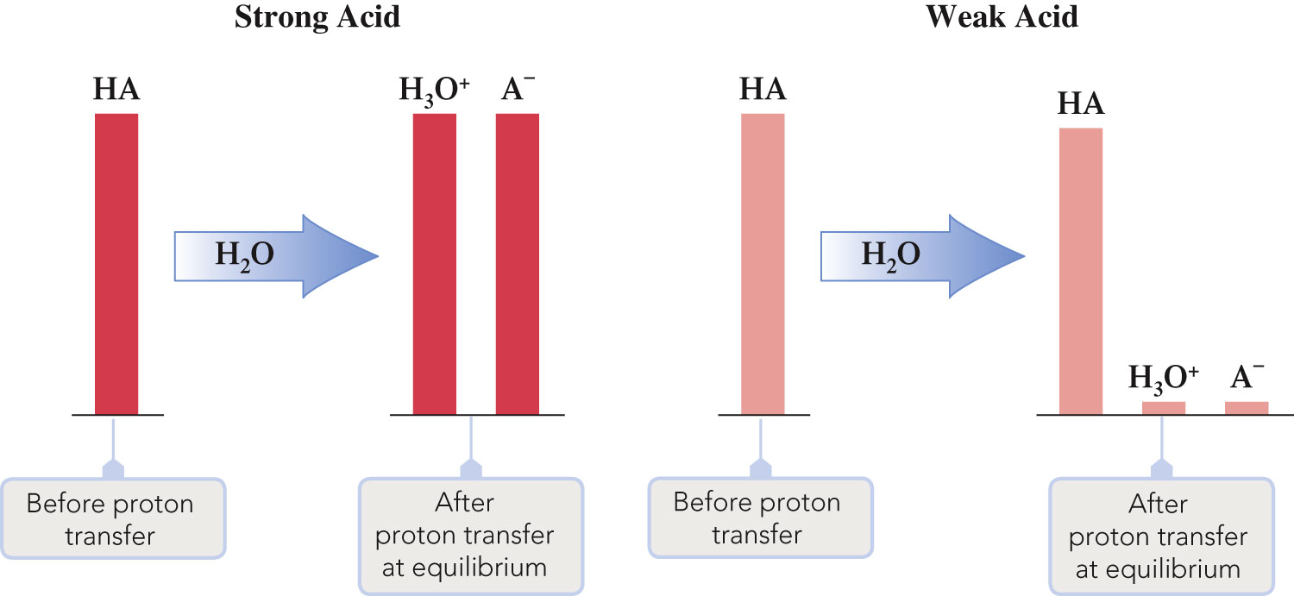
Differences Between Strong and Weak Acids in Terms of Species Present

Slide 19
Strong Acid
Transfers ~100% of its protons to water in an aqueous solution. (aq)
HCl + H₂O → H₃O⁺(aq) + Cl⁻(aq)
Ionization equilibrium lies far to the right (product).
Yields a weak conjugate base Cl⁻ ion .

Slide 20
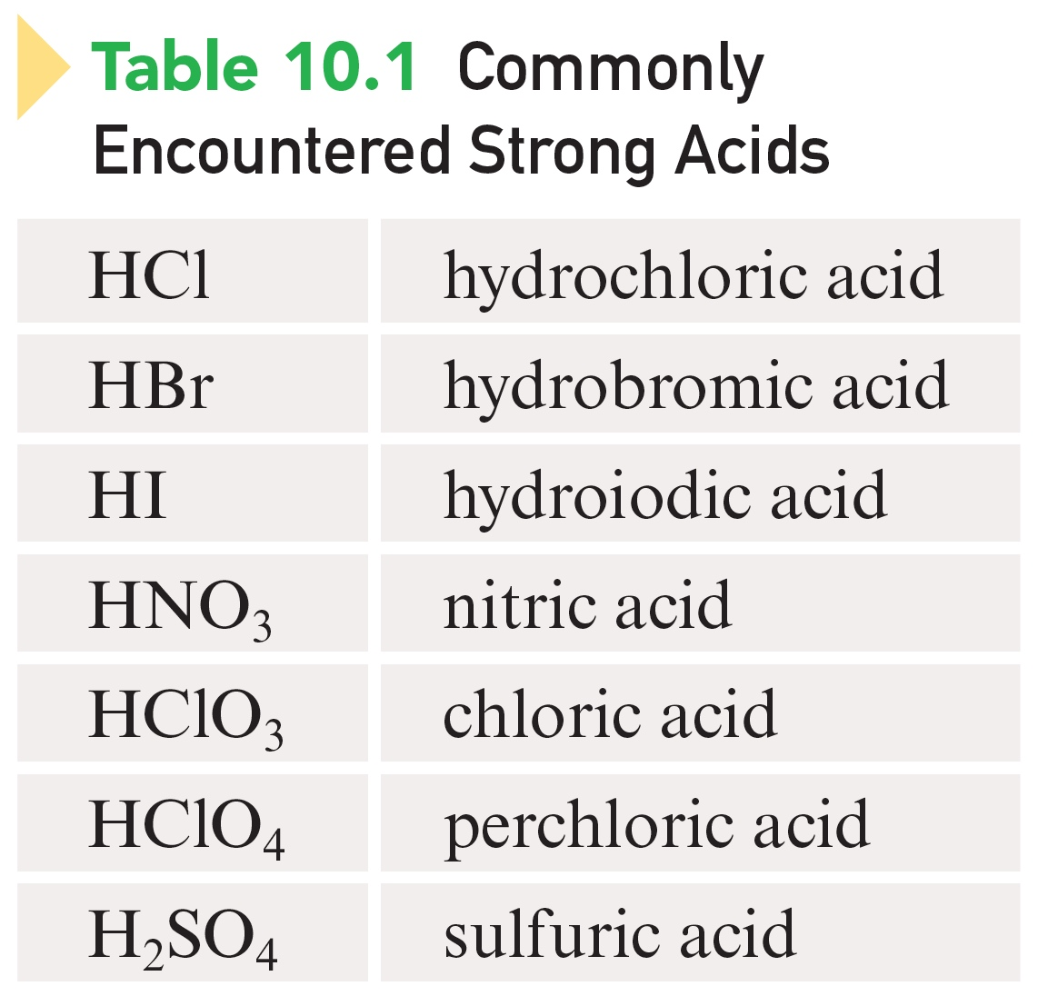
Commonly Encountered Strong Acids

Slide 21
Weak Acid
Transfers ~small % of its protons to water in an aqueous solution.
HC₂H₃O₂(aq) + H₂O(l) H₃+O(aq) + C₂H₃O₂-(aq)
weak Acid conjugate base
Ionization equilibrium lies far to the left (reactant).
Yields a strong conjugate base C₂H₃O₂- ion .

Slide 22
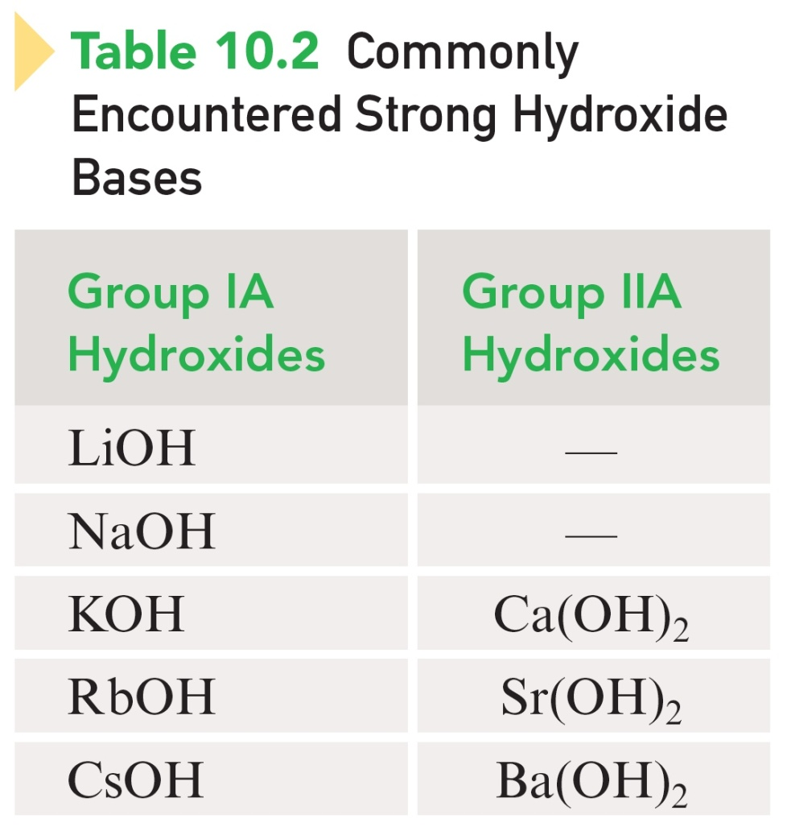
Bases
Strong bases: hydroxides of Groups IA and IIA.

Slide 23
Acid Ionization Constant
The equilibrium constant for the reaction of a weak acid with water.
HA(aq) + H₂O(l) H₃O⁺(aq) + A⁻(aq)

Slide 24
Acid Strength, % Ionization, and K_{a} Magnitude
Acid strength increases as % ionization increases.
Acid strength increases as the magnitude of K_{a} increases.
% Ionization increases as the magnitude of K_{a} increases.

Slide 25
Base Ionization Constant
The equilibrium constant for the reaction of a weak base with water.
B(aq) + H₂O(l) BH⁺(aq) + OH–(aq)

Slide 26
Ionic compounds containing a metal or polyatomic ion as the positive ion and a nonmetal or polyatomic ion (except hydroxide) as the negative ion.
NaCl, NH₄Cl, NaSO₄ NaOH
All common soluble salts are completely dissociated into ions in aqueous solution.
NaCl + H₂O(l) → Na⁺(aq) + Cl⁻(aq)
,
√
x
√
√

Slide 27
Neutralization Reaction
The chemical reaction between an acid and a hydroxide base in which a salt and water are the products.
Acid + Base → Salt + water
HCl + NaOH → NaCl + H₂O
H₂SO₄ + 2 KOH → K₂SO₄ + 2 H₂O

Slide 28
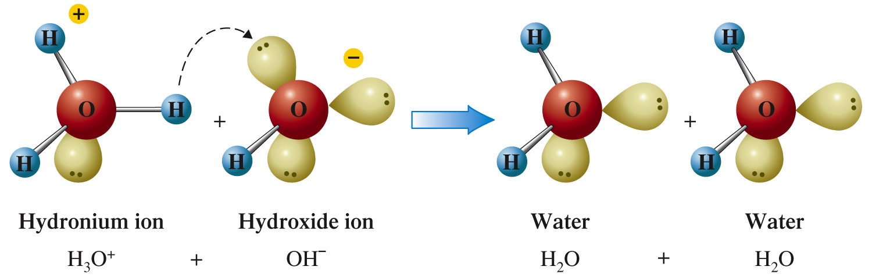
Formation of Water

Slide 29
Self-Ionization (Auto-Ionization)
Water molecules in pure water interact with one another to form ions.
[H₃O⁺] = 1x 10⁻⁷ 1x 10⁻⁷
H₂O + H₂O H₃O⁺ + OH–
Net effect is the formation of equal amounts of hydronium and hydroxide ions.
Ionic Product H₂O; K_{w} = [H₃O⁺][OH–] = 1.00 × 10^{–14}

Slide 30
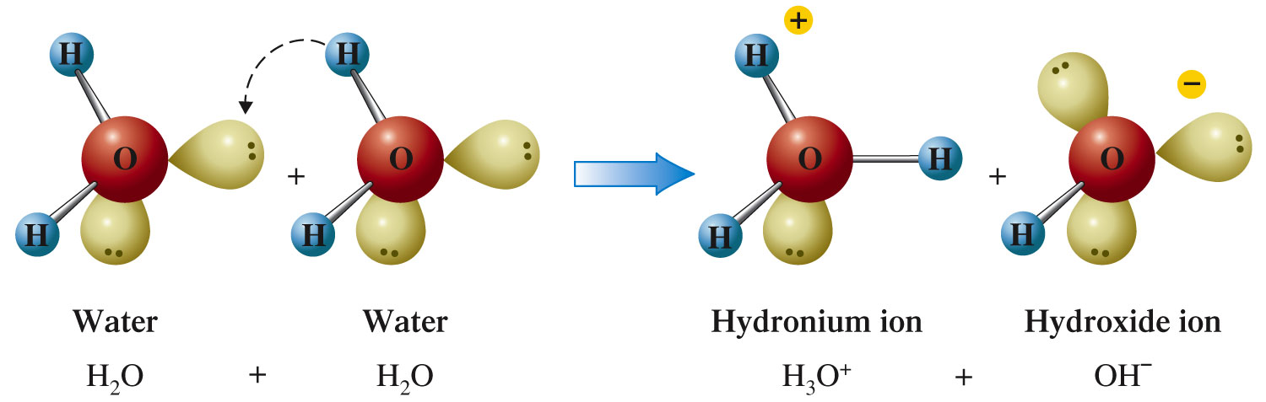
Self-Ionization of Water

Slide 31
Ion Product Constant for Water
At 24°C:
K_{w} = [H₃O⁺][OH–] = 1.00 × 10^{–14}
No matter what the solution contains, the product of [H₃O⁺] and [OH–] must always equal 1.00 × 10^{–14}.

Slide 32
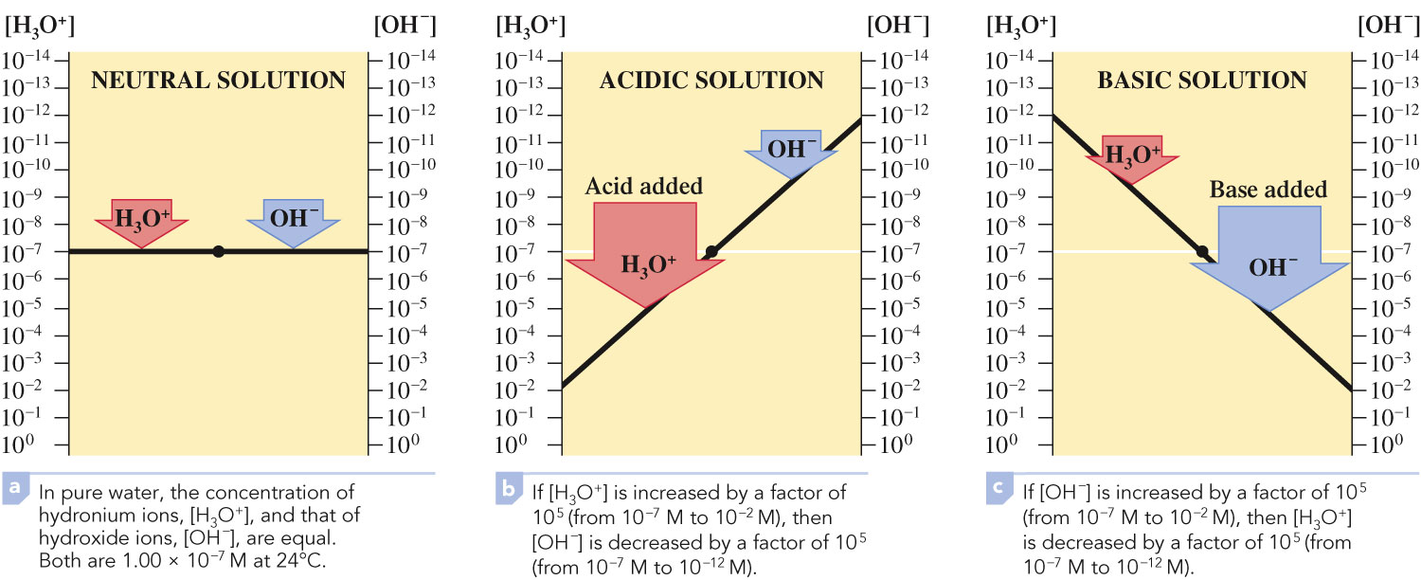
Relationship Between [H₃O⁺] and [OH–]

Slide 33
Three Possible Situations
[H₃O⁺] = [OH–]; neutral solution
[H₃O⁺] > [OH–]; acidic solution
[H₃O⁺] < [OH–]; basic solution

Slide 34

Exercise
Calculate [H₃O⁺] or [OH–] as required for each of the following solutions at 24°C, and state whether the solution is neutral, acidic, or basic.
  1.0 × 10^{–4} M OH–
  b) 2.0 M H₃O⁺
Notes:
K_{w} = [H₃O⁺][OH–] = 1.00 × 10^{–14}
1.00 × 10^{–14} = [H₃O⁺](1.0 × 10^{–4} M) = 1.0 × 10^{–10} M H₃O⁺; basic
1.00 × 10^{–14} = (2.0)[OH–] = 5.0 × 10^{–15} M OH–; acidic

Slide 35
Exercise
Calculate [H₃O⁺] or [OH–] as required for each of the following solutions at 24°C, and state whether the solution is neutral, acidic, or basic.
  1.0 × 10^{–4} M OH–
  1.0 × 10^{–10} M H₃O⁺; basic
  b) 2.0 M H₃O⁺
  5.0 × 10^{–15} M OH–; acidic
Notes:
K_{w} = [H₃O⁺][OH–] = 1.00 × 10^{–14}
1.00 × 10^{–14} = [H₃O⁺](1.0 × 10^{–4} M) = 1.0 × 10^{–10} M H₃O⁺; basic
1.00 × 10^{–14} = (2.0)[OH–] = 5.0 × 10^{–15} M OH–; acidic

Slide 36
pH = –log[H₃O⁺]
A compact way to represent solution acidity.
pH decreases as [H⁺] increases.
pH range between 0 to 14 in aqueous solutions at 24°C.

Slide 37
Exercise
Calculate the pH for each of the following solutions.
  1.0 × 10^{–4} M H₃O⁺
  0.040 M OH–
Notes:
pH = –log[H₃O⁺]
a) pH = –log[H₃O⁺] = –log(1.0 × 10^{–4} M) = 4.00
b) K_{w} = [H₃O⁺][OH–] = 1.00 × 10^{–14} = [H₃O⁺](0.040 M) = 2.5 × 10^{–13} M H₃O⁺
pH = –log[H₃O⁺] = –log(2.5 × 10^{–13} M) = 12.60

Slide 38
Exercise
Calculate the pH for each of the following solutions.
  1.0 × 10^{–4} M H₃O⁺
  pH = 4.00
  0.040 M OH–
  pH = 12.60
Notes:
pH = –log[H₃O⁺]
a) pH = –log[H₃O⁺] = –log(1.0 × 10^{–4} M) = 4.00
b) K_{w} = [H₃O⁺][OH–] = 1.00 × 10^{–14} = [H₃O⁺](0.040 M) = 2.5 × 10^{–13} M H₃O⁺
pH = –log[H₃O⁺] = –log(2.5 × 10^{–13} M) = 12.60

Slide 39
Exercise
The pH of a solution is 5.85. What is the [H₃O⁺] for this solution?
Notes:
[H₃O⁺] = 10^–5.85 = 1.4 × 10^{–6} M

Slide 40
Exercise
The pH of a solution is 5.85. What is the [H₃O⁺] for this solution?
[H₃O⁺] = 1.4 × 10^{–6} M
Notes:
[H₃O⁺] = 10^–5.85 = 1.4 × 10^{–6} M

Slide 41
pH Range
pH = 7; neutral
pH > 7; basic
  Higher the pH, more basic.
pH < 7; acidic
  Lower the pH, more acidic.

Slide 42
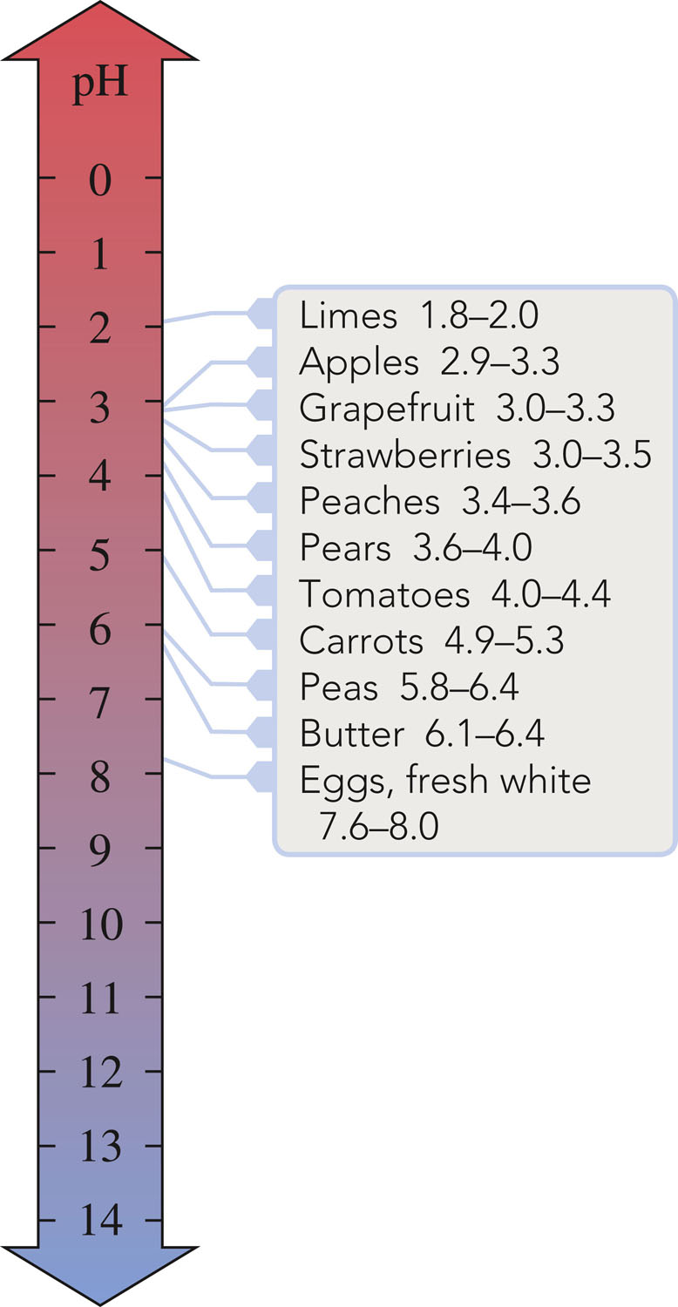
Relationships Among pH Values, [H₃O⁺], and [OH–]

Slide 43
pK_{a} = –log K_{a}
pK_{a} is calculated from K_{a} in exactly the same way that pH is calculated from [H₃O⁺].

Slide 44
Exercise
Calculate the pK_{a} for HF given that the K_{a} for this acid is 6.8 × 10^{–4}.
Notes:
pK_{a} = –log K_{a} = –log(6.8 × 10^{–4} M) = 3.17

Slide 45
Exercise
Calculate the pK_{a} for HF given that the K_{a} for this acid is 6.8 × 10^{–4}.
pK_{a} = 3.17a
Notes:
pK_{a} = –log K_{a} = –log(6.8 × 10^{–4} M) = 3.17

Slide 46
Salts
Ionic compounds.
When dissolved in water, break up into its ions (which can behave as acids or bases).
Hydrolysis – the reaction of a salt ions with water to produce hydronium ion or hydroxide ion or both.
  NH₄ ⁺ Cl ⁻ NH₄ ⁺ Conjugate acid of weak base
  NH₄⁺ + H₂O → NH₃ + H₃O⁺
Notes:
See notes on slide 1.

Slide 47
Types of Salt Hydrolysis
The salt of a strong acid and a strong base does not hydrolyze, so the solution is neutral.
  KCl, NaNO₃
Notes:
See notes on slide 1.

Slide 48
Types of Salt Hydrolysis
The salt of a strong acid and a weak base hydrolyzes to produce an acidic solution.
  NH₄Cl
  NH₄⁺ + H₂O → NH₃ + H₃O⁺
Notes:
See notes on slide 1.

Slide 49
Types of Salt Hydrolysis
The salt of a weak acid and a strong base hydrolyzes to produce a basic solution.
  NaF,
  F– + H₂O → HF + OH–
  F– Conjugate base of weak acid
  KC₂H₃O₂
  C₂H₃O₂– + H₂O → HC₂H₃O₂ + OH–
  C₂H₃O₂– Conjugate acid of weak acid
Notes:
See notes on slide 1.

Slide 50
Types of Salt Hydrolysis
The salt of a weak acid and a weak base hydrolyzes to produce a slightly acidic, neutral, or slightly basic solution, depending on the relative weaknesses of the acid and base.
Notes:
See notes on slide 1.

Slide 51
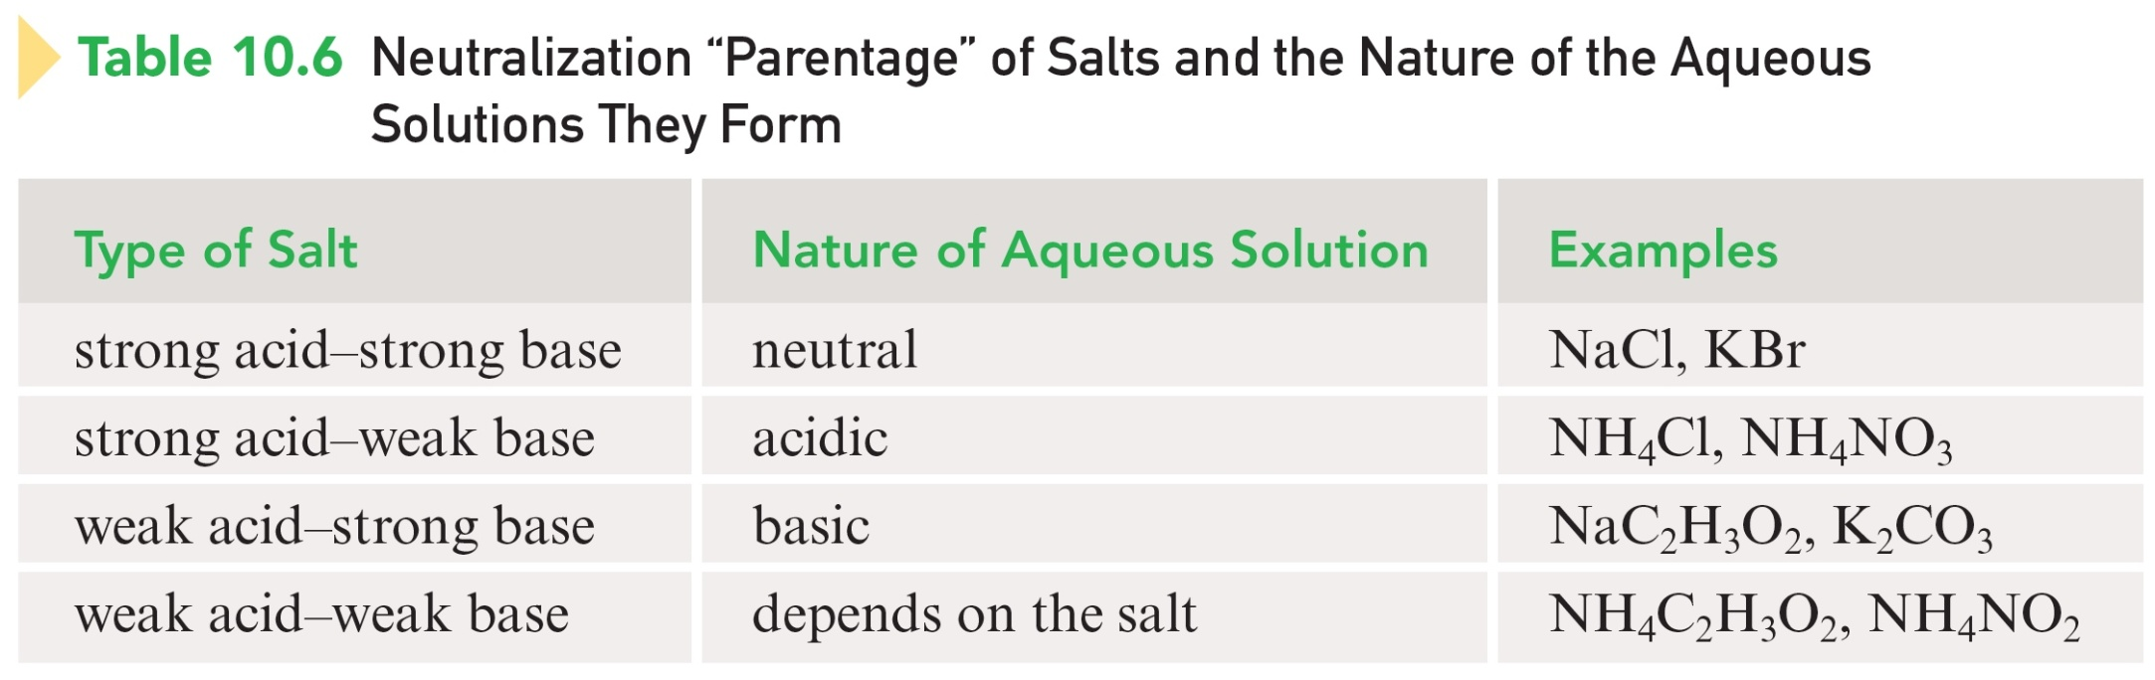
Neutralization “Parentage” of Salts
Notes:
See notes on slide 1.

Slide 52
Neutralization “Parentage” of Salts
Notes:
See notes on slide 1.

Slide 53
What salt solutions would be acidic, basic and neutral?
1) strong acid + strong base = neutral
2) weak acid + strong base = basic
3) strong acid + weak base = acidic
weak acid + weak base = neutral,
basic or an acidic solution depending on the relative strengths of the acid and the base.

Slide 54
Key Points about Buffers
Buffer – an aqueous solution containing substances that prevent major changes in solution pH when small amounts of acid or base are added to it.
They are weak acids or bases containing a common ion.
Typically, a buffer system is composed of a weak acid and its conjugate base.

Slide 55
Buffers Contain Two Active Chemical Species
A substance to react with and remove added base.
A substance to react with and remove added acid.

Slide 56
Adding an Acid to a Buffer
To play movie you must be in Slide Show Mode
PC Users: Please wait for content to load, then click to play
Mac Users: CLICK HERE

Slide 57
Buffers
To play movie you must be in Slide Show Mode
PC Users: Please wait for content to load, then click to play
Mac Users: CLICK HERE

Slide 58
Addition of Base [OH– ion] to the Buffer
HA + H₂O H₃O⁺ + A–
The added OH– ion reacts with H₃O⁺ ion, producing water (neutralization).
The neutralization reaction produces the stress of not enough H₃O⁺ ion because H₃O⁺ ion was consumed in the neutralization.
The equilibrium shifts to the right to produce more H₃O⁺ ion, which maintains the pH close to its original level.

Slide 59
Addition of Acid [H₃O⁺ ion] to the Buffer
HA + H₂O H₃O⁺ + A–
The added H₃O⁺ ion increases the overall amount of H₃O⁺ ion present.
The stress on the system is too much H₃O⁺ ion.
The equilibrium shifts to the left consuming most of the excess H₃O⁺ ion and resulting in a pH close to the original level.

Slide 60
Henderson-Hasselbalch Equation

Slide 61
Exercise
What is the pH of a buffer solution that is 0.45 M acetic acid (HC₂H₃O₂) and 0.85 M sodium acetate (NaC₂H₃O₂)? The K_{a} for acetic acid is 1.8 × 10^{–5}.
pH = 5.02
Notes:
pH = –logK_{a} + log([C₂H₃O₂–] / [HC₂H₃O₂]) = –log(1.8 × 10^{–5}) + log(0.85 M / 0.45 M) = 5.02

Slide 62
Acids, bases, and soluble salts all produce ions in solution, thus they all produce solutions that conduct electricity.
Electrolyte – substance whose aqueous solution conducts electricity.

Slide 63
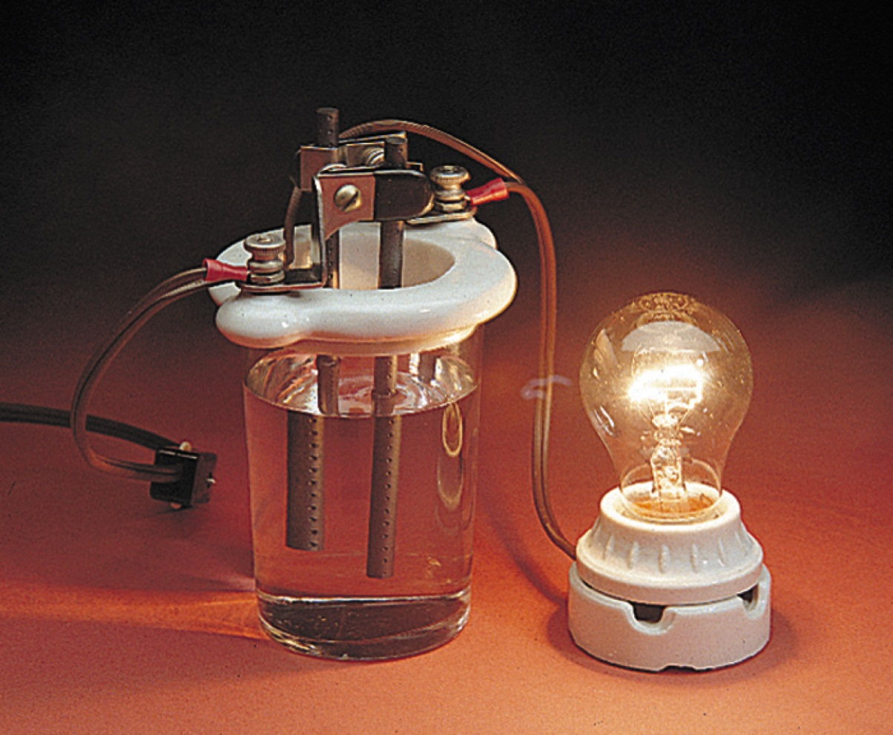
Nonelectrolyte – does not conduct electricity
Example: table sugar (sucrose), glucose

Slide 64
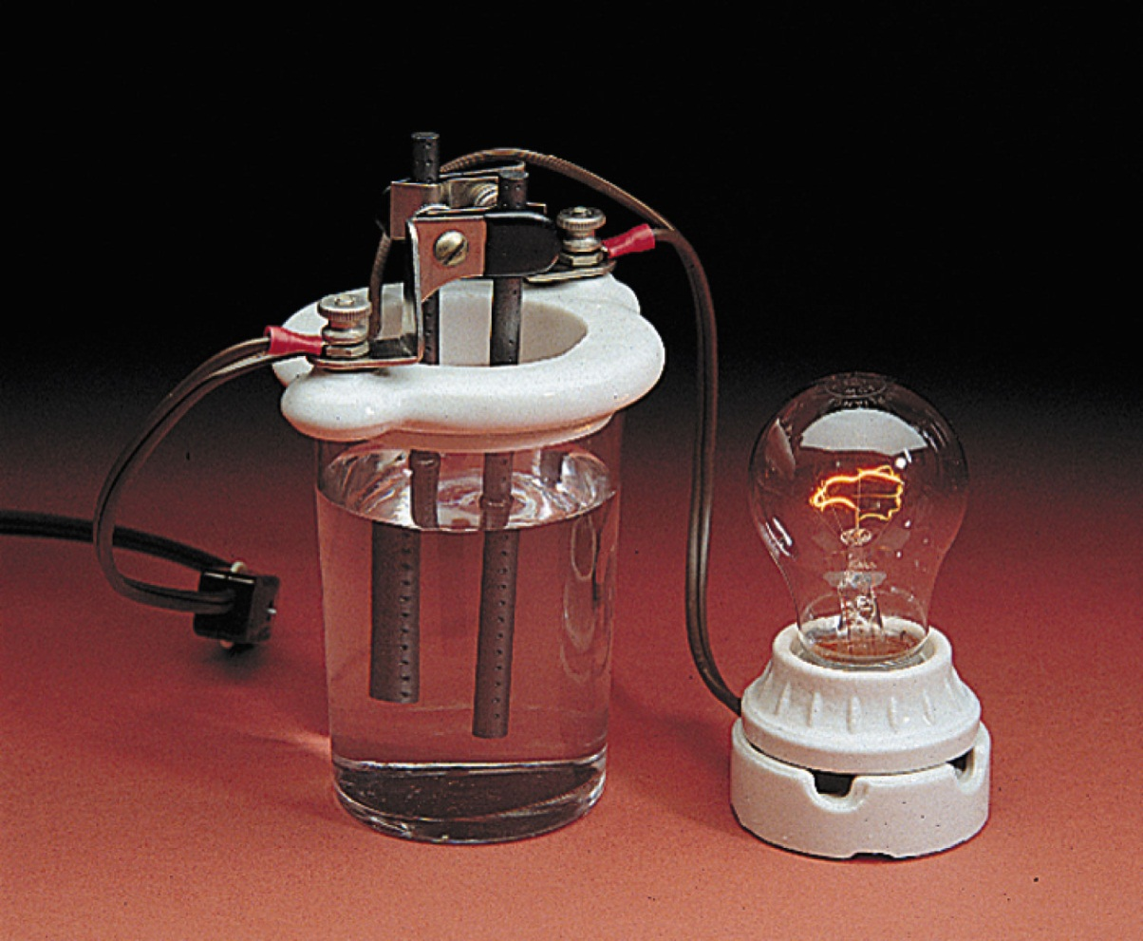
Strong Electrolyte – completely ionizes/dissociates
Example: strong acids, bases, and soluble salts

Slide 65
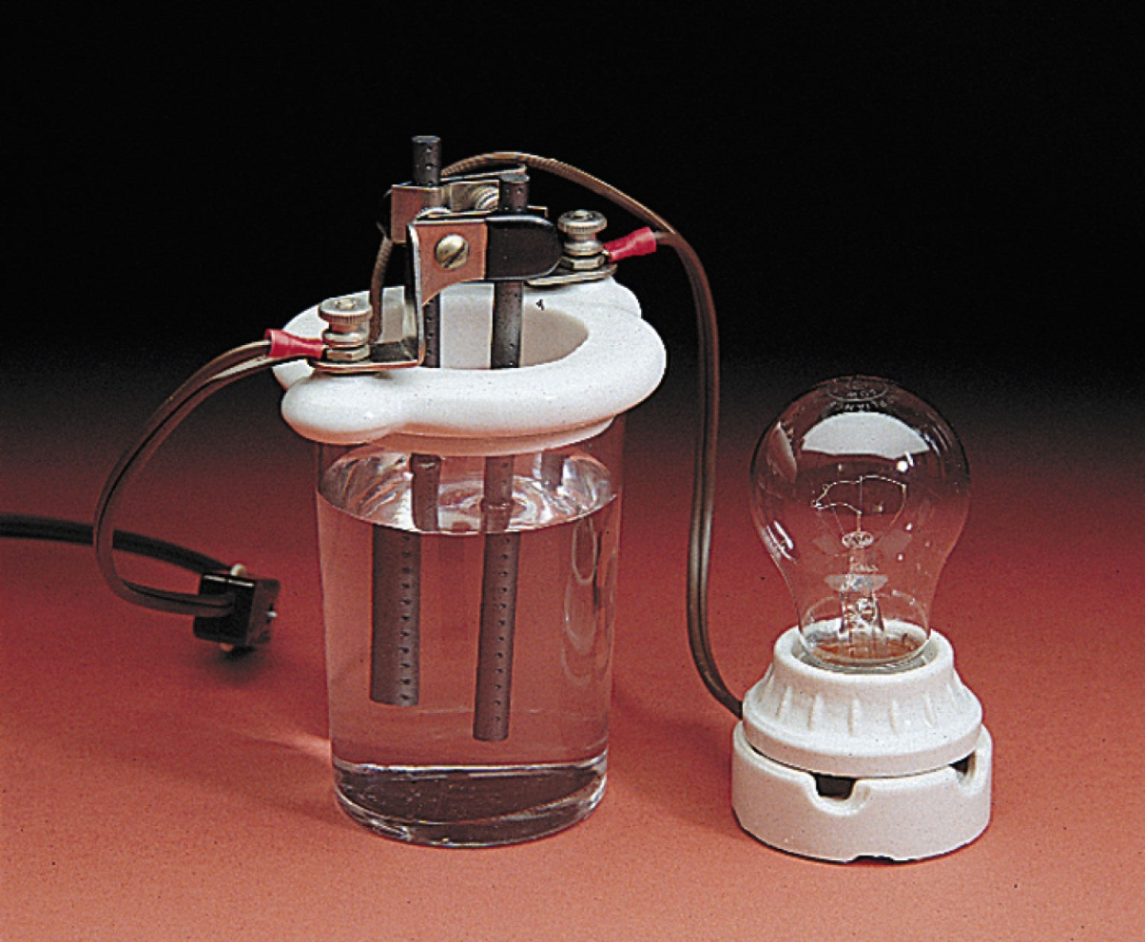
Weak Electrolyte – incompletely ionizes/dissociates
Example: weak acids and bases

Slide 66
Equivalent (Eq) of an Ion
The molar amount of that ion needed to supply one mole of positive or negative charge.
1 mole K⁺ = 1 equivalent
1 mole Mg²⁺ = 2 equivalents
1 mole PO₄^{3–} = 3 equivalents

Slide 67
Milliequivalent
1 milliequivalent = 10^{–3} equivalent

Slide 68
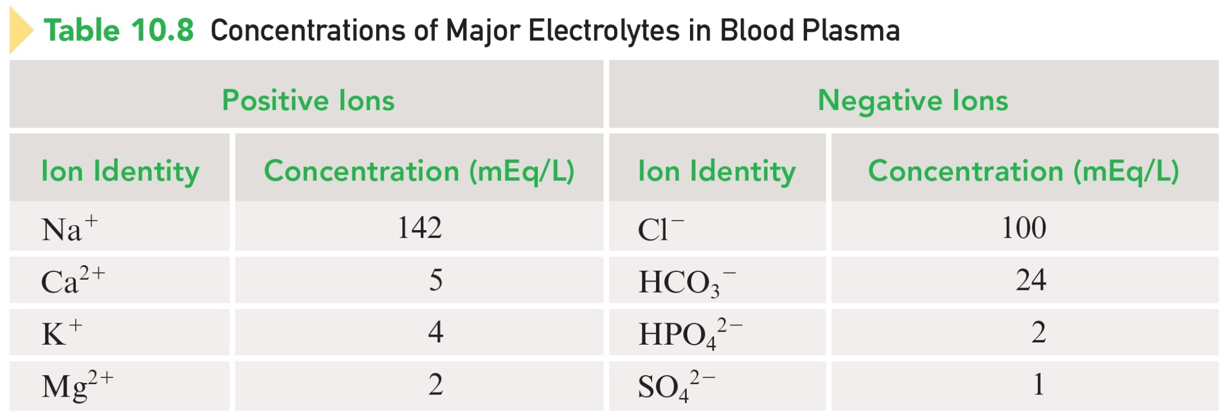
Concentrations of Major Electrolytes in Blood Plasma

Slide 69
Exercise
The concentration of Ca²⁺ ion present in a sample is 5.3 mEq/L. How many milligrams of Ca²⁺ ion are present in 180.0 mL of the sample?
Notes:
(180.0 mL)(1 L/1000 mL)(5.3 mEq/L)(1 Eq/1000 mEq)(1 mol Ca²⁺/2 Eq Ca²⁺)(40.08 g/mol)(1000 mg/1g) = 19 mg Ca²⁺ion

Slide 70
Exercise
The concentration of Ca²⁺ ion present in a sample is 5.3 mEq/L. How many milligrams of Ca²⁺ ion are present in 180.0 mL of the sample?
19 mg Ca²⁺ ion
Notes:
(180.0 mL)(1 L/1000 mL)(5.3 mEq/L)(1 Eq/1000 mEq)(1 mol Ca²⁺/2 Eq Ca²⁺)(40.08 g/mol)(1000 mg/1g) = 19 mg Ca²⁺ion

Slide 71
A neutralization reaction in which a measured volume of an acid or a base of known concentration is completely reacted with a measured volume of a base or an acid of unknown concentration.
For a strong acid and base reaction:
  H⁺(aq) + OH–(aq) → H₂O(l)

Slide 72
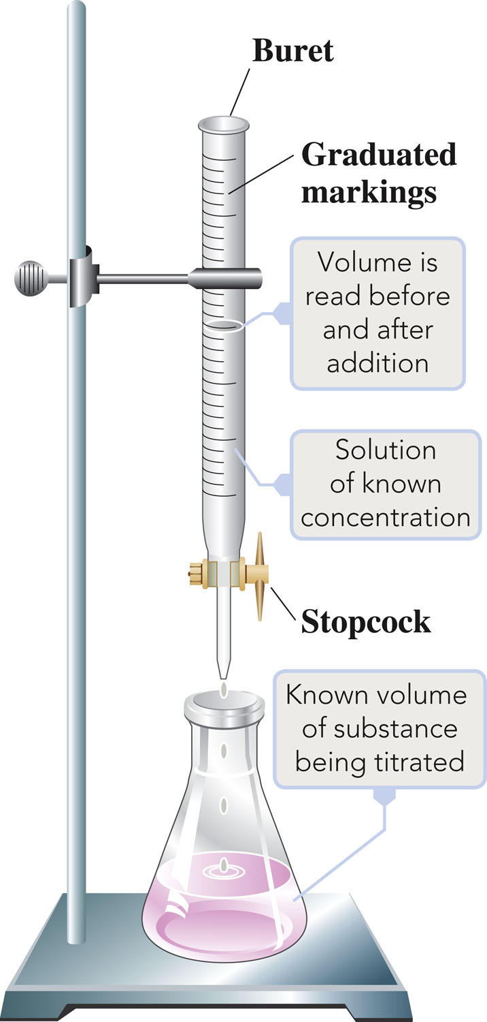
Titration Setup

Slide 73
Acid-Base Indicator
A compound that exhibits different colors depending on the pH of its solution.
An indicator is selected that changes color at a pH that corresponds as nearly as possible to the pH of the solution when the titration is complete.

Slide 74
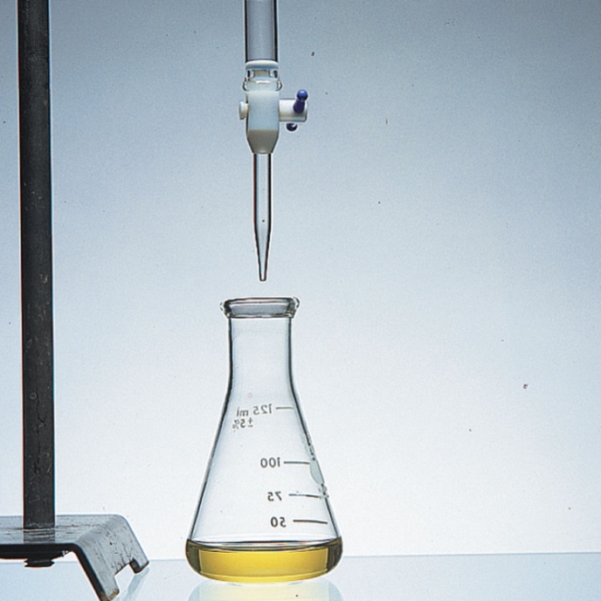
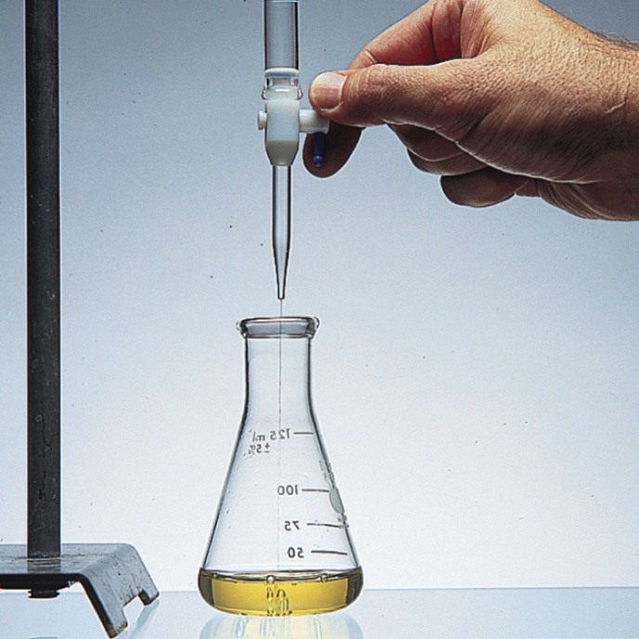
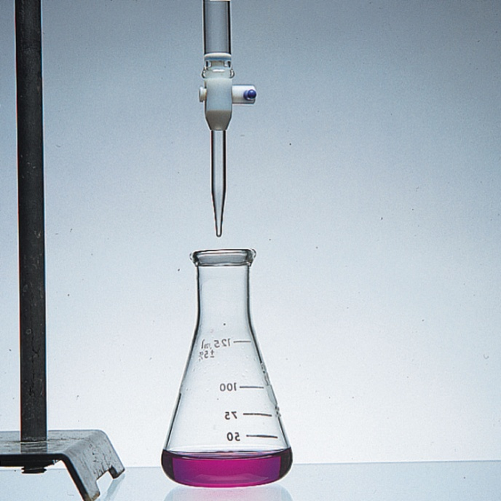
Indicator – yellow in acidic solution; red in basic solution

Slide 75
Concept Check
For the titration of sulfuric acid (H₂SO₄) with sodium hydroxide (NaOH), how many moles of sodium hydroxide would be required to react with 1.00 L of 0.500 M sulfuric acid to reach the endpoint?
Notes:
1.00 mol of sodium hydroxide would be required.

Slide 76
Concept Check
For the titration of sulfuric acid (H₂SO₄) with sodium hydroxide (NaOH), how many moles of sodium hydroxide would be required to react with 1.00 L of 0.500 M sulfuric acid to reach the endpoint?
H₂SO₄ + 2NaOH → Na₂SO₄ + 2 H₂O
1.00 mol NaOH
Notes:
1.00 mol of sodium hydroxide would be required.

