Slide 1
Chemistry 120 Fall 2016
Instructor: Dr. Upali Siriwardane
e-mail: upali@latech.edu
Office: CTH 311
Phone 257-4941
Office Hours: M,W,F 9:30-11:30 am T,R 8:00-10:00 am or by appointment;
Test Dates:
September 23, 2016 (Test 1): Chapter 1,2 &3
October 13, 2016 (Test 2): Chapter 4 & 5
October 31, 2016 (Test 3): Chapter 6, 7 & 8
November 15, 2016 (Test 4): Chapter 9, 10 & 11
November 17, 2016 (Make-up test) comprehensive:
Chapters 1-11

Slide 2
Chapter 1. Basic Concepts About Matter
1-1 Chemistry: The Study of Matter
1-2 Physical States of Matter
1-3 Properties of Matter
1-4 Changes in Matter
1-5 Pure Substances and Mixtures
1-6 Elements and Compounds
1-7 Discovery and Abundance of the Elements
1-8 Names and Chemical Symbols of the Elements
1-9 Atoms and Molecules
1-10 Chemical Formulas

Slide 3

Chemistry – the bestest thing ever!
Chemistry is the study of
matter and the transformations
that it undergoes.

Slide 4
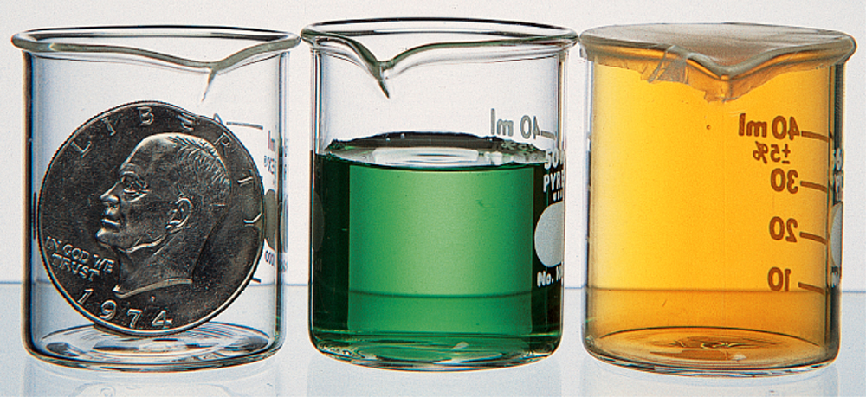
Matter
Matter is anything that has
mass and takes up space.
Mass is a measure of the amount of matter in an object
Weight: a measure of the force exerted on an object
by a gravitational pull

Slide 5
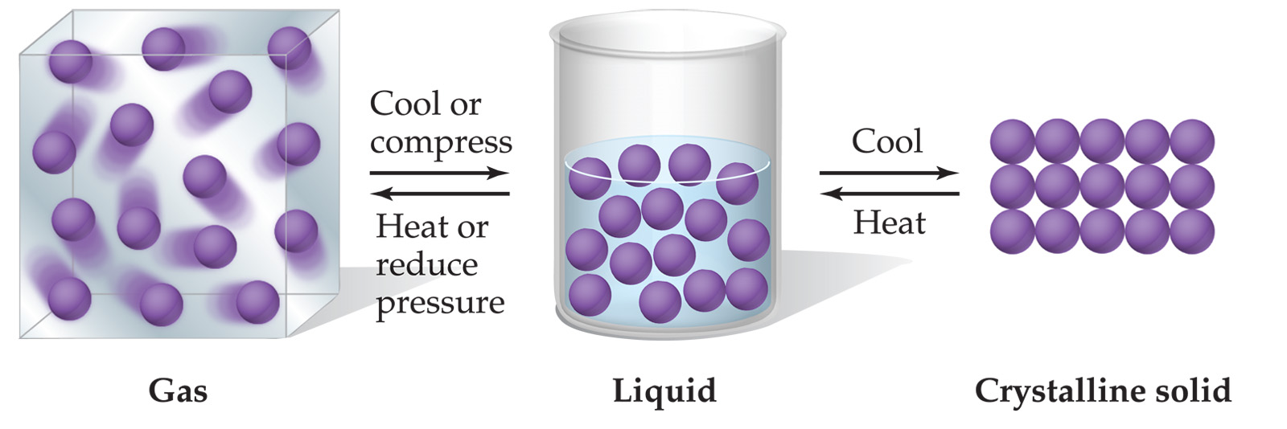
Physical states of matter
Indefinite shape
Indefinite volume
Indefinite shape
Definite volume
Definite shape
Definite volume

Slide 6
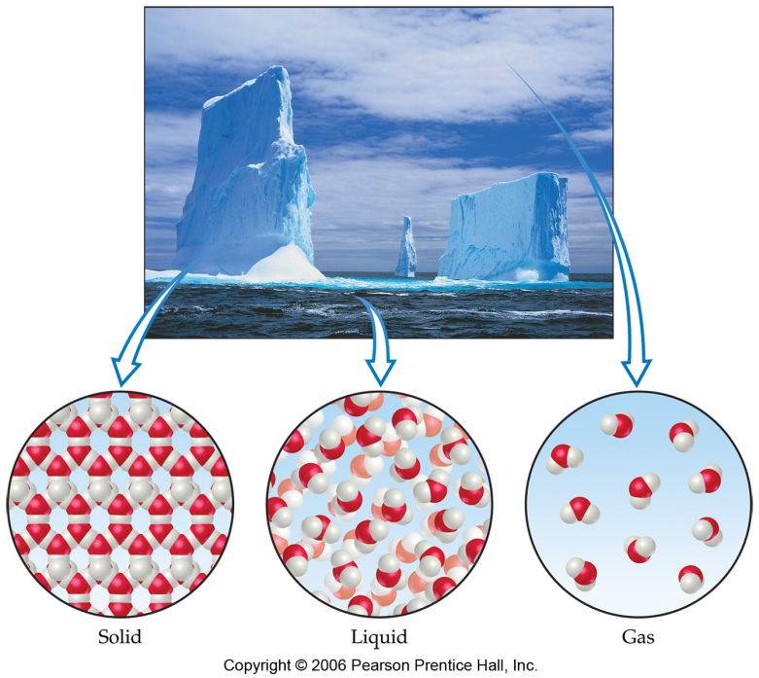

Chemical and physical properties of matter
Physical Properties:
  Can be observed without transforming a substance into another substance.
    Boiling/melting points, density, mass, volume, etc.
Chemical Properties:
  Can only be observed when a substance is changed into another substance.
    Flammability, corrosiveness, reactivity with acid, etc.

Slide 7
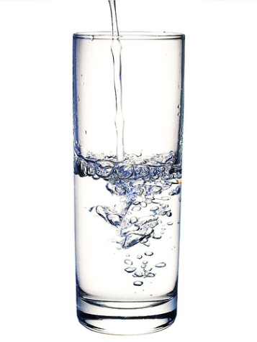
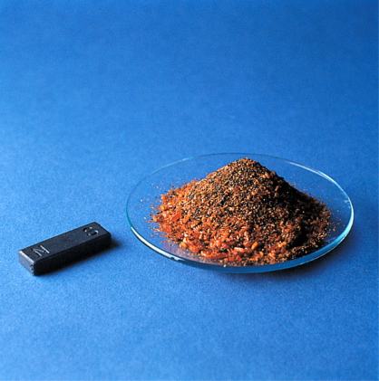
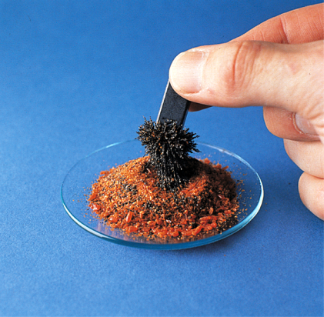
Matter: pure substances vs mixtures
In a pure substance, only a single kind of matter can be found. The substance cannot be separated into simpler components through physical means
Pure substances have definite and constant compositions
Mixtures are combinations of two or more pure substances which can be separated into simpler components through physical means
Separation of iron filings from something non-magnetic
Something we can’t drink
in this classroom

Slide 8
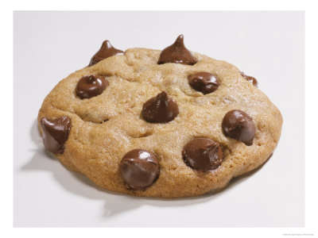

Heterogeneous and homogeneous mixtures
Heterogeneous mixtures consist of visibly different parts, each part having its own properties
Homogeneous mixtures appear to be of the same composition throughout, and appear to possess uniform properties

Slide 9
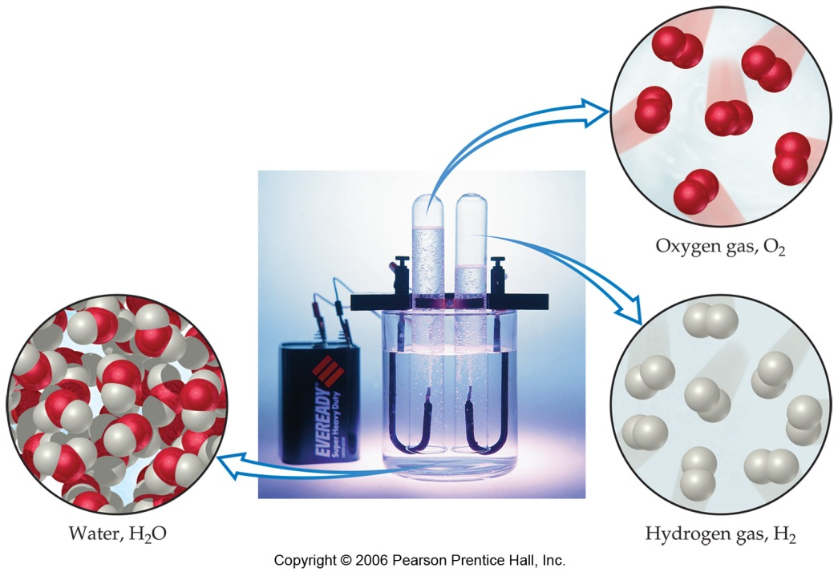
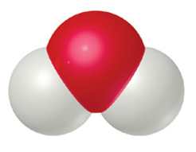
Elements and compounds
Elements and compounds are both pure substances.
Elements can’t be broken down and isolated into simpler, pure substances by either physical or chemical means.
Compounds may be decomposed into two or more simpler components though chemical means.

Slide 10
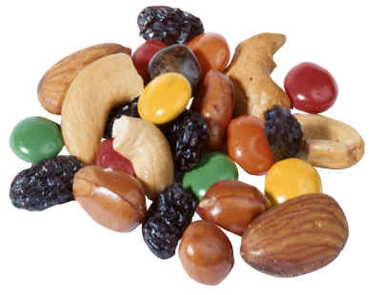
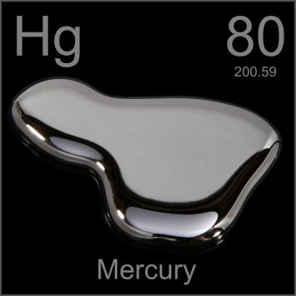

Classification of matter

Slide 11
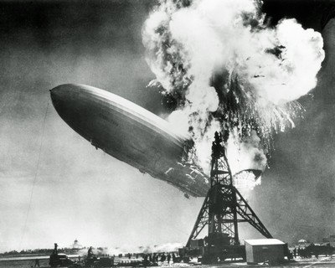
Elements
There are 117 elements known at the present time. Of these, 88 are naturally occurring.
Elements are identified by their chemical and physical properties, and are represented by names and chemical symbols.
Hydrogen, H.
Found as a gas at room
temperature and pressure.

Slide 12
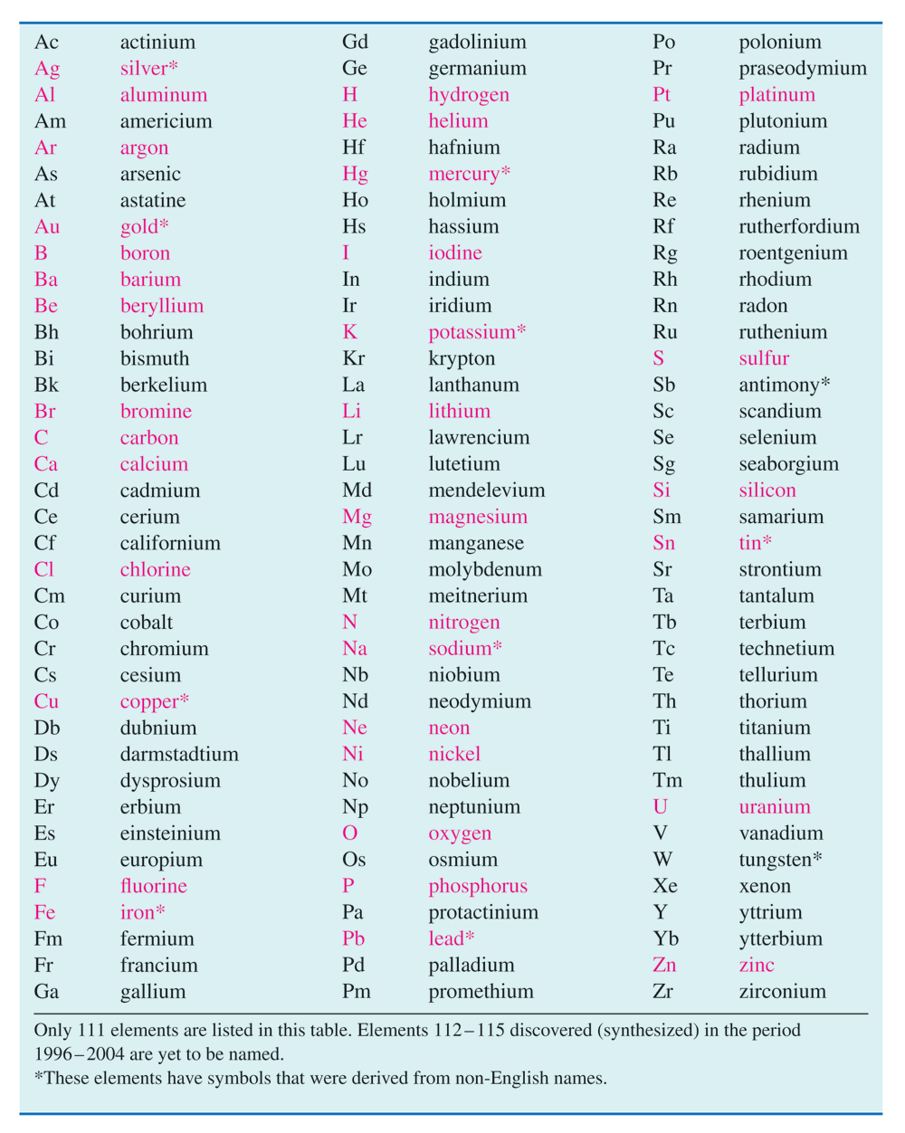
Know the names
and symbols for the
elements listed in red

Slide 13
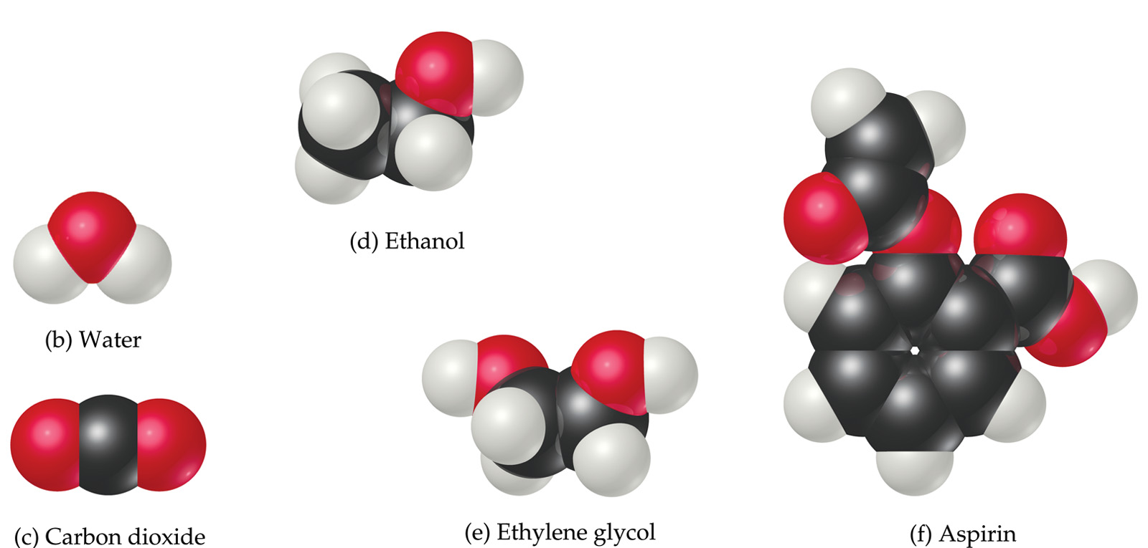
Atoms, elements and compounds
The simplest unit of an element which possesses all of the properties of the element is an atom. Atoms are the basic building blocks of matter.

Slide 14
Matter
A compound is made of two or more different kinds
of elements.

Slide 15
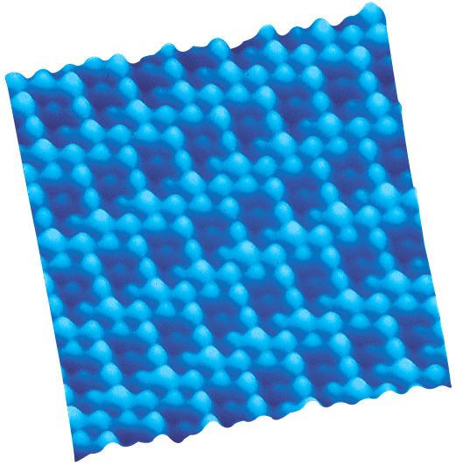
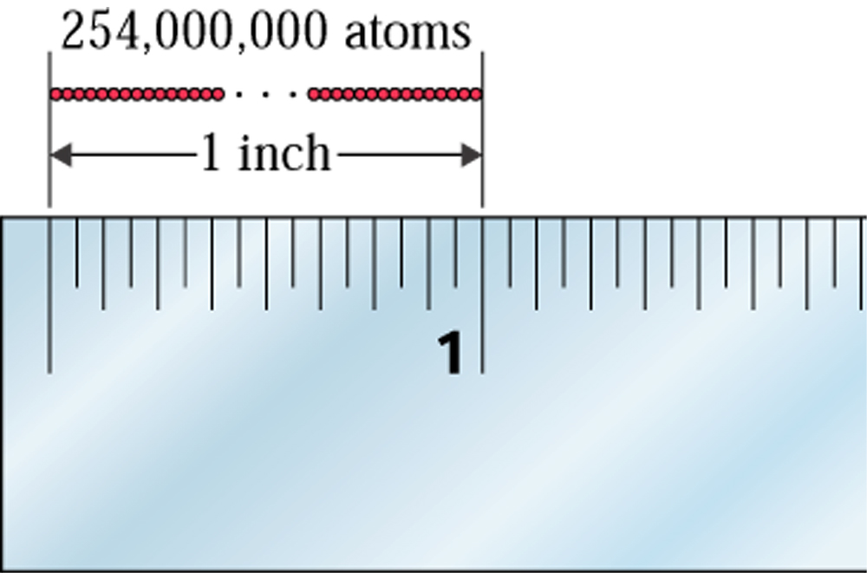
Atoms
Atoms have extremely small dimensions. They cannot be seen with the naked eye, but sophisticated (and very expensive) techniques may enable resolution of atoms
STM image of a
crystal surface

Slide 16
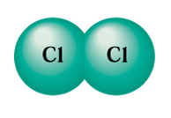

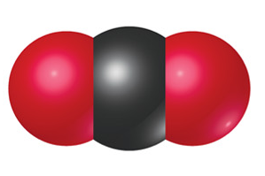
Molecules
Atoms can combine to form larger structures called molecules. A molecule is a combination of two or more atoms to create a new unit which possesses properties that are different from the atoms that make it up.
Molecules that consist of two atoms are called diatomic. Molecules that consist of three atoms are called triatomic, etc.
If only one type of atom exists in a molecule, it is called homonuclear or homoatomic. If two or more, different types of atoms exist in a molecule, it is called heteronuclear or heteroatomic.
In an element, there is only one type of atom
H
Cl
O
C
O
Cl₂
HCl
CO₂

Slide 17
Chemical formulas
Chemical formulas represent the number and type of atoms of each element in a molecule
Chemical symbols represent the type of each element (e.g. C, H, O, N, etc.)
Subscripts to the lower right of a chemical symbol represent the number of atoms of that element
C₂H₅OH
C₉H₈O₄
H₂O
CO₂
C₂H₆O₂

