Slide 1
Chemistry 120 Spring 17
Introduction to Inorganic Chemistry
Instructor Dr. Upali Siriwardane (Ph.D. Ohio State)
E-mail: upali@latech.edu
Office: 311 Carson Taylor Hall ; Phone: 318-257-4941;
Office Hours: MWF 8:00-9:00 and 11:00-12:00;
TR 10:00-12:00
Contact me trough phone or e-mail if you have questions
Online Tests on Following days
March 24, 2017: Test 1 (Chapters 1-3)
April 7, 2017 : Test 2 (Chapters 4-5)
April 28, 2017: Test 3 (Chapters 6,7 &8)
May 12, 2017 : Test 4 (Chapters 9, 10 &11)
May 15, 2017: Make Up Exam: Chapters 1-11)
.

Slide 2
Basic Concepts of Matter
1.1 Chemistry: The Study of Matter
1.2 Physical States of Matter
1.3 Properties of Matter
1.4 Changes in Matter
1.5 Pure Substances and Mixtures
1.6 Elements and Compounds
1.7 Discovery and Abundance of the Elements
1.8 Names and Chemical Symbols of the Elements
1.9 Atoms and Molecules
1.10 Chemical Formulas

Slide 3
What is Chemistry?
The field of study concerned with the characteristics, composition, and transformations of matter.

Slide 4
Matter
Anything that has mass and occupies space.
  Mass refers to the amount of matter (substance) present in a sample.

Slide 5
Matter
Includes all things – both living and nonliving as well as naturally occurring and manmade.
  Examples: plants, soil, rocks, air, bacteria, plastics
Various forms of energy such as heat, light, and electricity are not considered to be matter.
The universe is composed entirely of matter and energy.

Slide 6
The classification of a given matter sample in terms of physical state is based on whether its shape and volume are definite or indefinite.
Matter exists in three physical states:
  Solid
  Liquid
  Gas

Slide 7
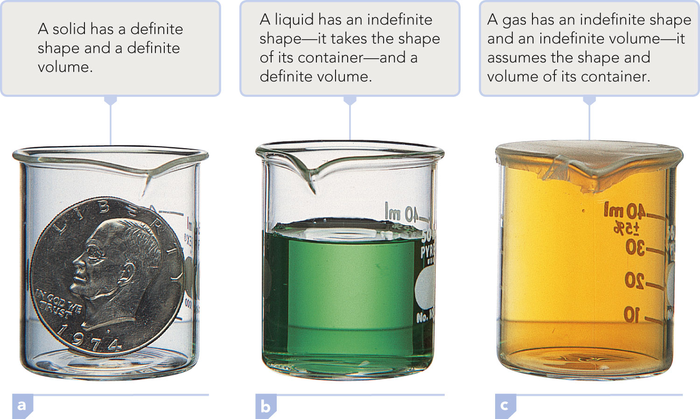
Examples of the Three States of Matter

Slide 8
Solid
Physical state characterized by a definite shape and a definite volume.

Slide 9
Structure of a Solid
To play movie you must be in Slide Show Mode
PC Users: Please wait for content to load, then click to play
Mac Users: CLICK HERE

Slide 10
Liquid
Physical state characterized by an indefinite shape and a definite volume.
Always takes the shape of its container to the extent that it fills the container.

Slide 11
Structure of a Liquid
To play movie you must be in Slide Show Mode
PC Users: Please wait for content to load, then click to play
Mac Users: CLICK HERE

Slide 12
Gas
Physical state characterized by an indefinite shape and an indefinite volume.
Always completely fills its container, adopting both the container’s volume and its shape.

Slide 13
Structure of a Gas
To play movie you must be in Slide Show Mode
PC Users: Please wait for content to load, then click to play
Mac Users: CLICK HERE

Slide 14
The state of matter observed for a particular substance depends on its:
  Temperature
  Surrounding pressure
  Strength of the forces holding its structural particles together

Slide 15
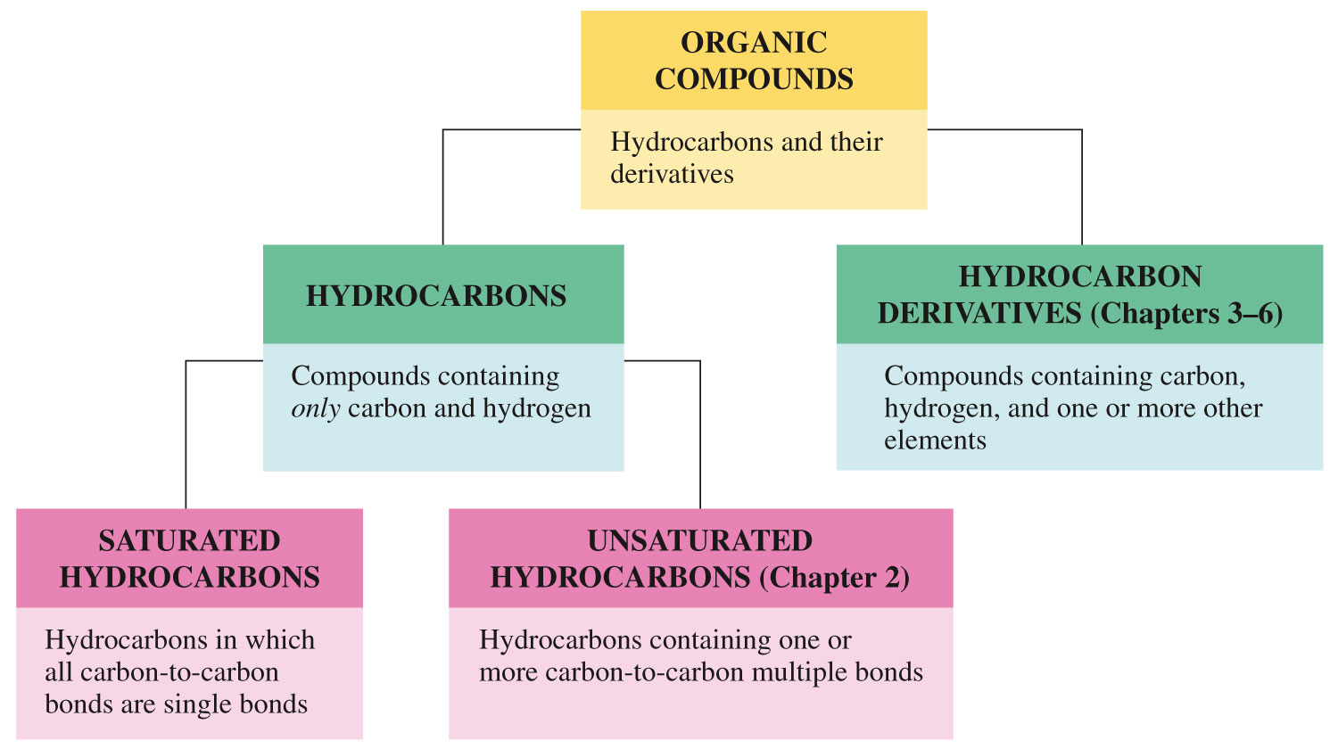
Water Can Be Found in All Three States Simultaneously

Slide 16
Property
Distinguishing characteristic of a substance that is used in its identification and description.
Each substance has a unique set of properties that distinguishes it from all other substances.
Two General Types:
  Physical
  Chemical

Slide 17
Physical Property
Characteristic of a substance that can be observed without changing the basic identity of the substance.
  Color, odor, physical state, melting point, boiling point, and hardness

Slide 18

Concept Check
To measure the boiling point of a substance, a liquid must be changed into a gas. Why is boiling point considered a physical property when a gas’ appearance is much different from that of a liquid?
Notes:
Although the appearance is different, the substance is still the same. It’s chemical identity has not changed.

Slide 19
Concept Check
To measure the boiling point of a substance, a liquid must be changed into a gas. Why is boiling point considered a physical property when a gas’ appearance is much different from that of a liquid?
Although the appearance is different, the substance is still the same. It’s chemical identity has not changed (remains the same irrespective of the physical state).
Notes:
Although the appearance is different, the substance is still the same. It’s chemical identity has not changed.

Slide 20
Chemical Property
Characteristic of a substance that describes the way the substance undergoes or resists change to form a new substance.
  Example: copper objects turn green in air
Most often the changes result from the reaction of a substance with one or more other substances.
Sometimes energy (like heat or light) can trigger a change (decomposition).

Slide 21
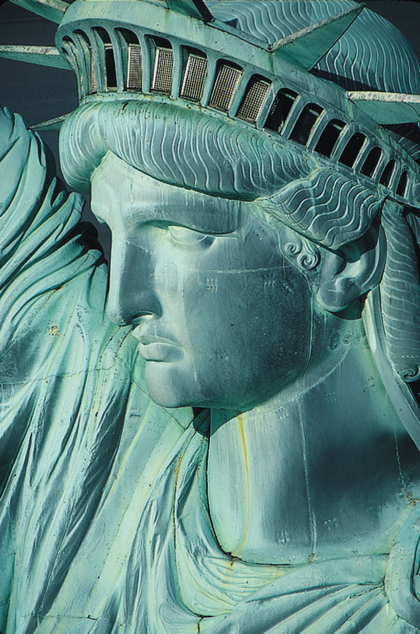
A Chemical Property of Copper

Slide 22
Exercise
Classify each of the following as a physical or chemical property.
  A marshmallow gets black when roasting it in a campfire.
  Zinc is a solid at room temperature.
  When rubbing alcohol is rubbed on your skin, it evaporates very quickly.
Notes:
Chemical property
Physical property
Physical property

Slide 23
Exercise
Classify each of the following as a physical or chemical property.
  A marshmallow gets black when roasting it in a campfire.
chemical property
  Zinc is a solid at room temperature.
physical property
  When rubbing alcohol is rubbed on your skin, it evaporates very quickly.
physical property
Notes:
Chemical property
Physical property
Physical property

Slide 24
Physical Change
Process in which a substance changes its physical appearance but not its chemical composition.
A new substance is never formed as a result of a physical change.
  Example: boiling or freezing water

Slide 25
Chemical Change
A process in which a substance undergoes a change in chemical composition.
Involves conversion of the material(s) into one or more new substances.
  Example: methane reacts with oxygen to form carbon dioxide and water

Slide 26
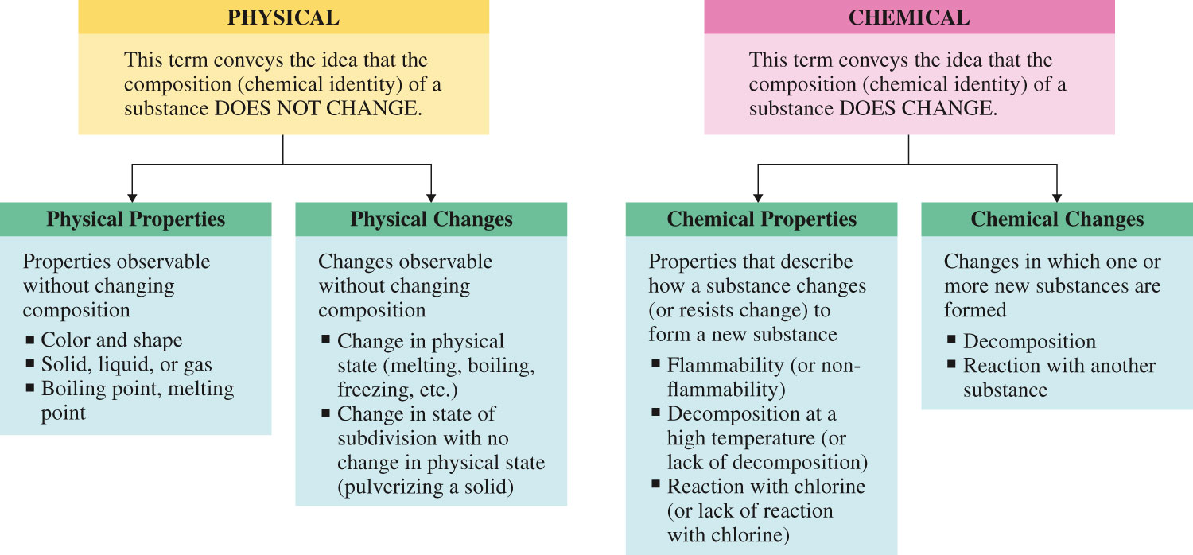
Use of the Term Physical

Slide 27
Use of the Term Chemical

Slide 28
Concept Check
Which one of the following are examples of a chemical change?
  Pulverizing (crushing) rock salt
  Burning of wood
  Dissolving of sugar in water
  Melting a popsicle on a warm summer day
Notes:
1 (burning of wood)

Slide 29
Concept Check
Which one of the following are examples of a chemical change?
  Pulverizing (crushing) rock salt
  Burning of wood
  Dissolving of sugar in water
  Melting a popsicle on a warm summer day
Notes:
1 (burning of wood)

Slide 30
Pure Substances vs. Mixtures
Pure substance – a single kind of matter that cannot be separated into other kinds of matter by any physical means.
  Examples: water or carbon dioxide
Mixture – a physical combination of two or more pure substances in which each substance retains its own chemical identity.
  Example: salt water

Slide 31
Mixtures
Have variable composition
  Homogeneous Mixture:
Contains only one visibly distinct phase (part), which has uniform properties throughout; solution
  Heterogeneous Mixture:
Contains visibly different phases (parts), each of which has different properties

Slide 32
Homogeneous Mixtures
To play movie you must be in Slide Show Mode
PC Users: Please wait for content to load, then click to play
Mac Users: CLICK HERE

Slide 33
Homogeneous vs. Heterogeneous Mixtures
To play movie you must be in Slide Show Mode
PC Users: Please wait for content to load, then click to play
Mac Users: CLICK HERE

Slide 34
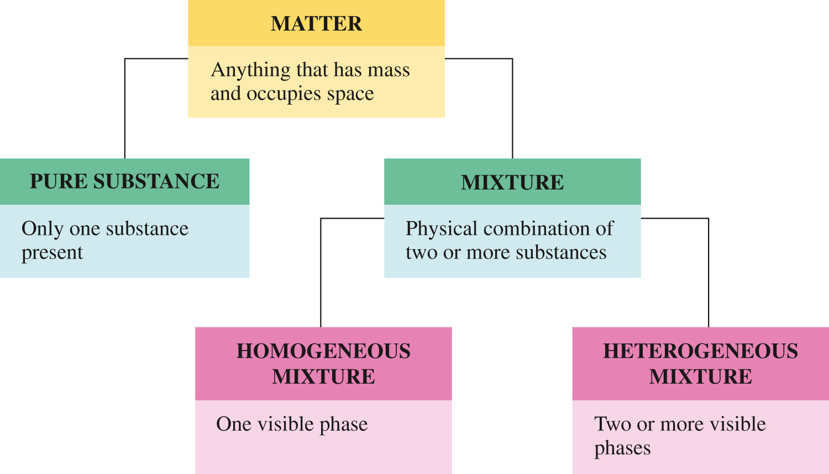

Slide 35
Concept Check
Which of the following is a homogeneous mixture?
  Pure water
  Gasoline
  Jar of jelly beans
  Soil
  Copper metal
Notes:
gasoline

Slide 36
Concept Check
Which of the following is a homogeneous mixture?
  Pure water
  Gasoline
  Jar of jelly beans
  Soil
  Copper metal
Notes:
gasoline

Slide 37
Element
Element – a pure substance that cannot be broken down into simpler pure substances by chemical means such as a chemical reaction, an electric current, heat, or a beam of light.
  Examples: gold, silver, copper

Slide 38
Compound
Compound – a pure substance that can be broken down into two or more simpler pure substances by chemical means.
  Examples: water, carbon dioxide, ammonia

Slide 39
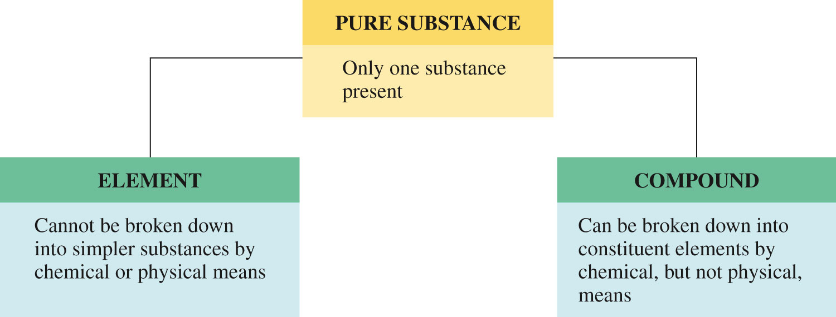
A Pure Substance Can Be Either An Element or Compound

Slide 40
Compound vs. Mixture
To play movie you must be in Slide Show Mode
PC Users: Please wait for content to load, then click to play
Mac Users: CLICK HERE

Slide 41
Distinguishing Between Compounds and Mixtures
Compounds have properties distinctly different from those of the substances that combined to form the compound. The components of mixtures retain their individual properties.

Slide 42
Distinguishing Between Compounds and Mixtures
Compounds have a definite chemical composition. Mixtures have a variable chemical composition.

Slide 43
Distinguishing Between Compounds and Mixtures
Physical methods are sufficient to separate the components of a mixture. The components of a compound cannot be separated by physical methods; chemical methods are required.

Slide 44
To Classify a Sample of Matter
Does the sample of matter have the same properties throughout?
Are two or more different substances present?
Can the pure substance be broken down into simpler substances?

Slide 45
118 known elements:
  88 of the elements occur naturally
  30 of the elements have been synthesized

Slide 46
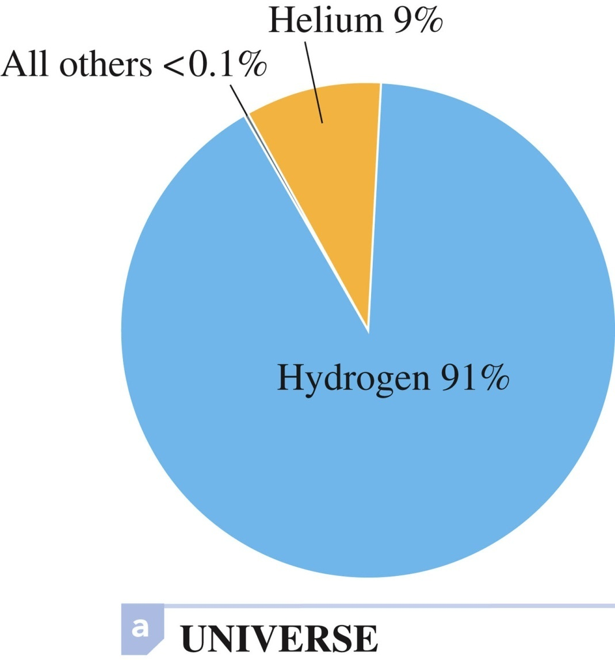
Abundance of Elements (in Atom Percent) in the Universe

Slide 47
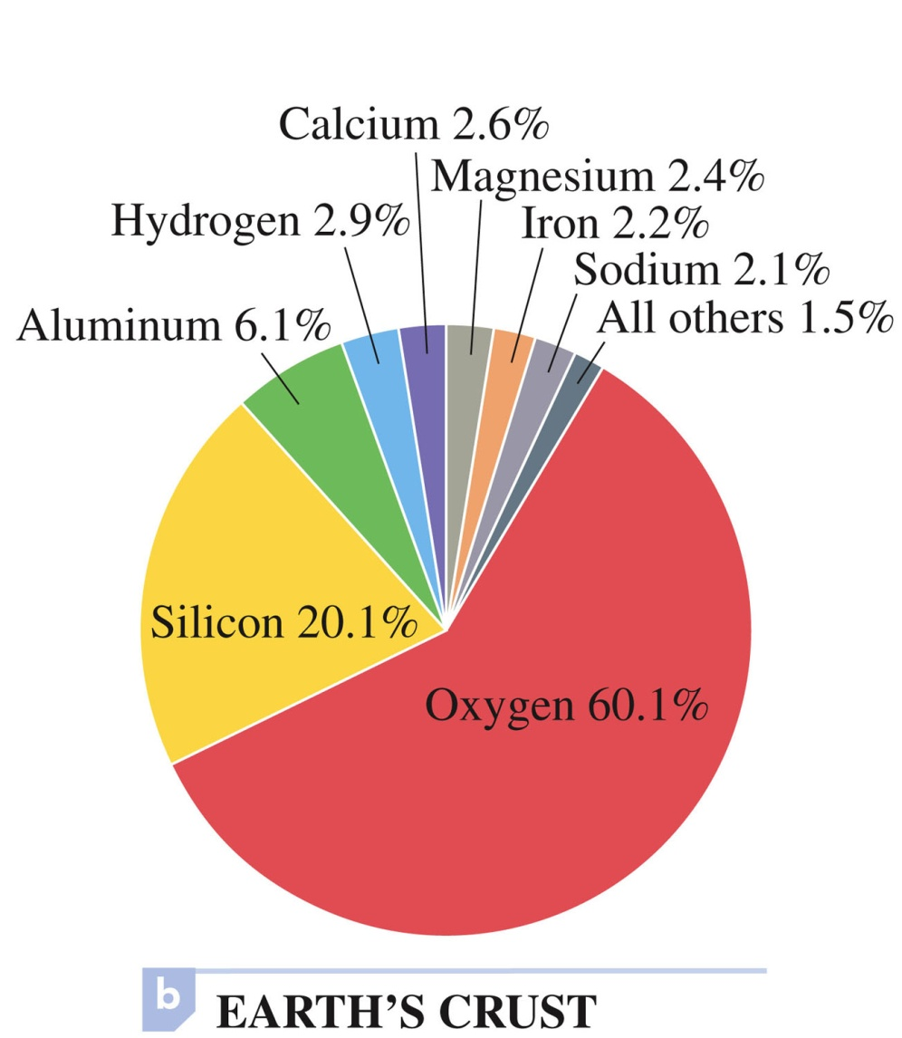
Abundance of Elements (in Atom Percent) in the Earth’s Crust

Slide 48
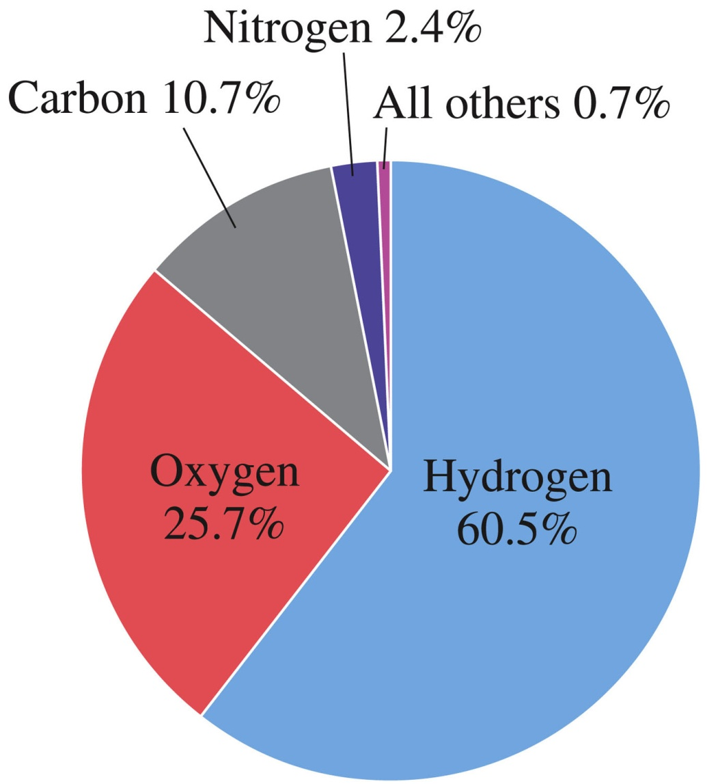
Elemental Composition of the Human Body (in Atom Percent)

Slide 49
Chemical Symbol
One- or two-letter designation for an element derived from the element’s name.
Two letter symbols are often, but not always, the first two letters of the element’s name.

Slide 50
Chemical Symbol
First letter of a chemical symbol is always capitalized and the second is not:
  H – hydrogen
  Ba – barium
  Co – cobalt
  Pb – lead
  Ag – silver

Slide 51
Latin Names
For some elements, the symbol is derived from the Latin name of the element:
  Ag – silver
  Au – gold
  Fe – iron
  Pb – lead
  Cu – copper

Slide 52
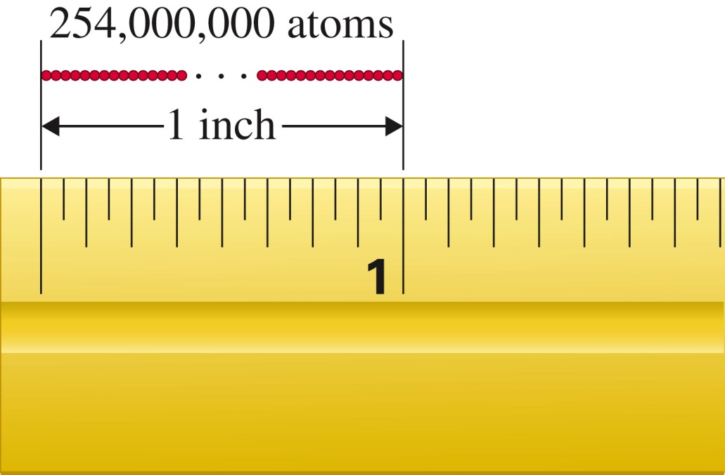
Atom
The smallest particle of an element that can exist and still have the properties of the element.
The limit of chemical subdivision.
Atoms are extremely small particles.

Slide 53
Molecule
Group of two or more atoms that functions as a unit because the atoms are tightly bound together.
The limit of physical subdivision.
Behaves in many ways as a single, distinct particle would.
Diatomic molecule – contains two atoms
Triatomic molecule – contains three atoms
Tetraatomic, pentatomic, etc.

Slide 54
Homoatomic Molecule
Molecule in which all atoms present are of the same kind.
Substance containing homoatomic molecules must be an element.
  Examples: H₂, O₂, N₂, Cl₂, P₄, S₈

Slide 55
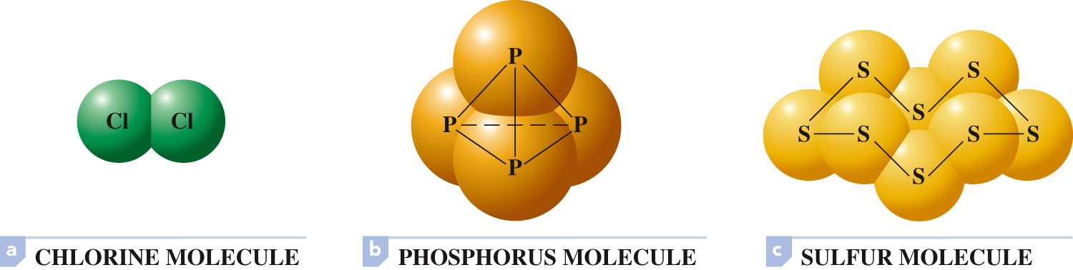
Homoatomic Molecules

Slide 56
Heteroatomic Molecule
Molecule in which two or more kinds of atoms are present.
Substance containing heteroatomic molecules must be compounds.
  Examples: H₂O, CO₂, N₂O₄, C₁₂H₂₂O₁₁

Slide 57
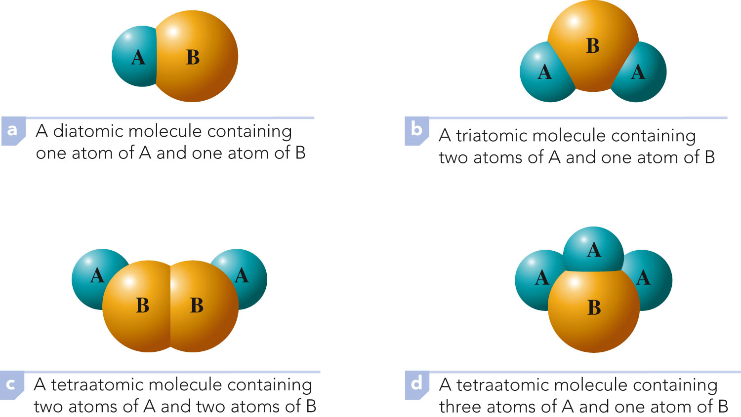
Heteroatomic Molecules

Slide 58
Concept Check
Classify XeF₄ as:
  diatomic, triatomic, etc.
  homoatomic or heteroatomic
  element or compound
Notes:
Although the appearance is different, the substance is still the same. It’s chemical identity has not changed.

Slide 59
Concept Check
Classify XeF₄ as:
  diatomic, triatomic, etc.
pentatomic
  homoatomic or heteroatomic
heteroatomic
  element or compound
compound
Notes:
Although the appearance is different, the substance is still the same. It’s chemical identity has not changed.

Slide 60
A notation made up of the chemical symbols of the elements present in a compound and numerical subscripts (located to the right of each chemical symbol) that indicate the number of atoms of each element present in a molecule of the compound.
  Examples:
    H₂O – two atoms of hydrogen, one atom of oxygen
    Ca₃(PO₄)₂ – three atoms of calcium, two atoms of phosphorus, eight atoms of oxygen

Slide 61
Exercise
For each of the following chemical formulas, determine how many atoms of each element are present:
  H₂SO₄
  Fe₂(CO₃)₃
Notes:
Chemical property
Physical property
Physical property

Slide 62
Exercise
For each of the following chemical formulas, determine how many atoms of each element are present:
  H₂SO₄
two hydrogen; one sulfur; four oxygen
  Fe₂(CO₃)₃
two iron; three carbon; nine oxygen
Notes:
Chemical property
Physical property
Physical property

